Slide 1

MS Beginnings
Jill Dent, Ph.D.
Joyce Greer, NBCT, M.Ed.
Marisa Prewitt, NBCT, M.Ed.
November 5, 2021

Slide 2
State Board of Education STRATEGIC PLAN GOALS

Slide 3
Mississippi Department of Education

Slide 4
Early Learning Collaborative Curriculum Requirements
Thematic based
Emphasis on early childhood literacy
Aligned to Early Learning Standards
Comprehensive to cover all domains
Evidence – base of child outcomes

Slide 5
Curriculum Conundrum…
Opening the World of Learning (OWL) – out of print
Reviewed list of curricula: Pre-Kindergarten Comprehensive Curriculum Results for Children Ages Three and Four Executive Summary
Focus on Pre-K: Pre-K — Focus on Early Learning (bpsearlylearning.org)
Focus has been renamed to “MS Beginnings” for our state
MDE will conduct a quasi-experimental design study to measure implementation and child outcomes

Slide 6
Focus on Pre-K Research
Results — Focus on Early Learning (bpsearlylearning.org)
Large Pre-K Impact in the Boston Public Schools (Harvard study) Impacts of a Prekindergarten Program on Children's Mathematics, Language, Literacy, Executive Function, and Emotional Skills - Weiland - 2013 - Child Development - Wiley Online Library
The internal BPS study relies on results from the Dynamic Indicators of Basic Early Literacy Skills (DIBELS) assessment.
Findings from the ExCEL study, a five-year longitudinal study funded by the Institute of Educational Sciences, evaluates all aspects of our program from Pre-K through third grade. These findings provide further longer-term evidence around the effectiveness of our Pre-K (K1) program and help the Department of Early Childhood identify how to further improve our curriculum and the supports we provide our educators. Nationally, this study will help understand the challenges of sustaining the Pre-K gains.
MIT Study on Boston PreK outcomes

Slide 7
What the studies found...
Positive effects on student performance in both the short and long term.
Positive effects of Pre-K (K1) programs on student achievement.
Black and Hispanic/Latino students who participate in Boston Public Schools Pre-K outperform white students who do not participate in Pre-K.
Students who participated were more likely to be “ready for kindergarten” than students who did not participate.
Students who attended the Boston Public Schools Pre-K Program outperform their peers on standardized state tests, years after their Pre-K attendance.

Slide 8
What the studies found...
Among students who qualified for free-or-reduced-price lunch, 71 percent who participated in a BPS Pre-K program scored at or above benchmark when they entered Kindergarten, compared to 46 percent who did not.
Among students who have a disability, 57 percent who participated in a BPS Pre-K program scored at or above benchmark when they entered Kindergarten, compared to 41 percent who did not.

Slide 9
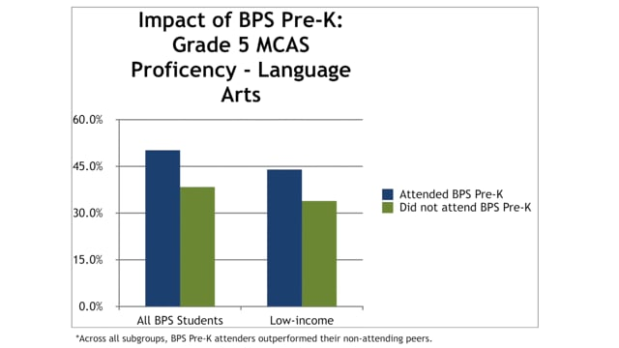
Boston Research and Evaluation
https://vimeo.com/279725886

Slide 10
Timeline of Implementation
EC staff conducted Children at the Center book study - summer 2021
Committed staff member to work on curriculum implementation
Working with Boston staff to assist with training and technical assistance
Working with REACH MS, Graduate Center, and Education Counsel to help with standards alignment and development
Creation of webpage – spring 2022

Slide 11
Timeline of Implementation Continued
Training for MDE staff and district administration – spring 2022
Training for MDE staff, administrators and teachers – summer 2022
Implementation in ELC Cohort IV classrooms – August 2022

Slide 12

Strategy Shift
  p.12 “Instead of building an education
  program from the top down, as many
  school systems do, Boston is rebuilding
  it's from the bottom up.”- Children at
  the Center

Slide 13
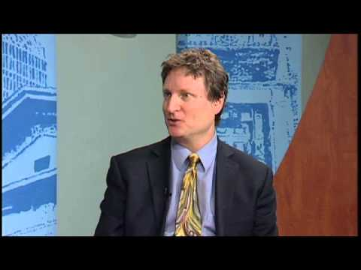
Why is high-quality Early Childhood Education such a critical lever for closing the opportunity and achievement gaps?
Executive Director Jason Sachs
Focus on Pre-K (K1): Pre-K 4-year-old
https://youtu.be/FZAqtnRYIas

Slide 14
Curriculum Comparable Struggles
"Some teachers were not on board right away. They were involved only because their principals had signed them up." (pg. 108)
"Some teachers said that they knew about good practice, but their administrators wouldn't let them teach in developmentally appropriate ways." (pg. 47)
"Should children get to choose what centers they go to, or should teachers organize Center Time so that children participate in all the activities. What if they spend too much time in some centers and ignored others?" (pg. 109)

Slide 15
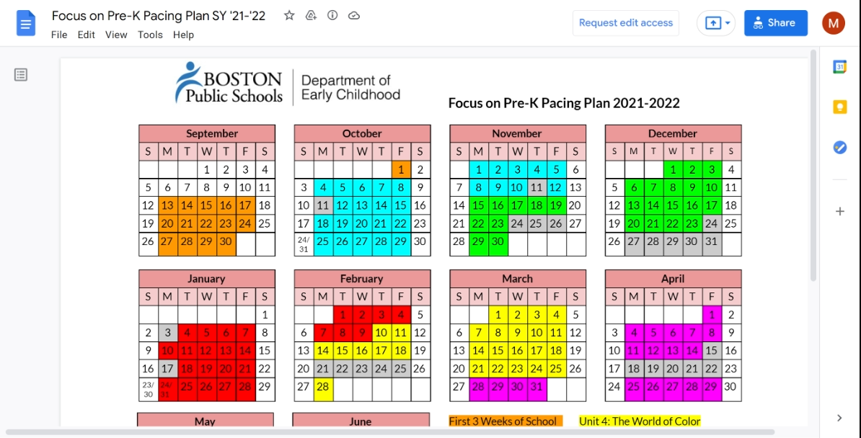
Themes
Pre-K
Getting started (3 weeks)
Family (5 weeks)
Friends (5 weeks)
Wind and Water (5 weeks)
The World of Color (5 weeks)
Shadows/Reflections (5 weeks)
Things that Grow (5 weeks)

Slide 16
Pre-K through 2nd grade curriculum contains the following:
Unit overview
  Enduring understandings (what it is the children will learn during the unit)
  Essential questions (support the conceptual development)
  Core texts (fiction & non-fiction)
  Incorporates social-emotional
  Encourages teachers to document
  https://www.bpsearlylearning.org/focus-on-k0-k1

Slide 17
Weekly Pre-K plan includes:
Arrival centers/gather stories for story acting
Greeting
Intro to centers
Centers
Thinking and feedback
Read aloud
Transition
Small literacy group
Math small groups
SWPL/BB whole group (/swipple/: Songs, Word Play, and Letters)/ (Building Blocks)
Let's find out about it problem story: using information from non-fiction text and experiences to explore concepts related to OWL units (what's a pinwheel? Washable vs permanent colors)
Story acting

Slide 18
Sample of an Activity
Standards-
Reading Information
Speaking and Listening
Language
Measurement and Data
Geometry
Intro to centers and centers (10 min)

Slide 19

Teacher Supports: Professional Development
Slideshows https://www.bpsearlylearning.org/voice-threads
Unit Previews
Curriculum Components
Additional Topics
Make and Takes https://www.bpsearlylearning.org/make-and-takes
Labels for centers (all subject areas)
Miscellaneous
Research Articles https://www.bpsearlylearning.org/research-articles
Calendar Time for Young Children: Good Intentions Gone Awry (NAEYC)
Stages of Writing Development
Bridging the Vocabulary Gap

Slide 20
Thinking and Feedback
Unique component to curriculum
Relevant to preschoolers because:
  Their work is elevated and visible to classroom communication
  Reflect on and extend their learning
  Development of critical thinking and discourse skills
Happens immediately after centers
Only takes 8 - 10 minutes max

Slide 21
Thinking and Feedback
Children LOOK (silently)
Children are asked what do you NOTICE statement (teacher or child chooses 2 - 3 children to share)
LISTENING the child shares with the group what materials used, what he created and any problems that occurred
WONDERING (the hardest for children, because they have to ask a question) the teacher should model this often..."I wonder why you used so much green?"
INSPIRING or SUGGESTIONS (should be kind, specific, and helpful) "it looks like you worked very hard on this Ian"

Slide 22
Thinking and Feedback In Action
Glitter teacher and child (1 min)
Thinking and Feedback in action (10 min)
Interview with teacher (3 min)

Slide 23

Teacher Supports: Toolbox
Set Up for Success
Pacing Calendar
SWPL (Songs, Word Play and Letters) Songs and Poems
Vocabulary Picture Cards
Book List
Assessments

Slide 24
Family Engagement
Weekly Home Links provided for each unit
  Language conversation starters
  Literacy conversation starters
  Gross motor
  Read & Talk Together conversation starters
  Math conversation starters
  Tips for reading together
For Families link:
https://www.bpsearlylearning.org/family-engagement
  Wealth of information for parents ranging from research shows to direct links for all subject areas and Kindergarten information
  BPS Parent University sessions

Slide 25

Coaching
What were you working on with the child or group?
What did you hope they would learn?
Why did you choose that particular activity, approach, or strategy?
What did you think about how Circle Time went?
Tell me a little more about the learning goals of the art activity?
How do you think your questions changed the child's thinking direction?
How do you think the child felt?
How did your teaching strategy sustain the child's interest and engagement?

Slide 26
Standards Alignment
Boston only has Math and English Language Arts Standards listed.
We have aligned Mississippi Standards to the Overview and have added in our other domains.

Slide 27
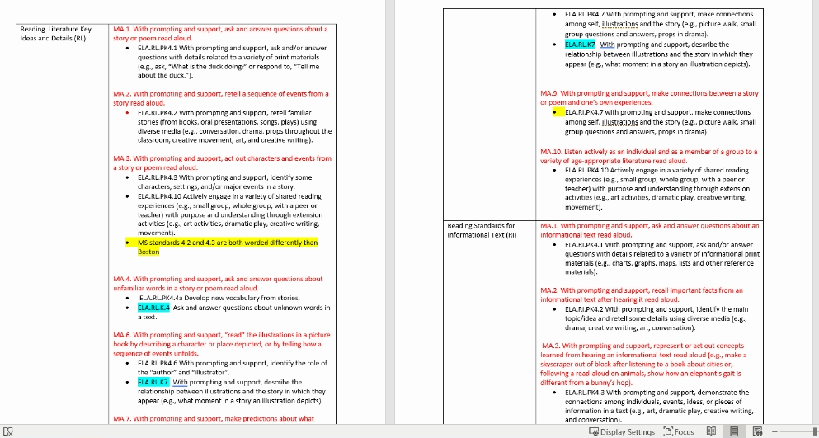
Standards Alignment

Slide 28
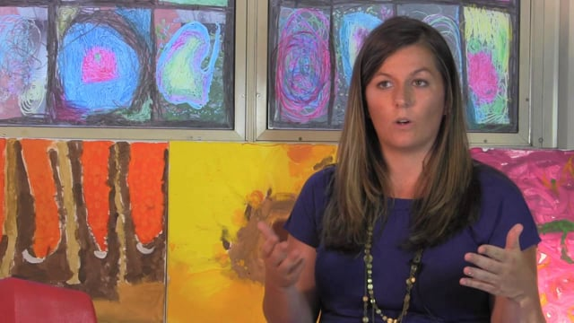
The Color Investigation
https://vimeo.com/74481930

Slide 29
Other Locations of Implementation
Maine Department of Education: Pre-K for ME
Rhode Island Department of Education: Kindergarten and First Grade

Slide 30
Jill Dent jdent@mdek12.org
Joyce Greer jgreer@mdek12.org
Marisa Prewitt mprewitt@mdek12.org

