Slide 1
MDE Procurement Training
An Operational Overview
Monique Corley, Director
Office of Procurement
Dr. Felicia Gavin, Chief
Office of Operations
June 28 – 29, 2022

Slide 2
Mississippi Department of Education

Slide 3
State Board of Education STRATEGIC PLAN GOALS

Slide 4
Office of Procurement Staff
Technology - Teresa Washington
Contracts/Grants - Ashley Robinson, Betsy Toles, Patricia Youngblood, and Qualandia "Star" Hooker
Purchasing - Vivian Taylor and Candice Webster
Office Director - Toya Brown
Director - Monique Corley

Slide 5
Agenda
The Purpose of Training
Procurement Stakeholders & Thresholds
Grants
Technology
Contracts
Purchasing
Procurement Process Maps
Q & A

Slide 6
Understanding MDE Procurement
  What is the Office of Procurement’s role?
  What is the Office of Grants Management’s role?
    Ensure the public that the State’s purchasing awards are competitive, fair, and transparent

Slide 7
Who are the Stakeholders? What are their responsibilities?
Procurement Opportunity
Grants
Technology
Services
Commodities
External Stakeholders
(Oversight Entities)
N/A
Information Technology Services Board
$1m+
(tech services & commodities)
(50k+ ITS Staff Only)
Public Procurement Review Board
$75k+
(DFA/OPSCR)
Public Procurement Review Board
$75k+
(DFA/OPTFM)
Internal Stakeholders
(MDE)
Program/Office
Procurement
Grants Mgmt
SBE - $50k+
Program/Office
OTSS
Procurement
SBE - $50k+
Program/Office
Procurement
SBE - $50k+
Program/Office
Procurement
SBE - $50k+
Notes:
Internal Stakeholders
Federal funds includes Office of federal programs with program/office

Slide 8
Part 1:
Grants

Slide 9
Types of Grants
State/Local/Other Grants. State, Local, and national foundations offer funding opportunities, as do cities and counties. These opportunities are typically narrowly focused on a specific need. Awards are usually smaller than those available from the federal government.
Federal State-Administered Grants. Federally funded opportunities that MDE receives based on a formula. These grants pass funds on to eligible subgrantee(s) to carry out the program, but the MDE is permitted to use some funds directly to administer the grant program.
Direct Federal Grants. Federal agencies announce, award, and supervise all aspects of grant-funded projects. Federal opportunities are typically the largest awards available.

Slide 10
Grant Disbursement Methods
There are two (2) methods of procuring grants: Request for Application and Request for Proposal
Request for Application – Program creates an application of questions to obtain required eligibility information.
Request for Proposal – Program requests a plan-of-action to review implementation of how the work will be accomplished.

Slide 11
Grant Disbursements
Formula grants – (RFA) Noncompetitive awards based on a predetermined formula established by law and the required forms are due at the awarding of the grant funds
State-Administered grants – (RFA) Competitive awards based on the review of an application, eligibility, and the required forms are due at the awarding of the grant funds.
Educator in Residence – (RFA) Competitive awards based on the review of an application.
Competitive grants – (RFP) Competitive awards based on the review of a proposal.
Discretionary grants – (RFP/A) Competitive awards based on the review of an application or proposal based on eligibility and a specialized population.

Slide 12
Grant Disbursement (Cont.)
State Administered Grants
    Application
    Points/priority required, if funds are limited
    Program review
    Subgrantee(s) must meet eligibility
    All awarded or award highest to lowest score

Slide 13
Grant Requirements
Methodology
New Process to Replace DUNS Number
  Unique Entity Identifier
New State-Administered Grants Process

Slide 14
Grant Award
Award Process:
After an RFP/A is released, the evaluation, selection, and awarding of the grants must take place
The SBE approves ALL grant awards $50,000 and over

Slide 15

Methodology
REMEMBER!
The MDE cannot grant awards to any entity unless it is outlined in law or the State Board of Education has approved a methodology.

Slide 16
Grants Process Map
Pre-Award (12 Months)
Planning
Proposal
Selection
Tentative Start Date
Method of Determination & Requirements Development
Methodology/ Solicitation
Evaluation
Selection
Negotiation
Award
Proposal Planning & Submission
(3-6 months)
Program Office
Proposal Review, Approval, Negotiation, Protests
(3 - 6 Months)
MDE Office of Procurement
Performance & Administration
Post Award Activities
Agreement Management
Inspection/Acceptance
Modifications
Disposition
Signatures
Quality Assurance
Review Deliverables
Adjustments
Renewals
Budget /Grants Management
Schedule Monitoring
Review Invoices/Requests for Funds
Approvals, if applicable
Expiration
Termination

Slide 17


Audience Q&A Session
ⓘ Start presenting to display the audience questions on this slide.

Slide 18
Part 2:
Technology

Slide 19
Technology
Thresholds | Procurement Methods
$.01 - $49,999 | Does not require ITS approval Technology Procurement Request Required Requires two quotes for processing
$50,000 and over | Technology Procurement Request Required Approval is required by SBE ITS
Notes:
CONTRACTS EXEMPT FROM APPROVAL BY THE PPRB The following contracts are exempt from approval by the PPRB: Unless otherwise ordered by regulation of the PPRB, the following listed items are exempt from the competitive bid process and do not require approval of the OPTFM except as may be required when submitting an Inventory Deletion Form.
By authority of the Mississippi Legislature, service contracts which do not exceed $75,000.00 do not require approval of the PPRB. Contracts which do not exceed $75,000.00 shall follow the procedures set forth in Section 3-205 (Small Purchases). The following are exempt from the purview of the PPRB in accordance with Mississippi Code Annotated § 27-104-7(2)(f) and as determined by the PPRB when performing duties for which they are licensed or certified.
• Personal service contracts not exceeding $75,000
• Contracts between agencies under the purview of the PPRB
• Computer or information technology-related services governed by the Mississippi Department of Information Technology Services (ITS)
• Personal service contracts entered into by the Mississippi Department of Transportation
• Contracts exempt by legislative statutory authority
Contracts for equipment repairs governed by Mississippi Code Annotated 31-7-13
• Contracts to manage trust funds by the Board of Trustees of the Public Employees’ Retirement System
• Accountant
• Engineer
• Architect
• Attorney
• Utility rate expert services

Slide 20
Technology
MDE Technology Request Procedures
Review TPR Revisions
Notes:
Add technology process handouts

Slide 21
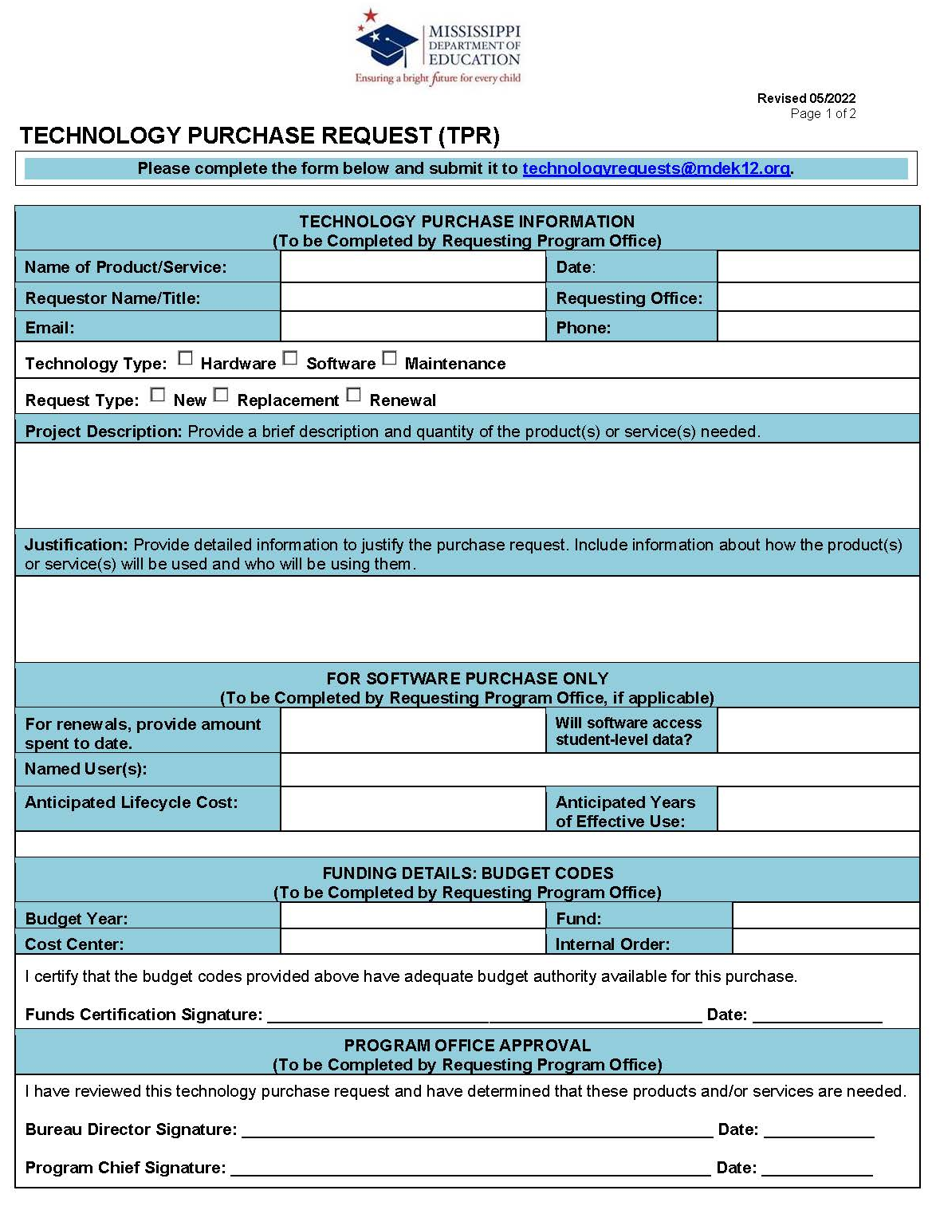
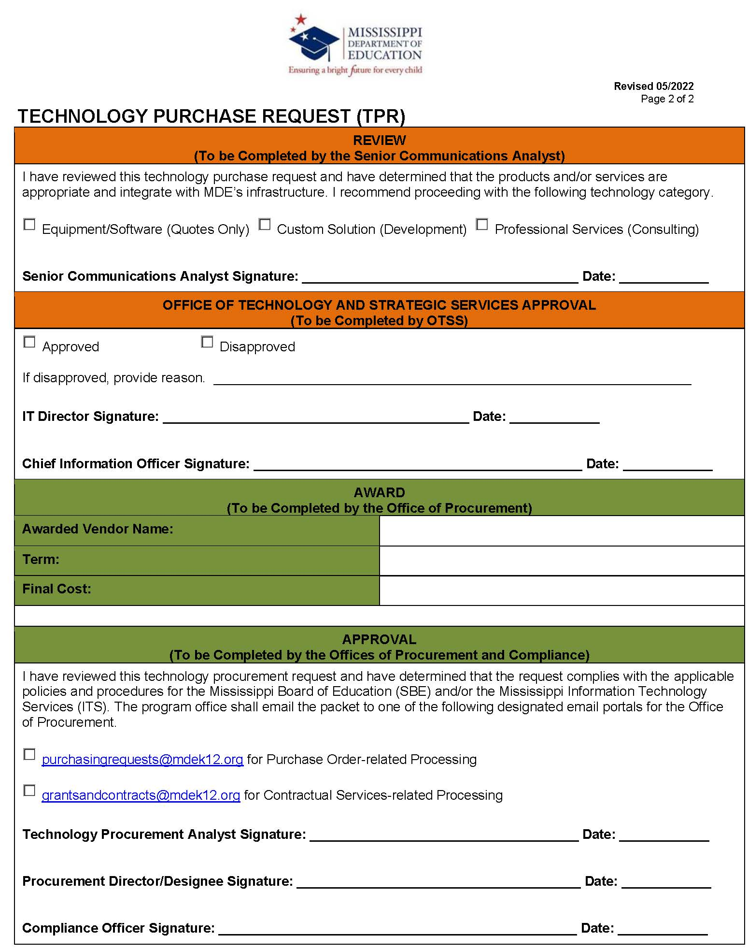

Slide 22

For State Funded grants, when are the required forms due
ⓘ Start presenting to display the poll results on this slide.

Slide 23
Federally funded grants must be procured using a competitive method
ⓘ Start presenting to display the poll results on this slide.

Slide 24
An SBE Methodology is required for all grants over $50k.
ⓘ Start presenting to display the poll results on this slide.

Slide 25
The Technology Purchase Request Form requires signatures from the program office director and chief.
ⓘ Start presenting to display the poll results on this slide.

Slide 26
Does the technology procurement analyst or the program office complete the Request for Quotes Form?
ⓘ Start presenting to display the poll results on this slide.

Slide 27
Audience Q&A Session
ⓘ Start presenting to display the audience questions on this slide.

Slide 28
Part 3:
Contracts

Slide 29
Personal and Professional Services
Independent Contractor Thresholds | Procurement Methods
Up to $10,000 | Two (2) Written Quotations No contract required/Purchase Order (PO) required
$10,000.01 - $49,999 | Three (3) written quotations Invitation for Bid Request for Proposal Request for Qualification PPRB Preapproved Vendor List Contract/PO required
$50,000 - $75,000 | Invitation for Bid Request for Proposal Request for Qualification PPRB Preapproved Vendor List Contract/PO required
Over $75,000 | Invitation for Bid Request for Proposal Request for Qualification PPRB Preapproved Vendor List Contract/PO required

Slide 30
Personal and Professional Services (Continued)
Contract Worker Thresholds | Procurement Methods
Up to $75,000 | Application through the Office of Human Resources (HR) Employment agreement required
Over $75,000 | Office of Procurement Request for Application Contract required
Notes:
A competitive quote is required once a vendor’s cumulative total of multiple contracts or purchases exceeds the threshold between awarding offices within the agency for the same service or product. All contracts in in excess of $50,000 shall be approved by the Mississippi Board of Education (Board). Additionally, contracts in excess of $50,000 shall be approved by the PPRB for commodities, equipment, furniture, printing, construction, repair, fleet and personal and real property. Contracts in excess of $75,000 for personal and professional services shall be approved by the SBE and PPRB prior to the Department awarding a contract. The awarding office shall present any such contract to the SBE and PPRB at each Board meeting prior to the beginning date of a contract.

Slide 31
Methods of Solicitation
Request for Quote (RFQuotes)
Invitation for Bid (IFB)
Request for Proposal (RFP)
Request for Qualification (RFQ)
Request for Application (RFA)
  Contract Worker $75k+
Emergency
Sole-Source
Preapproved Vendor Lists (PVL)

Slide 32

What’s the difference between an RFQuote, IFB, RFP, RFQ, and RFA?

Slide 33
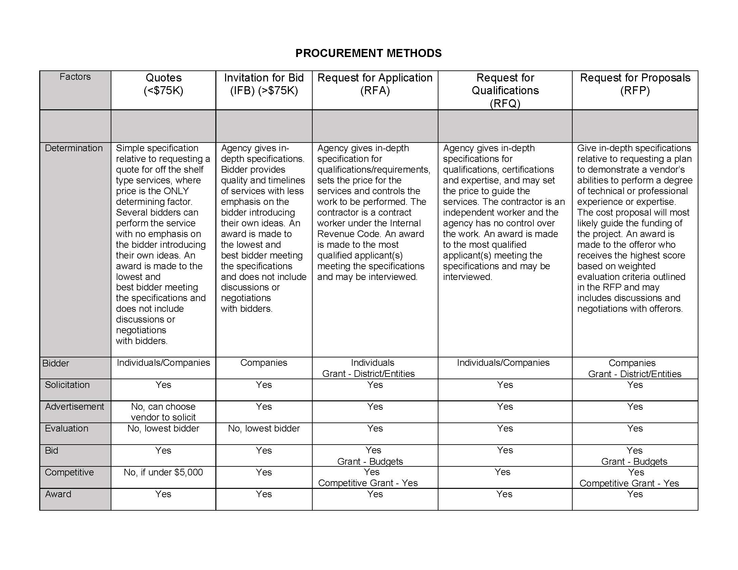

Slide 34
When to use a Request for Quote
When cost/price alone is not a factor
When the specification/scope of work is well-defined (clear to both the seller and buyer)
When the agency has the ability to adequately describe its needs
When the specification/scope of work are specific to the performance and design
Must solicit at least two (2) or three (3) vendor quotes, pending applicable threshold

Slide 35
When to use an IFB?
When cost/price alone is not a factor
When the specification/scope of work is well-defined (clear to both the seller and buyer)
When the agency has the ability to adequately describe its needs
When the specification/scope of work are specific to the performance and design
Must be solicited publicly

Slide 36
When to use an RFP?
When factors other than price alone are critical
When the requirements are highly technical
When the agency looks for each proposer to develop and provide ideas or solutions
When an agency has a complex need that is difficult to specify
If the agency needs flexibility in the award process to allow vendors an opportunity to revise their initial submission

Slide 37
When to use an RFQ?
When the most critical factor to an agency is the vendor’s qualification or specialized experience
When no plan, only qualifications are needed
When a professional service organization prohibits members from bidding

Slide 38
When to use an RFA?
Human Resources
$0 - $75,000
Procurement
$75,000.01 and Over
Agency gives in-depth specification for:
  Qualifications/requirements,
  Sets price for the services and
  Controls the work to be performed.
The contractor is a contract worker under the IRS code.
An award made to the most qualified applicant meeting the specifications and may be interviewed.

Slide 39
PPRB Preferred Method to Award
Invitation for Bids (IFB)
  If it is determined that an IFB is not the best method, MDE has to do the following:
    Submit a Petition for Relief 30 days before PPRB Meeting/Issuing Solicitation.
    The Petition must include:
      Alternate Method of Procurement
      Evaluation factors that will be used in reviewing submitted proposals or qualifications.
      Must be in writing and signed by the Agency Head
  PPRB must approve the Petition in order to use any other method

Slide 40
PPRB Procurement Requirements
Petition for Relief
Acknowledgement of Amendments Form
Receipt of Responses
Evaluation Process
Notice of Intent to Award

Slide 41
Contract for Services Award
Award Process:
After an RFQuote is released, the lowest bidder receives the award
After an RFP/Q/A is released, the evaluation, selection, and awarding of the contract must take place
A board item is developed for awards of $50,000 and over
The board approves ALL service contract awards $50,000 and over
A PO shall be requested upon receipt of the signed contract

Slide 42
Contracts Process Map
Pre-Award (12 Months)
Planning
Proposal
Selection
Tentative Start Date
Method of Determination & Requirements Development
Solicitation
Evaluation
Selection
Negotiation
Award
Proposal Planning & Submission
(3-6 months)
Program/Office
Proposal Review, Approval, Negotiation, Protests
(3-6 Months)
MDE Office of Procurement
Performance & Administration
Post Award Activities
Agreement Management
Inspection/
Acceptance
Modifications
Disposition
Signatures
Quality Assurance
Review Deliverables
Adjustments
Renewals
Request PO
(excludes contract workers)
Schedule Monitoring
Review Invoices/Requests for Funds
Approvals, if applicable
Expiration
Termination

Slide 43
Audience Q&A Session
ⓘ Start presenting to display the audience questions on this slide.

Slide 44
Part 4:
Purchasing
Commodities, Equipment, Repairs, Furniture, Fleet, and Personal and Real Property

Slide 45
Commodities, Furniture, Printing, Construction, Repair, Fleet and Personal and Real Property
Purchasing
Thresholds | Procurement Methods
Up to $50,000 | Two (2) Written Quotations (Exception: Competitive State Contracts)
$50,000 - $75,000 | Three (3) Written Quotations (Exception: Competitive State Contracts)
Over $75,000 | Invitation for Bid
Notes:
CONTRACTS EXEMPT FROM APPROVAL BY THE PPRB The following contracts are exempt from approval by the PPRB: Unless otherwise ordered by regulation of the PPRB, the following listed items are exempt from the competitive bid process and do not require approval of the OPTFM except as may be required when submitting an Inventory Deletion Form.
By authority of the Mississippi Legislature, service contracts which do not exceed $75,000.00 do not require approval of the PPRB. Contracts which do not exceed $75,000.00 shall follow the procedures set forth in Section 3-205 (Small Purchases). The following are exempt from the purview of the PPRB in accordance with Mississippi Code Annotated § 27-104-7(2)(f) and as determined by the PPRB when performing duties for which they are licensed or certified.
• Personal service contracts not exceeding $75,000
• Contracts between agencies under the purview of the PPRB
• Computer or information technology-related services governed by the Mississippi Department of Information Technology Services (ITS)
• Personal service contracts entered into by the Mississippi Department of Transportation
• Contracts exempt by legislative statutory authority
Contracts for equipment repairs governed by Mississippi Code Annotated 31-7-13
• Contracts to manage trust funds by the Board of Trustees of the Public Employees’ Retirement System
• Accountant
• Engineer
• Architect
• Attorney
• Utility rate expert services

Slide 46
Procurement Methods
Competitive State Contracts
Cooperative and Negotiated Contracts
Non-State Contract Items

Slide 47

Purchase Order Request Methods
Requisitions
  Should only be used when purchasing technology, equipment/fixed assets, furniture, and fleet
Shopping Cart
  All other purchases
Notes:
Add Handout for Shopping Carts

Slide 48
State Procurement Card Program
Procurement Card Guidelines
Notes:
Food and space requests may be submitted as far in advance

Slide 49

Food & Space Request Form
1
1: To Reserve Food or Space
Complete the RFQuote process first to select the vendor with the lowest bid.
4. If approved, proceed with event
4
2. Complete Food & Space Request Form
Upon receipt of all bids for either food or space, complete and submit Food and Space Request Packet to Procurement for Review.
2
3
3. Procurement Review

Slide 50
Food and Space Request (Cont.)
Refreshment cost
The Procurement Office will require at least seven (7) business days to process and approve a food and space request.

Slide 51
Group Activity
A program is planning to host an annual conference. The agency wants to contract with a motivational speaker to inspire teachers and administrators and lunch will be served.
How should your program office proceed?
Email final RFQ Form to kwiggins@mdek12.org

Slide 52
Audience Q&A Session
ⓘ Start presenting to display the audience questions on this slide.

Slide 53
Documents from this presentation will be emailed to you at the conclusion of this session.

