Slide 1
School Based Administrative Claiming Program

Slide 2
2 Types of Employee Training
SBAC Employee Training
When a new employee is added to the system, they will be sent a link within 24 hours and the module will teach them about the program requirements.
SBAC Employee Training (Annual requirement)
All employees listed on the employee roster must be trained once a year.
They can be trained in a professional development setting or by using an online module.

Slide 3
Online Training Tool: New feature
SBAC Coordinator:
Can be used to train employees, track progress and build SBAC employee profiles

Slide 4
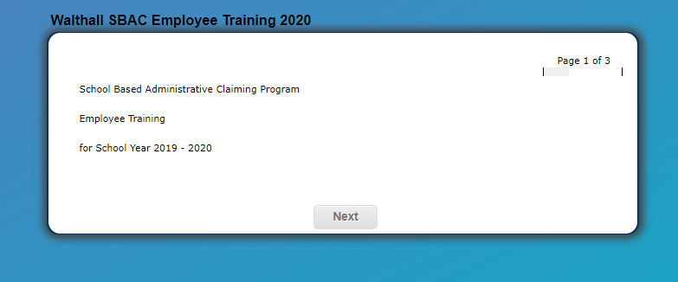
Online Training Tool

Slide 5
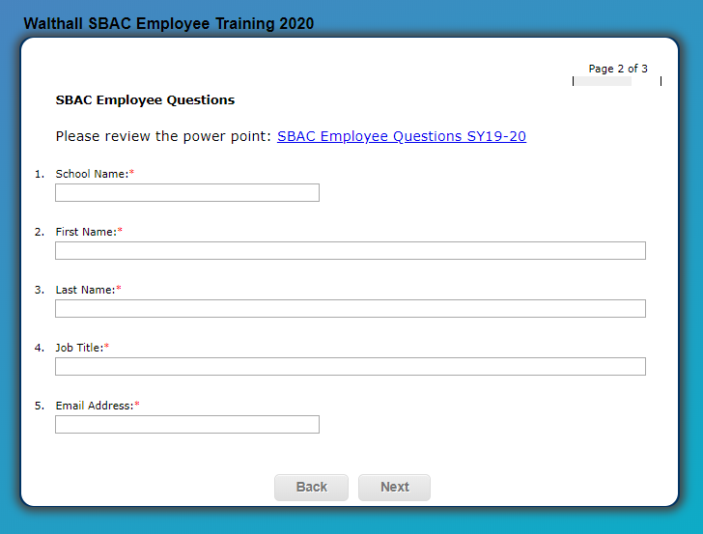
Online Training Tool
Information can be used to build employee profile in the SBAC system

Slide 6
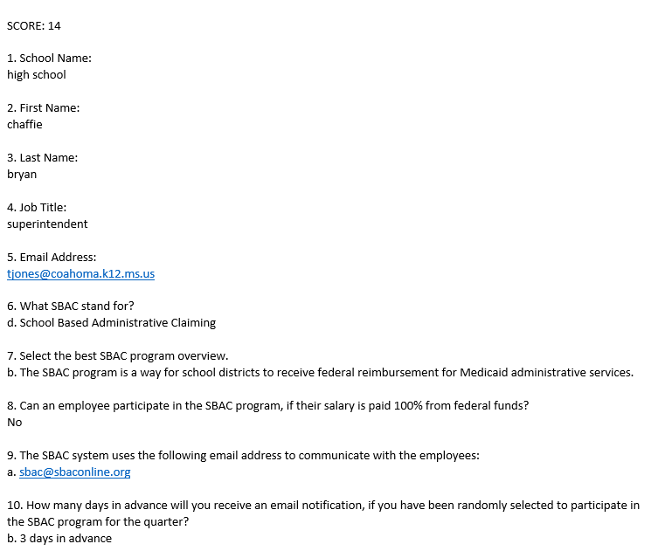
Online Training Tool
System will email results to the SBAC Coordinator
Results can be used to determine if additional help is needed

Slide 7
If you are interested in using the online module, please contact the SBAC staff.

Slide 8
Contact Information
Mississippi Department of Education
Office of Healthy Schools
359 North West Street
Jackson, MS 39205
Phone: (601) 359-1737
Fax: (601) 576-1417
SBAC website: www.sbaconline.org
Office of Healthy Schools
Louis King, Office Director II
Phone: (601) 359-1737
Email: lking@mdek12.org
Office of Healthy Schools
Shun Taylor, Accounting Specialist
Phone: (601) 359-1737
ShTaylor@mdek12.or
Office of Healthy Schools
Kegila Lyles, Programmer Analyst
Phone: (601) 359-1737
Email: klyles@mdek12.org

