Slide 1
OFFICE OF EDUCATOR QUALITY
MASS Summer Conference
July 2015

Slide 2
Equity Access to Excellent Educators
EQUITY ACCESS

Slide 3
Equity Access to Excellent Educators
Teachers are the single most important school-based factor affecting student achievement.¹
Low-income students and students of color are disproportionately located in the lowest-performing schools, which have half as many highly effective and 1.5 times as many ineffective teachers as high-performing schools.²
Providing high-need students with equitable access to effective teachers is a strategy that can close the achievement gap.
  High-need students means students at risk of educational failure or otherwise in need of special assistance and support, such as students who are living in poverty, who attend high-minority schools, who are far below grade level, who have left school before receiving a regular high school diploma, who are at risk of not graduating with a diploma on time, who are homeless, who are in foster care, who have been incarcerated, who have disabilities, or who are English language learners.³

Slide 4
Development of Teachers
Although the problem of inequitable access may begin with the supply of teachers, it compounds over time as new teachers develop their skills.³
  In low-poverty, low-minority schools, teachers develop more quickly and improve over a longer period of time more often than in high-poverty, high-minority schools.⁴
  In low-poverty schools, teacher effectiveness increases with experience, particularly from years 6 to 12; whereas teacher effectiveness plateaus in high-poverty schools after 5 years of teaching.⁵

Slide 5
Teacher Mobility and Attrition
Teacher attrition is problematic because high levels of teacher turnover usually result in higher levels of teachers with little or no experience, who are on average less effective than their peers with at least 2 years of experience.
To address the issue of inequitable access, we must also understand the impact initial placement has on a teacher’s career and student learning, the amount of time he or she will stay in his or her initial placement and the reasoning behind his or her decision to transfer to another school or district or to leave the profession entirely.

Slide 6
State Data
2014-2015:
  7.65% of teachers do not have previous teaching experience
  25.43% of teachers have between 0-3 years are inexperienced
  Of the 55 school districts with 90% or more free/reduced lunch status:
    47 districts exceed state average of new/inexperienced teachers
  9.84% of teachers are eligible to retire

Slide 7
State Data
14 School Districts employ 25% or more non-highly qualified teachers.
All 14 of those districts are 100% free/reduced lunch based on 2014-15 snapshot data.

Slide 8
Conducting a Root Cause Analysis
  Ongoing Professional Learning
    Lack of Aligned Professional Learning Opportunities – Teachers and principals may not have access to professional learning that is directly linked to their goals, needs, or content area or linked to the expectations included in the evaluation system. This situation not only negatively affects the district’s ability to improve the practice of the existing teaching force but also limits opportunities for teacher advancement into leadership roles.
    Inconsistent Induction and Mentoring Opportunities – Stakeholders (including teacher and district personnel) shared that this challenge is especially relevant to new teachers, who often need higher levels of professional learning than their more veteran peers.

Slide 9
Conducting a Root Cause Analysis
  Teacher and Principal Preparation
    Well-prepared educators positively impact student achievement and have lower turnover rates, and thorough teacher and principal preparation provides candidates with the knowledge and skills they need for successful instruction and leadership.
  Fiscal Equity
    High-need schools tend to face complicated resource needs at the school level (e.g., larger individualized education program costs, costs associated with behavioral issues, remedial education needs.) If available resources at these schools are systematically inadequate, their ability to maintain attractive school facilities and provide teachers with instructional and non-instructional supports will suffer, leading to high turnover.

Slide 10
No single strategy will solve the problem of inequity access. Those committed to improving access will likely employ a combination of strategies to address root causes of inequity access.

Slide 11
Educator Licensure:
LICENSURE AND ELMS

Slide 12
LICENSURE & ELMS
Elementary Certification:
  Beginning September, 2016, all teachers seeking elementary certification through a traditional route program will be required to take and pass the Pearson Foundations of Reading assessment for certification. Information about that assessment can be found on the Educator Quality website.
  Beginning September 30, 2015, the Praxis I will no longer be accepted for certification.

Slide 13
LICENSURE & ELMS
Student Intern License (101)
  Will certify all student teachers with a temporary license for student teaching only.
  Will require student teachers to abide by the MS Educator Code of Ethics.
  Proposed implementation: Fall 2015

Slide 14
LICENSURE & ELMS
The requirements for ENTRY into a teacher preparation program have been revised (MS Code 37-3-2) and now require:
  Passing Praxis Core scores or 21 or above ACT scores
  Minimum GPA of 2.75 with a cohort GPA of 3.0

Slide 15
LICENSURE & ELMS
Applications for certification (renewals, upgrades, reciprocity, etc.) are loaded into ELMS. Once the file is complete it is assigned to an analyst and processed in order based on the date the application was complete.
There are 2,973 applications pending now (as of this morning). The turnaround time for processing applications is currently 20 business days.
If you are awaiting certification to offer a job to a prospective teacher please use the contingent contract. If the educator fails to receive his/her license, the contract will become void in October.
  Things you should verify before issuing a contingent contract: Praxis scores and transcript confirming a degree

Slide 16
LICENSURE & ELMS
Applications in ELMS are considered confidential. Discussions about the contents of an educator’s file will only be conducted with the educator.

Slide 17
LICENSURE & ELMS
Renewing licenses in ELMS
  CEUs must be obtained through an accredited CEU granting agency. Any Continuing Education Office at a college, university, or community/junior college is an accredited CEU granting agency.
  CEU credit for less than .5 should not be accepted.
  10 hours = 1 CEU
  An annual audit will be conducted to verify renewals at the district level are compliant with SBE policy.
  An educator’s renewal will be void if proper documentation is not used to satisfy the requirements for renewal.

Slide 18
Educator Misconduct
Reporting period for Superintendents – 10 days
Code of Ethics training – Please conduct annually
Common Reporting offenses:
  Texting
  Sexting
  Breach of Contract
  Inappropriate Relationships – Physical
  Inappropriate Relationships – Non-Physical
  Violation of Student Rights to Privacy and Religion.

Slide 19
Educator Evaluations
Cerissa Neal
Office of Educator Quality

Slide 20
Federal and State Theory of Action
Improved Educator Quality
Improved Student Outcomes
Improved Evaluation System

Slide 21
The Goals of an Evaluation System
“In theory, an evaluation system should identify and measure individual teachers’ strengths and weaknesses accurately and consistently, so that teachers get the feedback they need to improve their practice and so that schools can determine how best to allocate resources and provide support.”
Weisberg, D., Sexton, S., Mulhern, J., Keeling, D. (2009). The Widget Effect: Our National Failure to Acknowledge and Act on Differences in Teacher Effectiveness. Retrieved from the New Teacher Project: http://tntp.org/publications/view/the-widget-effect-failure-to-act-on-differences-in-teacher-effectiveness

Slide 22
Improving Teaching Practice
“Across the nation, states and districts are in the process of building better teacher evaluation systems that not only identify highly effective teachers but also systematically provide data and feedback that can be used to improve teacher practice.”
Goe, L., Holdheide, L., & Miller, T. (2011). A Practical Guide to Designing Comprehensive Teacher Evaluation Systems A Tool to Assist in the Development of Teacher Evaluation Systems. Retrieved from National Comprehensive Center for Teacher Quality: http://www.lauragoe.com/LauraGoe/practicalGuideEvalSystems.pdf

Slide 23
Teacher Evaluation IS NOT a Silver Bullet
“Teacher evaluation systems alone are insufficient to improve instructional quality and increase student achievement. To be successful, reform efforts need to be coherent and aligned across the educator career continuum, beginning with recruitment and preparation, and extending to support, evaluation, and compensation.”
Angela Minnici
The Mind Shift in Teacher Evaluation

Slide 24
MS Board of Education Strategic Plan
Goal 4
Every School Has Effective Teachers and Leaders
Strategy:
Implement with fidelity Mississippi Teacher Evaluation System (MTES) and Mississippi Principal Evaluation System (MPES) and other educator evaluation systems.

Slide 25
Educator Evaluations
Mississippi Teacher Evaluation System
Mississippi Principal Evaluation System
Mississippi Counselor Appraisal Rubric
Mississippi Student Services Appraisal Rubric
Mississippi Speech-Language Pathologist Assessment
Mississippi Librarian Evaluation Instrument

Slide 26
M-STAR
Teacher Self-Assessment
Walk-through Visits
Formal Observations/Conferences
Review of Artifacts
Student Survey (optional)

Slide 27
The Teacher Observation Cycle
Teacher Self-Assessment (optional)
    Based on the M-STAR standards
  2. Walk-through (informal) Observations
    A minimum of two are required (at least five are recommended)
    Beyond the two required, the frequency and length of time of the walk-through visits are at the discretion of the school district.

Slide 28
The Teacher Observation Cycle
3. Formal Observation and Conferences
    Pre-Observation Conference (optional)
      Discussion of the lesson to be observed
      Discussion of teacher self-assessment
    Formal Observation
      Two are recommended
      A minimum of one is required
      A minimum of 30 minutes
    Formal Post-Observation Conference
      Required after each formal observation
      Discussion/Feedback
      Next Steps/professional growth plan
4. Student Surveys (optional)

Slide 29
Rubric Overview
Five domains (weighted equally)
Planning
Assessment
Instruction
Learning Environment
Professional Responsibilities
20 Standards

Slide 30
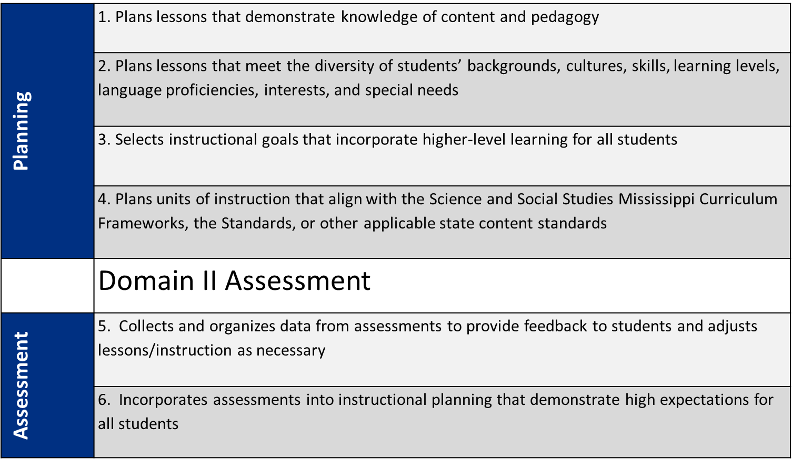
Rubric

Slide 31
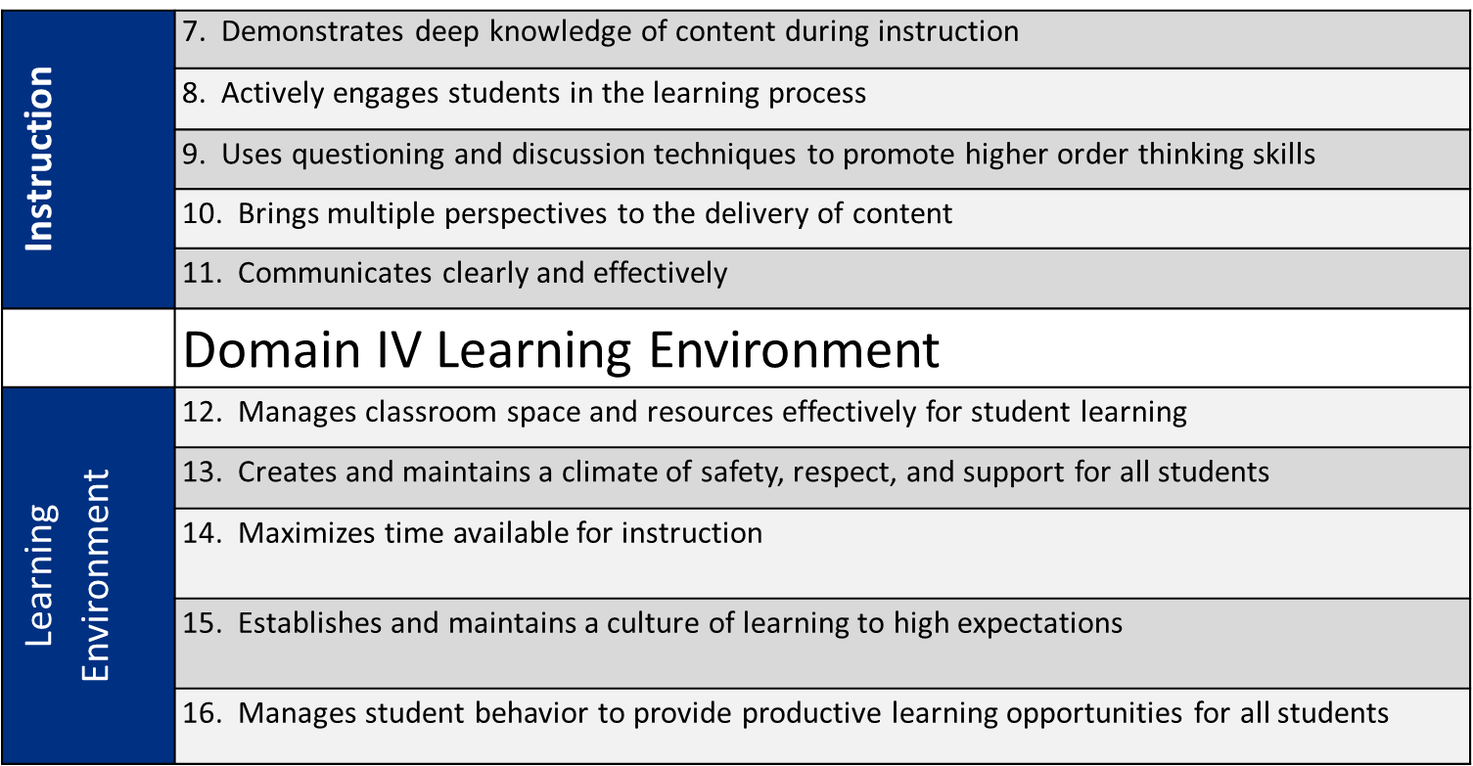
Rubric

Slide 32
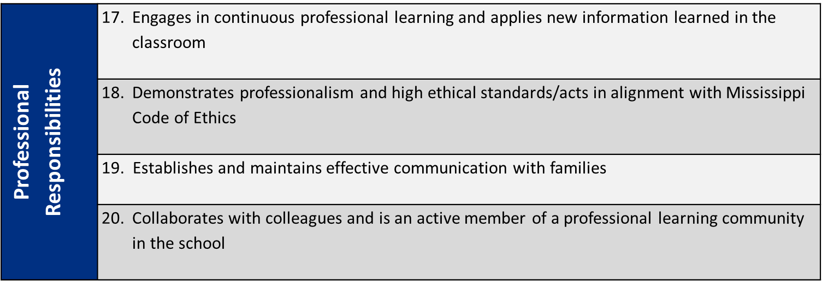
Rubric
 | Domain V Professional Responsibilities

Slide 33
Performance Levels
Performance ratings
Description
  Level 4 is the most effective level of teacher performance. Rating at this level indicates that the teacher’s performance is exemplary; consistently exceeding expectations. Teachers who receive this rating should receive professional development and support to continue to grow and develop their skills.
  Level 3 is the expectation for all teachers. Rating at this level indicates the teacher’s performance consistently meets expectations. Teachers who receive this rating should receive professional development and support designed to address the identified area(s) for growth.
  Level 2 indicates either a beginning teacher or a teacher who needs focused professional development. Rating at this level indicates the teacher is sometimes meeting expectations, but not doing so consistently. Teachers who receive this rating should receive professional development and support designed to address the identified area(s) of challenge.
  Level 1 is the least effective level of teacher performance. Rating at this level indicates the teacher’s performance is not acceptable. Teachers who receive this rating rarely meet expectations. Teachers who receive this rating should receive immediate and comprehensive professional development and support designed to address the identified area(s) for growth.
Level 4
Level 3
Level 2
Level 1

Slide 34
M-STAR Standards Ratings
Ratings for all twenty standards should be linked to the evidence collected during the formal observation(s), walk-through (informal) observations, artifact review, and post-observation conference(s).
Pre-observation conferences and student surveys are optional methods of evidence collection.

Slide 35
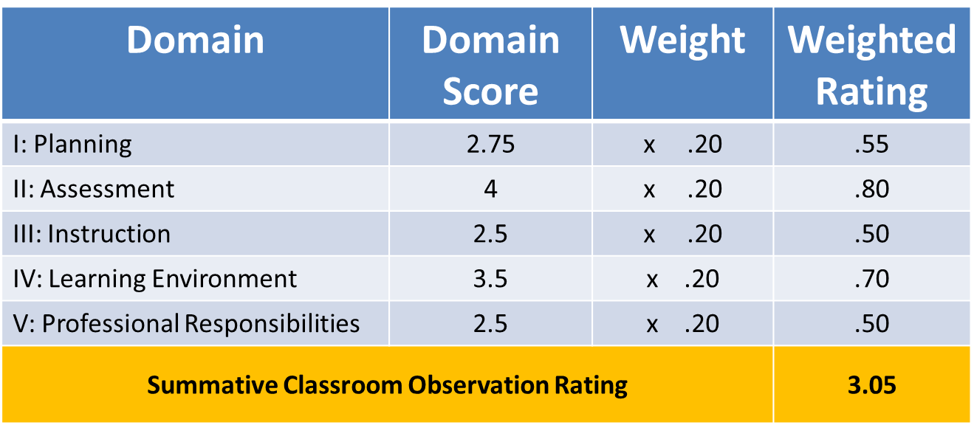
Example: Summative
Observation Rating

Slide 36
PRINCIPAL EVALUATION

Slide 37
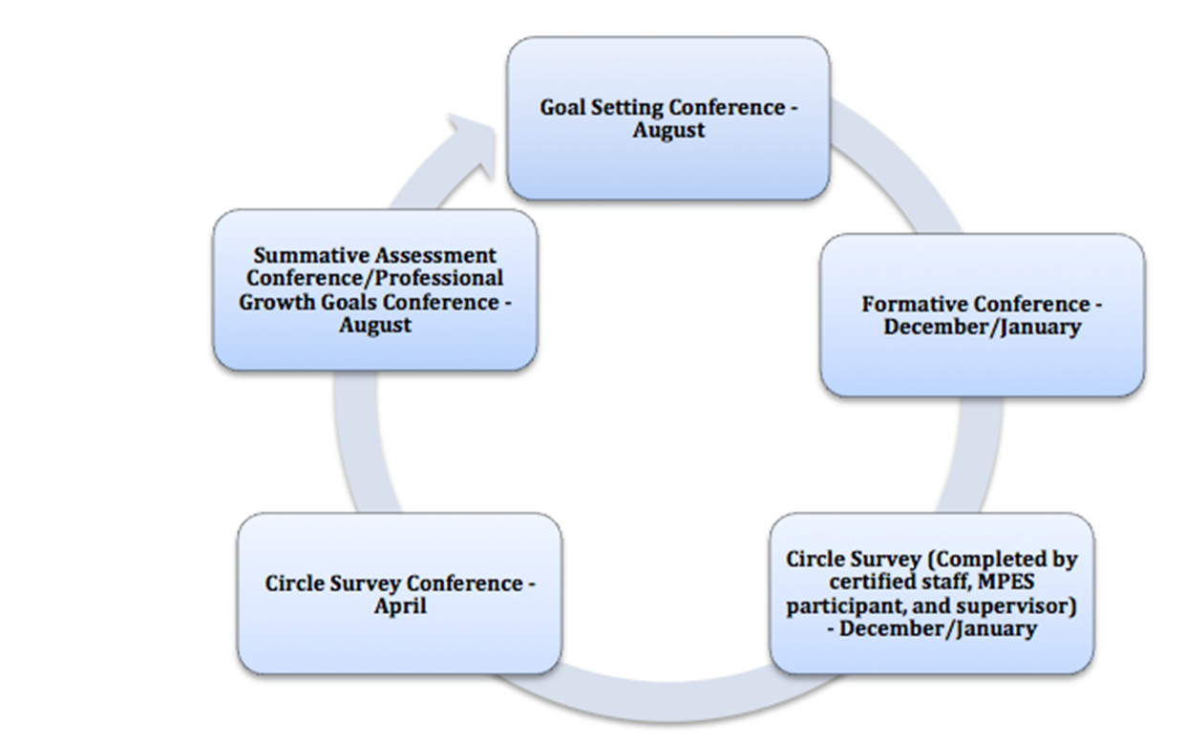
MPES Target Dates

Slide 38
MS Principal Evaluation System
In 2014-2015, the MDE began capturing MPES data in ELMS as the method chosen to monitor MPES implementation throughout the school year (federal requirement).
*Note: Scores will be reported via SharePoint for the 2014-2015 MPES cycle due to the waiver that allows states respite from using student assessment data in educator evaluation for 2014-2015.

Slide 39
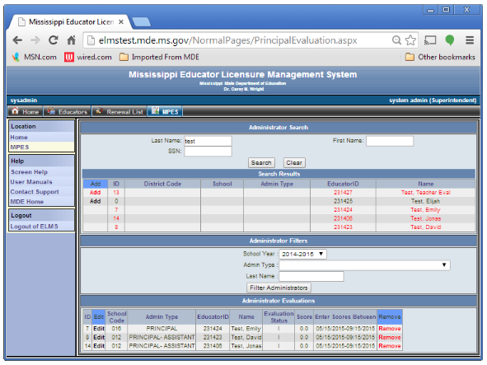
MPES-ELMS:
Superintendent
The superintendent (or his/her designee) creates a list of all school administrators in the district (which assigns the MPES module to them)
The superintendent reports MPES scores at the end of the MPES cycle

Slide 40
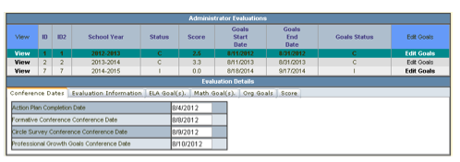
MPES-ELMS:
School Administrators
School administrators log into ELMS after MPES conferences and enter required data in the MPES module
Required data include:
  All goal-setting data
  Supervisor information
  Certified staff and student numbers
  Action plan completion date
  Conference dates

Slide 41
Educator Misconduct
Conducting Investigations

Slide 42

Educator Misconduct
Conducting an Investigation
MS Code 37-3-2 Certification of Teachers and Administrators
Obtain as much information as possible. The more information that is obtained the easier it becomes to make a decision.

Slide 43
Educator Misconduct
Begin the investigation Immediately!
Secure Physical Evidence
Photograph the scene of the event
Document what happened
Make a list of potential witnesses

Slide 44
Educator Misconduct
Plan the Investigation
Who is in charge of the investigation?
What facts are needed to substantiate or prove unsubstantiated the allegation?
What documentation is available?
Is there evidence that needs to be collected?
Who should be interviewed? (What information is expected?)
What other agencies (DHS, Police, District Attorney, etc.)? need to be involved
What independent actions should the school system take immediately?

Slide 45
Educator Misconduct
Conducting and Investigation
Questions to Ask:
WHO was involved?
WHAT happened?
WHEN did it happen?
WHERE did it happen?
WHY did it happen?
HOW did it happen?

Slide 46
Educator Misconduct
Interview Questions
Avoid Leading Questions
Do you remember X?
Avoid Yes or No Questions.
Were you at the gym on Friday?
Ask: Where were you on Friday?
Avoid Negative Wording
You don’t remember X, do you?
Allow the witness to talk.
Ask: Tell me what you remember about…

Slide 47
Educator Misconduct
Interviewing Children
  Open-Ended Questions - avoid the use of questions that typically result in a Yes or No answer.
  Do not assume that you understand. If at first you don’t understand what they are trying to tell you, ask them to re-state what they want to say.
  Allow the child to move around, fiddle it allows the child feel they have some control.
  Listen and observe nonverbal expressions. Indirect approaches work best with reluctant children.
  Encourage the child to expand, “What happened next?” and “You were saying that ____ ”
  Adolescents - written statements are possibly more effective than interviews. They tend to express private
  feelings.

Slide 48
Educator Misconduct
What to Report
Violations of Standard 1.2 (Misuse or mismanagement of tests or test materials) that affect the validity of mandatory uniform test results as provided in Section 37-16-4 (1)
Violations of Standard 2 (Trustworthiness) that result in a felony conviction
Violations of Standard 3 (Unlawful Acts) (felony and sex offense convictions)
Violations of Standard 4 (Educator/Student Relationships)
Violations of Standard 7 (Public Funds and Property) that result in a felony conviction
Violations of Standard 6 (Alcohol, Drug and Tobacco Use or Possession) that result in termination and/or a felony conviction
Violations of Standard 9 (Maintenance of Confidentiality) that affect the validity of mandatory uniform test results as provided in Section 37-16-4 (1)
Violations of Standard 10 (Breach of Contract or Abandonment of Employment)

Slide 49
Contact Information
Cerissa Neal, Executive Director, Office of Educator Quality
  601-359-3631 or cneal@mde.k12.ms.us
Sargent Holley Haywood, Licensing Investigator
  601-359-3631 or hhaywood@mde.k12.ms.us
Amy Daniel, Office Director, Educator Misconduct
  601-359-3483 or adaniel@mde.k12.ms.us
Tarance Hart, Office Director, MS Teacher Center
  601-359-3631 or thart@mde.k12.ms.us
Lisa White, Educator in Residence, Principal Evaluations
  601-359-3631 or lwhite@mde.k12.ms.us

Slide 50
References
¹Aaronson, D., Barrow, L., and Sander, W. (2007). Teachers and students achievement in Chicago public high schools. Journal of Labor Economics. 25(1): 95-135.
²TNTP. (2012). The irreplaceables: Understanding the real retention crisis in America’s urban schools. The New Teacher Project.
³Reform Support Network. (2015). Promoting more equitable access to effective teachers: Problem and root causes.
⁴Tenessee Department of Education. (2009).
⁵Sass, T. (2010). Value added of teachers in high-poverty and lower-poverty schools. National Center for Analysis of Longitudinal Data in Education Research.
⁶Goldhaber, D. (2009). Teacher career paths, teacher quality, and persistence in the classroom: Are public schools keeping their best?. National Center for Analysis of Longitudinal Data in Educational Research.

