Slide 1
Impact of Pre-Kindergarten Programs on Student Performance in Early Schooling in the State of Mississippi
The Path From A Research Agenda To Actionable Outcomes
Mississippi’s Story
July 25th, 2019
2019 NCES STATS-DC Data Conference
“Providing Evidence to Drive Education”
John Kraman
Chief Information Officer
Mississippi Department of Education
Jkraman@mdek12.org
Yan Li, Ph.D.
Director, Office of Research and Development
Mississippi Department of Education YLi@mdek12.org

Slide 2
Outlines
Outlines

Slide 3
Path Outlines
Path Outlines
Integration
Agenda Development
Advancement
Efforts
Rethinking From Current Research Studies
Motivation
Challenges
Agenda Implementation
Time

Slide 4
Introduction
Introduction
Motivation

Slide 5
Research Capability Maturity Model
Research Capability Maturity Model
5
Matured
Absolute advantages to comparative advantages
4
Maturity Level
Optimized
Portfolio-based approach
3
Managed
Clearly articulated accountability
2
Directed
In response to a need
1
Ad-Hoc
No control of any kind

Slide 6
Motivation
Motivation
Demand grew for more analytical use of data to inform decision-making and program implementation.
Prior to the 2017, there was no research agenda. There was an urgent need to increase the agency’s awareness of what is a research agenda is and why it is needed.

Slide 7
2015-SLDS
Opportunity: 2015 MS SLDS Grant
Grant Priorities
1. Research and Evaluation
2. Early Learning
Grant Expected Outcomes
1. Creating data dashboard and establishing a research office
2. Completing the Early Childhood Education component of the P-20W SLDS
For more information:
Statewide Longitudinal Data Systems Grant Program

Slide 8
Research Office Establishment
Research Office Establishment
Office of Research and Development
The Office of Research and Development (ORD) is committed to producing objective and accurate research and analytics. It transforms data into insights that inform the decision-making of the MDE leadership. ORD supports the broader mission of Mississippi State Board of Education strategic plan, to improve student achievement, and opportunities throughout Mississippi’s education system.

Slide 9
Research Goals
Research Goals
Better integration
Achieve better integration with better data.
SLDS enhancement
Effectiveness and efficiency maximization
Leverage the statewide longitudinal data system for each data contributor to achieve its goals.
Education data
Research
Identify and leverage talents for maximum effectiveness and efficiency.
Knowledge dissemination
Disseminate knowledge and insights to promote evidence-based decision-making.

Slide 10
Agenda Development
Agenda Development
Dynamic Research Framework development efforts

Slide 11
Research framework development curve
Research Framework Development Curve
Interviews
Preliminary Questions
Goal Alignment
Stakeholder Feedback
Final Product
Interviewed program office staff regarding various needs and challenges
54 staff members across 23 program offices
Combined with a thorough literature review
Converted to a dynamic system
Focused to align with the Mississippi State Board of Education Strategic Plan
Presented early drafts
Gained benefits of stakeholders’ expertise
Incorporated the MDE executive leadership team’s feedback
Generated final product

Slide 12
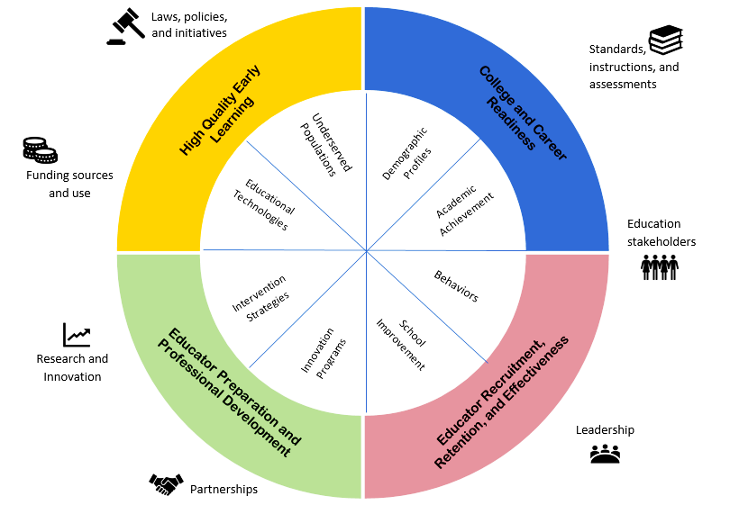
Dynamic Research Framework
Dynamic Research Framework

Slide 13
Agenda Implementation
Agenda Implementation
Early Learning

Slide 14
MS Early Learning Collaborative (ELC) Act 2013
MS Early Learning Collaborative (ELC) Act 2013
What is Mississippi’s Early Learning Collaboratives?
The Early Learning Collaborative Act of 2013, which become law on April 18, 2013, establishes Mississippi’s first state-funded, voluntary Pre-K program on a phased-in basis.
Provide funding (competitive basis) to local communities to establish, expand, support and facilitate the successful implementation of quality early childhood education and development services.
The state provides $2150 per full-time child enrolled. All state dollars must be matched on a 1:1 basis at the local level to make the total investment for each child enrolled in ELC $4300.

Slide 15
MS Early Learning Collaboratives
MS Early Learning Collaboratives
Lead Partner
History, commitment, and need
Staff qualifications
((assistant) teachers+
CLASS)
Professional development
(15 hours APD, PCL)
Assessments
Learning standards, curriculum
(MKAS2, OWL)
Program length, class size, teacher-child ratio, and parent engagement
Public schools
Head Start
Private agencies (i.e. child care centers or non-profit organizations)
Faith-based centers
The majority of the ELCs are led by school districts, but some are led by nonprofit organizations. A few ELCs include multiple school districts.
For more information:
Early Childhood

Slide 16
Research Phase I, II, and III
Research Phase I, II, and III
Research Questions
Phase I: Is Early Learning Collaborative program effective during its first year of operation?
Phase II: Using pooled cross-sectional analysis, does attending an Early Learning Collaborative (ELC) center improve preschoolers’ kindergarten readiness? Is the impact increasing or decreasing since the program implemented?
Phase III: What is the longitudinal effect of the ELCs program on the third grade performance (reading gate)? For kids who were in the ELCs program, what is the effect of the ELCs program on their performance in RLA, Math, and retention? Do students who perform well in Pre-kindergarten programs continue to perform well in the third grade?

Slide 17
Research Phase I and II Revisit - Overview of Findings
Research Phase I and II Revisit
Overview of Findings
An overall positive trend of relationship between ELC participation and the likelihood that a student will achieve proficiency as well as score higher on the Kindergarten Readiness Assessment from over two-year window (SY14-15 to SY16-17)
With SY14-15 as the base year and other things being equal, a kid enrolled in an ELC public classroom is 7% more likely than his/her peer who enrolled in a non-ELC public classroom to achieve proficiency on the Kindergarten Readiness Assessment in SY16-17.
With SY14-15 as the base year and other things being equal, a kid enrolled in an ELC public classroom in SY16-17 earned about 18 points more than his/her peer who enrolled in a non-ELC public classroom.

Slide 18
Research Phase I and II Revisit - Policy
Research Phase I and II Revisit
Policy Indications
There is an overall positive trend of relationship between ELC participation and the likelihood that a student will achieve proficiency as well as score higher on the Kindergarten Readiness Assessment.
The effect of ELC participation on Kindergarten Readiness Assessment outcomes grew more positive between 2014-2015 and 2016-2017. This could reflect a maturing of the program and resultant increase in program quality.

Slide 19
Agenda Implementation
Agenda Implementation
College and Career Readiness

Slide 20
Background
Background
Recent literature suggests that although students are earning degrees and high school graduation rates continue to increase, there is still concern as to whether students are prepared for college and career. 30%-60% of freshman students are taking remedial courses.
One-size-fits-all college-readiness agenda has resulted in students who do not graduate from high school or in students who graduate but are not academically prepared or college-ready.

Slide 21
Objectives
Objectives
Develop a college and career readiness framework for Mississippi public schools.
Provide a scientifically firm foundation for other ongoing and planned work (MS Succeed Report Card and dashboards, High School Feedback Report).
Provide students with better programs and services to prepare students for academic and career pursuits.

Slide 22
College and career readiness framework- preliminary
College and Career Readiness Framework - Preliminary
Self-regulated Knowledge
Academic Knowledge
Career-based Knowledge
Social-emotional Knowledge
Transitional Knowledge
Cognitive and learning skills
Rigorous course work
Grade point average
Advanced placement program
Dual coursework
College entrance exams
Career planning
Career technical education
Career readiness test
Work-based learning
Service learning
School climate
Instructional quality
Free application for federal student aid (FASFA)
College preparatory activities

Slide 23
Conclusions
Concluding Remarks

Slide 24
What we have learned
What We Have Learned
Internal
External
Internal research capacity
Evidence-based
Intra-agency collaboration
Schools
Educators
Feedback from program offices and other internal stakeholders
Literature
Feedback from external education stakeholders
External dissemination of research findings
Internal dissemination of research findings
Students
Research – Practitioner Collaboration

Slide 25
Contact
John Kraman
Chief Information Officer
Mississippi Department of Education
Jkraman@mdek12.org
Yan Li, Ph.D.
Director, Office of Research and Development
Mississippi Department of Education
YLi@mdek12.org

