Slide 1
Accelerated Process for Districts/Schools of Innovation in Mississippi
Dr. Lea Johnson
Director of PD and Innovative Programs
Fall 2022
Notes:
Good Morning,
We are so excited you are here. Would you please put your name and school district in the chat? Thank you
While you do that I have put three documents into the chat, this PowerPoint, the application and the rubric.

Slide 2
Mississippi Department of Education
Notes:
Lets talk a minute about the foundations that allow us to reach to the outer limits or in my son’s vanacular “to Infinity and Beyond!”

Slide 4
State Board of Education STRATEGIC PLAN GOALS
Notes:
The state board of education goals help to provide a roadmap for all districts. If you review these goals you will see that most DOI and SOI touch 5 out of 6 of these. And some touch all six.

Slide 5
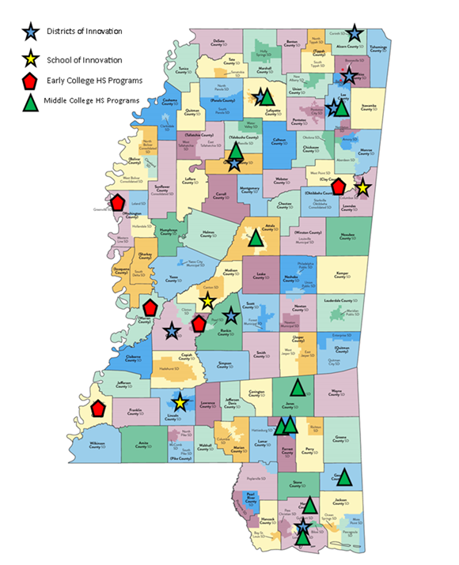
Accelerated District/School of Innovation Process
New Application and Rubric are on the Innovation Website here.
Applications are due September 30, 2022, by 3 pm
For more information email Lea Johnson (lea.johnson@mdek12.org)
Notes:
The application process to become a district or school of innovation has been accelerated to allow schools to receive their designations before January 2023.
In the chat are the updated application and rubric for the DOI/SOI process.

Slide 6
Application Process

Slide 7
Notes:
Here is the timeline for the Accelerated Process. Please note that dates may be changed due to unforeseen conditions.

Slide 8
Phase 1: Review of Application
The application can be found on the District of Innovation Page here.
The review committee will consist of
A peer from a current DOI
MDE Experts
The application will be scored using the rubric found on the DOI page here.

Slide 9
Phase 2: Interview
All applications that meet the minimum score are sent to phase 2.
Interviews may be virtual or face-to-face as needed.
Each district should plan to have present
Application contact person
Superintendent
Administration
Teacher Representatives
Community Partners, etc.
The review team asks questions from their review of the application.
Notes:
Minimum Acceptable Points for Consideration of Innovative Status:
Elementary or Middle School of Innovation: 63/93
Career Academies:70/104
High School or DOI: 65/97
Will last no more than one hour.

Slide 10
Phase 3: Executive Leadership Review
Applications that pass phases 2 are sent to the Executive Leadership Team (ELT).
ELT can approve or deny the application.
Waivers will be reviewed and approved or denied.
Approved applications are scheduled for presentation at the state board of education meeting.
Districts are notified and may send delegates to the board meeting.

Slide 11
Phase 4: State Board of Education Approval
Approved applicants with their list of approved waivers are sent to the SBE for final approval.
Districts will be notified in writing (email) when their application is approved.

Slide 12
Application Review
A quick review of the parts of the application

Slide 13
Application Review
Front matter
Pages 1-8 are for your use only.
Please do not send page 1-8 with your application.
Start your application on page 9.
Notes:
Application Submission Guidelines
3
Application Guidelines
4
Purpose of a District of Innovation or School of Innovation
4
Definitions
4
Waivers and Exemptions
6
Application Plan – Approval, Amendment, and Revocation Process
6

Slide 14
Application Review
Page 9 Cover page has not changed
Page 10 Assurances has been moved to the front.
Pages 11-13 contain the parts of the application that should be completed fully.
Notes:
May want to switch to the application and show.

Slide 15
Application Review
Component 1 Mission and Goals
Address all five subcomponents.
Subcomponent B should show how it differs from “normal school” in your district.
Subcomponent E should show five years of projected data.

Slide 16
Application Review
Component 2 Innovative Program Design and Structure
Address all three subcomponents.
If changing the calendar or master schedule, please provide examples of the changes.
Clearly explain in this section why waivers are needed for calendar and time changes.
The process in subcomponent C should be public facing.

Slide 17
Application Review
Component 3 Support for Innovation
Address both subcomponents.
This is where you include letters of support
Funding and planning
Component 4 Staffing
Address both subcomponents.
Clearly explained in this section why any staffing waivers are needed.

Slide 18
Application Review
Component 5 Professional Development
Address all three subcomponents.
Clearly explained in this section why any PD waivers are needed.
Component 6 Governance
Include community stakeholders and industry partners by name in this section.
Should have a letter of support or some type of agreement for each group mentioned.

Slide 19
Application Review
Component 7 Innovative Teaching and Leading
This is the heart of the application.
Address all seven subcomponents.
ISPs and accelerated course options are critical and must be shown through the application.
Notes:
This is the meat of the plan. Do not scrimp on this section.

Slide 20
Application Review
Component 8 Stakeholder Collaboration
Address all three subcomponents (if applicable).
Show how each stakeholder will participate.
Explain how the innovation will assist the local economy.
Component 9 Annual Reporting of Performance Measures
Address all three subcomponents.
Be extremely specific in this section.

Slide 21
Application Review
Component 10 Sustainability
Address all three subcomponents.
Show specifically how the district will evaluate the plan.
Evaluations should cover all aspects of this application.

Slide 22
Application Review
Component 11 Waivers and Exemptions
Be sure to include the exact item you are requesting a waiver from.
Complete and include the waiver table.
Remember there are no waivers possible for state testing or awarding of letter grades to districts.
Be prepared to implement your plan without the requested waivers.

Slide 23
Application Review
Component 12 Timeline of Activities
Address all three subcomponents.
Include items already completed in your timeline.
Explain in detail the steps to be used to implement your innovation.
Discuss how setbacks and changes to the timeline will be handled and communicated to your district and MDE.

Slide 24
Application Review
Component 13 Data Sharing Agreement
Any stakeholder in the innovation who will have access to the data should be included in an agreement.
If you have questions regarding data sharing agreements, please contact datagovernance@mdek12.org.

Slide 25
Rubric Review
A quick guide to the parts of the Rubric

Slide 26
Rubric Review
Page 1
Assurances must be signed, or application will not be reviewed.
The minimum number of points required to pass to phase 2 depends on your type of application.

Slide 27
Rubric Review
Pages 2-11
Each component, 1-13, is addressed in the rubric.
Each subcomponent is listed in the first column.
The second columns shows the minimum level to receive points for that subcomponent.
The third column provides room for the notes and scores from the evaluator.
Page 11 provides additional space for notes, questions, etc. from the reviewer.

Slide 28
Questions?
Lea Johnson, Ph.D.
lea.johnson@mdek12.org

