Slide 1
Intro to Teaching College & Career Readiness Course Training
Heather Morrison
Theresa Conner
Shannon Grimsley
mdek12.org
July 18, 2024

Slide 2


Welcome
All of you are muted upon entry into the meeting
Please utilize the feature to add to the group discussion questions.
Make sure your screen name is your first and last name. To change your name click on the 3 dots on your picture and select “Rename”

Slide 3
Welcome
Please have a sheet of paper and pen in front of you.
You can change the view of the meeting in the top right hand corner of your screen
If possible please keep your camera on throughout the training.
There will be “after class time” at the end of training
If you do not have access to the Canvas course please in chat private message Heather Morrison your email address.

Slide 4
Welcome
Activity
In the answer the following:
What is your experience level with teaching the College & Career Readiness Course?

Slide 5
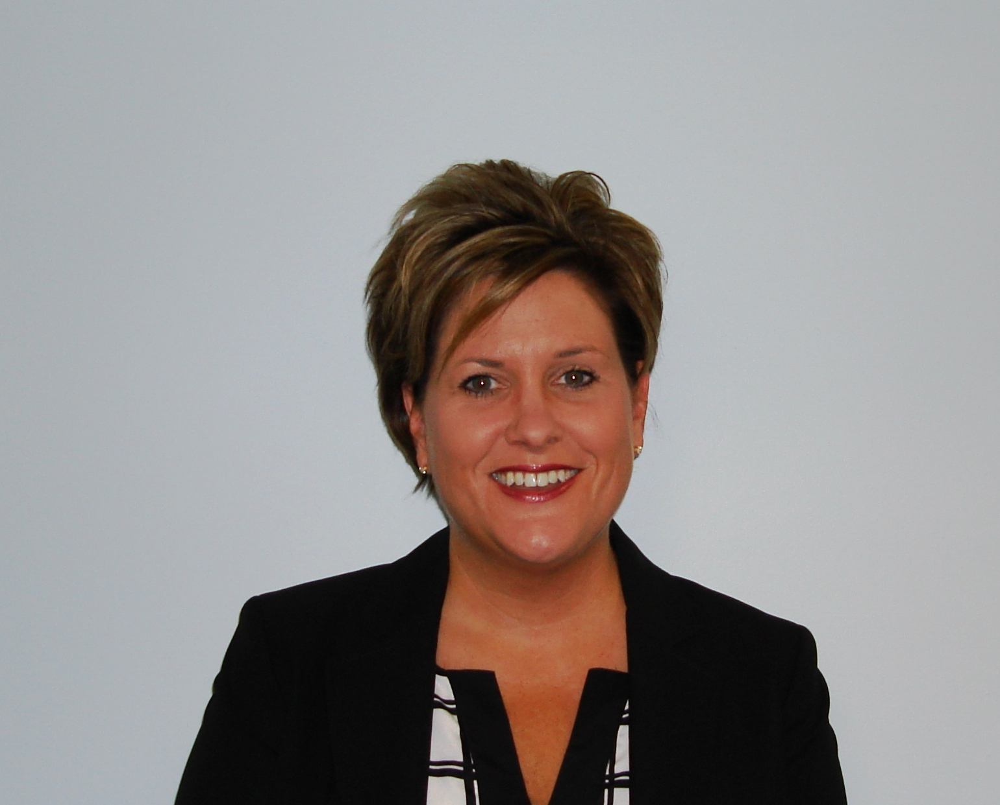
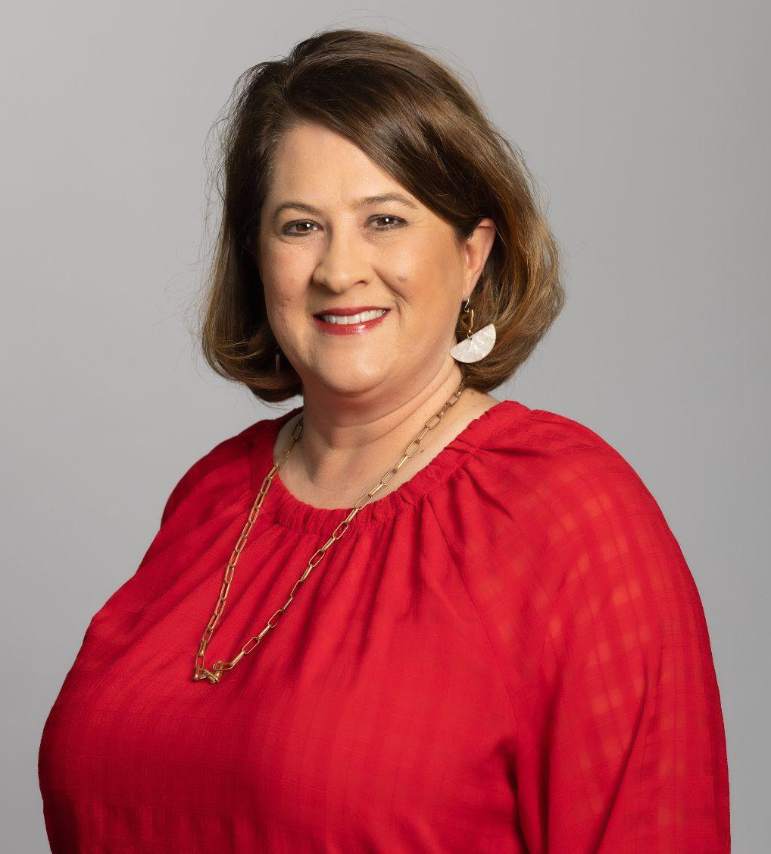

Heather Morrison
Director P20 Partnerships
IHL
Shannon Grimsley
Assistant Director of External Training & Partnerships
Get2College
Theresa Conner
College & Career Readiness/
Work-based Learning Teacher
Northwest Rankin HS

Slide 6
Agenda
Outcomes/goals, MDE Vision and Mission, CCR Resources
Discussion:
1. Roles of the CCR Teacher and Counselor
2. CCR Units
3. Group specific
Units 3 & 4
CCR Canvas Course
Resources & PD for all CCR teachers
Wrap up and next steps

Slide 7
Outcomes
4
Identify opportunities for teachers and counselors to collaborate during the CCR course.
Gain instructional strategies and resources for teaching the CCR course.
Provide recommendations for next steps.

Slide 8
MISSION
Mississippi Department of Education
VISION
To create a world-class educational system that gives students the knowledge and skills to be successful in college and the workforce, and to flourish as parents and citizens
To provide leadership through the development of policy and accountability systems so that all students are prepared to compete in the global community

Slide 9



State Board of Education
STRATEGIC PLAN GOALS
ALL Students Proficient and Showing Growth in All Assessed Areas
EVERY School Has Effective
Teachers and Leaders
1
2
3
4
5
6
EVERY Student Graduates from High School and is Ready for College and Career
EVERY Community Effectively Uses a World-Class Data System to Improve Student Outcomes
EVERY Child Has Access to a High-Quality Early Childhood Program
EVERY School and District is
Rated “C” or Higher

Slide 10
Role Specific Discussion

Slide 11
Overview of Roles in CCR
How are each role involved in the CCR course:
Counselors
Teachers
Administrators
Career Coaches

Slide 12
Units Overview

Slide 13
CCR Curriculum Units
Unit 1- Introduction to College & Career Readiness
Unit 2- Student Portfolio & Exhibit
Unit 3- College Selection
Unit 4- Applying for Financial Aid
Unit 5- Preparing for a Career & Internship
Unit 6- Financial Literacy
Unit 7- Community Service
Unit 8- Digital Literacy & Citizenship
Unit 9- College Transition/Summer Melt

Slide 14


Support for Units 3, 4, 5, & 9

Slide 15

CCR Instructor Important Dates
FALL
Spring
After
Graduation
July 1: Some MS 4-Year college admissions apps open
Jan-Feb: Most 4-year and 2-year colleges scholarship app deadlines (school specific date in these months)
Sept 15: MTAG & MESG Deadline
August 1: all 4-year and 2-year college admissions apps open
Oct 1: MAAPP (State Financial Aid) app open
March 31: HELP Grant deadline
April 30: Counselor deadline for HELP Grant certification & FAFSA due
Dec 1: Some MS 4-Year college scholarship app deadline
May 1: National Decision Day
Fall 2024: 25-26 FAFSA opens

Slide 16

CCR Workbook
Free resources for units 3, 4, & 5
Request on Get2College website annually
Also includes:
  Classroom poster bundle

Slide 17
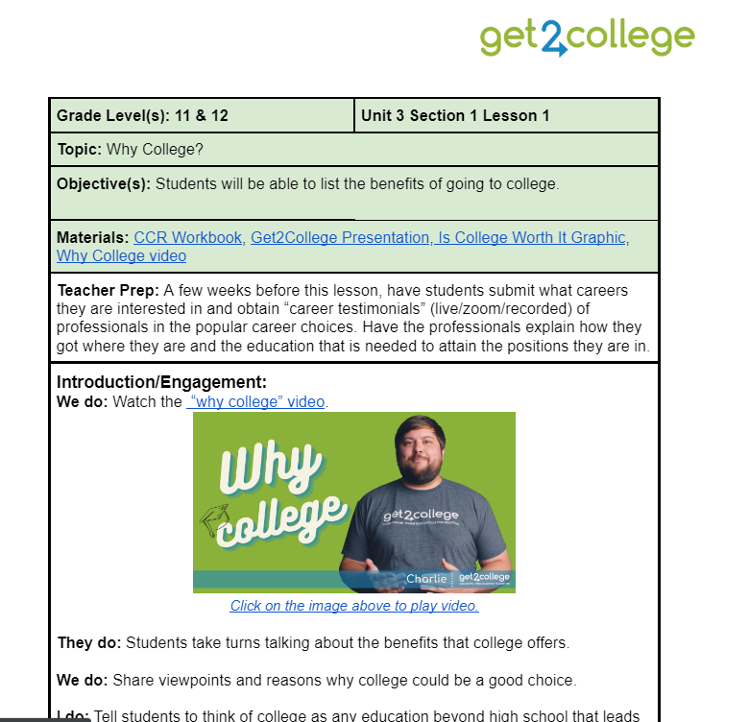
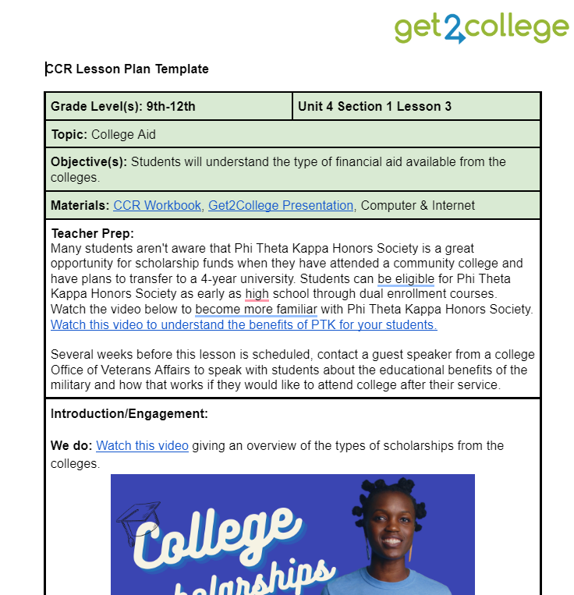
Lesson Plans
Free instructional lesson plans for units 3, 4, 5, & 9
Request on Get2College website
Updated annually
Also includes:
  Videos
  Activities
  Classroom presentation
  CCR workbook instruction

Slide 18
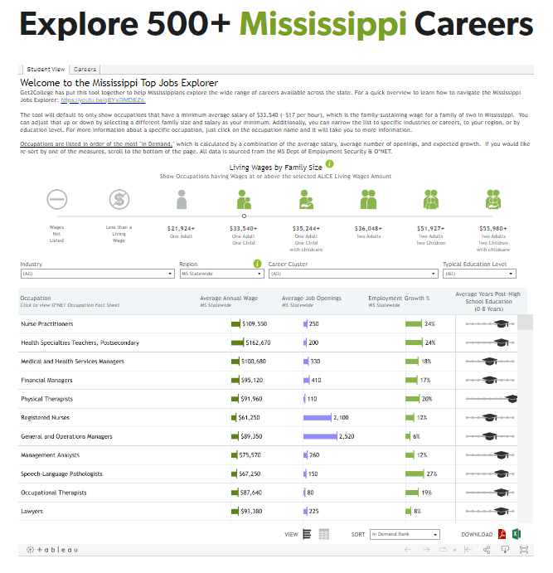

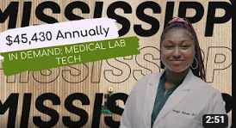

Mississippi Top Jobs
Over 500+ Mississippi in-demand careers with Mississippi specific salaries and job openings
Will link to all colleges offering the major for the career
Over 20 videos of Mississippians in the top in-demand jobs

Slide 19
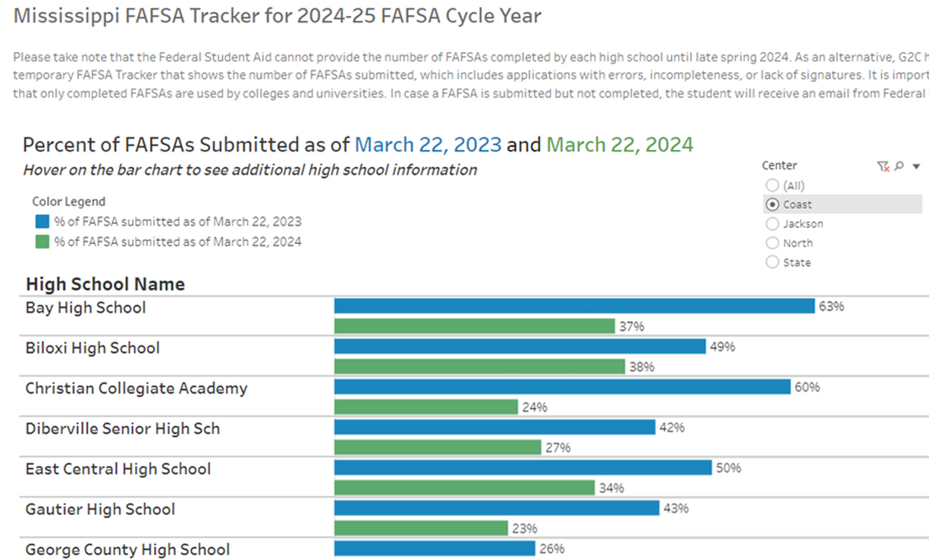
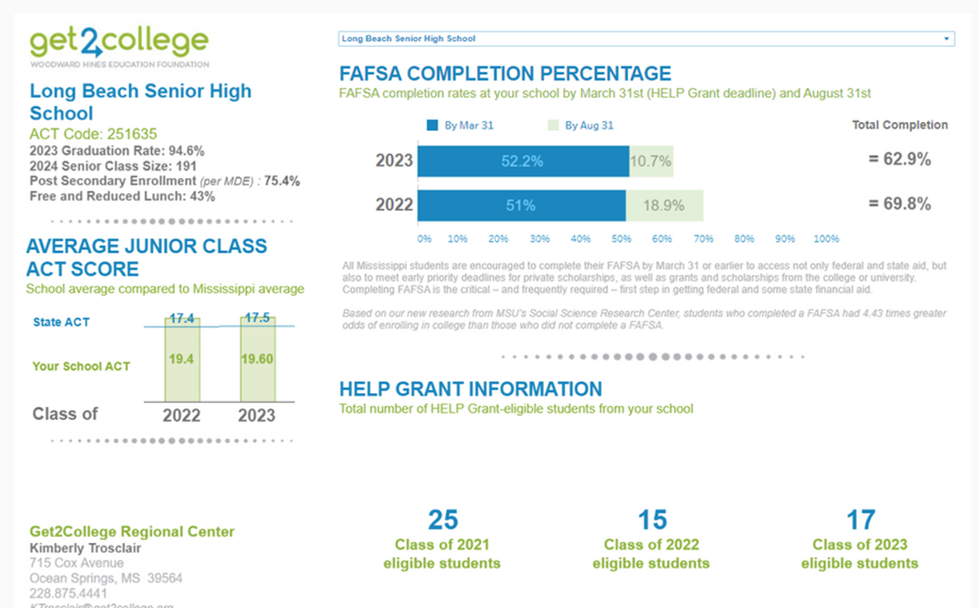
Educator Online Resources

Slide 20
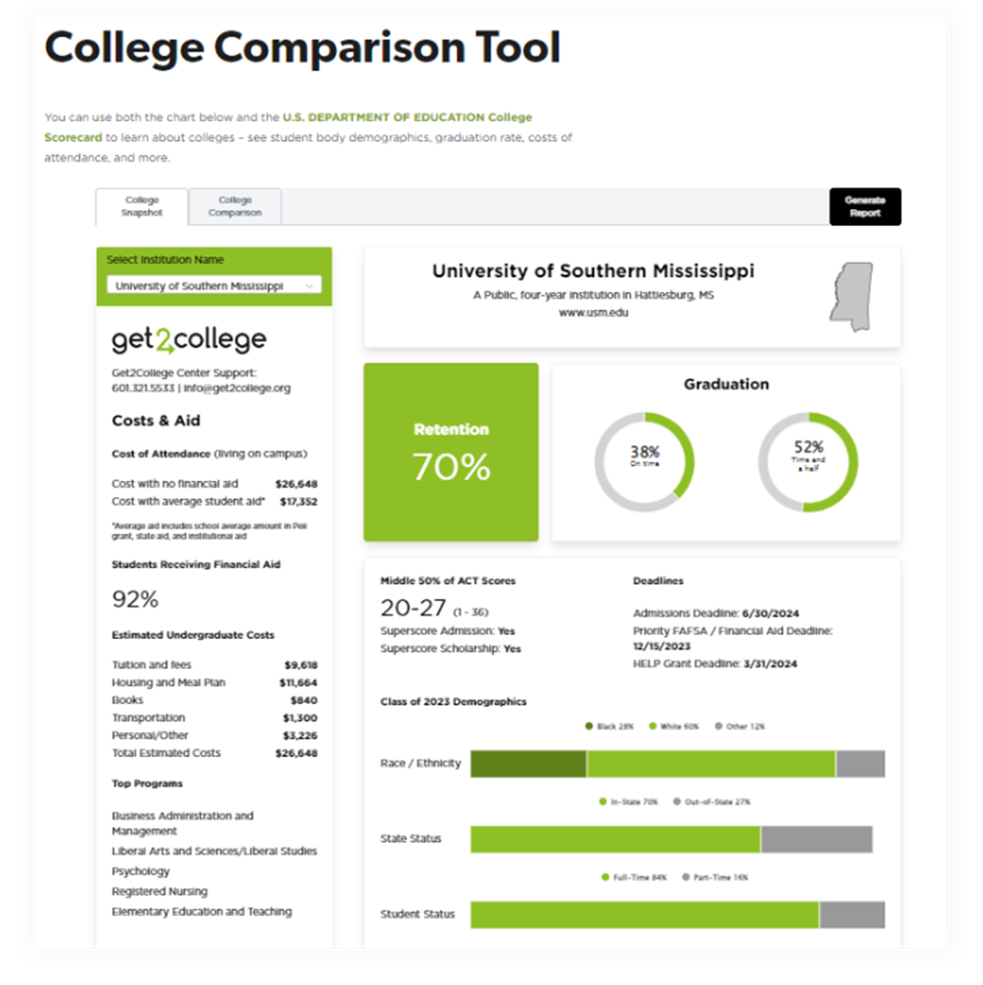
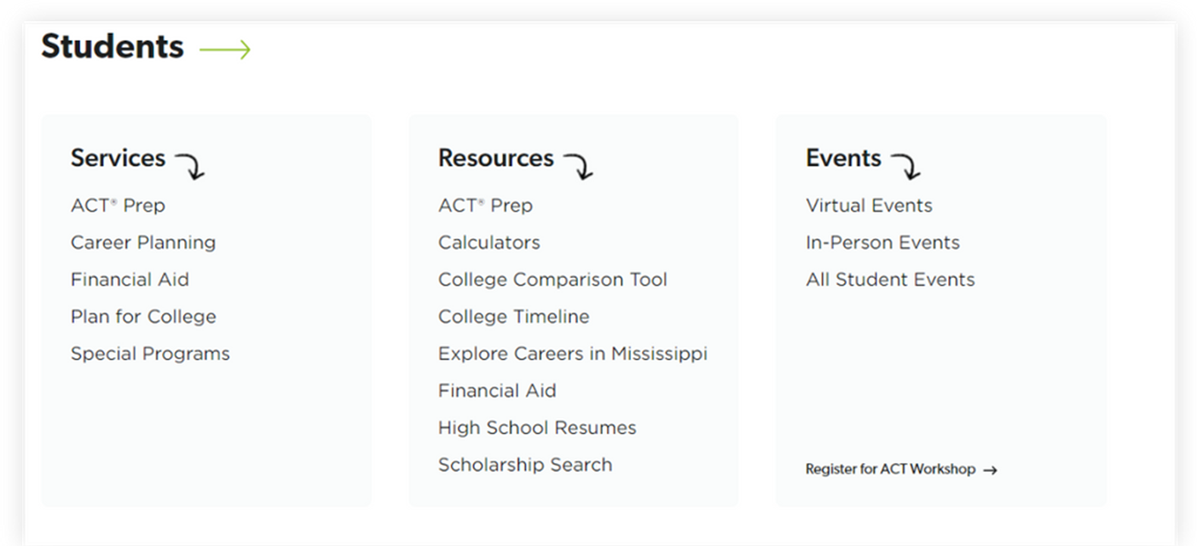
Student Online Resources

Slide 21




Supporting College Culture Opportunities
Application Days
Academic Signing Days
FAFSA Days

Slide 22
2024-25 Training Opportunities
FALL
Spring
Summer
Topic Tuesday webinars
College Access Educator Training
FAFSA & MS Aid Application Training
eLearning Modules on college access topics
Topic Tuesday webinars
FAFSA & MS Aid Application Training
eLearning Modules on college access topics
Master Teacher of College & Career Readiness
ACT Instructor Training
eLearning Modules on college access topics

Slide 23
The cost of college & how to pay for it

Slide 24


COST OF ATTENDANCE
Net Price Calculator
$12,803
avg. annual
cost of attendance
$25,216
avg. annual
cost of attendance
$3,120 - $4,152
annual tuition
(2023-2024)
$7,394 - $9,815
annual tuition
(2023-2024)
Community Colleges
In Mississippi
Public Universities
In Mississippi

Slide 25




Outside Aid
College Aid
Federal Aid
State Aid

Slide 26
Mississippi Financial Aid
MAAPP
HELP
FAITH
MTAG
MESG
Full tuition at any public college; avg. cost of IHL at private college
Up to full Cost of Attendance at any college in MS + break housing
$500/year Fr & Soph
$1,000/year Jr & Sr
$2,500/year for 4 years
15 ACT Superscore
2.5 GPA
No max Pell
Sept 15, 2024 deadline
20 ACT Superscore
2.5 GPA
Income Requirement
March 31 deadline
Under 25
Complete FAFSA
Meet CPS Requirement
Enroll in any undergrad credential or degree
No deadline
29 ACT Superscore
3.5 GPA
Sept 15, 2024 deadline

Slide 27

Federal Aid – FAFSA
The Free Application for Federal Student Aid
It is only an application- the colleges aware the $
Types of Federal Student Aid:
Pell Grant ($7,395/year for 24-25)
Work-Study
FSEOG (grant)
Loans
25-26 FAFSA open date- TBD
  p

Slide 28
FAFSA Fast Facts
Notes:
This wasChe a part with the Future act in December 2019. As of right now it is estimated that there will be 49 “questions” on the new FAFSA (currently there are 100+). BUT some questions have 7+ lines to answer within the question.

Slide 29
1. Use 2-year old taxes (2023 taxes for class of 2025)
2. Everyone needs an FSA ID (username and password)
Notes:
Cheslea

Slide 30
FSA ID
FSA ID= unique username and password used to access and sign the FAFSA
Still have Multi Factor Authentication (the text/email code each time log in)
All contributors have to have one (parent(s), student)
All FSA ID’s have to be created AT LEAST 3 DAYS BEFORE LOGGING INTO THE FAFSA
Still requires that same information to create: know legal name + access to email and text immediately
Parents without social security numbers require extra verification steps
Notes:
Kierstan

Slide 31




Everyone has to have an FSA ID:
+FSA ID
(non-married parent)
FSA ID
(student)
+
+FSA ID
(filed separately parent)
+
+
+Only 1 FSA ID
(filed jointly parents)
Notes:
Kierstan

Slide 32
1. Use 2-year old taxes (2023 taxes for class of 2025)
2. Everyone needs an FSA ID (username and password) created at least 3- days before starting FAFSA
3. Students will never use grandparent, aunt, sibling, etc. information
Notes:
Cheslea

Slide 33
Role-Based Experience
Anyone who needs to complete a part of a FAFSA is a “contributor”
Each contributor has their own FAFSA form
Student must provide these details in their form to trigger parent contributor(s):
  Legal first & last name, Date of Birth, Social Security Number, Email
Early education to students on who should be added as a contributor
Notes:
Kierstan

Slide 34
Contributors:
The parent that provide the most financial support in the last 12 months.
Parent is never married OR divorced/separated OR qualifying widower.
= Completed FAFSA
+
+
Parents are married but filed 2022 taxes as married filing separate OR single & head of household.
= Completed FAFSA
+
Parents are married and filed 2022 taxes married filing joint.
Notes:
Kierstan

Slide 35
Role-Based Experience
FAFSA is not completed until each contributor submits their form (this could be 1-3 separate submissions)
Each contributor will receive an email immediately to log into the FAFSA and complete their section or can go to studentaid.gov
Student can edit who is an contributor and track contributor progress in studenaid.gov
Notes:
Kierstan

Slide 36
What you need to make sure students & parents know in 3 stages:
Before begin
During completion
After completion(ish)
Notes:
Kierstan

Slide 37
BEFORE BEGIN FAFSA:
  Timeline changes: Opening Fall 2024
  Help student determine who are their contributors on the FAFSA- which parent to use: Who provides the most financial support in the last 12 months.
  Have FSA IDs created at least 3-days before logging into beginning a FAFSA.
  Early Awareness:
    Min/Max Pell (AGI, household size & PPY Fed Poverty Tables)

Slide 38
DURING COMPLETION:
  Different Experiences for Different Roles
    A FAFSA for each contributor
    FAFSA incomplete until all contributors log in and complete
  Student and parents don’t have to be together to complete and can do at different times or at the same time
    Parent can begin and invite student
    Easiest: Student invites parent(s) contributor(s)
FAFSA will last 45-days waiting for contributor to complete their sections, clock resets at every log in

Slide 39
AFTER COMPLETION(ISH):
  FAFSA Submission Summary
    Studentaid.gov to track the status of all the contributors
    Financial Aid office will not get the FAFSA or know if waiting on contributors until all are done
  Students receive email with estimated Pell and loan eligibility once completed
  Two types of verification a student could be selected for: (1) institutional or (2) federal

Slide 40
Example of Course Implementation
Example of course implementation

Slide 41
Canvas Instructions
Go to mvcc16.instructure.com, and login.
Minimize the ZOOM window in the upper righthand corner of your screen so that you can see Canvas and ZOOM at the same time.
*If you are not able to login into Canvas today, it’s okay. You can follow along with us in the ZOOM session and login to Canvas later.

Slide 42
Contact Information
Heather Morrison
Director of P20 Partnerships
Office of Student and Academic Services
Mississippi Institutions of Higher Learning
hmorrison@mississippi.edu
Shannon Grimsley
Assistant Director External Training & Partnerships
Woodward Hines Education Foundation, Get2College
sgrimsley@get2college.org
Theresa Conner
College & Career Readiness/Work-Based Learning Teacher
Northwest Rankin High School
theresa.conner@rcsd.ms
Online resources from today found: https://www.mdek12.org/ese/College-and-Career-Readiness

