Slide 1
Follow the Data Data PLCs that Work
Dr. Fredrick Robinson- Principal
Mrs. Chawonea Presley- Instructional Coach
Mrs. Keisha Tanna- Math Teacher
Data PLCs that work

Slide 2
What does the following quote means to you?
“without data, you are just another person with an opinion”

Slide 3
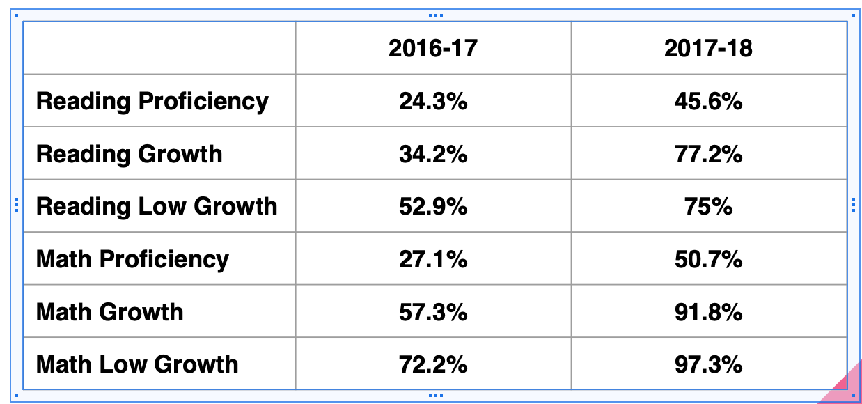
QCES MAAP Comparison

Slide 4
Follow the Data
Leads you to determining if students mastered the skill that was taught
Leads you to determining if the strategies used to teach the skill worked
Leads you to determining which students need in-class remediation or intervention.
Leads you to determine if in-class remediation or out of class interventions worked.

Slide 5
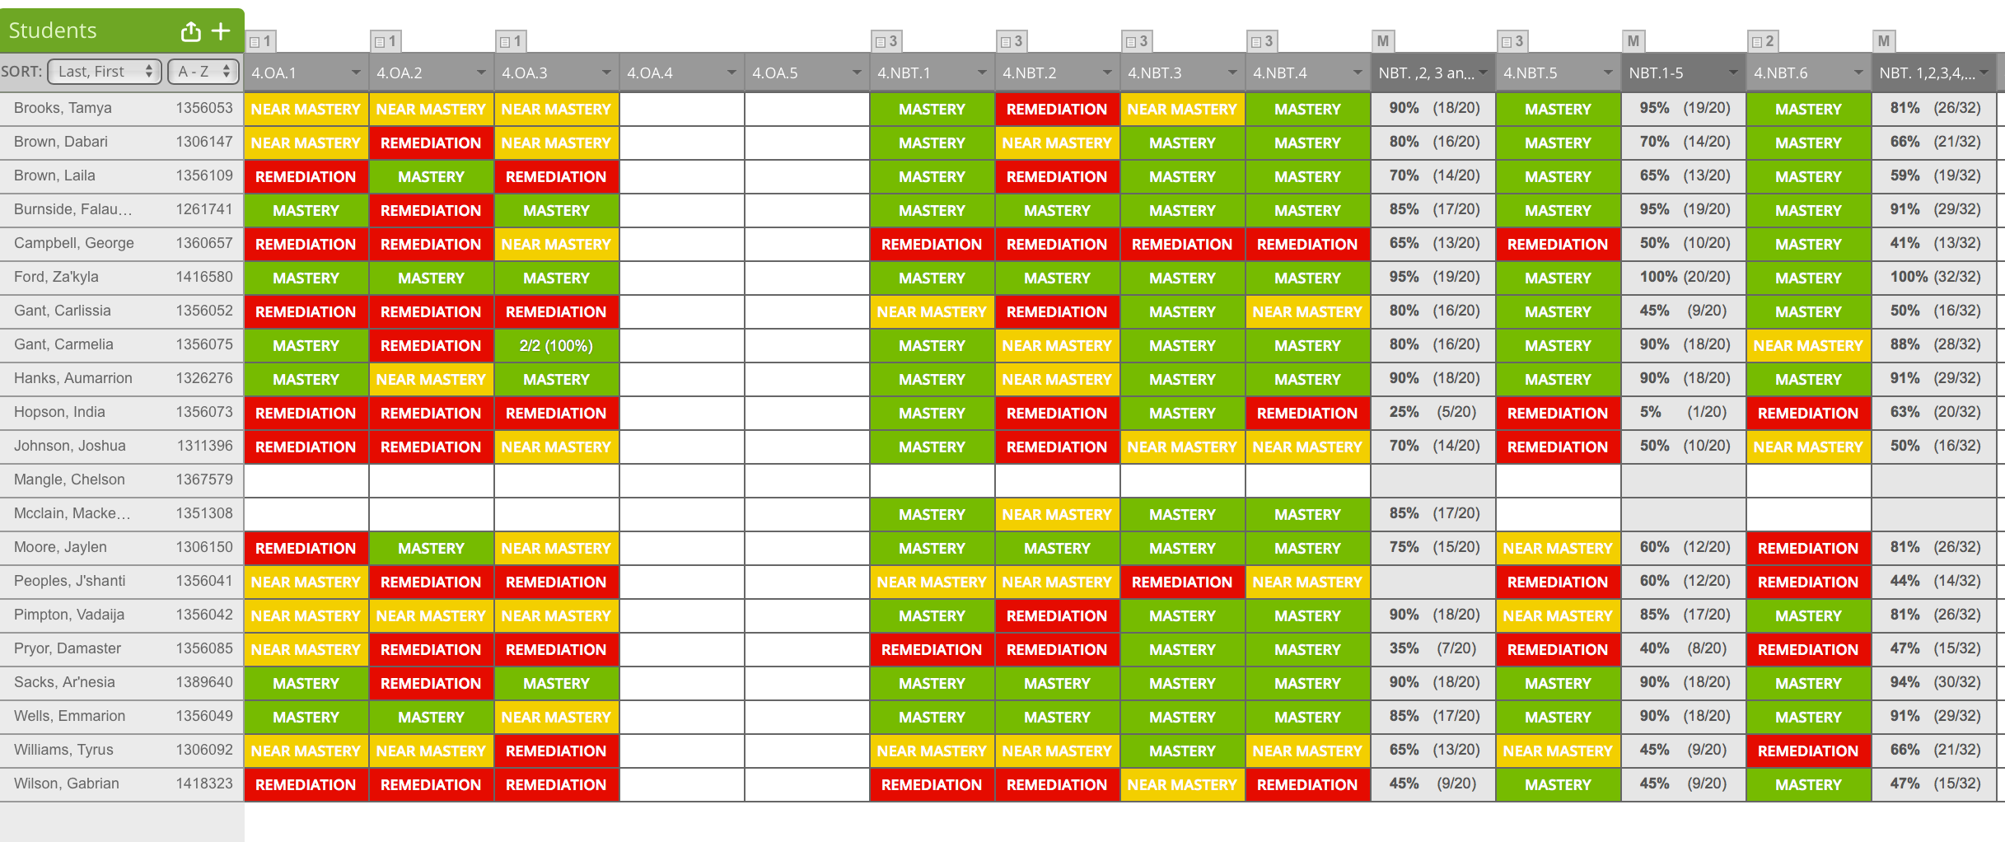

Slide 7
From Paper to Practice
Notes:
When establishing PLC norms…. Include that everyone in the professional learning community must have their data in the plc form before the meeting. (this saves time)

Slide 8
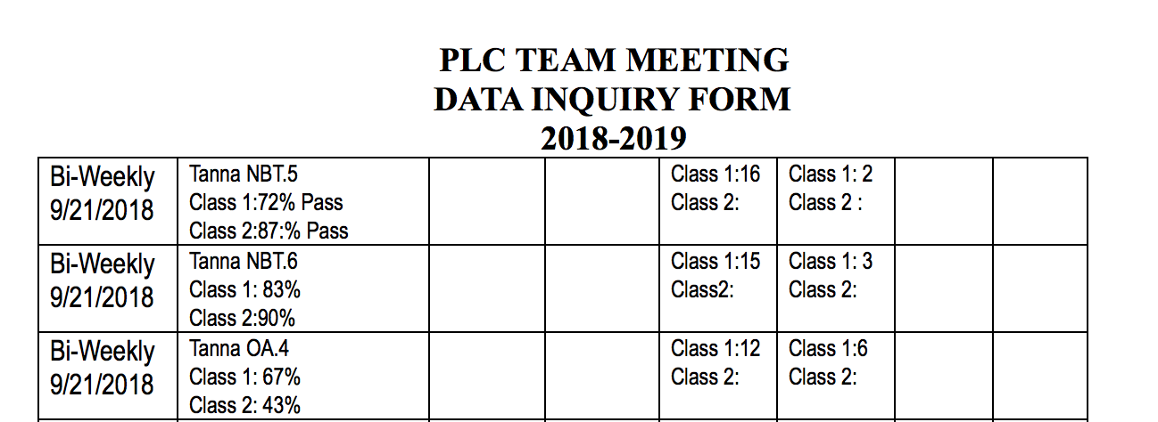
From Paper to Practice cont...

Slide 9
Guiding Questions
Did the class meet 70% or higher on tested standard
Based on the data, what is the urgent need?
Identify individual students that did not master the standard.
If intervention or in-class remediation was provided to a group of students on that standard, did it work.
Do I need to revisit my strategy?

Slide 10
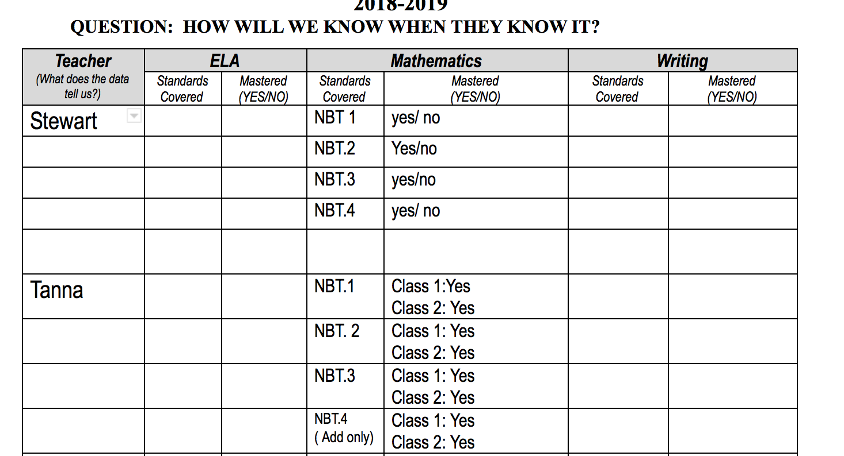
How will we know when the know it?
Notes:
At the Elementary School each Standard has to be mastered at 70%.
So, if the standard is not mastered at 70% we reflect on how it was taught(alignment), strategies used, student engagement, urgent needs.
We also develop an action plan.(students pulled out intervention, in-class intervention, develop new strategy, teach pre-skill, and how we will assess skill to evaluate the action plan)

Slide 11
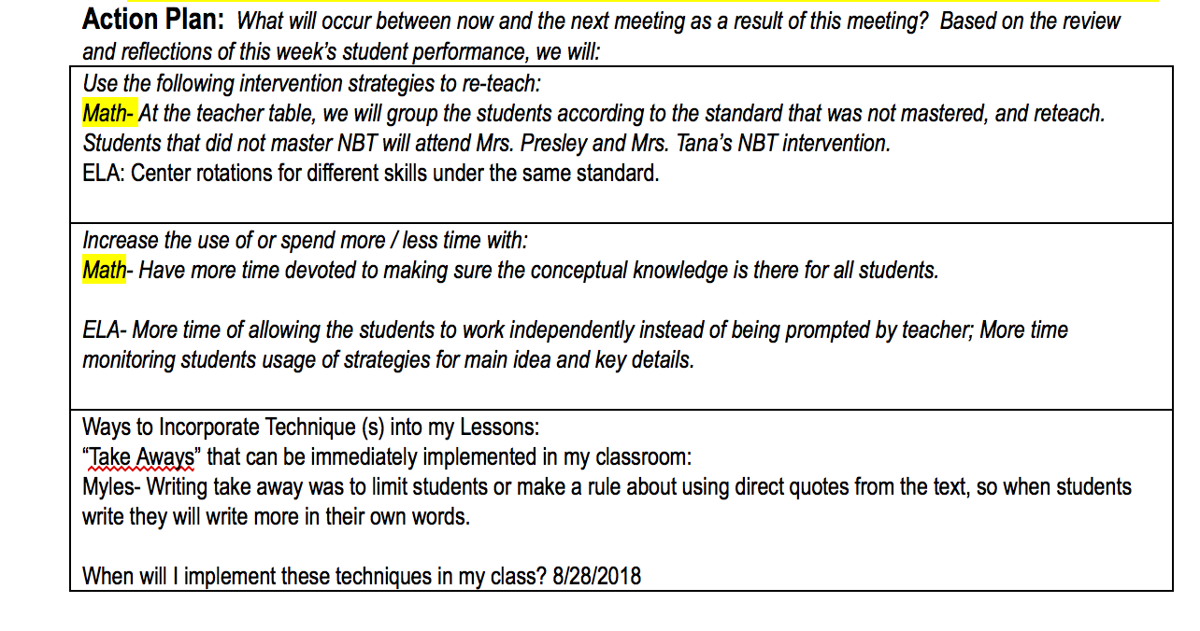
What do you do when they don’t know it? WIN!!!
Notes:
This is where you note exactly what you are going to do to insure mastery of the standard that was not mastered.

Slide 12
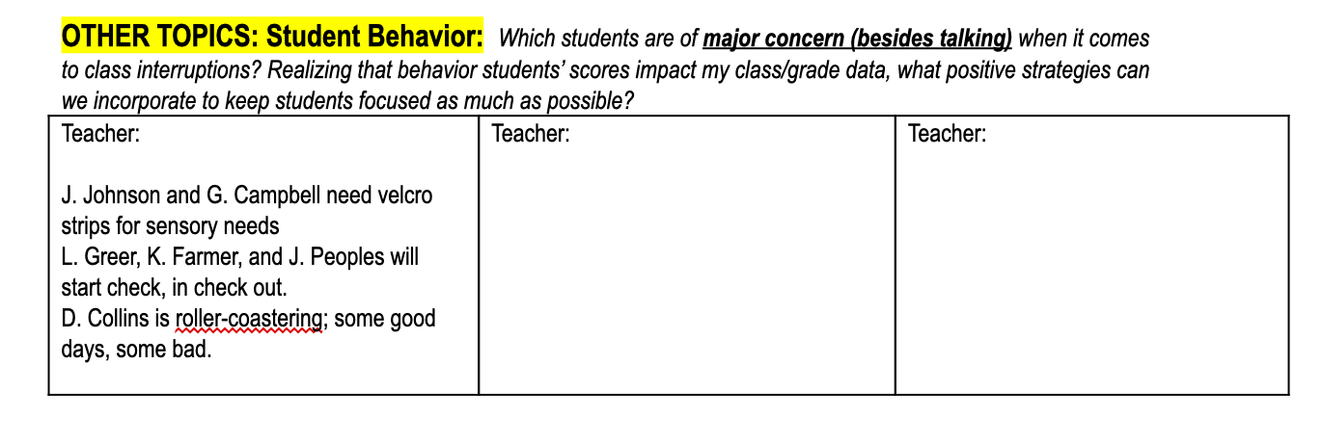
Student Behavior

Slide 13
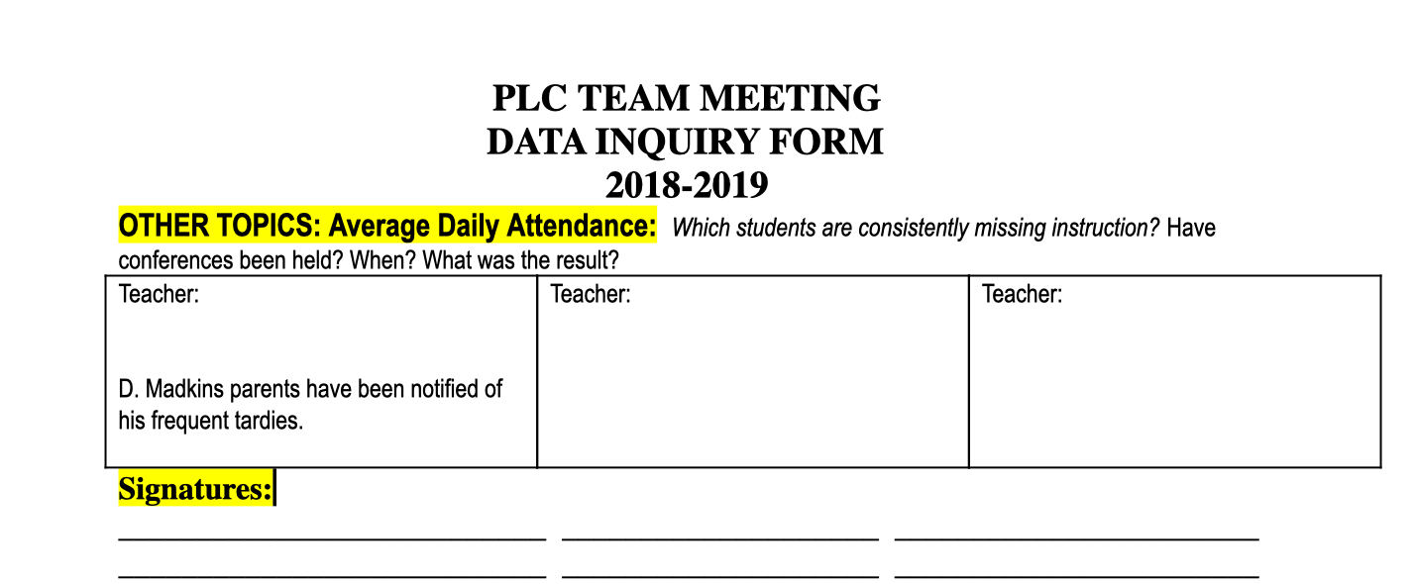
Attendance

Slide 14
Evidence: In God I trust but everything else Data
Teacher Observations, Exit Tickets, Paper Test, and BI-WEEKLY TEST(Aligned to standard and in the condition that they are going to be tested in is the key)
Check-In and Check-out behavior Form

Slide 15
Your Turn
Use the Data given to fill in Standards taught and pass fail ratio.
Use the Data to complete Part 2. (How will you know when they know it.)
Together we will come up with an action plan
Together we will decide what will be our evidence that will measure the success of our action plan.

Slide 16
From Paper to Practice
Q and A
&
Take Aways

Slide 17
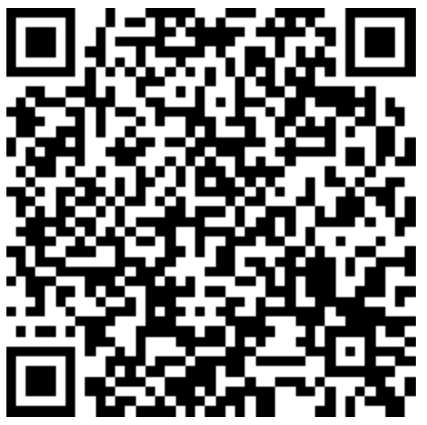
Evaluation
https://www.surveymonkey.com/r/3J8CM7R

