Slide 1
New Special Education Teacher Webinar Series
December 2017
Teresa Laney, M.S., CCC-SLP
Instructional Support Specialist
tlaney@mdek12.org

Slide 3
State Board of Education Goals FIVE-YEAR STRATEGIC PLAN FOR 2016-2020
All Students Proficient and Showing Growth in All Assessed Areas
Every Student Graduates from High School and is Ready for College and Career
Every Child Has Access to a High-Quality Early Childhood Program
Every School Has Effective Teachers and Leaders
Every Community Effectively Uses a World-Class Data System to Improve Student Outcomes
Every School and District is Rated “C” or Higher

Slide 4
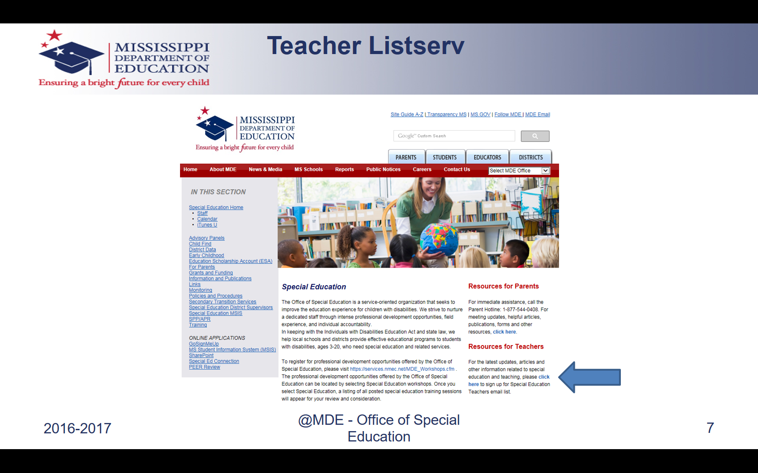
Teacher Listserv

Slide 5
Overview

Slide 6
Target Audience
This webinar series is intended for special education teachers with 0-3 years experience. However, it is available to anyone who would like to participate.

Slide 7
Purpose
To provide support and guidance to new special education teachers on a consistent basis throughout the school year
To address the topics and issues that are relevant to new special education teachers in a timely manner

Slide 8
Registration and Dates
Registration link:
https://attendee.gotowebinar.com/register/8555677492844037122
The webinar will be the first Thursday of every month at 3:00 p.m.
October 5, 2017 February 1, 2018
November 2, 2017 March 1, 2018
December 7, 2017 April 5, 2018
January 11, 2018

Slide 9
Recordings
For those who are not able to participate in the live webinar, the recordings will be posted to the Office of Special Education’s website along with any supporting documents that may be referenced during the webinars.
The webinar recordings can be found by clicking on the following link: www.mdek12.org/ose/training/webinars.

Slide 10
Format
Hot Topics will address any new initiatives or important updates in special education.
Do Now will provide teachers with a “To-Do List” of time- sensitive tasks.
Did You Know will address specific special education topics.
FAQ will answer questions submitted by participants.

Slide 11
Questions
Submit questions to be addressed during the FAQ section of each webinar to scoon@mdek12.org by the Friday prior to the first Thursday of each month.
Put New Special Education Teacher FAQ in the subject line.

Slide 12
Hot Topics

Slide 13
Timeline
November 2017 Stakeholder group met to develop suggested requirements
January 2018 Requirements were presented to the Superintendent’s Teacher Advisory Panel
February 1, 2018 Commission on School Accreditation(CSA) reviewed and approved requirements be submitted to the State Board
February 15, 2018 State Board will consider the recommendation of the CSA. If approved, requirements will then go out for public comment

Slide 14
Definition
A Certificate of Completion is not a high school diploma or an Alternate Diploma, but rather an acknowledgement of the student’s participation in and completion of his/her Individualized Education Program (IEP).
Students eligible to receive a Certificate of Completion must fall into one (1) the following categories:

Slide 15
Eligibility
Students without a Significant Cognitive Disability at the end of 8th grade who:
Are 16 years old or older; AND
At least 3 or more grade levels below their peers in reading and math; AND
Have a signed statement from the parent that they understand that the Certificate of Completion is not a standard diploma and will not meet the requirements for entry into any career or post-secondary opportunity that requires a diploma.

Slide 16
Eligibility
Students with a Significant Cognitive Disability at the end of 8th grade who:
Have extremely limited or no receptive and expressive communication skills AND
Have a signed statement from the parent that they understand that the Certificate of Completion is not a standard diploma and will not meet the requirements for entry into any career or post-secondary opportunity that requires a diploma.

Slide 17
Eligibility
Students with or without a Significant Cognitive Disability at the end of their third school year of high school (6 semesters) who:
Have not earned at minimum of 3 English credits, 3 math credits, 2 science credits, 2 social studies credits, and 5 electives; AND
Have a signed statement from the parent and student that they do not wish for the student to be given services through age 20 and understand that the Certificate of Completion is not a standard diploma and will not meet the requirements for entry into any career or post-secondary opportunity that requires a diploma; AND

Slide 18
Eligibility
Have evidence of 3 or more years of intensive intervention to earn Carnegie Unit bearing courses (Or Alternate Diploma Course Credits for students with a Significant Cognitive Disability).

Slide 19
Requirements
The student’s IEP committee determines the course of study for the Certificate of Completion. Areas of instruction should be developed based on the needs of the individual student. Course work could include, as appropriate for the student:
Intensive remediation in deficit area skills
Career preparation courses
Life skills courses

Slide 20
Requirements
Students earning the certificate of completion must have completed at least four years of high school and/or be at least 19 years of age at the time of graduation.
All students are required to participate in the Mississippi Academic Assessment Program.

Slide 21
Do Now

Slide 22
Do Now
Schedule and conduct ESY meetings.
Preparing for Statewide Assessments.
Begin reviewing student progress and preparing for annual IEP meetings

Slide 23
Did You Know?

Slide 24
Reevaluations
Public agencies will ensure that all children with disabilities are evaluated periodically to determine whether the child continues to have a disability that requires special education and related services.
State Board Policy Chapter 74, Rule 74.19
§ 300.303

Slide 25
Reevaluations
Unless the parent and the public agency agree to an exception, reevaluations
Must occur at least once every three years
May occur not more than once a year
Must be documented on the Eligibility Determination Report
Notes:
Example of when the IEP comm agrees to break this rule: out-of-state transfer w recent comp reeval but IEP comm feels like it doesn’t match classroom performance
A reevaluation must be considered when
The educational or related services needs of the child warrant a reevaluation (includes improved academic achievement and functional performance)
OR
Requested by the child’s parent or teacher

Slide 26
Reevaluations
When should a reevaluation be considered more often than every 3 years?
When considering a dismissal from any related service (i.e. speech, OT, PT)
Educational or related service needs warrant a reevaluation. (includes improved academic and/or functional performance)
Disability category no longer appropriate
Requested by the child’s parent or teacher
Notes:
Reevaluation Process
IEP Committee proposes to
Gather additional data, or
Determine continuing eligibility and child’s educational needs based on existing data, or
IEP Committee refuses to
Gather additional data, assessment, or
Continue eligibility based on existing data

Slide 27
Reevaluations
When should a reevaluation be considered more often than every 3 years?
Committee disagreement with a child’s eligibility status or disability category
Exit from special education services for reasons other than
Graduation with a regular diploma
Reaching the maximum age of eligibility for services
Parent revocation of services
Student has DD eligibility and is approaching 10th birthday

Slide 28
Reevaluations
A reevaluation may consist of
A review of existing and ongoing progress monitoring data, with or without a limited collection of new data
A comprehensive reevaluation
Notes:
Review of existing information, including
To determine if additional data are needed to establish continued eligibility and determine appropriate service provision
Can be conducted with or without a formal meeting
Evaluations and information provided by the parent
Current curriculum-based assessments, progress monitoring data, and other ongoing observations
ALL committee members must have input and a chance to review data
Information from existing observations by teachers and related services providers
Information contained in the current IEP, including progress reports on goals
If no info needed, document in writing
If the IEP Committee or any member determines that additional data are needed, they must identify the data needed to determine
Whether the child continues to have a disability
Whether the child continues to need special education and related services
The child’s present levels of academic achievement and functional performance
The child’s educational needs
Any additions or modifications necessary for the child to meet their annual IEP goals and/or to participate in the general curriculum or developmentally-appropriate activities

Slide 29
Parental Consent for Reevaluation
Consent is recommended but not required prior to conducting a reevaluation using existing data
When additional data are needed, the IEP Committee must
  Provide the parent with Prior Written Notice of the public agency’s intention to conduct a reevaluation
  Obtain Informed Parental Consent prior to conducting any new individual assessments

Slide 30
Parental Consent for Reevaluation
If a parent fails to respond to the request for consent, the public agency may proceed with the new individual assessments if it has made reasonable attempts to obtain consent from the parent.
If the parent refuses to consent for additional data collection for reevaluation, the public agency may not conduct new individual assessments for the reevaluation.
A comprehensive reevaluation should be completed within a reasonable time.
Notes:
Public agency may continue to collect ongoing progress monitoring data which may be used to determine if the child continues to be eligible for special education and the child’s educational needs.
If a parent refuses to provide consent, the public agency may, but is not required, to use due process procedures to override the parent’s refusal.

Slide 31
Reevaluation Report
The IEP Committee must document the results of the reevaluation in a written reevaluation report(s).
Must meet the same criteria as evaluation reports
May compile all reevaluation information into a single comprehensive report or allow each examiner to submit an individual report
Parents receive a copy of all reevaluation reports at least seven (7) calendar days prior to the meeting to determine or reestablish eligibility

Slide 32
Eligibility Determination Meeting
The IEP Committee, which includes the parent, must meet to review the reevaluation report(s) and to draft an eligibility determination report
Parent must be invited in writing to attend the eligibility determination meeting
Must document eligibility decision in an Eligibility Determination Report to either continue or change the eligibility

Slide 33
Reevaluation Decisions
Reevaluation
Eligible |  | Not Eligible
No change in eligibility category | Change in eligibility category | No longer eligible for special education and related services
Document continued eligibility status and disability category | Document change in disability | Document decision
 | Parent provided with Prior Written Notice of the change and parent’s receipt of the Prior Written Notice is documented | Parent provided Prior Written Notice of the intent to exit the child from special education services and parent’s receipt of the Prior Written Notice is documented
Parent provided with Prior Written Notice for any necessary revisions in the IEP and parent’s receipt of the Prior Written Notice is documented
Notes:
If the parent is in attendance at the IEP Committee meeting, the public agency may provide any required Prior Written Notice to the parent at the meeting.
Also, can use same PWN for change in eligibility category and IEP revision

Slide 34
FAQ

Slide 35
Madelyn Harris and Edryce Thompson
Instructional Specialist
601-359-3498

