Slide 1
Dyslexia School-wide Implementation Special Education Conference Building Partnerships 2016

Slide 2
Vision
To create a world-class educational system that gives students the knowledge and skills to be successful in college and the workforce, and to flourish as parents and citizens
Mission
To provide leadership through the development of policy and accountability systems so that all students are prepared to compete in the global community

Slide 3
State Board of Education Goals 5-Year Strategic Plan for 2016-2020
All Students Proficient and Showing Growth in All Assessed Areas
Every Student Graduates High School and is Ready for College and Career
Every Child Has Access to a High-Quality Early Childhood Program
Every School Has Effective Teachers and Leaders
Every Community Effectively Using a World-Class Data System to Improve Student Outcomes

Slide 4
Agenda
Public School Requirements for Dyslexia
Dyslexia Scholarship
Eligibility
Application Process
Additional Statute Provisions
State Board Policy 4300
Multi Tiered System of Supports
Goal
Data Collection
Implementation
Progress Monitoring
Determinations
Program Qualities

Slide 5
Public School Requirements

Slide 6
Dyslexia Requirements for Public Schools
Adopt a local board policy about screening students for dyslexia.
Screen all students during the 2nd semester of Kindergarten and during the 1st semester of First Grade.

Slide 7
Dyslexia Requirements for All Public Schools
Ensure that the screener addresses the following components:
Phonological awareness and phonemic awareness
Sound symbol recognition
Alphabet knowledge
Decoding skills
Encoding skills
Rapid naming

Slide 8
Dyslexia Requirements for Public Schools
Notify parents if a student fails the dyslexia screener.
Accept dyslexia evaluations administered by a licensed psychologist, psychometrist, or speech language pathologist.

Slide 9
Dyslexia Student Scholarship Eligibility and Application Process

Slide 10
Student Scholarship Eligibility at Non-Public School
To be eligible for the dyslexia scholarship to attend a special purpose nonpublic school the student must have the following:
diagnosis of dyslexia provided by a licensed psychometrist, psychologist or speech language pathologist that is ASHA certified
acceptance for enrollment that meets all criteria
enrolled previously in a public school at the time that average daily attendance (ADA) was determined for the public school systems

Slide 11
Non Public School Requirements
Nonpublic schools receiving students under the statute must meet the following criteria:
State accredited special purpose nonpublic designation
Licensed dyslexia therapist on staff
Provide daily Orton-Gillingham based program
Employ administrator with training in dyslexia

Slide 12
Submitting Dyslexia Student Scholarship Application
Parent completes and submits the Dyslexia Scholarship Application Packet www.mde.k12.ms.us/ESE/dyslexia, via certified mail, to the Office of Elementary Education and Reading by July 15th
Application packet must include:
completed application
proof of enrollment
verification of diagnosis
tuition/fee schedule

Slide 13
Processing the Scholarship Application
The MDE will verify the following:
prior student enrollment in a public school
submission of required documents that meet eligibility requirements
The MDE will provide the following:
approval of the application to the parent, previous school district, and the nonpublic school the student has been approved to attend
denial of the application to the parent and the nonpublic school the student has been approved to attend and the reason for the decision
Notification to school financial services so funds can be dispersed

Slide 14
Dyslexia Student Scholarships
Funded 264 dyslexia scholarships for students to attend approved special purpose non-public schools
New Summit, Jackson, MS
North New Summit, Greenwood, MS
Magnolia Speech School, Jackson, MS
3-D School, Petal, MS
Total Funds Awarded - $1,741,559.28

Slide 15
Additional Provisions for Dyslexia Scholarship

Slide 16
Dyslexia Guidance
Students diagnosed and served will not necessarily have a ruling under IDEA and/or Section 504.
A diagnosis of dyslexia may be provided by the school district or obtained independently by parents.
Once a diagnosis of dyslexia is made, districts must follow IDEA child find procedures to determine next steps.

Slide 17
Statute Overview
Statute addresses only students in grades K-6
Statute does not prevent students from transferring or applying for the scholarship even if their school district provides comparable services.

Slide 18
Statute Overview
Statute does not make provisions for transfer to out-of-state schools.
Statute does not make provisions for private independent therapy.

Slide 19
State Board Policy 4300
September 2015

Slide 20
State Board Policy 4300
State Board Policy 4300 was adopted January 21, 2005 and revised September, 2015.
The Mississippi Department of Education shall require every school district to follow the instructional model which consists of (3) three tiers of instruction:
Tier 1: Quality classroom instruction based on
Curriculum Frameworks
Tier 2: Focused supplemental instruction
Tier 3: Intensive interventions specifically designed
to meet the individual needs of students
20

Slide 21
State Board Policy 4300: Addition
A dyslexia screener must be administered to all students during the spring of their kindergarten year and the fall of their first grade year. The screening must include the following components:
Phonological awareness and phonemic awareness;
Sound symbol recognition;
Alphabet knowledge;
Decoding skills;
Encoding skills; and
Rapid naming (quickly naming objects, pictures, colors, or symbols (letters or digits) aloud.
Site with a sample screener: msdta.org

Slide 22
State Board Policy 4300: Change
All students in Kindergarten and grades 1 through 3 shall may be administered a state- approved screener within the first 30 days of school and repeated at mid-year and at the end of the school year to identify any deficiencies in reading. In addition to failure to make adequate progress following Tier 1 and Tier 2, students will be referred to the TST for interventions as specified in Response to Intervention guidelines developed by MDE if any of the following events occur:
22

Slide 23
State Board Policy 4300
Failure to make adequate progress following Tier 1 and Tier II, students will be referred to the TST if any of the following events occur:
Grades 1–3: A student has failed one (1) grade;
2. Grades 4–12: A student has failed two (2) grades;
3. A student failed either of the preceding two (2) grades and has been suspended or expelled for more than twenty (20) days in the current school year; or
4. A student scores at the Minimal level on any part of the Grade 3 or Grade 7 Mississippi statewide accountability system,
5. A student is promoted from grade 3 to 4 under a good cause exemption of the Literacy Based Promotion Act.
23

Slide 24
Multi-Tiered System of Supports
Student Intervention Services

Slide 25
Using a Multi-Tiered System of Supports to Identify Potential Dyslexic Students

Slide 26
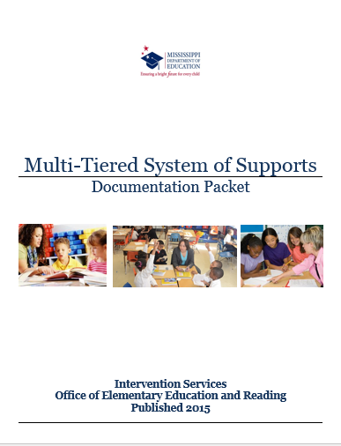
Multi-Tiered System of Supports

Slide 27
Terminology: Making the Shift
Multi Tiered System of Supports
Integration of RtI for academics and RtI for behavior into a unified model that recognizes the reciprocal influence academic performance and social/emotional/behavior have on each other
27

Slide 28
MTSS: Goal
Being prevention oriented: knowing who needs support as early as possible each year and putting those supports in place
Implementing evidenced based interventions for all students and tailoring interventions based on student’s needs.
Using progress monitoring data to know when to make changes in instruction
28

Slide 29
Dyslexia Identification Process
Phase I – Student Profile: Data Collection and Review
Course Performance
Behavior
Retention
Universal Screener Results
Retention
Medical information
Hearing and Vision Screener
Dyslexia Screening K and 1st grade

Slide 30
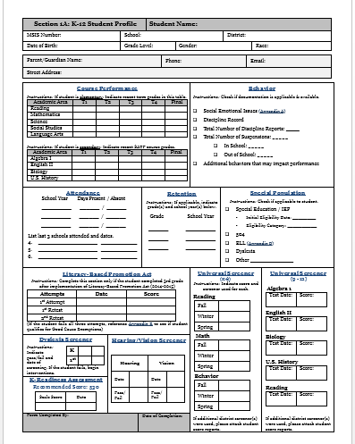
Student Profile Sheet

Slide 31
Dyslexia Identification Process
Phase II – Instructional Interventions within the Regular Classroom
Tier II Interventions to address specific weaknesses of students
Determine duration and frequency of interventions
Monitor progress to determine next if further assessments or specific intensive interventions are needed

Slide 32
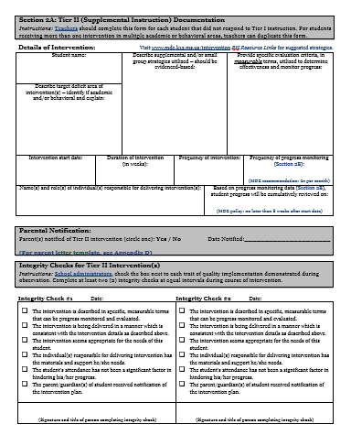
Phase II - Tier II Interventions

Slide 33
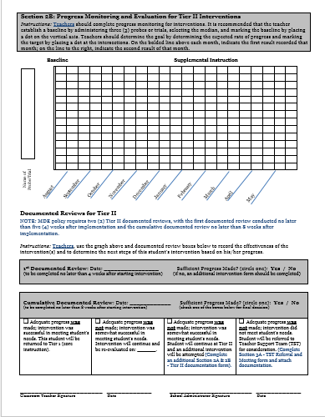
Phase II – Progress Monitoring

Slide 34
Further Assessments
The following data and components regarding the student should be collected and reviewed to determine if additional assessments are needed:
Characteristics of dyslexia
Lack of progress is evidenced despite intervention
Average intelligence or cognitive abilities are demonstrated
High Quality Classroom Instruction has been delivered
Lack of progress is not a result of sociocultural factors
Lack of progress has a constitutional origin
If no additional factors warrant other assessments, move to Phase III.

Slide 35
Informal Assessment for Dyslexia
Phase III – additional information needed
Data gathered in Phase I and Phase II of the Intervention Process reviewed by TST team
Complete Dyslexia Checklist for Teachers
Parent(s) complete Dyslexia Parent Questionnaire
Evaluation Team convenes, reviews, and recommends one of the following:
Formal Comprehensive Battery of Test for Dyslexia; or
Tier Process continues according to District Policies

Slide 36
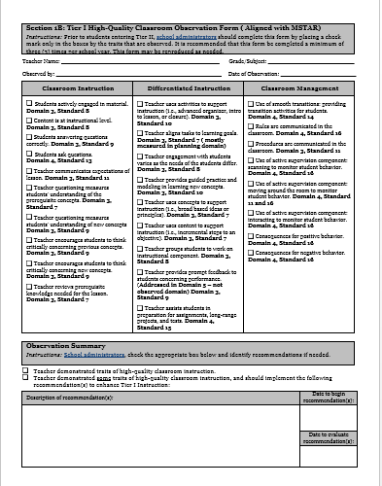
High Quality Classroom Instruction

Slide 37
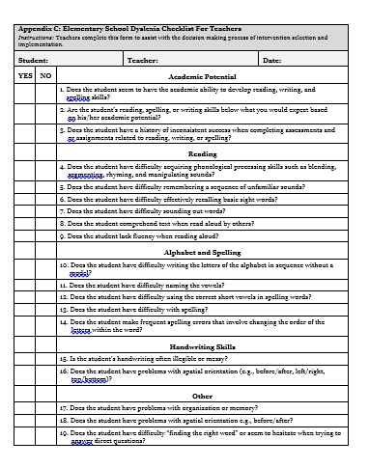
Dyslexia Checklist for Elementary Teacher

Slide 38
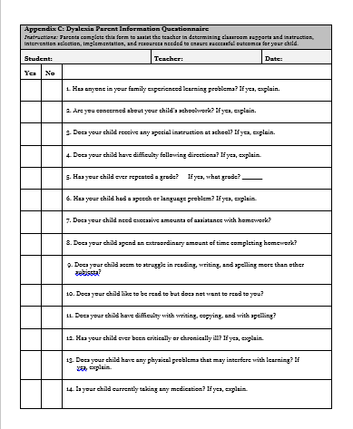
Dyslexia Parent Questionnaire

Slide 39
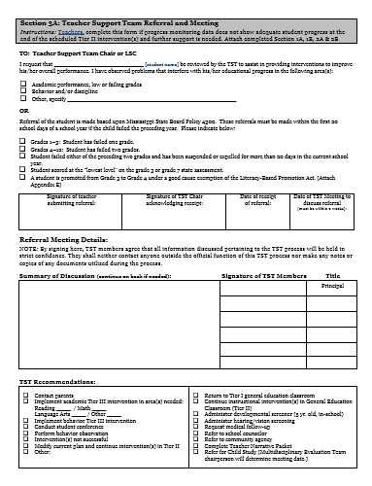
Refer to Teacher Support Team

Slide 40
Teacher Support Team
Functions as a problem solving unit
Reviews all available data
Provides intervention support
Determine resources necessary to implement and evaluate the intervention
Evaluates the success of the intervention
Determines next steps

Slide 41
Teacher Support Team
If the District provides a comprehensive assessment for dyslexia and the TST determines that the student would benefit from the assessment then the following components are recommended for the evaluation of Dyslexia.
The district is not required to assess for dyslexia.

Slide 42
Phase IV – Comprehensive Dyslexia Evaluation
IQ Test
Oral Language
Phonological Processing
Phonological Memory
Rapid Automatic Naming
Letter Knowledge
Reading Words in Isolation
Reading Comprehension
Decoding
Encoding
Fluency

Slide 43
Definition of Dyslexia
The following definition of dyslexia is endorsed by the Board of Directors of the International Dyslexia Association.
Dyslexia is a specific learning disability that is neurological in origin. It is characterized by difficulties with accurate and/or fluent word recognition and by poor spelling and decoding abilities. These difficulties typically result from a deficit in the phonological component of language that is often unexpected in relation to other cognitive abilities and the provision of effective classroom instruction.
Secondary consequences may include problems in reading comprehension and reduced reading experience that can impede the growth of vocabulary and background knowledge

Slide 44
Phase V (Tier III) Implementation
If it is determined that the student has Dyslexia or characteristics of dyslexia, Phase V (Tier III) implementation would begin.
The next few slides describe the program descriptors that are best utilized with dyslexic students in Phase V.

Slide 45
Implementation of Specialized Dyslexia Instructional Programs
Phase V
Individualized – refers to the personalization of instruction to student ability levels, interests, and learning styles.
Multisensory – refers to the combined use of visual, auditory, kinesthetic, and tactile senses to reinforce learning.

Slide 46
Implementation of Specialized Dyslexia Instructional Programs
Phase V
Language-based – refers to the relating of all aspects of language into meaningful settings.
Intensive phonetics – takes advantage of the letter-sound plan in which words that carry meaning are made of sounds; sounds are written with letters in the right order.

Slide 47
Implementation of Specialized Dyslexia Instructional Programs
Phase V
Synthetic phonics – sounds of letters can be blended into words for reading, and the words can be divided into the component sounds for spelling and writing
Linguistic – based in proficiency and fluency with the patterns of language so that words and sentences are the carriers of meaning.

Slide 48
Implementation of Specialized Dyslexia Instructional Programs
Phase V
Meaning based – directed toward reading comprehension and/or written composition.
Process oriented – places emphasis on the processes as much as on the product.

Slide 49
Implementation of Specialized Dyslexia Instructional Programs
Phase V
Systematic, sequential, cumulative – material is organized and presented in a logical way. The material builds on previous knowledge when teaching reading, writing and spelling

Slide 50
Resources
http://www.mde.k12.ms.us/ESE
http://www.mde.k12.ms.us/ESE/dyslexia
http://www.mde.k12.ms.us/ESE/links/response-to-intervention-teacher-support-team
http://www.mde.k12.ms.us/ESE/literacy

Slide 51
Contact Information
Office of Elementary Education and Reading
Robin Lemonis, M.Ed., CALT, L.D.T., Director of Student Intervention Services PreK – 12
rlemonis@mde.k12.ms.us or 601-359-2586

