Slide 1
Special Considerations: Assistive Technology and Communication
Office of Special Education Division of District Support

Slide 2
FYI Note from MDE
This event is being funded with State and/or Federal funds and is being provided for employees of school districts, employees of the Mississippi Department of Education and Department contractors. Miss. Const. Art. 4, Section 66 prohibits governing authorities from making donations. According to the Mississippi Attorney General, once the Federal funds are turned over to the State, the rules for the expenditure of State funds apply. Based on Mississippi law, this event is not being provided for third party vendors or external providers.

Slide 3
State Board of Education
Vision _________________________________
To create a world-class educational system that gives students the knowledge and skills to be successful in college and the workforce, and to flourish as parents and citizens
Mission _______________________________
To provide leadership through the development of policy and accountability systems so that all students are prepared to compete in the global community

Slide 4
State Board of Education Goals
5-Year Strategies Plan for 2016-2020
All Students Proficient and Showing Growth in All Assessed Areas
Every Student Graduates High School and is Ready for College and Career
Every Child Has Access to a High-Quality Early Childhood Program
Every School Has Effective Teachers and Leaders
Every Community Effectively Using a World-Class Data System to Improve Student Outcomes

Slide 5
Alignment of Training to Strategic Plan
This training is designed to provide districts with tools for examining the Special Communications section of the IEP and making decisions/determinations for those Special Considerations in order to help guarantee that all students with disabilities who need special education services receive a FAPE.

Slide 6
Teacher Listserv
The OSE has a teacher listserv available for special education teachers.
The purpose of the listserv is to inform special education teachers of upcoming trainings, upcoming webinars, and other resources provided by MDE.
www.mdek12.org

Slide 7
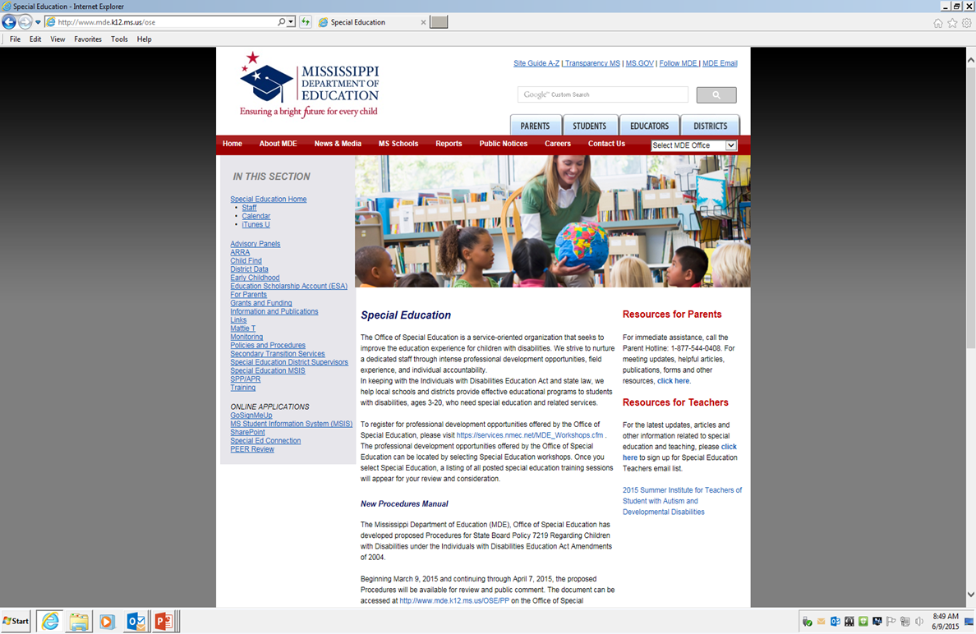
Teacher Listserv

Slide 8
What are Special Considerations?
State Board Policy 7219 identifies five (5) circumstances when the Individualized Education Program (IEP) Committee must make special considerations when developing, reviewing, and/or revising an IEP.

Slide 9
What are Special Considerations?
Communication Needs (Required)
Assistive Technology Needs (Required)
Special needs for children who are
Blind / Visually Impaired
Deaf / Hearing Impaired
Children who require behavior intervention
Children with Limited English Proficiency

Slide 10
Special Considerations on the IEP

Slide 11
Something to Think About
If the child has a primary or related service eligibility ruling in Language/Speech or receives any type of Language/Speech service, the IEP Committee must answer Yes to the question “Does the child have special communication needs?”

Slide 12
Document the Basis for
the Decision
When considering the child’s communication needs, ask:
What communication demands and opportunities does the child have?
Does the child have the skills and strategies to meet those demands?
Notes:
Communication demands = What setting? Which partners?
Skills and Strategies = social skills, receptive/expressive language skills?

Slide 13
Document the Basis for
the Decision
Can the child fulfill his or her need to communicate in different settings?
Does the child communicate appropriately and effectively?
How would the communication be described?
Notes:
Communicate appropriately? Consider not only whether the child is able to speak, but how effectively (articulation skills / intelligibility)
Describe communication: Ex: Susie speaks in short 3-4 word sentences, often leaving out adjectives, tense markers, etc. Her language/communication skills make it difficult for her to converse with her teachers and peers.

Slide 14
Document the Basis for
the Decision
Write a description of the child’s needs including methods of communication, the settings and/or situations in which the child will need support, etc.
Record the sources of data used to determine the child’s special communication needs.
Notes:
Record source of data: You may write the needs statement beginning with “According to (what data), Susie has difficulty with……

Slide 15
Special Considerations
Communication
Standards-Based IEPs @MDE – Office of District Support

Slide 16
Special Considerations
Communication
Standards-Based IEPs @MDE – Office of District Support

Slide 17
What is Assistive Technology?
An Assistive Technology Device is any item, piece of equipment, or product system, whether acquired commercially or off the shelf, modified, or customized, that is used to increase, maintain, or improve the functional capabilities of a child with a disability. It does not include a medical device that is surgically implanted, or the replacement of such device.

Slide 18
What is Assistive Technology?
An Assistive Technology Service is any service that directly assists a child with a disability in the selection, acquisition, or use of an assistive technology device.
Assistive Technology is not just a device…
What does the child need in order to access the general education curriculum?

Slide 19
Examples of Assistive Technology
Augmentative/Alternative Communication: Supports that allow a child who cannot speak, or whose speech is not understood by others, to communicate. This includes picture boards, voice output communication devices, communication software, and computers.

Slide 20
Examples of Assistive Technology
Access and Environmental Controls: Devices that allow increased control of the environment or that open up access to things in the environment. This includes electronic controls like switches, special keyboards or mice, and remote controls as well as things that help people get around the community, like ramps, automatic door openers, and Braille signs.

Slide 21
Examples of Assistive Technology
Aids to Daily Living: Special tools for daily activities, like brushing teeth, dressing or eating. This includes adapted utensils, plates and cups, non-skid surfaces, and specially-designed toilet seats and shower stalls.

Slide 22
Examples of Assistive Technology
Assistive Listening: Supports that help a student who is either deaf or has a hearing loss. This includes hearing aids, amplifiers, captions on TV, and typing telephones.

Slide 23
Examples of Assistive Technology
Computer-Based Instruction: Software to help students with learning difficulties in reading, writing, math and other subject areas.
Mobility: Equipment that allows a student with a physical or visual disability to move independently and safely through the community. This includes wheelchairs, walkers, and adapted bicycles.
Notes:
Think low-tech to high-tech. Something as simple as a pencil grip, used consistently, may be assistive technology.

Slide 24
Examples of Assistive Technology
Positioning: Any support that helps a student with a physical disability remain in a good position for learning without becoming tired. This includes adjustable chairs, tables, standers, wedges, and straps.

Slide 25
Examples of Assistive Technology
Visual Aids: Supports that give a student with visual difficulties access to information. This includes large-print books, books on tape, magnifiers, talking computer software, and Braillers.

Slide 26
Assistive Technology Service
The evaluation of the needs of the child with a disability, including functional evaluation of the child in the child’s customary environment;
Purchasing, leasing, or otherwise providing for the acquisition of assistive technology devices by children with disabilities
Selecting, designing, fitting, customizing, adapting, applying, maintaining, repairing, or replacing assistive technology devices;

Slide 27
Assistive Technology Service
Coordinating and using other therapies, interventions, or services with assistive technology devices such as those associated with existing education or rehabilitation plans and programs;
Training and/or technical assistance for a child with a disability or his/her family, if appropriate; and
Notes:
Project Start has loaner devices.

Slide 28
Assistive Technology Service
Training and/or technical assistance for professionals (including individuals providing education or rehabilitation services), employers, or other individuals who provide service to, employ, or are substantially involved in the major functions of that child.

Slide 29
Something to Think About
How do you justify the student’s needs for assistive technology?
Does the child need an assistive technology assessment?
What have you tried, if anything, before requesting an assessment? Did it help? To what extent?

Slide 30
Document the Basis for
the Decision
When considering the child’s assistive technology (AT) needs, ask:
Does the child require an AT assessment to determine his/her needs?
What type of AT might increase the child’s participation in the general education curriculum (or developmentally appropriate activities)?

Slide 31
Document the Basis for
the Decision
Is the child currently using any AT device or services? If so, does it work? Is it meeting his/her needs?
Write a description of the device, service, or assessment needs, including the settings and/or situations where the child needs support.
Record data sources used to determine the child’s AT needs.

Slide 32
Consideration for Technology Checklist
Notes:
http://www.ocali.org/up_doc/AT_Resource_Guide_4.pdf

Slide 33
Consideration for Technology Checklist

Slide 34
Special Considerations
Assistive Technology
Standards-Based IEPs @MDE – Office of District Support

Slide 35
Special Considerations
Assistive Technology
Standards-Based IEPs @MDE – Office of District Support

Slide 36
Something to Think About
The Present Levels of Academic Achievement and Functional Performance (PLAAFP) should address the need for Language-Speech services and/or Assistive Technology devices or services.
What is the educational impact?

Slide 37
IEP – Common Errors
IEP teams do not know how to include AT in IEPs.
IEPs including AT use a “formula” approach to documentation. All IEPs are developed in similar fashion and the unique needs of the child are not addressed.
AT is included in the IEP, but the relationship to goals and objectives is unclear.
AT devices are included in the IEP, but no AT services support the use.
AT expected results are not measurable or observable.
(The QIAT Consortium, 2012, pp 5-6)

Slide 38
Resources
Assistive Technology: Key Considerations for Students with Disabilities; Vincent J. Varrassi, MA, LDT-C
AT Internet Modules (click on the Dashboard) http://www.atinternetmodules.org
A Quick Guide to AAC http://www.sc.edu/scatp/aacguide.html
Helpful Links to Assistive Technology http://autismnow.org/articles/helpful-links-to-assistive-technology/#Intro
Consideration for AT Checklist http://www.ocali.org/up_doc/AT_Resource_Guide_4.pdf
IEP Guidance Document www.mde.k12.ms.us/OSE
Notes:
http://www.ocali.org/up_doc/AT_Resource_Guide_4.pdf
Consideration for AT Checklist in this ppt can be found on the AT Internet Modules website. You must create an account to view, but it’s free and loaded with AT considerations.

Slide 39
Special Considerations
Questions?
Comments?

Slide 40
Contact Information
OSE District Support Staff:
Tanya Bradley, Bureau Director tbradley@mdek12.org
M. April Rice, Office Director marice@mdek12.org
Sharon Coon, Autism Specialist scoon@mdek12.org
Teresa Laney, CCC-SLP tlaney@mdek12.org
MS Dept. of Education
Office of Special Education
P. O. Box 771
Jackson, MS 39205
(601) 359-3498

