Slide 1
Constructing a Firm Foundation Filling Foundational Gaps in Tier 1 Instruction
Bethani Welch
Melissa Hinton
MDE Regional Literacy Coordinator
MDE Literacy Coach
February 2022

Slide 2
Mississippi Department of Education

Slide 3
State Board of Education STRATEGIC PLAN GOALS

Slide 4
Session Norms
Silence your cell phones.
Please check and/or reply to emails during the scheduled breaks.
Be an active participant.
Do not hesitate to ask questions.

Slide 5
Session Goals
In this session, we will explore:
The Reading Universe grid
Concepts of print, phonological awareness, & phonemic awareness
Screening data
Teacher-led reading centers
Schedules

Slide 6
The Reading Universe

Slide 7
The Reading Universe
Understanding the Big Picture:
A Professional Development Guide to Illustrate the Universe of Skills for a Structured Approach to Early Literacy Instruction
www.readinguniverse.org
password: abc123

Slide 8
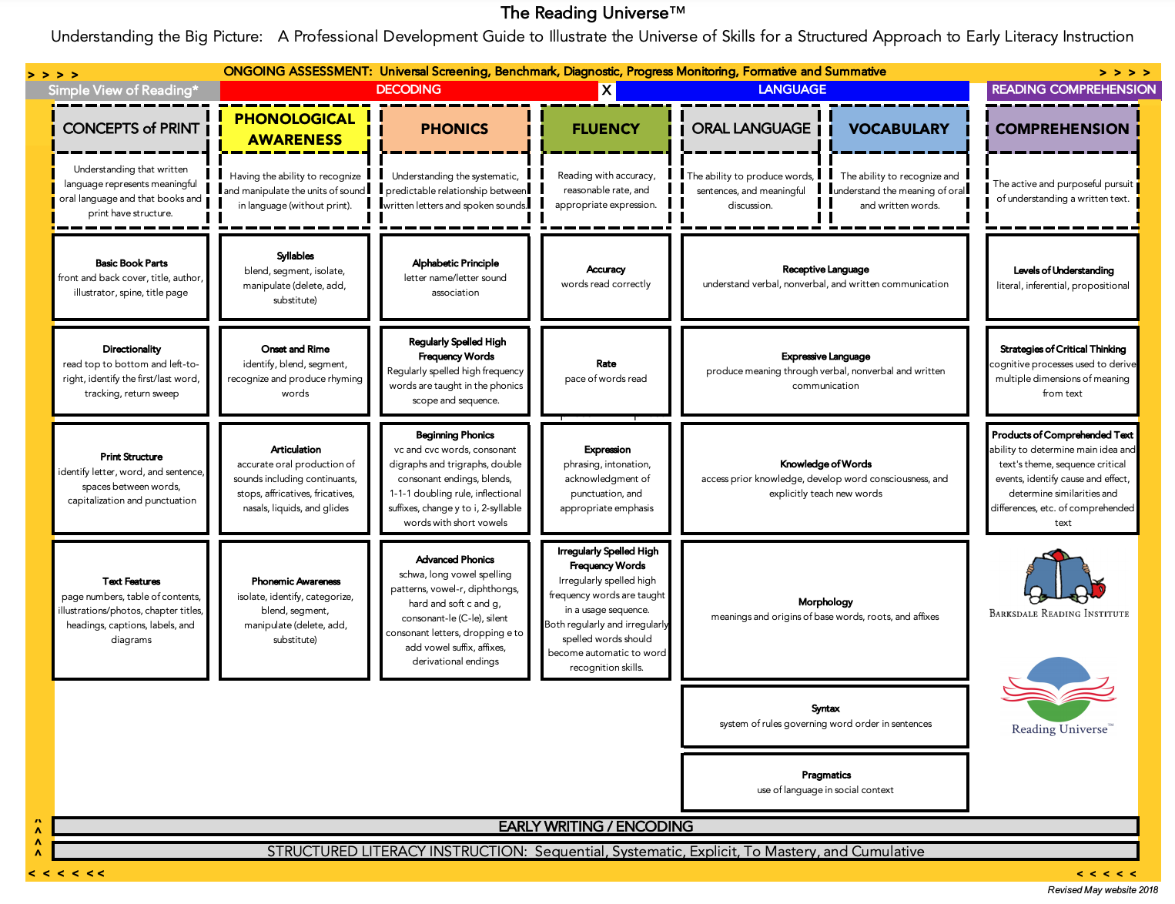
Fill gaps here so the foundation will hold for more advanced reading skills
Notes:
The Reading Universe™ Understanding the Big Picture: A Professional Development Guide to Illustrate the Universe of Skills for a Structured Approach to Early Literacy Instruction
www.readinguniverse.org

Slide 9
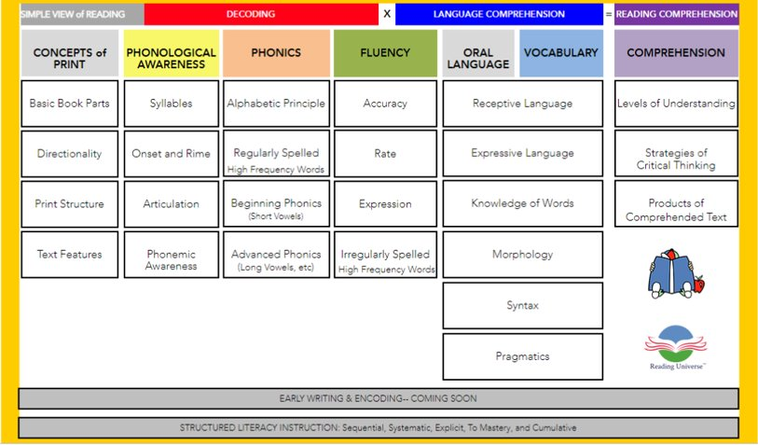
Interactive tiles with definitions, slide shows, and skill practices

Slide 10
Tier 1 Instruction

Slide 11
Tier 1 Instruction
High-quality classroom instruction aligned to the Mississippi College and Career-Readiness Standards (MS-CCRS)
Instruction within an evidence-based, scientifically researched core program
High quality reading instruction incorporates the five components of reading (phonemic awareness, phonics, vocabulary, fluency, comprehension) delivered through a coherent instructional design

Slide 12
Tier 1 Instruction
MTSS
The Mississippi Department of Education's Multi-Tiered System of Supports Documentation Packet lists 3 domains for Tier 1 high-quality classroom observations:
Classroom Instruction
Differentiated Instruction
Classroom Management

Slide 13
Tier 1 Instruction
Classroom Instruction
Students are actively engaged in learning.
Content is at students’ grade level (whole group) and differentiated (small group)
Students are answering questions correctly.
Students are asking questions.
Teacher communicates expectations of lesson.
Teacher questioning measures students' understanding of the prerequisite concepts.

Slide 14
Tier 1 Instruction
Classroom Instruction
Teacher questioning measures students' understanding of new concepts
Teacher encourages students to think critically concerning previous concepts and new concepts
Teacher reviews prerequisite knowledge needed for the lesson in order to effectively build student understanding

Slide 15
Tier 1 Instruction: Differentiating Instruction
Teacher uses activities to support instruction (i.e., advanced organizer, introduction to lesson, or closure)
Teacher aligns tasks to learning goals
Teacher engagement with students varies
Teacher provides guided practice and modeling in learning new concepts through gradual release (I do, we do, you do)
Notes:
Anchor chart

Slide 16
Tier 1 Instruction: Differentiating Instruction
Teacher uses a variety of techniques to support students in making meaning of content
Teacher groups students to work on instructional component
Teacher provides prompt feedback to students concerning performance
Teacher assists students in preparation for assignments, long-range projects, and tests

Slide 17
Concepts of Print

Slide 18
Concepts of Print
The understanding that words in print carry meaning
Basic concepts of print skills acquired in kindergarten and advanced skills in first grade
Continuum: book parts, directionality, print structure, and text features
With mastery of skills, students will have firmer understanding of how to address texts in reading and writing
Barksdale Reading Institute

Slide 19
Concepts of Print
By the end of kindergarten, a student should know:
Parts of a book and how to hold it
The title, author, illustrator, and their roles
Be able to follow the direction of print when read to aloud​
Distinguish between letters and words​
Identify spaces between words and understand different words compose a sentence
Understand that print gives meaning to spoken language
Connect relationship between illustrations and print​
Teaching Reading Sourcebook

Slide 20
Concepts of Print: Modeling at the Teacher Table
Text Directionality:
Read left to right continuously across the page by sweeping back
Concept of Word:
Use colored lines or fingers to frame words in text or build the number of words in a sentence with a visual
Students may then count the number of words and practice reading the sentence.
Teaching Reading Sourcebook
Notes:
Concepts of Word: maybe have an example on an anchor chart and show them how to frame it using highlighter tape, wiki sticks, etc.

Slide 21
Concepts of Print: Modeling at the Teacher Table
Use matching and sorting activities for students to identify identical letters/words, letters with similar shapes, or to sort out letters from numbers and words.
Bring meaning to words and illustrations through having students identify words in text that represent the image.
Read a sentence from a text, cut it up, and have students reorder.
Each activity should follow the I do, we do, you do model.
Notes:
See uploaded sorting activity

Slide 22
Phonological Awareness

Slide 23
Phonological Awareness
Identifying and manipulating sound parts in spoken language. This includes syllables, pictures or onset and rime, and individual phonemes.
Picture manipulatives can be used to support, but no letters.
No print, can be done with your eyes closed!
Older students only with deficits, may use letters to help link understanding and support phonology.
This Photo by Unknown author is licensed under CC BY-NC.
Barksdale Reading Institute
Notes:
Update QR Code

Slide 24
Effective Phonological Awareness Instruction
Explicit and systematic instruction in nature
Conduct in whole/small groups
Focus on no more than one or two skills simultaneously
Utilize manipulatives to make concepts more concrete
Correctly pronounce phonemes
Phoneme awareness performance is a strong predictor of long-term reading and spelling success and can predict literacy performance more accurately than variables such as intelligence, vocabulary, knowledge, and socioeconomic status.
- Gillon, 2004
WHY?
Teaching Reading Sourcebook
Notes:
Update QR Code

Slide 25
Phonological Awareness Skills Sequence
Concept of Spoken Word | distinguish words in sentences
Rhyme | recognize, complete, produce
Syllable | blend, segment, delete
Phonemes | Initial and final sounds blend onset and rime blend, segment, delete
Phoneme Manipulation | add or substitute phonemes
Phonological Awareness Assessment Tools and Strategies; Yvette Zgonc; SDE Resources
Notes:
Handout

Slide 26
Phonological Awareness: The How
Whole Group | Small Group
3-5 minutes daily | 5-8 minutes of small group differentiated instruction
Target one skill a week | Teach to mastery
Explicitly model through small group and individual practice | Give feedback
Follow the scope and sequence | Follow the scope and sequence
 | Target the lowest deficit skill first
Barksdale Reading Institute
Notes:
Handout

Slide 27
Phonological Awareness: Modeling at the Teacher Table
Concept of Spoken Word​ | Utilize a story to read aloud Give students character shape as in story Read sentences from story to students and model how to move one character per word of sentence Continue with additional sentences
Rhyme​ | Rhyming rhymes: in small group begin a rhyme such as “Old Mac Donald” and have students fill in the last word Repeat activity by changing the last word to a new rhyming word
Syllable​ | Play Raceway: In groups, move cars for each syllable of a word and have teams blend them together Move their car around the racetrack as they blend correctly
I do,
we do, you do method
Phonological Awareness Assessment Tools and Strategies; Yvette Zgonc; SDE Resources
Notes:
Handout

Slide 28
Phonological Awareness: Modeling at the Teacher Table
Phonemes | Fly Swatter Swat: Place various pictures in front of students Give each student a fly swatter Tell students that you are thinking of a word that begins with the same sound as a given word First student to swat the correct picture, moves it to his/her pile for a point Continue until all pictures have been used or several rounds played Student with the most picture cards wins Manipulate between initial, medial, and final sounds as they are taught
Phoneme Manipulation | Sound Swap: Give each student a sound box and a predetermined amount of manipulatives State word and move manipulatives for number of sounds Tell students to change a target sound to a different sound and then state word made Could also be done using pictures for a differentiated approach
Notes:
See uploaded activities.

Slide 29
Phonics

Slide 30
Phonics
Phonics instruction has its greatest impact with beginning readers in kindergarten and first grade and should be implemented at those levels.
National Reading Panel, 2000
Systematic instructional approach
to teach the relationship between
graphemes in written language and
phonemes in spoken language.
Why teach phonics?
To be able to both decode and
encode. Decode – convert a word
from print to speech. Encode –
convert a language into print
Teaching Reading Sourcebook
Notes:
Update QR Code

Slide 31
Phonics: What Shows Mastery in Area?
Alphabetic Principle | Regularly Spelled High Frequency Words | Beginning Phonics (short vowels) | Advanced Phonics (long vowels, etc.)
Alphabet order Difference between vowels and consonants Upper and lowercase Different fonts Write letters in both cases Letter name and sound association Alphabetical order | Spell words accurately Read words with automaticity and accuracy | Accurately and with automaticity decode and encode words | Decode in context and in isolation Encode with accuracy Schwa Vowel-r Long Vowel Spelling Patterns 1) Vowel-Consonant-e 2) Open syllables 3) Vowel teams Diphthongs Hard and Soft c and g Consonant-le Silent Consonant Letters Dropping e to add Vowel Suffix Derivational Affixes
Barksdale Reading Institute
Notes:
Handout

Slide 32
Phonics: Modeling at the Teacher Table
Name That Sound | Teacher states word and asks for target sound in certain position (beginning, medial, final) Students locate the letter from the alphabet arc Students state the letter name and sound it makes Teacher and students can then sort words with the same positional sound and extend through creating additional words
Tap It, Show It, Write It | Use words from current reading story Students tap out the sounds heard in the word Students pull down marker for each sound heard Students push markers up and write grapheme Work toward no longer needing markers for sounds.
I do,
we do, you do method
Notes:
Handout
See uploaded activities.

Slide 33
Phonics: Modeling at the Teacher Table
Link Those Syllables | Use words from current story/theme Divide the words into appropriate syllables, increasing the number of syllables for groups as needed Students work to build the syllables into words Students read the word in entirety Syllable division may be done/shown Students may sort by number of syllables or type
Mystery Words (Word Chaining) | Teacher may choose to manipulate word building cards or have students to. Progress as students gain understanding. Build words and manipulate sounds. Add new sounds as they are introduced. For Example: Bus---bug----bag----flag----flip
I do,
we do, you do method
Notes:
Handout
See uploaded activities.

Slide 34
Screening Data
Notes:
A universal screener is administered to all students at BOY, MOY, and EOY
MS has approved of 6 different universal screeners--Most schools administer either the iready or STAR screener
The data received from the screener provides a snapshot of what students know, what they should know, and what can be done to meet a student's academic needs.
With appropriate analysis and interpretation of data, we as educators can make informed decisions that positively affect student outcomes

Slide 35
Screening Data
Universal screener data should be used to guide Tier 1 instruction.
The MDE has collaborated with the Mississippi Reading Panel to develop a guidebook to support purposeful interventions when a student is identified as “at-risk” on a Universal Screener. Visit https://www.mdek12.org/OSA/USDA for more information.
It is important to use results from these screeners in a manner that helps to identify the lowest deficit skill. The lowest deficit skill is
the point where an intervention begins because it
represents where the breakdown in mastery has
occurred.
Notes:
As I mentioned, students take a universal screener at BOY, MOY, and EOY
The data collected from the universal screener is what should be used to drive our Tier 1 instruction
MDE has collaborated with the Ms Reading Panel to develop a guidebook to support purposeful interventions when a student is identified as “at-risk” on a Universal Screener
It is important to use the results from these screeners to help identify student's lowest deficit skill.
The lowest deficit skill is the point where an intervention begins because it represents where the breakdown in mastery has occurred.

Slide 36
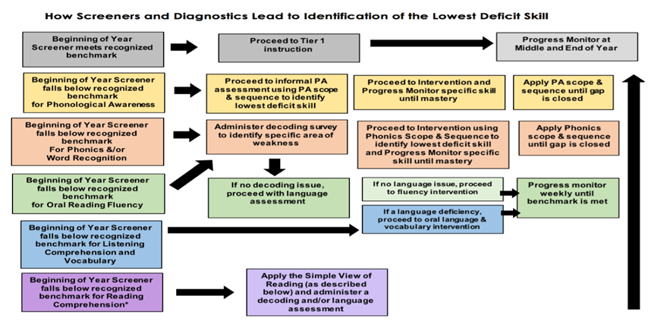
Screening Data
MDE Universal Screener Companion Guide
Notes:
Have sample diagnostics to show. Explain the process.

Slide 37
Screening Data
Reading comprehension deficits are rarely remediated simply by teaching comprehension strategies as an intervention. A reading comprehension deficit is rooted in either a decoding deficit or a language comprehension deficit or both. To achieve grade level comprehension, a student benefits most from interventions in the subskills of these two domains.
Notes:
Create a human “simple view of reading.” Print off domains and components on cardstock and allow participants to build this entire equation as parts are discussed.
“Simple view of reading” consists of 2 domains- decoding x Language comprehension
When we think about decoding, we should focus on these components (Phonological Awareness, phonics, and fluency)
When we add in the components of language comprehension which are vocabulary and reading comprehension
What do you think happens? Our students are then able to apply the skills they have been taught and they are able to comprehend what has been read.

Slide 38
Teacher-Led Reading Centers
Notes:
The teacher-led center is where the magic really happens! This is where true differentiation should be taking place. Our students in urgent intervention should not be receiving the same identical instruction that our at and above grade level students are receiving.

Slide 39
Tier 1 Instruction

Slide 40
What's So Great About Teacher-Led Reading?
A teacher-led reading center can...
provide teachers the perfect opportunity to observe and offer guidance to their students as they read aloud in a small group setting.
provide daily experience reading a text at a level that supports accuracy and comprehension.
create opportunities to talk and write about texts.
Notes:
What’s so great about the teacher-led Reading?
First of all, it provides the teacher the opportunity to meet with students in a small group setting
It provides daily experiences reading a text at a level that supports accuracy and comprehension
It creates opportunities for students to discuss the text and practice writing about the texts

Slide 41
What's So Great About Teacher-Led Reading?
A teacher-led reading center can...
give teachers the opportunity to ensure more "eyes on text" with instructional support.
offer experience with a wide variety of genres so that students can develop favorite types of texts.
encourage students to read at their independent level
Notes:
The teacher-led center also
give teachers the opportunity to ensure more "eyes on text" with instructional support.
offer experiences of reading a wide variety of genres so that students can develop favorite types of texts.
Lastly, it encourage students to read at their independent level

Slide 42
Teacher-Led Reading & the 5 Components
Though whole group instruction can be used to address the 5 components of reading, a small, teacher-led group can be used
to effectively address deficit areas identified through data, teach standards-based skills, and make connections among phonemic awareness, phonics, vocabulary, fluency and comprehension.
Notes:
Teacher-led reading and the 5 components of reading
Teachers most often use whole group instruction to address the five components of reading
But a small teacher-led group can be used to effectively address deficit areas identified through data, can teach standards-based skills, and
Make connections among PA, phonics, vocabulary, fluency, and comprehension
Though comprehension and vocabulary may not be "listed" as a foundational skill, the kindergarten through 3rd grade RF.x.4 standards speak of "reading with purpose and understanding”

Slide 43
Teacher-Led Reading & the 5 Components
Teacher-Led Reading Center (25-30 minutes)
Phonemic Awareness Skill Review (5 minutes)
Phonics Skill Practice (10-12 minutes)
Vocabulary (5 minutes)
Fluency Practice (3-5 minutes)
Comprehension (5-7 minutes)
*Times will vary according to skill level and grade level
https://www.mdek12.org/ESE/literacy/professional-development-and-resources-for-teachers
Notes:
This is an example you can use when planning for your Teacher-Led Reading Center.
We all know to well that a 25-30 minute teacher-Led center is ideal but not always realistic.
Take advantage of the time that you do have and plan accordingly.
Teacher-Led Reading Center (25-30 minutes)
Phonemic Awareness Skill Review (5 minutes)
Phonics Skill Practice (10-12 minutes)
Vocabulary (5 minutes)
Fluency Practice (3-5 minutes)
Comprehension (5-7 minutes)
Keep in mind the time frames designated for each of the five components of reading will vary according to skill level and grade level of your students.
You can find sample Literacy Block Schedule on the MDE website
Make sure to point out the point at the bottom that times will vary according to skill level, grade level, and data.

Slide 44
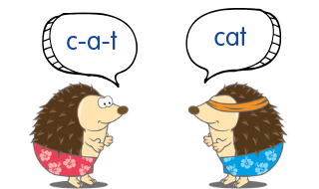
Phonemic Awareness Skill Review
Use first 5 minutes of the teacher led reading center
Focus on skills that have been covered during the PA routine that students are struggling with
Teach skills explicitly using a scope and sequence to achieve mastery
Notes:
Phonemic Awareness is one piece of the “learning to read” puzzle
It is crucial, that we as teachers, plan and prepare instruction in advance so that we are prepared to explicitly teach all the components of phonemic awareness
When it comes to planning for the teacher-led center , and the student's deficits are in phonemic awareness, then you review the specific skill starting with the easiest and progressing to the more difficult skills
For example, if students have mastered rhyme identification but are struggling with producing rhyme, then “Producing Rhyme” would be your focus skill
If segmentations is the deficit area, the you would review segmentation at the beginning of the center
For mastery to occur, students must be taught explicitly and given multiple opportunities to practice the skills

Slide 45
Phonics Skill Practice Review
Use decodable reader
Take opportunities to model encoding (word in text: bed; write
word that rhymes: fed)
Students read decodable reader with teacher as guide to practice
phonics skill(s)
Use routine for new words (segment, blend, read word again)
Notes:
If students are struggling with phonics skills, then we plan and prepare activities to address deficit areas
A great tool to provide additional practice with phonics skills is to incorporate decodable text or the leveled reader
The text allows opportunities to model encoding
For example, student reads the word “bed” in the text, have the student think of a word that rhymes with “bed”
Then have the student write the word that rhymes with “bed”
Students can read the decodable text with teacher guidance to practice phonics skills
When students come to an unknown word in the text- have them segment the individual sounds of the word, blend the sounds together, and then read the word again

Slide 46
Vocabulary Skill Practice Review
Choose 1-2 word(s) from text
Use routine (students say word multiple times; kid-friendly
definition; hand motion; use in a sentence
https://explicitinstruction.org/ (Anita Archer)
Prepare word for word wall
Encourage student use of word(s) throughout day
Notes:
Share video if time allows.
Share video if time allows.
When reviewing vocabulary words choose 1-2 words from the text
Use an explicit routine when teaching and reviewing vocabulary words
Raise your hand if you are familiar with or use Anita Archers vocabulary routine
Where you introduce the word and say it multiple times—kid-friendly definition—gesture or hand motion—and lastly, use in a sentence
Make sure to post the word on the word wall
And encourage student use of the word (s) through-out the day

Slide 47
Fluency Skill Practice Review
Model fluent reading with portions of the text (Listen to me read
This sentence as you follow along. Now let's read it together like
that.)
Use routine for select sentences (I read, we read, you read)
Take opportunities to change inflection of voice if punctuation
was different (How would this sentence sound if it had a question
mark at the end?)
Notes:
Modeling fluent reading is so important to our students
You can use portions of the student text by having students listen to you read as they track and follow along
Then you can read the text together while students track as they read with you
Great routine to use (I read, We read, You read)
While you are reading take the opportunity to change the inflection of your voice when the punctuation is different
Ask your students “How would this sentence sound if it had a question mark at the end?

Slide 48
Comprehension Skill Practice Review
Prepare higher order thinking questions ahead of time
Give opportunities for students to locate evidence within the text
Understanding comprehension of the text supports the RF.x.4
MSCCRS and can be addressed during small groups
(K-1-Print Concepts, Phonological Awareness, Phonics, Word Recognition and
Fluency; 2nd –3rd grade-Phonics, Word Recognition, and Fluency) )
Notes:
The key to comprehension is Preparing in advance!
If we do not prepare in advance, sometimes our text does not match our standard or the questions we want to ask.
Prepare higher order thinking questions ahead of time
Model and give students opportunities to locate evidence within the text
Make sure you understand comprehension of the text supports the Reading Foundational Standards RF.x..4 …the x stands for the grade level. For example, RF.1.4
Kinder and 1st Grade-Foundational Skills (Print Concepts, Phonological Awareness, Phonics and Word Recognition, and Fluency)
2nd and 3rd grade- Foundational Skills (Phonics and Word Recognition, and Fluency)
When teaching and reviewing comprehension --Make sure the text that you are using matches the standard.

Slide 49
How Leveled Readers Are Used
2009 Readsters, LLC
Students use pictures and context to "read" words they can't decode or haven't memorized
All words are in the students' vocabularies
Accuracy when reading is not as important as comprehension.
Often, reading errors that do not affect meaning are not corrected.
Use with beginning readers as a read-aloud or for echo reading.
Do not expect beginning readers to read these independently.
Ask students about the text and pictures after you have read the book or during the time you are rereading the book.
Use to help students develop concepts of print, such as:

Slide 50
How Leveled Readers Are Used
2009 Readsters, LLC
Use to help students develop concepts of print, such as:
Text moves from top to bottom and left to right.
Sentence begins with a capital letter and ends with a period.
Words have spaces between them.
Where to find the title.
Locating the most frequent words such as the, is, a, I, etc.

Slide 51
How Decodable Readers Are Used
2009 Readsters, LLC
Include only:
Words with phonics patterns that have been taught
High frequency words that have been taught.
Start with CVC words and move slowly to more complex patterns.
Focus on teaching accurate reading more than comprehension.
Pictures support the story, but not the specific words.
Subject matter is secondary to the decodability of the words.

Slide 52
How Decodable Readers Are Used
2009 Readsters, LLC
Students learn to read words by (1) reading heart words they have practiced and (2) utilizing phonics patterns.
Almost all the words in the decodable books will be heart words that have been taught or have phonics patterns that have been taught.
When students don't know a decodable word, they sound it out using their knowledge of grapheme-phoneme patterns.
Developing a habit of reading accurately occurs before reading with fluency is expected.
After students read with accuracy, the teacher may decide to have them re-read one or more times to develop fluency.

Slide 53
Build a Plan to Share: Activity
Locate decodable readers in the center of table and choose one
Locate lesson planning template in the center of table
Use the copy of the model as a guide to create a guided reading group lesson to incorporate the 5 components of reading—Take note of the time allotted for each section since times may need to be modified according to skill level.
Build the lesson. Include the appropriate foundational skill standard as shown in the lesson plan model.
Notes:
Now that I have modeled “I do, We do” its time for “You to do”
At your table locate the decodeablereaders, the planning template, and the lesson model explained in the presentation.
Work with a partner at your table using these materials to create a guided reading lesson that will incorporate the 5 components of reading
Be prepared to share out when you’re completed.
You will have 10 minutes to complete.

Slide 54
Schedules
Notes:
Why have a schedule?
Classrooms with consistent schedules and routines—
facilitate students understanding of the learning environment expectations.
Students who are familiar with the classroom schedule and routine are more likely to be engaged, attentive, and learn new knowledge.

Slide 55
Schedules
The uninterrupted 90-minute reading block contains three parts: whole group, teacher-led small groups, and independent student centers.
If more than 90 minutes can be devoted to the reading block, add that time to the amount spent in teacher led small group centers.
Notes:
The uninterrupted 90-minute (120 minute) reading block contains 3 parts. Whole group instruction, teacher-led small groups, and independent centers
If you can devote more than 90 minutes to the reading block, add that time to the amount of time spent in teacher led small group centers
This is an example of a 90-minute reading block-Read slide

Slide 56
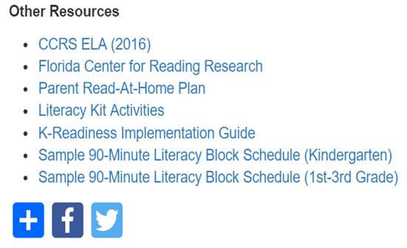
Schedules
MDE Sample Schedules:
Kindergarten reading block
1st through 3rd grade reading block
Located under “Other Resources”
on the “Professional Development and Resources for
Teachers” webpage
Notes:
MDE is in the process of updating the sample Literacy Block Schedule. We have a draft to share, but the final will be uploaded soon.

Slide 57
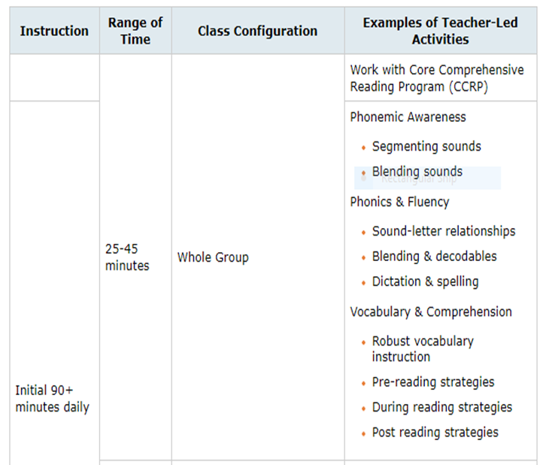
Schedules
Notes:
This is an example of a 90 minute reading block broken down to include whole and small group instruction

Slide 58
Family Resource
58
Strong Readers Strong Leaders Mississippi Strongreadersms.com website developed to help families assist children with building their reading skills. The site provides activities, resources and information for children from birth through grade 5 to become strong readers.

Slide 59
References
https://www.readinguniverse.org/
www.scholastic.com
https://www.fcrr.org/
MDE Screener Companion Guide
www.explicitinstruction.org
Notes:
Update QR Code

Slide 60
References
Teaching Reading Sourcebook: Honig; Diamond; Gutlohn; Core Literacy Library
Phonological Awareness Assessment Tools and Strategies; Yvette Zgonc; SDE Resources
Fifty Nifty Activities by Judith Dodson
Notes:
If possible, have these to share with teachers.

Slide 61
Bethani Welch Melissa Hinton
MDE Regional Coordinator
Bethani.Welch@mdek12.org
MDE Literacy Coach
Melissa.Hinton@mdek12.org

