Slide 1
Teaching Reading Remotely
Yes, It’s Totally Possible
Introduce yourself in the Chat:
Name, Role
and please share
What’s one benefit of teaching remotely?
Presenter: Margaret Goldberg

Slide 2
Agenda
Setting Up for Success with Remote Instruction
Phonological Awareness and Phonics Instruction
Fluency Practice
Teaching Writing
Building Comprehension
Q&A
©2020 Right to Read Project

Slide 3
Setting Up for Success
with
Remote Instruction

Slide 4
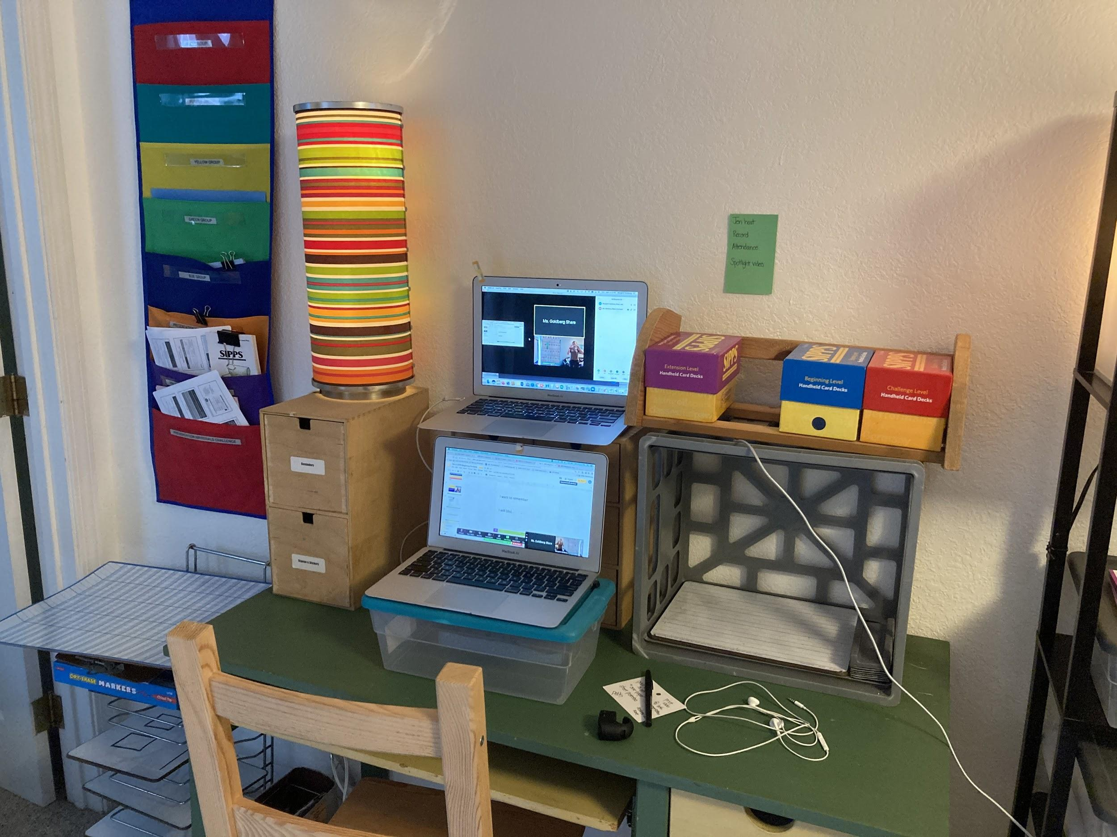
Two Screens
iPhone Doc Cam
Lesson Materials

Slide 5
Features to Know
Split Screen with Gallery View
Spotlight the Speaker
Open Breakout Rooms and Then Assign

Slide 6
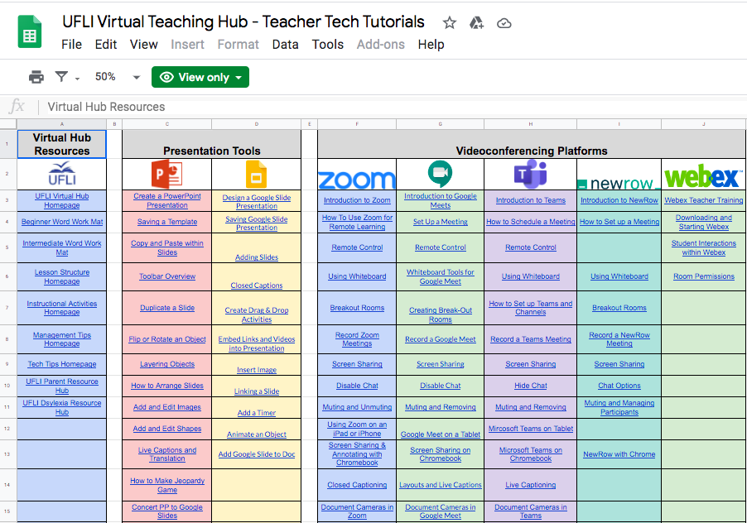
Notes:
https://docs.google.com/spreadsheets/d/1C8oLYz0JdN1CFsTCFDQOOZlSafHDnvADbJOxsUP6wWE/edit#gid=0

Slide 7
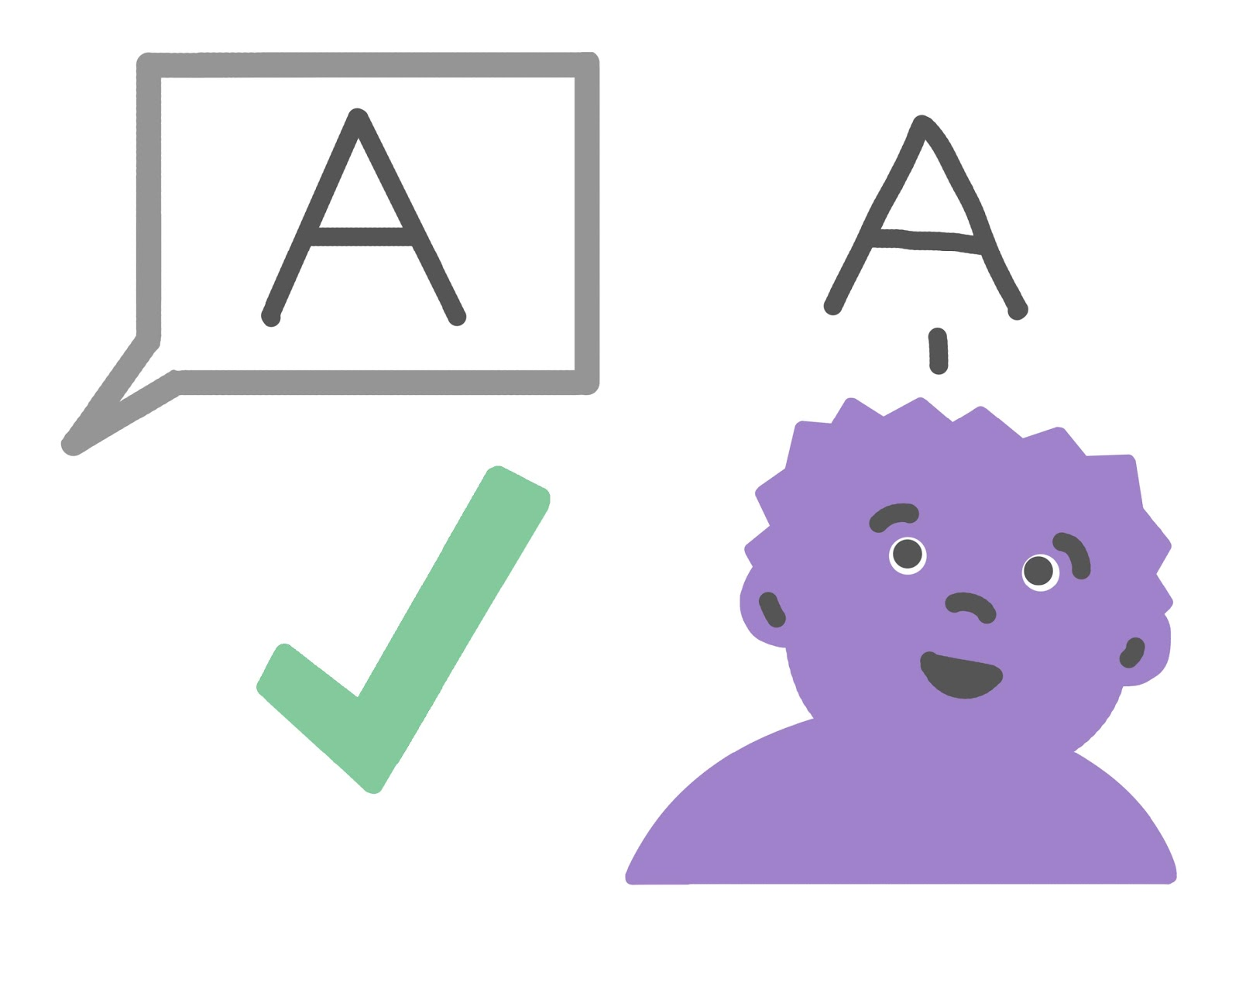
Expectations
Stay in 1 spot
Listen with care.
Look at the camera.
Follow teacher directions the
first time.
Respond to others.
Raise a quiet hand.
Notes:
Check in about Breakout Rooms

Slide 8
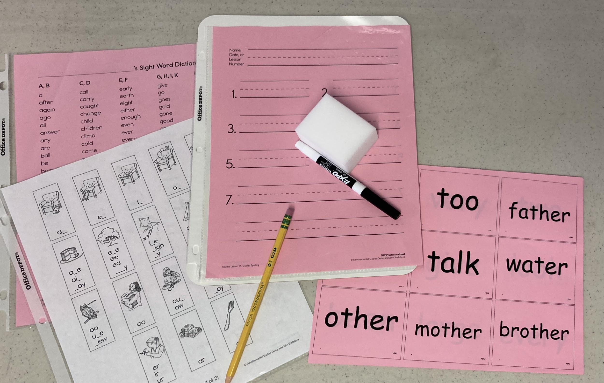
Student Materials for Phonics

Slide 9
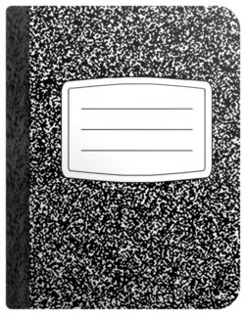
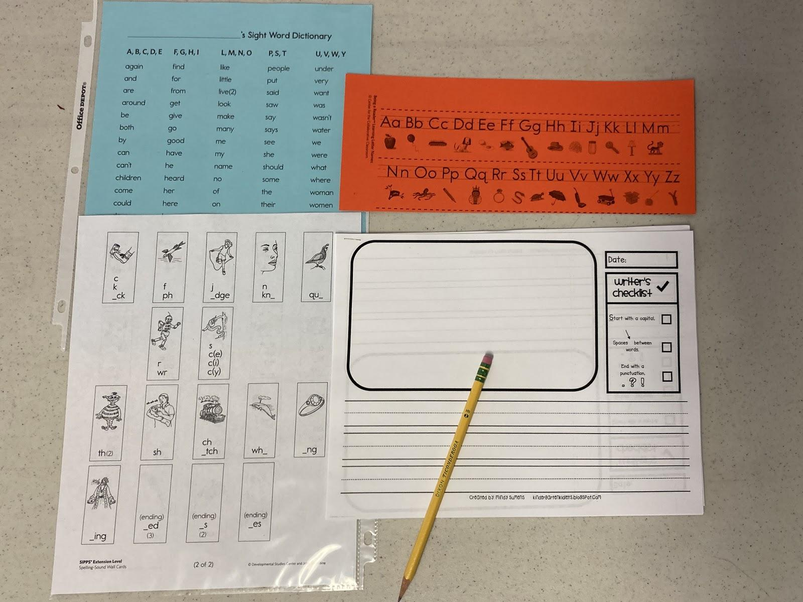
Student Materials for Writing

Slide 10
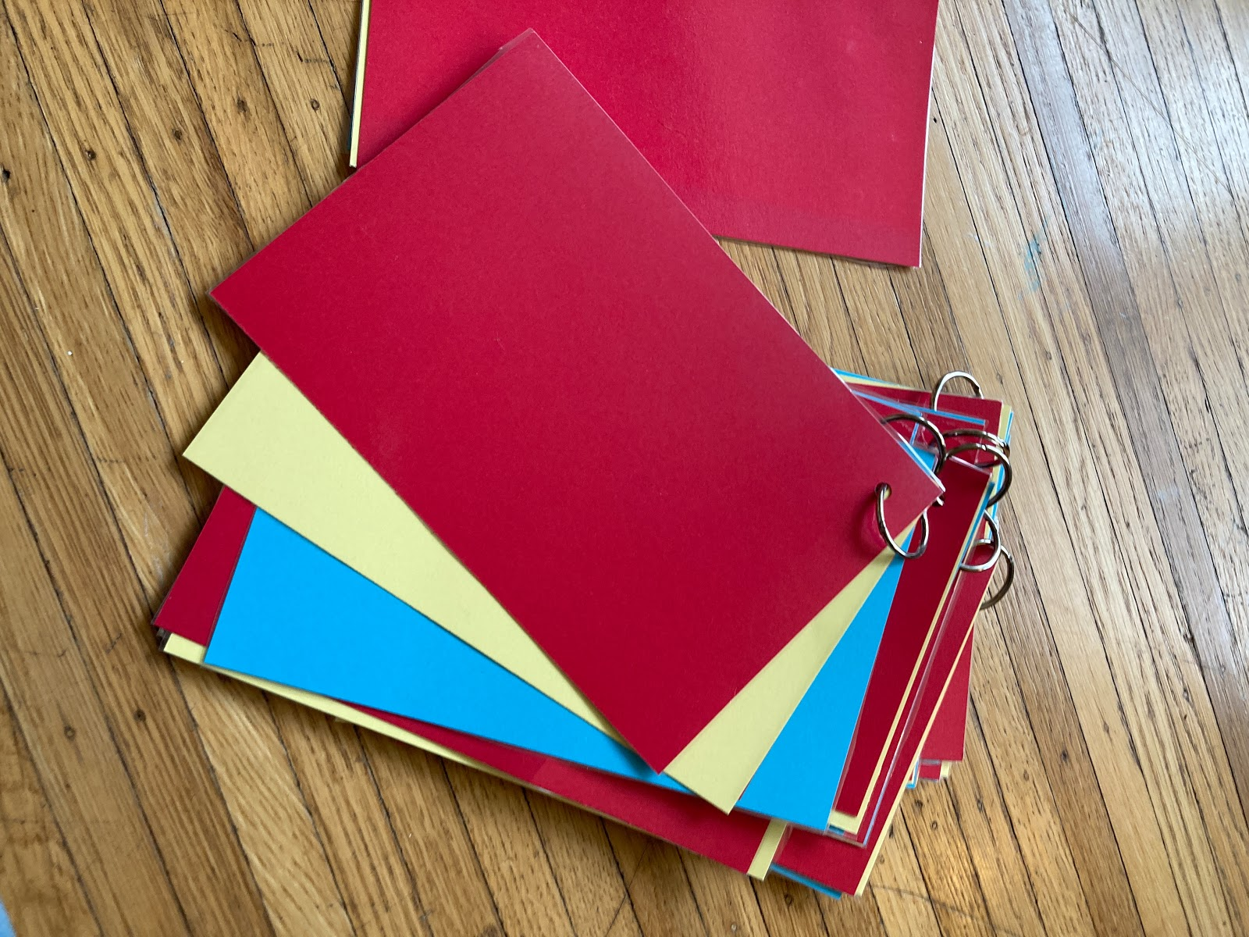
Student Materials
for Engagement

Slide 11
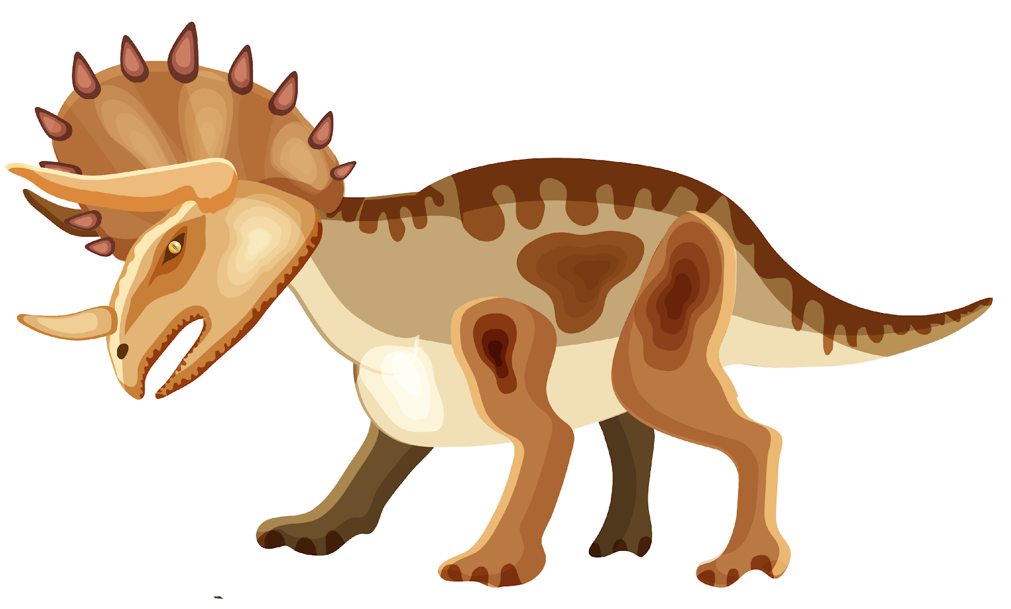
Green Group
 | Mon. | Tues. | Wed. | Thurs. | Fri.
Ja’King
Kah’Marii
Luna
Elijah
Matthew
Mohammed

Slide 12
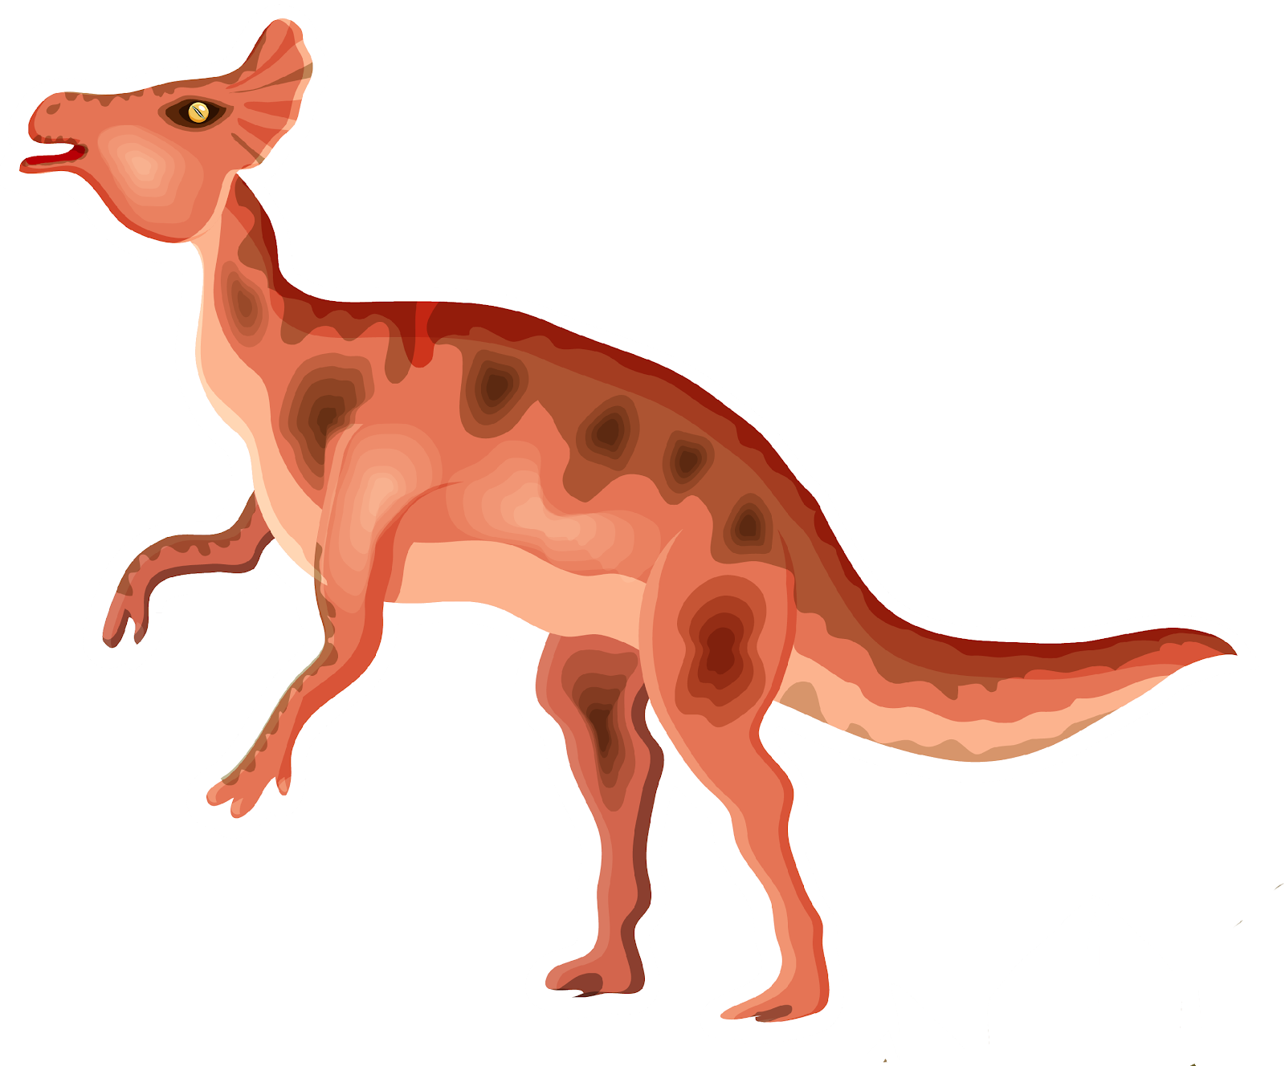
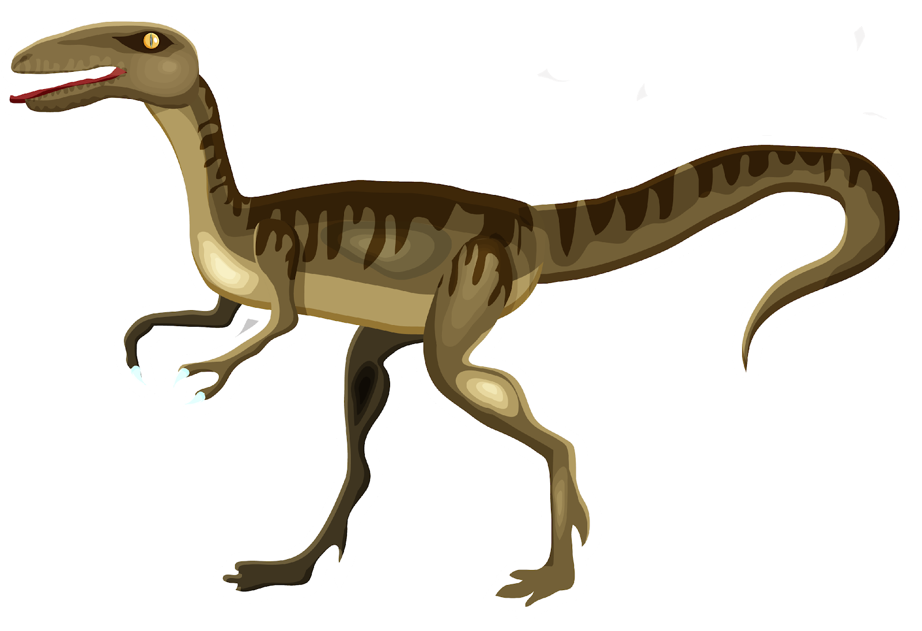
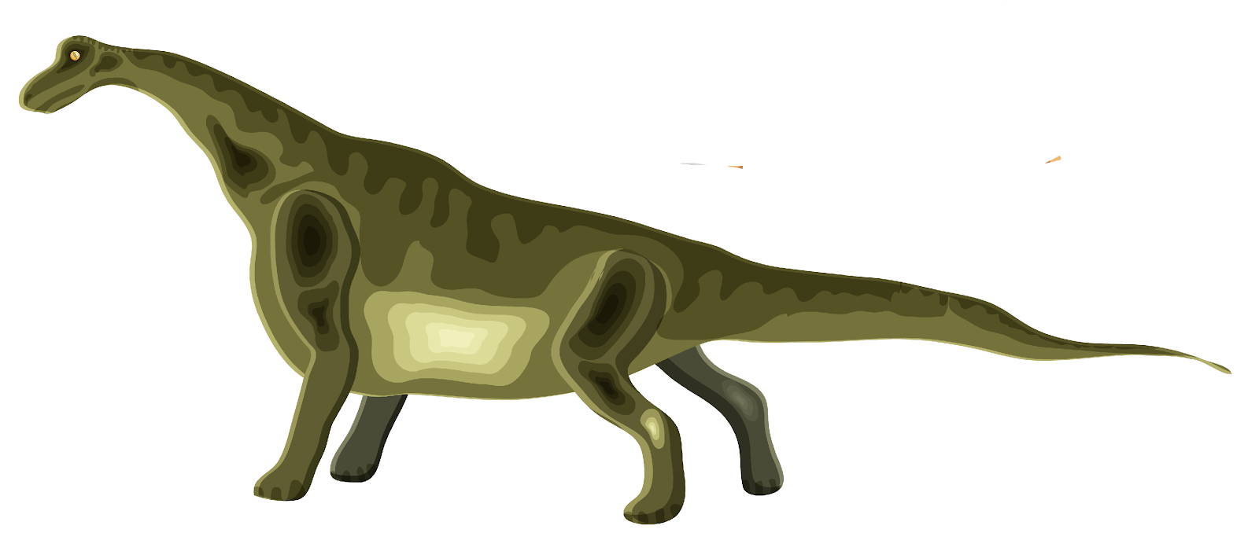

Slide 13
Agenda
Setting Up for Success with Remote Instruction
Phonological Awareness and Phonics Instruction
Fluency Practice
Teaching Writing
Building Comprehension
Q&A
©2020 Right to Read Project

Slide 14
Phonological Awareness
and
Phonics Instruction

Slide 15
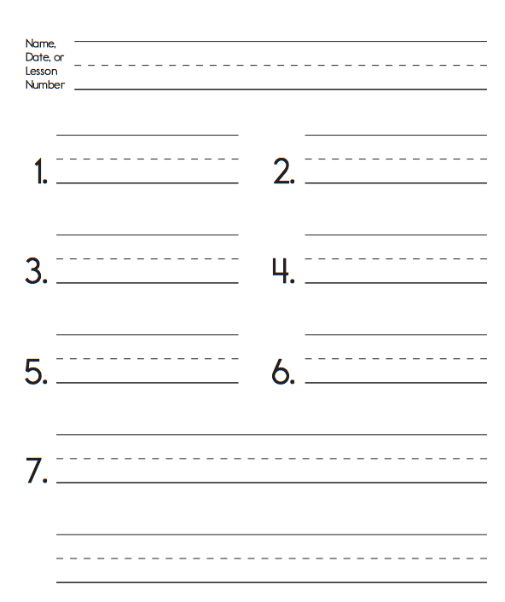
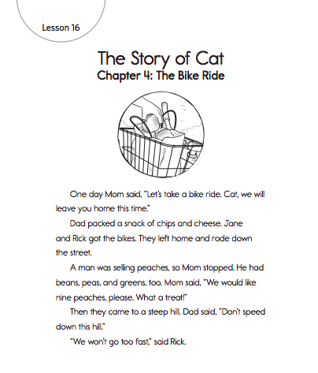
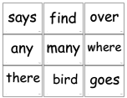
Phonemic Awareness
Sounds
Guided Spelling
Mixed List
Reading a Story
Sight Words
Fluency

Slide 16
Agenda
Setting Up for Success with Remote Instruction
Phonological Awareness and Phonics Instruction
Fluency Practice
Teaching Writing
Building Comprehension
Q&A
©2020 Right to Read Project

Slide 17
Fluency Practice
(and Reader’s Response)

Slide 18
Notes:
Asynchronous work: Fluency Practice

Slide 19
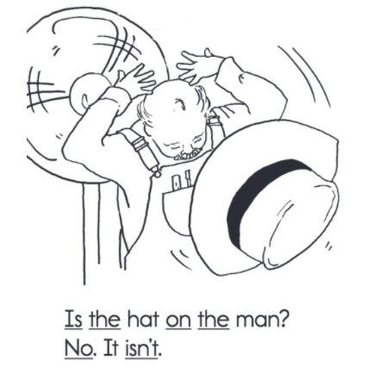
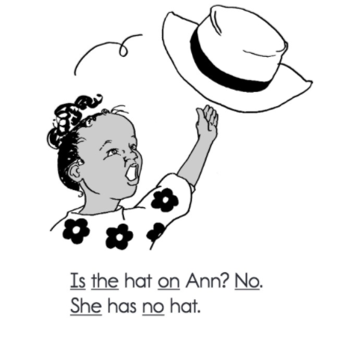
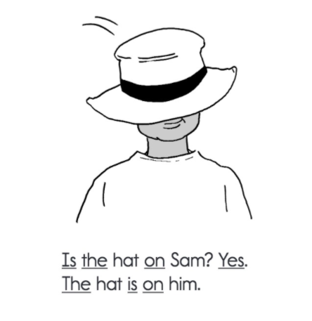
Notes:
Asynchronous work: Comprehension

Slide 20
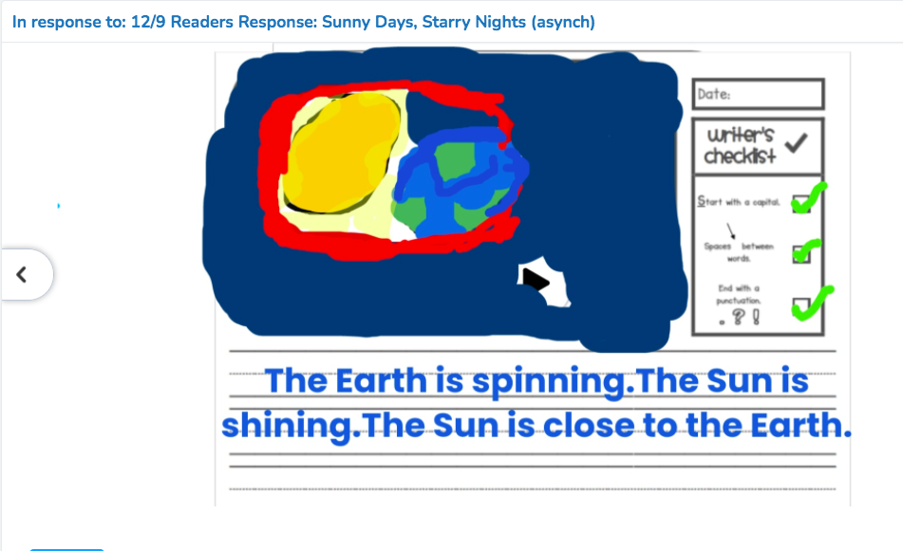

Slide 21
Agenda
Setting Up for Success with Remote Instruction
Phonological Awareness and Phonics Instruction
Fluency Practice
Teaching Writing
Building Comprehension
Q&A
©2020 Right to Read Project

Slide 22
Teaching Writing

Slide 23
It is ____.
The _____, _____ sun is ____.
The sun sees ______________.

Slide 24
Think, Then Draw and Write on Your Whiteboard
Word Bank:
morning
sunrise
bright
fiery
What time is it?
What does the sun look like?
Where in the sky is the sun?
What does the sun “see”?

Slide 25
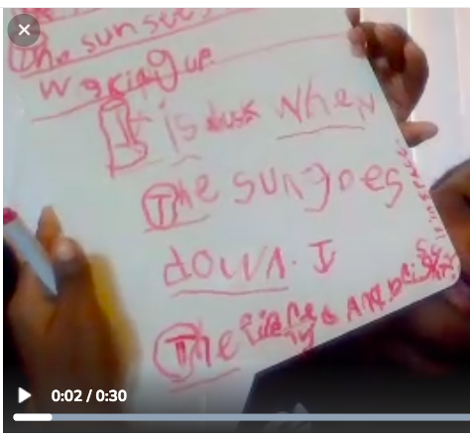

Slide 26
Now we will revise our work to make sure it is high-quality.
revise: to improve, make better

Slide 27
Possibly
Yes
No

Slide 28
Think to yourself.
Look for evidence in your poem.
Use your color cards to tell us what you find.
Details | Yes Possibly No | Evidence
Descriptions make sense and create a picture in the reader’s mind.

Slide 29
What can you do to add description to your poem?

Slide 30
I can provide kind, helpful, and specific feedback to my classmates.
clear suggestions with evidence

Slide 31
Cairo
Details | Yes Possibly No | Evidence
Descriptions make sense and create a picture in the reader’s mind. Uses adjectives. |  | He used the words “fiery” and “bright” and “round.” He described owls waking up at dusk.
Correctly spells sight words.
Uses complete sentences with the first word capitalized and ending punctuation.

Slide 32
Compliment(s)
Suggestion
I liked the adjectives that you used, like “fiery,” “bright” and
“round.”
I liked it because I could picture owls waking up at dusk.
You could add more description to the middle verse so that we can imagine what the sun sees in the afternoon. (Saige)

Slide 33
Cairo

Slide 34
Give a classmate a compliment on their work in Seesaw.

Slide 35
Agenda
Setting Up for Success with Remote Instruction
Phonological Awareness and Phonics Instruction
Fluency Practice
Teaching Writing
Building Comprehension
Q&A
©2020 Right to Read Project

Slide 36
Building Comprehension

Slide 37
Agenda
Setting Up for Success with Remote Instruction
Phonological Awareness and Phonics Instruction
Fluency Practice
Teaching Writing
Building Comprehension
Q&A
©2020 Right to Read Project

Slide 39
I can distinguish what I learn from the illustrations and what I learn from the text in the book What Makes Day and Night to describe the pattern of light and dark on earth.

Slide 40
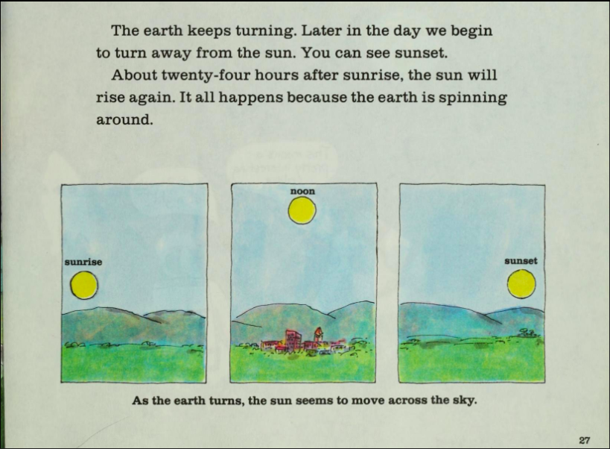

Slide 41
I can distinguish what I learn from the illustrations and what I learn from the text in the book What Makes Day and Night to describe the pattern of light and dark on earth.

Slide 43
I can distinguish what I learn from the illustrations and what I learn from the text in the book What Makes Day and Night to describe the pattern of light and dark on earth.
distinguish: tell the difference between

Slide 44
What did we learn from the text?
I learned...

Slide 45
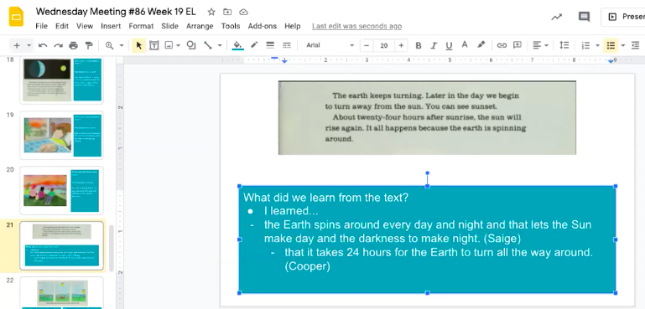
Notes:
What’s on my computer

Slide 46
What did we learn from the text?
I learned...
What did we learn from the illustrations?
The illustrations show...

Slide 47
What did we learn from the text?
I learned...
the Earth moves
the Sun seems to move but it is not moving
What did we learn from the illustrations?
The illustrations show…
the sun seems like it is moving
across the sky.
Notes:
Snippet of 1st grade instruction

Slide 48
Snippet of 1st grade instruction
Notes:
If this is helpful, here’s a bit of instruction

Slide 49
Agenda
Setting Up for Success with Remote Instruction
Phonological Awareness and Phonics Instruction
Fluency Practice
Teaching Writing
Building Comprehension
Q&A
©2020 Right to Read Project

Slide 50
Q&A

Slide 51
Margaret Goldberg
margaret@righttoreadproject.com
@right2readproj

