Slide 1
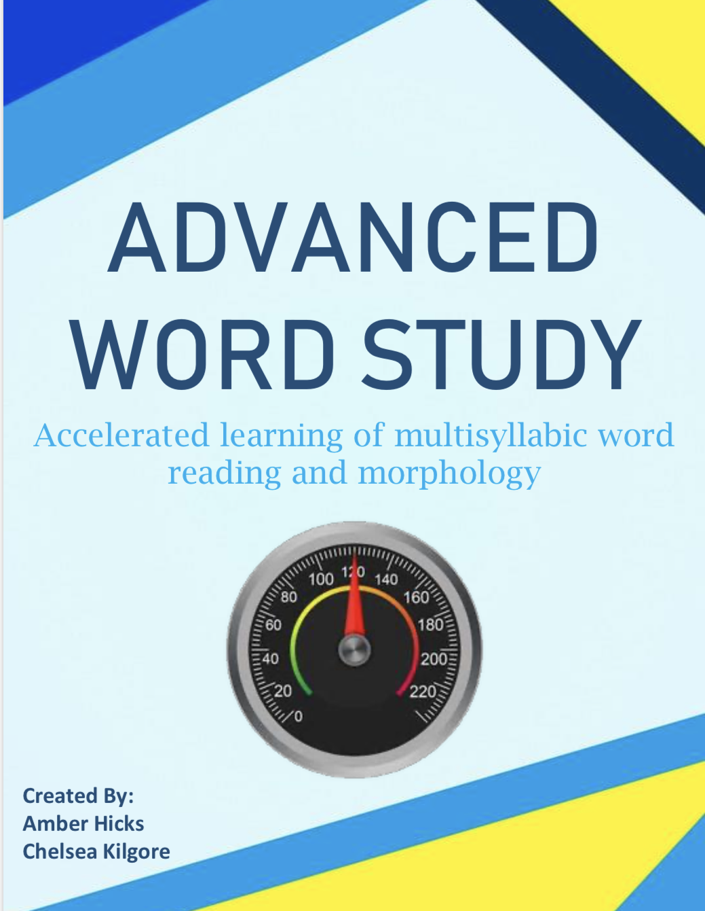
Advanced Word Study
Accelerated Learning of Multisyllabic Word Reading and Morphology
Document Guidance 2020-2021
Division of Literacy
Office of Elementary Education and Reading
601-359-2586
Notes:
Hello. My name is Amber Hicks. I am a Literacy Coach with the Mississippi Department of Education, Office of Elementary Education and Reading. Today, I will introduce a new resource that is being add to the MDE Website. We will discuss the document “Advanced Word Study-Accelerated Learning of multisyllabic word reading and morphology.

Slide 2
Mississippi Department of Education
Vision:
To Create A World-Class Educational System That Gives Students The Knowledge And Skills To Be Successful In College And The Workforce, And To Flourish As Parents And Citizens
Mission:
To Provide Leadership Through The Development Of Policy And Accountability Systems So That All Students Are Prepared To Compete In The Global Community
Notes:
First, lets view the Vision and Mission.
The Vision.
To create a world-class educational system that gives students the knowledge and skills to be successful in college and the workforce, and to flourish as parents and citizens.
The Mission.
To provide leadership through the development of policy and accountability systems so that all students are prepared to compete in the global community

Slide 3
State Board of Education Goals STRATEGIC PLAN
Goals:
All Students Proficient and Showing Growth in All Assessed Areas
Every Student Graduates from High School and is Ready for College and Career
Every Child Has Access to a High-Quality Early Childhood Program
Every School Has Effective Teachers and Leaders
Every Community Effectively Using a World-Class Data System to Improve Student Outcomes
Every School and District is Rated “C” or Higher
Notes:
Now, let’s look at the State Board of Education Goals. The Board has developed a Strategic Plan that includes six goals. Today’s presentation will focus on Goals 1 and 4:
Goal 4: Every School has effective teachers and leaders which impacts
Goal 1: All Students Proficient and Showing Growth in All Assessed Areas

Slide 4
Session Goals
Discuss the purpose and intended audience of advanced phonics instruction
Examine each component of the Advanced Word Study resource
Explore how to implement the Advanced Word Study resources with students
Notes:
Our session goals are to:
Discuss the purpose and intended audience of advanced phonics instruction.
Examine each component of the Advanced Word Study resource.
And to Explore how to implement the Advanced Word Study resources with students.

Slide 5
Why and For Whom?
Advanced Word Study
Notes:
To begin, let’s look at why Advanced Word Study is important and the grade levels we provide this instruction to.

Slide 6
Why Advanced Phonics?
Multisyllabic Word Reading
Improves the ability to decode unknown multisyllabic words
Breaks larger words into smaller more manageable parts
Morphology
Separates word parts in order to assist in understanding the meaning of unknown words
Notes:
Multisyllabic word reading instruction or advanced phonics as it is sometimes called improves the ability to decode unknown multisyllabic words. With explicit and systematic instruction, students are supported in learning how to break larger words into smaller more manageable parts.
Morphology is the meaningful study of word parts. With morphology instruction, students use knowledge about separate word parts in order to assist in understanding the meaning of unknown words.

Slide 7
Who Should Receive Advanced Phonics Instruction?
3rd Grade
RF.3.a Identify and know the meaning of the most common prefixes and derivational suffixes
RF.3.b Decode words with common Latin suffixes
RF.3.3c Decode multisyllable words
4th Grade
RF.4.3a Use combined knowledge of all letter-sound correspondences, syllabication patterns, and morphology to read accurately unfamiliar multisyllabic words in context and out of context
Notes:
Students in 3rd and 4th grade should receive explicit and systematic advanced phonics or word study instruction. The Mississippi College and Career Readiness Standards has identified three foundational standards for third grade which are identifying and knowing the meaning of the most common prefixes and derivational suffixes, decoding words with common Latin suffixes and decoding multisyllable words. In 4th grade there is one foundational standard which is to use combined knowledge of letter-sound correspondences, syllabication patterns, and morphology to read accurately unfamiliar multisyllabic words in context and out of context.

Slide 8
Resource Purpose
Advanced Word Study
Notes:
Now, let’s dive into the purpose of the Advanced Word Study resource.

Slide 9
Resource Purpose and Implementation
The purpose of this resource is to support teachers in providing accelerated advanced phonics instruction due to the State of Emergency school closures in 2020.
It was created for teachers to implement with students that demonstrate little to no advanced phonics knowledge.
Notes:
The purpose of this resource is to support teachers in providing advanced phonics instruction in an accelerated manner to students to help fill the gap that may be missing due to the State of Emergency school closure that happened this past year due to COVID-19. It was designed to be implemented with students that may demonstrate little to no advanced phonics knowledge.

Slide 10
Resource Purpose and Implementation
It is not a one size fits all for struggling readers.
It is not intended to replace any published curriculum.
Students should have present and consistent support from instructional staff during each lesson component. This was not designed to be independent seat work.
Notes:
The Advanced Word Study document is not a one size fits all for struggling readers. It is not intended to replace any published curriculum. Additionally, the resource components call for direct, explicit instruction that require consistent support from the instructional staff. It was not designed to be independent seat work.

Slide 11
Scope and Sequence
Advanced Word Study
Notes:
Now we are going to explore the Scope and Sequence for the Advanced Word Study Document.

Slide 12
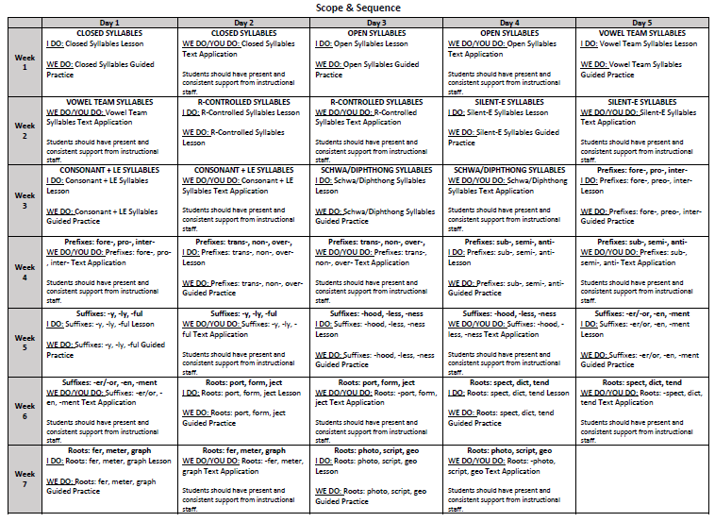
Scope and Sequence
Notes:
The document contains 7 weeks of accelerated instruction. Three weeks are spent studying the syllable types. 2 weeks provide instruction with affixes and then the last 2 weeks are focused on roots. The lessons were created to be implemented over a two-day period. Day 1 includes the teacher modeling followed up with guided practice. Day 2 reviews with additional guided practice followed up with independent practice through text application. Each lesson should take about thirty minutes to complete. This could vary depending on the needs of the students.

Slide 13
Lesson Outline
Advanced Word Study
Notes:
Let’s take a look at the lesson itself.

Slide 14
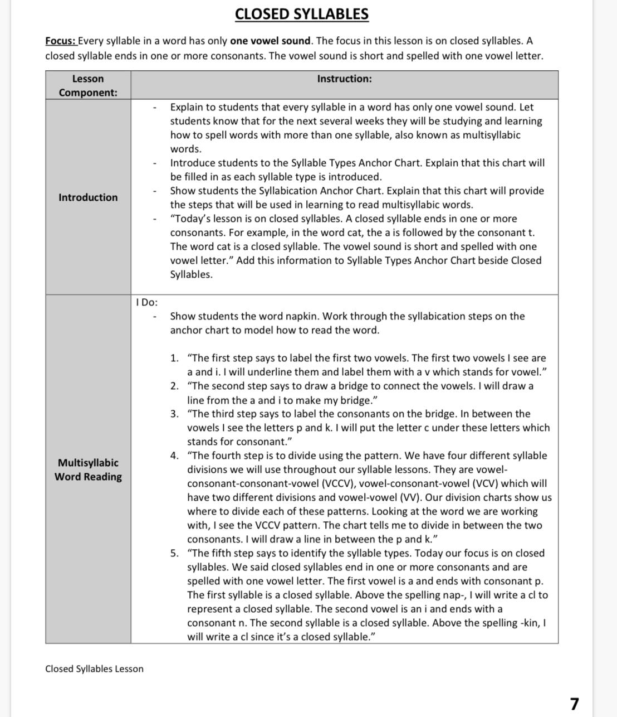
The Lesson
The lesson contains a detailed script to assist teachers with limited content knowledge on advanced phonics.
Notes:
Each lesson in the document contains a detailed script to assist teachers with limited content knowledge on advanced phonics.

Slide 15
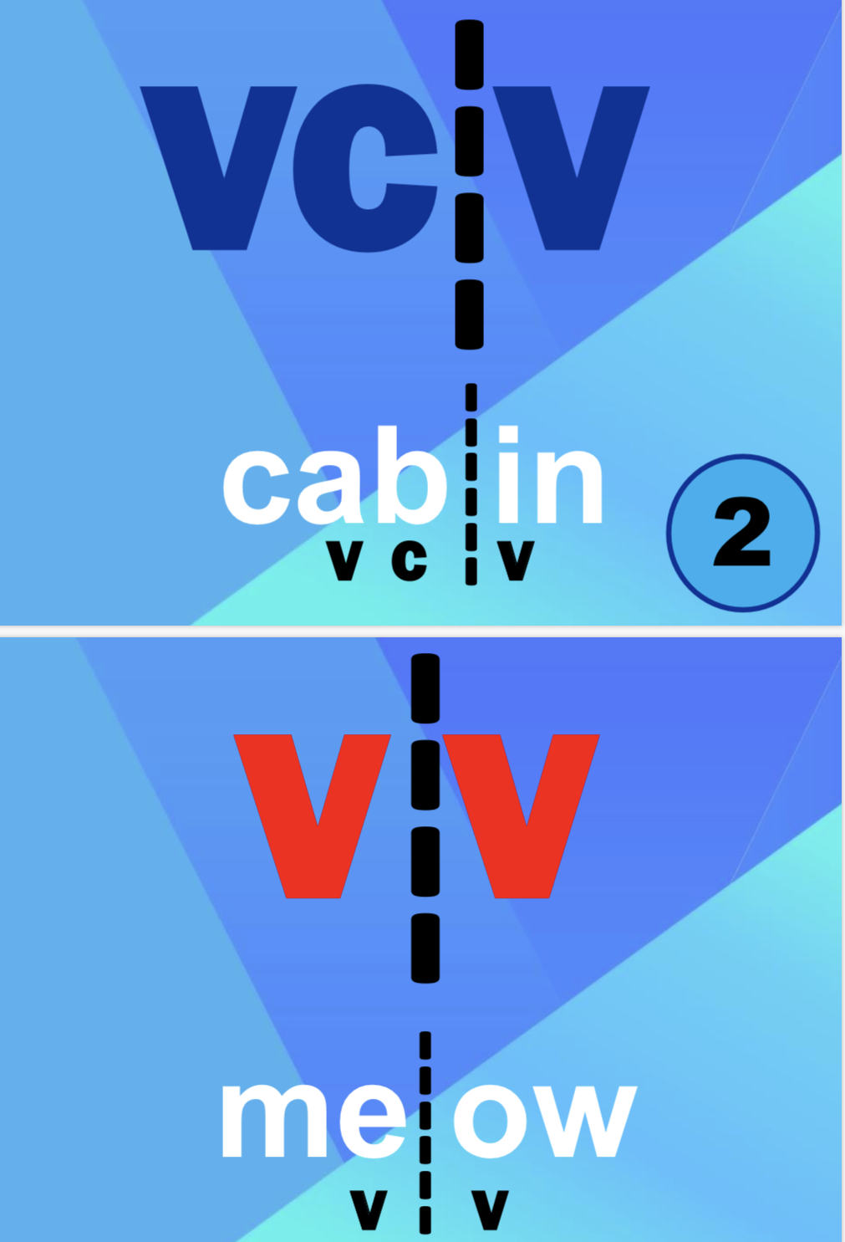
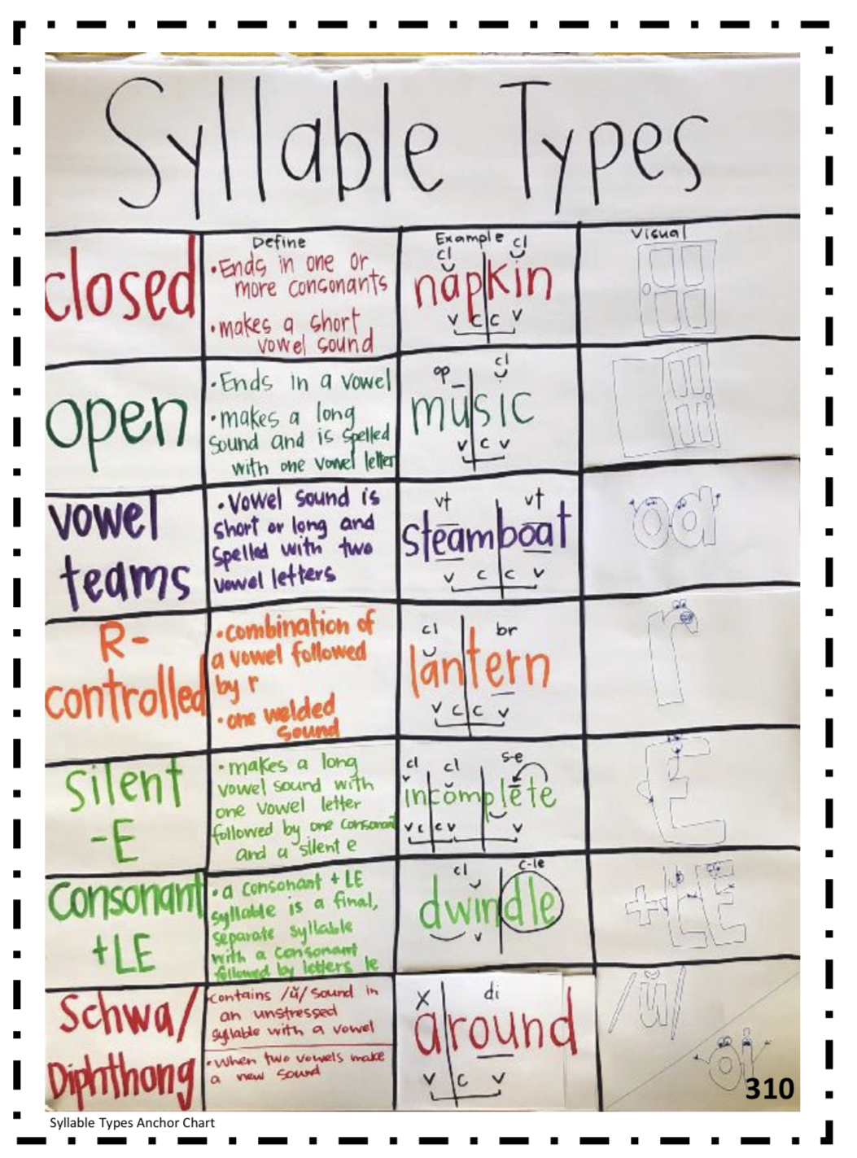
The Lesson
Lessons will reference the use of visual aids found in the Appendices. (pg. 307)
Notes:
The lessons will reference the use of several visual aids found in the appendices. These can be printed or recreated by teachers to use throughout the lessons. In the appendices, you will find anchor chart examples, syllable division posters, morphology base explanation poster, along with other resources.

Slide 16
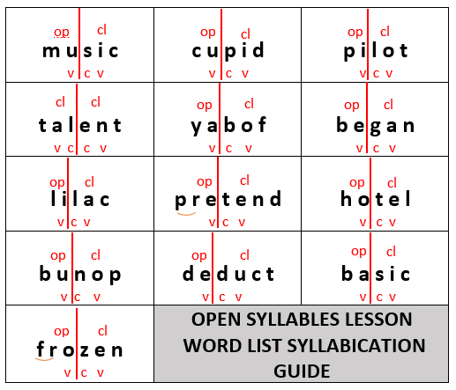
The Lesson
Each lesson also provides an answer key to assist teachers in accuracy.
Notes:
Each lesson also provides an answer key to assist teachers in accurately dividing words into syllables and for deconstructing the words correctly in the affixes and roots lessons. The goal for the answer keys are for teachers to practice, prepare and check their understanding before delivering the instruction to the students.

Slide 17
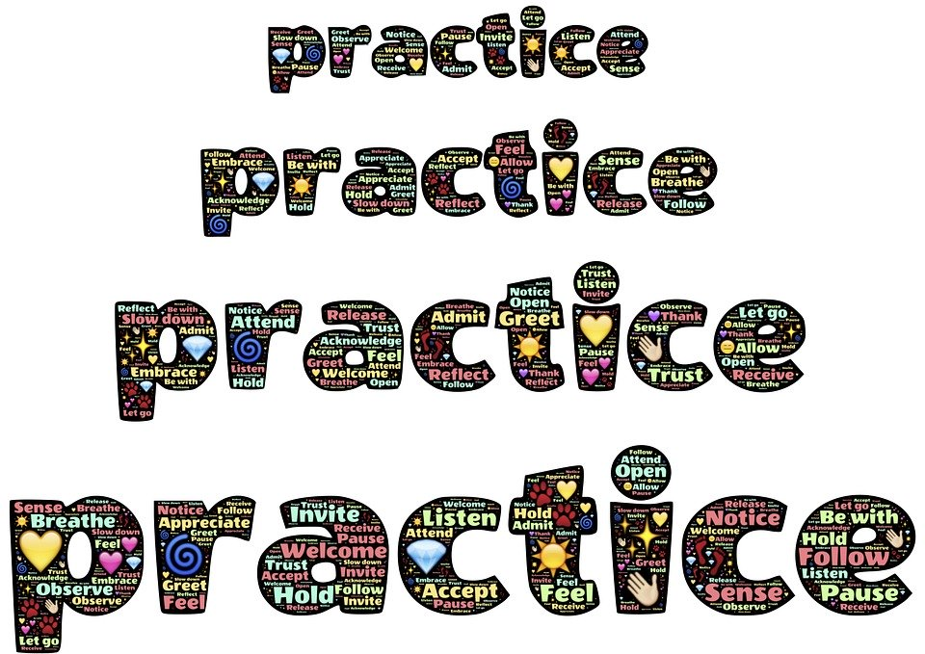
Guided Practice
Advanced Word Study
Notes:
Hello. My name is Chelsea Kilgore. I am also a Literacy Coach with the Mississippi Department of Education. As we move forward, we will look at practice the Advanced Word Study Resource provides for students. Day 1 and Day 2’s lesson contains guided practice.

Slide 18
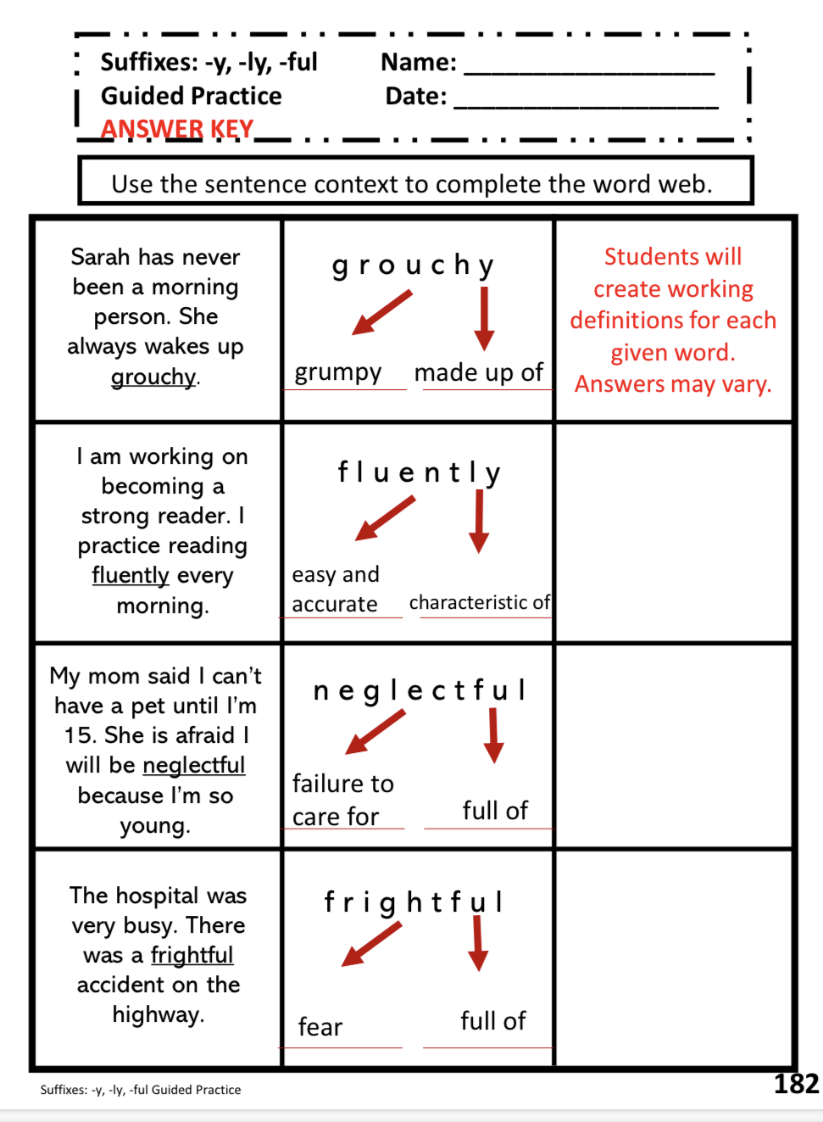
Guided Practice
Students apply concepts in isolation with a variety of multisyllabic words.
An answer key is available for each activity.
Notes:
With day 1’s guided practice, students will apply concepts in isolation with a variety of multisyllabic words. On day 2, the beginning of the instruction is additional guided practice in isolation. An answer key, again is provided for each activity. Each guided practice follows the same coding that is found in the I DO portion of the lesson for consistency throughout.

Slide 19
Independent Practice
Advanced Word Study
Notes:
Day 2’s guided practice is followed up with independent practice.

Slide 20
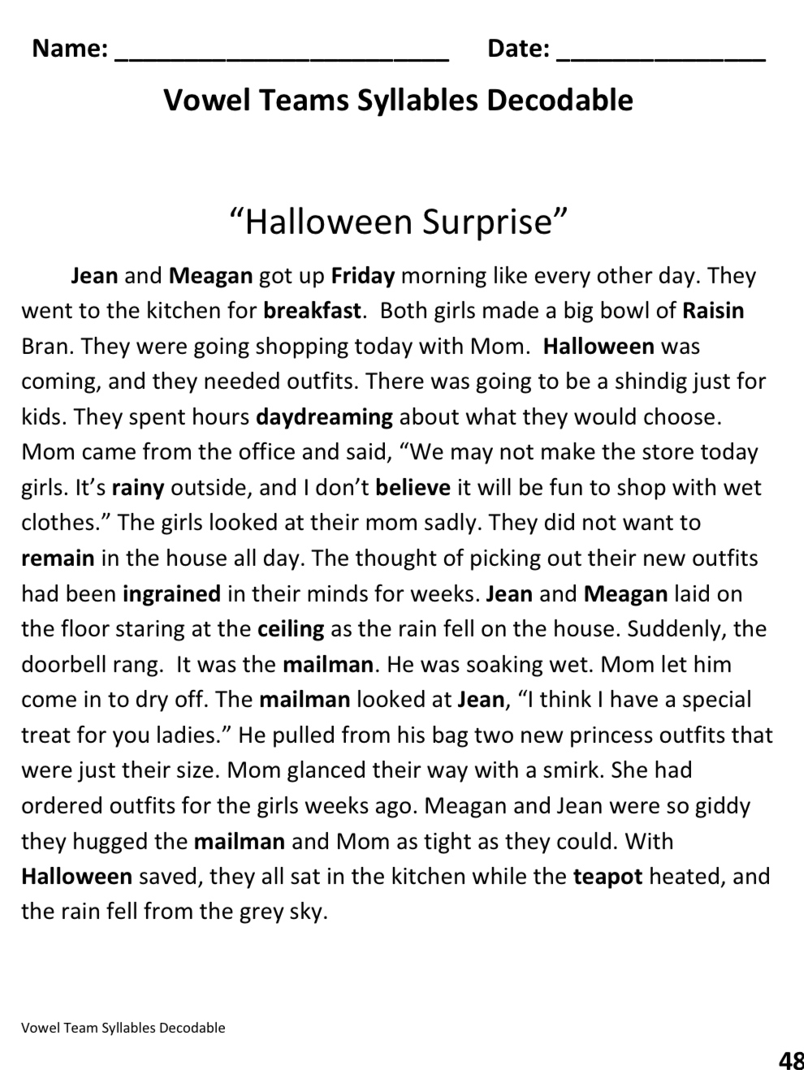
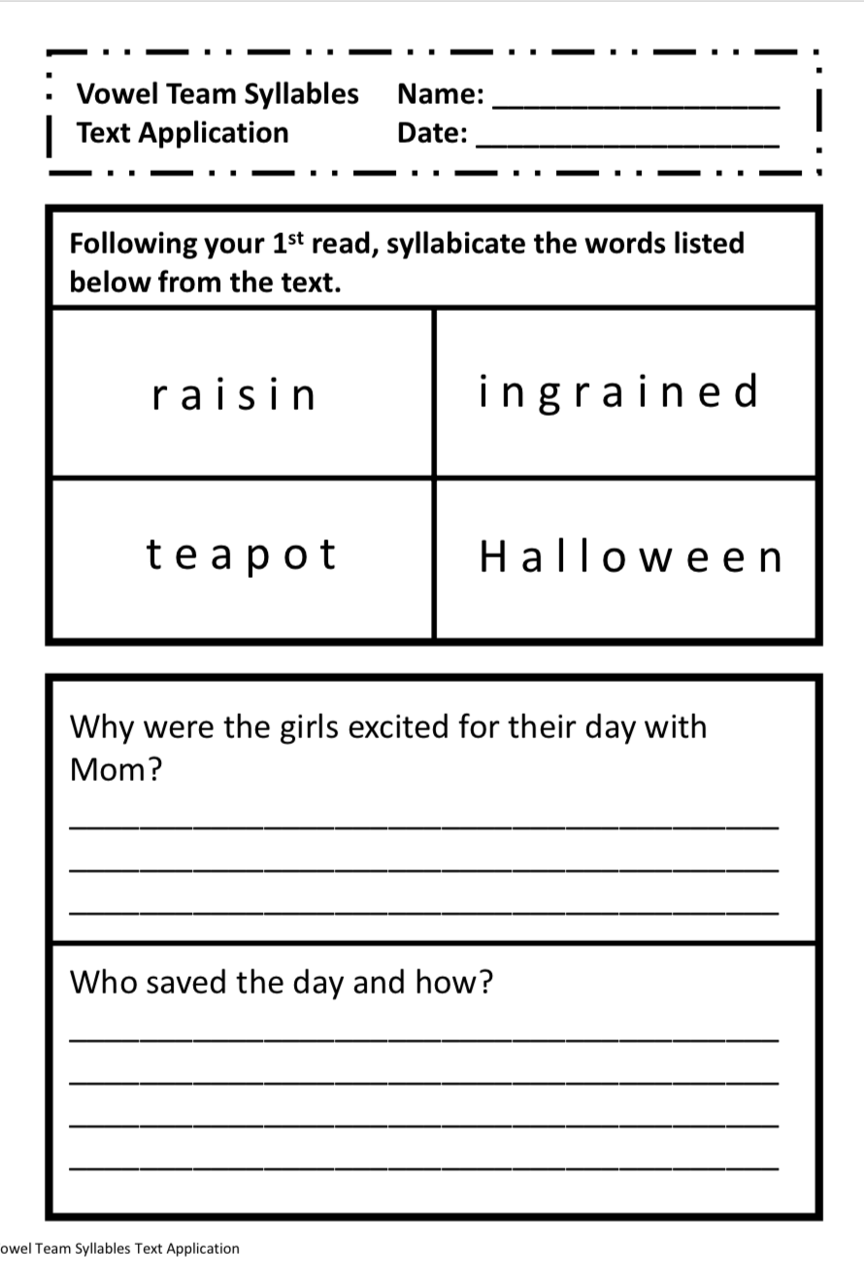
Independent Practice
Includes:
short decodable text
space to analyze word parts
text dependent questions
Notes:
The independent practice includes a short decodable text that includes a variety of multisyllabic words that fit the focus skill of each lesson. Prior to students answering text-dependent questions to check for understanding, students are asked to syllabicate chosen words from the text.

Slide 21
Additional Resources
Advanced Word Study
Notes:
There are a variety of resources that were created to support each of the multisyllabic lessons.

Slide 22
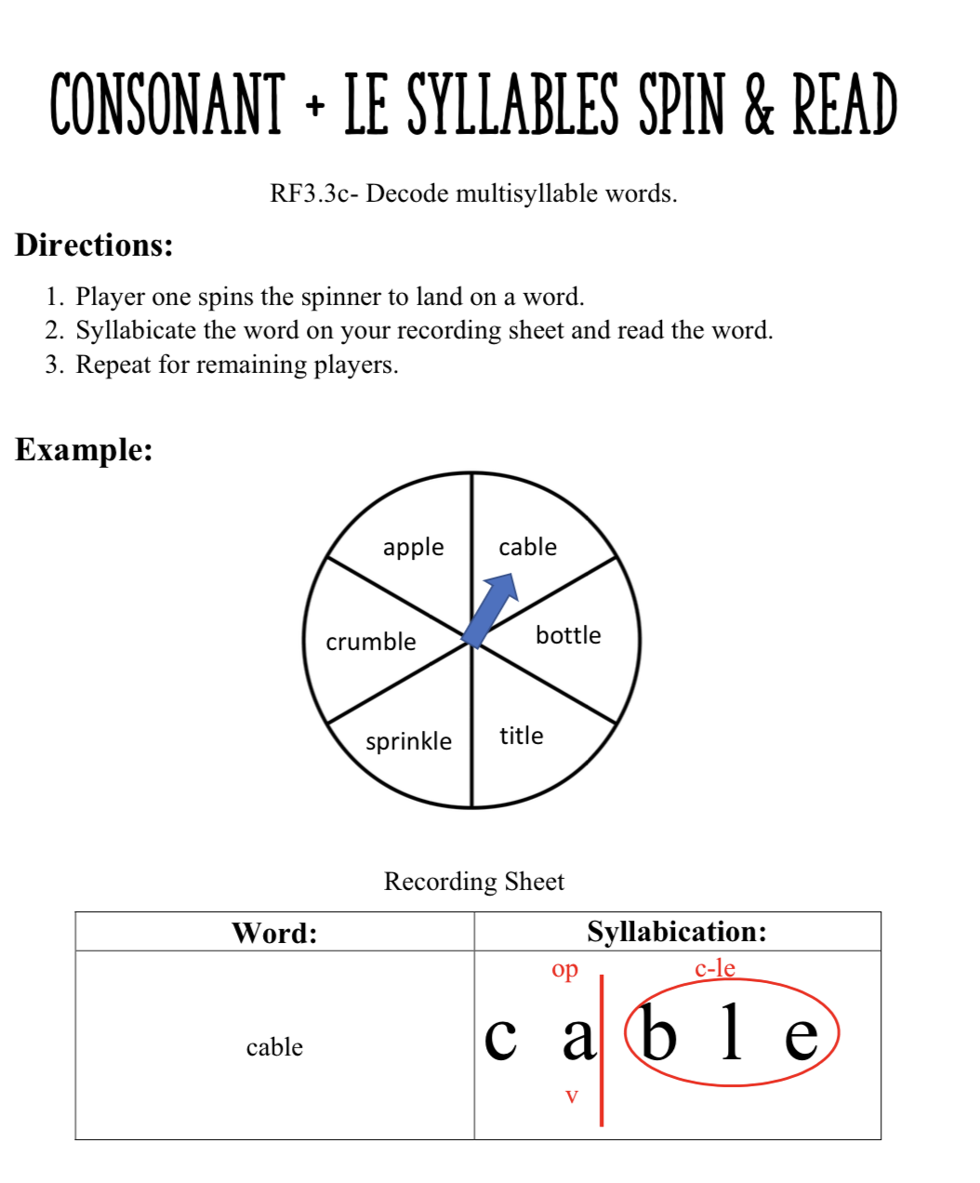
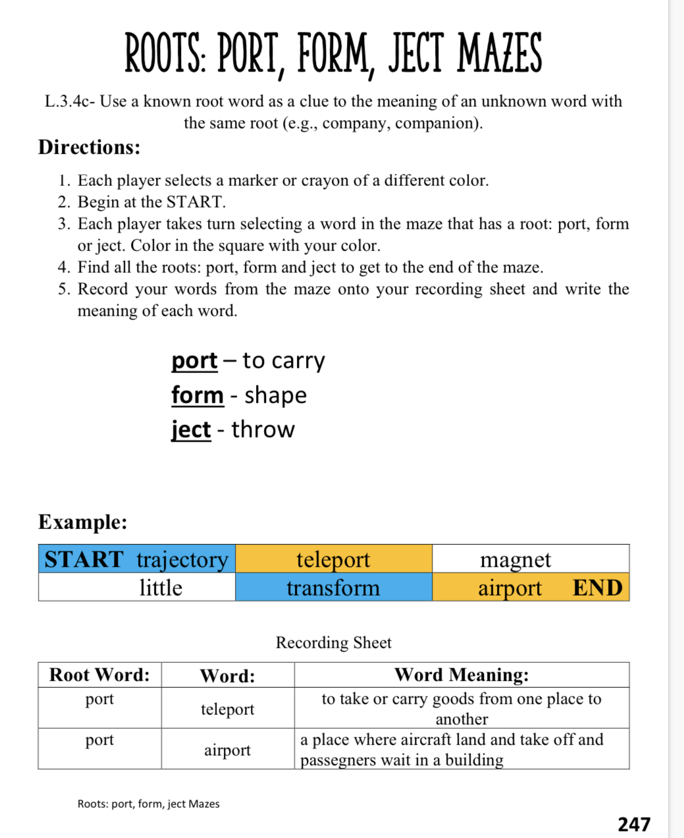
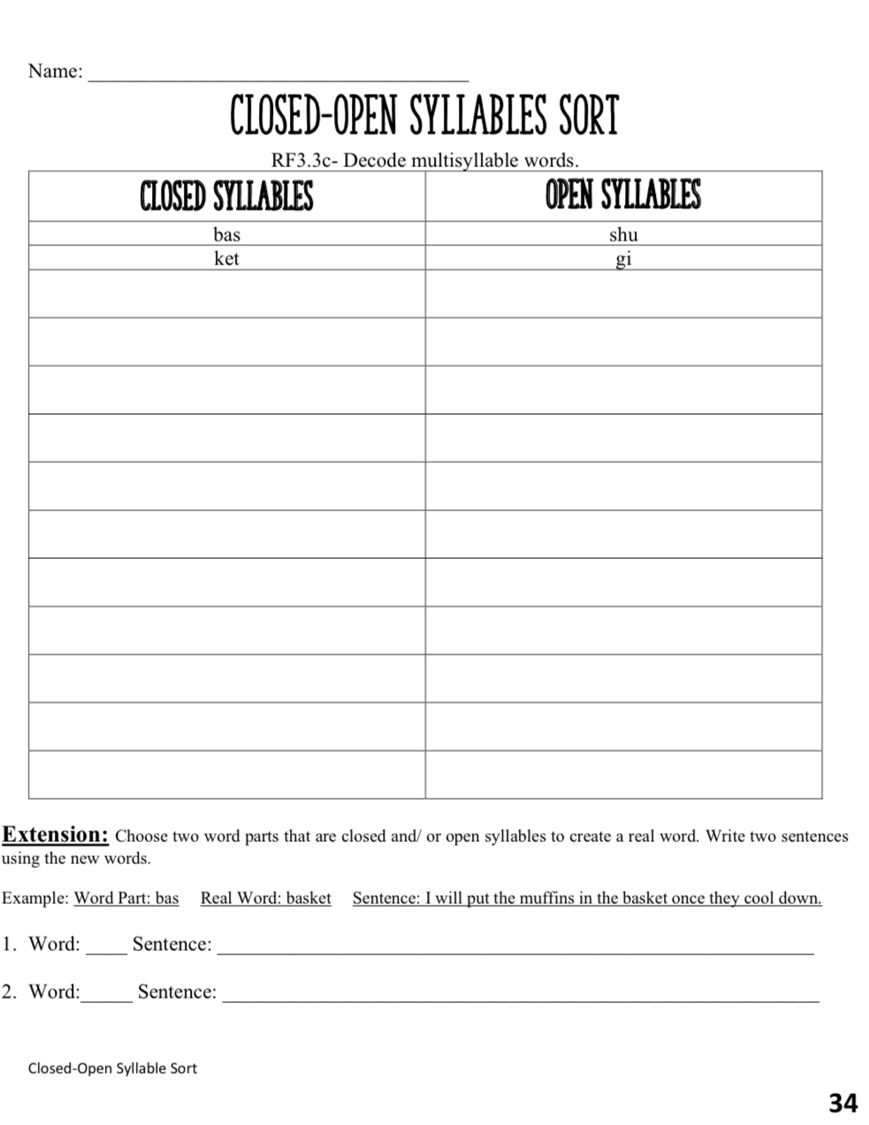
Center Activities
Support the students continued practice with multisyllabic words
Notes:
Each lesson has a center activity that supports the students in continued practice with multisyllabic words. The center activities are not listed in the scope and sequence but have been included to assist with additional practice if necessary.

Slide 23
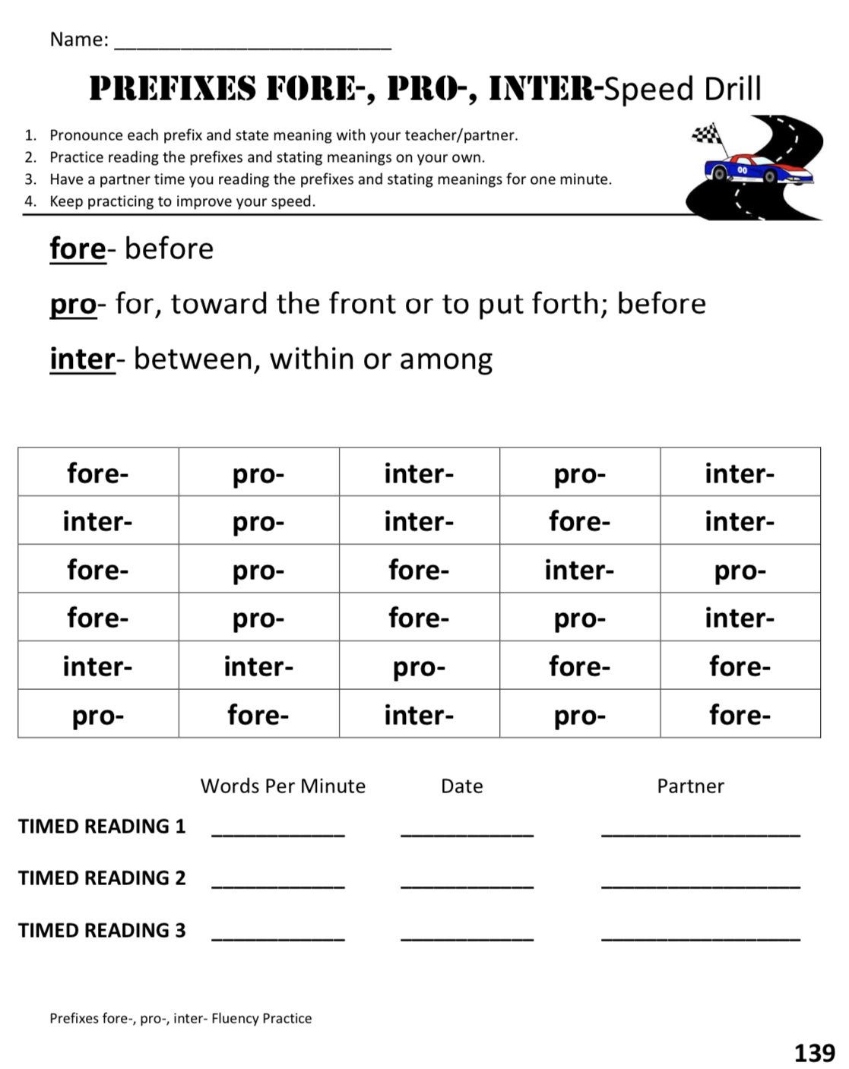
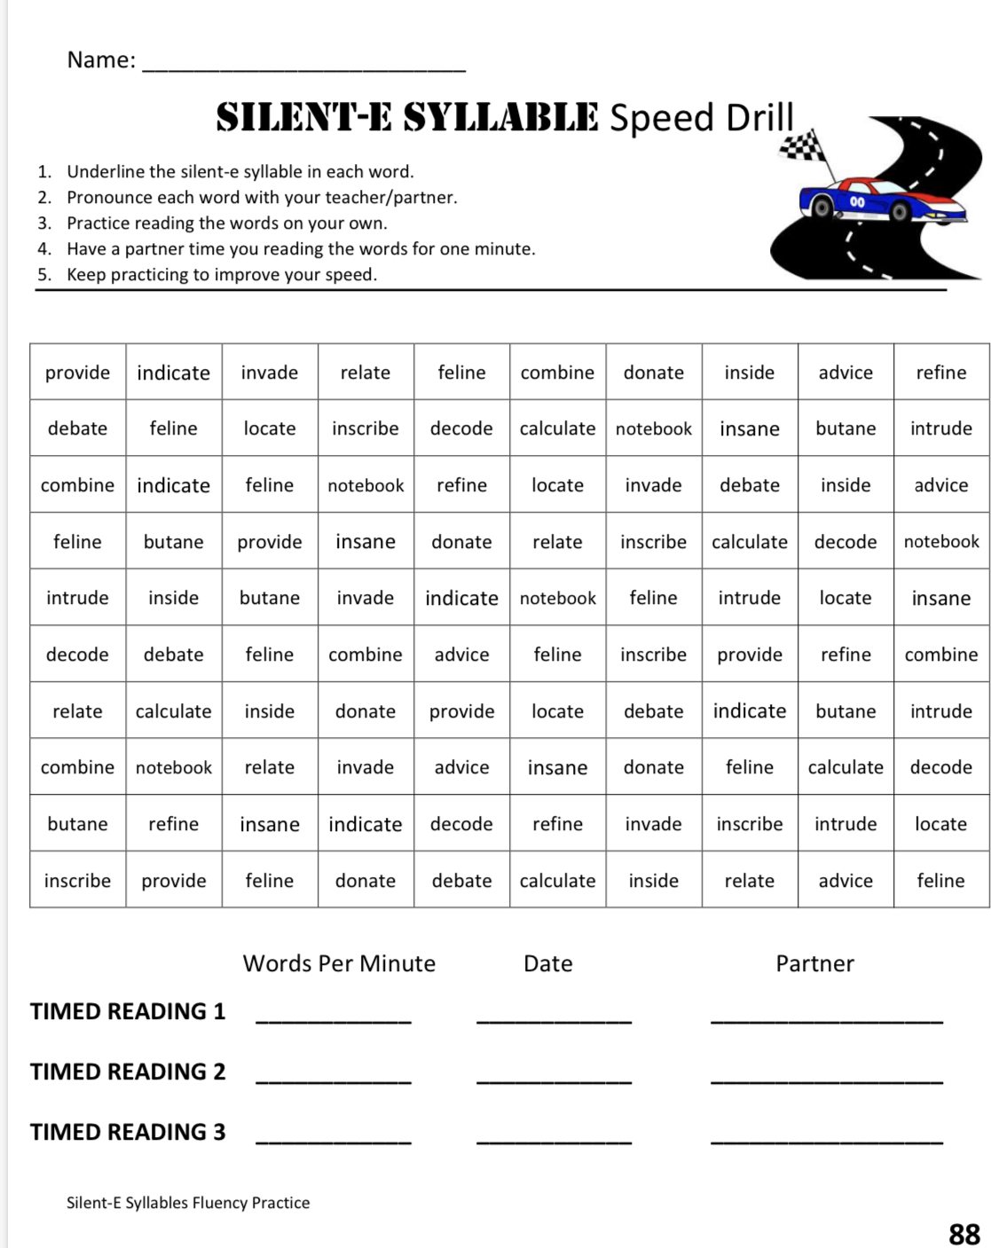
Speed Drills
Additional resources are available to build fluency on each lesson’s focus.
Notes:
Speed drills are an additional resource available for each lesson to build fluency on each lesson’s focus. These again, are not listed in the scope & sequence but are available if needed to support fluency instruction.

Slide 24
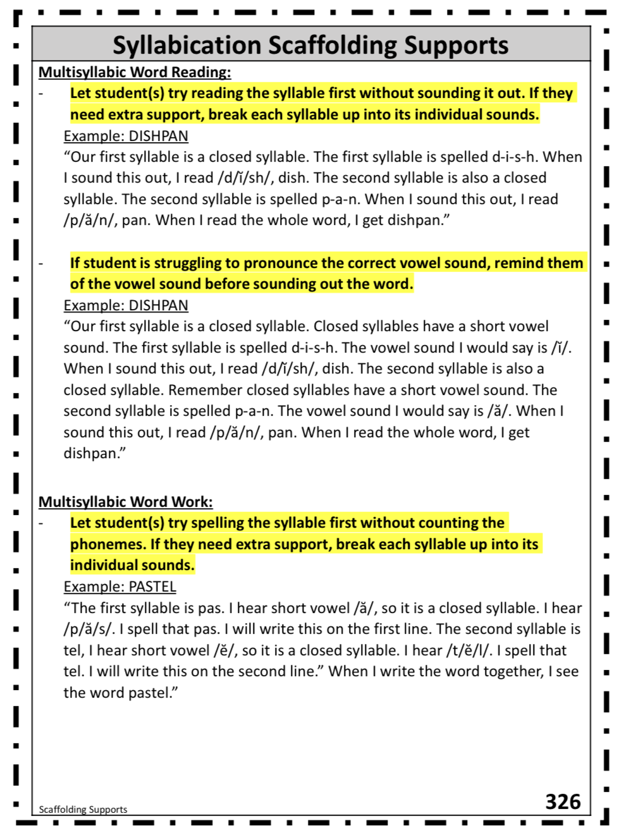
Scaffolding Supports
Notes:
There are a variety of resources found in the Appendices section of the document. One resource is the scaffolding supports for the syllabication and morphology instruction. This resource provides the teacher with strategies to support students if they are struggling with a particular component of the lesson.

Slide 25
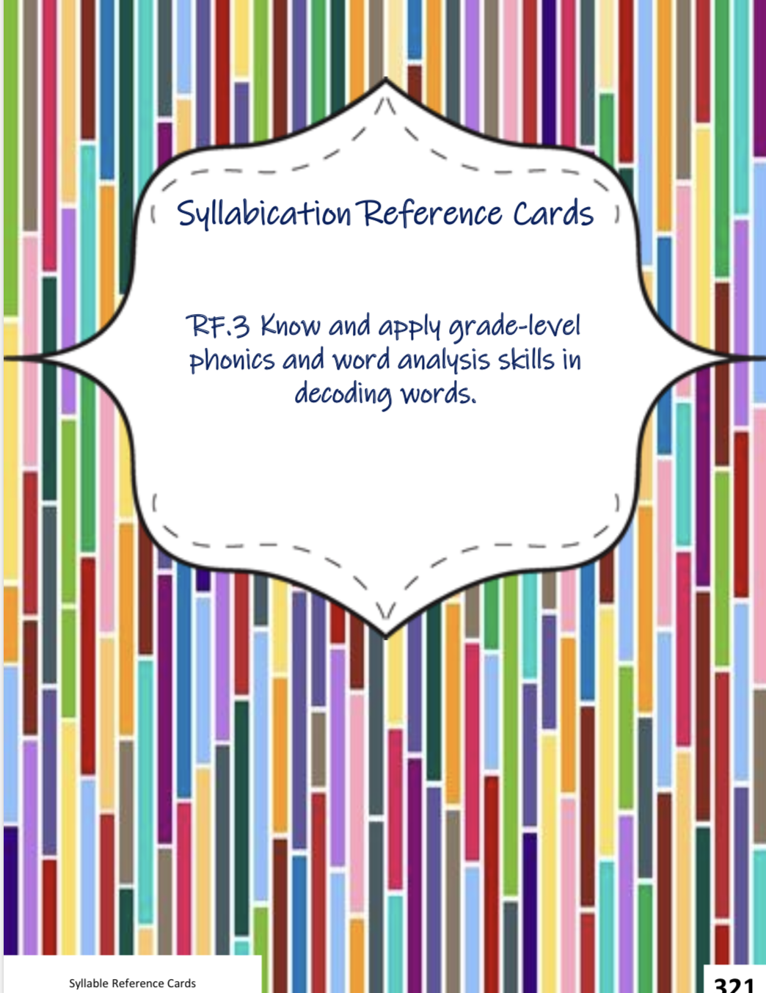
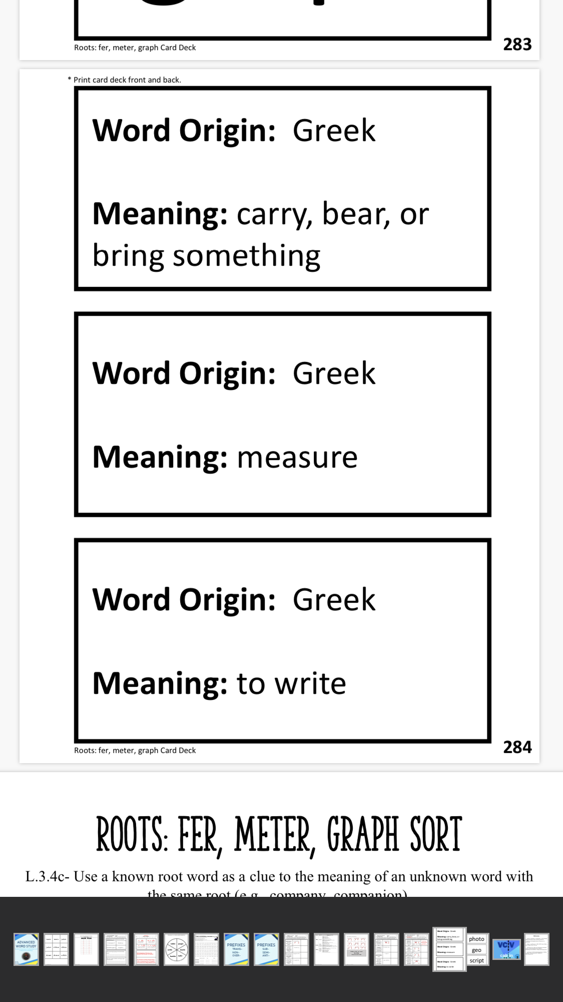
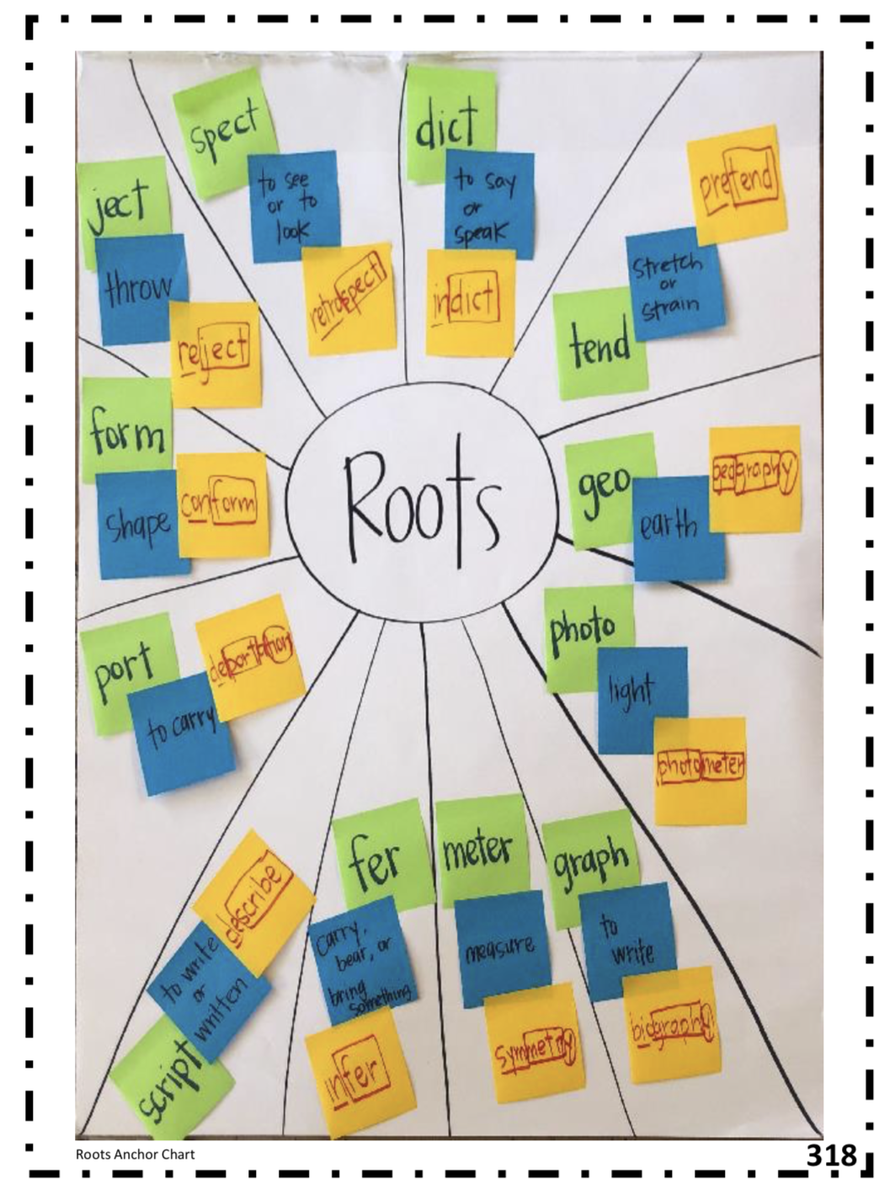
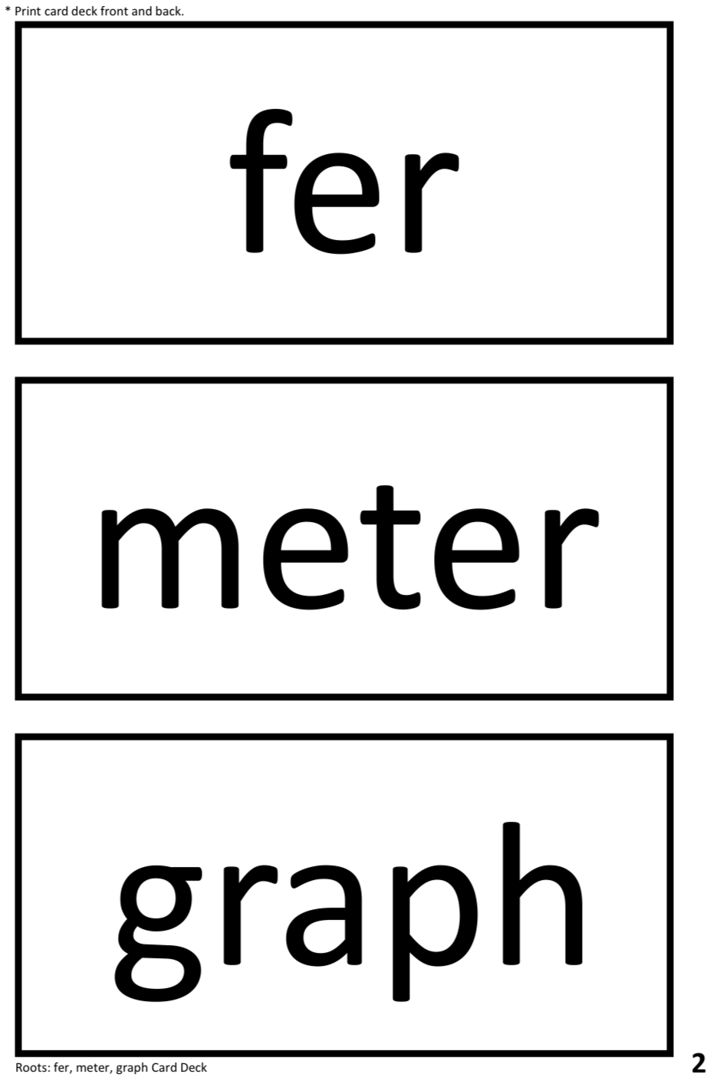
Visual Aids
Notes:
An assortment of visual aids can be found in the appendices. This includes reference cards for each syllable type, anchor chart examples that are to be used in each lesson, anchor charts that reflect the Syllabication or Morphology steps and morphology word wall cards.

Slide 26
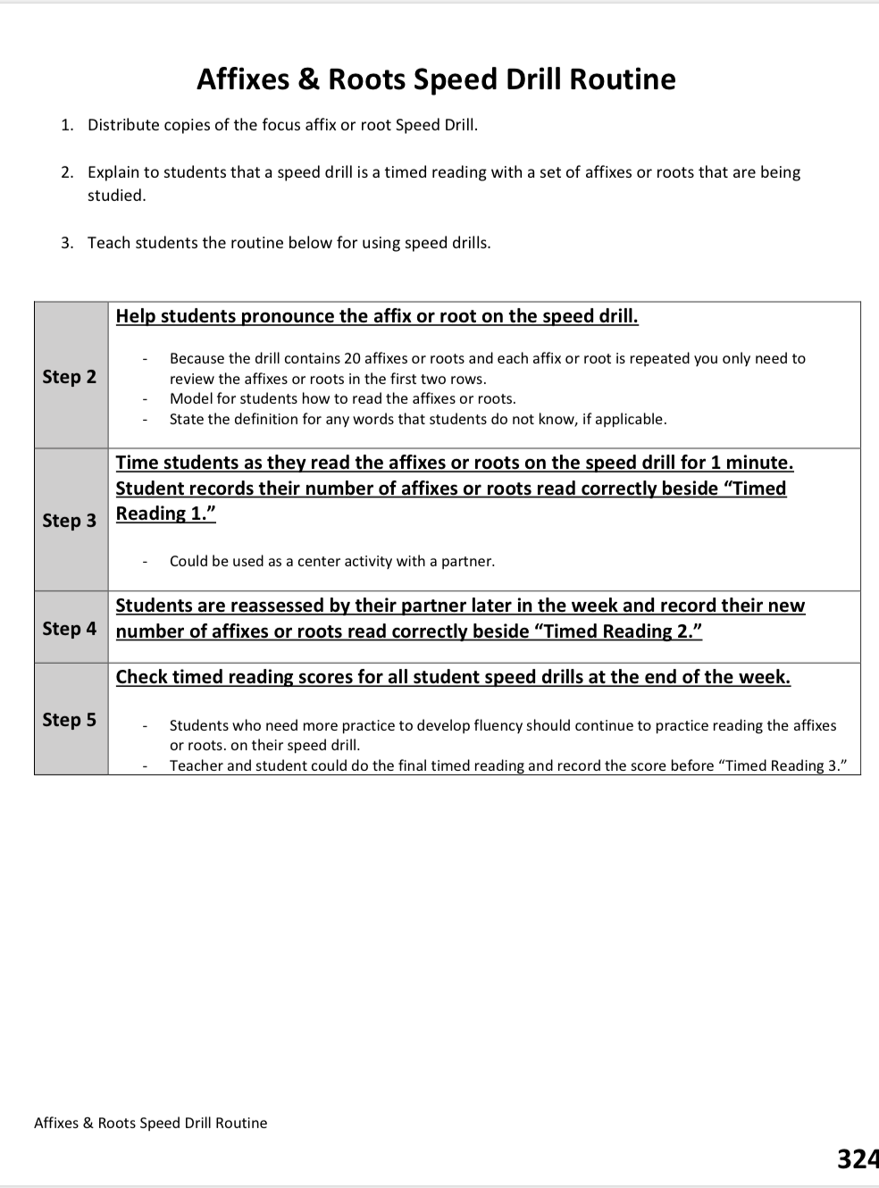
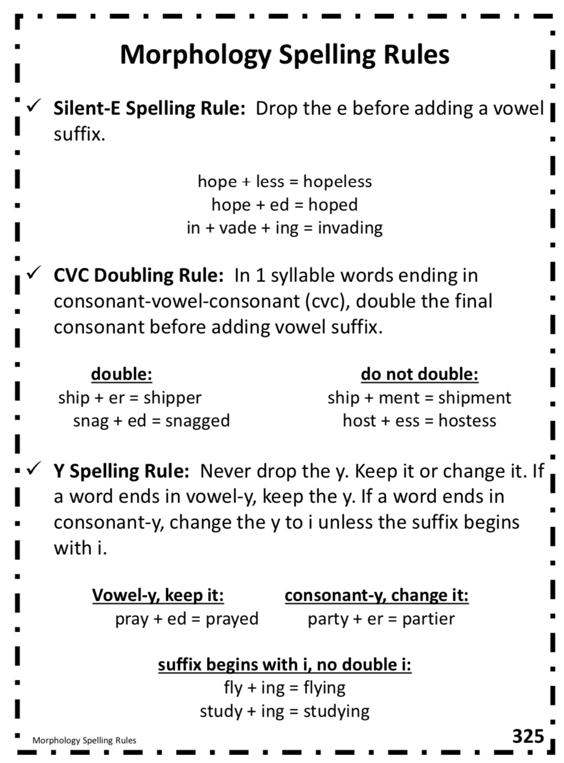
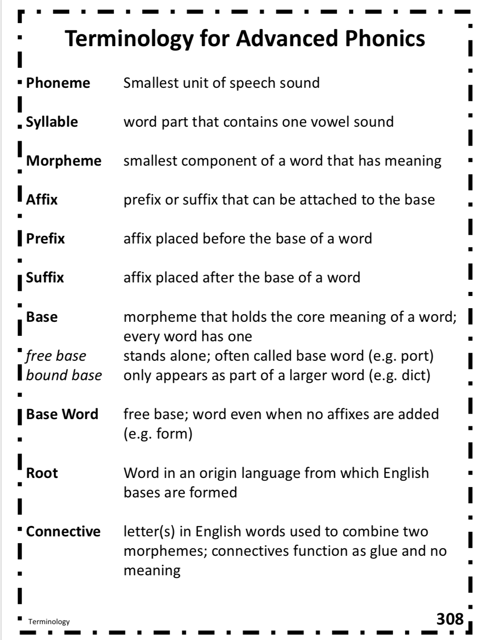
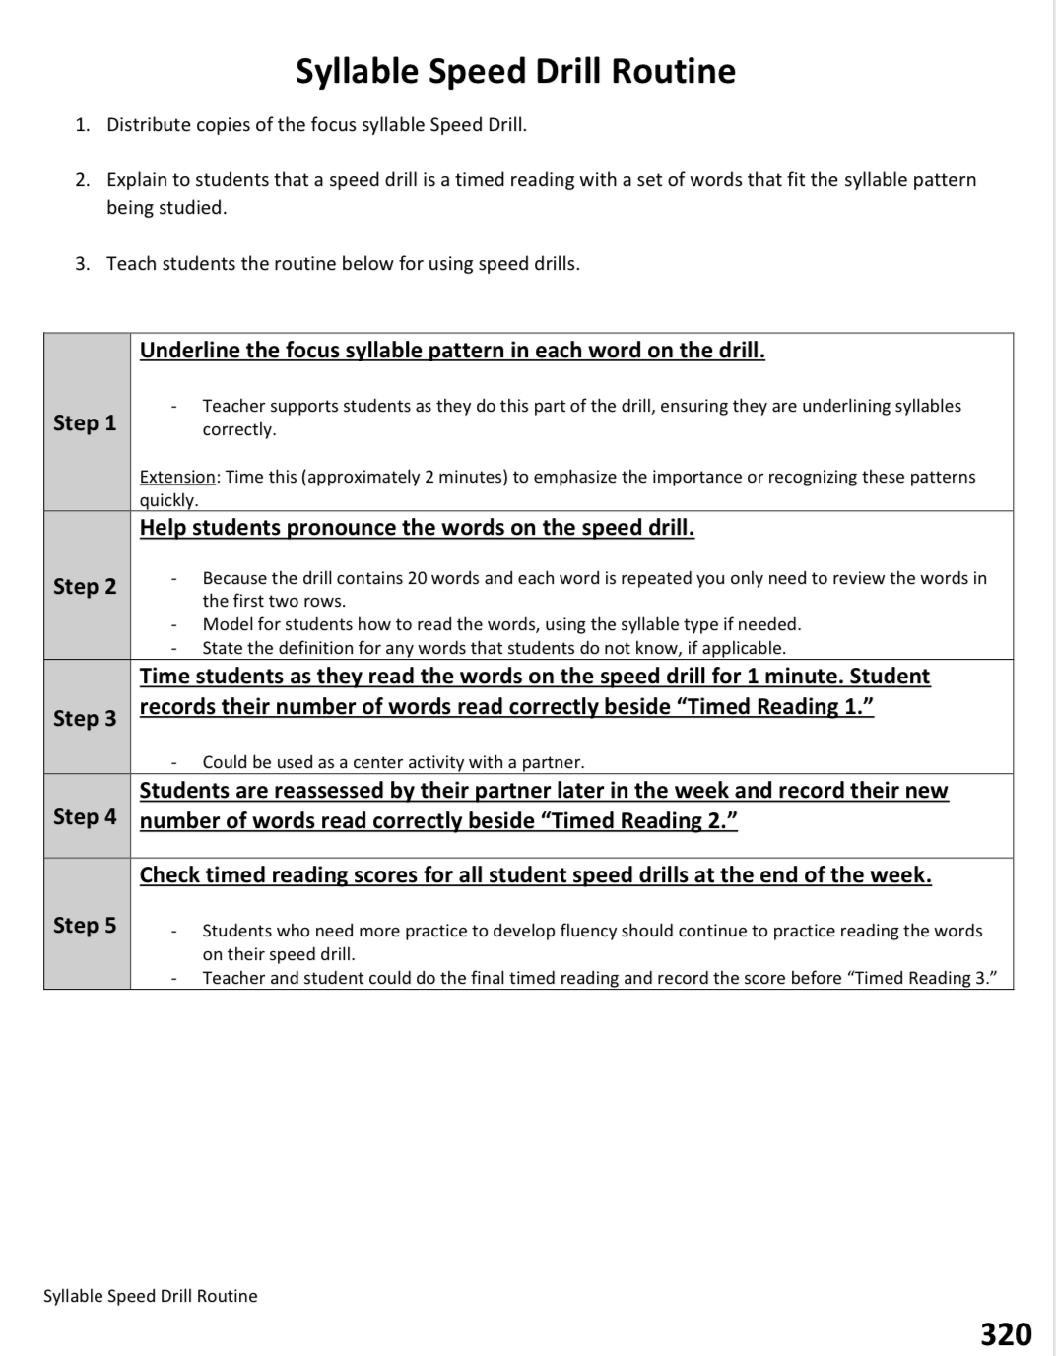
Terminology and Routine Guidance
Notes:
The final pages of the appendices include morphology spelling rules for additional guidance, speed drill routines and a terminology reference page.

Slide 27
This Resource?
Where Can I Find
https://www.mdek12.org/Literacy
Notes:
This resource can be found under the Literacy Page on The Mississippi Department of Education’s website at www.mdek12.org forward slash literacy.

Slide 28
Division of Literacy
Office of Elementary Education and Reading 601-359-2586
Chelsea Kilgore
ckilgore@mdek12.org Literacy Coach
Amber Hicks
ahicks@mdek12.org Literacy Coach
Notes:
We hope that after this brief overview, you are more comfortable with the Advanced Word Study Resource. Please utilize this resource to provide accelerated multi-syllabic instruction to your 3rd and 4th grade students. Keep in mind, you will need to adjust the document to fit the specific needs of your students. We know that you will plan the most appropriate and beneficial instruction for the children you serve.
Above is the contact information for the Division of Literacy in the Office of Elementary Education and Reading. If you have questions regarding the use or implementation of this document, please do not hesitate to reach out to one of the assistant state literacy coordinators or myself, Chelsea Kilgore at ckilgore@mdek12.org or Amber Hicks at ahicks@mdek12.org
Have a great day and successful advanced phonics instruction!

