Slide 1
The Puddle Pail by Elisa Kleven
Kleven, Elisa. The Puddle Pail. Tricycle Press, 2007.​​​​​​​​​​​​
https://youtu.be/gu14rnfzPxI
Unit 5

Slide 2
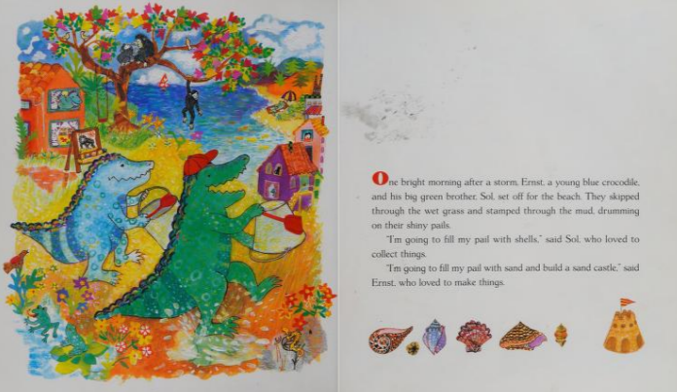

Slide 4
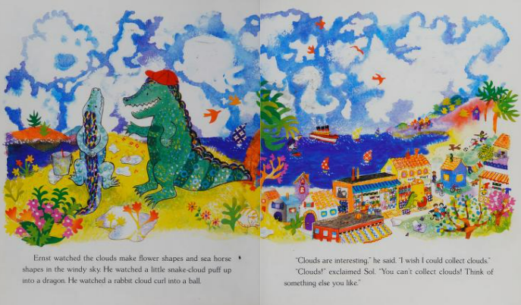

Slide 5
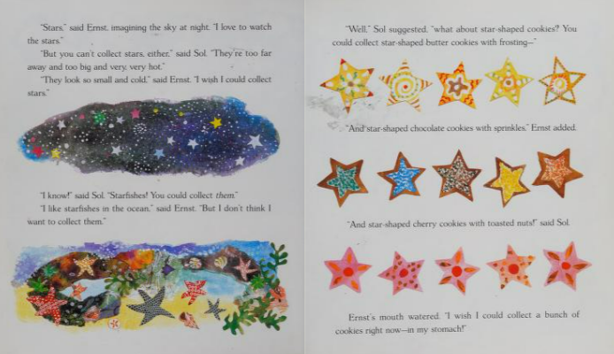

Slide 6
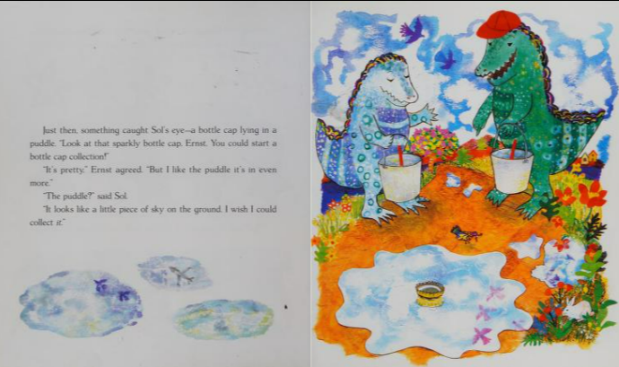

Slide 7
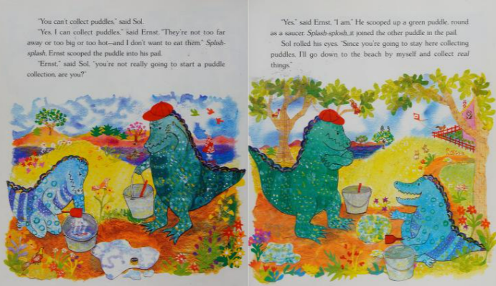

Slide 8
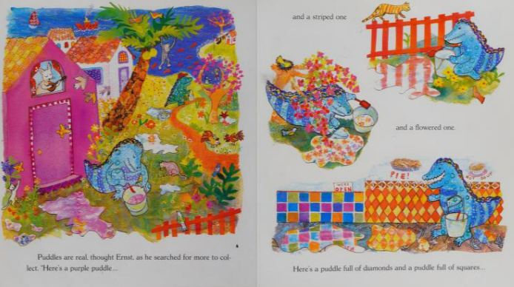

Slide 9
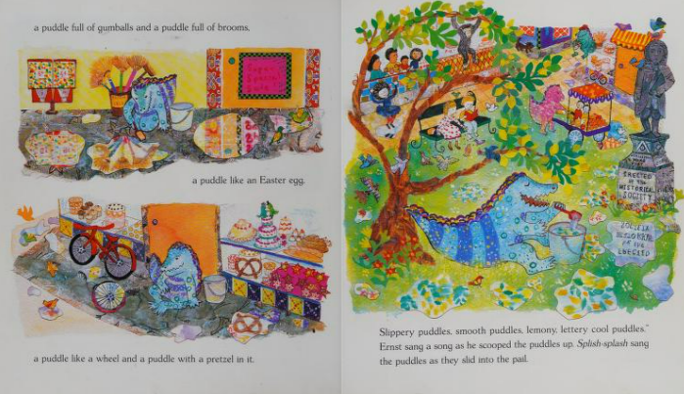

Slide 10
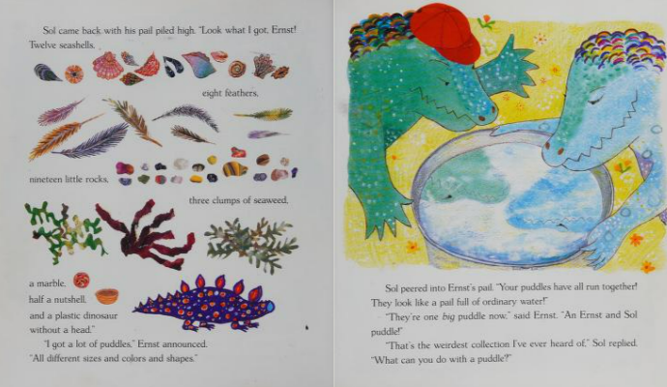

Slide 11
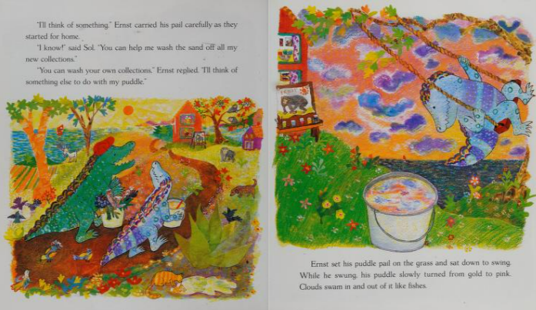

Slide 12
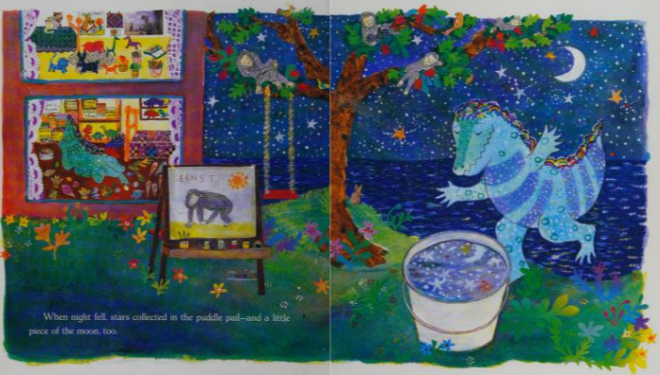

Slide 13
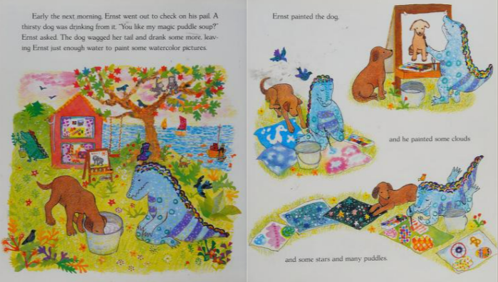

Slide 15
