Slide 1
Max’s Dragon Shirt by Rosemary Wells
Wells, Rosemary. Max's Dragon Shirt. Dial, 1991.​​​​​
https://youtu.be/Y_ha96Yv9M0
Unit 4

Slide 2
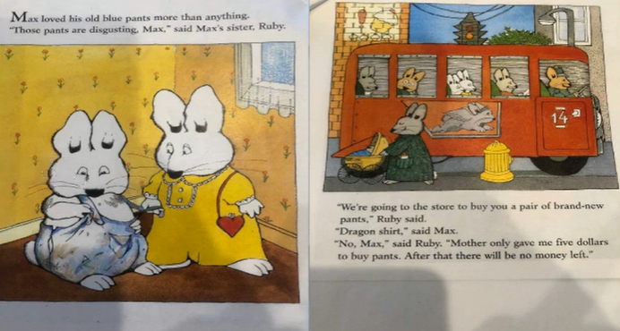

Slide 3
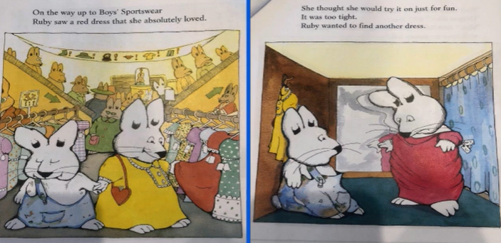

Slide 4
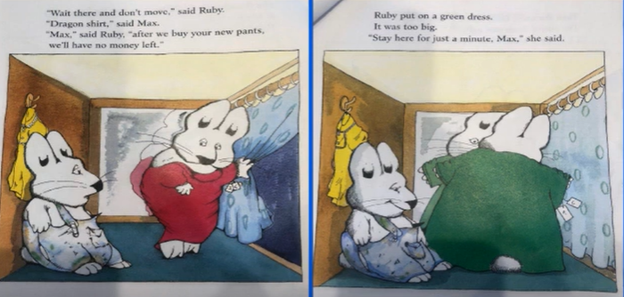

Slide 5
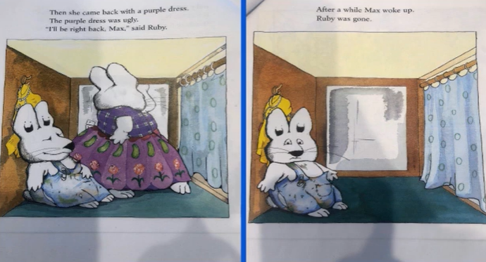

Slide 6
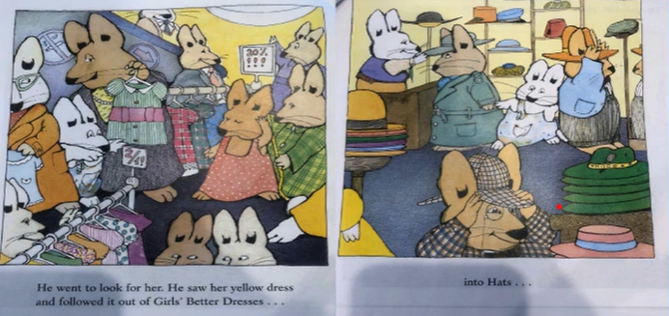

Slide 7
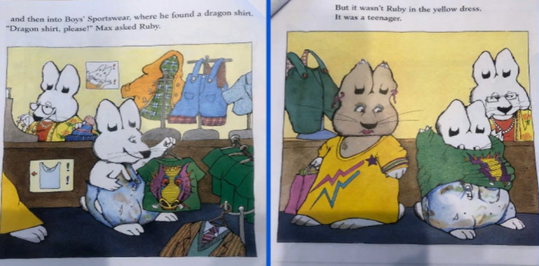

Slide 8
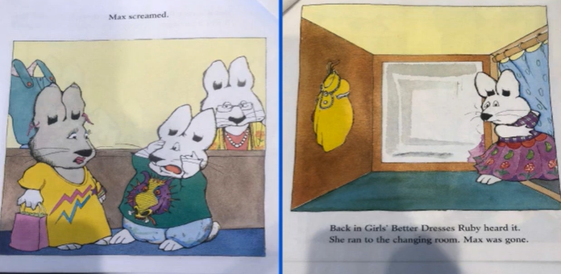

Slide 9
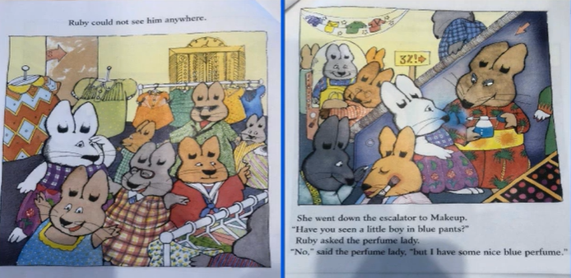

Slide 10
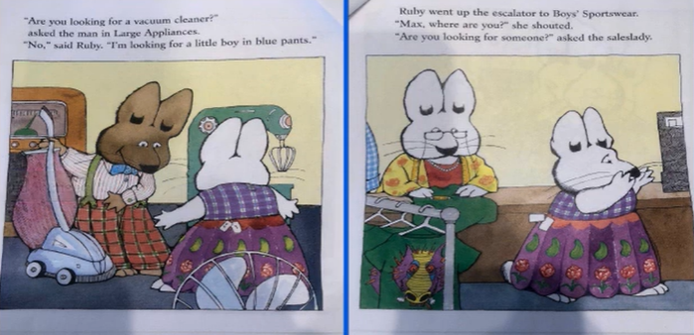

Slide 11
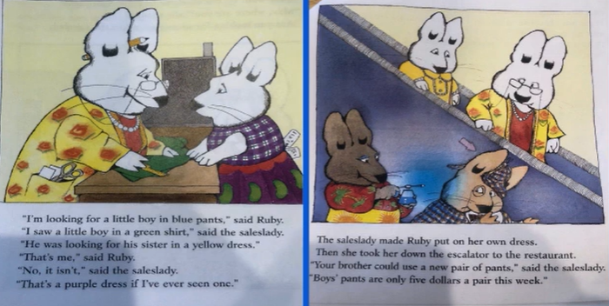

Slide 12
