Slide 1
Rabbits & Raindrops by Jim Arnosky
Arnosky, Jim. Rabbits & Raindrops. Puffin Books, 2001.​​
https://youtu.be/-MDLevwscrE
Unit 3

Slide 2
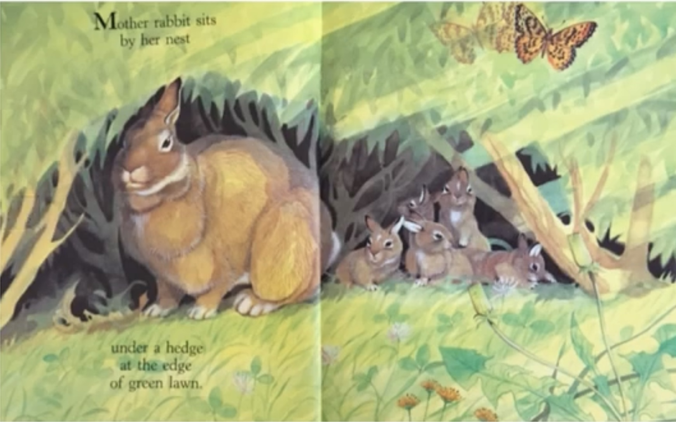
Notes:
This is a sample of what the pages should look like☺

Slide 3
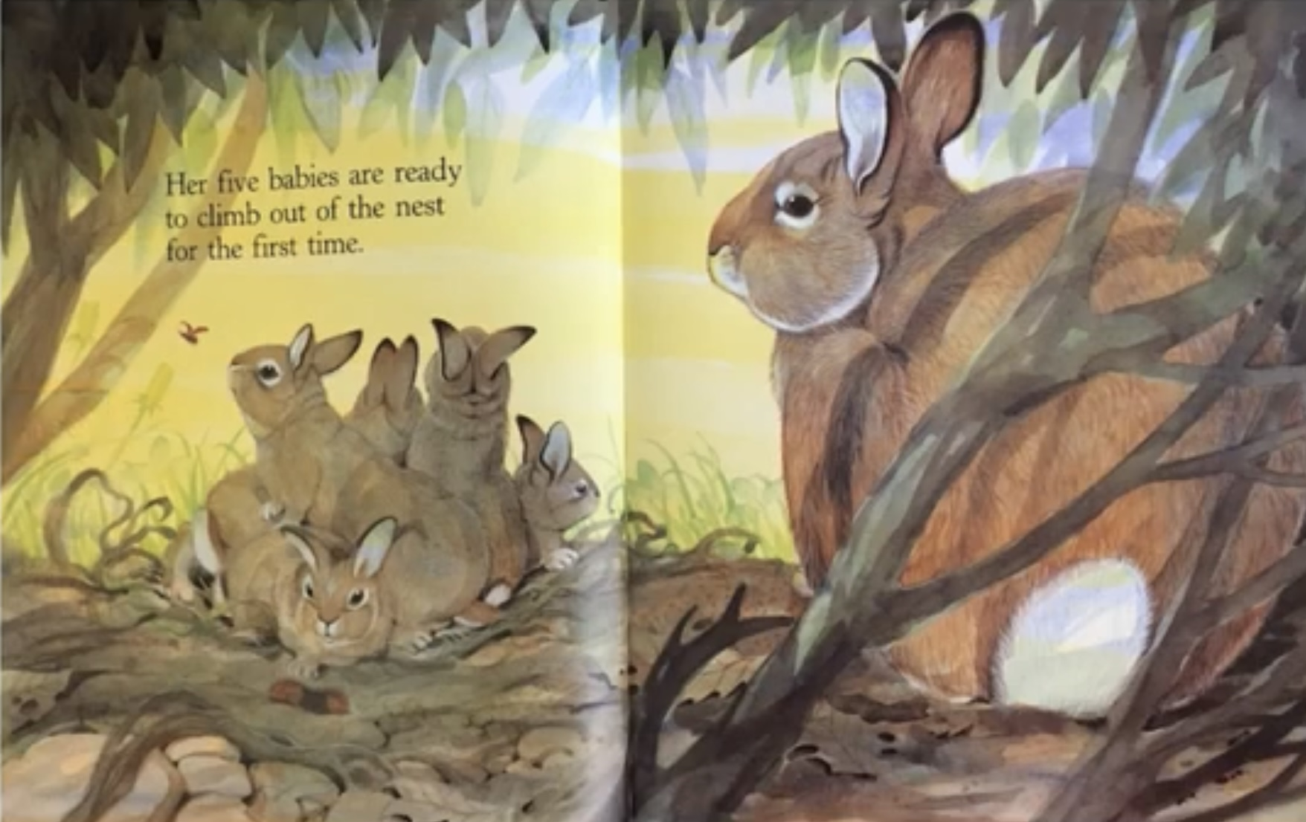

Slide 4
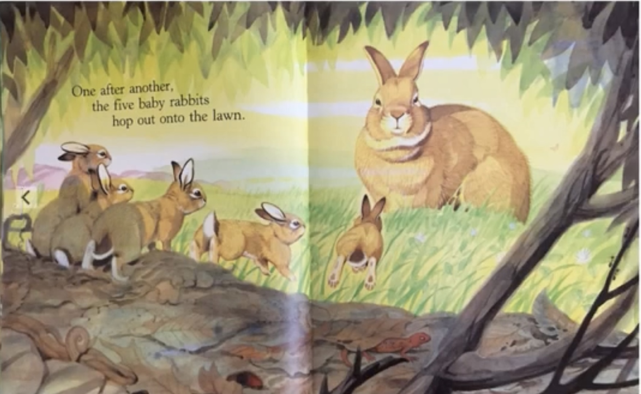

Slide 6
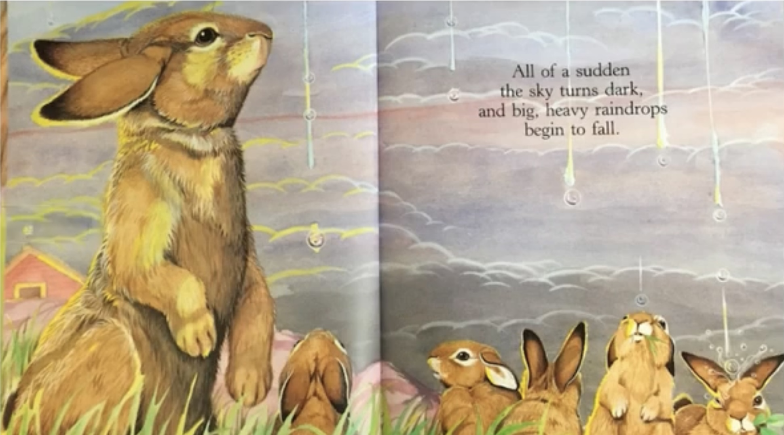

Slide 8
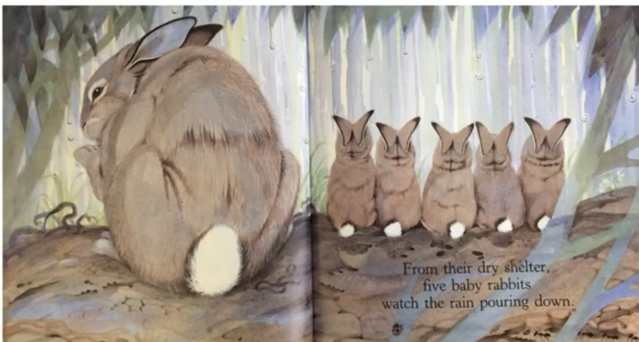

Slide 9
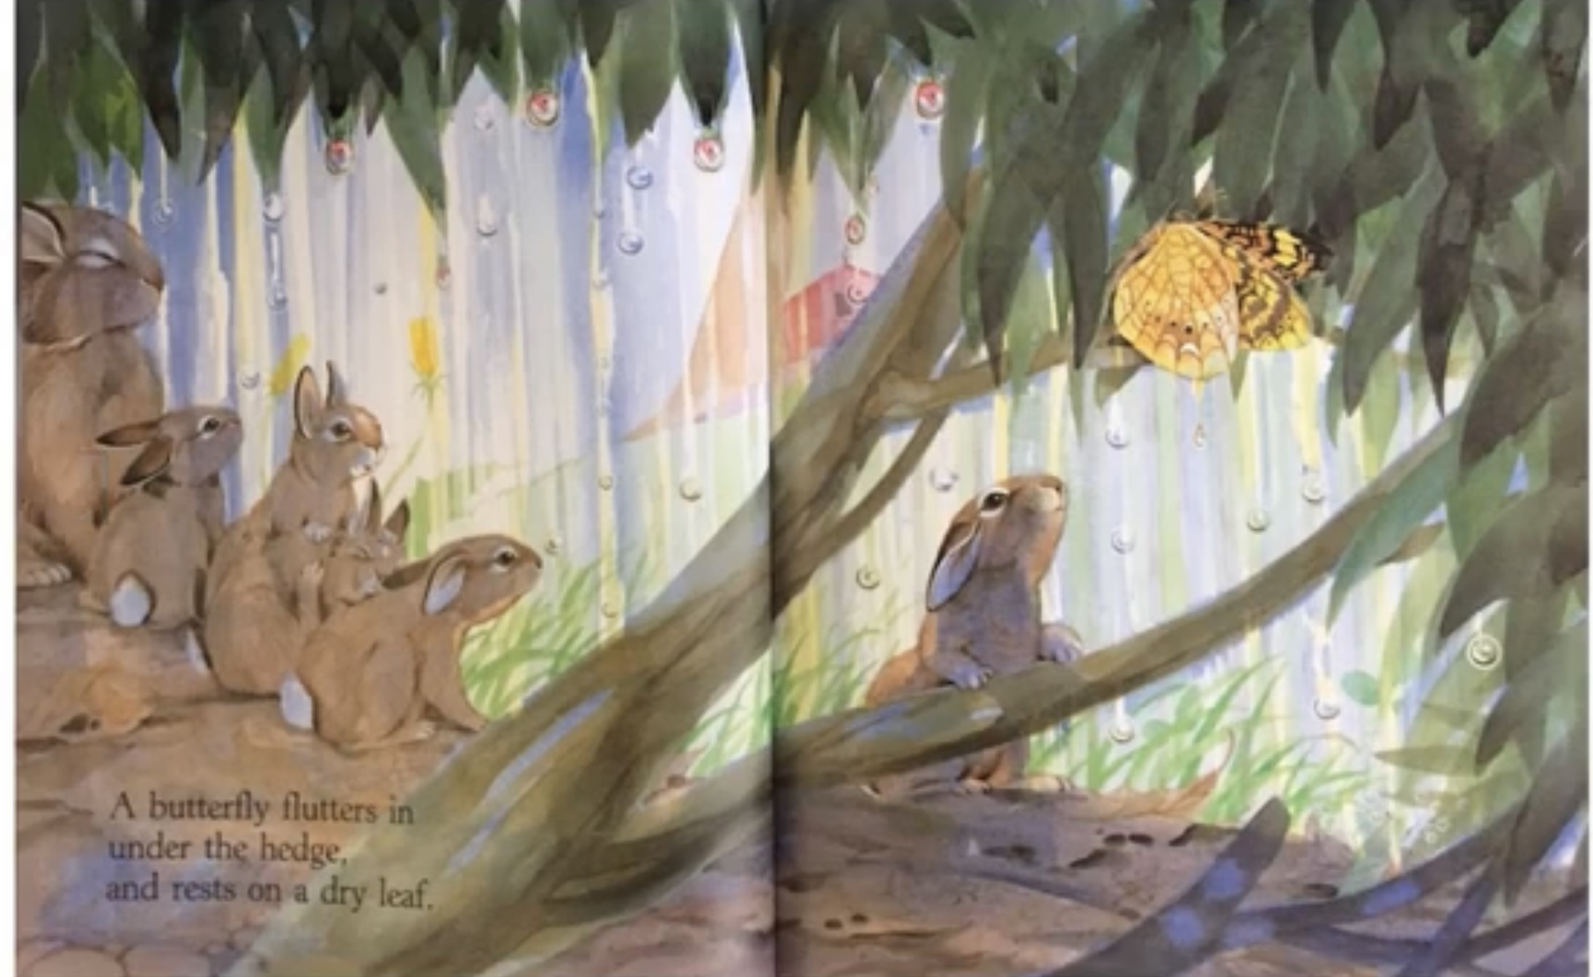

Slide 12
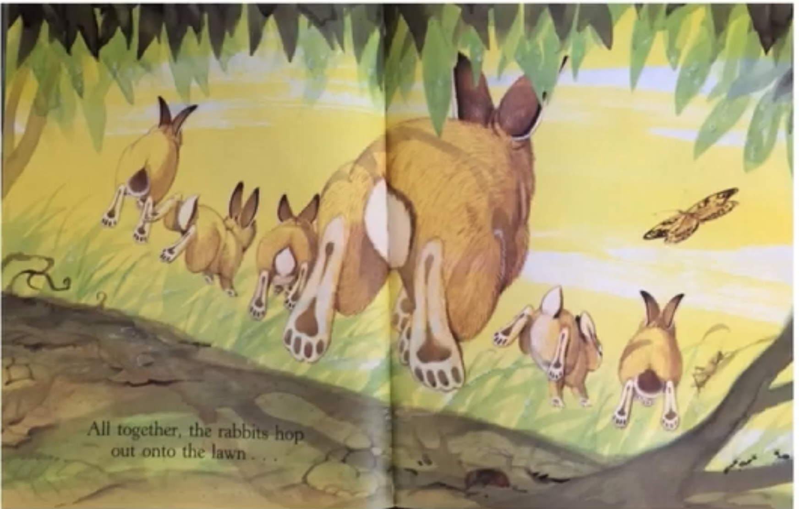

Slide 13
