Slide 1
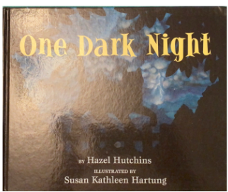
One Dark Night by Hazel Hutchins
Hutchins, Hazel. One Dark Night. Penguin Putnam for Young Readers, 2003.
https://youtu.be/Z4iNhOQnQHE
Unit 3

Slide 16
