Slide 1
Matthew and Tilly by Rebecca C. Jones
Jones, Rebecca C. Matthew and Tilly. Puffin Books, 1995. ​​​​​
https://youtu.be/WawjVXuF6W8
Unit 2

Slide 2
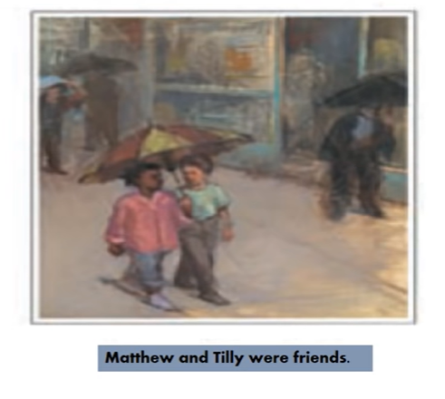

Slide 3
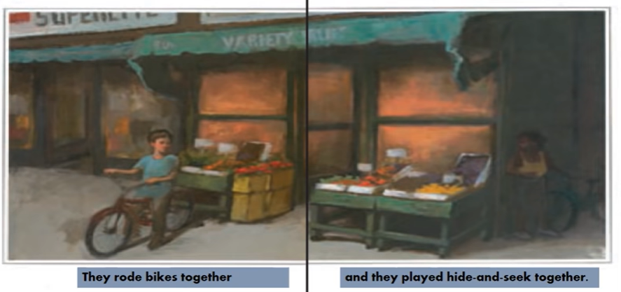

Slide 4
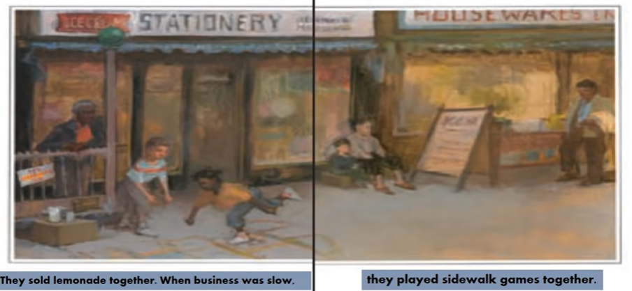

Slide 5
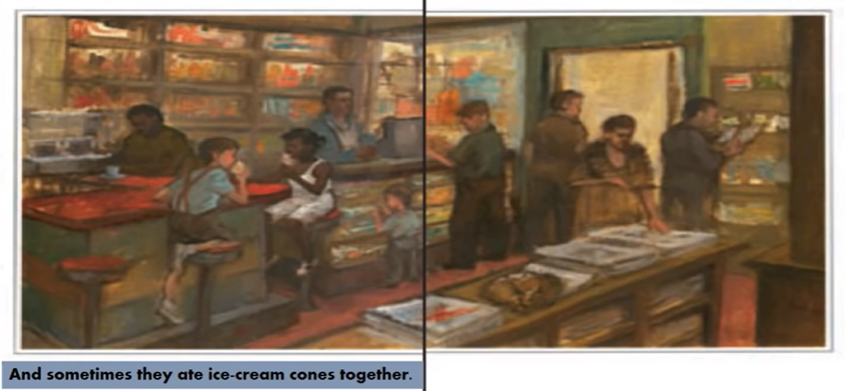

Slide 13
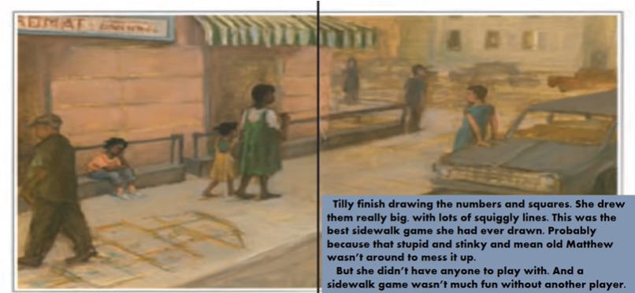

Slide 15
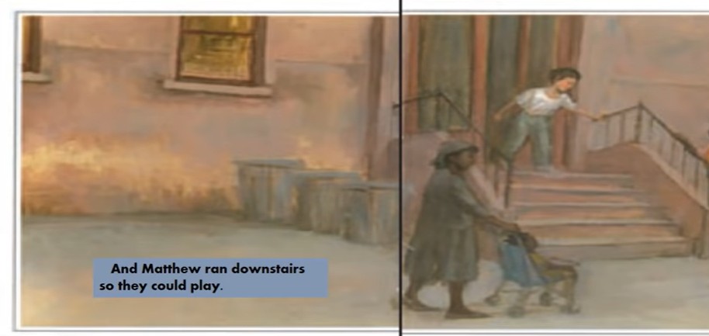

Slide 16
