Slide 1

Sometimes I'm Bombaloo by Rachel Vail
Vail, Rachel. Sometimes I'm Bombaloo. Scholastic Paperbacks, 2005.
https://youtu.be/30EgC0bxCOw
Unit 1

Slide 2
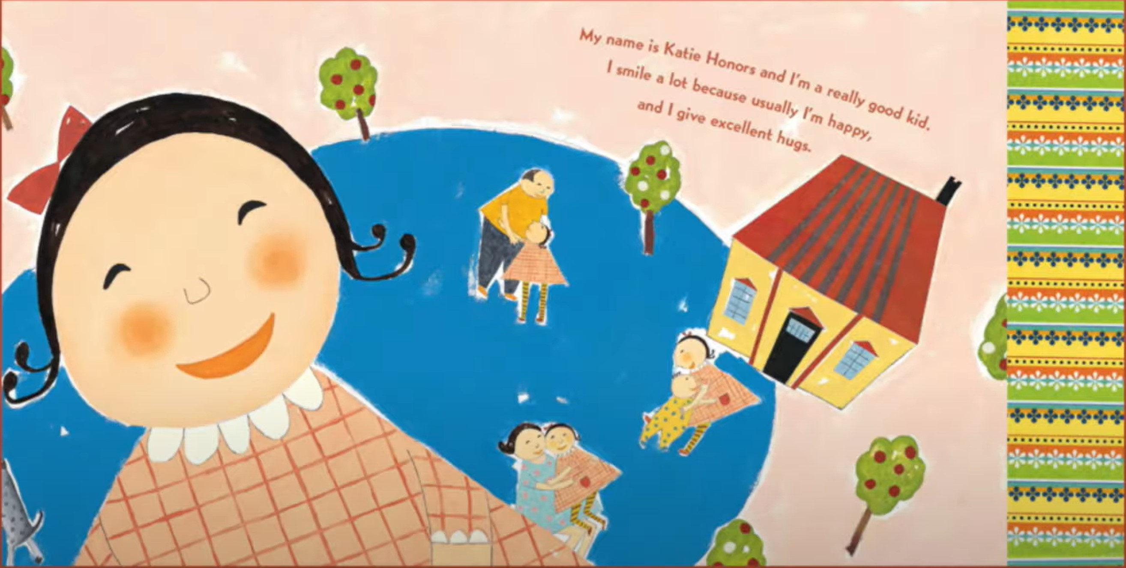
Notes:
This is a sample of what the pages should look like☺

Slide 3
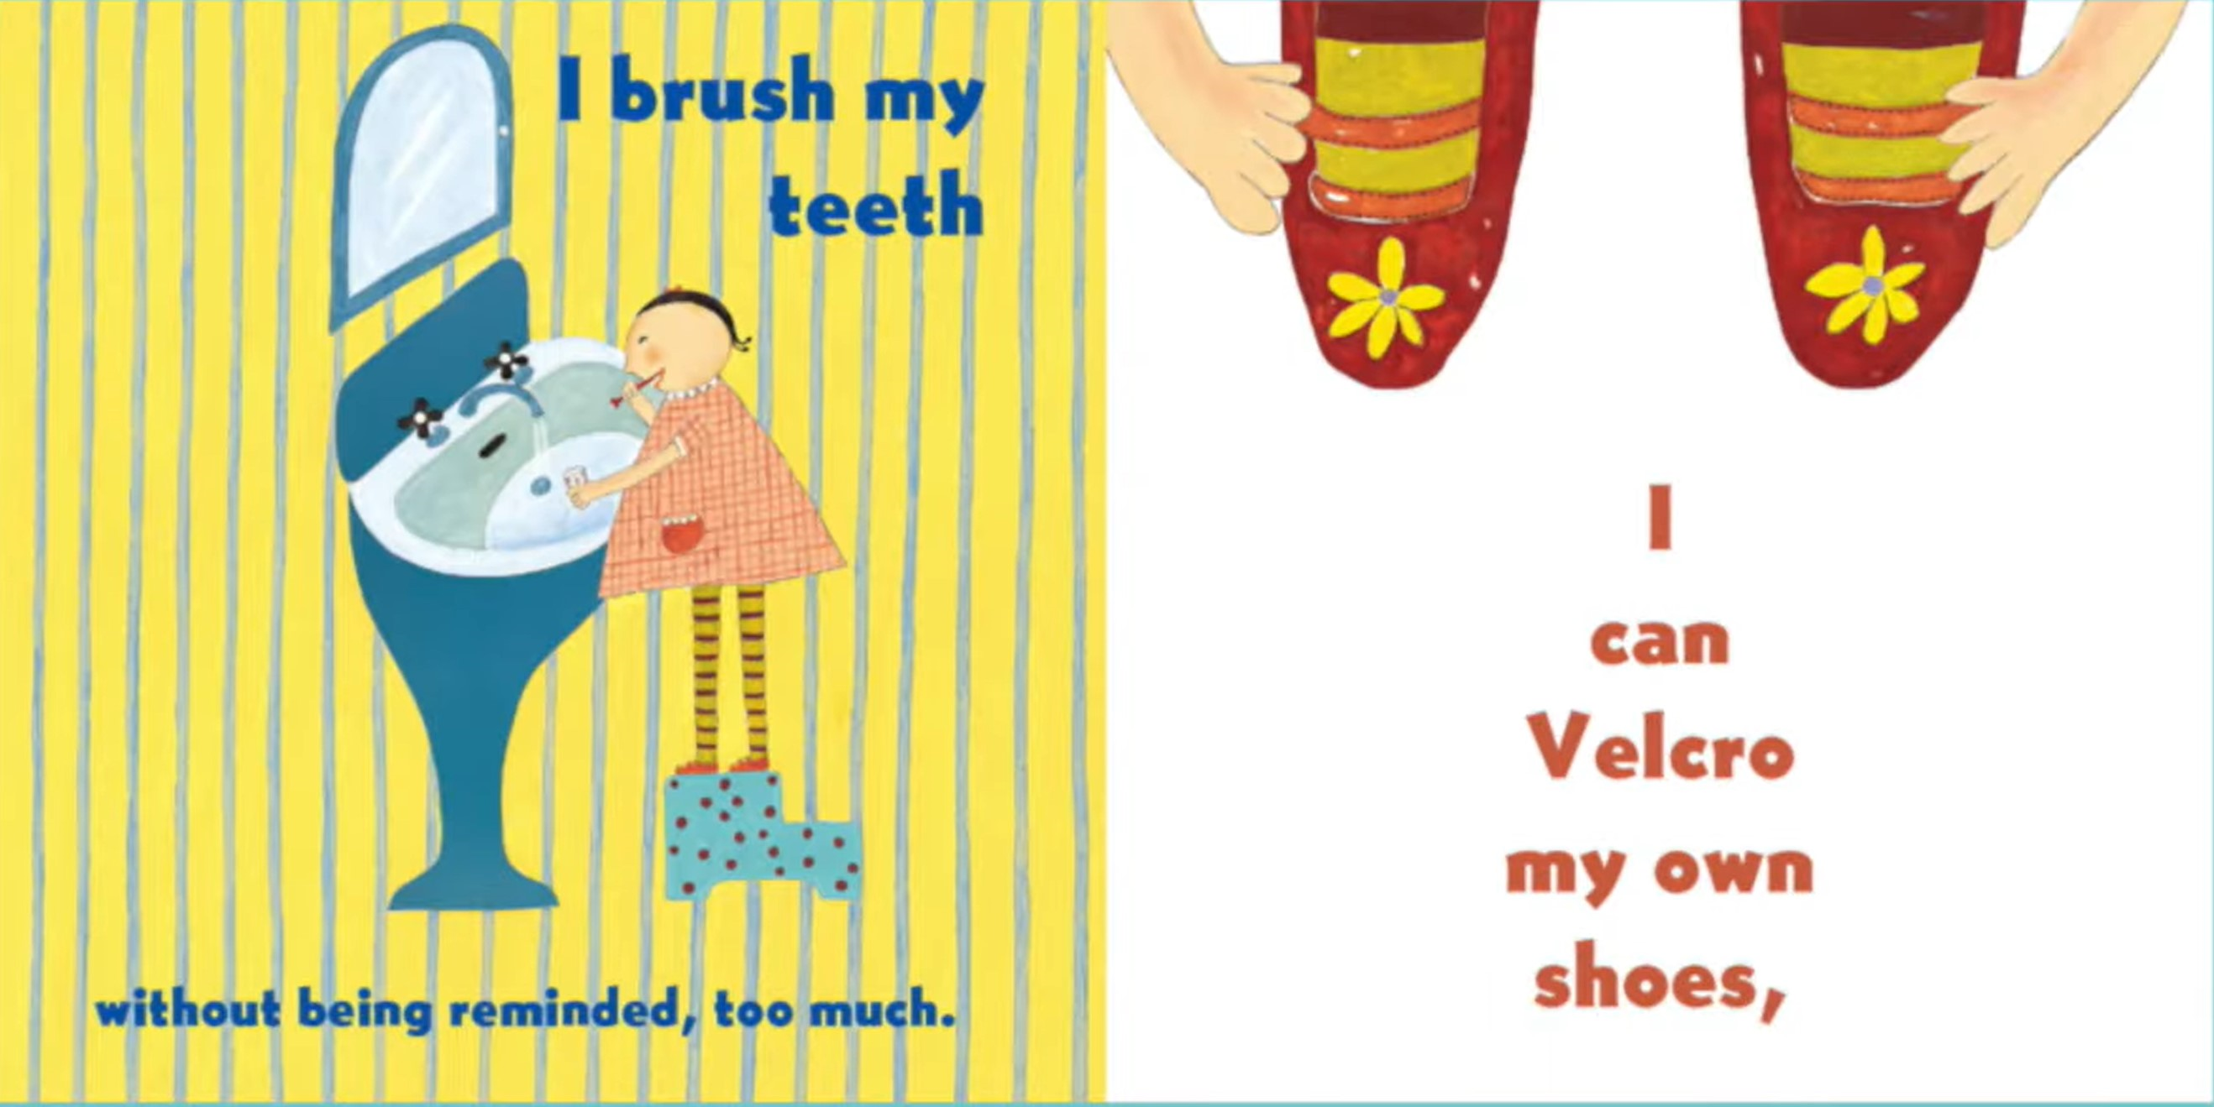

Slide 4


Slide 5
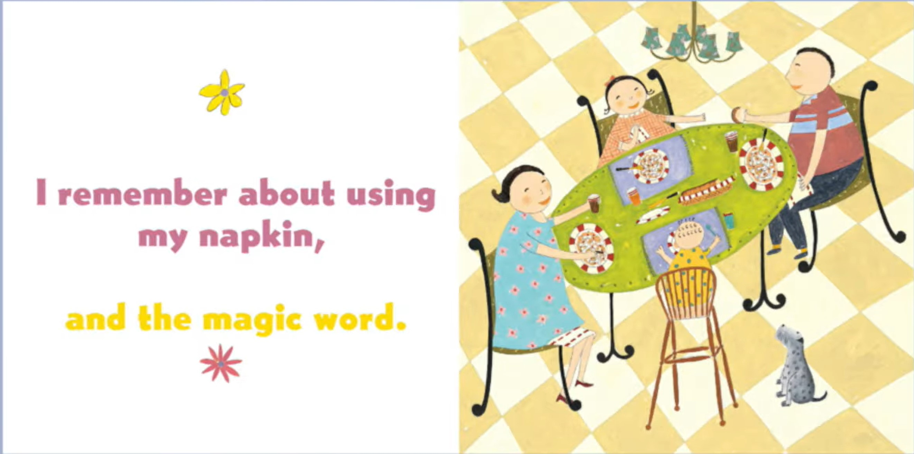

Slide 6
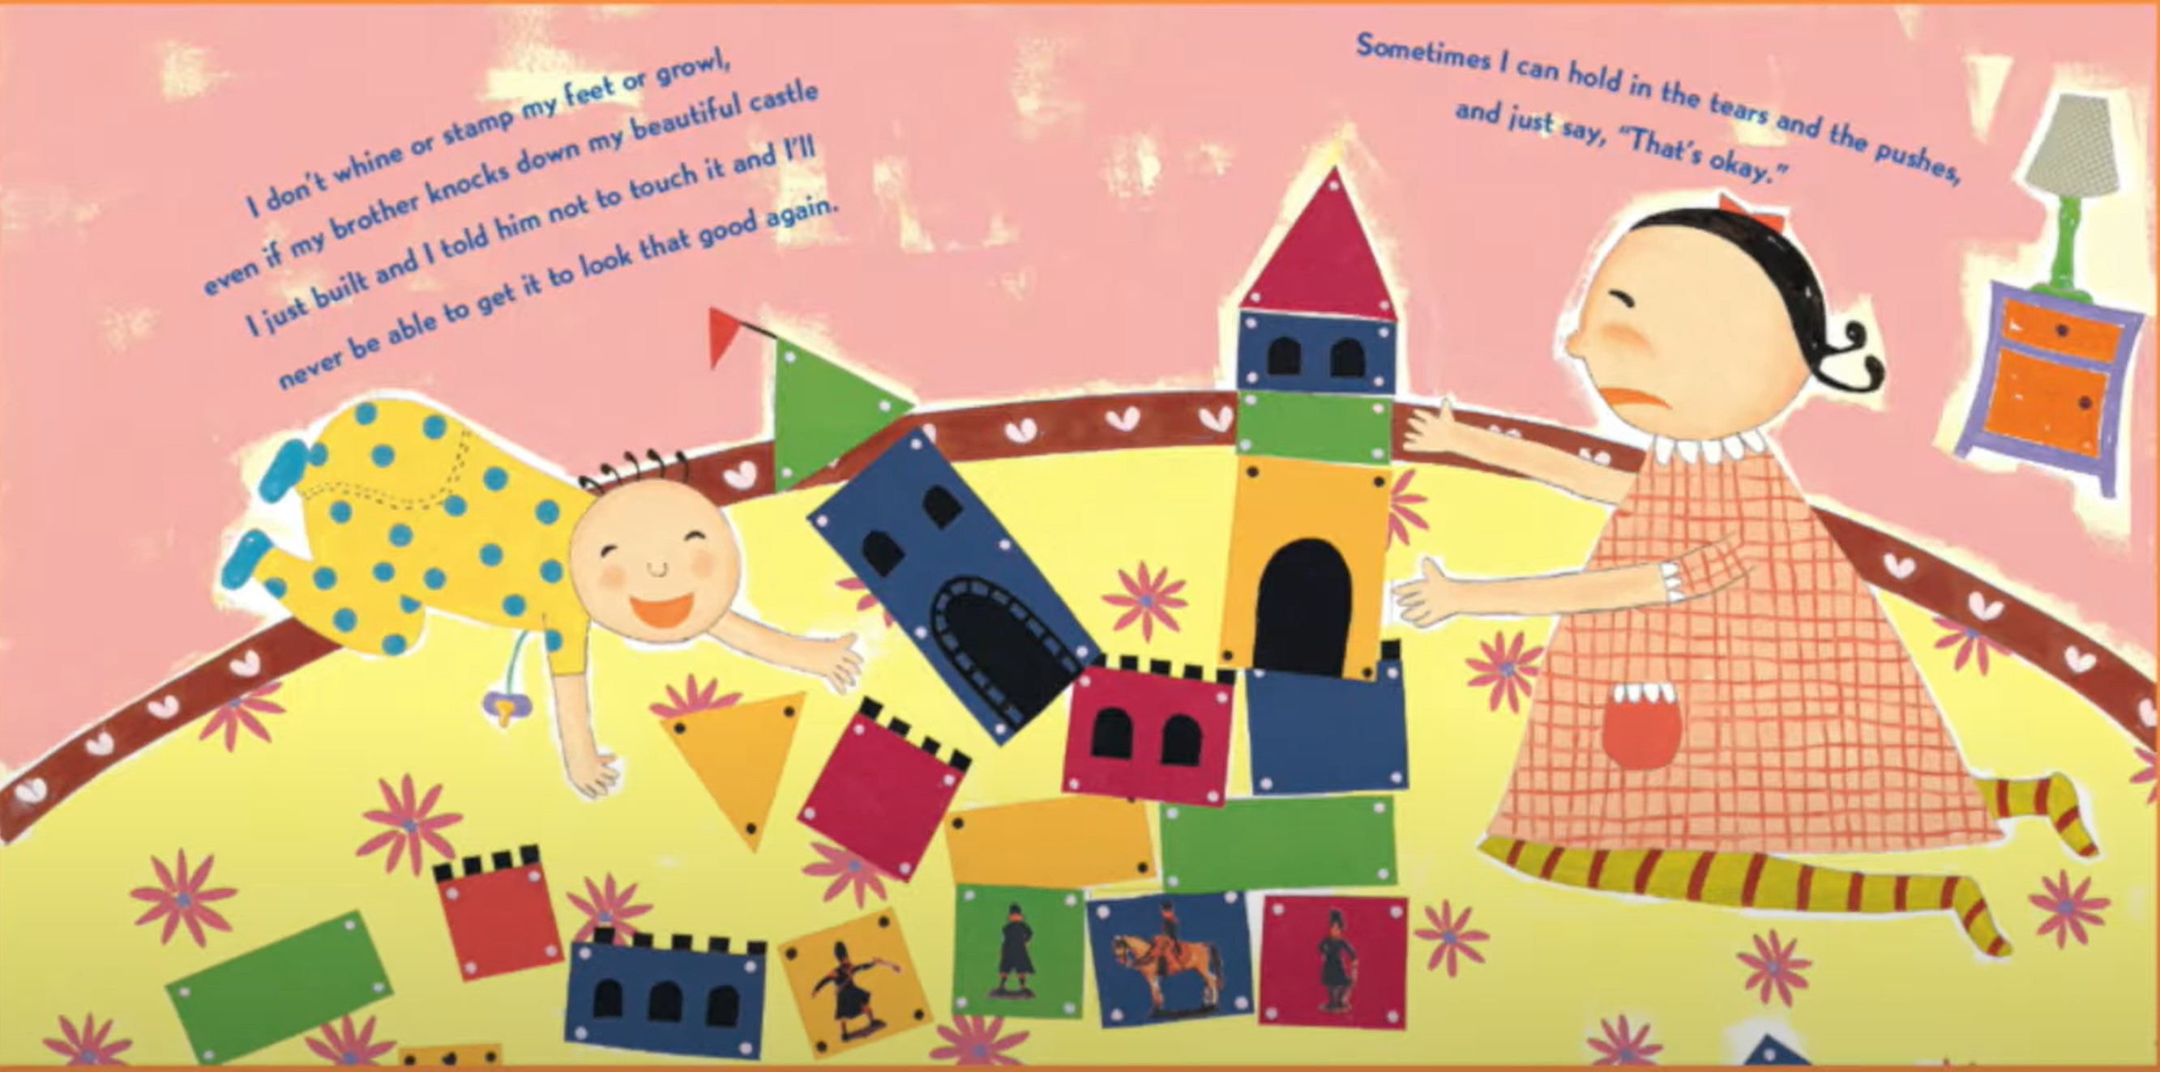

Slide 7
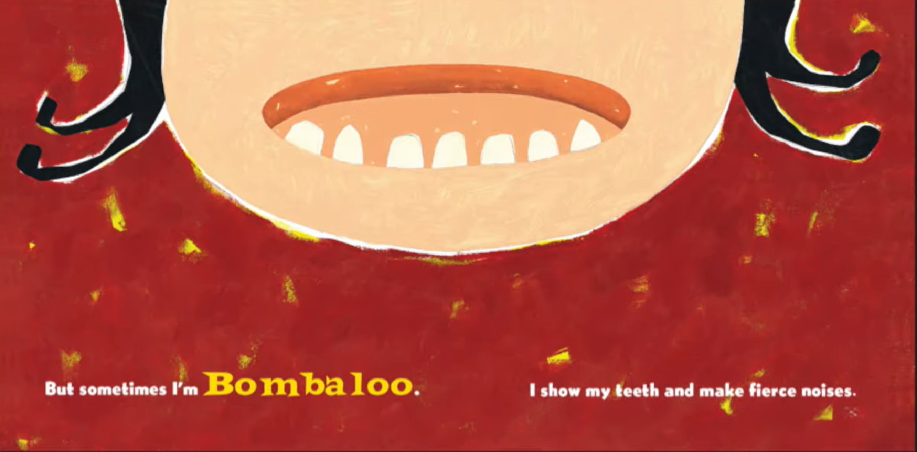

Slide 8


Slide 9
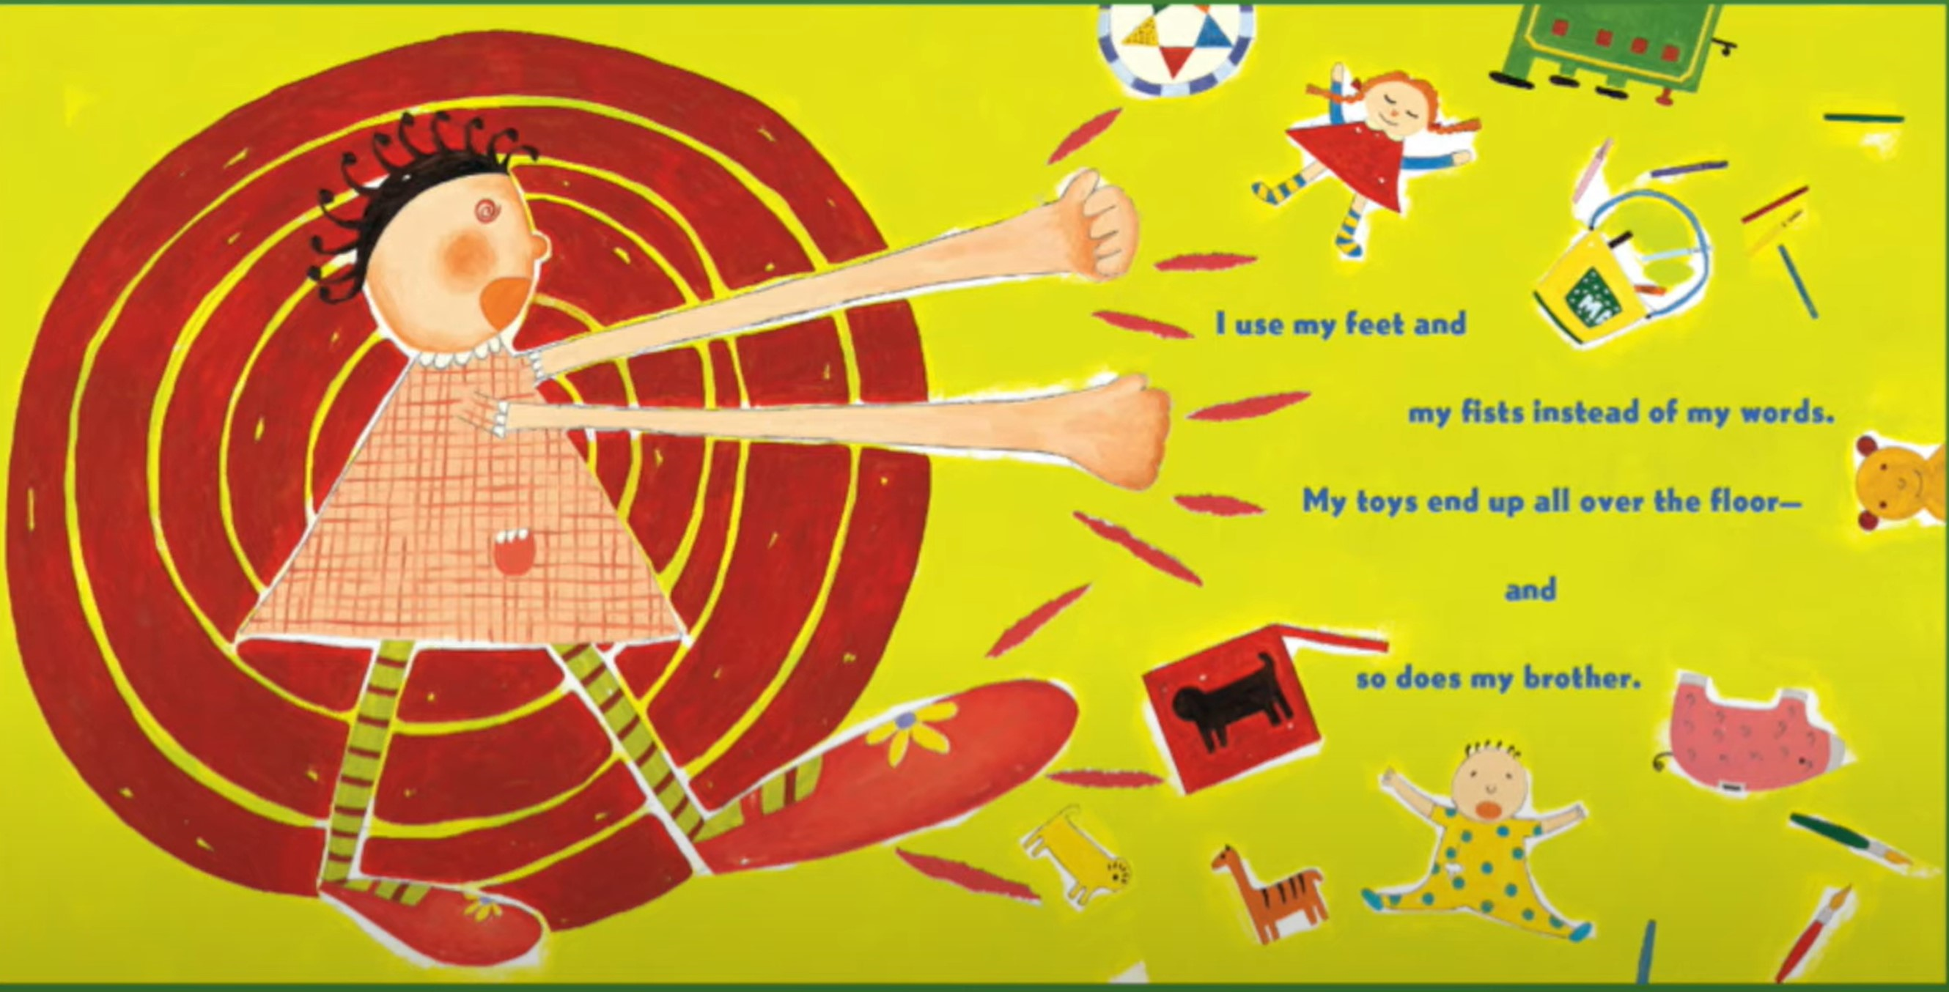

Slide 10


Slide 11
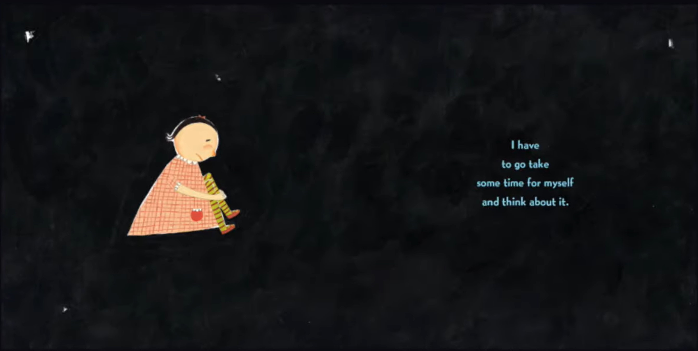

Slide 12
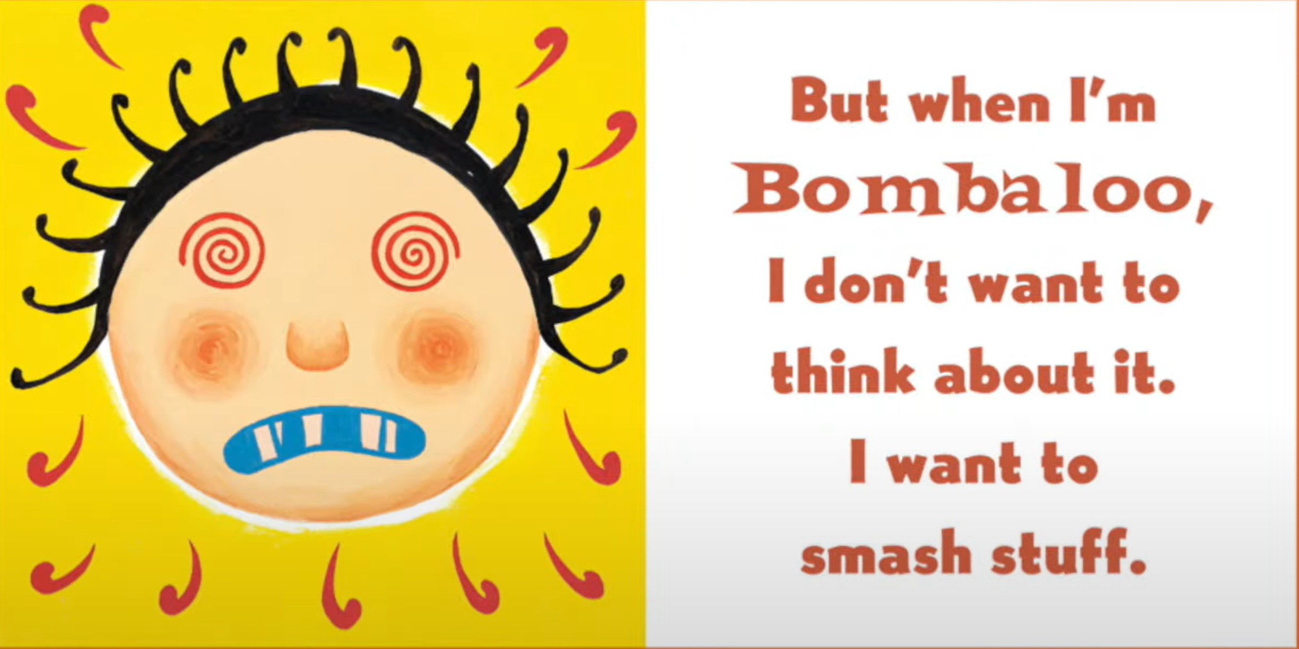

Slide 13
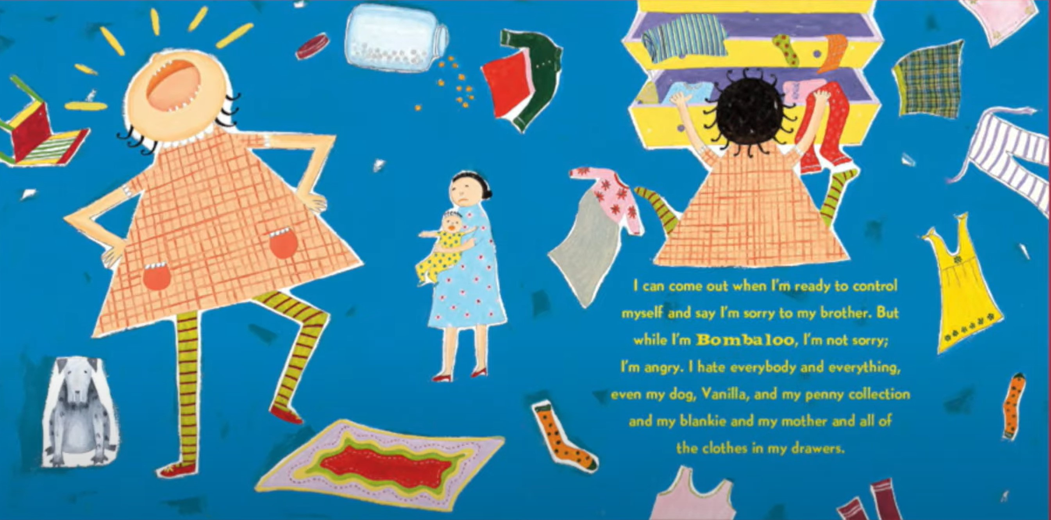

Slide 14


Slide 15
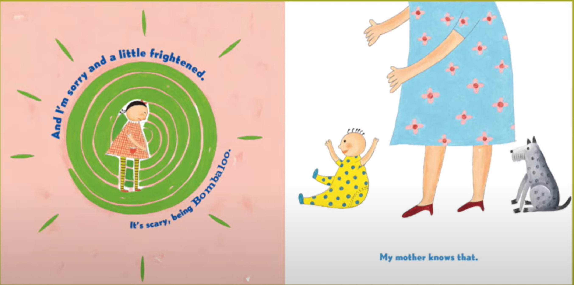

Slide 16
