Slide 1
Oonga Boonga by Frieda Wishinsky
Wishinsky, Frieda. Oonga Boonga. Dutton Juvenille, 1999.
Unit 1
https://youtu.be/uaA0lwbTxTI

Slide 2
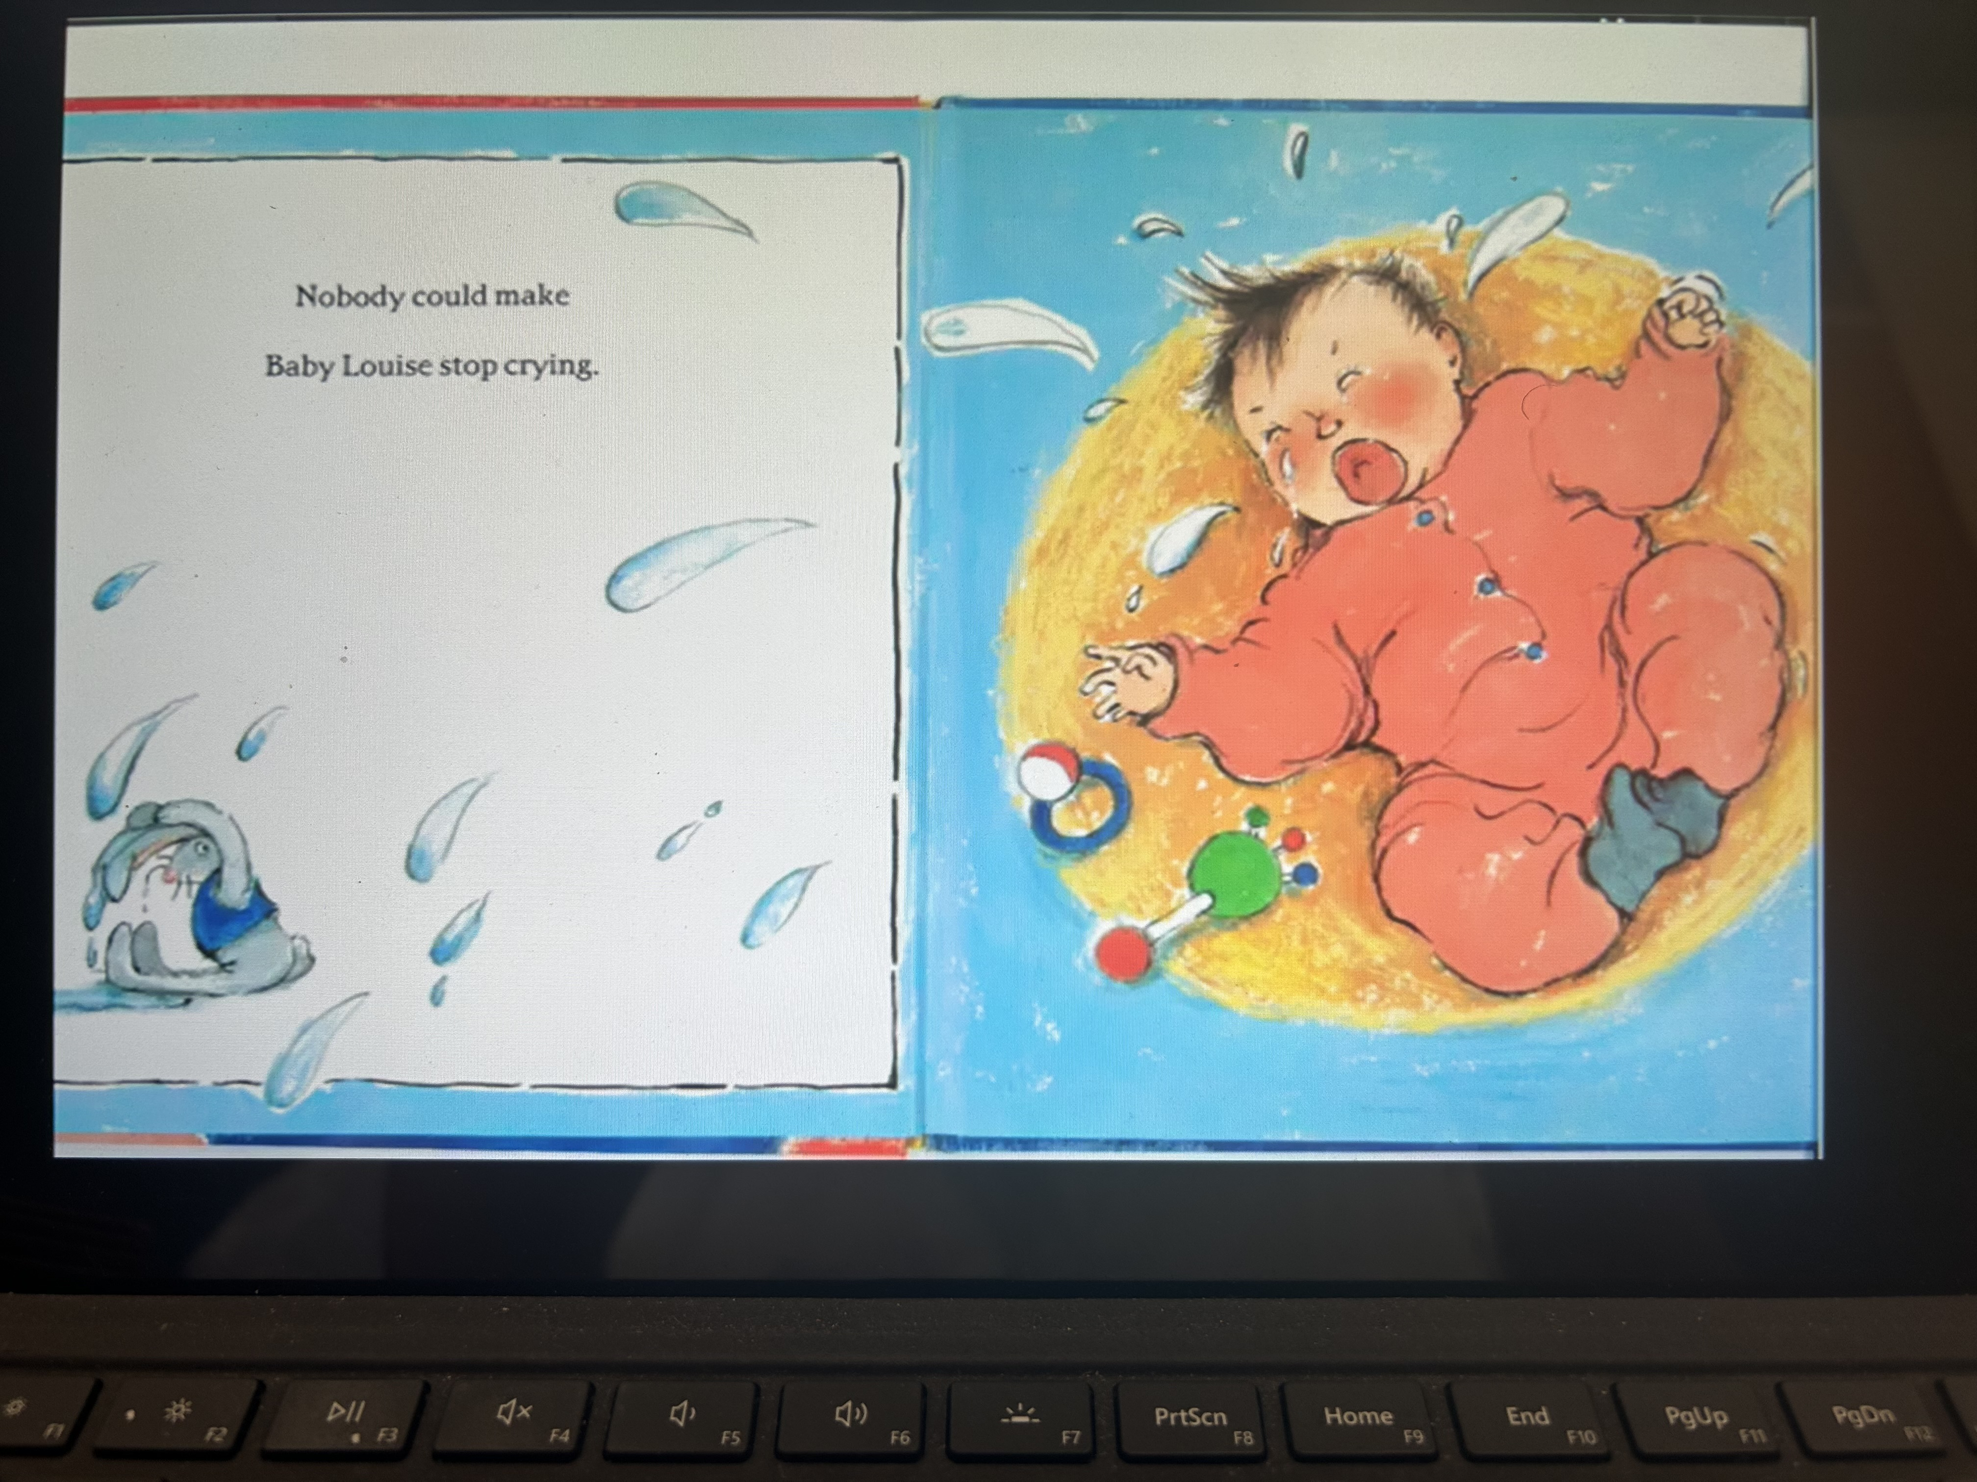

Slide 3
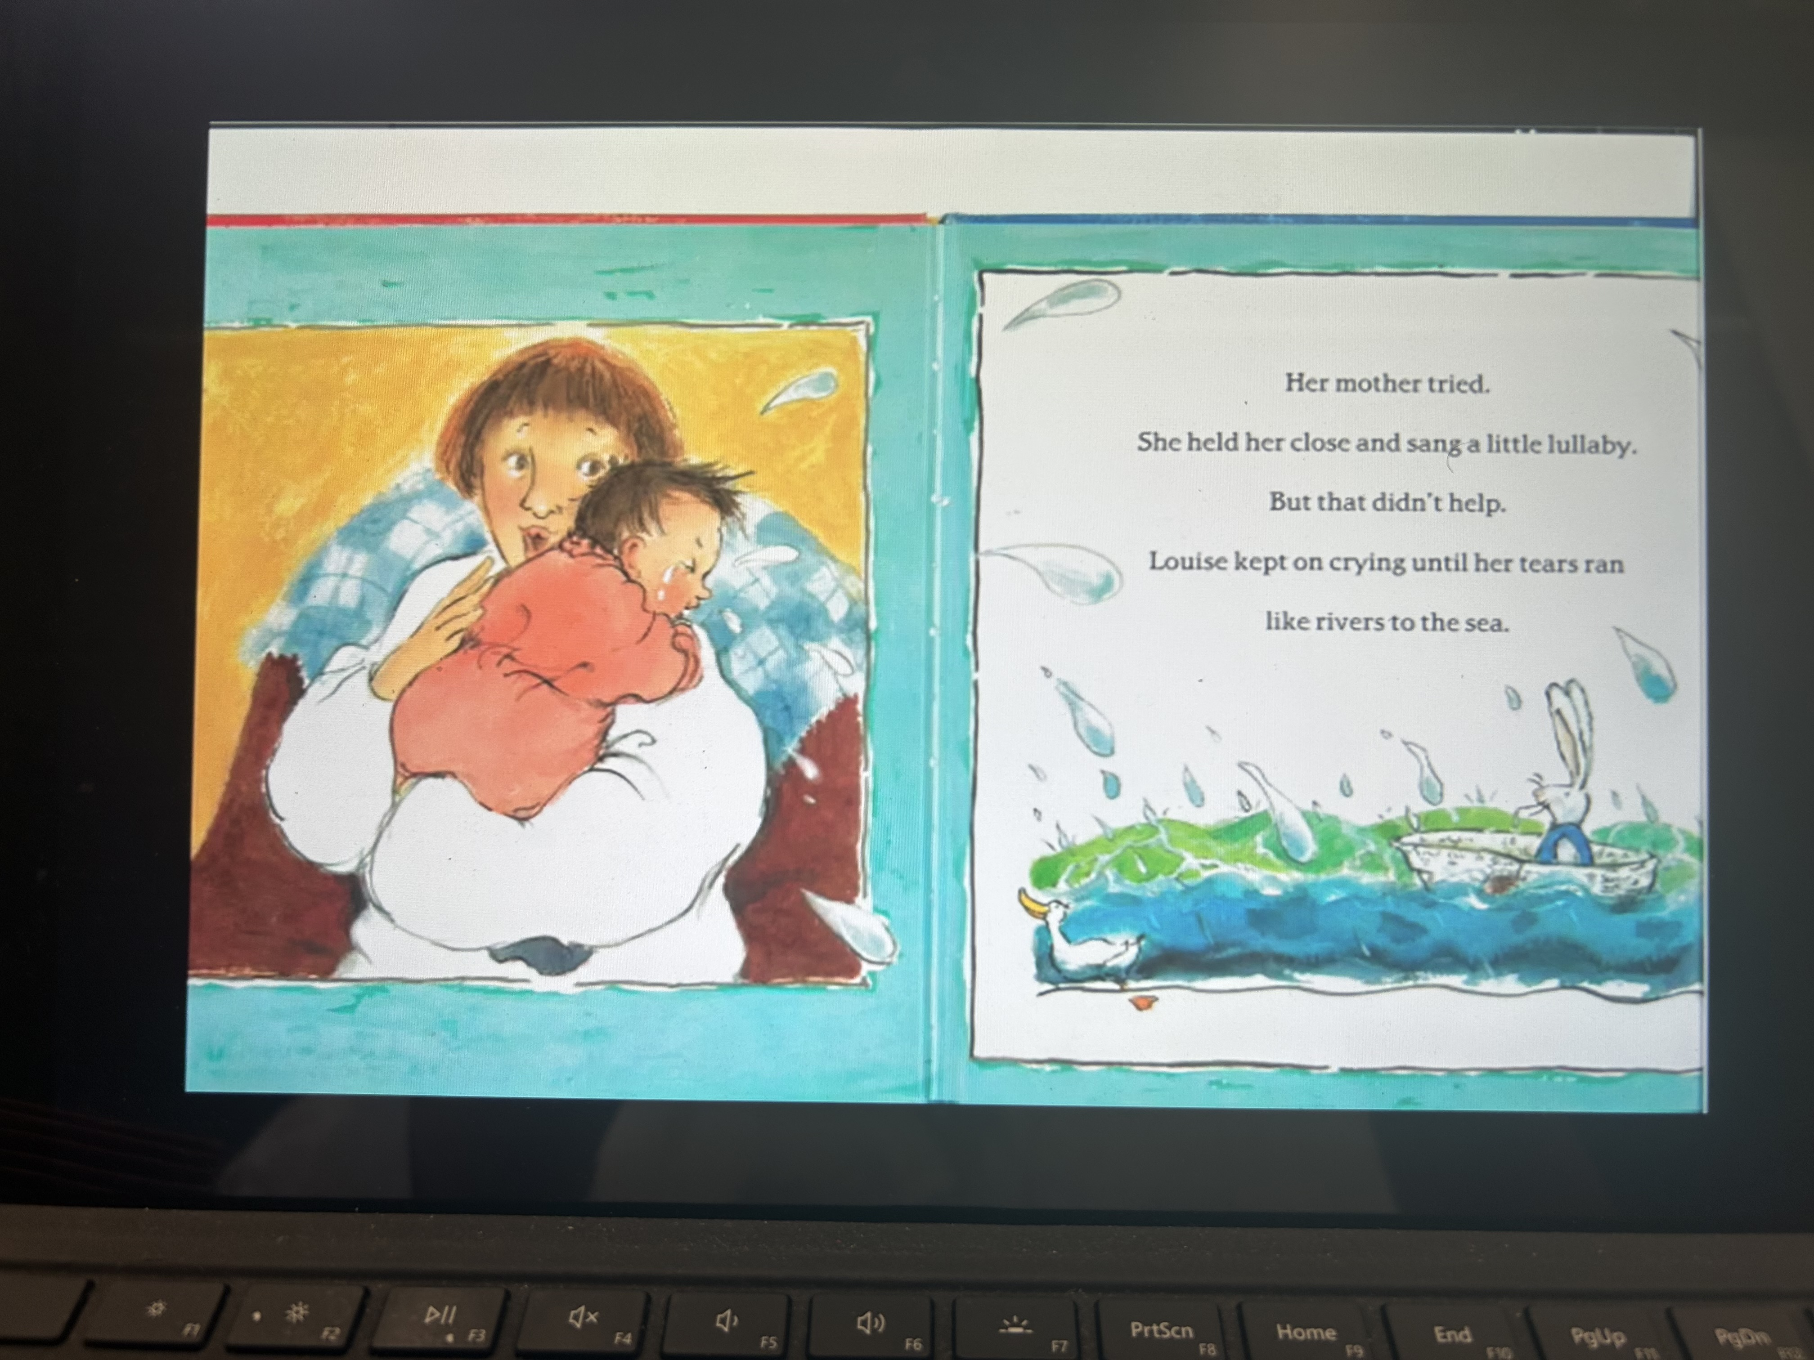

Slide 4
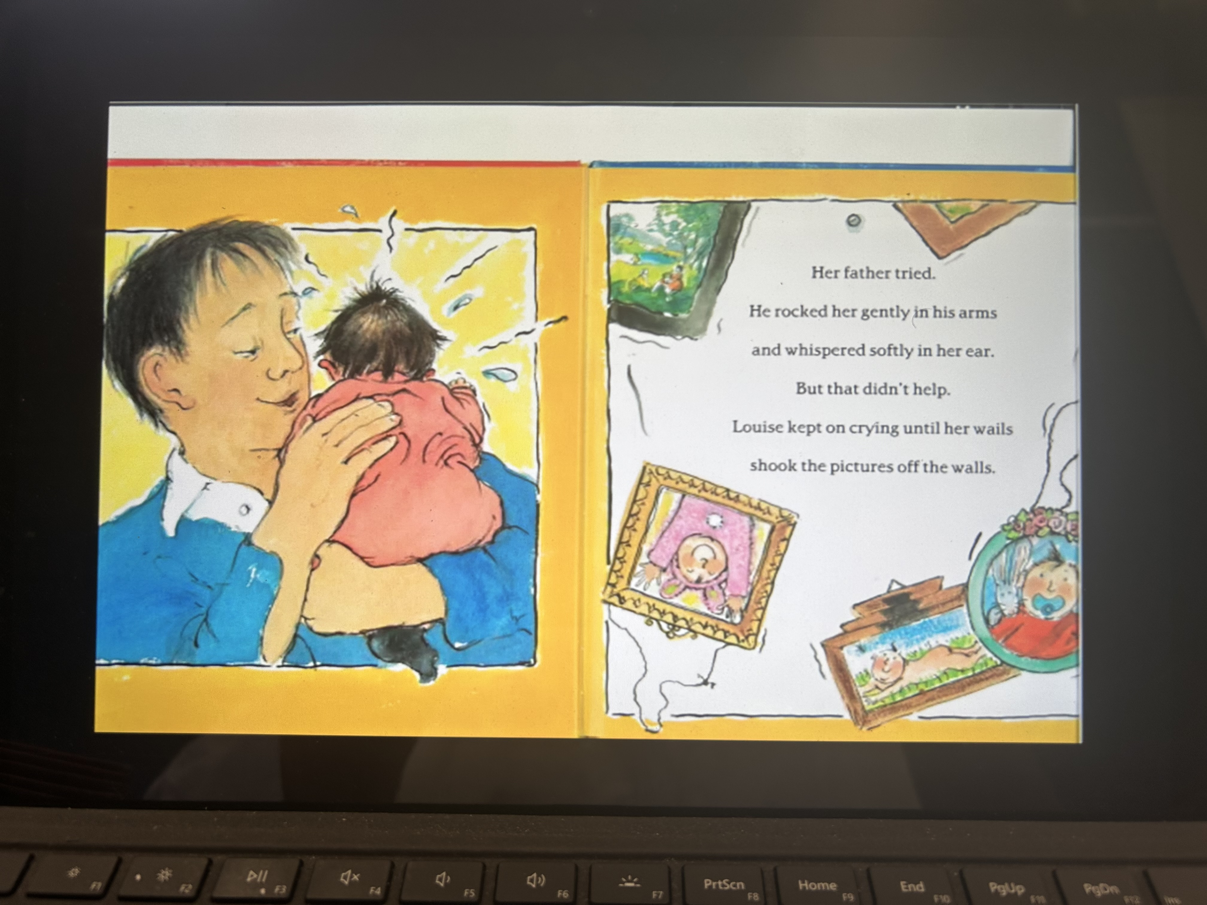

Slide 8
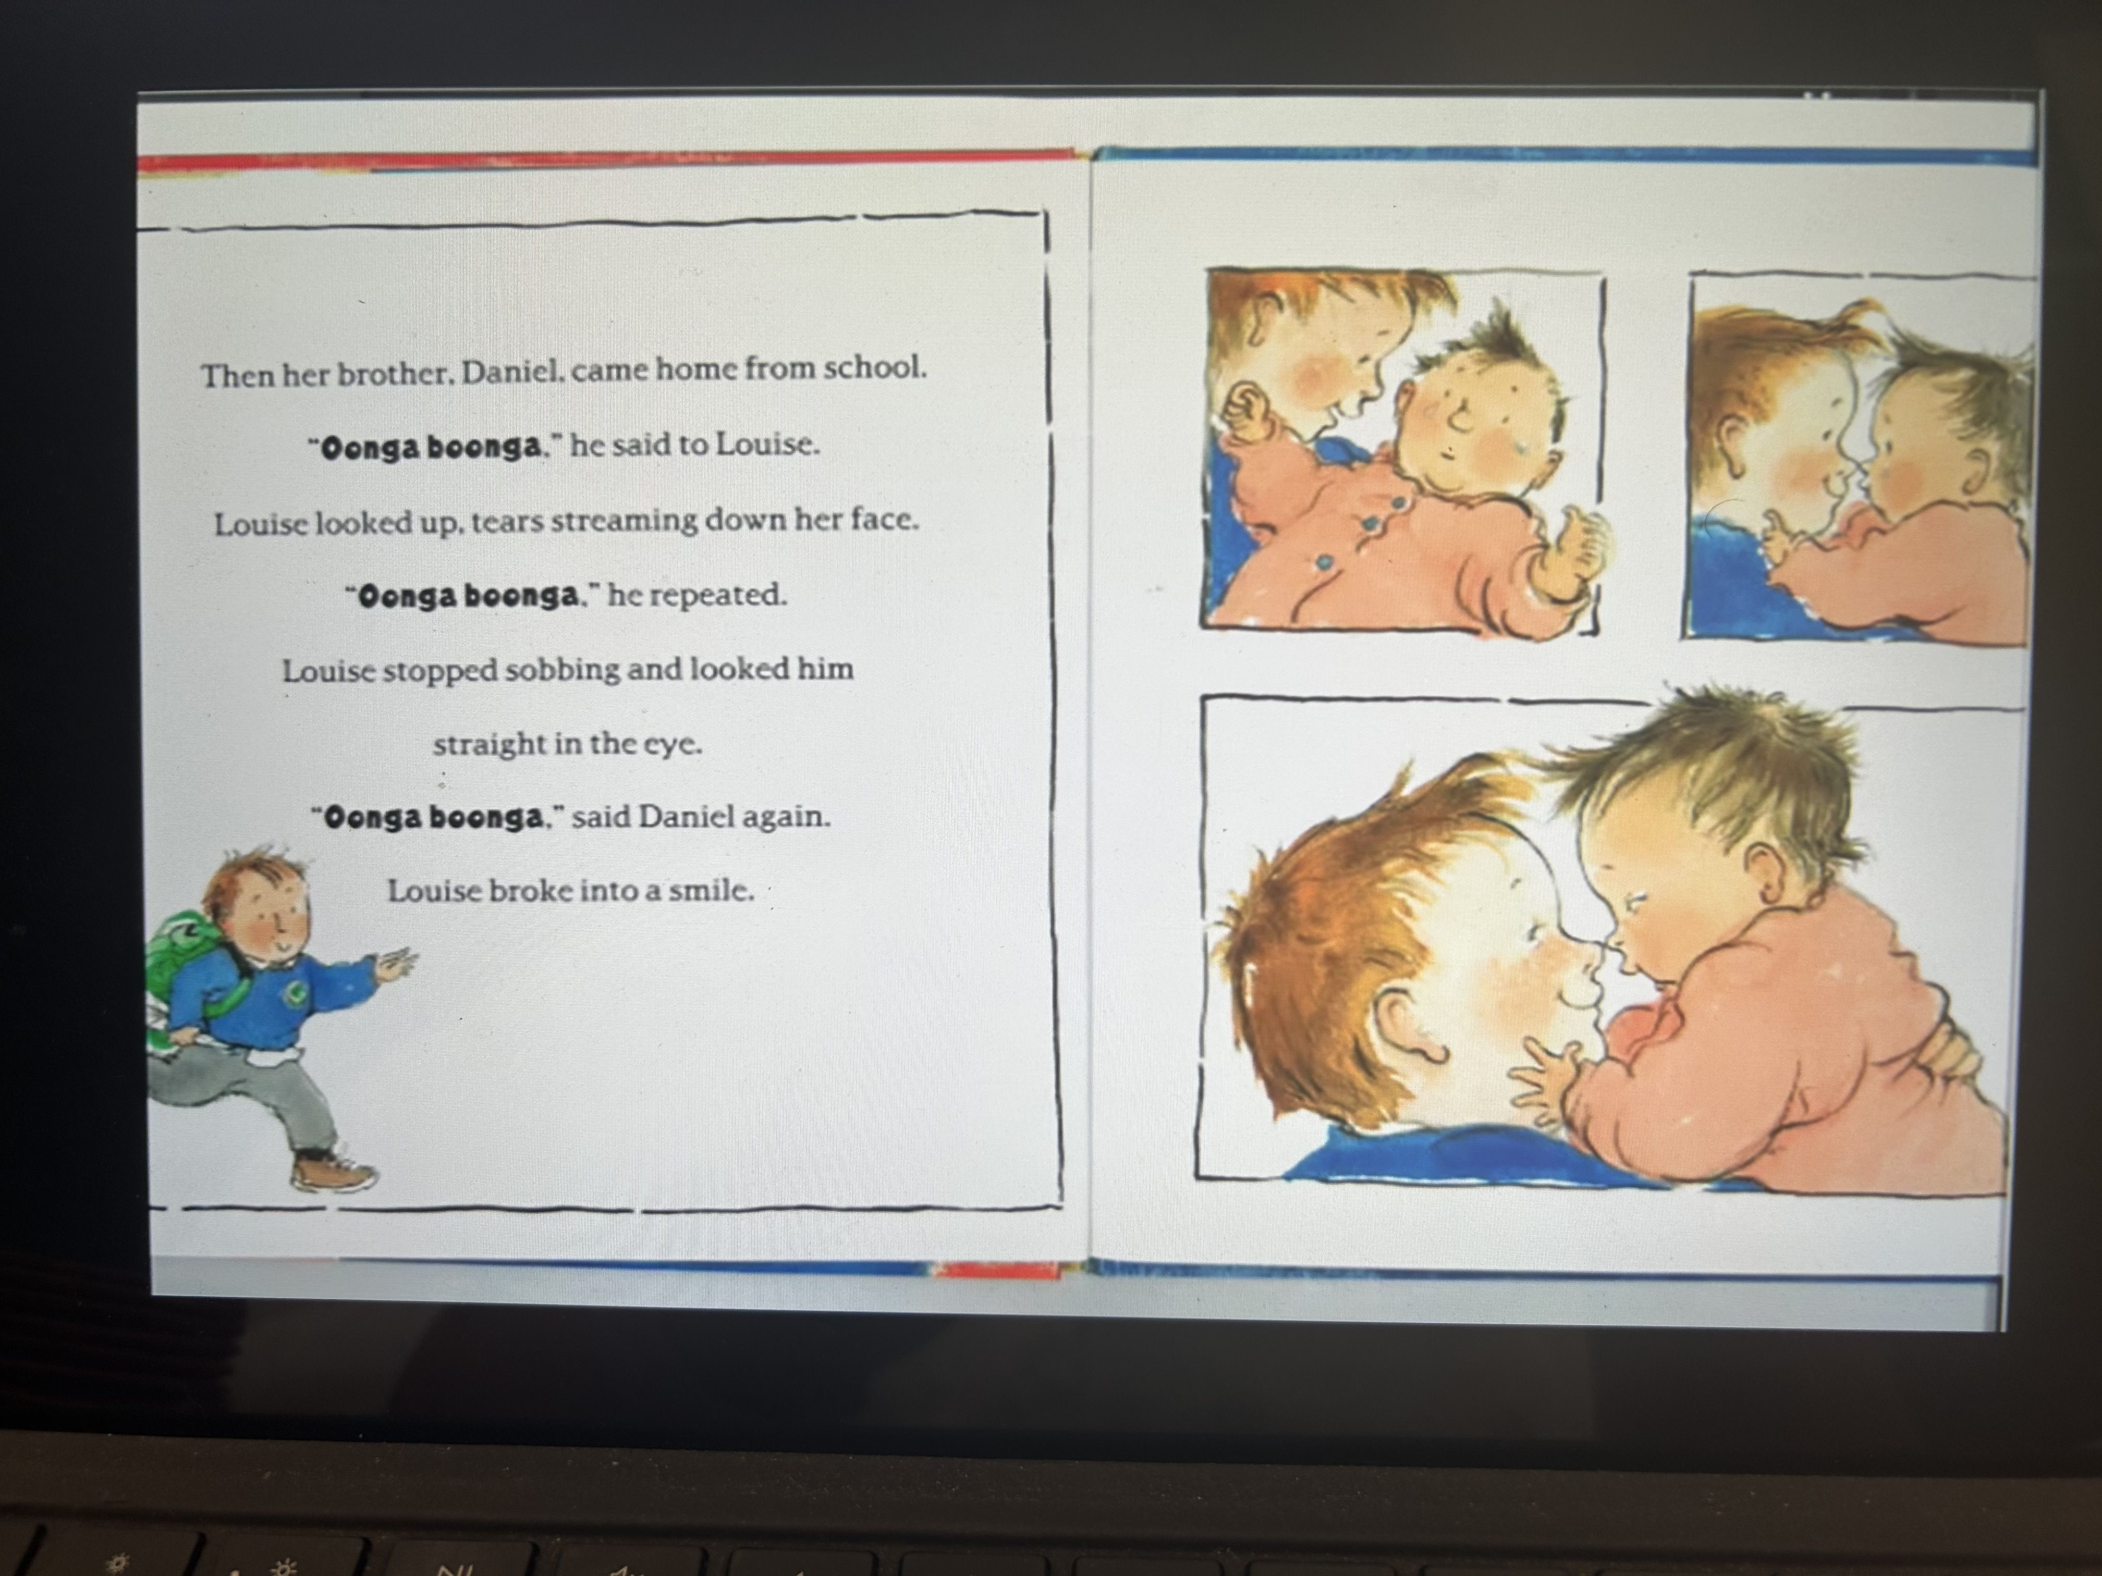

Slide 10
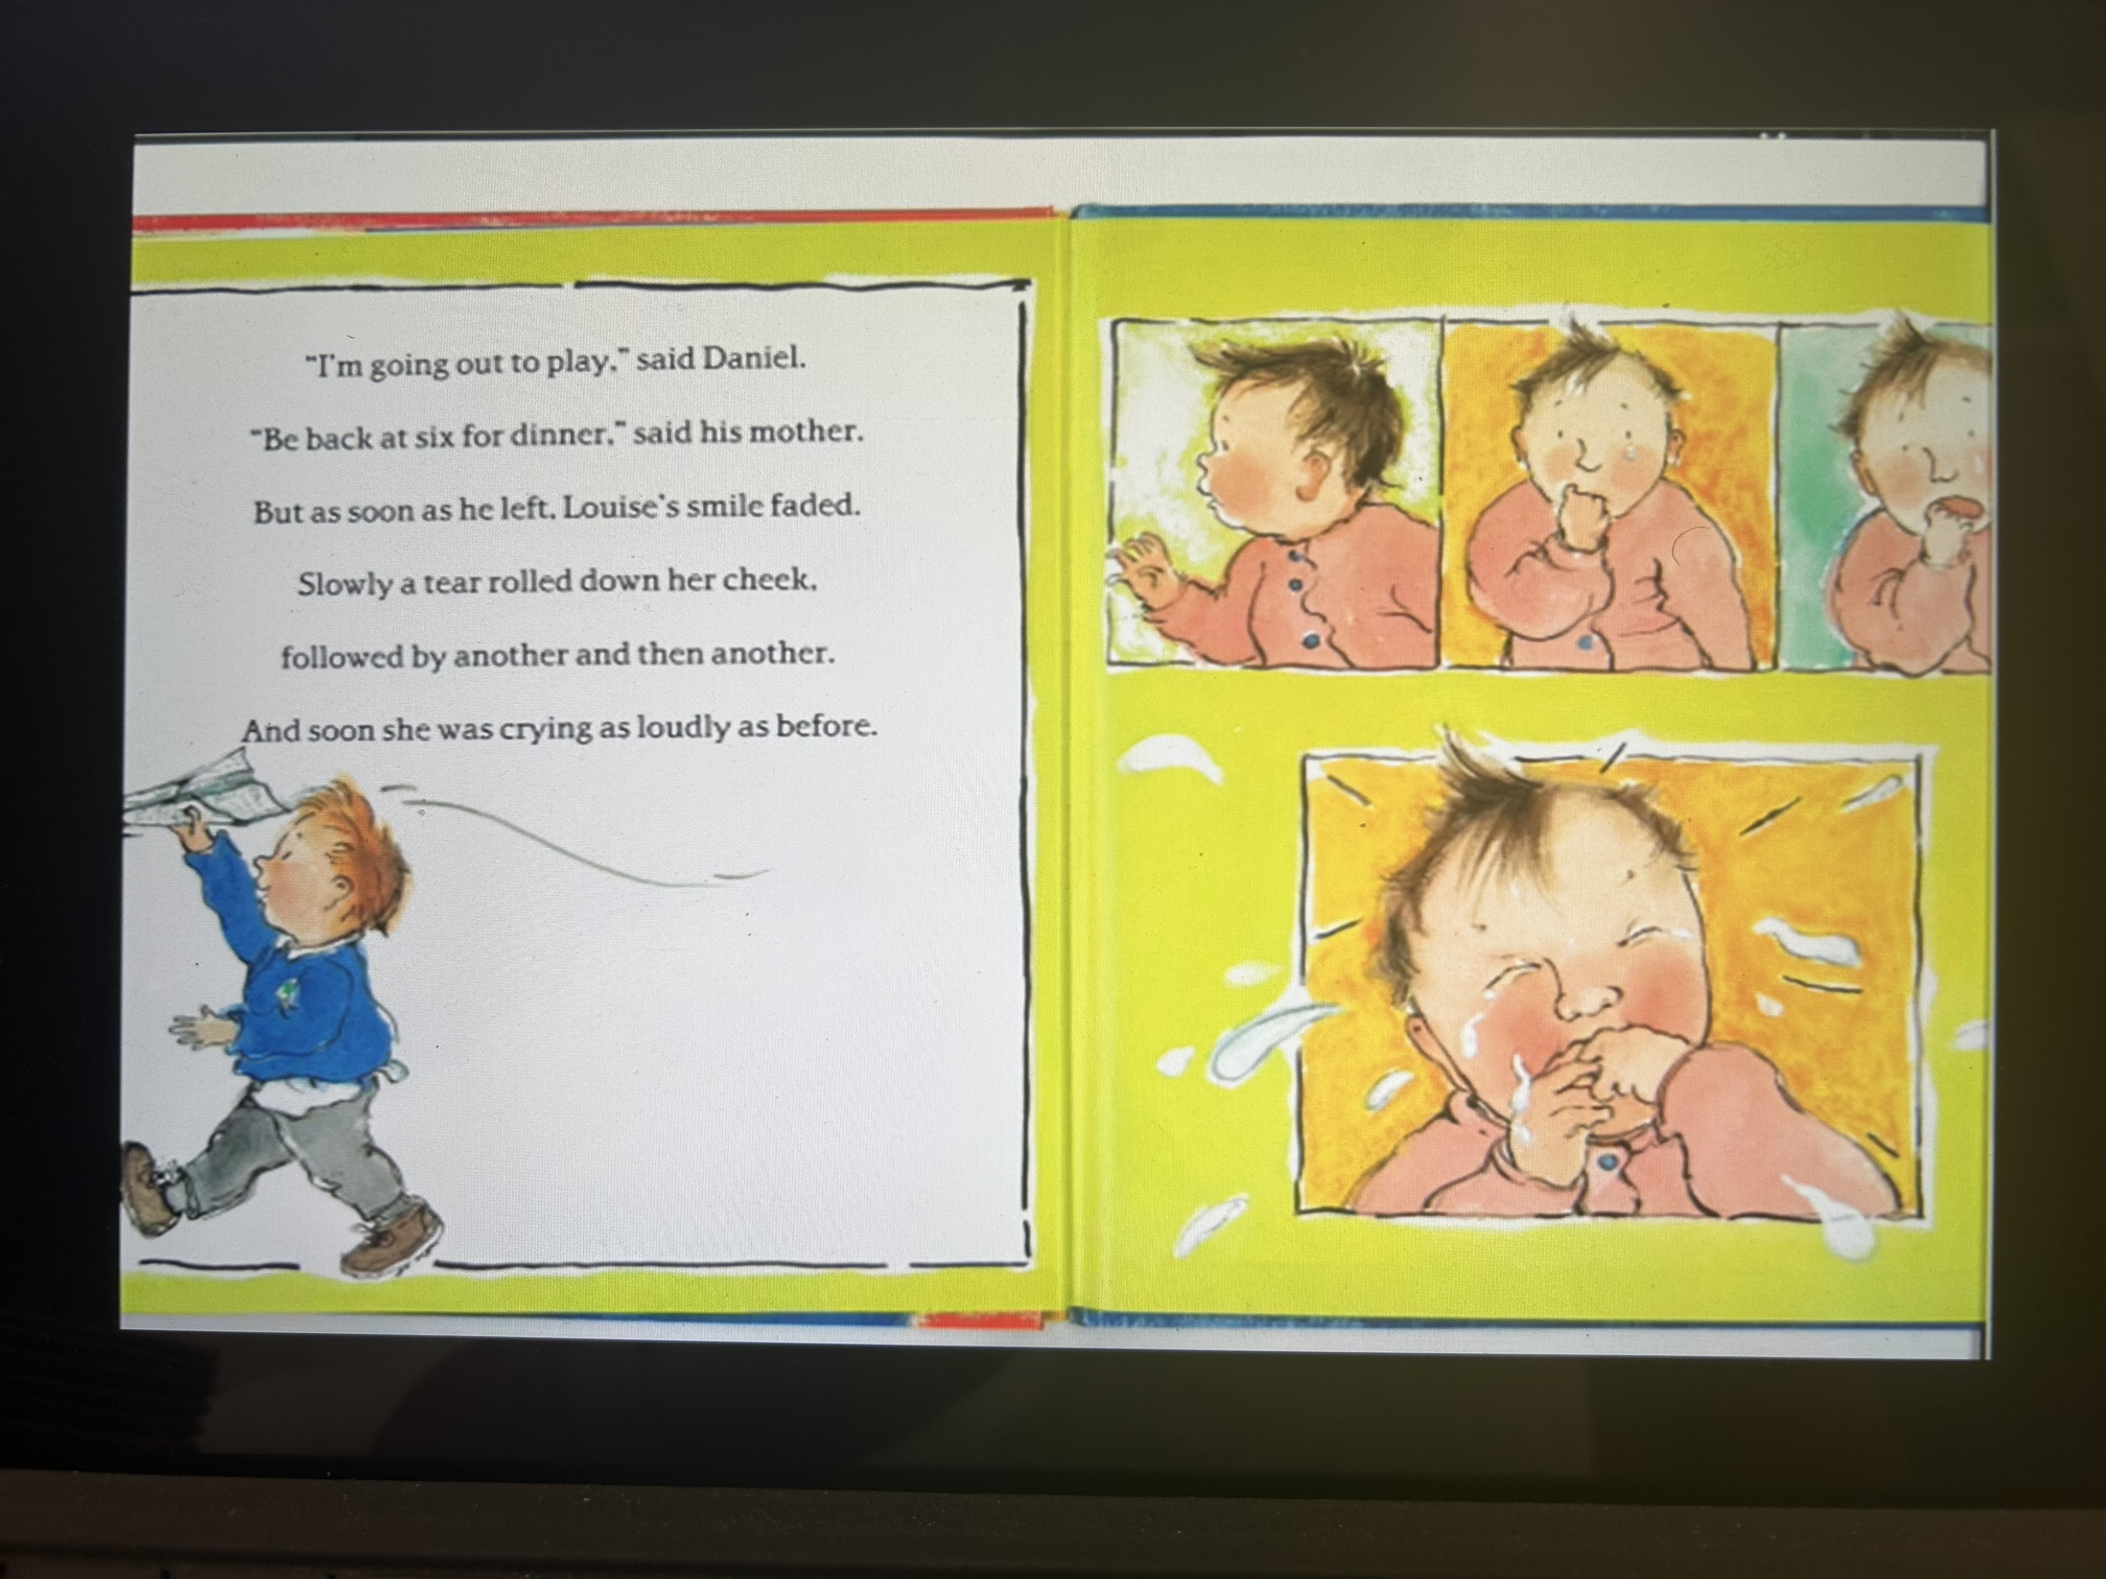

Slide 12
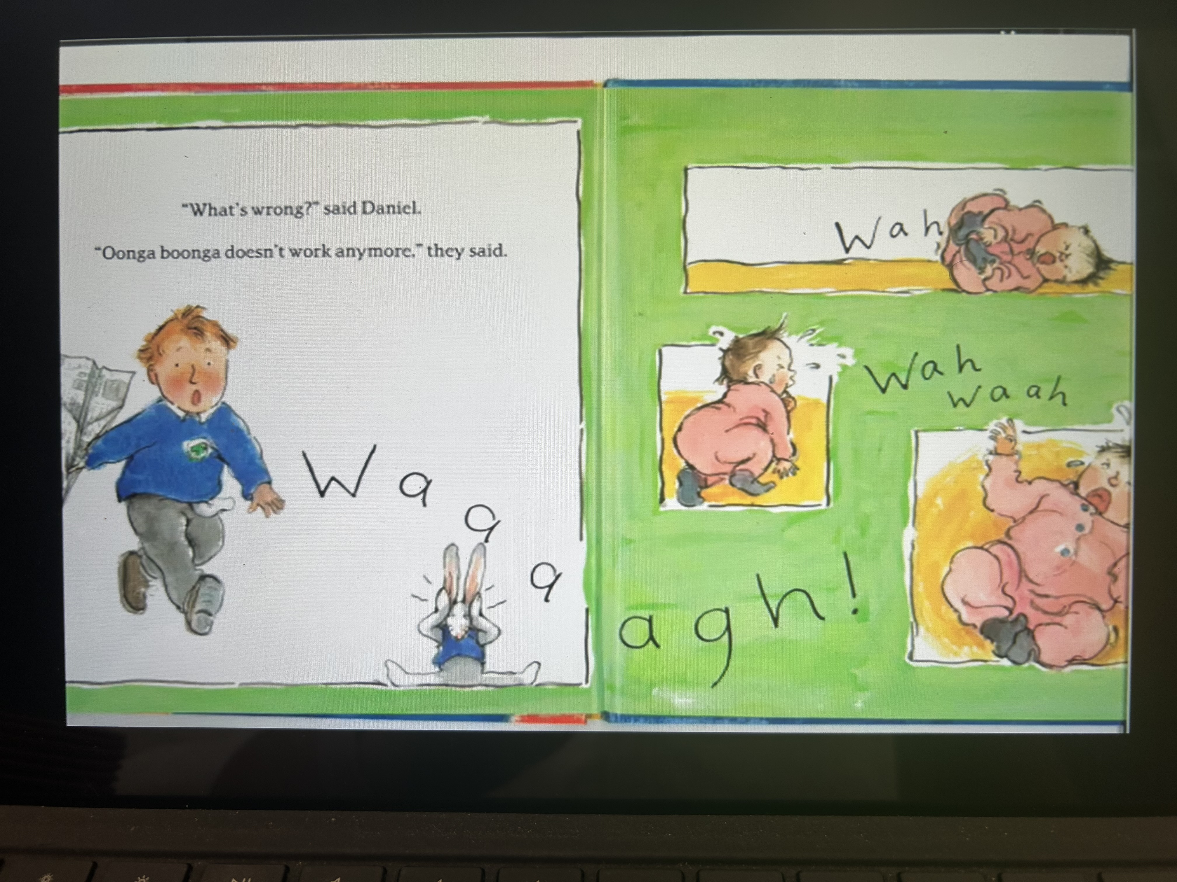

Slide 13
