Slide 1
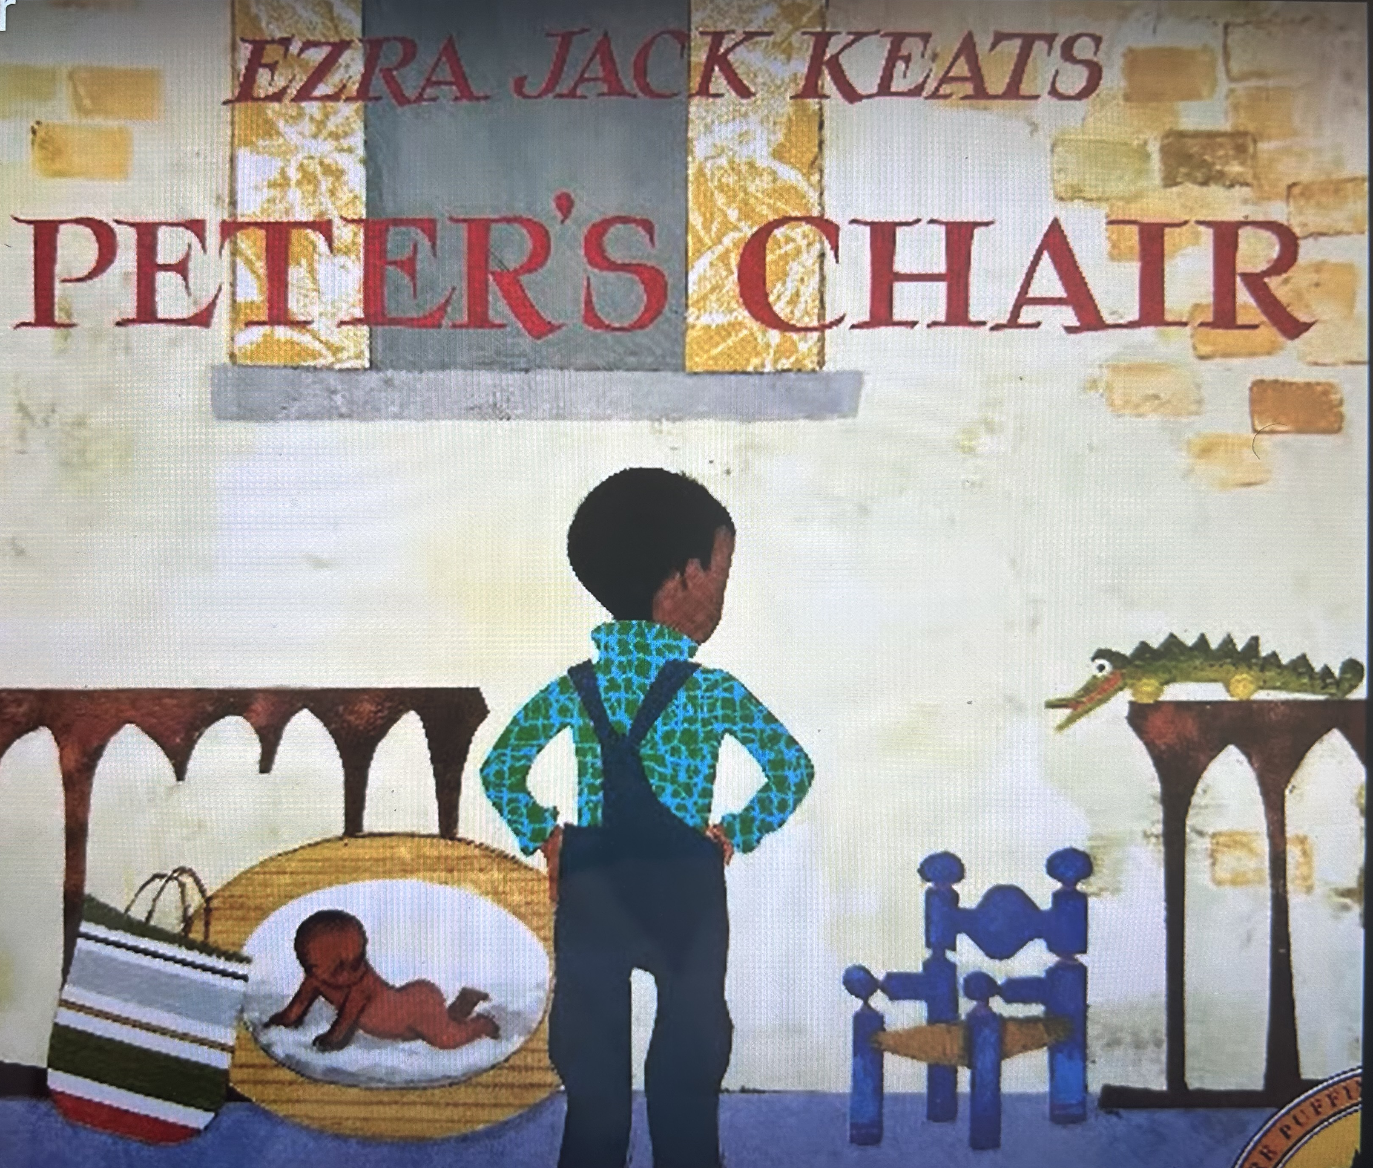
Peter’s Chair by Ezra Jack Keats
Keats, Ezra Jack. Peter's Chair. Puffin, 1998.
https://youtu.be/DW_QIMBjvHQ
Unit 1

Slide 2
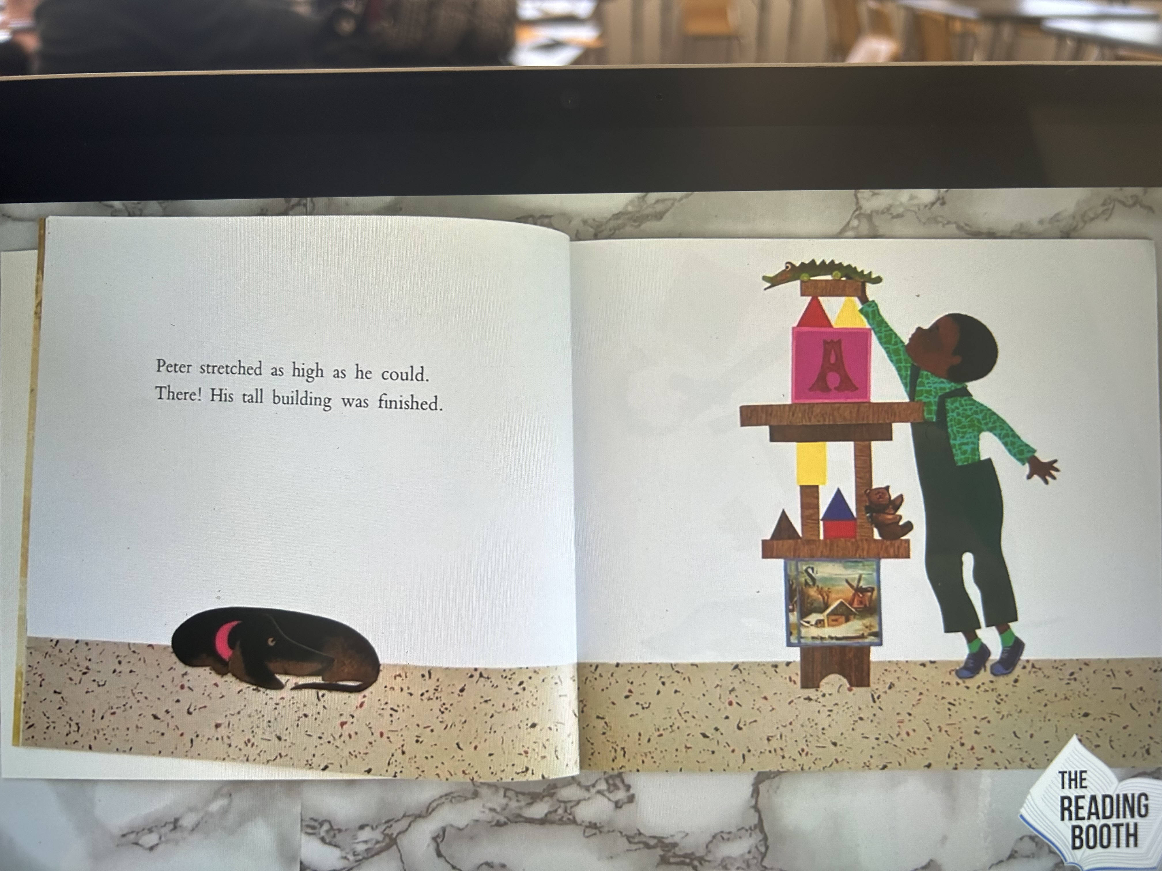

Slide 13
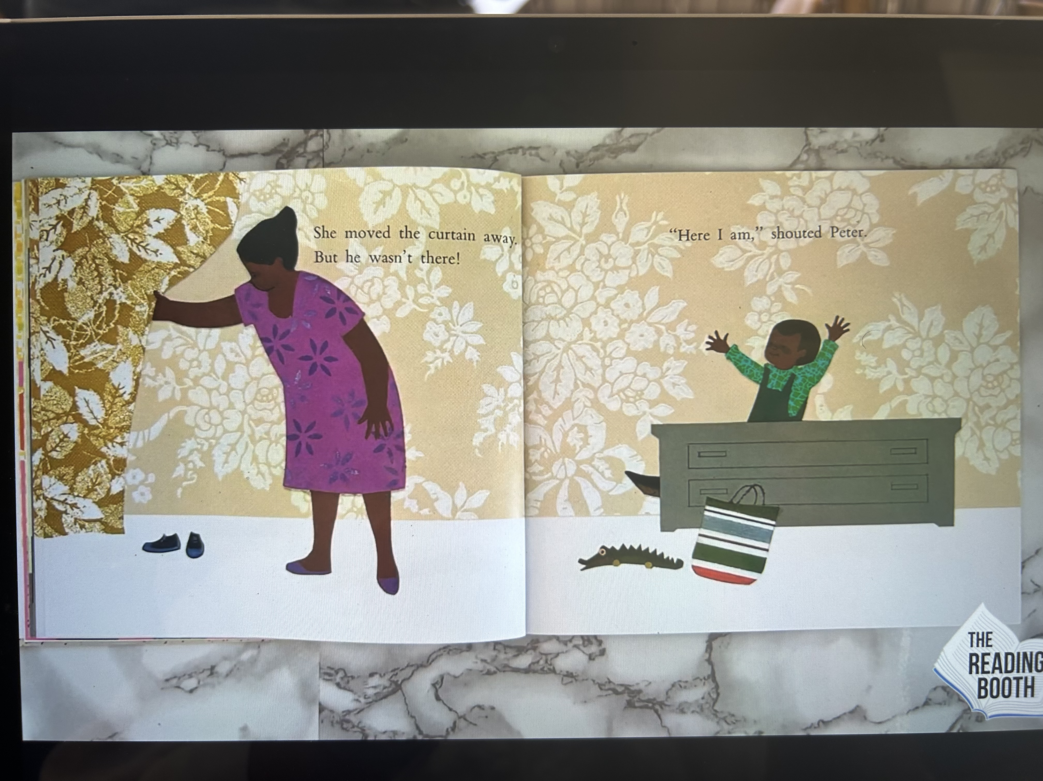

Slide 14
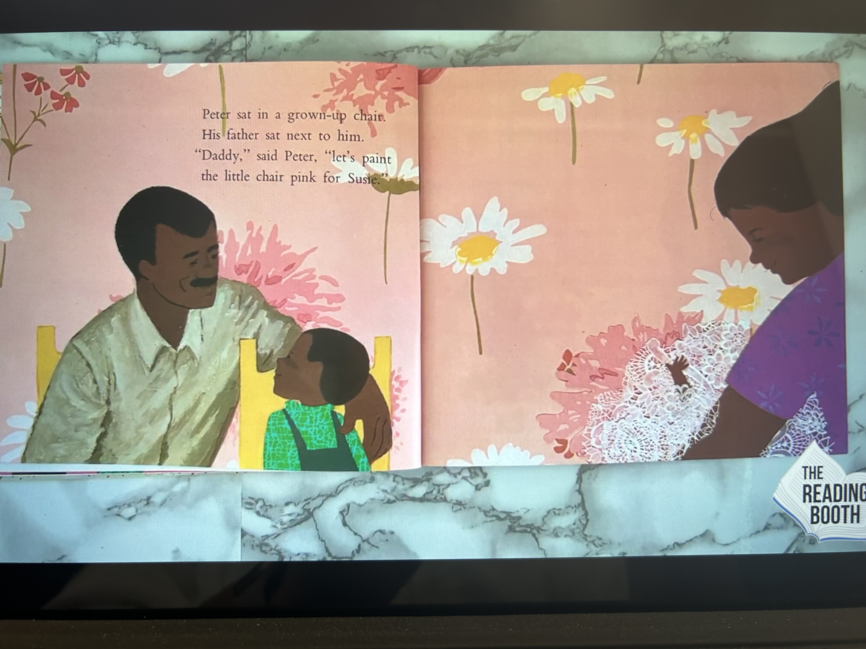

Slide 15
