Slide 1
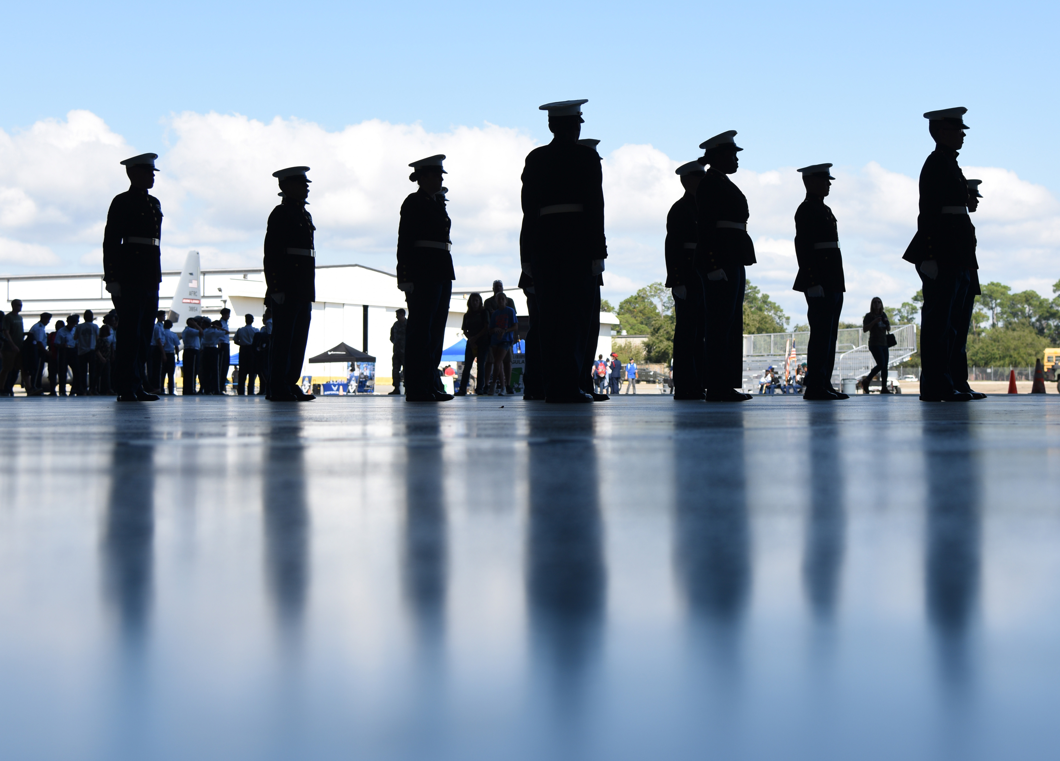
Germantown High School Marine Corps Junior ROTC compete in the unarmed regulation drill during the Fourth Annual Mississippi All-Services Junior ROTC Drill Competition Nov. 4, 2017, on Keesler Air Force Base, Mississippi. More than 400 Junior ROTC cadets, spectators and volunteers were in attendance where cadets battled for the best all-services Junior ROTC team in Mississippi. Thirteen Junior ROTC teams from all military branches were represented at the event with the Pearl High School Navy Junior ROTC earning the top honors. (U.S. Air Force photo by Kemberly Groue)

