Slide 1
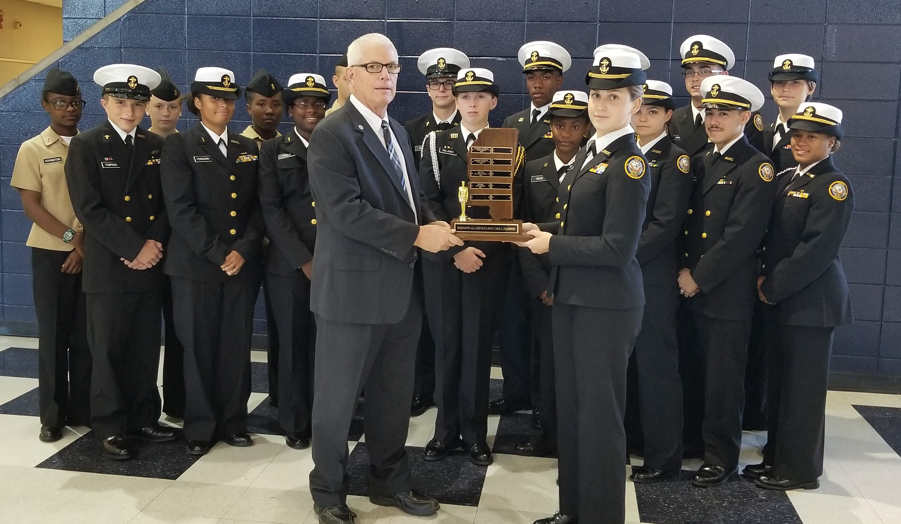
Mr. John Craven, Assistant Principal Pearl High School, and Cadet Commander Kelly, Commanding Officer PHS’ Navy JROTC Unit with the Mississippi JROTC All-Service Drill Champions travel trophy. As the reigning champions, Pearl High will display the travel trophy until the next All-Service Drill Championship (Jan/Feb 2019). Congratulations to CDR Jackson, 1ST SGT Schaab and the PHS NJROTC Drill Team—well done!

