Slide 1
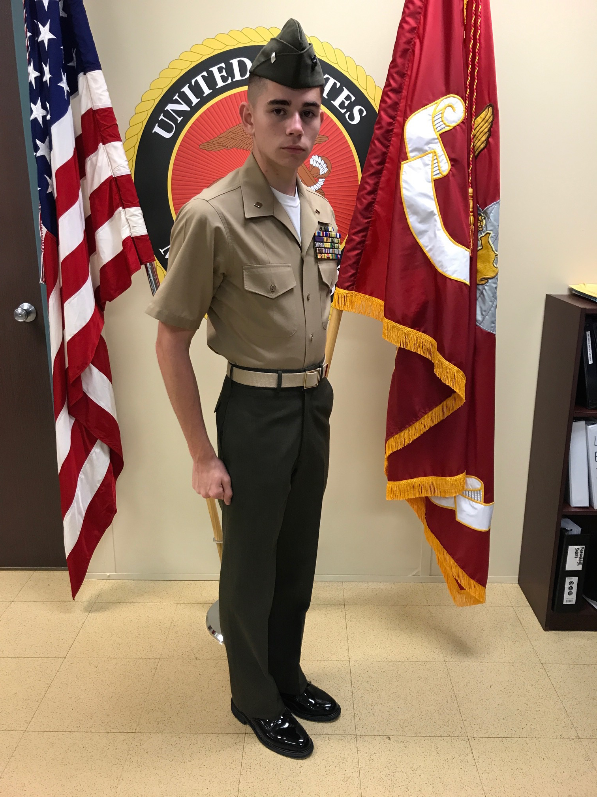
Olive Branch MCJROTC Cadet Selected for NAPS
Cadet Boyero has just been accepted to the Naval Academy Preparatory School (NAPS) in Newport, RI. The mission of NAPS is to enhance midshipman candidates’ moral, mental and physical foundations to prepare them for success at the U.S. Naval Academy in Annapolis, MD. The 10-month course of instruction at NAPS emphasizes preparation in English Composition, Mathematics, Chemistry, Physics and Information Technology.
Cadet Boyero is a senior at Olive Branch High School. He’s currently the Commanding Officer for his Marine Corps JROTC unit and has been in the program since its conception. He currently holds a 4.75 GPA and takes an advanced placement curriculum, ranks within the top 10% of his graduating class and has put in over 300 hours at various community service events within Desoto and Tate Counties.
Other accomplishments include the 30+ ACT score award, academic achievement awards, along with many other scholastic and ROTC awards. He was awarded positions within the National Honor Society, Superintendent’s Leadership council and the Olive Branch High School Leadership Council.
Upon completion of NAPS, Cadet Boyero will attend the U.S. Naval Academy (Class of 2023). His goal is to graduate with a degree in History with an emphasis on Military History and Political Science. Upon graduation from the academy, he plans on serving as an officer in the United States Marine Corps.

