Slide 1

See Every Student.

Slide 2


Assessing for Kindergarten Readiness
Jennifer Wright DeHart, Ph.D.
July 18, 2023
Notes:
Thank you for joining today! We truly are your partner in learning here, wherever you are in your learning journey (new or veteran). We're glad to support you and partner with you!
Before we get into the material, I just want to make sure that everybody understands this is being recorded today. The slide deck and the recording will be made available on the Mississippi Department of Education webpage, which is a really important reference for you, so we encourage you to bookmark it.

Slide 3


Our mission
Since 1986, our mission has remained the same:
To accelerate learning for all
children and adults of all ability levels and ethnic and social backgrounds, worldwide.
Notes:
We always begin our mission with each presentation, which is to accelerate learning for all, all children and adults of all ability levels, ethnic and social backgrounds worldwide so wherever you are today in your learning with Renaissance products. we're going to go on that journey together, so I am glad that you are here.

Slide 4
Agenda
1. Defining Kindergarten Readiness
Purpose for screening
2. Kindergarten Readiness Assessment
Preparing your students, Supporting ELC’s, Student and Admin Experience
3. Support and Resources
Notes:
Let’s break today’s agenda down with a123. First, we are going to talk about what the kindergarten readiness assessment; what's the purpose and how do we do it. How is it done so, the first one is really the what, while the second is the how, how do you prepare your students? how we're going to support the early learning collaborative or SIPs? Also, what does the student experience look like; what does the administrator experience look like; and then, finally, wrap up with support and resources.

Slide 5



Defining Kindergarten Readiness
Who takes the test?
When do they test?
Metrics
All public school and charter school K
All public Pre-K
All Collaborative Pre-K
All SIPs
Pre-Test in Fall
July 20 – September 22 (test within first 30 school days)
Post –Test in Spring
April 1, 2024 –May 10, 2024
Key Dates (23-24)
Kindergarten
Fall –SS 530
Spring –SS 681
Pre-K -Spring – SS 498
Notes:
All public, charter K and PreK students, as well as all ELCs and SIPs
Link to key dates document. https://www.mdek12.org/sites/default/files/Offices/MDE/OA/OSA/LPBA/2023-2024_k-3_assessments_key_dates_0.pdf
Now, if you look in the middle you'll see some really key dates, I want to call out the screening window dates for the pre-test and the post test. you're required to test all of your students within the first 30 days of school beginning the day you start school so, believe it or not, looking at the dates the screening window for the Mississippi kindergarten readiness assessment actually starts July 20. Beginning July 20th, we would have 30 days of school from July 20th to get all your students tested. So, the reports are going to reflect the benchmarks for both the fall and the spring, according to the benchmarks set.
The metrics for kindergarten, what are we looking for we're looking for a scale score of 530 is a measure of readiness for Mississippi in the fall. However, that number changes in the spring, so if you have a kindergartner in the spring, the Scaled score goal is a 681. If you have pre-kindergarten students, we're not looking for a scale score cut in the fall window, but in the spring, it is a scale score of 498. So, keep those in mind as you go through, and you may want to screenshot this document or look this up in their PowerPoint as you go through take a note of these spring dates as well, so that you have those on your calendars.

Slide 6
Purpose for Universal Screening
Notes:
The scaled score is set by Mississippi Department of Education and in the fall, that is a target of 530. With these scores on the enterprise scale, it is an approximate range scale score with the students age, so a student here, who is approximately four years and five months would approximate to a 450-scale score if I'm a student at approximately five years old somewhere between that 500-600 hundred score is typical; of course, we're talking about children so we're going to have a range but that's Just to give you an idea of how this scale works.

Slide 7
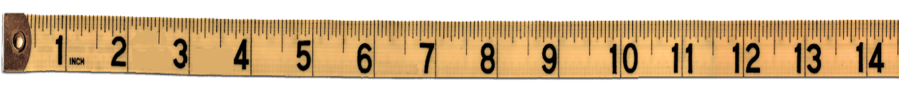
Star items are on the Star scale
300
900
Star items
Notes:
This scale is 300- 900. The SS set for K readiness by the Mississippi Department of Education. The scores, roughly equate to years in age. With this scale, we would expect a 4-year-old child to score within the 300- 450 SS range and a 5-year-old to score between 500-600 SS at the beginning of the year.
However, Mississippi K Readiness target for K Readiness is 530.

Slide 8

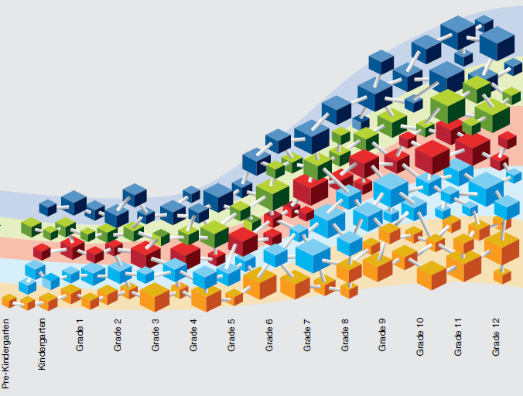
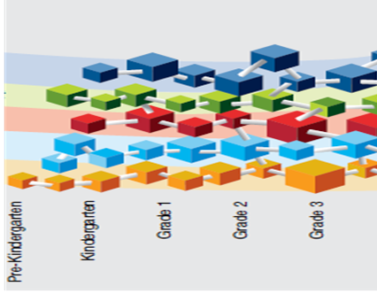
Learning progression skills are on the Star scale
675 Scaled Score (SS)
300
900
Star items
Student performance
Learning progression skills
Notes:
SS also is part of a learning progression. Discreet skills embedded, where instead of having to test each of those 41 skill areas, STAR Early Literacy uses item response theory to determine which skills a student likely knows, and which are too difficult.
Remember that when students take STAR Early Literacy the test adapts to find the right level of items to determine what the student can or cannot do. The correct response to one question on the development scale means that STAR can try another at a similar level and keep going, making smaller and smaller adjustments based on how the student responds. The end result—the student’s scaled score–can be compared to the learning progression of skills to help educators figure out what a student has likely mastered and some options for what would be appropriate to learn next.

Slide 9
Basics of Star Early Literacy
Computer Adaptive
Designed for Pre-K - 3 grade non-readers
Assess within 3 domains (including early numeracy)
27 items
Scores most closely align with a student’s age
If students cannot get through the practice questions. Refer to item 31 on the FAQ document
LBPA FAQ
Notes:
To begin, the SEL is computer adaptive. This means that it will adjust in difficulty as the student responds. Assesses three domains, 11 sub domains and 42 skill areas. Purpose is to find where is student is on their learning progression and mastery of skills. As part of a computer adaptive test, their will be questions that the students find difficult and might not be able to answer. Set that expectation. Designed for Pre-K – 3 students. There is always a practice session before they begin the assessment. When they pass the practice questions, this will take them into the 27-item assessment.
Also, we use the item response theory to level and get the right scale score during the questioning of 27 questions, so the end result, Is the student receives a scale score that can actually be compared to the learning progression of skills to help the educator figure out what a student is likely mastered and some options for what would be appropriate to learn next.
https://www.mdek12.org/sites/default/files/Offices/MDE/OA/OSA/LPBA/lbpa_faqs-2022_3_14_2022v2.pdf
On the FAQ document that is on the Mississippi department education web page, it will tell you what to do if the student cannot get through those practice questions.

Slide 10
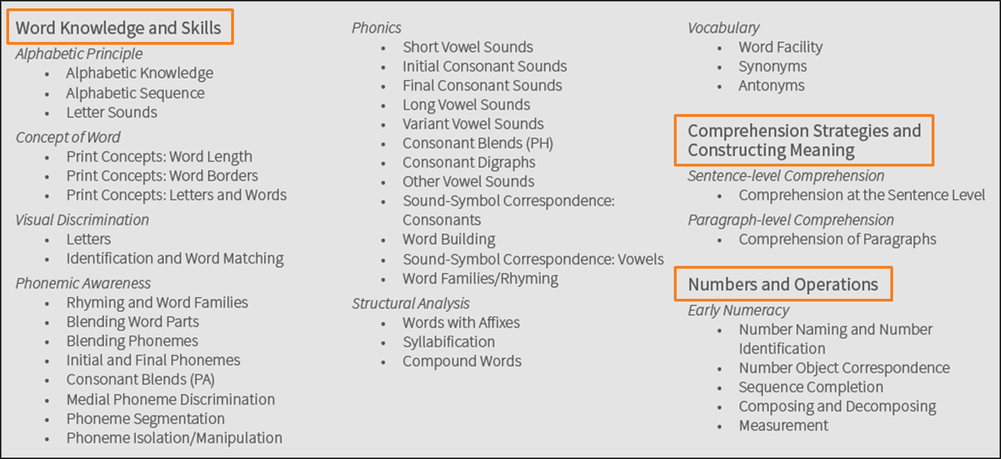
Key Domain Areas
Notes:
This shows what is assessed.
3 domains, 11 sub domains and 42 skill areas.
How are we able to get an accurate read of skills in just 27 questions. This is due to item response theory and statistical inference. If a student gets a question that says what the number is between 3 and 5, it is assumed that the student will know that a number is different to a letter and the numbers 0-10 in order of value. These skills are also on the learning progression, so we know which skills they have mastered, which skills are pre-requisite to those and which skills they need to master to get to the next level in reading. And this slide really solidifies how's this computer of adapting testing works

Slide 11
How computer-adaptive testing works
More
Difficult
Easier
Items answered by a student
Correct Response
Incorrect Response
Standard Error of Measurement
Notes:
The first item is based on estimated ability level, using a student’s grade level or previous test score. We are going to give the student an entry level test question for that grade. Correct responses cause the difficulty level of the next item to increase. If the student misses an item, the difficulty level is reduced.
Remember that when students take STAR Early Literacy the test adapts to find the right level of items to determine what the student can or cannot do. The correct response to one question on the development scale means that STAR can try another at a similar level and keep going, making smaller and smaller adjustments based on how the student responds minimizing the standard error of measurement.
The end result—the student’s scaled score–can be compared to the learning progression of skills to help educators figure out what a student has likely mastered and some options for what would be appropriate to learn next.

Slide 12
STAR Early Literacy Scaled Score (SS)
300 SS
530 SS Fall
681 SS Spring
900 SS
Notes:
The information you get back from STAR does not report a student’s right or wrong answers on any individual items. Instead, their overall test performance provides a scaled score which can be used to compare student performance or determine if they’ve met predetermined levels of proficiency.
A student’s scaled score is the raw score the student attained based upon the difficulty of the questions the student was given and whether or not they were answered correctly.
The STAR Early Literacy scale ranges from 300 to 900. A students Scaled Score will be within that this range.
It may help to think of the scale like a ruler, measuring student performance. A student with a lower level of knowledge of early literacy skills would score in the 300 to 400 range while a student with a high degree of knowledge, able to answer the more difficult items of the assessment, would score in the 700s or 800s.
Where would you expect your pre-k students to score? (likely toward the first half of the scale, 300 to 600).
Beyond that, how do we know if a student’s scaled score is good enough or is where it should be? Based upon student data from this assessment, Renaissance Learning and the Mississippi Department of Education made a determination about what scaled score a student needs in order to be ready for kindergarten.
[click] The data we currently have from students assessed with STAR Early Literacy across the country indicates that students with a scaled score of 530 or above in the fall are typically ready to learn kindergarten-level skills. Students with a score below 530 usually need additional help.
(CLICK) The Scale Score for Kindergarteners in the Spring is set at 681

Slide 13
Preparing for the Assessment
Notes:
So let's talk about preparing for this assessment. what can we do to get our students ready.

Slide 14
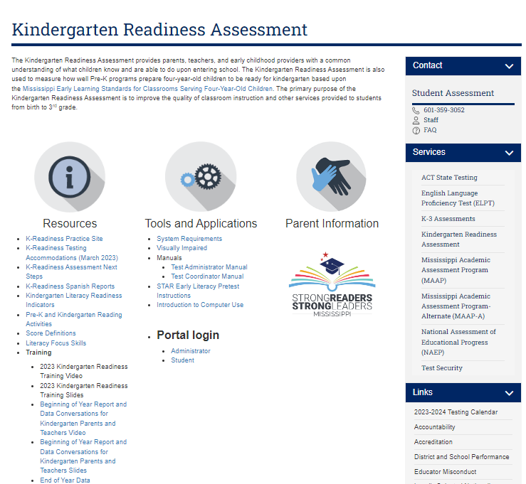
Kindergarten Readiness Assessment
https://mdek12.org/OSA/K_Readiness
STAR Early Literacy Pretest directions
Introduction to computer use
Notes:
The pretest instructions can be found on this helpful site. Bookmark this site as it contains all kinds of support resources that we will dig into more later.

Slide 15
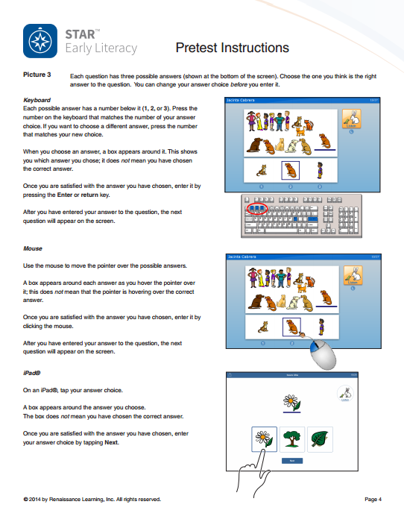
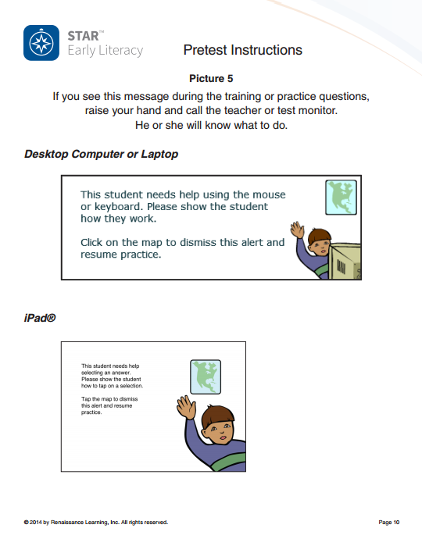
Pretest Instructions
Prepare students for technology
Notes:
Pretest instructions are the main document you’ll use to prepare students for testing, so all students hear a common message.
They provide a checklist of what to do to prepare for testing, a teacher script to read to students before the assessment, and pictures to show students what to expect.
Familiarize yourself with the instructions so you’ll know how to prepare students for testing.
https://videos.renaissance.com/watch/5XNUpPs1GU8ZmTVvJXwJAd

Slide 16
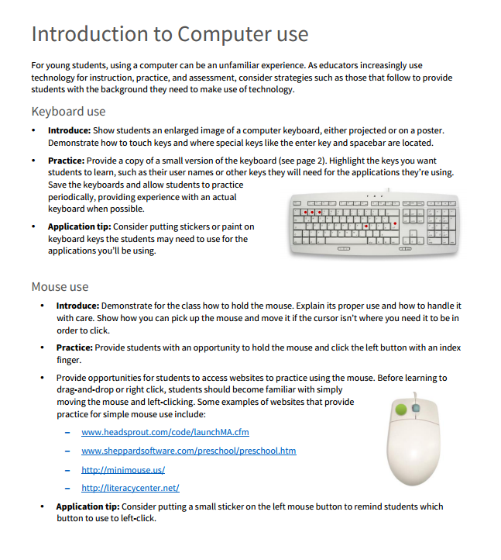
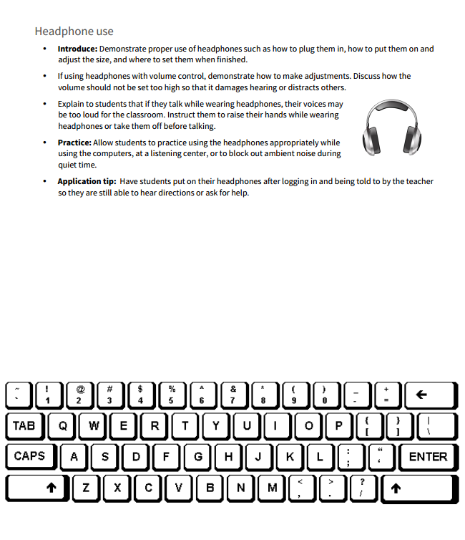
Introduction to Computer Use
Taking Test with Tablet or iPad
Prepare students for technology
Notes:
This is a helpful document for introducing young students to using a computer, keyboard, headphones, and mouse. It includes links to websites recommended for practicing with a mouse. Just a very neat document to prepare your students who may not have experience with the different hardware of a computer. Students can also use an iPad to take the assessment.
https://videos.renaissance.com/watch/5XNUpPs1GU8ZmTVvJXwJAd

Slide 17
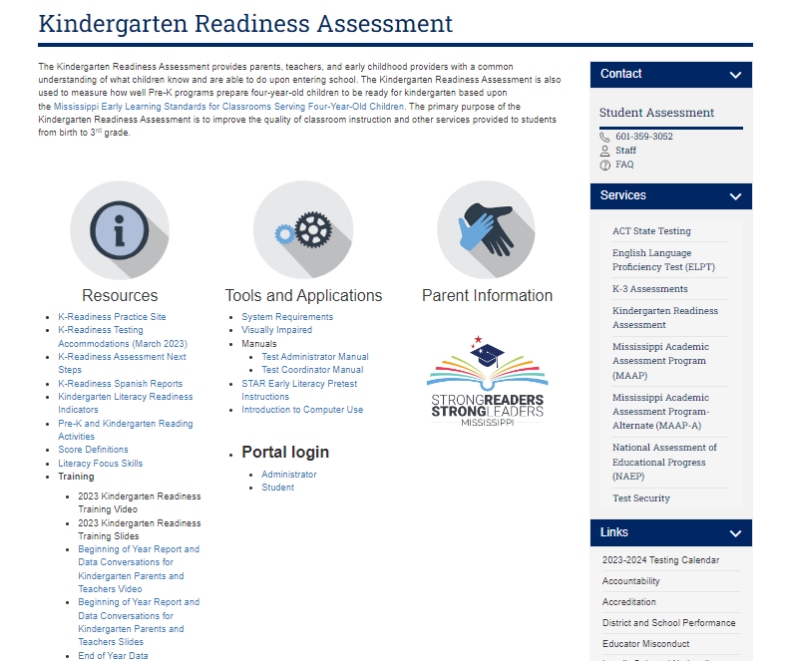
Practice
K Readiness practice site. Teachers and students can see what the test will look like. Watch the student practice video and view sample questions.
Notes:
All right, let's talk about practice, this is the kindergarten readiness practice site, and you can see it is marked with this pink arrow here. Teachers or students can actually go here to see what the test will look like; there's a practice student video and it's a computer-generated voice it's like a cartoon of this. It’s a female student who's going through the clicking and she's learning how to do the different pieces and parts of the assessment and you can view the video view the sample questions, and you can go ahead on that kindergarten readiness practice site.

Slide 18
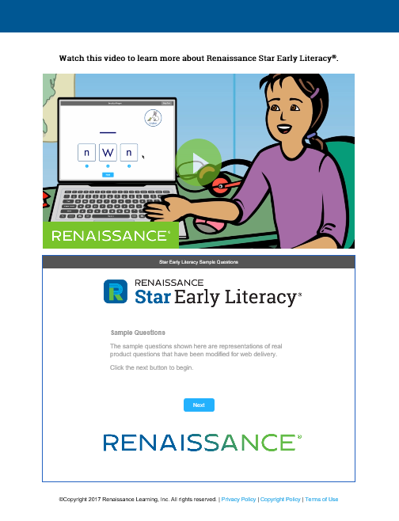
STAR Early Literacy Practice Website
Demonstrate taking the test
Talk through the information on the pretest instructions
Model “think aloud” strategies to verbalize your thought processes
  Making an answer choice
  Needing an item repeated
  Not knowing an answer
  Waiting
Notes:
Before working with students, teachers should try out the demonstration site to know what to expect and can plan how to use it with students.
Demonstrate: Using a projector or similar method, show students the video that describes how the student takes the test. The practice items can be used by the teacher to demonstrate to students what their thought process is like for taking the test. During the demonstration, talk through the information on the pretest instructions. Model some “think aloud” strategies to verbalize your thought processes around ideas like:
Making an answer choice (“I’m going to think about what they are asking me and click on the one that I think is right.”)
Needing an answer repeated (“I need to listen to that again to make sure I understood what they meant.”
Not knowing an answer (“I don’t know how to answer this one…I’m going to pick what I think it might be and then I’ll get a new question.” Some of the last few items in the demonstration require students to read so those would be good to show students how they don’t need to get frustrated, just make a selection and move on.”
Waiting-please do not try to answer the question until the question has been read aloud.
There are 7 sample questions within the Practice site – give the students a 1st chance feel on what it will be like to take the assessment

Slide 19

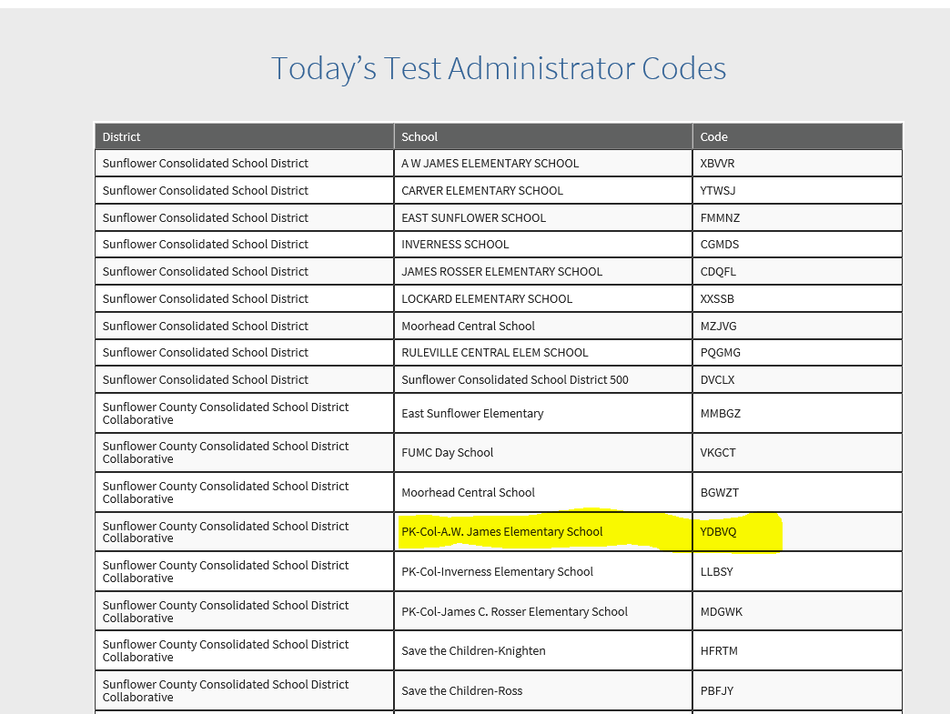
Select Correct Daily Test Code
Notes:
If you are an admin for both the public, SIP, or ELC sites, you will see multiple daily test codes – Please select the Pre-K code. Some of you are veterans to the kindergarten readiness assessment so you already know about the code, some of you are brand new. However, this is really important, when the student is going to test, they have to have a daily testing ticket and in order for you to get the correct code. In order to print out those tickets you're going to have to go to this site, it is really important if you are an administrator, especially if you're an administrator for the public, SIP, and collaborative ELC sites, you will see multiple daily test codes; I'm going to show you an example, make sure you select the correct pre-K code, so, if you look in this example okay look in this example I actually have A w James elementary schools, I have the sunflower consolidated school district. And this here is the school district site, and this is my code. Down here is the collaborative site with a different code, and they are not the same. New codes are generated daily.
If you put the incorrect code in, then it will move the score to the wrong place, so it's really vital that you select the correct code.

Slide 20

Steps to Taking the test
Print your daily Test ticket
Missing Student in Portal
Select daily test code
Does the student have an MSIS number? If yes- check the number is correctly entered in the student information system and in Renaissance Place.
If no – check Renaissance place for name spelling errors grade and D.O.B, correct and wait 24 hours. Students must be rostered in a class.
The day before, go to the portal and print the test ticket with student usernames, passwords and the daily test code.
Public schools and ELC’s have different daily test codes. The daily test code moves the student into the corresponding site. Select the Pre-K code carefully.
Do not write the code on a board for others to use. This moves students into the incorrect school location.
Notes:
Remember this three simple steps!

Slide 21
Student Rostering
Notes:
Let's talk about rostering, and this is something that is always really important for our students.

Slide 22

Rostering Options
Early Learning Collaboratives (ELCs)
  Students are entered into the Renaissance portal and then will be brought into the Kindergarten Readiness portal.
Public School Districts
  Your students will be imported using SRDI. When students are entered into the school student information system, this syncs daily, and your students will be brought into the Kindergarten Readiness portal.
State Invested PreK (SIPs)
  - SIP districts/schools will roster the same way the ELCs do, by manually entering students into Renaissance site. Then as long as all of the criteria is met, they will be pulled into Mississippi Kindergarten Readiness portal via the syncing process.
Notes:
Read this slide carefully. Explain that every year we have duplication of students. Future slides will dig deeper into the rostering process. Only place students cannot have an MSIS is the collaborative site.
The regular public school district, If you have pre-K students or kindergarten students, then your students are imported using srdi. What does that mean? it’s the student roster and data integration. So, when the student registers school the registrar puts them in the student information system, this is going to sync daily with Renaissance and those students are going to be automatically brought into the kindergarten readiness portal, so you do not need to add any students manually. All my students are going to be brought in through that student information system and must have the correct name, correct grade. date of birth and have their MSIS number. And those will be brought into the Mississippi kindergarten readiness portal. And my student can test.
Early learning collaborative means that pre-K students, are in the collaborative site, so I don't have an MSIS number. That means I'm going to add those students; we're going to enter those students in the Renaissance portal and then they're going to come into the Mississippi kindergarten readiness site.
We will dig a little deeper in just a second. The code still printed on student testing tickets; that procedure is exactly the same.
Lastly, we have a new category this year called SIPs (state invested pre-K) which will roster the same way the ELCs do, by manually entering students into Renaissance site. Then as long as all of the criteria are met, they will be pulled into Mississippi kindergarten readiness site via the syncing process.

Slide 23
Early Learning Collaboratives
Specific Support
Notes:
All right, let's talk about early learning collaborative and it's really key that we talk this through, because there is a little bit of a difference here with some specific support we want to give.

Slide 24
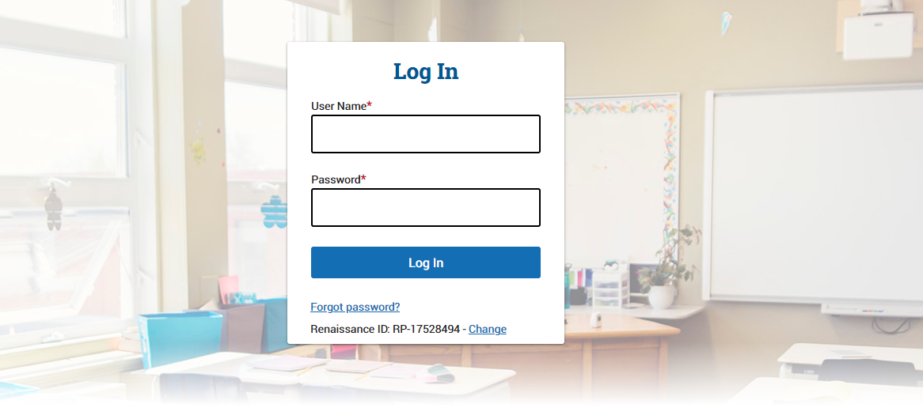
Administrator / Teacher Log In
ID Provided
ID Provided
Notes:
As students test in the state portal, the scores will be transferred to the Renaissance portal within 24 hours. This is only for ELC’s!

Slide 25
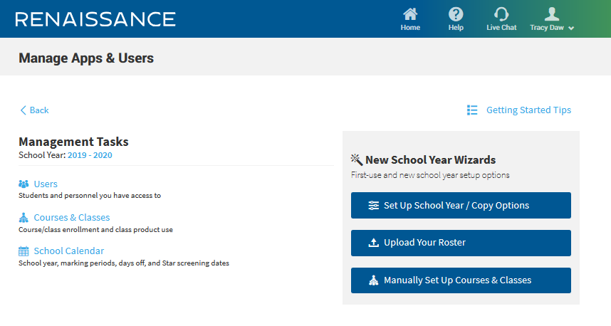
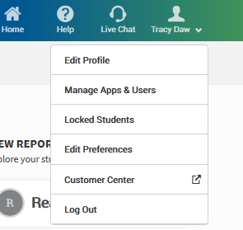

Adding a student
Notes:
Let’s add a student, I have to let's walk through this piece, If I'm in a collaborative, and I need to add a student into that collaborative site, remember, this is a student who does not have an MSIS number and is not in that public school district. I am going to click on my name. And then I'm going to Click manage Apps and users. My next step is I'm going to click on users.

Slide 26
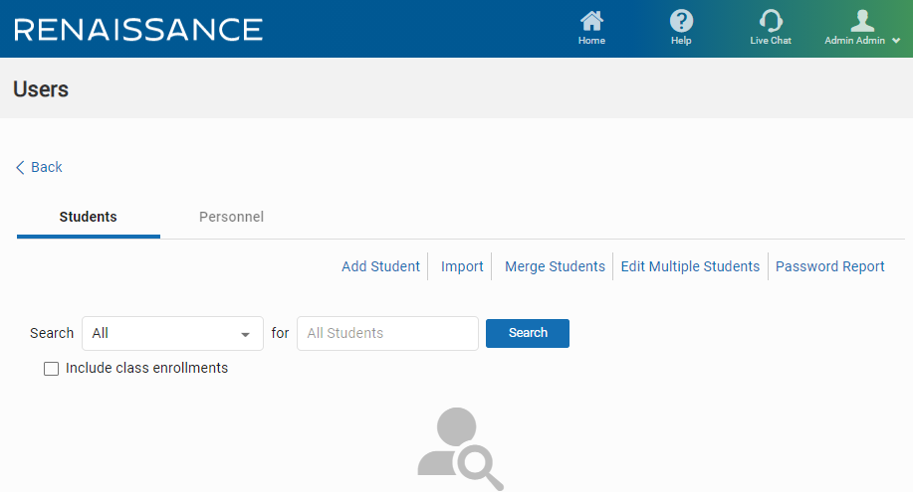
Adding a new student
Notes:
Then I'm going to click on students and add students. When I get here, I'm going to add my students in and you're going to see various required fields.

Slide 27
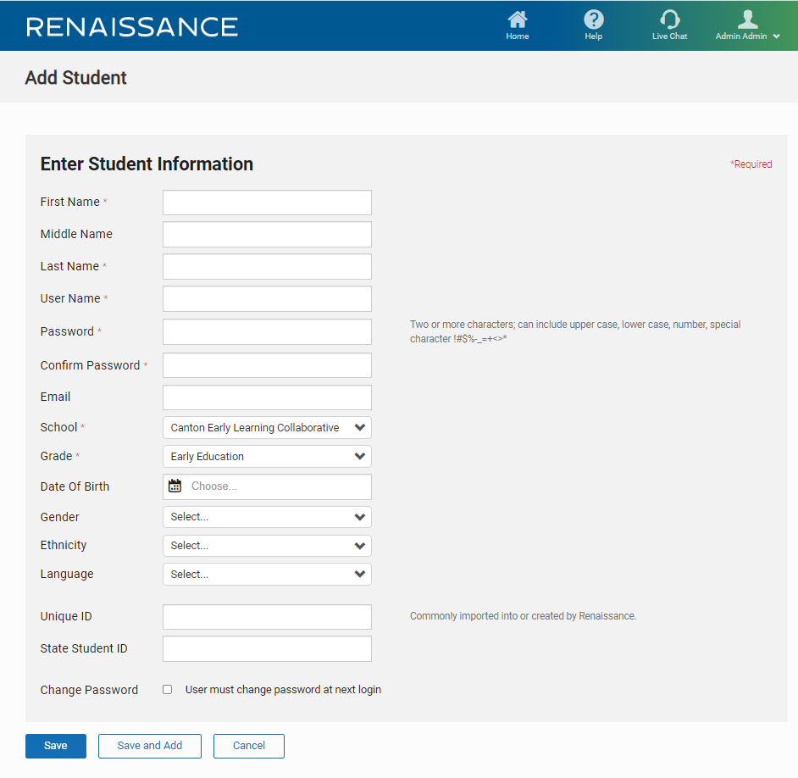
Adding a new student
Notes:
first name, last name, username, password, School, grade, and date of birth are required. Then you also have a couple of other fields here if the student does not have an MSIS number, then they're going to get a temporary number, and that is the number that's going to go into the Mississippi kindergarten readiness portal.
The MSIS number if the student has an MSIS number, which means they have a public school MSIS number that can actually be entered into the state student ID field. The username can be auto generated. The passwords are case sensitive so that's really important. If the student does not have an MSIS number a Temporary number will populate in the MKAS.
Remember a Username can be auto generated.
Passwords are case sensitive.
Then click Save.

Slide 28
What to do if a student is in ELC and has an MSIS
Add MSIS number to the Unique ID field to ensure student is moved to correct location = ELC site.
Notes:
first name, last name, username, password, School, grade, and date of birth are required. Then you also have a couple of other fields here if the student has an MSIS number and is in an ELC, then you will add that MSIS number into the unique ID field to ensure the student is moved to the correct location, which is the ELC site.
The username can be auto generated. The passwords are case sensitive so that's really important.
Then click Save.

Slide 29
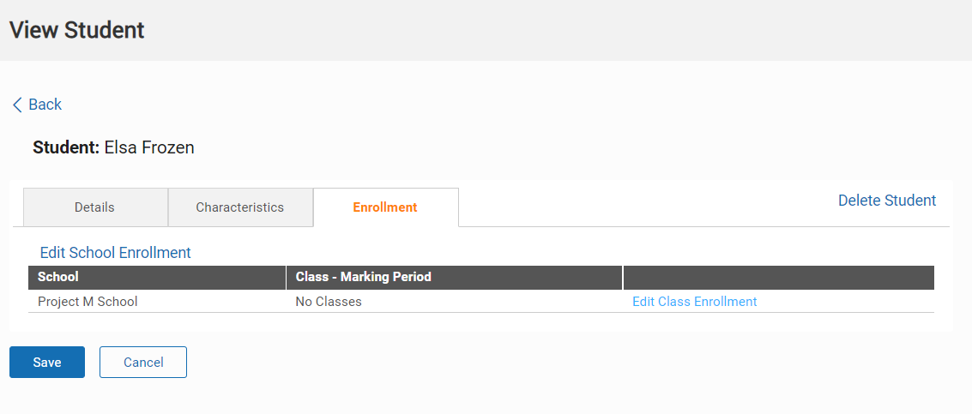
Assigning a student to a teacher
Notes:
once we've added our students and remember this is for the collaborative only. I need to edit the class enrollment and I need to assign this student to a teacher, because if I don't do that, there’s not going to be any report that can be run. I'm going to go to enrollment and edit class enrollment.
Lastly, I’m going to press save.

Slide 30
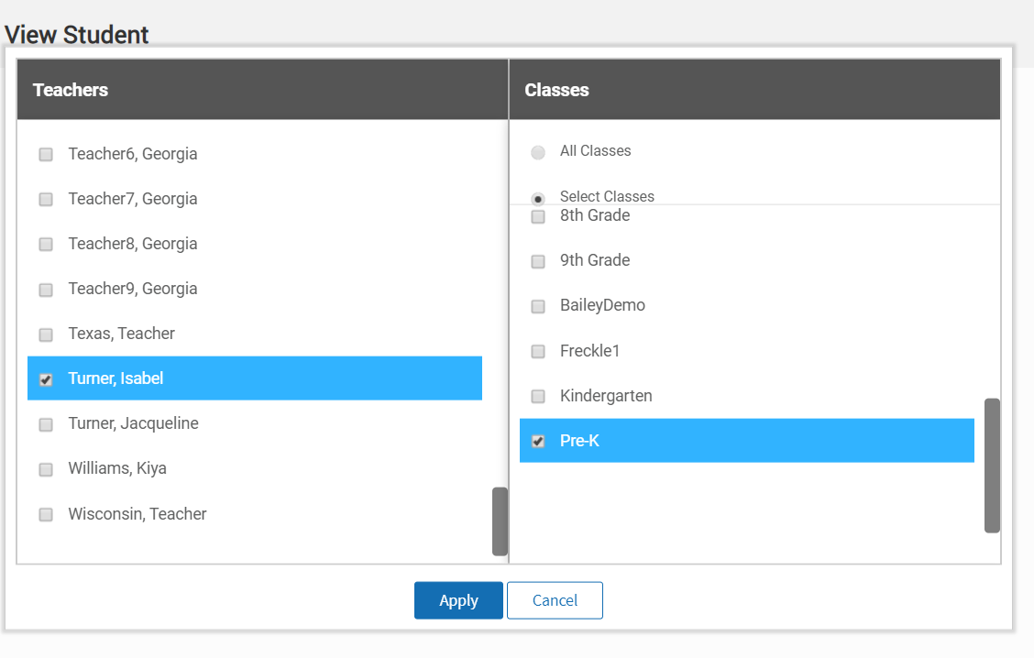
Assigning a student to a teacher
Notes:
You can see how easy it is to pick the correct teacher and grade level and apply the changes.
If all those fields are correctly done in the student information system, they're going to go straight into the Mississippi kindergarten readiness portal, then they're going to sync up to the Renaissance place portal, so I don't have to do anything. If my student doesn't have an MSIS, so for an example, if I'm a head start, I don't have an MSIS number, so I have to actually add the student to Renaissance place.
In those directions, we just showed, we're going to leave the unique ID field empty, and the temporary ID number will be issued to you. So that temporary number is going to be that testing number that the student uses, and this might take 24 hours to sync up.
.

Slide 31

Rostering Students
Check for MSIS
Missing Student in Portal
Select daily test code
Does the student have an MSIS?
YES- Student is added to the K Readiness site automatically if all required fields are met.
NO- Add the student to Renaissance Place and leave the Unique ID field empty. A temporary ID number will be issued.
May take 24 hours to sync.
Does the student have an MSIS number? If yes- check the number is correctly entered in the student information system and in Renaissance Place.
If no – check Renaissance place for name spelling, grade and D.O.B. Correct these and wait 24 hours.
Public schools and ELC’s have different daily test codes. The daily test code moves the student into the corresponding site. Select the Pre-K code carefully.
Do not write the code on a board for others to use. This moves students into the incorrect school location.
Notes:
If you are in a public school your students will have an MSIS number, if you are in a childcare center or head start your students will not have an MSIS number.
Emphasize Grade
The student is added to the kindergarten readiness site automatically if all the required fields on that so those required fields are your name school grade, date of birth. So, if my student has an MSIS number, and all the fields were correctly done in the student information system, they're going to go straight into the Mississippi kindergarten readiness portal. Then they're going to sync up to the Renaissance place portal, so I don't have to do anything.
If my student doesn't have an MSIS, for example, if I’m a head start, I don't have an MSIS number. What do I have to do is actually add the student to Renaissance place. In those directions we just showed and remember to leave the unique ID field empty, and the temporary ID number will be issued to you. That temporary number is going to be that testing number that the student uses, and this might take 24 hours to sync up. Which is okay.
Make sure to print the test ticket that has the collaborative code, so that when my students test, I'm going to use the student's name, the date of birth and remember, we had the slide earlier where we had the collaborative student daily test code, that code is powerful, and it will put that student in that collaborative.
First question is does that student have an MSIS number? if they yes, check the number is correctly entered in the student information system.
And if they’re a collaborative, then check that they're in there, because what happens often is, it is not rolling into the Mississippi kindergarten readiness portal because it's a digit off. We've all done it; I’ve done it transposed a number; it’s easy to do but you've got to check that student information system MSIS number is correct and sometimes it's a case of actually going back into the student information system and correcting those errors.
If the student doesn't have a MSIS number, then check Renaissance place. Check Renaissance place for the spelling of the name, the grade often the grader is incorrect we're talking about pre-K student, but they've entered first grade or kindergarten. The date of birth, must be correct, a lot of times we'll see the date of birth is the day in the year of transpose or the year is incorrect. Correct these! Your student information system has to roll for 24 hours, and then it will update.
The next one is really important, under the light bulb: the daily test code. As we showed before, the public schools and the early learning collaborative, as well as the new SIPs, will have different daily test codes and the daily test code moves that student into the corresponding site. You've got to make sure you do the correct one. We've had instances before where well meaning teacher has put the code on the board hey, this is the code of the day, but actually. f you put that on the board and the wrong person uses the code, it's actually going to move that student score into the incorrect school location. So, it's really, really important that you use the correct code. If you're in a public school, your students will have an MSIS number. If you're in a childcare Center or a head start, your students will not have an MSIS number.

Slide 32
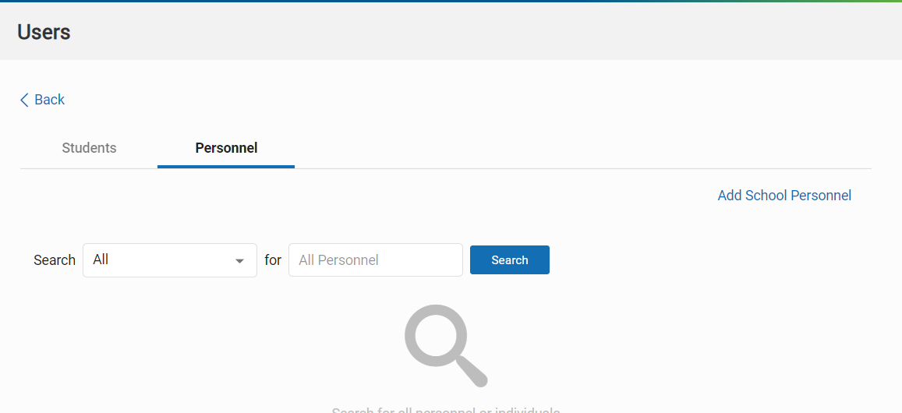
Adding Teachers
Notes:
Sometimes in the Renaissance place for our pre K, we have to add teachers manually sometimes, so how do we do that? click on my name again, go into to manage Apps and users, go to users, and click on personnel. So what do I do I need to see if the student the teachers already in there? First, I can do a search, so I'm going to type in my last name and I'm going to press search.

Slide 33
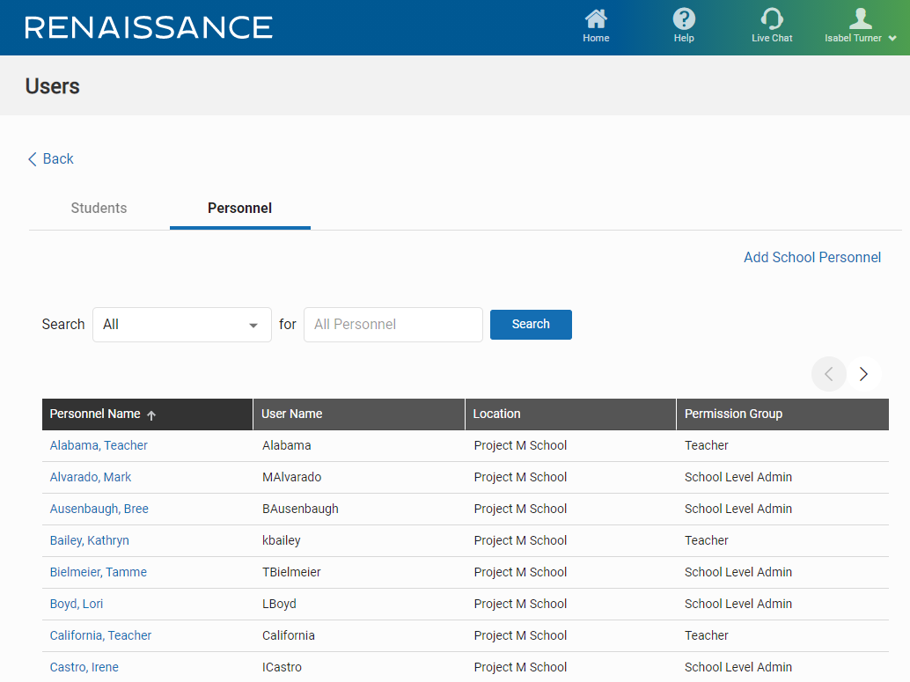
Adding Teachers
Notes:
Then I can see if the teacher is already in there. I can see the teacher is not there, so I'm going to add school personnel.

Slide 34
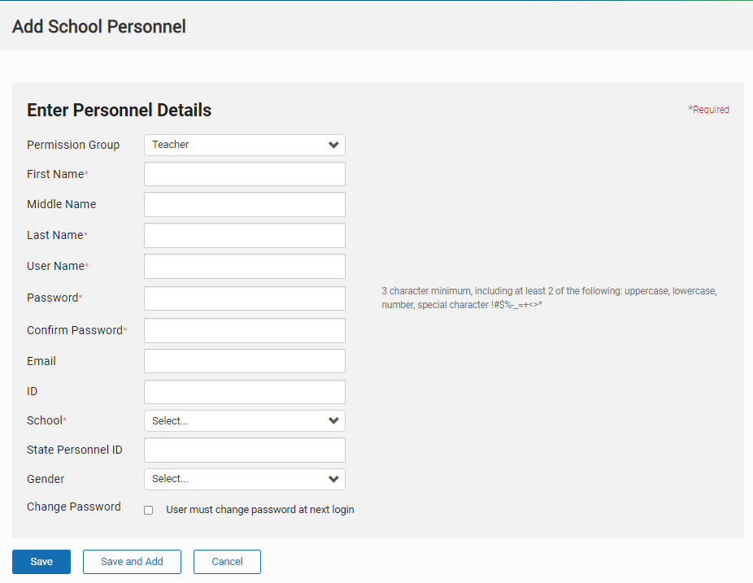
Adding Teachers
Notes:
Fill in the required fields, name, username, password school and select save.
There is a feature that allows teachers to change passwords at the next login if that feature is needed.

Slide 35
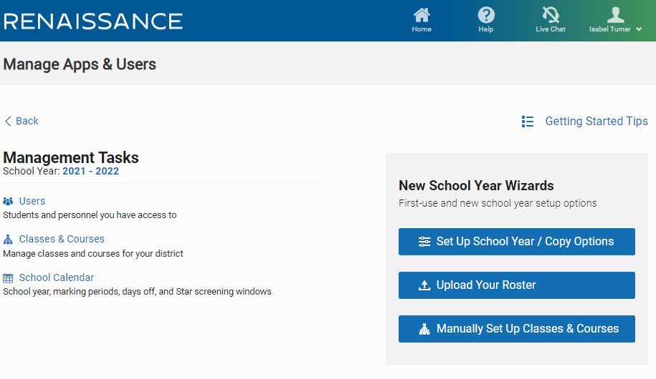
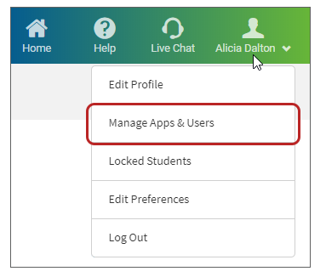
Assigning Product
Notes:
Fill in the required fields, name, username, password school and select save.
There is a feature that allows teachers to change passwords at the next login if that feature is needed.

Slide 36
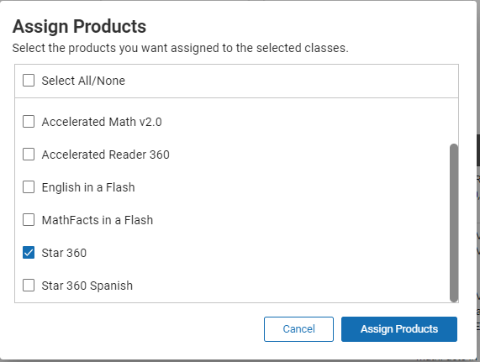
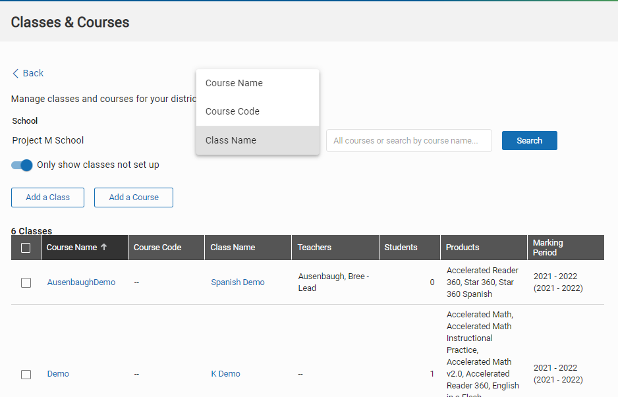
Assigning Product
Notes:
The next thing we have to do is assign products to the students, otherwise they're not going to have anything to assess in. SO, I am going to click on my name, click on manage Apps and users, and this time, I'm going to click on classes and courses. I got to fill in the required fields, of course, I can search by course name, course code, class name, or teacher name, I can search through those and I can toggle to only show classes that are not set up, so if I've already set up classes, I know I don't have to look for those, I can look for ones that aren't set up and then I find the class that I need to add product to. Select one or all classes to assign product.

Slide 37
The Student Experience
Notes:
Let’s talk about the student experience for just a moment.

Slide 38
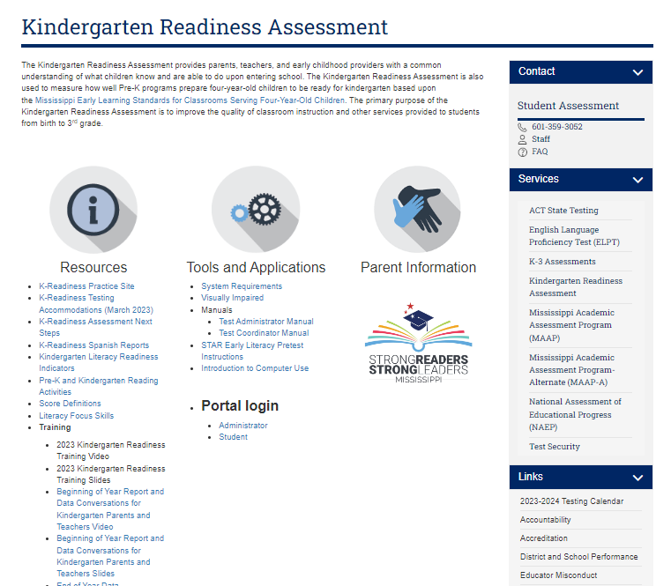
MDE Support and Resources https://mdek12.org/OSA/K_Readiness
Notes:
The MDE K readiness website is a place to bookmark and is full of helpful resources.
Students and teachers will enter the portal from this area.
It is worth noting here all the other resources available on this page. Point out score definitions, Literacy focus skills, Training videos and PPT’s and this recording will also be housed here.

Slide 39
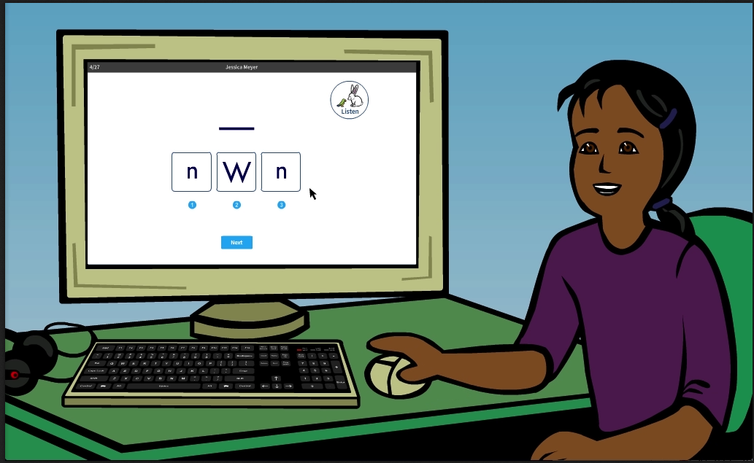
Student Introductory Video
Notes:
How should students prepare? There is an introductory video and practice questions and these instructions are also located on the MDE webpage. This will walk students through how to answer questions, the questions are read aloud twice so practice with students, listening for the questions, pausing and thinking of their answers.

Slide 40
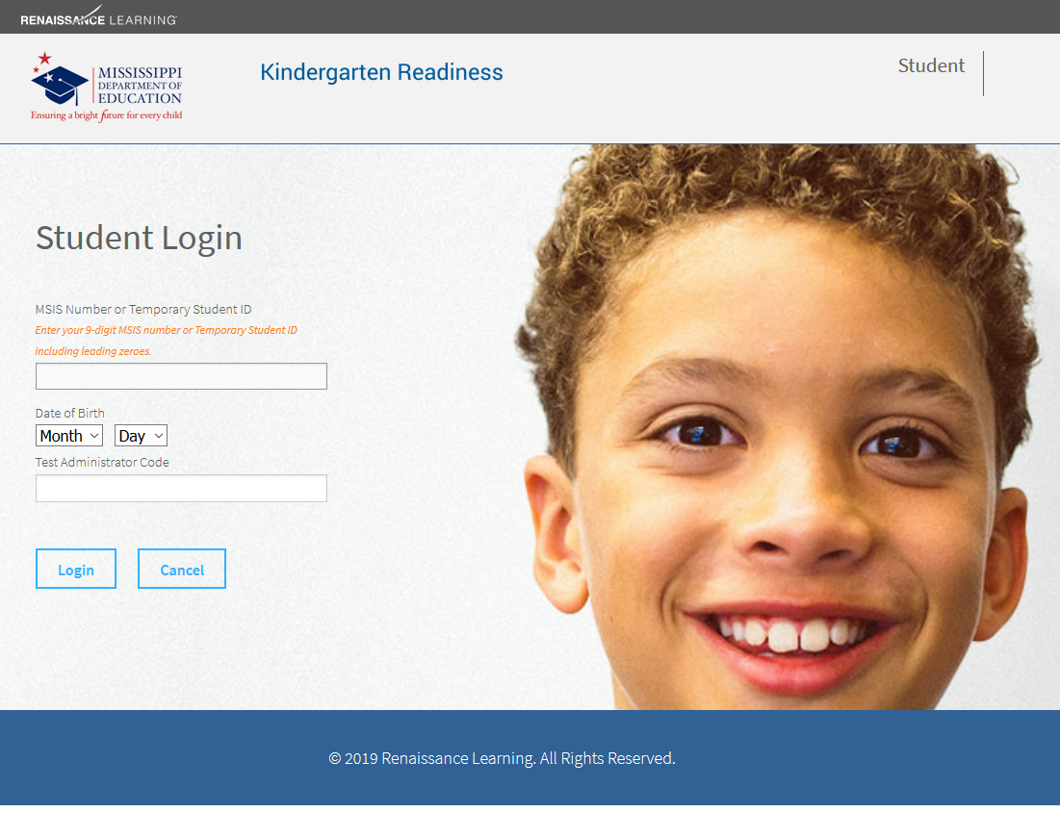
Student Login
Notes:
Required information for login: each student’s 9-digit MSIS number (or temporary ID) and date of birth as well as the Test Administrator Code, which is site specific and changes daily.
Most Pre-K students will not know this information or be able to enter it independently.
The administrator can print out the Enrollment Report which contains student information to have this information available prior to testing.
The Student Daily Test Ticket Report can also be used for this information. You can print this out before the day of your testing to help you with planning.
We will discuss how to access these reports later in the webinar.

Slide 41
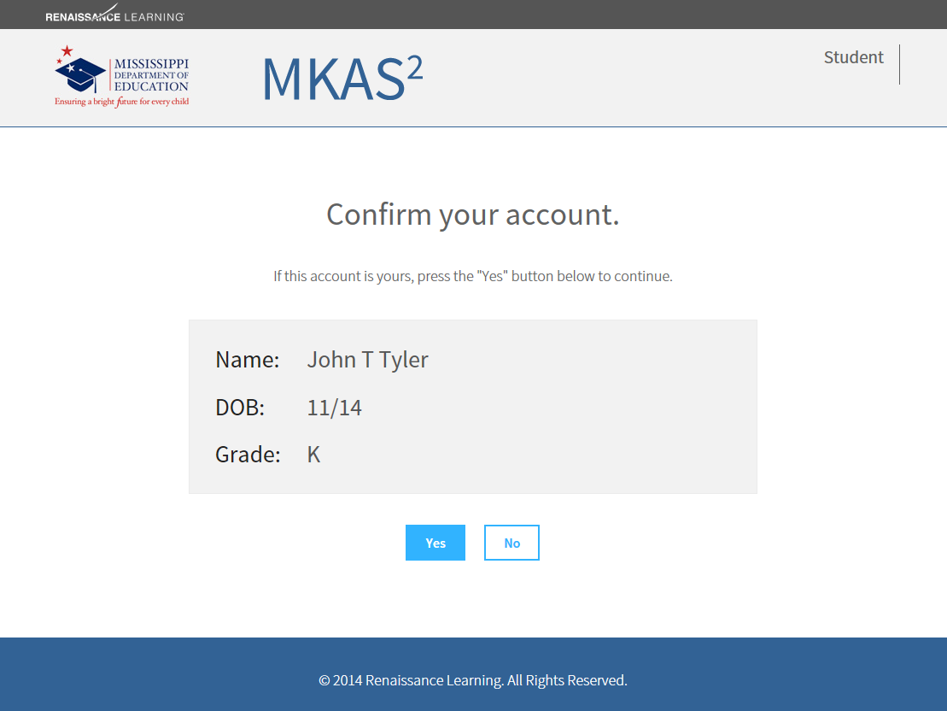
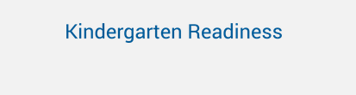
Student Confirmation
Notes:
The next page that comes up for your students will ensure the correct student is logging in. This is a GREAT page for the test monitor to double check that the account listed is the correct one for the student seated at the computer. We want to ensure the correct student is assessing under his or her name to keep them from having to test again.

Slide 42
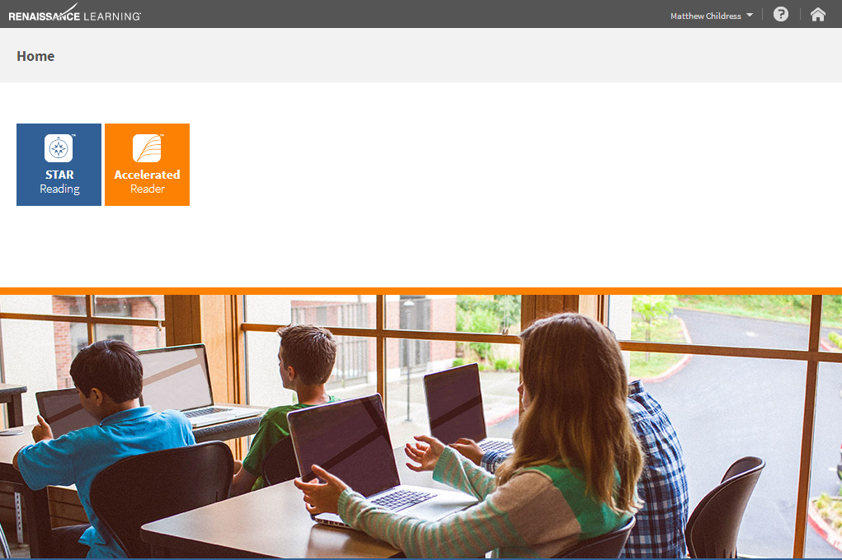
Renaissance Place Home Page
John Tyler
Early Literacy
Notes:
The student will click on the STAR Early Literacy icon to begin the test.
Notice that the administrator will be able to verify that the correct student is taking the test by using the information on the gray bar at the top of the page.

Slide 43
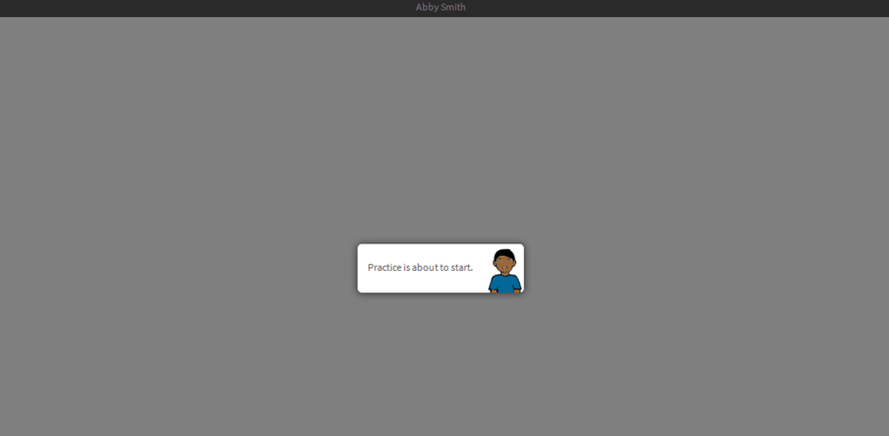

Begin practice items
John Tyler
Notes:
Once they click on the Star Early Literacy tile, the Student will begin with 3 to 7 practice items. Once they’ve answered three correctly, it will prompt them to the assessment.

Slide 44
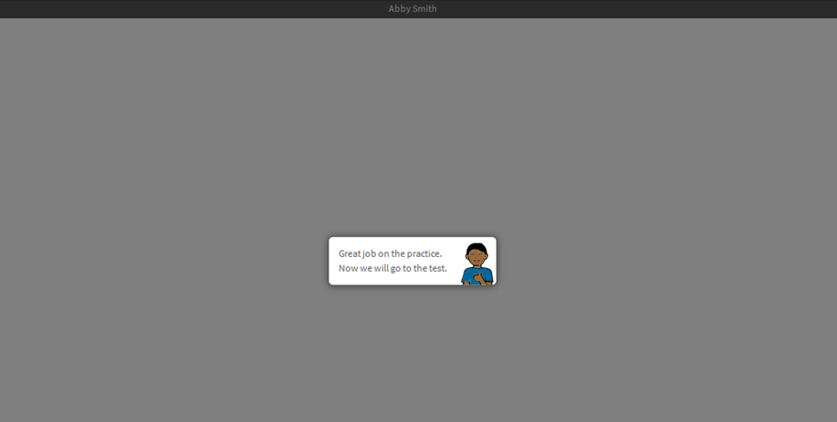
Begin the test
John Tyler
Notes:
Then students will begin the test. They will not need to click anything to begin.

Slide 45
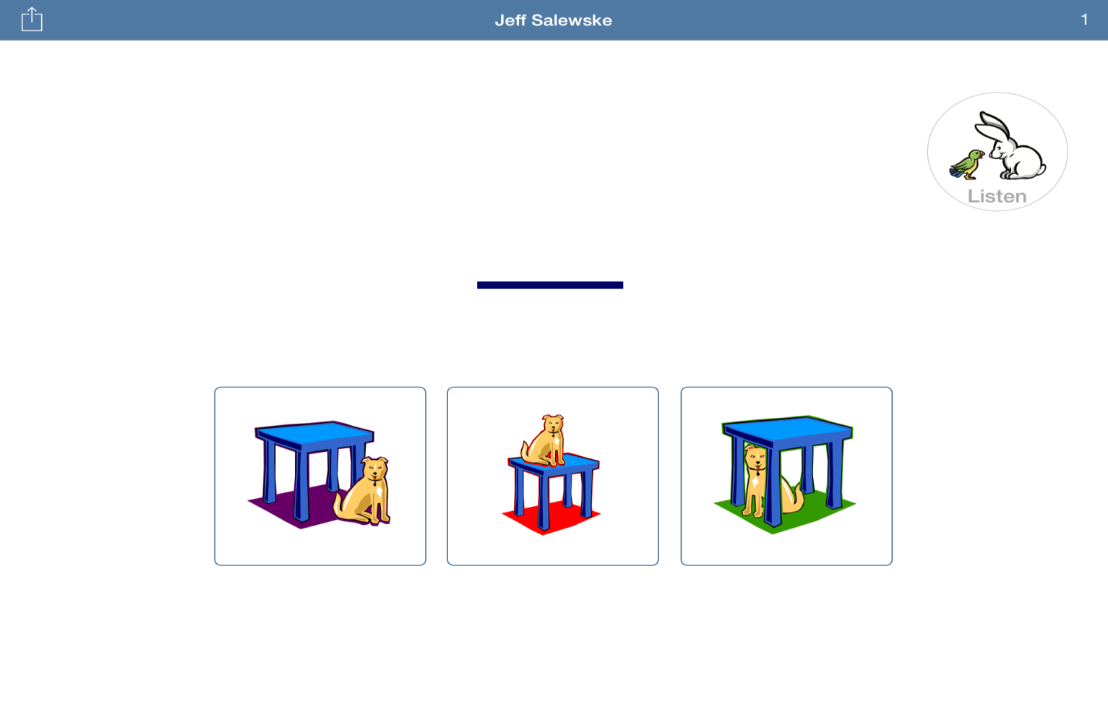
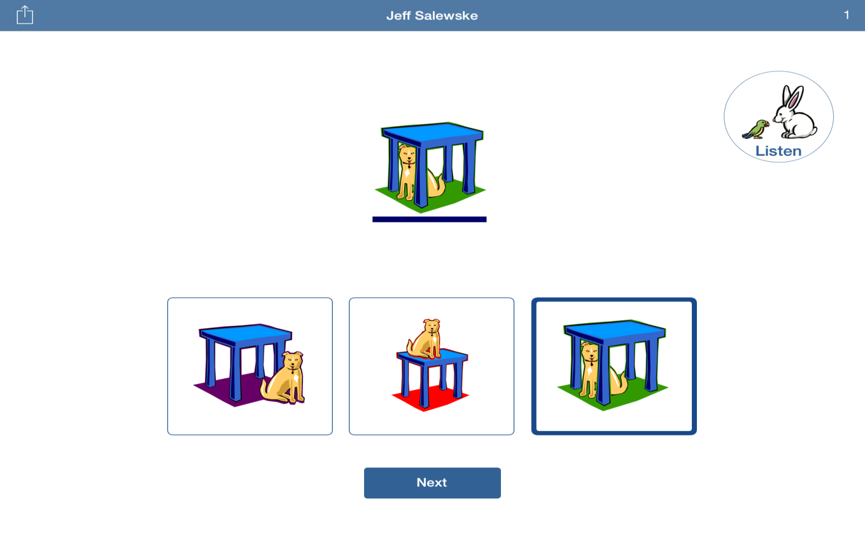
Answer Items
Notes:
This is an example of what a possible question will look like
There are 3 multiple choice items for each question
When the question is being read to the student, you will see the bunny ears are pointed down as he is listening to the question,
(CLICK) Once the question is finished being read to the student, you will notice the bunny ears pop up. If a student would like to have the question reread to them, they will simply click on the bunny icon in the top right corner
After 10 seconds without an answer, the question will automatically be reread to them and if they choose to not answer, it will advance to the next question
Student’s can select an answer at anytime, however the Next button must appear, and this only occurs after the entire question has been read to the student
A student can only move on to the following item after clicking Next

Slide 46
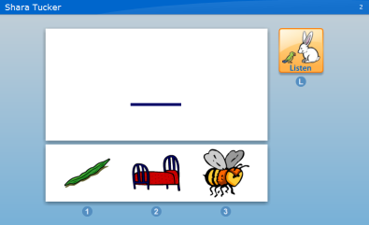
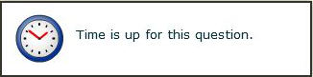
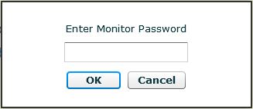
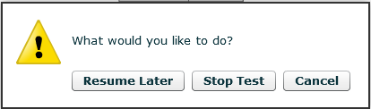
Practice Items
Item Time Limits
ADMIN
Pause or Stop a Test
(Ctrl + A)
Monitor Password
Notes:
A quick overview:
Practice items: The first time students test they will see a few practice items. The practice session before the test allows students to get comfortable with the test interface and to make sure that they know how to operate it properly. As soon as a student has answered three practice questions correctly, the program takes the student into the actual test. If the student is not successful with the practice items, STAR will halt the testing session and tell the student to ask the teacher for help. It may be that the student needs help operating the mouse or hearing the prompts, in which case the monitor should work with the student to correct the problem. If a student is unable to answer the practice items – please refer to the FAQ Document
Item time limits: [click] There is not an overall time limit for students to complete the test, but there are time limits for each individual item (90 seconds for each item; and then move onto the next question). Our data have shown that nearly all students are able to answer items within this amount of time. In STAR Early Literacy, the listening prompt is repeated every 10-15 seconds for students. Students can also choose to listen to the prompt again by selecting the “Listen” option on the screen.
Pause a test/Stopping a test: [click] If you need to stop a student’s test after they’ve started, use Ctrl+A and enter the monitor password. This is different than the password used to log students in to the test each day. The default monitor password is “admin.” If the “resume later” option is chosen, the student has up to a week to complete the test. Having students pause and resume tests often can be distracting for them, so use this option sparingly.

Slide 47
End of assessment
Notes:
At the end of the assessment, the student will be returned to the K readiness home page. They will not see results.

Slide 48
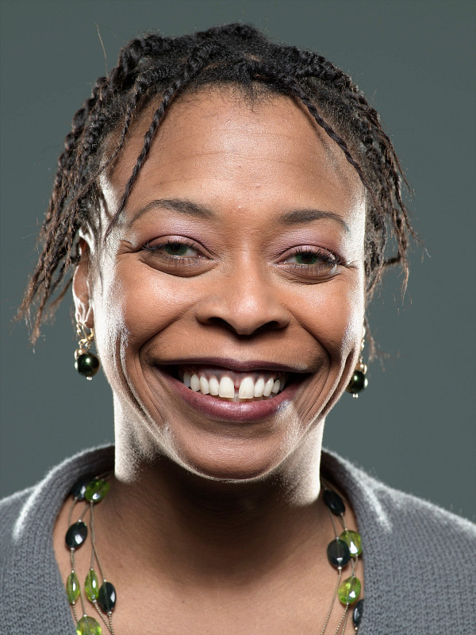
The Administrator Experience
Notes:
District contacts will receive an email with login information. Please note that that usernames and passwords are now case sensitive.

Slide 49
Administrator Login
Notes:
Administrators will access the test via the Mississippi Department of Education K Readiness .

Slide 50
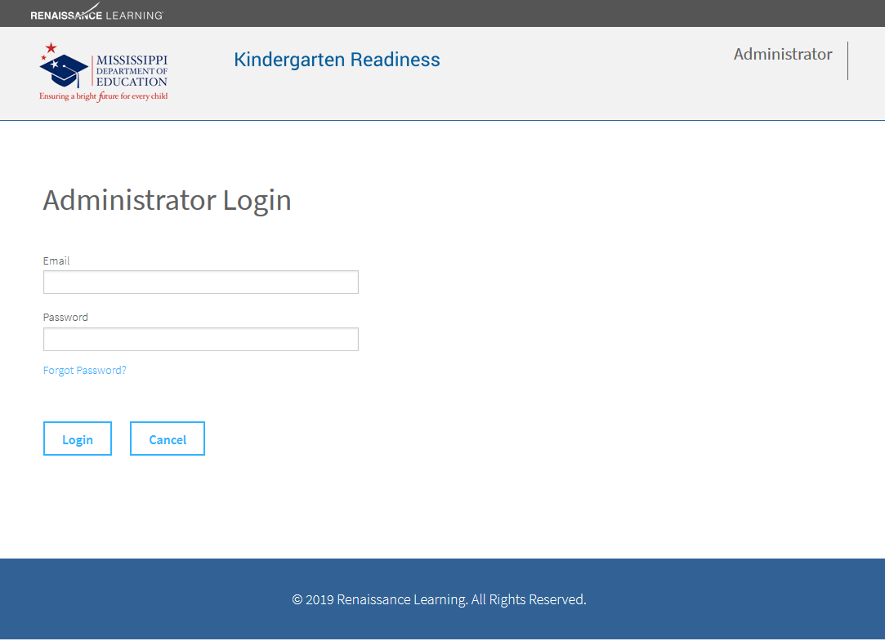
Administrator Login
Notes:
Enter your email and password.
(When you are set up to be an administrator for this assessment, you are sent an email asking you to activate your account and set your password. We will talk about this later in the webinar.)
Once the DTC’s have been added, they can go in and add all other admins within the site. We will talk more about this in a moment

Slide 51
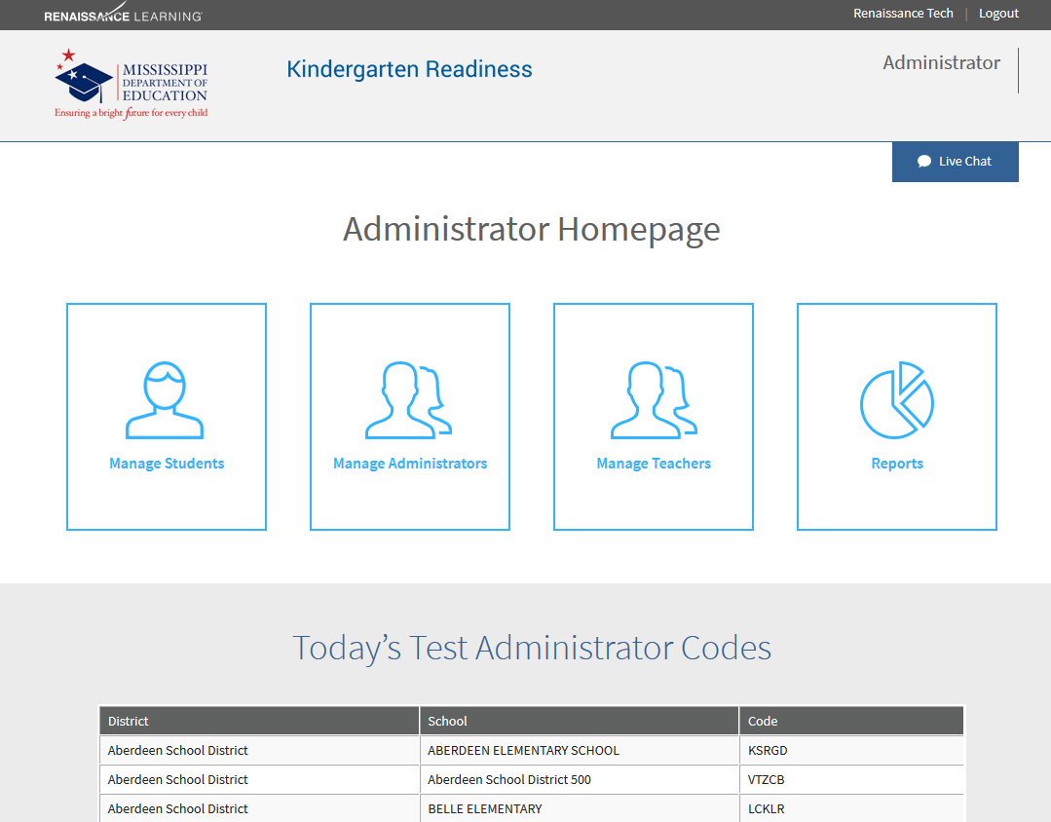
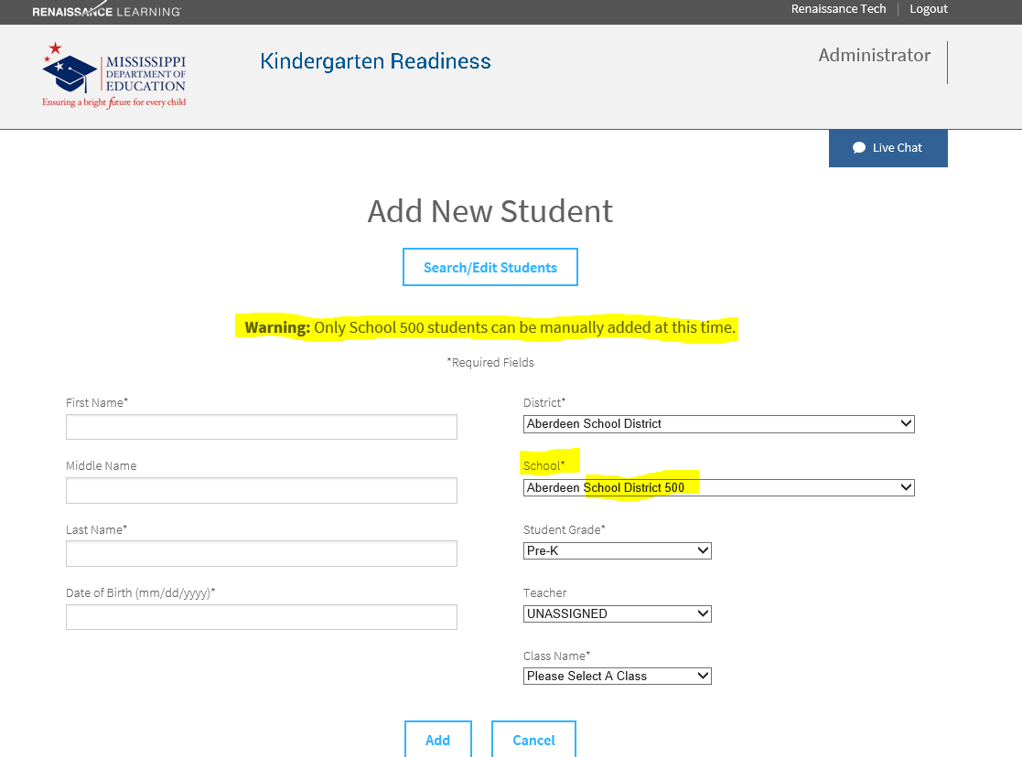
Administrator Landing Page
Notes:
Once you have logged in, this is where you will find the Test Administrator Code. Note that this code is school specific and changes daily. You will be able to see the codes for each school you are an administrator for. This code is necessary for students to login to test.
You can choose to manage students, which would only need to be utilized to search students – the only admin that would utilize the Add new student feature would be our School 500 folks.
Notice that there is a Live Chat tab in the upper right-hand corner. If you have questions, you can click on this for immediate assistance. This tab is present on each page you will need to navigate through.
You can also check on this screen, the gray bar at the top of the page to be sure you are logged in correctly.
CLICK:– ---I want to call out that the only admin that should use the Add Students within the manage Students tile should be the School 500 districts. For the School 500 users, PLEASE ENSURE YOU ARE Selecting the correct school under the drop-down menu on the Add new Student page.
All others districts just know that your student’s will not show up in the portal until they have been added into your Student Information System
It is critical that only 500 students are manually added. If students are missing, please reach out and let us know to help you resolve the issue.

Slide 52
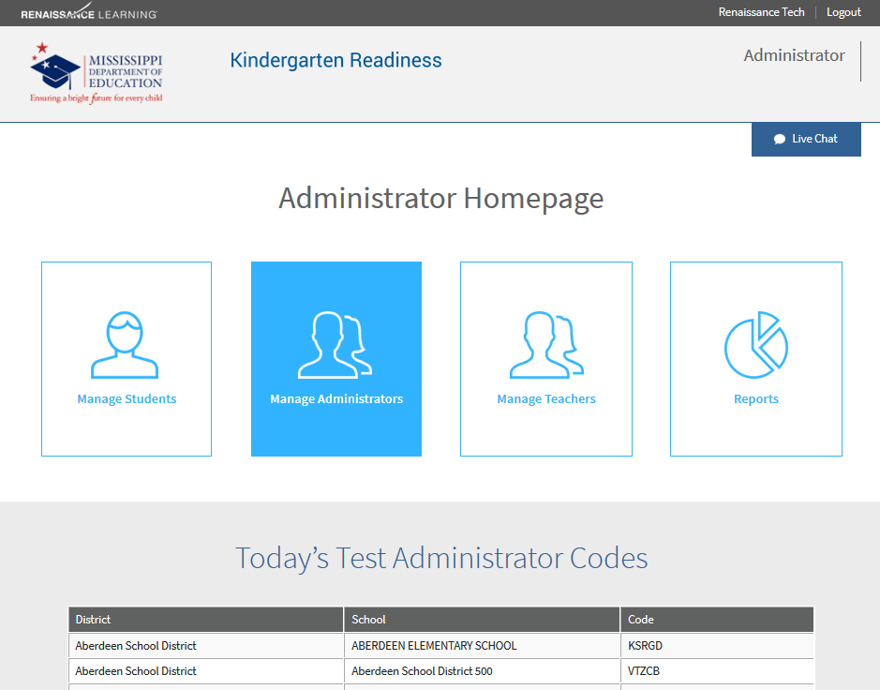
Add New Administrator
Notes:
If you need to add additional administrators, you would choose Manage Administrators.

Slide 53
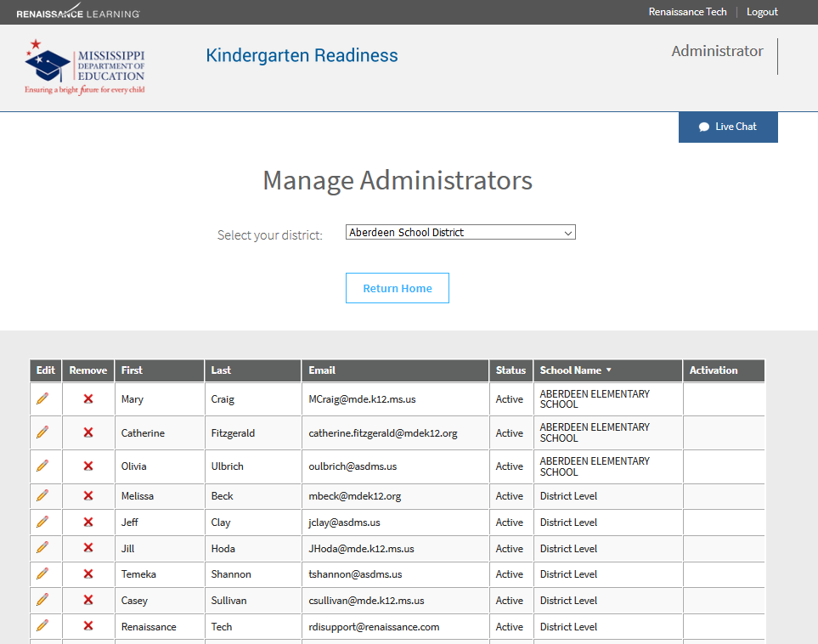
Manage School Administrators
Notes:
The first screen you will see will show a list of all administrators for your School & Districts
It is your responsibility to ensure you have the correct admin within your site, so please check to make sure if someone has moved on from the school or district to remove them from the list of admin
Here you can edit their information and check their status.
If you do not see an administrator you are searching for, you can click Add an Administrator at the bottom of this page.

Slide 54
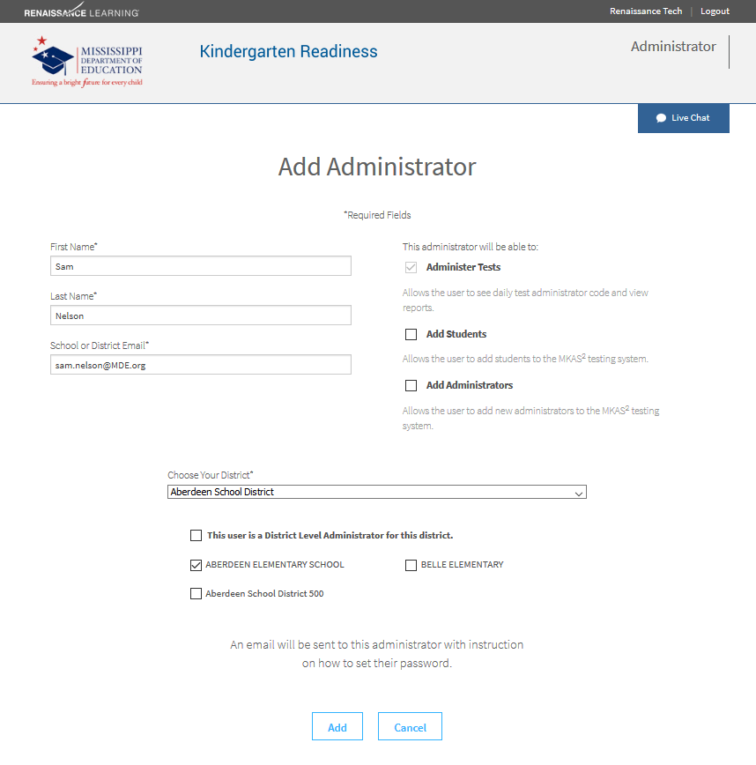
Add Administrator
Notes:
You will need to enter the first and last name of the staff member, check the correct school name, and the staff member’s email address.
Note that the Add Students and Add Administrators boxes to the right of the staff member can be checked – We advise to be aware when adding admin to the different level of permissions given to the right.
You will be able to see a current list of administrators in your school as well as their permissions if you need to check if they have been added.
An email will be sent to the new administrator with instructions on how to activate their access and set a password.

Slide 55
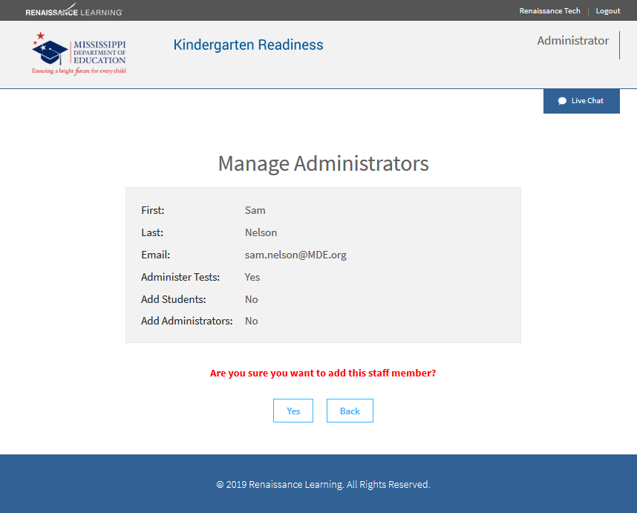
New Administrator Verification
Notes:
An email will be sent to the new administrator with instructions on how to activate their access and set a password.

Slide 56
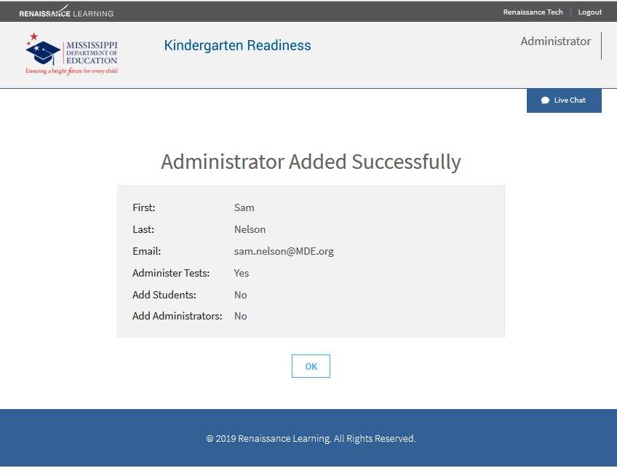
Administrator Added Successfully
Notes:
You will be informed that the staff member was added successfully.

Slide 57

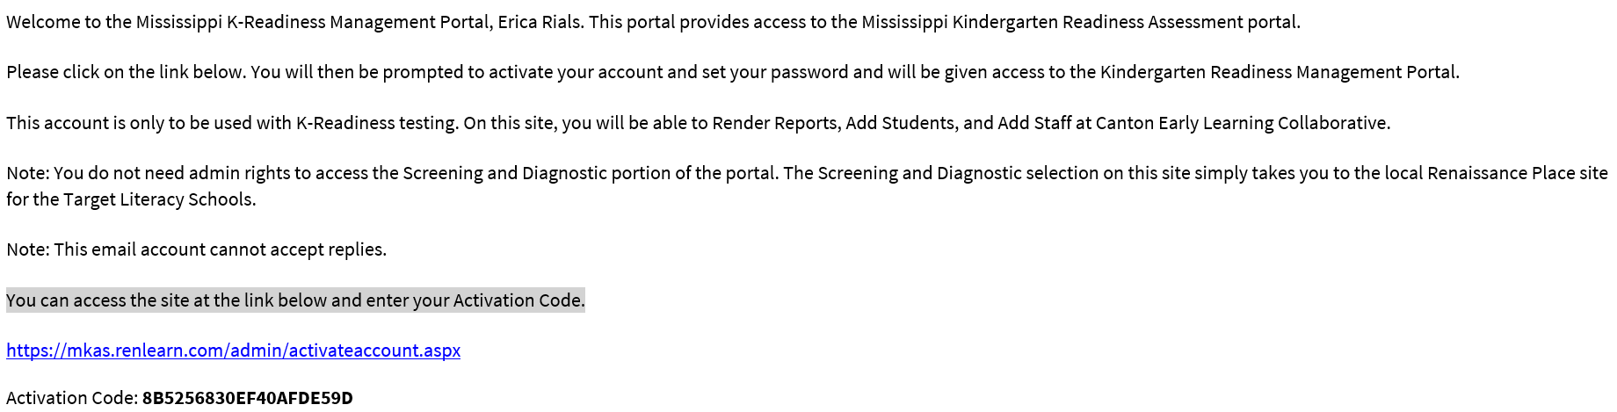
E-mail Notification
Notes:
Once a staff member has been successfully added, they will receive an email asking them to activate their account and set a password.
He or she should copy the activation code listed at the bottom of the email.
They may need to delete this e-mail

Slide 58

Account Activation Code
Notes:
To activate their account, the administrator needs to enter (paste) their activation code and click Activate.

Slide 59

Account Activation - Password
Notes:
You will need to enter and re-enter a password.
The password must be at least eight characters long and contain at least one letter and one number.

Slide 60

Successful Account Activation
Notes:
Once you have activated your account, you can click on the Mississippi K Readiness Portal tab to navigate the site.

Slide 61

Reports
Notes:
This is the best bit now because we’re here now and we want to see reports and what we can do with this data. First, To view reports from the K-Readiness assessment, click on reports. This is where you will go to find the Enrollment Report; a list of students, their birthdates, and MSIS numbers.

Slide 62

Report Options
Notes:
When digging into the reports, please note the correct district/school & grade is selected. As mentioned earlier when getting your students ready to test, the top two reports are very helpful.

Slide 63


Participation/Enrollment Report
Notes:
The 1st report is that Participation/Enrollment Report is very helpful during test administration
This is where you will find student names, MSIS numbers (or temporary student IDs), and birthdates. This is also a great place to check for errors in MSIS numbers and name spelling. This is where you will see duplicate students if they have been incorrectly added.
It is recommended that you check this report before testing to ensure that all students are listed. If a student needs to be added, the student information will show up on the report immediately after the student has been added by an administrator.
[Click] Also on this report is information about the number of students who have completed testing. Administrators may want to monitor this throughout the testing window.

Slide 64


Student Authorization Ticket
001234567
Notes:
This report is given to students to have at their computer at the beginning of testing.
Test administrators can use this report to enter information on the Student Login page.
The report has information that is student specific (name, MSIS, and date of birth). It also includes the test code for the day of testing.
Student Authorization Tickets can be printed out prior to testing. For example, if you are testing on July 20th, you can print your Student Authorization Tickets on July 19th. You will need to indicate your testing date and the Daily Test Administrator Code for that date will appear on the tickets.

Slide 65







Additional Reports
Score Overview
Diagnostic Report
Instructional Planning Report
Parent Report
Score Summary Report
Your School District
Notes:
There are four additional reports for looking at data after students have tested.
Parent Report – Gives parents their child’s most recent test score, a brief definition of the score, and skills for their child to work on.
Diagnostic Report – Displays a student test score, their literacy classification, and their scores for specific skill sets within each sub-domain.
Score Summary Report – This report provides scores for all students within a teacher’s class.
Instructional Planning Report – Provides a list of skills that an individual student is likely ready to learn next based on the most recent test scaled score.

Slide 66
Support and Resources
Notes:
Let’s move into support and resources

Slide 67

Renaissance Mississippi K-Readiness Technical Support
Notes:
Remember live chat; do not hesitate, if you have a question, we are here for you. And we've been partnered with you for a long time, and we're excited to bring our resources to you, please, use live chat in and let’s get those issues solved.

Slide 68

Support Solutions
Renaissance.com
    Visit often for updated product information
Email help
    answers@renaissance.com
    Get answers quickly
    https://www.renaissance.com/request-support/
Give us a call
    1-800-338-4204
Notes:
Renaissance.com is going to be updated product information, so you can get that there, but if you need email help because we know, sometimes you don't have time to make the call, you need to get the email help, email us at answers@renaissance.com
Also, we have new support request at https://www.renaissance.com/request-support/
Last, but certainly not least, you can call us at 1-800-338-4204; we will be happy to assist.

Slide 69

Renaissance Mississippi K-Readiness Support Requests
Notes:
Sometimes there are issues that arise that may need some attention, such as a test reset. We ask that you send these to your superior to approve in the following format. The request needs to include the student’s MSIS or Temporary ID number, Student full name, Student’s grade, gender, DOB, as well as the teacher’s first and last name with a detailed summary of the issue and request.

Slide 70
MDE Support and Resources https://mdek12.org/OSA/K_Readiness
Notes:
The MDE K readiness website is a place to bookmark and is full of helpful resources.
Students and teachers will enter the portal from this area.
It is worth noting here all the other resources available on this page. Point out score definitions, Literacy focus skills, Training videos and PPT’s and this recording will also be housed here.
If you have not explored strong reader strong leaders Mississippi., I encourage you to because it's an excellent resource that really provides some practical things that parents can do with their children.

Slide 71
MDE Support and Resources https://mdek12.org/OSA/K_Readiness
Notes:
I want to highlight again some things such as if your student is visually impaired, what do we do. The test administration manual location; I need to know some information about the test design, or pretest instructions, they’re all right here at your fingertips!

Slide 72
Key Takeaways
Testing Window Dates
  Fall - July 20, 2023 – September 22, 2023
  Spring – April 1, 2023 – May 10, 2024
Scale Score Benchmarks
  Kindergarten Fall- Scale Score 530 Spring- Scale Score 681
  Pre- K Spring – Scale Score 498
Do not enter students and teachers in the State K Readiness Portal unless you are a School 500.
  Ensure your School 500 students are coded correctly and not under the public school.
Daily Test code
  Select the correct daily test code for your school location and grade level for ELC students
Portal cleanup
  Delete any users no longer in your district
Notes:
Emphasize screening window dates, scale score benchmarks, Really key that we got this in the fall 530 is our fall scale score for kindergarten readiness in the spring, that changes to a 681.
Pre K in the fall remember we're just getting that baseline for our students, there is no scale score expected; we're understanding, where our students are then the spring pre-K readiness, is 98.
Do not enter students in and teachers in the state kindergarten readiness portal unless your school 500 school.
Ensure your school 500 students are coded correctly and not under the public school.
daily task code we've said it, I think 15 times that's how important it is make sure you got the correct one, and the correct grade level for your early learning collaborative students.
Lastly portal cleanup if you're the district administrator, go in there, clean up that site if you've got administrators that who moved away retired it's time to clear those out add your new people in make sure that that's cleaned up.

Slide 73
Jennifer Wright DeHart, Ph.D.
Notes:
Do you have any questions at all? please, please, please reach out we've given you that support; contact us please at renaissance.com, give us a call, or you can use the live chat. We really do want to hear from you.
I want to say thank you for everything today, thank you for your learning, thank you for being with us today and partnering with us. Any closing remarks from my panelists?

