Slide 1
Accountability Task Force
Via Webinar
March 24, 2020

Slide 3
State Board of Education Goals STRATEGIC PLAN
Goals:
All Students Proficient and Showing Growth in All Assessed Areas
Every Student Graduates from High School and is Ready for College and Career
Every Child Has Access to a High-Quality Early Childhood Program
Every School Has Effective Teachers and Leaders
Every Community Effectively Using a World-Class Data System to Improve Student Outcomes
Every School and District is Rated “C” or Higher

Slide 4
Welcome and Introductions
Agency: | Position: | Last Name: | First Name:
Aberdeen School District | Principal | Fondren | Kristen
Bay Waveland School District | Director of Federal Programs | Menotti | Nicole
Board of Education | Board Member | Rosemary | Aultman
Center for Assessment | External Facilitator | Chris | Domaleski
Clinton Public Schools | Superintendent | Martin | Tim
Copiah County School District | Curriculum Coordinator | Brown | Demarrio
Corinth School District | Math Specialist | Jones | Marion
DeSoto County | Director of Accountability & Research | Kuykendall | Ryan
Foundation for Excellence in Education | External Expert | Christy | Hovanetz
Gulfport School District | Commission on School Accreditation | Michael | Lindsay
Lowndes County School District | Deputy Superintendent | Ballard | Robin
Madison County Schools | Superintendent | Seals | Charlotte
MDE | Data Analytics and Reporting | Deborah | Donovan
MDE | Chief Accountability Officer | Paula | Vanderford
MDE | Director of District and School Performance | Alan | Burrow
Mississippi Legislature | House Education Chair | Bennett | Richard
Mississippi Legislature | Senate Education Chair | TBD
New Albany School District | Superintendent | Evans | Lance
Noxubee County | Assistant Superintendent | Baliko | Richard
Ocean Springs School District | Principal | Tiblier | Vickie
Petal School District | Director of Student Assessment | Brown | Kelli
Rankin County School District | Principal | Pambianchi | Lee
Senatobia School District | Special Education Teacher | Brewer | Elaine
Simpson County School District | Teacher | Williams | Aaron
Starkville-Oktibbeha School District | Superintendent | Peasant | Eddie
Sunflower County School District | Superintendent | Davis | Miskia
Tunica County | Superintendent | Pulley | Margie
Union County School District | Assistant Superintendent | Faulkner | Windy
Vicksburg Warren | Principal | Minor | LaToya

Slide 5
Agenda
9:00 a.m. Welcome and Introductions
Review Meeting Notes
9:15 a.m. Updates from MDE (COVID-19 Shutdown)
9:45 a.m. Incorporating ACT Work Keys in Accountability
10:30 a.m. Future Implications for Accountability
Prioritizing Action Items/ Next Steps
11:00 a.m. Adjourn

Slide 6
Purpose and Overview
Primary purpose is to help MDE make good decisions about the design and implementation of the state, school accountability system under ESSA
We will focus on identifying policy priorities and identifying decisions in support of those priorities that are technically defensible and operationally feasible
Feedback from the Task Force is received as a recommendation to the department

Slide 7
Ground Rules/ Group Norms
Listen actively and attentively; ask for clarification as needed
Everyone should have an opportunity to ‘be heard’ without interruption and to receive courteous feedback
Critique ideas, not people or organizations
Build on one another’s comments; work toward shared understanding
We will attempt to make decisions based on group consensus, but when necessary we will take a vote
When/ if requested do not disclosure confidential information
At the end of each meeting we will prioritize topics for future meetings and discuss action items

Slide 8
MDE Updates

Slide 9
COVID-19 Pandemic Disruption
The Mississippi State Board of Education voted on March 19 to suspend all federal and state assessments for the 2019-2020 school year and to submit a waiver request to USED for exemption of those federal requirements.
Districts and schools will maintain the same accountability designation in the 2020 - 2021 school year as assigned in the 2019 - 2020 school year with no cumulative impact for cases where multiple years with the same designation could lead to more severe consequences.

Slide 10
ACT Testing
Offered vouchers for the June/July national test date to state testing students who have not tested in the state administration
Offered current juniors to test as seniors in October 2020 (paper only)
Still exploring:
If during the June/July national test date, schools can open a new test site and have it available only for the students in their school – this would be like creating “a school day testing” experience on a Saturday

Slide 11
School Improvement Designations
Anticipated:
Schools and districts will retain their designations for CSI, TSI, and ATSI from the 2018 - 2019 school year. The three-year average performance used in identification would exclude the 2019 - 2020 school year.

Slide 12
Special Called Board Meeting
Thursday, March 26, 2020, 10:00 a.m.
The meeting is to discuss any waivers/suspensions of statutes and/or rules and regulations as a result of the impact of COVID-19 (coronavirus).

Slide 13
Discussion
Any initial thoughts or questions?
We will have “next steps” at the end.

Slide 14
Representing Career Readiness in Accountability

Slide 15
Purpose
The purpose of this item is to explore how career readiness can be more fully represented in the state accountability system.
In previous meetings, members have expressed interest in incorporating ACT Work Keys and/or similar measures.
We should identify the approach (or a small number of promising approaches) for how to do this so we can explore the method(s) more fully in future meetings.

Slide 16
How is career readiness currently reflected?
Acceleration (~50 points)
Participation/ Performance: AP, IB, AICE, dual credit/enrollment, industry certification
College/ Career Readiness (~50)
Percent of students meeting ACT benchmarks

Slide 17
Acceleration
Participation 50%
Denominator:
All students enrolled in grades 11 and 12, plus 9th and 10th grade students taking and passing accelerated courses
Numerator:
All students taking accelerated courses (AP, IB, AICE, dual credit/enrollment, industry certification)
25 Points Possible:
e.g., 133 ÷ 200 = 0.67
0.67 x 25 = 16.8 points
$$÷$$
$$=$$
30.3 points total
Performance 50%
Numerator:
All courses/exams meeting performance standards by student (e.g., C grade in dual c/e, 3 on AP exam, or 4 on IB)
Denominator:
All courses/exams taken by participating students in AP, IB, AICE, dual credit/ enrollment, industry certifications
25 Points Possible:
e.g., 72 ÷ 133 = 0.54
0.54 x 25 = 13.5 points
$$÷$$
$$=$$

Slide 18
College and Career Readiness (CCR)
CCR
(from ACT) includes:
50% English or Reading;
+
50% Math
Numerator:
All students meeting ACT benchmarks (18 in English or 22 in Reading; 22 in Math)
Denominator:
All students from Senior Snapshot who participated in ACT (both statewide and non-state administration)
Example: School A has 40 students who participated in ACT; 34 met English/ Reading and 30 met Math benchmarks.
English/Reading (25 points):
34 ÷ 40 = 0.85 x 25 = 21.25
Math (25 points):
30 ÷ 40 = 0.75 x 25 = 18.75
21.3 + 18.8 = 40 points total
$$÷$$

Slide 19
What measures should be included?
2017 Report “Destination Known” (CCSSO, ESG, and Advance CT)
1. Progress toward Post-High School Credential (e.g. % of students on-track, course credits)
2. Co-curricular Learning and Leadership Experiences (e.g. work-based learning, internships, service learning projects)
3. Assessment of Readiness (e.g. ACT, Work Keys)
4. Transitions beyond High School (e.g. post secondary enrollment, job placement)

Slide 20
Assessment – Questions to Consider
What assessments should the ATF consider to better reflect career readiness? Many support Work Keys, should other assessments be considered as well?
What are promising models for including it in the system?
How much ‘weight’ should it have?
What is an appropriate performance standard?

Slide 21
Potential Models for Inclusion
Add component in CCR.
Disjunctive: student meets ACT benchmark OR WorkKeys Criterion
Conjunctive: separate calculations for ACT AND WorkKeys
Compensatory: performance on ACT and WorkKeys is combined, such that higher performance on one offsets the other
Create a ‘menu’ approach (some state examples follow)

Slide 22
New Hampshire
NH computes an index for all seniors reflecting the percentage of students who meet any 2 of the following:
Completion of a NH Scholars program of study (Standard, STEM, or Arts).
A grade of C or better in a dual-enrollment course.
SAT scores meeting or exceeding the college and career ready benchmark
ACT scores meeting or exceeding the college and career ready benchmark
A score of 3 or higher on AP exam
A score of 5 or higher on IB
Earning a CTE industry-recognized credential.
Completion of NH career pathway program of study
Scoring at least Level III on components of the ASVAB that comprise the Armed Forces Qualifying Test (AFQT).

Slide 23
State Reviews - Wyoming
Option 1 – Evidence of college readiness is based on completion of a college preparatory curriculum and one or more of the following: a college-ready score on a standardized college entrance exam or eligibility to earn college credits through Advanced Placement, International Baccalaureate, or dual/concurrent courses.
Evidence of college readiness from a dual/concurrent course requires the evidence from the WDE 950 transcript collection that a graduate earned a grade of “C” or better in a1000- level or higher dual/concurrent course
Option 2 – Evidence of career readiness is based on completion of a career/technical education pathway (i.e., minimum of a three course sequence and one or more of the following: a passing score on a state-approved CTE exam or state-approved industry- recognized certification.
Option 3 – Evidence of military readiness is based upon completion of a college preparatory curriculum or a CTE pathway and a military-readiness score on the ASVAB.

Slide 24
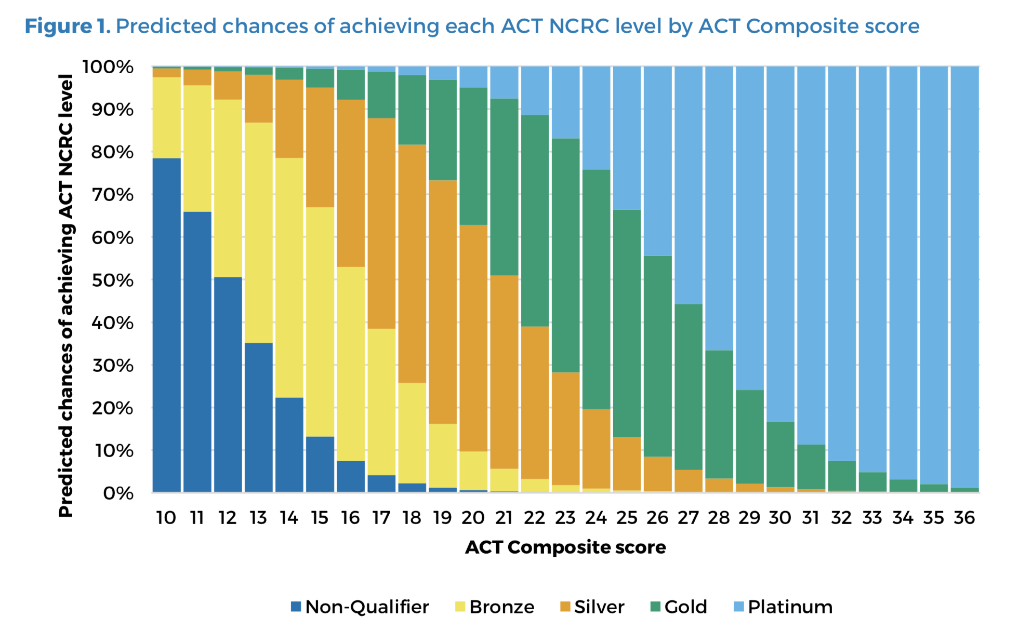
Performance Criterion
Retrieved from ACT Technical Brief, August 2018: http://www.act.org/content/dam/act/unsecured/documents/R1712-ACT-progress-toward-NCRC.pdf

Slide 25
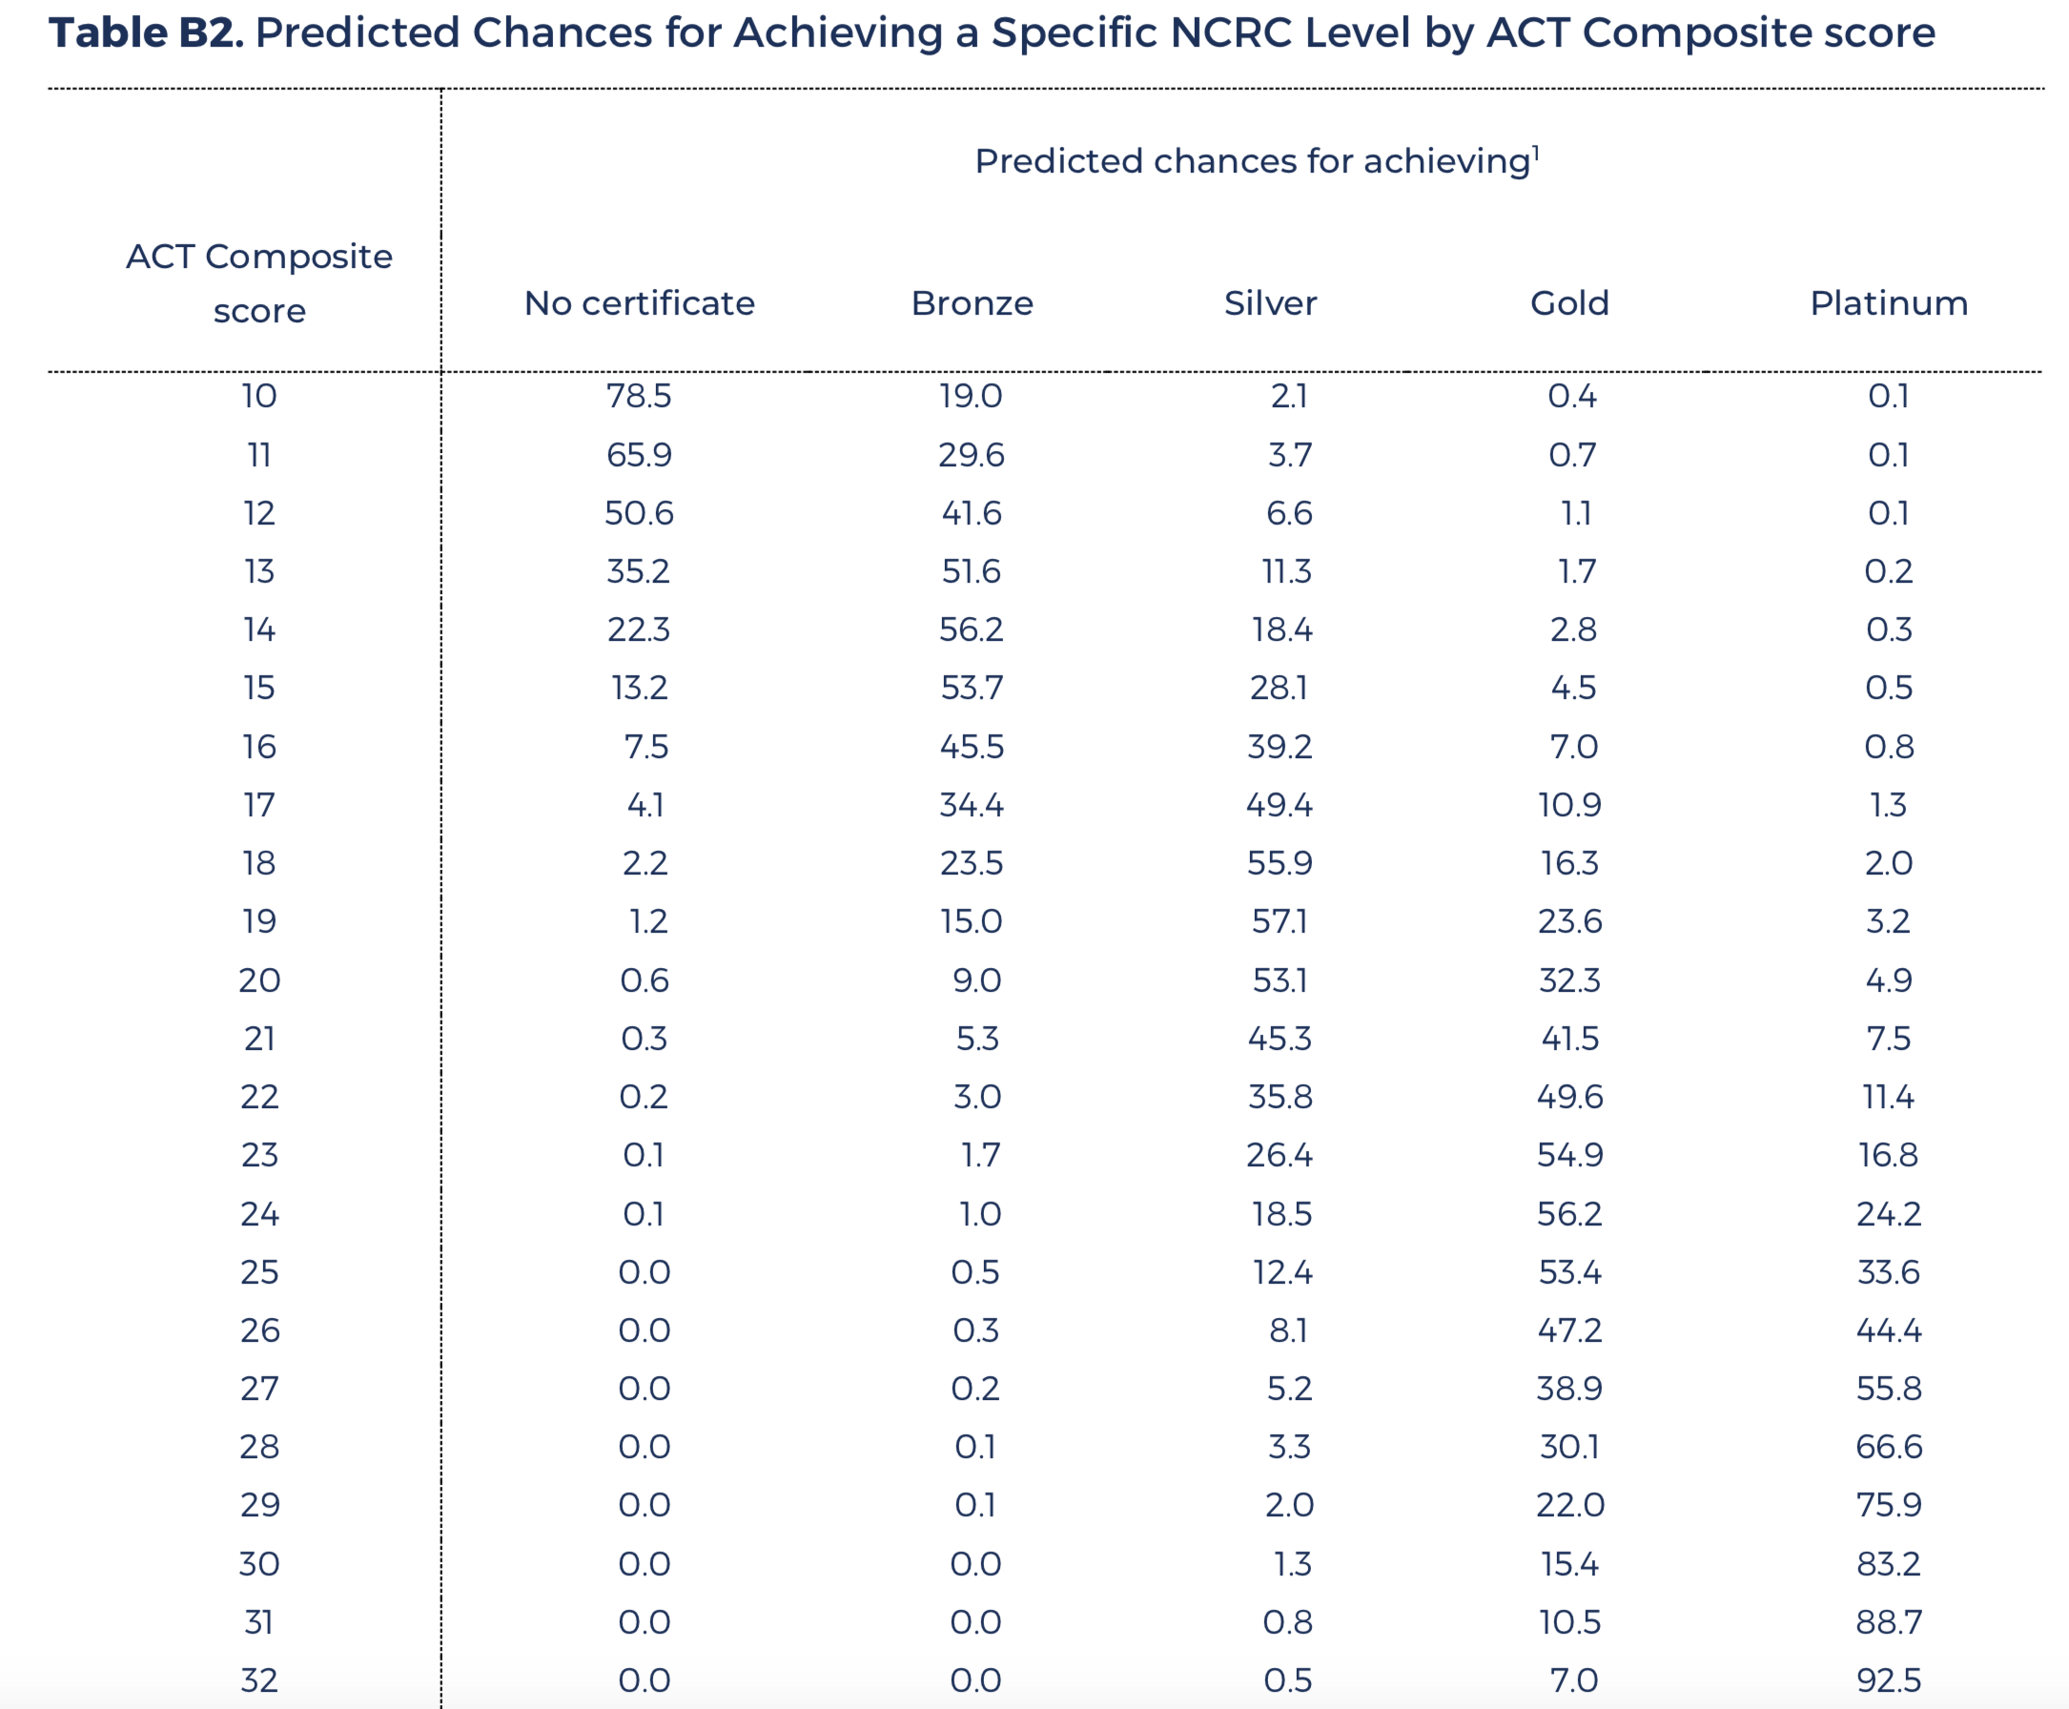
Performance
Criterion
ACT Performance ranges for predicted NCRC level
Bronze 13-16
Silver 17-20
Gold 22-25
Platinum 27-28
Retrieved from ACT Technical Brief, August 2018: http://www.act.org/content/dam/act/unsecured/documents/R1712-ACT-progress-toward-NCRC.pdf

Slide 26
Next Steps
Identify career readiness indicators most important to include
Offer recommendations for promising approaches for inclusion in the model
Provide guidance on performance expectations

Slide 27
Diploma Endorsements
Discussion regarding the option of using diploma endorsements in CCR/Acceleration.

Slide 28
Future Topics

Slide 29
Implications of Disruption
Given the disruption to assessment and accountability in 2020, what are implications for 2021?
Uncertain opportunity to learn
Performance expectations
Calculation of growth scores
Banked assessment results
Other?

Slide 30
Future Topics/ Meetings
As we prepare for future meetings, what issues should be prioritized?
Schedule the next meeting

Slide 31
Thank you for your participation

