Slide 1
Accountability Task Force
March 8, 2023

Slide 2
Mississippi Department of Education

Slide 3
State Board of Education STRATEGIC PLAN GOALS

Slide 4
Welcome and Introductions
First Name: | Last Name: | Organization: | Position in Organization:
Rosemary | Aultman | State Board of Education | Board Member
Crystal | Bates | Wayne County High School | Assistant Principal
LaToya | Blackshear | Jackson Public Schools | Director of Planning and Evaluations
Lindsay | Brett | Lee County Schools | Principal
Jermaine | Brown | Hattiesburg | Director of College & Career Readiness
Angela | Burch | Pascagoula-Gautier School District | Principal
Alan | Burrow | Mississippi Department of Education | Director of District and School Performance
Alicia | Conerly | Lawrence County | Principal
Chris | Domaleski | The Center for Assessment | External Facilitator
Deborah | Donovan | Mississippi Department of Education | Data Analytics and Reporting
Glen | East | State Board of Education | Board Member
Steven | Hampton | Lamar County | Superintendent
Raina | Holmes | Jackson County School District | High School Principal
Christy | Hovanetz | Foundation for Excellence in Education | External Expert
Lawrence | Hudson | Western Line School District | Superintendent
Tameka | Hyland | Vicksburg Warren School District | Principal
Tarrinasha | Jones | Greenville Public School District | Principal
Ryan | Kuykendall | DeSoto County | Director of Accountability & Research
Lisa Renee | LaMastus | Cleveland School District | Principal
Greg | Paczak | Madison County Schools | Director of Research & Development
William | Roberson | Oxford School District | Superintendent
Robert | Sanders | Hinds County School District | Assistant Superintendent
Paula | Vanderford | Mississippi Department of Education | Chief Accountability Officer
LaVonda | White | Rankin County School District | Director of Accreditation, Accountability, and Assessment

Slide 5
Agenda
9:00 a.m. | Welcome and Introductions
9:15 a.m. | MDE Updates
9:30 a.m. | Revisions to Business Rules
10:30 a.m. | Break
10:45 a.m. | Beyond Academics
12:00 p.m. | Lunch
1:00 p.m. | Examining Growth
2:30 p.m. | Break
2:45 p.m. | Attendance/ Absenteeism
3:30 p.m. | Prioritizing Future Meeting Topics
4:00 p.m. | Adjourn

Slide 6
Purpose and Overview
Primary purpose is to help MDE make good decisions about the design and implementation of the state, school accountability system under ESSA
We will focus on identifying policy priorities and identifying decisions in support of those priorities that are technically defensible and operationally feasible
Feedback from the Task Force is received as a recommendation to the department

Slide 7
Ground Rules/ Group Norms
Listen actively and attentively; ask for clarification as needed
Everyone should have an opportunity to ‘be heard’ without interruption and to receive courteous feedback
Critique ideas, not people or organizations
Build on one another’s comments; work toward shared understanding
We will attempt to make decisions based on group consensus, but when necessary we will take a vote
When/ if requested do not disclosure confidential information
At the end of each meeting we will prioritize topics for future meetings and discuss action items

Slide 8
Revisions to Business Rules

Slide 9
Section 9, Acceleration
9.2.1 Dual credit courses must be credit-bearing courses at both the high school and postsecondary institution with a minimum of three (3) semester hours credit, and beginning in school year 2019 - 2020, shall be limited to the list of articulated courses found in Appendix V of the current Procedures Manual for the State of Mississippi Dual Enrollment and Accelerated Programs document. Refer to the current edition of the Approved Courses for Secondary Education for approved Career and Technical Education (CTE) courses.
9.3 The Acceleration component will consist of a Participation and a Performance component. Each of these components will have a score calculated by dividing the numerator by the denominator and multiplying the resulting value by 50. These two (2) components scores will then be added together combined and reported for as one (1) score worth fifty (50) points. and phased in on the following sliding scale:
9.4.3 The denominator for the Participation component calculation shall include all students whose Mississippi Student Information System (MSIS) grade or peer-grade equivalent is 11th or 12th grade plus any 9th or 10th grade students who are takeing and passing these accelerated assessments/courses. (Ninth (9th) and 10th grade students will not be included in the denominator unless they are also included in the numerator.)

Slide 10
Section 9, Acceleration (continued)
9.10 For students in 9th through 12th grade that participate in accelerated IB courses as described in Section 9.2 that are designed with a two (2) year curriculum and do not have an associated assessment in the first year, the student will be included in participation calculations but will be excluded from performance measures in the first year and will be included in both participation and performance measures in year two (2).
9.12 Ungraded SCD students, as defined in 16.4 and 16.5, will not be included in participation or performance measures once the student has reached age 18 as of September 1st of the school year.

Slide 11
Section 15, English Learners (EL)
15.3 Progress toward proficiency will be calculated for all EL students using the state English Language Proficiency Test (ELPT). An annual progress goal will be calculated for each student based on reaching overall proficiency on the ELPT within five (5) years of entry into an EL program. The annual progress goal will be equal to the minimum overall scale score needed to achieve proficiency at year five (5), minus the prior year overall scale score, divided by the number of years the student had remaining to exit the EL program in the prior year.
15.3.1 In year five (5) and beyond, the annual progress goal is equal to the minimum scale score needed to achieve overall proficiency, minus the prior year overall scale score.
15.4 EL performance will be measured by the annual progress achieved by EL students. Each student will have a rate ranging between zero (0) and one (1) based on the student’s current year ELPT overall scale score, minus the prior year overall scale score, divided by the annual progress goal as defined in 15.3. Any student who does not demonstrate progress will have a rate of zero (0). No student will receive a rate higher than one (1).
15.4.1 The student must meet FAY requirements in the current year but is not required to meet FAY requirements in the prior year.
15.4.2 The student must have a prior year score to be included in the calculation.
15.4.3 EL students that have reached overall proficiency on the ELPT shall not be included in the EL Performance component in subsequent years.

Slide 12
Section 19, Rounding
19.1 In the calculation of each of the components in the statewide accountability system that are reported to schools, the final value of each component will be rounded to one (1) decimal place (tenths place). Any weighting of components is then applied to the rounded value. After the weighted components are summed, the total value will be rounded to a whole number and reported for the final performance classification calculation.

Slide 13
Section 25, College – and Career-Readiness Indicator
25.15 ACT WorkKeys is not included in participation calculations and does not replace the ACT participation requirement defined in 25.14.

Slide 14
Section 27, Other
27.2.1 Beginning in school year 2013-2014, foreign exchange students will automatically be included in accountability calculations just as any other students. However, if a school/district wishes to have a foreign exchange student excluded from the accountability calculations, the request should be made through the Internal Review Process and documentation of the student’s participation in the foreign exchange program must be provided in the request.

Slide 15
Beyond Academics

Slide 16
Overview
The MDE has received feedback suggesting the indicators of school quality and student success included in the state accountability model should be broadened
Often the feedback is framed as a desire to include more sources of information beyond academic achievement given the prominent role of proficiency and growth in the current model
Our objective today is to develop a deeper understanding of the ATF’s priorities for broadening the range of indicators in order to pursue the most promising alternatives in future meetings

Slide 17
School Quality Student Success
ESSA Requirements
The indicator(s) allows for meaningful differentiation in school performance.2
The indicator(s) must be valid and reliable.
The same indicator(s) must be used within each grade span.
The indicator(s) must be comparable and applicable statewide.
The indicator(s) must be measured and reported annually for all students and disaggregated by sub-group.

Slide 18
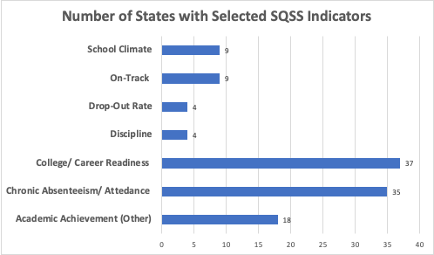
What approaches are states using for SQSS?

Slide 19
Review of College- and Career-Readiness Component
CCR Measure Includes:
50% ACT English or Reading Benchmark
+
50% ACT Math Benchmark
OR
ACT WorkKeys Silver with Career Pathway/Industry Certification or ACT WorkKeys Gold or Platinum
CCR Score by Student:
0.5 Point + 0.5 Point
OR
1.0 Point
(Max 1 point/student)

Slide 20
Review of Acceleration
Participation 50%
Denominator:
All students enrolled in grades 11 and 12, plus 9th and 10th grade students taking and passing accelerated courses
Numerator:
All students taking accelerated courses (AP, IB, AICE, dual credit/enrollment, industry certification)
25 Points Possible:
e.g., 133 ÷ 200 = 0.67
0.67 x 25 = 16.8 points
$$÷$$
$$=$$
30.3 points total
Performance 50%
Denominator:
All courses/exams taken by participating students in AP, IB, AICE, dual credit/ enrollment, industry certifications
Numerator:
All courses/exams meeting performance standards by student (e.g., C grade in dual c/e, 3 on AP exam, or 4 on IB)
25 Points Possible:
e.g., 72 ÷ 133 = 0.54
0.54 x 25 = 13.5 points
$$÷$$
$$=$$

Slide 21
Post-Secondary Success
Refers broadly to accountability initiatives design to promote and monitor preparation for education, careers, and civic participation after high school.
It may include
‘Along-the-way’ inputs and measures: such as earning credits or industry certifications
Outcomes: such as graduation or assessment performance
Post-secondary attainment: such as college-going rates, military, or other career accomplishments

Slide 22
Conley, D. (2012). A Complete Definition of College and Career Readiness. Educational Policy and Improvement Center.

Slide 23
Destination Known: Valuing College and Career Readiness in State Accountability Systems. Council of Chief State School Officers (2017). Retrieved from: http://edstrategy.org/wp-content/uploads/2017/08/Destination-Known.pdf

Slide 24
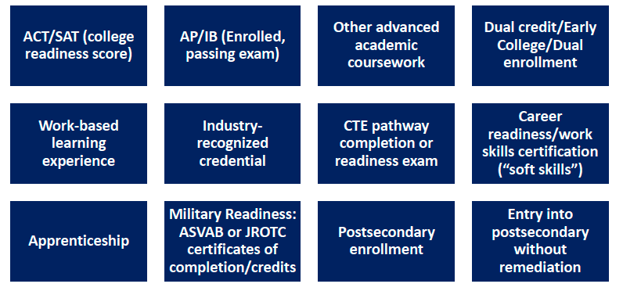
State Scan: College and Career Readiness
Education Counsel reports that 75% of states have a college and career readiness indicator in their ESSA system.
Most states use some form of an index system comprising multiple indicators, as depicted in the figure at right
Data from Education Counsel presentation to the Accountability Systems and Reporting SCASS, June 2018.

Slide 25
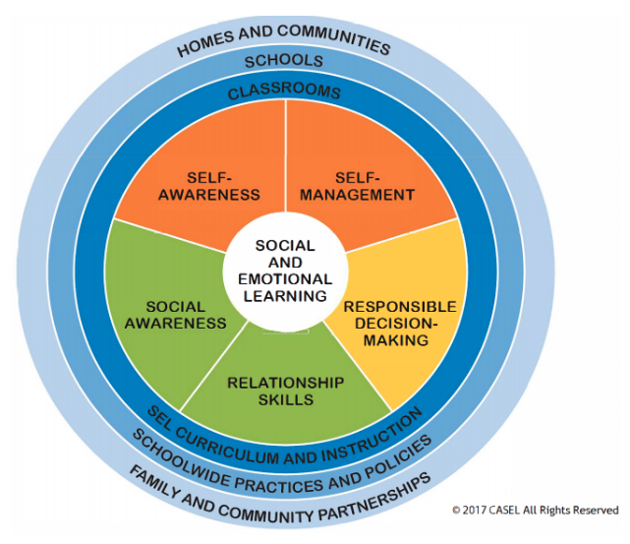
Trans-Academic Skills
We are using trans-academic skills as an umbrella term meant to include a broad range of skills, attitudes, and behaviors associated with student success.
For example, the Collaborative for Academic, Social, and Emotional Learning (CASEL) promotes the core Social and Emotional Learning (SEL) competencies in the figure to the left.
CASEL (2017) Retrieved from: https://casel.org/wp-content/uploads/2019/12/CASEL-Competencies.pdf

Slide 26
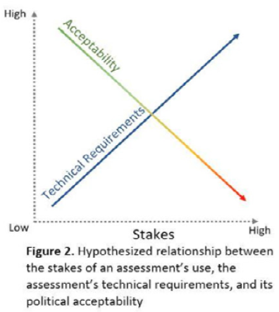
An Important Caveat…
The higher the stakes of an assessment’s intended use, the greater burden that assessment carries to demonstrate strong technical qualities such as score reliability, generalizability, and evidence of validity for that use. At the same time, the higher the stakes of an assessment’s intended use, the more likely it is to face resistance from at least some stakeholders.
(CASEL Assessment Work Group, 2019, p.22)
Assessment Work Group. (2019). Student social and emotional competence assessment: The current state of the field and a vision for its future. Chicago, IL: Collaborative for Academic, Social, and Emotional Learning Retrieved from: https://measuringsel.casel.org/wp-content/uploads/2019/09/AWG-State-of-the-Field-Report_2019_DIGITAL_Final.pdf

Slide 27
Summary of Research and External Scan
Most states have expanded the range of CCR indicators in recent years to include advanced coursework and selected career ready credentials.
Apart from CCR indicators, few states have explored SQSS options other than 1) additional academic indicators and 2) attendance/ absenteeism.
Infrequently, we find examples of school climate or discipline
We find no states that have incorporated formal, direct measures of trans-academic skills. Some indirect measures may be found in indicators such as service, co/extra-curricular activities.

Slide 28
Activity
Please individually review the indicator forms for readiness, social emotional, and school climate
Independently provide a response for 1) priority level 2) sources of data and 3) recommendations for data use
In groups, discuss your feedback and identify shared perspectives
Groups will share out and we will attempt to summarize the highest-priority areas for follow-up

Slide 29
Examining Growth

Slide 30
Overview
The MDE has received questions/ suggestions about growth in accountability to include:
Equal credit should be given for levels 4 and 5
Growth is should be more sensitive to progress at or above level 3. For example:
Create a level “3C”
Give partial credit for maintaining a level in 3
More weight should be given to students showing progress from levels within/ across levels 1-3.

Slide 31
Calculation of Growth
Earning Growth Points:
Moving 1 Growth* level = 1 pt
Moving 2 Proficiency* levels = 1.25 pts
Moving from any lower level to level 5 = 1.25 pts
Staying at level 5 = 1.25 pts
1a
4
5
1b
2a
2b
3a
3b
1.25pt
1.25pt
1.25pt
1pt
1pt
1
2
3
4
5
Proficiency Levels

Slide 32
Growth Weighting
First Year Proficiency Level | Level Needed in Year Two to Earn Growth | Level Needed to Earn Weighted Growth
Advanced | -- | Advanced (1.25)
Proficient | Proficient (1.0) | Advanced (1.25)
Top Half of Pass | Proficient (1.0) | Advanced (1.25)
Bottom of Pass | Top Half of Pass or Proficient (1.0) | Advanced (1.25)
Top Half of Basic | Pass (1.0) | Proficient or Advanced (1.25)
Bottom Half of Basic | Top Half of Basic or Pass (1.0) | Proficient or Advanced (1.25)
Top Half of Minimal | Basic (top or bottom) (1.0) | Pass, Proficient, or Advanced (1.25)
Bottom Half of Minimal | Top Half of Minimal or Basic (top or bottom) (1.0) | Pass, Proficient, or Advanced (1.25)
Notes:
This table summarizes all the growth score possibilities.

Slide 33
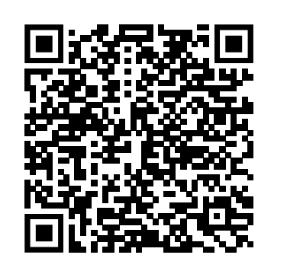
Activity
Individually complete the online growth feedback form
We will review and discuss feedback together to identify priorities for next steps
https://tinyurl.com/bdetm8tu

Slide 34
Attendance/ Absenteeism

Slide 35
Overview
The MDE has received feedback suggesting that attendance/ absenteeism should be considered for accountability.
We will broadly review and discuss the topic seeking a recommendation from the ATF regarding whether this is a priority for continued exploration.

Slide 36
How Chronic Absenteeism is Calculated
Student Enrollment is based on the district’s cumulative enrollment number.
Students enrolled in more than one school and that miss 10% of the time there will be included.
Any student enrolled in a school for at least 10 days and misses 10% of the school days must be included.
Any student absent 10% or more of the time that he/she was enrolled in any school will be included.
Any student who misses 50% or more of a school day will be counted as absent starting with the 2018-2019 school year.

Slide 37
The Case for Chronic Absenteeism
Since 2008, research from across the United States has produced significant and growing evidence of the adverse impact of chronic absence on a range of academic and other child outcomes, starting as early as preschool . Studies3 show that chronic absence is associated with lower achievement throughout a student’s academic life, from a lack of school readiness to falling behind in early literacy and numeracy, greater grade-level retention, failing middle school courses, dropping out of high school, and less persistence in college.
Data Matters: Using Chronic Absence to Accelerate Action for Student Success. (Chang, H., Bauer, L., Byrnes, V., 2018).

Slide 38
National Landscape
35 States include Chronic Absenteeism in their ESSA accountability system
Along with CCR indicators it’s the most prevalent SQSS indicator
Weights generally range from 5% to 20%

Slide 39
Example – Alabama
Chronic Absenteeism defined as students absent 18 or more days.
Weight
15% Elementary and Middle Schools
10% High Schools
Points calculated as: 100- [rate]

Slide 40
Example – Illinois
Chronic Absenteeism defined as missing 10% ore more of days enrolled
Weights
High schools: 10%
Elementary and Middle: 20%
Points calculated as: [(rate) x -2] +100.
Values are bound by 50 and 100
Points
CA Rate

Slide 41
Discussion
Is it important to include chronic absenteeism in the state accountability model or is supporting collection, reporting, and use sufficient?
If Chronic Absenteeism should be included in accountability
Should it apply to both the 700 and 1000 point models?
Should it be added to or replace existing indicator(s)
What weight should be assigned in each model?
Is the value sufficient to warrant the disruption in continuity?
What data or research would help the ATF make a recommendation about whether and how to include it?

Slide 42
Future Topics

Slide 43
Discussion
In your opinion, what are the top priorities for discussion at future Accountability Task Force meetings?

