Slide 1
Accountability Task Force
March 22, 2022

Slide 2
Mississippi Department of Education

Slide 3
State Board of Education STRATEGIC PLAN GOALS

Slide 4
Welcome and Introductions
First Name: | Last Name: | Organization: | Position in Organization:
Karen | Howard | Aberdeen School District | Principal
Kemi | Strain | Amory School District | Assistant Principal and Counselor
Shalondia | Washington | Canton Public Schools | Principal
Anthony | Goins | Clinton Public School District | Assistant Superintendent
Ryan | Kuykendall | DeSoto County School District | Director of Accountability & Research
Christy | Hovanetz | Foundation for Excellence in Education | External Expert
Kenneth | Pulley | Greenwood Leflore Consolidated School District | Deputy Superintendent
Fredrick | Hickmon | Kemper County School District | Assistant Superintendent
Greg | Paczak | Madison County School District | Director of Research & Development
Alan | Burrow | Mississippi Department of Education | Director of District and School Performance
Deborah | Donovan | Mississippi Department of Education | Data Analytics and Reporting
Paula | Vanderford | Mississippi Department of Education | Chief Accountability Officer
Jay | Smith | North Pike School District | Superintendent
Richard | Baliko | Noxubee County School District | Assistant Superintendent
Jacob | Dykes | Ocean Springs School District | Principal
Fina | Hence | Perry County School District | Accountability Director
Amanda | Garcia | Petal School District | Assistant Principal
Rosemary | Aultman | State Board of Education | Board Member
Chris | Domaleski | The Center for Assessment | External Facilitator
Matt | Thompson | Union County School District | Director of Federal Programs & Accountability
Crystal | Bates | Wayne County School District | Curriculum/Data administrator
Tracy | Cameron | West Bolivar Consolidated School District | Curriculum Director/Testing Director/Accountability Director

Slide 5
Agenda
9:00am | Welcome and Introductions
9:15 am | Review 2022 System Components
10:00 am | Review Evidence for 2021 Assessments
10:45 am | Discuss Post Administration Analyses
11:15 am | Discuss Priorities for Future Topics and Model Improvements
12:00 pm | Adjourn

Slide 6
Purpose and Overview
Primary purpose is to help MDE make good decisions about the design and implementation of the state, school accountability system under ESSA
We will focus on identifying policy priorities and identifying decisions in support of those priorities that are technically defensible and operationally feasible
Feedback from the Task Force is received as a recommendation to the department

Slide 7
Ground Rules/ Group Norms
Listen actively and attentively; ask for clarification as needed
Everyone should have an opportunity to ‘be heard’ without interruption and to receive courteous feedback
Critique ideas, not people or organizations
Build on one another’s comments; work toward shared understanding
We will attempt to make decisions based on group consensus, but when necessary we will take a vote
When/ if requested do not disclosure confidential information
At the end of each meeting we will prioritize topics for future meetings and discuss action items

Slide 8
Review 2022 System Components

Slide 9
Background
Traditional, in-person student learning was suspended in March 2020 of the 2019 – 2020 school year due to COVID-19 pandemic; statewide assessments were not administered in the Spring of 2020 due to the waiver granted by the U.S. Department of Education.
In 2020 – 2021, the State Board of Education (SBE) and the MDE issued guidance requiring the administration of all federal and statewide assessments to all eligible students while waiving the requirement to assign letter grades to schools and districts for the 2020-2021 school year.
In addition, the MDE provided districts pandemic-related flexibilities to administer statewide assessments.
Schools provided safe, on-site testing environments to all students, including full-time virtual students.

Slide 10
Background Continued
November 20, 2021: Governor Reeves’ Executive Order 1460 ended the declared State of Emergency in Mississippi and rescinded the authorization given to the SBE to waive assessment and or accountability requirements on March 19, 2020.
December 17, 2021: The United States Department of Education (USED) released guidance and an addendum template for states to submit adjustments to comply with federal school identification requirements for the 2021-2022 school year. The addendum provides for “temporary adjustments to the State’s accountability system, consistent with statutory requirements, that may be needed in the short-term (e.g., for one year)…”
Therefore, there are no waivers in place for statewide assessments or accountability measures in the 2021-2022 school year.

Slide 11
Indicators for Elementary and Middle Schools
READING | MATH | SCIENCE | ENGLISH LANGUAGE PROGRESS
Proficiency 95 pts | Proficiency 95 pts | Proficiency 95 pts | Progress to Proficiency 35 pts
Growth All Students 95 pts | Growth All Students 95 pts
Growth Lowest 25% 95 pts | Growth Lowest 25% 95 pts

Slide 12
Indicators for Elementary and Middle Schools Continued
Proficiency
2021-2022 Assessment Data
English 3-8th grade
Math 3-8th grade
Science 5th and 8th Grade
Growth
2020-2021 Assessment Data
2021-2022 Assessment Data
English 3-8th grade
Math 3-8th grade
2020-2021
2021-2022
Growth

Slide 13
Indicators for Elementary and Middle Schools Continued
EL Progress
2020-2021 ELPT Assessment Data
2021-2022 ELPT Assessment Data
2020-2021
2021-2022
EL Progress

Slide 14
Indicators for High Schools and Districts
READING | MATH | OTHER SUBJECTS | GRADUATION 4-YEAR | ACCELERATION | COLLEGE & CAREER READINESS | ENGLISH LANGUAGE PROGRESS
Proficiency 95 pts | Proficiency 95 pts | Science Proficiency 47.5 pts | 4-year Cohort Rate 190 pts | Performance 23.75 pts | ACT Performance 47.5 pts Or | Progress to Proficiency 50 pts
Growth All Students 95 pts | Growth All Students 95 pts | U.S. History Proficiency 47.5 pts |  | Participation 23.75 pts | ACT WorkKeys Option 47.5 pts
Growth Lowest 25% 95 pts | Growth Lowest 25% 95 pts

Slide 15
Indicators for High Schools
Proficiency
2019-2020 Assessment Data (Banked)
2020-2021 Assessment Data (Banked)
2021-2022 Assessment Data
Algebra I
Biology I
English II
US History

Slide 16
Indicators for High Schools Continued
Growth
2018-2019 Assessment Data
2019-2020 Assessment Data
2020-2021 Assessment Data
2021-2022 Assessment Data
English II
Algebra I

Slide 17
Illustration of Banking – Math
2020
2021
2022
Grade 8, Math
Grade 9, No test
Grade 10, Algebra I
Potential scenarios for calculating high school growth in math.
Shaded cells indicate year of missing data.
2020
2021
2022
Grade 8, Math
Grade 9, Algebra I
Grade 10
Most common scenario
2020
2021
2022
Grade 8, Algebra I
Grade 9, No test
Grade 10
2019
Grade 7, Math

Slide 18
Illustration of Banking – ELA
Potential scenarios for calculating high school growth in ELA.
Shaded cells indicate year of missing data.
2020
2021
2022
Grade 8, ELA
Grade 9, No test
Grade 10, English II
Most common scenario
2020
2021
2022
Grade 8, ELA
Grade 9, English II
Grade 10

Slide 19
Mississippi Grade 11 Tested Students
Three (3) Year Comparison – Average ACT Scores
 |  | 2018-2019 | 2019-2020 | 2020-2021
Number of Students Tested | Number of Students Tested | 29,817 | 28,394 | 27,972
Average ACT Scores | English | 16.8 | 16.8 | 16.4
 | Mathematics | 17.4 | 17.5 | 17.1
 | Reading | 17.8 | 17.9 | 17.5
 | Science | 17.9 | 18.2 | 17.6
 | Composite | 17.6 | 17.7 | 17.3

Slide 20
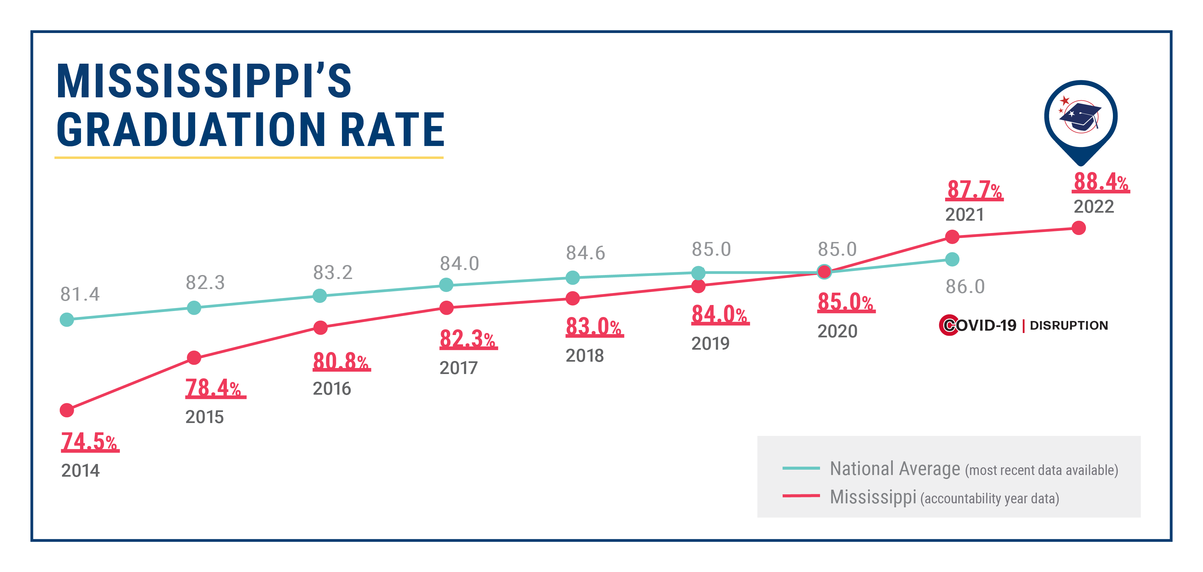
Statewide Graduation Rate 9-Year History

Slide 21
Acceleration
Acceleration includes participation and performance in Advanced Placement (AP), International Baccalaureate (IB), Advanced International Certificate of Education (AICE), industry certifications, dual credit/dual enrollment post-secondary courses
The state-level acceleration score remained steady from 2019 to 2021.

Slide 22
EL Progress for High Schools
EL Progress
2020-2021 ELPT Assessment Data
2021-2022 ELPT Assessment Data
2020-2021
2021-2022
EL Progress

Slide 23
Research on 2021 Assessments

Slide 24
Purpose
Because 2021 assessments will have some influence in the 2022 accountability system, primarily as a prior for growth, we want to ensure there is evidence to support this use.
While it is not possible to predict assessment or accountability results in 2022, we can look to evidence from 2021 to inform our decisions.
The MDE has been working with the assessment contractors and the TAC to review this evidence throughout the year.

Slide 25
Research Questions
Is there evidence to support the technical defensibility of the 2021 state assessments?
Were observed performance results substantially influenced by population or participation shifts?
Was school level variability with respect to score changes substantially different compared to previous years?

Slide 26
Item Stability

Slide 27
Claim #1 – Item Parameter Stability Study
In addition to the range of typical validation studies (e.g., equating, scaling) conducted by the assessment contractors, we are sharing part of one study specifically designed to address potential pandemic impact on the 2021 tests.
The study was conducted by Questar and reviewed with the MDE Technical Advisory Committee (TAC)
The purpose was to investigate whether the changes in leaning opportunities, learning methods, and the one-year gap in test administration affects item statistics.
Study Design: Used past item statistics to establish baseline information and compares the 2021 item statistics against the baseline
The scope includes both general and alternate assessments in 3-8 and HS. We show only a portion of the results for the sake of time.

Slide 28
Claim #1 – Item Parameter Stability Study
Method:
  Identify items that have stats from at least two administrations (operational or field test)
  Compute item b parameter differences of:
    Consecutive years: recent year minus older year
    With one-year gap: recent year minus older year
  Produce summary of:
    Items by general and alternate assessments
    Items by content standards and general/alternate assessments

Slide 29
Item Parameter Stability Study - Illustrative Results (1)
Descriptive Stats of MS Item Parameter Stability before 2021 by Content Standards based on one year gap
Content Area | Content Standards | Mean | SD
ELA | Language | -0.01 | 0.45
ELA | Reading Informational Text | -0.06 | 0.37
ELA | Reading Literature | 0.03 | 0.42
ELA | Writing | -0.09 | 0.23
Math | Algebra | -0.05 | 0.26
Math | Expressions and Equations | 0.05 | 0.16
Math | Functions | 0.14 | 0.28
Math | Geometry | 0.03 | 0.13
Math | Measurement and Data | -0.07 | 0.23
Math | Number System | -0.02 | 0.22
Math | Number and Operations | -0.02 | 0.03
Math | Number and Quantity | 0.01 | 0.24
Math | Operations and Algebraic Thinking | -0.06 | 0.23
Math | Ratios and Proportional Relationships | 0.01 | 0.13
Math | Statistics and Probability | -0.01 | 0.45

Slide 30
Item Parameter Stability Study - Illustrative Results (2)
Descriptive Stats of MS Item Parameter Stability 2021 by Content Standards based on one year gap
Content Area | Content Standards | Mean | SD
ELA | Language | -0.04 | 0.23
ELA | Reading Informational Text | -0.05 | 0.25
ELA | Reading Literature | -0.04 | 0.23
ELA | Writing | 0.23 | 0.28
Math | Algebra | 0.03 | 0.24
Math | Expressions and Equations | -0.03 | 0.30
Math | Functions | -0.01 | 0.29
Math | Geometry | 0.03 | 0.25
Math | Measurement and Data | -0.07 | 0.23
Math | Number and Operations | 0.01 | 0.27
Math | Number and Quantity | 0.00 | 0.15
Math | Number System | 0.07 | 0.25
Math | Ratios and Proportional Relationships | -0.08 | 0.34
Math | Statistics and Probability | 0.00 | 0.24

Slide 31
Summary
Summary of 2021 Item Parameter Stability
  Mean item parameter shifts are near zero.
  The SDs are similar to the past item parameter stability results.
  The range of differences is generally narrower than past item parameter stability results.
  Differences are generally small and non-uniform

Slide 32
Academic Impact Study

Slide 33
Academic Impact Study
We will share results of an ongoing study being conducted by the Center for Assessment. Draft results were presented at the December 2021 TAC.
Research Question: To the extent that matched samples can be constructed, what do the results of a “fair comparison” illustrate in terms of comparative performance between the 2020-2021 and 2018-2019 school years?

Slide 34
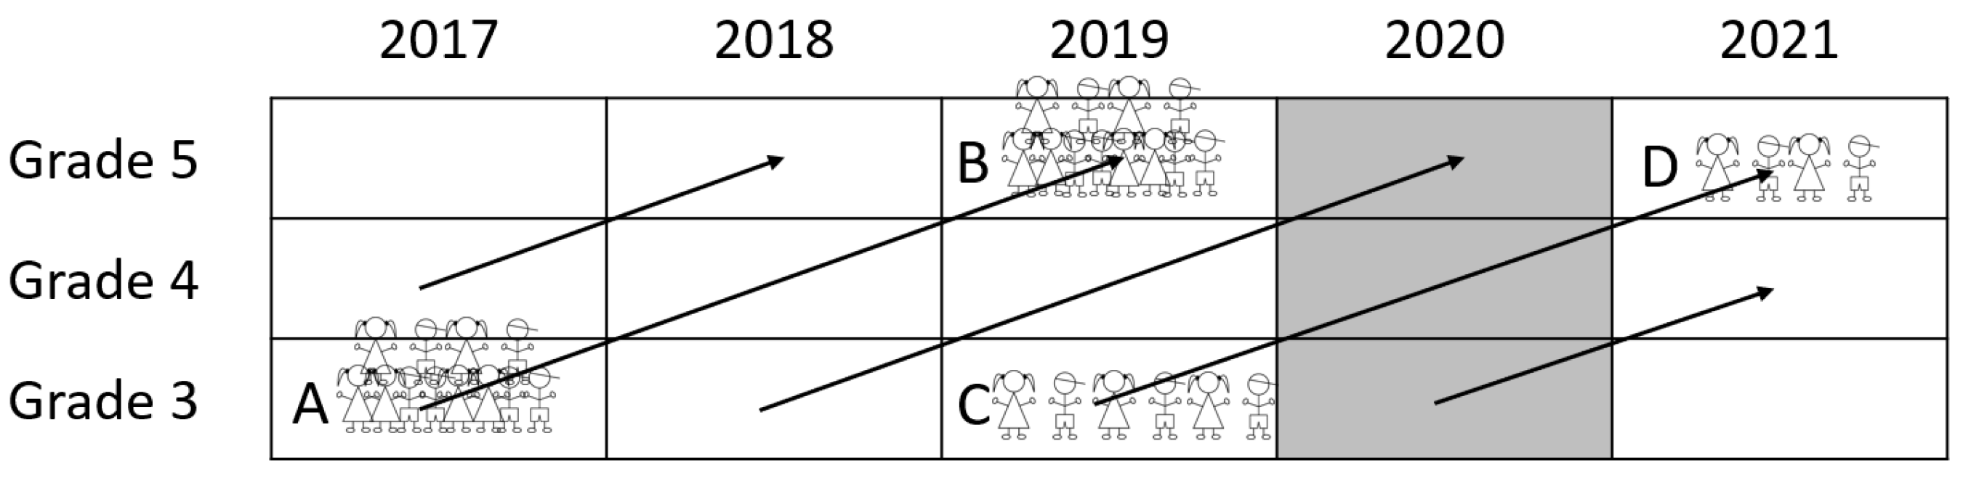
Computing the Fair Trend Metric
Identify students in school 𝑠 and grade 3 in 2019 (Cell C) who have comparable test scores in grade 5 in 2021 (Cell D).
Find their same-score ‘academic peers’ in 2017, in grade 3 (Cell A).
  We used case-control matching, similar to propensity score or ‘nearest neighbor’ techniques. Criteria were set to identify exact matches without replacement.
Report the academic outcomes of these academic peers in 2019 in grade 5 (Cell B). The Fair Trend compares observed scores in Cell D to the scores of academic peers in Cell B.

Slide 35
Summary of Results – ELA & Math Scale Scores
Values in bottom right cells can be regarded as the estimated academic impact based on the fair trend

Slide 36
Summary
The differences in estimated academic impact based on cohort adjusted estimates or ‘fair trend’ are slightly larger but overall very similar to the values from the non-adjusted trend
This is logical given the high participation rate in 2021 and the similar characteristics of the actual versus peer adjusted cohorts
Assuming these results hold across grades and content areas, MDE can interpret 2019 to 2021 achievement patterns as a credible reflection of academic impact.

Slide 37
School Level Variability

Slide 38
Math Scale Score Change by Grade
Blue box plots represent scale score changes from 2017 to 2019.
Red box plots represent scale score changes from 2019 to 2021.
Box: Middle 50% of schools.
Whiskers: 95% range of school
Dots: Outliers

Slide 39
ELA Scale Score Change by Grade
Blue box plots represent scale score changes from 2017 to 2019.
Red box plots represent scale score changes from 2019 to 2021.
Box: Middle 50% of schools.
Whiskers: 95% range of school
Dots: Outliers

Slide 40
Summary
In 2019 the 2-year scale score change for the middle 50% of schools was approx. 0 to +10. The vast majority of schools had 2-year change between -10 and +20.
In 2019 the 2-year scale score change for the middle 50% of schools was approx. -5 to -15. The vast majority of schools had 2-year change between +10 and -25.
Clearly, performance declined across the board in 2021 compared to 2019. The variability also increased, but not substantially. The variability was often more pronounced for early grades.
The number of outlier schools were relatively consistent.

Slide 41
Algebra
We examined algebra scores to get a sense for the extent to which school level performance in 2021 was consistent with expectations based on prior performance.
School level scores from 2018 and 2019 were used to predict performance in 2021. Then we looked at the deviation of the observed scores in 2021 from prediction (residuals).
Any analyses of this nature is limited insofar as data prior to 2020 cannot account for a ‘pandemic effect’

Slide 42
2021 School Level Algebra Predicted from 2018 and 2019
Each dot is a school. If every dot falls on the diagonal line, there is perfect prediction.
Most schools cluster near the prediction line; as expected some perform higher, others lower.
Very few schools are outliers (standardized residuals of more than 2.5.)

Slide 43
Post Administration Analyses

Slide 44
Introduction
As noted previously, we will not be able to predict conditions or outcomes in 2022.
We believe it advisable to plan for careful study of the results before reporting accountability outcomes as part of ongoing quality assurance.

Slide 45
Overall Analyses
Examine distribution of outcomes by score and grade for all districts and schools
  Are any shifts in the distribution skewed in ways that suggest problems?
Examine school and district level changes for 2019-2022 in comparison to prior year changes
  Are any unexpected results observed that would call into question outcomes from 2021 or 2022?

Slide 46
Indicator Analyses
Examine distribution of scores for all indicators separately.
  Are any shifts in the distribution skewed in ways that suggest problems?
Compare growth in 2022 to growth in 2019 with a focus on:
  Are there systematic differences by grade or content?
  Are there differences by school type or characteristics?
  What is the relationship to current and prior year percent proficient?

Slide 47
Discussion
Does the ATF have recommendations for additional analyses?
Are there any differences to the standard quality assurance processes that the ATF would suggest?

Slide 48
Future Topics and Model Improvements

Slide 49
Future Topics
What ideas do you have to help continuously improve accountability and reporting practices in Mississippi?
What are some specific suggestions for future research or topics that the ATF should consider?

