Slide 1
Accountability Task Force
January 11, 2023

Slide 2
Mississippi Department of Education

Slide 3
State Board of Education STRATEGIC PLAN GOALS

Slide 4
Welcome and Introductions
First Name: | Last Name: | Organization: | Position in Organization:
Rosemary | Aultman | State Board of Education | Board Member
Crystal | Bates | Wayne County High School | Assistant Principal
LaToya | Blackshear | Jackson Public Schools | Director of Planning and Evaluations
Lindsay | Brett | Lee County Schools | Principal
Jermaine | Brown | Hattiesburg | Director of College & Career Readiness
Angela | Burch | Pascagoula-Gautier School District | Principal
Alan | Burrow | Mississippi Department of Education | Director of District and School Performance
Alicia | Conerly | Lawrence County | Principal
Chris | Domaleski | The Center for Assessment | External Facilitator
Deborah | Donovan | Mississippi Department of Education | Data Analytics and Reporting
Glen | East | State Board of Education | Board Member
Steven | Hampton | Lamar County | Superintendent
Raina | Holmes | Jackson County School District | High School Principal
Christy | Hovanetz | Foundation for Excellence in Education | External Expert
Lawrence | Hudson | Western Line School District | Superintendent
Tameka | Hyland | Vicksburg Warren School District | Principal
Tarrinasha | Jones | Greenville Public School District | Principal
Ryan | Kuykendall | DeSoto County | Director of Accountability & Research
Lisa Renee | LaMastus | Cleveland School District | Principal
Greg | Paczak | Madison County Schools | Director of Research & Development
William | Roberson | Oxford School District | Superintendent
Robert | Sanders | Hinds County School District | Assistant Superintendent
Paula | Vanderford | Mississippi Department of Education | Chief Accountability Officer
LaVonda | White | Rankin County School District | Director of Accreditation, Accountability, and Assessment

Slide 5
Agenda
1:00 p.m. | Welcome and Introductions Context and Group Norms
1:30 p.m. | Background: Accountability in Mississippi
2:00 p.m. | ESEA Amendment Submission and Related Changes
3:00 p.m. | Break
3:15 p.m. | Industry Certification Self-Reporting
4:00 p.m. | Accountability Foundations and Future Topics
5:00 p.m. | Adjourn

Slide 6
Purpose and Overview
Primary purpose is to help MDE make good decisions about the design and implementation of the state, school accountability system under ESSA
We will focus on identifying policy priorities and identifying decisions in support of those priorities that are technically defensible and operationally feasible
Feedback from the Task Force is received as a recommendation to the department

Slide 7
Ground Rules/ Group Norms
Listen actively and attentively; ask for clarification as needed
Everyone should have an opportunity to ‘be heard’ without interruption and to receive courteous feedback
Critique ideas, not people or organizations
Build on one another’s comments; work toward shared understanding
We will attempt to make decisions based on group consensus, but when necessary we will take a vote
When/ if requested do not disclosure confidential information
At the end of each meeting we will prioritize topics for future meetings and discuss action items

Slide 8
Accountability in Mississippi

Slide 9
The Accountability System…
Establishes a set of minimum standards for public schools and districts in our state to ensure that Mississippi students are prepared to compete in a national workforce or go on to post-secondary education.
Informs the public on how well schools and districts are performing. Mississippi’s accountability system considers how well students perform on state tests, whether students are showing improvement on those tests from year to year and whether students are graduating on time.
Drives behavior of schools and districts and influences planning and interim measures of performance. This results in consistent best practices and can be seen in improvements on both statewide assessments and standardized national assessments.

Slide 10
Prior to 2013…
1988
First Accountability Results, Districts rated 1 – 3, based on Performance
1995
Districts Rated 1 – 5, based on Performance
2003
Schools Rated Level 1 – 5 based on Performance and Growth
2009
Districts and Schools Rated 1-7, based on Performance, Growth, and Completion
2013
Current Model Implemented

Slide 11
Mississippi Statewide Accountability System
Single “A” through “F” statewide accountability system with applicable state and federal requirements (Miss. Code Ann. § 37-17-6)
Approved by the Mississippi State Board of Education January 17, 2014
System developed in collaboration with the Accountability Task Force, Technical Review Committee, State Legislative Leaders, and MDE Staff

Slide 12
Miss. Code Ann. § 37-17-6 (Senate Bill 2396)
Implement a single “A” through “F” school and school district accountability system
Combine state and federal accountability systems into one (federally approved) system
Establish five performance categories (“A, B, C, D, & F”) and discontinue the use of the designations of “Star, High Performing, Successful, Low-Performing, At Risk of Failing”
Incorporate a standards-based growth model
Discontinue use of QDI
Include the federally compliant 4-year graduation rate and discontinue use of HSCI
Increase standards when 75% of students are Proficient and/or when 65% of schools or districts earn a “B” or higher grade

Slide 13
Every Student Succeeds Act (ESSA) Requirements
Goals
States must establish “ambitious, state-designed long-term goals” and interim progress targets for all students and for each subgroup for: Academic achievement High school graduation English language proficiency (all students only)
Identification of Schools
The accountability system must identify at least three categories of schools: Comprehensive support and improvement schools Targeted support and intervention schools Additional schools
School Accountability
States must establish a system of meaningfully differentiating schools on an annual basis, based on the following indicators for all students and separately for each subgroup (except that English proficiency need not be disaggregated). The system must give substantial weight to each indicator. Academic achievement indicator Another academic indicator (growth, grad rate) English proficiency Additional indicator of school quality or student success
Graphic by : Foundation for Excellence in Education
Notes:
Identification of schools for school improvement is the ultimate goal of federal accountability measures to ensure that resources are allocated where they are most needed. This process starts with state-defined goals and a state-defined system of meaningful differentiation of schools.

Slide 14
Mississippi Statewide Accountability System
Proficiency/Performance – Did the student meet expectations?
Growth - Did the student improve as expected?
Participation – Did the student participate in assessments/classes?
Graduation Rates – Did the student graduate as expected and on time?

Slide 15
Annual Subject Area Assessments
Assessments used for calculation of growth and proficiency include:
Grade-level (3-8) assessments in Reading/Language Arts
Grade-level (3-8) assessments in Mathematics
High School end-of-course assessment in English II
High School end-of-course assessment in Algebra I
Alternate Assessment (3-8 and High School end-of-course assessment) in Reading
Alternate Assessment (3-8 and High School end-of-course assessment) in Mathematics
Proficiency (not growth) is measured in Grades 5 and 8 Science, Biology, and U.S. History end-of-course assessments.

Slide 16
Calculation of Growth
Earning Growth Points:
Moving 1 Growth* level = 1 pt
Moving 2 Proficiency* levels = 1.25 pts
Moving from any lower level to level 5 = 1.25 pts
Staying at level 5 = 1.25 pts
1a
4
5
1b
2a
2b
3a
3b
1.25pt
1.25pt
1.25pt
1pt
1pt
1
2
3
4
5
Proficiency Levels

Slide 17
700-Point Elementary and Middle Schools
READING | MATH | SCIENCE | ENGLISH LANGUAGE PROGRESS
Proficiency 95 pts | Proficiency 95 pts | Proficiency 95 pts | Progress to Proficiency 35 pts
Growth All Students 95 pts | Growth All Students 95 pts
Growth Lowest 25% 95 pts | Growth Lowest 25% 95 pts

Slide 18
Indicators for High Schools and Districts
READING | MATH | OTHER SUBJECTS | GRADUATION 4-YEAR | ACCELERATION | COLLEGE & CAREER READINESS | ENGLISH LANGUAGE PROGRESS
Proficiency 95 pts | Proficiency 95 pts | Science Proficiency 47.5 pts | 4-year Cohort Rate 190 pts | Performance 23.75 pts | ACT Performance 47.5 pts Or | Progress to Proficiency 50 pts
Growth All Students 95 pts | Growth All Students 95 pts | U.S. History Proficiency 47.5 pts |  | Participation 23.75 pts | ACT WorkKeys Option 47.5 pts
Growth Lowest 25% 95 pts | Growth Lowest 25% 95 pts

Slide 19
Acceleration
Participation 50%
Denominator:
All students enrolled in grades 11 and 12, plus 9th and 10th grade students taking and passing accelerated courses
Numerator:
All students taking accelerated courses (AP, IB, AICE, dual credit/enrollment, industry certification)
25 Points Possible:
e.g., 133 ÷ 200 = 0.67
0.67 x 25 = 16.8 points
$$÷$$
$$=$$
30.3 points total
Performance 50%
Denominator:
All courses/exams taken by participating students in AP, IB, AICE, dual credit/ enrollment, industry certifications
Numerator:
All courses/exams meeting performance standards by student (e.g., C grade in dual c/e, 3 on AP exam, or 4 on IB)
25 Points Possible:
e.g., 72 ÷ 133 = 0.54
0.54 x 25 = 13.5 points
$$÷$$
$$=$$

Slide 20
College- and Career-Readiness Component
CCR Measure Includes:
50% ACT English or Reading Benchmark
+
50% ACT Math Benchmark
OR
ACT WorkKeys Silver with Career Pathway/Industry Certification or ACT WorkKeys Gold or Platinum
CCR Score by Student:
0.5 Point + 0.5 Point
OR
1.0 Point
(Max 1 point/student)

Slide 21
Grade Assignments
Grade | Districts | 700 Point Schools | 1,000 Point Schools
A | 668 | 442 | 754
B | 599 | 377 | 648
C | 536 | 328 | 584
D | 489 | 269 | 510
F | < 489 | < 269 | < 510

Slide 22
Graduation Rates
In accordance with 34 C.F.R. 200.19(b) and MS Code Ann. 37-17-6, graduation rates are calculated following the four-year adjusted cohort method.
Four-Year Cohort: a group of students who enter 9th grade in MS for the first time, adjusted for students transferring into and out of the cohort, and are expected to graduate within four years
Graduate: a student receiving a standard high school diploma in four years
Completer: a student receiving an occupational diploma, certificate of attendance, or GED within the district
Still Enrolled: a student still enrolled as September 1 of the year after the cohort’s expected completion date
Dropout: a student who leaves school during the cohort period without a diploma or certificate from the district

Slide 23
Assessment and Accountability Timeline
April-May
Assessment Period
August
Assessment Results
September
Accountability Results
February
Graduation Rates

Slide 24
Continuous Review and Improvement
Public Feedback
Accountability Task Force
Commission on School Accreditation
State Board of Education
Technical Advisory Committee

Slide 25
ESEA Amendment Submission

Slide 26
ESEA Amendment Submission
Required following the COVID Addendum (approved August 15, 2022)
Will include other needed additions and clarifications
- clarifications
- changes/additions in business rules
Public Comment Period

Slide 27
Targeted Support and Improvement (TSI)
Targeted Support and Improvement (TSI) is based on student group performance.
ESSA requires states to annually identify any school in which at least one subgroup of students is consistently underperforming. States have flexibility in how to designate such schools as long as the methods are based on all indicators in the system.
TSI Identification:
Subgroup is in the lowest 50% of overall accountability index AND
Subgroup is in the lowest quartile of 3-year average gap-to goal AND
Subgroup scores in the lowest quartile of 3-year improvement toward gap-to-goal closure

Slide 28
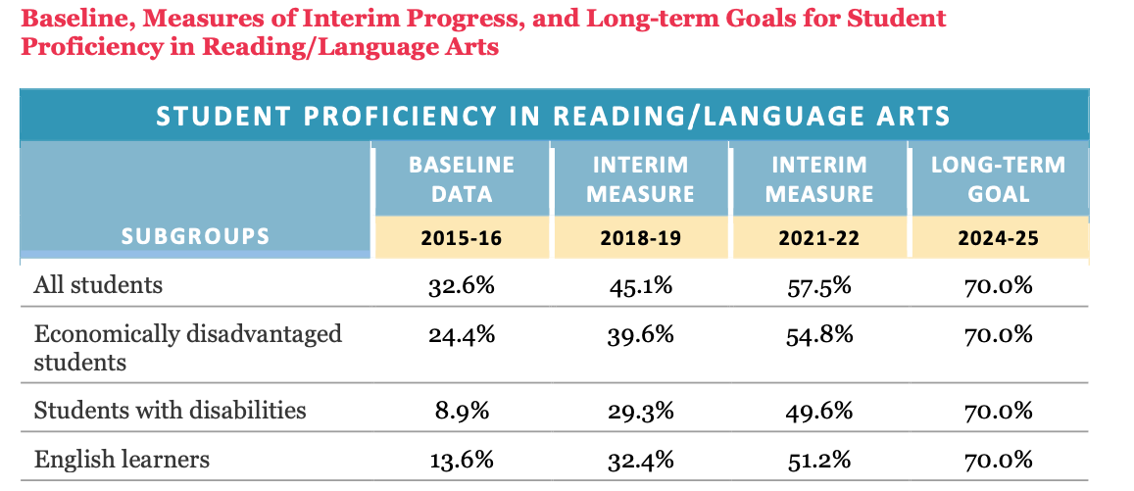
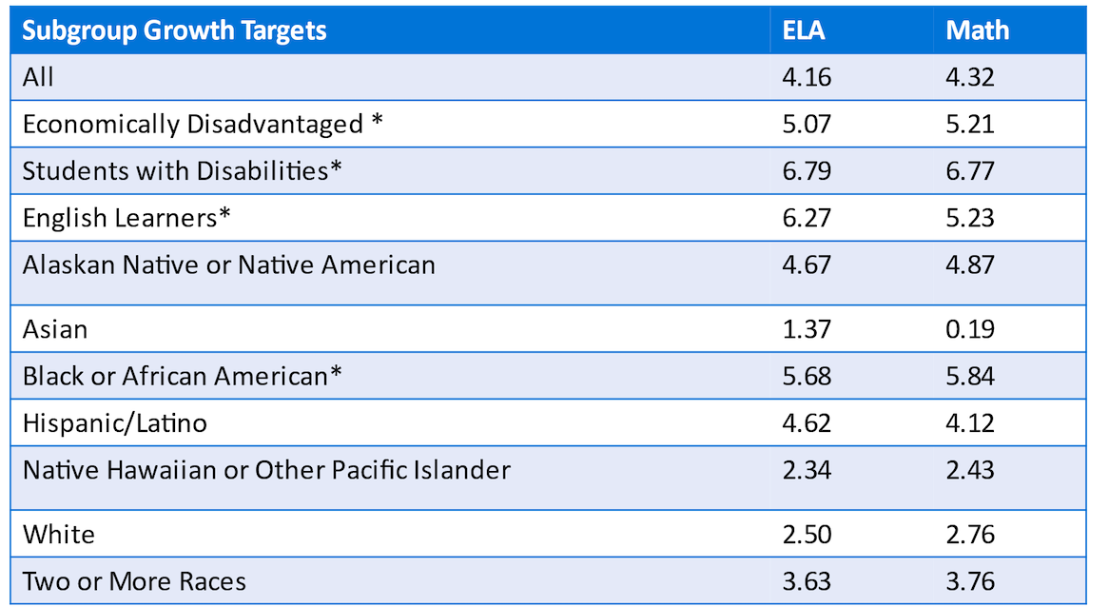
Exiting TSI
To exit TSI status a school must
No longer meet criteria that led to initial identification
Demonstrate 3-year average growth in subgroup proficiency that exceeds target proficiency growth rate projected for the same statewide subgroup

Slide 29
To what extent do schools meet these criteria?
50 schools potentially eligible to exit in 2022
49 of those schools were identified for the SWD group
1 school was identified for the Black/ African American group
40 schools identified for ELA
1 school exited
39 schools failed to exit; 38 failed to meet ‘growth’ criteria
42 schools identified for Math
9 schools exited
33 failed to exit; 32 failed to meet ‘growth’ criteria

Slide 30
Issue and Considerations
Exit criteria should be ambitious but attainable
Considerations
We want to avoid a ‘swinging door’ with school designations. Schools that exit should show demonstrated improvement and should be unlikely to be quickly reclassified.
We want to avoid unnecessary disruption to the system. All else being equal, we value coherence and consistency.

Slide 31
Potential Change to TSI Exit Criteria
Replace the second exit criterion – growth in subgroup proficiency – with growth as defined in the accountability system.
This is a more consistent definition of growth that is coherent with the principles of MDE’s system.
It rewards progress for cohorts of students over time.
It is better suited (compared to proficiency rates) to detect change across the performance continuum.
By keeping the first criterion, we ensure we do not exit schools that are among the lowest performing.

Slide 32
Growth Performance for Schools that Failed to Exit Based on Second Criterion
Q1=38, Q2=51, Q3=59
Q1=33, Q2=39, Q3=49

Slide 33
Example
If the second criterion were changed to subgroup growth based on the accountability system must be 50 or higher:
8 schools would meet the exit criterion for ELA
17 schools would meet the exit criterion for Math
This value represents, on average, half the students demonstrating progress

Slide 34
Discussion
Principally, is using growth as a TSI exit criterion a promising strategy?
What growth threshold should we consider and why?
Should we require multi-year growth (e.g., average over 2 or 3 years)?
What other considerations should inform our decision?

Slide 35
SBE Industry Certifications
Wendy Clemons
Associate State Superintendent

Slide 36
State Board of Education Approved Industry Certification and Acceleration
The Acceleration component refers to the percentage of students taking and passing the assessment associated with accelerated courses which include Advanced Placement (AP), International Baccalaureate (IB), Advanced International Certificate of Education (AICE), dual credit or SBE-approved industry certification courses.
For industry certification courses, the student must pass the exam.

Slide 37
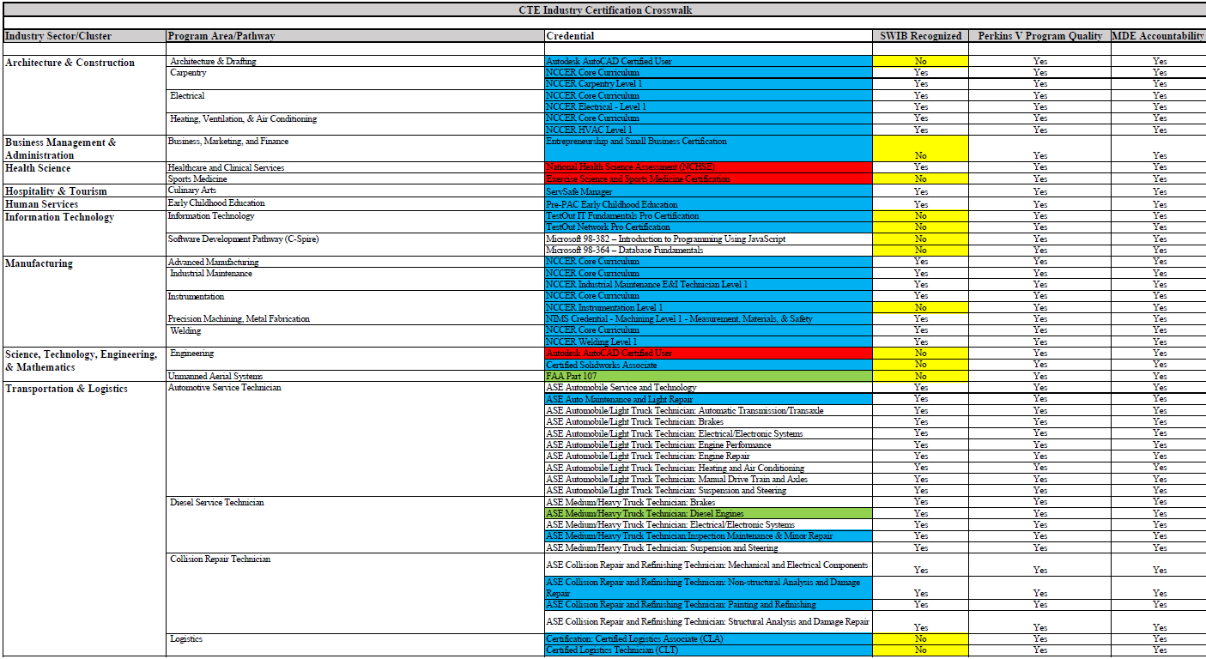
Notes:
The State Board of Education in October 2021, approved a list of Industry certifications that would count toward acceleration.

Slide 38
State Board of Education Approved Industry Certifications and Acceleration
Process for Acquiring SBE Industry Certification Data
Research and Curriculum Unit (RCU) at MSU administers all industry certifications through a voucher system
The RCU shares with MDE annually a data file that is used to calculate the SBE industry certifications for each district as part of acceleration
If a student acquires a SBE industry certification outside of the agreement with the RCU, the certification is not currently counted in acceleration

Slide 39
For Consideration
If a district chooses to test a student additionally (outside the RCU contract) to earn a SBE industry certification, should the MDE allow the district an opportunity to self-report that achievement for acceleration in the accountability model similar to ACT and ACT WorkKeys currently.

Slide 40
District Self-Reporting of SBE Industry Certifications Pros and Cons
Pros:
Districts would have the ability to include more assessment attempts in accountability measures.
Cons:
MDE verification of the district reported data
Equitable access to additional attempts on SBE industry certifications and implications on accountability
How do we treat unsuccessful attempts?

Slide 41
Accountability Foundations and Future Topics

Slide 42
What is the promise of school accountability?
signals what outcomes are valued
provides information about school performance with respect to those outcomes
prescribes, conditions, supports, and interventions to improve outcomes
improvement occurs by incentivizing the right kinds of behaviors and actions, providing feedback, and deploying ongoing and targeted supports

Slide 43
ESSA School Accountability
Under ESSA states are required to develop school accountability systems to meaningfully differentiate the performance of schools based on:
Academic achievement
Growth or other academic indicator
Progress in achieving English language proficiency
Graduation rate
School Quality/Student Success

Slide 44
Elements of Accountability Systems
Goals
Performance Indicators
Design Decisions
Consequences
Communication (e.g., reports)
Support
System Evaluation, Monitoring, and Support
Perie, Park, & Klau (2007). Key Elements for Educational Accountability Models. Council of Chief State School Officers.

Slide 45
Goals—What are we trying to do?
As we work together, it is critical to be explicit about the goals and rationale for any potential revisions.
This includes explaining intended purposes and uses and potentially unintended consequences.
Our goals and rationale serve as a referent for all our discussions and help ensure we ‘keep the main thing the main thing’.

Slide 46
Indicators and Measures
The sources of data that contribute information to the overall accountability determination.
Indicator – Data elements that address key areas.
For example: Academic Achievement in Math
Measure or Metric – The operational definition that addresses how the indicator is included in the model
For example: percent of full academic year students scoring proficient or higher on MAAP

Slide 47
Design Decisions
Include decisions such as:
To what extent are elements standardized or flexible?
How shall the various indicators be weighted and combined?
What is “good enough” performance?
How are exceptions handled?

Slide 48
Consequences and Supports
How will results be used (e.g. public reporting, school improvement actions) to create incentives for intended behavior?
How can we avoid unintended outcomes?
What supports will be provided to promote goals?

Slide 49
Communication (Reports)
Reports can help make the accountability results actionable.
Communication can include indicators associated with outcomes (e.g. those that contribute to classifications) or can be ‘outside the system’.
This is an area of rapid innovation in recent years (e.g. data visualizations, dynamic resources). However, it remains critical to distinguish data from information.

Slide 50
System Evaluation
Systems should be designed so that they can be evaluated and continuously improved.
Includes ongoing monitoring of outcomes and system features.
Outcomes: Is student achievement improving?
Features: Are indicators reliable, valid, and fair?
The accountability task force is part of Mississippi’s overall plan to monitor and evaluate the system

Slide 51
Looking Ahead: Promising Practices
Focus on equity and fairness (e.g., transparent group reporting, closing gaps, address conditions and opportunity to learn)
Include a broad range of factors associated with improved student outcomes
Develop and specify effective supports and interventions
Support appropriate interpretation and use
Enhance reporting systems
Ongoing system evaluation and refinement

Slide 52
Addressing Tensions
Continuity vs. Change
If you want to measure change don’t change the measure!
How can we innovate without disruption?
Complexity vs. Simplicity
As we attempt to create more comprehensive systems that address a range of considerations, complexity increases.
There is value in straightforward systems that are easy to explain to a wide range of stakeholders
Standardization vs. Flexibility
Standardization permits comparability
Flexibility may address nuance associated with specific contexts

Slide 53
Discussion
In your opinion, what are the top priorities for the Accountability Task Force this year?
What topics should we address and why?

