Slide 1
Accountability Task Force
February 23, 2024

Slide 2
Mississippi Department of Education

Slide 3
State Board of Education STRATEGIC PLAN GOALS

Slide 4
Welcome and Introductions
First Name: | Last Name: | Organization: | Position in Organization:
Lisa Renee | LaMastus | Cleveland School District | Principal
Ryan | Kuykendall | DeSoto County | Chief Accountability Officer
Christy | Hovanetz | Foundation for Excellence in Education | External Expert
Tarrinasha | Jones | Greenville Public School District | Principal
Jermaine | Brown | Hattiesburg | Director of College & Career Readiness
Robert | Sanders | Hinds County School District | Superintendent
Raina | Holmes | Jackson County School District | High School Principal
LaToya | Blackshear | Jackson Public Schools | Director of Planning and Evaluations
Steven | Hampton | Lamar County | Superintendent
Alicia | Conerly | Lawrence County | District Instructional Specialist
Lindsay | Brett | Lee County Schools | Principal
Greg | Paczak | Madison County Schools | Director of Research & Development
Alan | Burrow | Mississippi Department of Education | Director of District and School Performance
Deborah | Donovan | Mississippi Department of Education | Data Analytics and Reporting
Paula | Vanderford | Mississippi Department of Education | Chief Accountability Officer
Tim | Scott | Mississippi Department of Education | Director of Accountability Services
William | Roberson | Oxford School District | Superintendent
Angela | Burch | Pascagoula-Gautier School District | Principal
LaVonda | White | Rankin County School District | Director of Accreditation, Accountability, and Assessment
Glen | East | State Board of Education | Board Member
Chris | Domaleski | The Center for Assessment | External Facilitator
Crystal | Bates | Wayne County High School | Assistant Principal
Lawrence | Hudson | Western Line School District | Superintendent

Slide 5
Agenda
9:00am | Welcome and Introductions
9:15am | Business Rule Updates
10:00am | Break
10:15am | College and Career Readiness
11:30am | Accountability Weights
12:00pm | Lunch
1:00pm | Continue Accountability Weights Discussion
2:00pm | Break
2:15pm | Accountability Performance Standards
3:30pm | Future Topics
4:00pm | Adjourn

Slide 6
Purpose and Overview
Primary purpose is to help MDE make good decisions about the design and implementation of the state, school accountability system under ESSA
We will focus on identifying policy priorities and identifying decisions in support of those priorities that are technically defensible and operationally feasible
Feedback from the Task Force is received as a recommendation to the department

Slide 7
Ground Rules/ Group Norms
Listen actively and attentively; ask for clarification as needed
Everyone should have an opportunity to ‘be heard’ without interruption and to receive courteous feedback
Critique ideas, not people or organizations
Build on one another’s comments; work toward shared understanding
We will attempt to make decisions based on group consensus, but when necessary we will take a vote
When/ if requested do not disclose confidential information
At the end of each meeting we will prioritize topics for future meetings and discuss action items

Slide 8
Business Rule Updates

Slide 9
Section 4: Participation Rates
4.4 High School participation rates will be calculated based on the Senior Snapshot. Data from all statewide end-of-course, subject area assessments and the ACT will be used in the participation calculations. Students enrolled in grades 3-8 with any month 8 enrollment will be included in participation calculations for each required assessment in the school/district of final enrollment in month 8.
4.4.1 For the 2013-2014 school year, the Senior Snapshot process used for calculating participation rates in end-of-course, subject area assessments will remain consistent with previous years. Beginning with the 2014-2015 school year, U.S. History will be included in the participation rate calculations.
4.6 Deleted Beginning with the 2015-2016 academic year, the ACT assessment will be included in participation rate calculations. See Section 25.

Slide 10
Section 6: Growth
6.2 Additional weight in the numerator is given for the following increases:
• Staying at Advanced from one (1) year to the next will be given a weight = 1.25.
• Any increase of two (2) or more performance/proficiency levels will be given a weight = 1.25.
• Any increase to the highest performance/proficiency level will be given a weight = 1.25.
Note: Because additional weight is given, it is mathematically possible for a school or district’s growth value to be greater than 100 points for any/all of the four (4) growth components.Although this section allows for additional weight, no component may exceed the allocated points for that component.

Slide 11
Section 9: Acceleration
9.3 The Acceleration component will consist of a Participation and a Performance component. Each of these components will have a score calculated by dividing the numerator by the denominator and multiplying the resulting value by 50. These two (2) components scores will then be added together and reported as one (1) score worth a maximum of fifty (50) points.
9.6 For students taking and passing multiple dual credit courses, the additional weighting will be applied to the numerator consistent with Section 9.4.3 in the participation calculation. used in the participation calculations will be applied.
9.9 Deleted For students taking and passing accelerated courses in AP, IB, AICE, or industry certification that have a normed, end-of-course assessment, the numerator will be doubled in weight.

Slide 12
Section 10: Banking Scores
10.1 Scores of students taking Algebra I, Biology, English II, or U.S. History end-of-course, subject area tests assessments in a grade below 10th grade will be “banked” for proficiency/achievement and growth calculations until the student is in the 10th grade and then applied to the student’s 10th grade school (if the student met FAY requirements the year he/she was assessed and met traditional schedule FAY during his/her 10th grade year). See Section 6 for additional clarification on Growth.

Slide 13
Section 22: Schools without Test Subjects or Grades
22.4 Charter Schools
22.4.1 Any charter school that does not have reading or math scores because the school does not have the required grade level, the scores from the students in the next higher grade in the tested subject within the same served area (school district) will be applied back to the student’s school of origin. In order for the scores to be applied, the student must meet FAY at the lower grade school, the current school and if there is a gap in years, anywhere in the served area for the years in between.

Slide 14
College and Career Readiness

Slide 15
Overview
At the last meeting the ATF suggested focusing on acceleration and college and career readiness to ensure:
advanced courses are appropriately incentivized
the model differentiates performance effectively
the indicators are sufficiently broad

Slide 16
Session Outline
Review current specifications for acceleration and readiness
Review other state examples
Discuss
What measures should be included?
What performance expectations should be established?
How should the measures be combined?

Slide 17
Indicators for High Schools and Districts
READING | MATH | OTHER SUBJECTS | GRADUATION 4-YEAR | ACCELERATION | COLLEGE & CAREER READINESS | ENGLISH LANGUAGE PROGRESS
Proficiency 95 pts | Proficiency 95 pts | Science Proficiency 47.5 pts | 4-year Cohort Rate 190 pts | Performance 23.75 pts | ACT Performance 47.5 pts Or | Progress to Proficiency 50 pts
Growth All Students 95 pts | Growth All Students 95 pts | U.S. History Proficiency 47.5 pts |  | Participation 23.75 pts | ACT WorkKeys Option 47.5 pts
Growth Lowest 25% 95 pts | Growth Lowest 25% 95 pts
Combined, acceleration and CCR is 9.5% of the model (10% without ELP)

Slide 18
Acceleration
Numerator:
All students taking accelerated courses (AP, IB, AICE, dual credit/enrollment, industry certification)
Denominator:
All students enrolled in grades 11 and 12, plus 9th and 10th grade students taking and passing accelerated courses
25 Points Possible:
e.g., 133 ÷ 200 = 0.67
0.67 x 25 = 16.8 points
Participation 50%
30.3 points total
Numerator:
All courses/exams meeting performance standards by student (e.g., C grade in dual c/e, 3 on AP exam, or 4 on IB)
Denominator:
All courses/exams taken by participating students in AP, IB, AICE, dual credit/ enrollment, industry certifications
25 Points Possible:
e.g., 72 ÷ 133 = 0.54
0.54 x 25 = 13.5 points
Performance 50%

Slide 19
College- and Career-Readiness Component
CCR Measure Includes:
50% ACT English or Reading Benchmark
+
50% ACT Math Benchmark
OR
ACT WorkKeys Silver with Career Pathway/Industry Certification or ACT WorkKeys Gold or Platinum
CCR Score by Student:
0.5 Point + 0.5 Point
OR
1.0 Point
(Max 1 point/student)

Slide 20
Example 1: New Hampshire
CCR is based on the percentage of students who earn at least two (any two) accomplishments listed on the right.

Slide 21
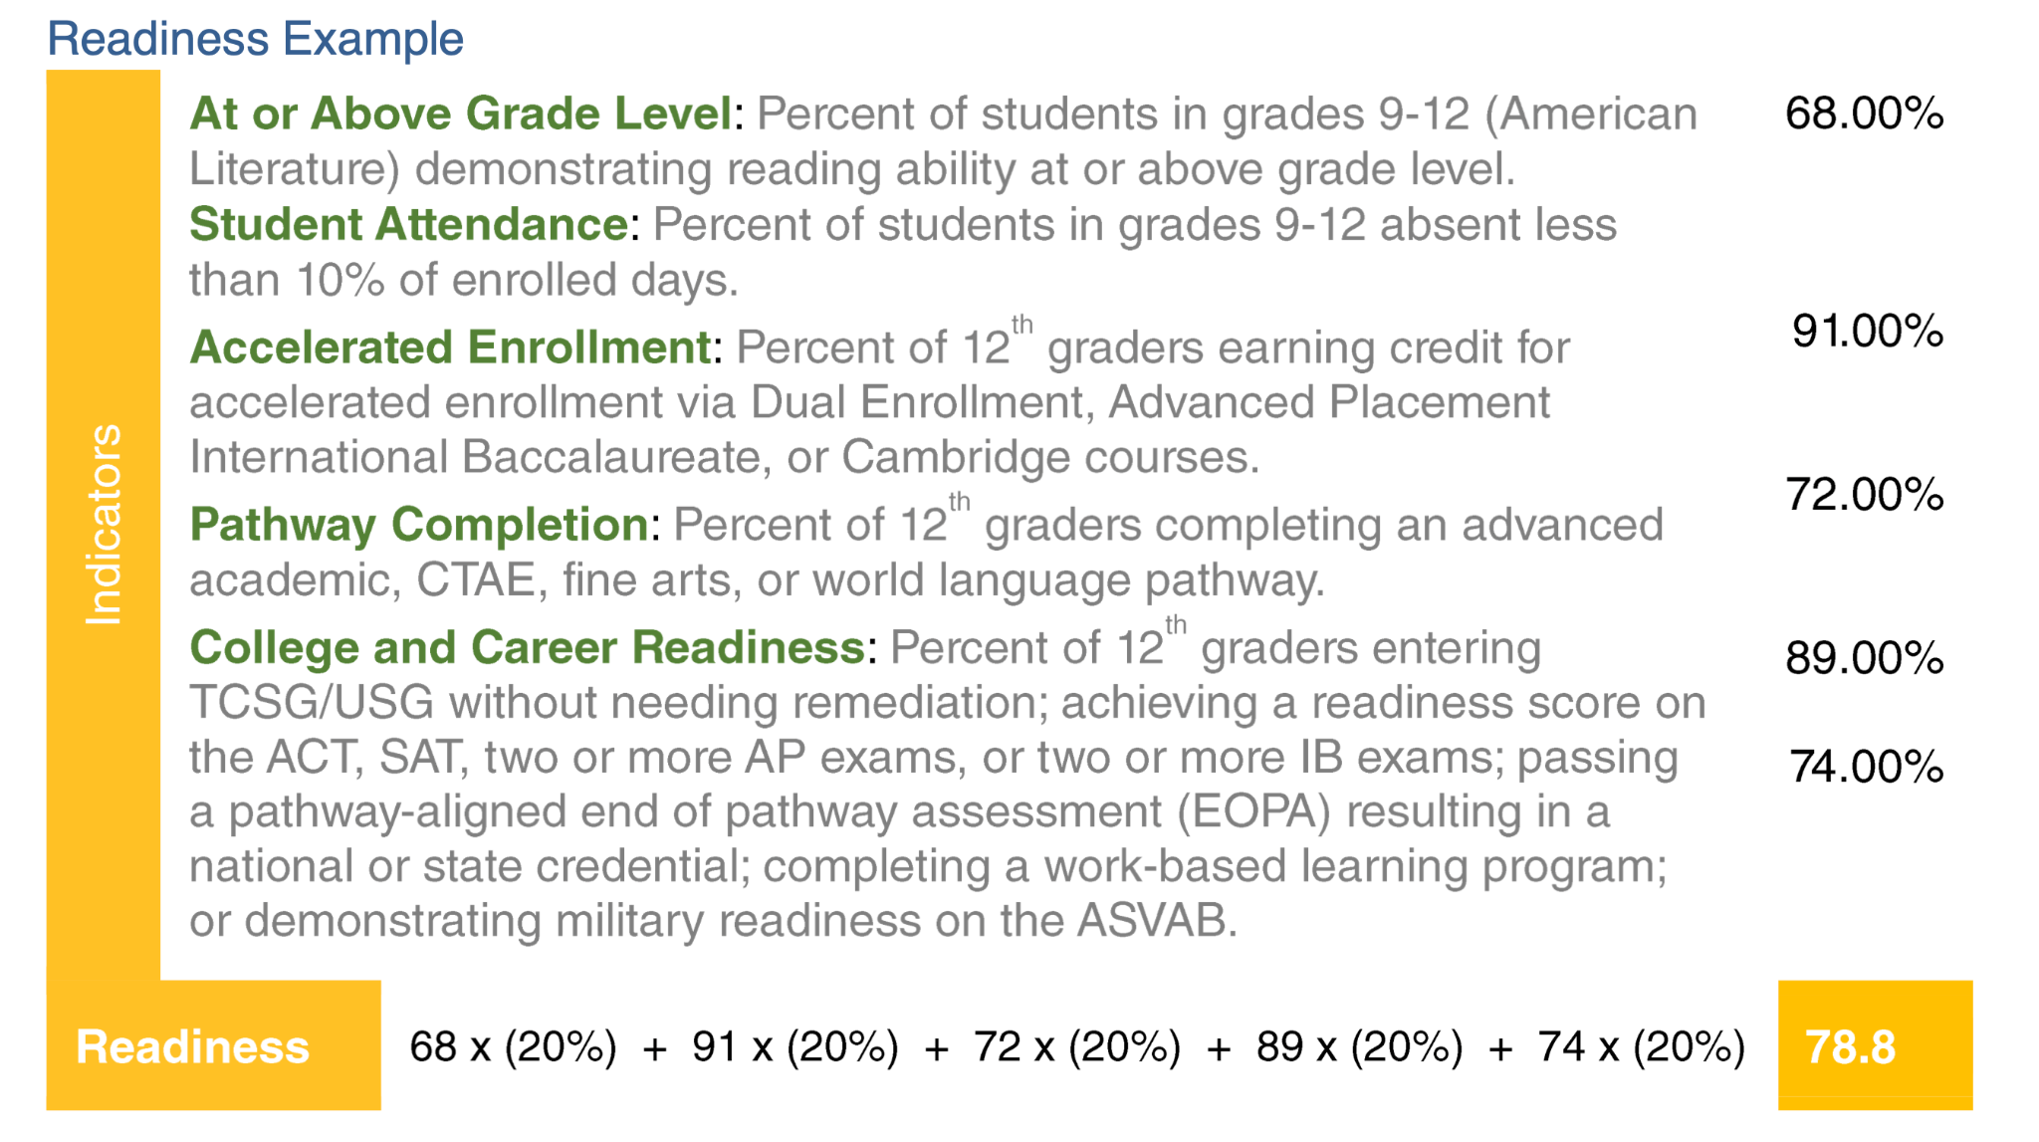
Example 2: Georgia

Slide 22
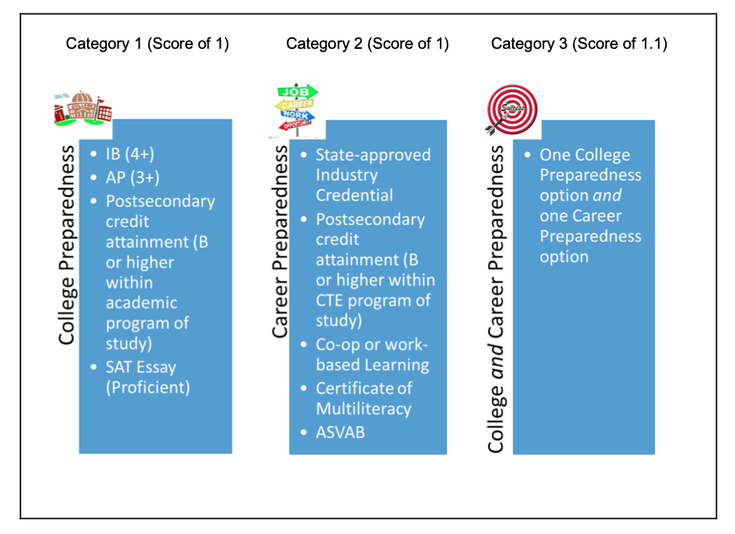
Example 3: Delaware
• Category 1 – Any FAY 12th grade student in a high school meeting one or more of the college preparedness options only (Score of 1)
• Category 2 – Any FAY 12th grade student in a high school meeting one or more of the career
preparedness options only (Score of 1)
• Category 3 – Any FAY 12th grade student in a high school meeting one or more of the career
preparedness options and one or more of the career preparedness options (score of 1.1)

Slide 23
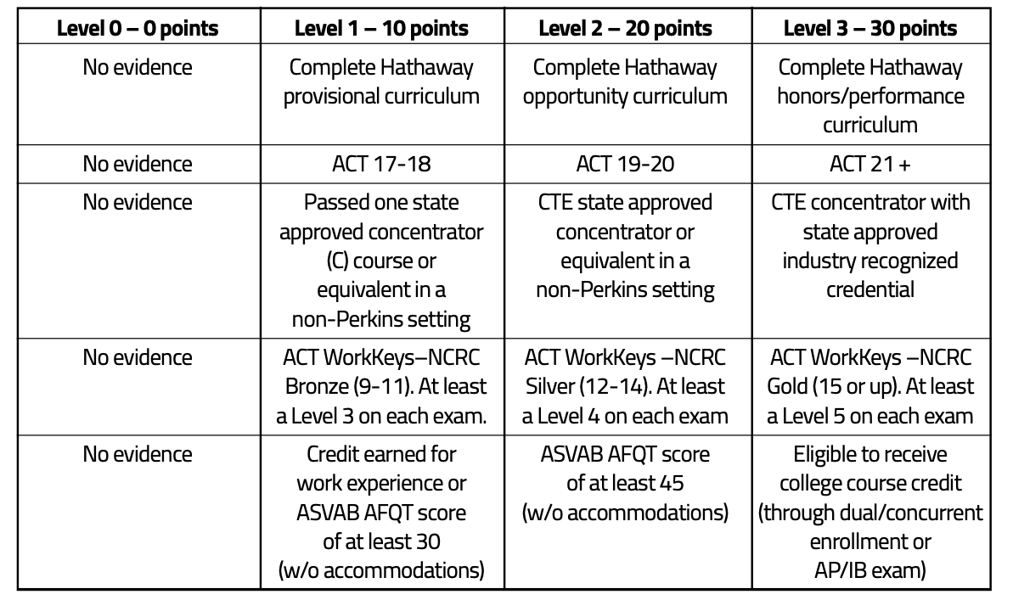
Example #4: Wyoming
Score is the highest from among each of the 5 rows

Slide 24
Mississippi College and Career Readiness Index - Illustration
One example for how acceleration and readiness could be combined into a single indicator that is broader and creates more performance differentiation
 | 0 points | 20 points | 30 points | 40 points | Maximum
Acceleration | No evidence of advanced coursework or program participation | Student participates in qualifying course or program (AP, IB, AICE, Dual Credit, Industry Certification) | Student meets performance expectation on at least 1 qualifying course (C or better in DC; 3 on AP; 4 on IB) | Student meets performance expectation on more than 1 qualifying course or program | 40
Assessment | Does not attain qualifying assessment score | ACT 17 English OR ACT 19 Math | ACT 18 English AND ACT 22 Math | Meets ACT Benchmark in English AND Math | 40
 |  | ACT WorkKeys Silver OR ASVAB/ AFQT 31 | ACT WorkKeys Silver with Industry Certification OR ASVAB/ AFQT 50 | ACT WorkKeys Gold with Industry Certification or ASVAB/ AFQT 65
Achievement | Does not graduate or earn GED by end of grade 12 | Graduate or GED | Diploma with Academic or Career/ Technical Endorsement | Diploma with Distinguished Academic Endorsement | 20
College and Career Readiness Score |  |  |  |  | 100
Indicators and values are simply placeholders to illustrate the concept and prompt discussion.

Slide 25
Discussion Questions
Based on the examples presented today, what approaches may be promising to ensure accomplishments associated with post-secondary success are incentivized and rewarded?
Consider:
What measures should be included?
What performance expectations should be established?
How should the measures be combined?

Slide 26
Accountability Weights

Slide 27
Overview
The purpose of this discussion is to elicit the committee’s recommendations regarding the influence or weight of each indicator in the model.
We are not making any recommendations today. Rather, this is an initial discussion to inform further discussions about model design alternatives.

Slide 28
ESSA Requirements
ESSA requirements:
With respect to the academic achievement, growth, progress in English language proficiency, and grad rate indicators, afford “substantial weight to each such indicator; and in the aggregate, much greater weight than is afforded to the indicator[s] [for school quality and student success].”
While not explicitly addressed in ESSA, the United States Department of Education (ED) generally has NOT approved state systems in which
HS Graduation Rate is < 15-20%
Progress in English Language Proficiency < 5%

Slide 29
700-Point Elementary and Middle Schools
READING | MATH | SCIENCE | ENGLISH LANGUAGE PROGRESS
Proficiency 95 pts | Proficiency 95 pts | Proficiency 95 pts | Progress to Proficiency 35 pts
Growth All Students 95 pts | Growth All Students 95 pts
Growth Lowest 25% 95 pts | Growth Lowest 25% 95 pts

Slide 30
Indicators for High Schools and Districts
READING | MATH | OTHER SUBJECTS | GRADUATION 4-YEAR | ACCELERATION | COLLEGE & CAREER READINESS | ENGLISH LANGUAGE PROGRESS
Proficiency 95 pts | Proficiency 95 pts | Science Proficiency 47.5 pts | 4-year Cohort Rate 190 pts | Performance 23.75 pts | ACT Performance 47.5 pts Or | Progress to Proficiency 50 pts
Growth All Students 95 pts | Growth All Students 95 pts | U.S. History Proficiency 47.5 pts |  | Participation 23.75 pts | ACT WorkKeys Option 47.5 pts
Growth Lowest 25% 95 pts | Growth Lowest 25% 95 pts

Slide 31
Current Weights
Indicators | ES/MS Weight
Proficiency Reading | 13.5%
Proficiency Math | 13.5%
Proficiency Science | 13.5%
Growth Reading | 13.5%
Growth Math | 13.5%
Growth L25 Reading | 13.5%
Growth L25 Math | 13.5%
English Language Progress | 5.0%
Indicators | HS Weight
Proficiency Reading | 9.5%
Proficiency Math | 9.5%
Proficiency Science | 4.8%
Proficiency U.S. History | 4.8%
Growth Reading | 9.5%
Growth Math | 9.5%
Growth L25 Reading | 9.5%
Growth L25 Math | 9.5%
Graduation Rate | 19.0%
Acceleration | 4.8%
College/ Career Readiness | 4.8%
English Language Progress | 5.0%

Slide 32
Rating Exercise - Round 1
Please use these forms to submit your recommended weights. Enter a number between 0-100 for each indicator. The total must sum to 100.
Elementary/ Middle
http://tinyurl.com/9ns2ruyk
High School
http://tinyurl.com/cwedz9x3

Slide 33
Rating Exercise - Round 2
Please use these forms to submit your recommended weights. Enter a number between 0-100 for each indicator. The total must sum to 100.
Elementary/ Middle
http://tinyurl.com/2p9tn98z
High School
http://tinyurl.com/mu78szjc

Slide 34
Accountability Performance Standards

Slide 35
Overview
The purpose of this discussion is to elicit initial guidance from the task force regarding the characteristics of schools that are regarded as minimally sufficient to earn each letter grade.
We will use this information to help construct school performance level descriptors for your review at a future meeting.

Slide 36
Process
Using the form provided, assign a letter grade to each of 42 schools ordered from highest performing to lowest performing.
Look at the overall pattern of performance and consider, “Is this good enough to earn an A, B, C, etc.?”
You DO NOT have to base your judgement on what has been good enough in the past. Consider what you think should be sufficient performance in the future.
These are your judgments and they are subjective. You may decide to value some indicators more than others.
All ratings are confidential.
After a first round of rating, we’ll discuss the findings as a group. Be prepared to explain why you rated the schools as you did during our discussion time.
Then, we’ll do a second round of ratings and review again.

Slide 37
Rating Exercise - Round 1
Link: http://tinyurl.com/yc6uuhvj

Slide 38
Rating Exercise - Round 2
Link: http://tinyurl.com/mbb7f5a

Slide 39
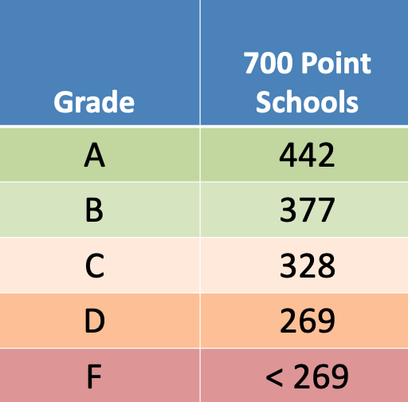
Current Thresholds

Slide 40
Follow-Up and Future Topics

Slide 41
Before we adjourn…
What’s one thing we covered today that you want to emphasize and/or request we follow-up on?
What’s a topic or issue we have not covered you’d like the task force to address in the future?

