Slide 1
Accountability Task Force
December 15, 2021

Slide 2
Mississippi Department of Education

Slide 3
State Board of Education STRATEGIC PLAN GOALS

Slide 4
Welcome and Introductions
First Name: | Last Name: | Organization: | Position in Organization:
Karen | Howard | Aberdeen School District | Principal
Kemi | Strain | Amory School District | Assistant Principal and Counselor
Shalondia | Washington | Canton Public Schools | Principal
Anthony | Goins | Clinton Public School District | Assistant Superintendent
Ryan | Kuykendall | DeSoto County School District | Director of Accountability & Research
Christy | Hovanetz | Foundation for Excellence in Education | External Expert
Kenneth | Pulley | Greenwood Leflore Consolidated School District | Deputy Superintendent
Fredrick | Hickmon | Kemper County School District | Assistant Superintendent
Greg | Paczak | Madison County School District | Director of Research & Development
Alan | Burrow | Mississippi Department of Education | Director of District and School Performance
Deborah | Donovan | Mississippi Department of Education | Data Analytics and Reporting
Paula | Vanderford | Mississippi Department of Education | Chief Accountability Officer
Jay | Smith | North Pike School District | Superintendent
Richard | Baliko | Noxubee County School District | Assistant Superintendent
Jacob | Dykes | Ocean Springs School District | Principal
Fina | Hence | Perry County School District | Accountability Director
Amanda | Garcia | Petal School District | Assistant Principal
Rosemary | Aultman | State Board of Education | Board Member
Chris | Domaleski | The Center for Assessment | External Facilitator
Matt | Thompson | Union County School District | Director of Federal Programs & Accountability
Crystal | Bates | Wayne County School District | Curriculum/Data administrator
Tracy | Cameron | West Bolivar Consolidated School District | Curriculum Director/Testing Director/Accountability Director

Slide 5
Agenda
8:00am | Welcome and Introductions Context and Group Norms
8:30 am | Background: Accountability in Mississippi
9:00 am | Discussion of Rule Changes for 2021-2022
9:30 am | Break
9:45 am | Discussion of Growth for students in grades 10-12 for 2021-2022
11:15 am | Prioritize future meeting topics; action items; next steps
12:00 pm | Adjourn

Slide 6
Purpose and Overview
Primary purpose is to help MDE make good decisions about the design and implementation of the state, school accountability system under ESSA
We will focus on identifying policy priorities and identifying decisions in support of those priorities that are technically defensible and operationally feasible
Feedback from the Task Force is received as a recommendation to the department

Slide 7
Ground Rules/ Group Norms
Listen actively and attentively; ask for clarification as needed
Everyone should have an opportunity to ‘be heard’ without interruption and to receive courteous feedback
Critique ideas, not people or organizations
Build on one another’s comments; work toward shared understanding
We will attempt to make decisions based on group consensus, but when necessary we will take a vote
When/ if requested do not disclosure confidential information
At the end of each meeting we will prioritize topics for future meetings and discuss action items

Slide 8
Accountability in Mississippi

Slide 9
The Accountability System…
Establishes a set of minimum standards for public schools and districts in our state to ensure that Mississippi students are prepared to compete in a national workforce or go on to post-secondary education.
Informs the public on how well schools and districts are performing. Mississippi’s accountability system considers how well students perform on state tests, whether students are showing improvement on those tests from year to year and whether students are graduating on time.
Drives behavior of schools and districts and influences planning and interim measures of performance. This results in consistent best practices and can be seen in improvements on both statewide assessments and standardized national assessments.

Slide 10
National Assessment of Edcuational Progress (NAEP)

Slide 11
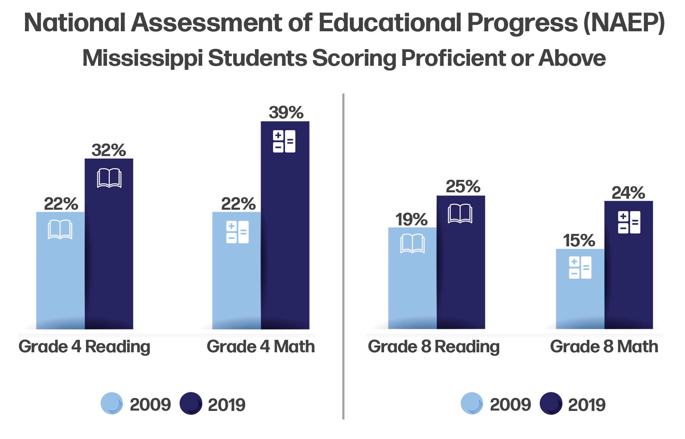
NAEP Proficiency Gains in Mississippi

Slide 12
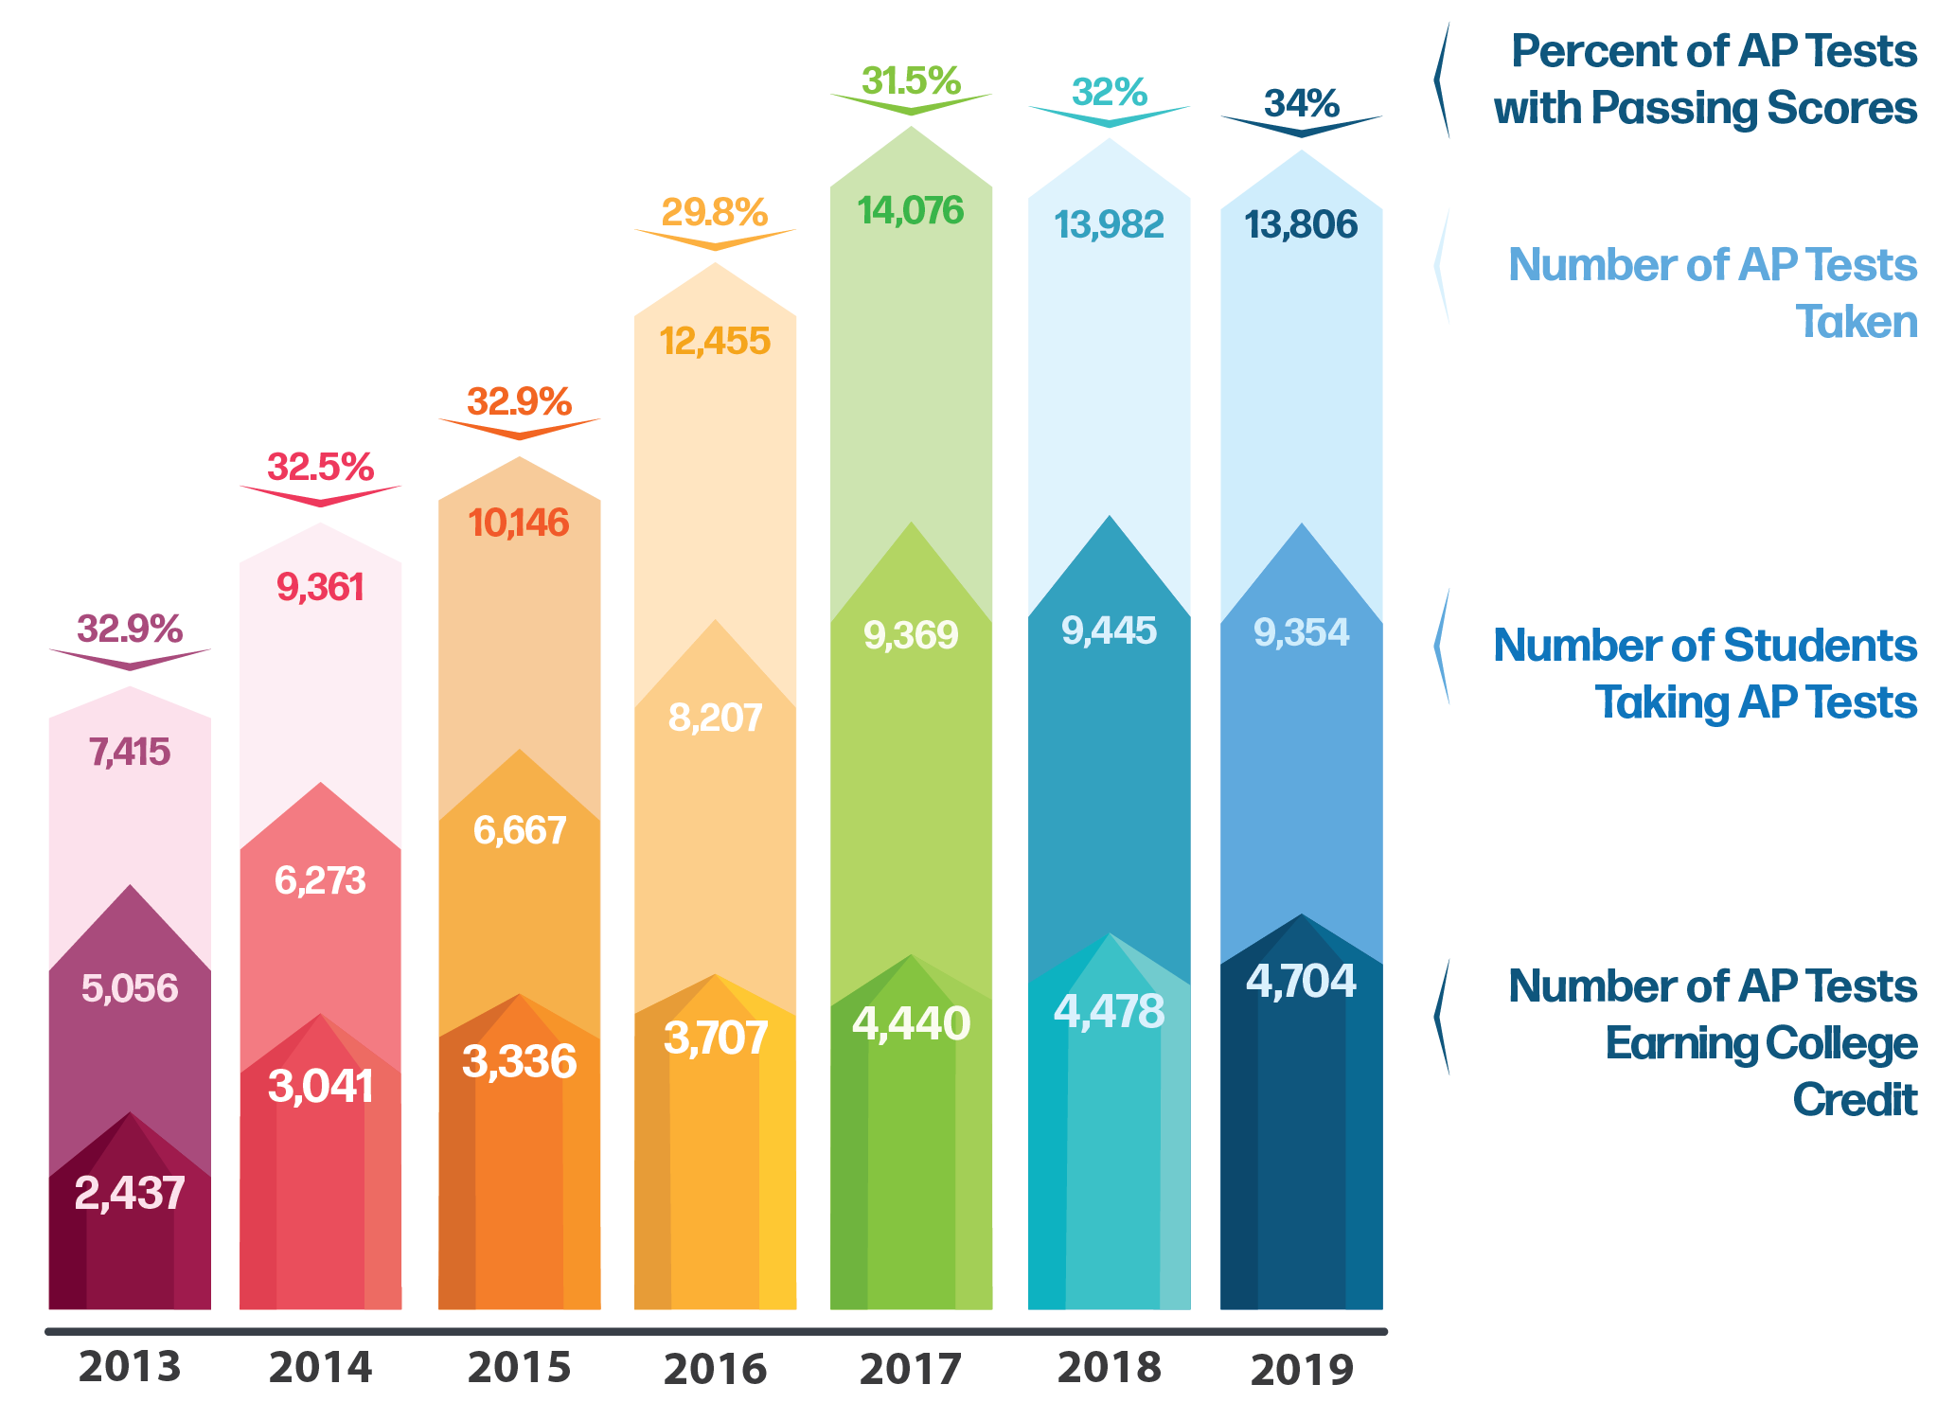
Advanced Placement (AP) Achievement
Advanced Placement (AP) participation and performance nearly doubled since 2013
AP pass rate reached an all-time high of 34% in 2019
Greatest increase in AP qualifying scores from 2018 to 2019 was among African-American students (+9.5%) and Hispanic students (+6.4%)

Slide 13
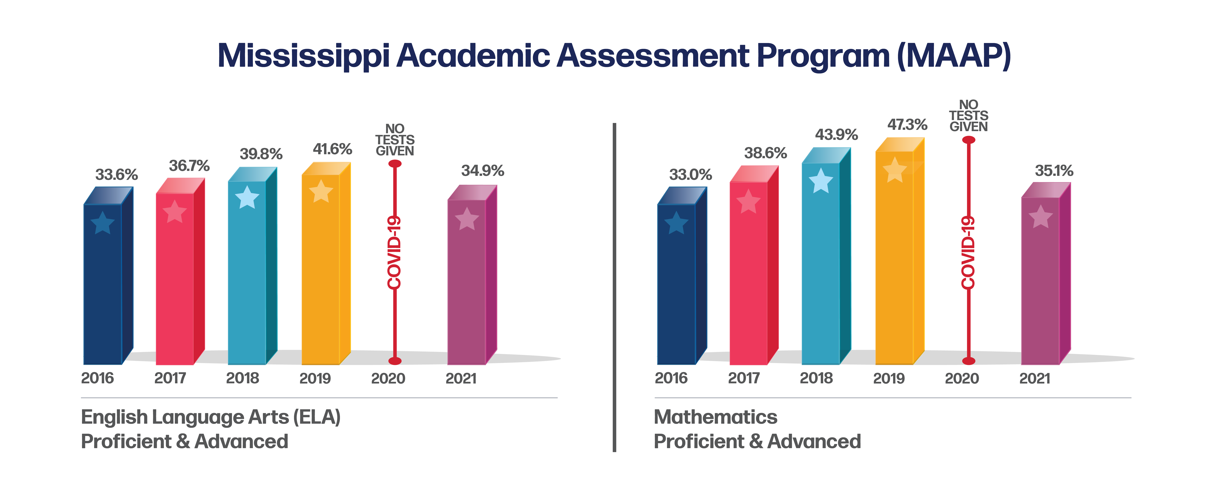
MAAP Results: ELA and Mathematics

Slide 14
Prior to 2013…
1988
First Accountability Results, Districts rated 1 – 3, based on Performance
1995
Districts Rated 1 – 5, based on Performance
2003
Schools Rated Level 1 – 5 based on Performance and Growth
2009
Districts and Schools Rated 1-7, based on Performance, Growth, and Completion
2013
Current Model Implemented

Slide 15
Mississippi Statewide Accountability System
Single “A” through “F” statewide accountability system with applicable state and federal requirements (Miss. Code Ann. § 37-17-6)
Approved by the Mississippi State Board of Education January 17, 2014
System developed in collaboration with the Accountability Task Force, Technical Review Committee, State Legislative Leaders, and MDE Staff

Slide 16
Miss. Code Ann. § 37-17-6 (Senate Bill 2396)
Implement a single “A” through “F” school and school district accountability system
Combine state and federal accountability systems into one (federally approved) system
Establish five performance categories (“A, B, C, D, & F”) and discontinue the use of the designations of “Star, High Performing, Successful, Low-Performing, At Risk of Failing”
Incorporate a standards-based growth model
Discontinue use of QDI
Include the federally compliant 4-year graduation rate and discontinue use of HSCI
Increase standards when 75% of students are Proficient and/or when 65% of schools or districts earn a “B” or higher grade

Slide 17
Every Student Succeeds Act (ESSA) Requirements
Goals
States must establish “ambitious, state-designed long-term goals” and interim progress targets for all students and for each subgroup for: Academic achievement High school graduation English language proficiency (all students only)
Identification of Schools
The accountability system must identify at least three categories of schools: Comprehensive support and improvement schools Targeted support and intervention schools Additional schools
School Accountability
States must establish a system of meaningfully differentiating schools on an annual basis, based on the following indicators for all students and separately for each subgroup (except that English proficiency need not be disaggregated). The system must give substantial weight to each indicator. Academic achievement indicator Another academic indicator (growth, grad rate) English proficiency Additional indicator of school quality or student success
Graphic by : Foundation for Excellence in Education
Notes:
Identification of schools for school improvement is the ultimate goal of federal accountability measures to ensure that resources are allocated where they are most needed. This process starts with state-defined goals and a state-defined system of meaningful differentiation of schools.

Slide 18
Mississippi Statewide Accountability System
Proficiency/Performance – Did the student meet expectations?
Growth - Did the student improve as expected?
Participation – Did the student participate in assessments/classes?
Graduation Rates – Did the student graduate as expected and on time?

Slide 19
Annual Subject Area Assessments
Assessments used for calculation of growth and proficiency include:
Grade-level (3-8) assessments in Reading/Language Arts
Grade-level (3-8) assessments in Mathematics
High School end-of-course assessment in English II
High School end-of-course assessment in Algebra I
Alternate Assessment (3-8 and High School end-of-course assessment) in Reading
Alternate Assessment (3-8 and High School end-of-course assessment) in Mathematics
Proficiency (not growth) is measured in Grades 5 and 8 Science, Biology, and U.S. History end-of-course assessments.

Slide 20
Calculation of Growth
Earning Growth Points:
Moving 1 Growth* level = 1 pt
Moving 2 Proficiency* levels = 1.25 pts
Moving from any lower level to level 5 = 1.25 pts
Staying at level 5 = 1.25 pts
1a
4
5
1b
2a
2b
3a
3b
1.25pt
1.25pt
1.25pt
1pt
1pt
1
2
3
4
5
Proficiency Levels

Slide 21
700-Point Elementary and Middle Schools
READING | MATH | SCIENCE | ENGLISH LANGUAGE PROGRESS
Proficiency 95 pts | Proficiency 95 pts | Proficiency 95 pts | Progress to Proficiency 35 pts
Growth All Students 95 pts | Growth All Students 95 pts
Growth Lowest 25% 95 pts | Growth Lowest 25% 95 pts

Slide 22
Indicators for High Schools and Districts
READING | MATH | OTHER SUBJECTS | GRADUATION 4-YEAR | ACCELERATION | COLLEGE & CAREER READINESS | ENGLISH LANGUAGE PROGRESS
Proficiency 95 pts | Proficiency 95 pts | Science Proficiency 47.5 pts | 4-year Cohort Rate 190 pts | Performance 23.75 pts | ACT Performance 47.5 pts Or | Progress to Proficiency 50 pts
Growth All Students 95 pts | Growth All Students 95 pts | U.S. History Proficiency 47.5 pts |  | Participation 23.75 pts | ACT WorkKeys Option 47.5 pts
Growth Lowest 25% 95 pts | Growth Lowest 25% 95 pts

Slide 23
Acceleration
Participation 50%
Denominator:
All students enrolled in grades 11 and 12, plus 9th and 10th grade students taking and passing accelerated courses
Numerator:
All students taking accelerated courses (AP, IB, AICE, dual credit/enrollment, industry certification)
25 Points Possible:
e.g., 133 ÷ 200 = 0.67
0.67 x 25 = 16.8 points
$$÷$$
$$=$$
30.3 points total
Performance 50%
Denominator:
All courses/exams taken by participating students in AP, IB, AICE, dual credit/ enrollment, industry certifications
Numerator:
All courses/exams meeting performance standards by student (e.g., C grade in dual c/e, 3 on AP exam, or 4 on IB)
25 Points Possible:
e.g., 72 ÷ 133 = 0.54
0.54 x 25 = 13.5 points
$$÷$$
$$=$$

Slide 24
College- and Career-Readiness Component
CCR Measure Includes:
50% ACT English or Reading Benchmark
+
50% ACT Math Benchmark
OR
ACT WorkKeys Silver with Career Pathway/Industry Certification or ACT WorkKeys Gold or Platinum
CCR Score by Student:
0.5 Point + 0.5 Point
OR
1.0 Point
(Max 1 point/student)

Slide 25
Graduation Rates
In accordance with 34 C.F.R. 200.19(b) and MS Code Ann. 37-17-6, graduation rates are calculated following the four-year adjusted cohort method.
Four-Year Cohort: a group of students who enter 9th grade in MS for the first time, adjusted for students transferring into and out of the cohort, and are expected to graduate within four years
Graduate: a student receiving a standard high school diploma in four years
Completer: a student receiving an occupational diploma, certificate of attendance, or GED within the district
Still Enrolled: a student still enrolled as September 1 of the year after the cohort’s expected completion date
Dropout: a student who leaves school during the cohort period without a diploma or certificate from the district

Slide 26
Grade Assignments
Grade | Districts | 700 Point Schools | 1,000 Point Schools
A | 668 | 442 | 754
B | 599 | 377 | 648
C | 536 | 328 | 584
D | 489 | 269 | 510
F | < 489 | < 269 | < 510

Slide 27
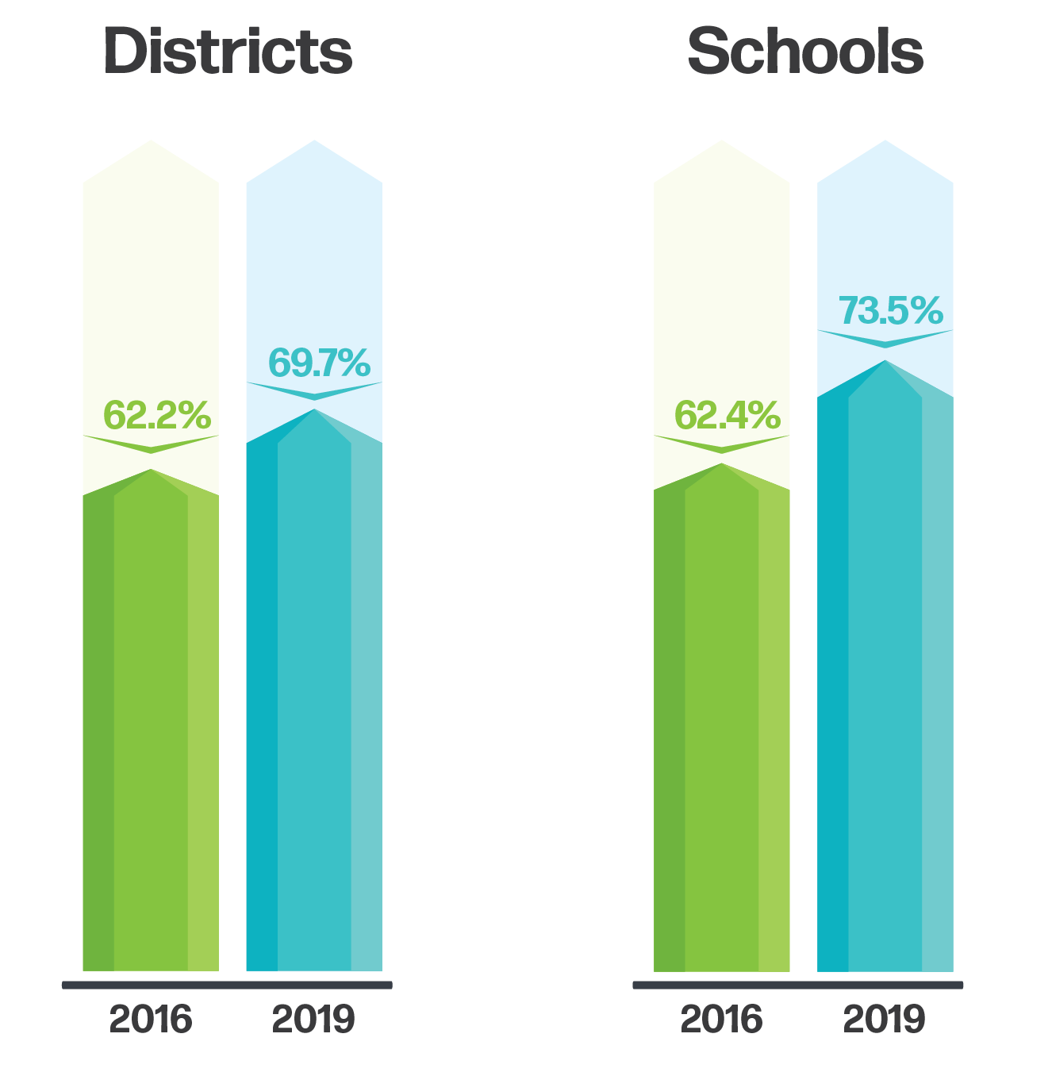
Percent of Districts and Schools Rated “C” or Higher

Slide 28
Continuous Review and Improvement
Public Feedback
Accountability Task Force
Commission on School Accreditation
State Board of Education

Slide 29
Proposed Rule Changes

Slide 30
Lowest Quartile Identification In Grades 10-12
For calculation of low-25 growth, put all prior scores in the same ‘bin’ regardless of when the prior test was taken.
Scores will be standardized to make them comparable.
Select the low-25 students for high school from the standardized, multi-year bin.
Proposed rule change:
7.4 Any baseline assessment scores used in the identification of the Lowest Performing Twenty-Five Percent Student subgroup for grades 10 through 12 that are from assessments below 8th grade will be standardized to the 8th grade grade-level assessment.

Slide 31
MAAP-A Lowest Quartile Identification
The minimum n-size rule would be removed for MAAP-A
Calculate the lowest 25% group for each subject, but combine for all grades tested at each school
Every school should have at least 1 examinee in the lowest 25%.
If multiple students have the same score as the score serving as the threshold for the L25 group, all students with this score and lower are designated L25
Proposed Rule Changes:
3.2.3 No N-count minimum will apply in the identification of the Lowest Performing Twenty-Five Percent Student subgroup for students taking the alternate assessment.
7.1.4 The Lowest Performing Twenty-Five Percent Student subgroup for students taking the alternate assessment will be identified by subject but not by each grade level.

Slide 32
Acceleration, Business Rule 9.8
The ATF discussed several options with the goal to find an approach that includes December graduates as well as those who arrive later in the fall but may earn a credit in the spring. Ultimately, the task force made the following ‘candidate recommendation’: students should be included in acceleration that meet FAY for the full year OR who are enrolled for full fall or spring term.
Further, the ATF agreed that if a students earns an acceleration credential not tied to the course, the credit will go to the last district/ school of enrollment.
Proposed Rules Changes:
9.8 Students enrolled in a block schedule must meet FAY either in the fall or spring to be included in the acceleration component. Students enrolled in a traditional schedule must meet FAY for the traditional schedule to be included in the acceleration component.
9.11 In the event that an accelerated credential, as defined in Section 9.2, is reported for a student that is not associated with a course, the credential will be included in the calculation for the final school in which the student meets FAY.

Slide 33
WorkKeys
Proposed Rule Change:
25.7 The highest available sub-score or WorkKeys Certification for each student at the end of month nine (9) in Mathematics and English/Reading, as described above, will be used in the College- and Career-Readiness Indicator accountability calculations.

Slide 34
Growth In Grades 10-12

Slide 35
Growth Challenges in 2021-2022
High school accountability pertains to the cohort of current 10th graders
Growth requires a score in Algebra I and English II in addition to a prior score, which is typically 8th grade math and 8th grade ELA, respectively.
Students may take these courses at different grades. Tests taken before grade 10 are ‘banked’

Slide 36
Reminder: Calculation of Growth
Earning Growth Points:
Moving 1 Growth* level = 1 pt
Moving 2 Proficiency* levels = 1.25 pts
Moving from any lower level to level 5 = 1.25 pts
Staying at level 5 = 1.25 pts
1a
4
5
1b
2a
2b
3a
3b
1.25pt
1.25pt
1.25pt
1pt
1pt
1
2
3
4
5
Proficiency Levels

Slide 37
Illustration of Banking – Math
2020
2021
2022
Grade 8, Math
Grade 9, No test
Grade 10, Algebra I
Potential scenarios for calculating high school growth in math.
Shaded cells indicate year of missing data.
2020
2021
2022
Grade 8, Math
Grade 9, Algebra I
Grade 10
Most common scenario
2020
2021
2022
Grade 8, Algebra I
Grade 9, No test
Grade 10
2019
Grade 7, Math

Slide 38
Illustration of Banking – ELA
Potential scenarios for calculating high school growth in ELA.
Shaded cells indicate year of missing data.
2020
2021
2022
Grade 8, ELA
Grade 9, No test
Grade 10, English II
Most common scenario
2020
2021
2022
Grade 8, ELA
Grade 9, English II
Grade 10

Slide 39
Potential Solutions for Missing Data
Calculate skip-year growth. When prior scores are missing attempt to find another prior from the previous year.
Remove from calculation. When scores are missing, simply remove them from the calculation and base growth scores on remaining scores.
Use legacy scores. If growth cannot be calculated, substitute with student’s most recent growth score (presumably 2019) if available.

Slide 40
Skip-Year Growth – Illustration for Math
2020
2021
2022
Grade 8, Math
Grade 9, No test
Grade 10, Algebra I
2019
Grade 7, Math
Potential scenarios for calculating skip-year growth in math
2020
2021
2022
Grade 8, Math
Grade 9, Algebra I
Grade 10
2019
Grade 7, Math
Most common scenario
2020
2021
2022
Grade 8, Algebra I
Grade 9, No test
Grade 10
2019
Grade 7, Math
Skip-year not available for this scenario

Slide 41
Skip-Year Growth – Illustration for ELA
Potential scenarios for calculating skip year growth in ELA
2020
2021
2022
Grade 8, ELA
Grade 9, No test
Grade 10, English II
2019
Grade 7, ELA
Most common scenario
2020
2021
2022
Grade 8, ELA
Grade 9, English II
Grade 10
2019
Grade 7, ELA

Slide 42
Potential Solutions
Option 1:
When growth priors are missing calculate school scores using skip-year growth.
When the outcome test (i.e. Algebra I or English II) is missing, no score is assigned (remove from the numerator and denominator).
Compare final school/ district score with legacy growth score and assign the higher of the two.
Option 2:
When growth priors are missing calculate growth scores using skip year growth.
When the outcome test (i.e. Algebra I or English II) is missing, use student’s legacy score if available.
Compare final school/ district score with with legacy growth score and assign the higher of the two.
Option 3:
Don’t calculate new growth scores in 2022. Use legacy scores only for all schools and districts.

Slide 43
Option 1 Summary
Math
ELA
If | Then
Student takes Algebra I in grade 10 | Skip-year growth (G7 to G10)
Student took Algebra I in grade 9 | Skip-year growth (G7 to G9)
Student took Algebra I in grade 8 | No growth calculated.
If | Then
Student takes English II in grade 10 | Skip-year growth (G7 to G10)
Student took English II in grade 9 | Skip-year growth (G7 to G9)
Compare school/ district score to previous growth score and assign the higher of the two.
Compare school/ district score to previous growth score and assign the higher of the two.

Slide 44
Option 2 Summary
Math
ELA
If | Then
Student takes Algebra I in grade 10 | Skip-year growth (G7 to G10)
Student took Algebra I in grade 9 | Skip-year growth (G7 to G9)
Student took Algebra I in grade 8 | Use legacy score if available (G6 to G7 in 2019)
If | Then
Student takes English II in grade 10 | Skip-year growth (G7 to G10)
Student took English II in grade 9 | Skip-year growth (G7 to G9)
Compare school/ district score to previous growth score and assign the higher of the two.
Compare school/ district score to previous growth score and assign the higher of the two.

Slide 45
Considerations/ Discussion
Preliminary research shows that skip-year growth is slightly higher for reading and slightly lower for math.
Removing some scores will make the results less representative of the school/ district population.
Using legacy results may not represent current performance of schools/ districts.

Slide 46
Difference Between Skip-Year and Standard Growth – Math

Slide 47
Difference Between Skip-Year and Standard Growth – Reading

Slide 48
Summary Statistics

Slide 49
Summary
For most schools, skip year growth is very similar to standard growth
There is a slight increase in reading and a slight decrease in math
A very small number of schools show substantial changes of more than 10 points overall or 20 points for low growth

Slide 50
Next Steps
Model impact based on guidance from ATF
Discuss at future ATF meeting, refine solution as needed

