Slide 1
Accountability Task Force
Central High School
December 5, 2019

Slide 2

VISION
To create a world-class educational system that gives students the knowledge and skills to be successful in college and the workforce, and to flourish as parents and citizens
MISSION
To provide leadership through the development of policy and accountability systems so that all students are prepared to compete in the global community
Notes:
Vision and mission provides direction and foundation for all work of the SBE, MDE, and ultimately districts, schools, and teachers across the state.
Ultimately, we are working to prepare students for what comes next in life – postsecondary study, military service, technical programs, world of work, parenthood, and citizenship at large. MDE is responsible for providing policy to drive this and accountability to measure progress. In addition, the MDE takes an active role in supporting districts through PD, TA, and resources.

Slide 3





MISSISSIPPI STATE BOARD OF EDUCATION
STRATEGIC PLAN GOALS
1
2
3
4
5
6
All
Students Proficient
and Showing Growth in All Assessed
Areas
Every
Student Graduates
from High School and
is Ready for College and Career
Every
Child Has Access
to a High- Quality Early Childhood Program
Every
School Has Effective Teachers and Leaders
Every Community Effectively
Uses a
World-Class Data System
to Improve Student Outcomes
Every
School and District is
Rated “C” or Higher

Slide 4
Welcome and Introductions
Agency: | Position: | Last Name: | First Name:
Aberdeen School District | Principal | Fondren | Kristen
Bay Waveland School District | Director of Federal Programs | Menotti | Nicole
Board of Education | Board Member | Rosemary | Aultman
Center for Assessment | External Facilitator | Chris | Domaleski
Clinton Public Schools | Superintendent | Martin | Tim
Copiah County School District | Curriculum Coordinator | Brown | Demarrio
Corinth School District | Math Specialist | Jones | Marion
DeSoto County | Director of Accountability & Research | Kuykendall | Ryan
Foundation for Excellence in Education | External Expert | Christy | Hovanetz
Gulfport School District | Commission on School Accreditation | Michael | Lindsay
Lowndes County School District | Deputy Superintendent | Ballard | Robin
Madison County Schools | Superintendent | Seals | Charlotte
MDE | Data Analytics and Reporting | Deborah | Donovan
MDE | Chief Accountability Officer | Paula | Vanderford
MDE | Director of District and School Performance | Alan | Burrow
Mississippi Legislature | House Education Chair | Bennett | Richard
Mississippi Legislature | Senate Education Chair | TBD
New Albany School District | Superintendent | Evans | Lance
Noxubee County | Assistant Superintendent | Baliko | Richard
Ocean Springs School District | Principal | Tiblier | Vickie
Petal School District | Director of Student Assessment | Brown | Kelli
Rankin County School District | Principal | Pambianchi | Lee
Senatobia School District | Special Education Teacher | Brewer | Elaine
Simpson County School District | Teacher | Williams | Aaron
Starkville-Oktibbeha School District | Superintendent | Peasant | Eddie
Sunflower County School District | Superintendent | Davis | Miskia
Tunica County | Superintendent | Pulley | Margie
Union County School District | Assistant Superintendent | Faulkner | Windy
Vicksburg Warren | Principal | Minor | LaToya

Slide 5
Agenda
9:00am | Welcome and Introductions Context and Group Norms
9:30am | Background: Accountability in Mississippi
10:15am | Break
10:30am | U.S. History in Accountability
12:00pm | Lunch
1:00pm | Discussion of growth measures
2:00pm | Break
2:15pm | Recommendations for changing Acceleration Business Rule 9.8
3:15pm | Prioritize future meeting topics; action items; next steps
4:00pm | Adjourn

Slide 6
Purpose and Overview
Primary purpose is to help MDE make good decisions about the design and implementation of the state, school accountability system under ESSA
We will focus on identifying policy priorities and identifying decisions in support of those priorities that are technically defensible and operationally feasible
Feedback from the Task Force is received as a recommendation to the department

Slide 7
Ground Rules/ Group Norms
Listen actively and attentively; ask for clarification as needed
Everyone should have an opportunity to ‘be heard’ without interruption and to receive courteous feedback
Critique ideas, not people or organizations
Build on one another’s comments; work toward shared understanding
We will attempt to make decisions based on group consensus, but when necessary we will take a vote
When/ if requested do not disclosure confidential information
At the end of each meeting we will prioritize topics for future meetings and discuss action items

Slide 8
Accountability in Mississippi

Slide 9
Prior to 2013…
1988
First Accountability Results, Districts rated 1 – 3, based on Performance
1995
Districts Rated 1 – 5, based on Performance
2003
Schools Rated Level 1 – 5 based on Performance and Growth
2009
Districts and Schools Rated 1-7, based on Performance, Growth, and Completion
2013
Current Model Implemented

Slide 10
Accountability Today – Minimum Standards
The Mississippi Statewide Accountability System establishes a set of minimum standards for public schools and districts in our state to ensure that Mississippi students are prepared to compete in a national workforce, or go on to post-secondary education.

Slide 11
Accountability Today - Reporting
The Accountability System also informs the public on how well schools and districts are performing. Mississippi’s accountability system considers how well students perform on state tests, whether students are showing improvement on those tests from year to year and whether students are graduating on time.

Slide 12
Accountability Today – Getting Results
Accountability systems also drive behavior of schools and districts and influence planning and interim measures of performance. This results in consistent best practices and can be seen in improvements on both statewide assessments and national assessments, such as NAEP and ACT.

Slide 13

National Assessment of Educational Progress (NAEP)

Slide 14
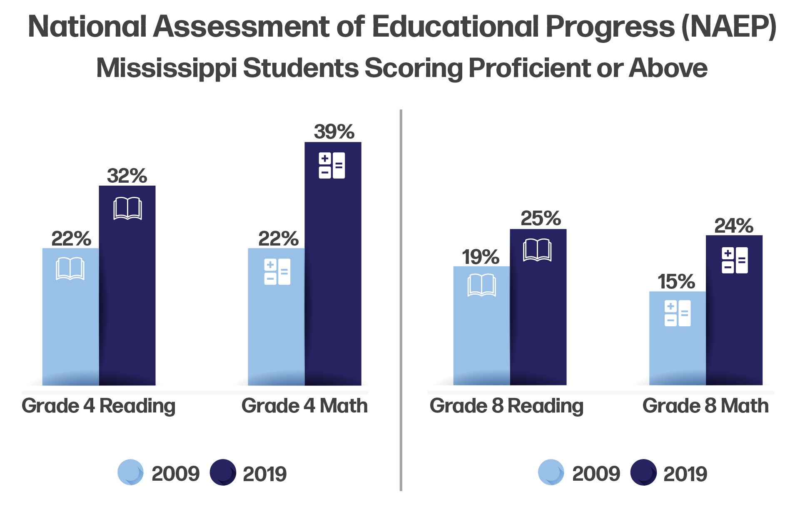
NAEP Proficiency Gains in Mississippi

Slide 15
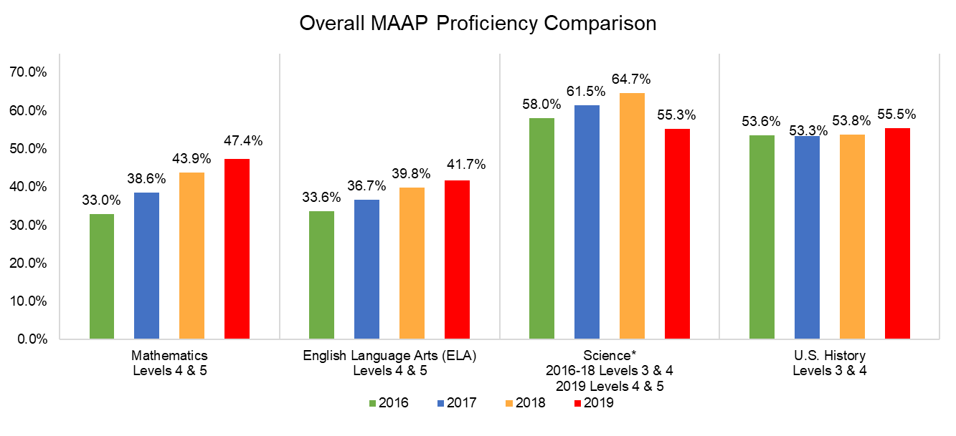
MAAP Overall Proficiency

Slide 16
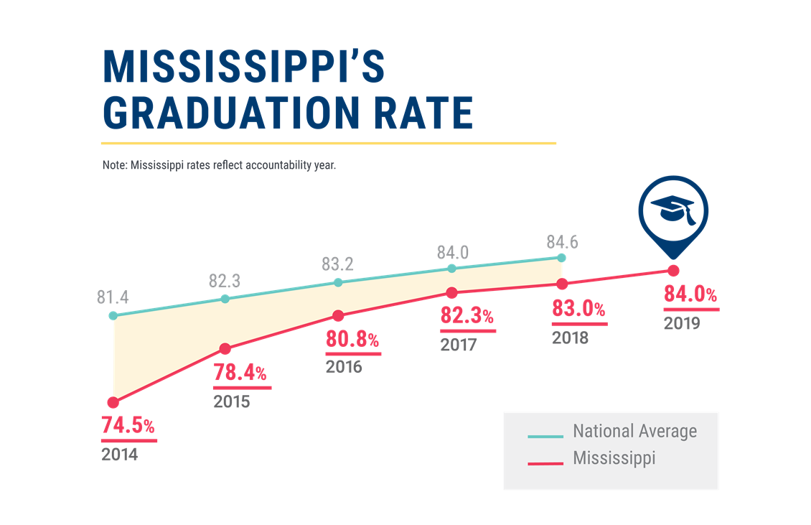
Graduation Rates

Slide 17
Dual Credit
Participation in dual credit more than doubled from 2014-15 to 2017-18
Participation increased among all subgroups

Slide 18
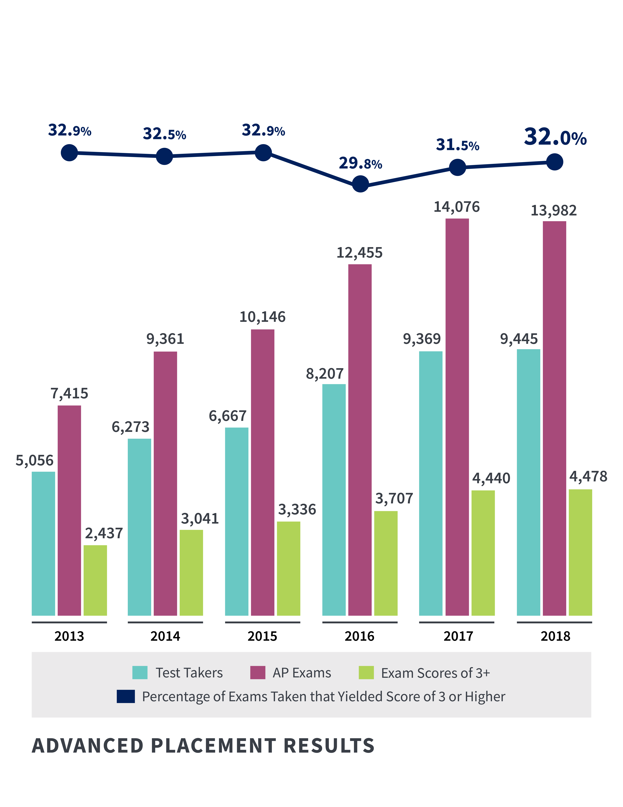
Advanced Placement (AP)
AP participation and achievement nearly doubled since 2013
Number of exams with a qualifying score of 3 or higher nearly doubled since 2013
All subgroups increased AP participation from 2015 to 2018
Greatest increase in AP qualifying scores from 2017 to 2018 were among African-American students (+10 percent) and Hispanic students (+7.3 percent)

Slide 19
Mississippi Statewide Accountability System
Single “A” through “F” statewide accountability system with applicable state and federal requirements (MS Code Ann. Section 37-17-6)
Approved by the Mississippi Board of Education January 17, 2014
System developed in collaboration with the Accountability Task Force, Technical Review Committee, State Legislative Leaders, and MDE Staff

Slide 20
MS Code § 37-17-6 (Senate Bill 2396)
Implement a single “A” through “F” school and school district accountability system
Combine state and federal accountability systems into one (federally approved) system
Establish five performance categories (“A, B, C, D, & F”) and discontinue the use of the designations of “Star, High Performing, Successful, Low-Performing, At Risk of Failing”
Incorporate a standards-based growth model
Discontinue use of QDI
Include the federally compliant 4-year graduation rate and discontinue use of HSCI
Increase standards when 75% of students are Proficient and/or when 65% of schools or districts earn a “B” or higher grade

Slide 21
Mississippi Statewide Accountability System
Proficiency/Performance – Did the student meet expectations?
Growth - Did the student improve as expected?
Participation – Did the student participate in assessments/classes?
Graduation Rates – Did the student graduate as expected and on time?

Slide 22
Annual Subject Area Assessments
Assessments used for calculation of growth and proficiency include:
  Grade-level (3-8) assessments in Reading/Language Arts
  Grade-level (3-8) assessments in Mathematics
  High School-level assessment in English II
  High School-level assessments in Algebra I
  Alternate Assessment (3-8 and High School) in Reading
  Alternate Assessment (3-8 and High School) in Mathematics
Proficiency (not growth) is measured in Grades 5 and 8 Science, Biology I and U.S. History assessments.

Slide 23
Calculation of Growth
Growth Levels
Earning Growth Points:
Moving 1 Growth* level = 1 pt
Moving 2 Proficiency* levels = 1.25 pts
Moving from any lower level to level 5 = 1.25 pts
Staying at level 5 = 1.25 pts
1a
4
5
1b
2a
2b
3a
3b
1.25pt
1.25pt
1.25pt
1pt
1pt
1
2
3
4
5
Proficiency Levels
*there are 5 Proficiency Levels and 8 Growth Levels

Slide 24
700-Point Elementary and Middle Schools
READING | MATH | SCIENCE | ENGLISH LANGUAGE PROGRESS
Proficiency 95 pts | Proficiency 95 pts | Proficiency 95 pts
Growth All Students 95 pts | Growth All Students 95 pts
Growth Lowest 25% 95 pts | Growth Lowest 25% 95 pts
 |  |  | Progress to Proficiency 35 pts

Slide 25
1,000-Point Schools and Districts
READING | MATH | OTHER SUBJECTS | GRADUATION 4-YEAR | ACCELERATION | COLLEGE & CAREER READINESS | ENGLISH LANGUAGE PROGRESS
Proficiency 95 pts | Proficiency 95 pts | Science Proficiency 47.5 pts | 4-year Cohort Rate 190 pts | Performance 23.75 pts | ACT Math Performance 23.75 pts
Growth All Students 95 pts | Growth All Students 95 pts | U.S. History Proficiency 47.5 pts |  | Participation 23.75 pts | ACT Reading or English Performance 23.75 pts
Growth Lowest 25% 95 pts | Growth Lowest 25% 95 pts
 |  |  |  |  |  | Progress to Proficiency 50 pts

Slide 26
Grade Assignments
Grade | Districts | 700 Point Schools | 1,000 Point Schools
A | 668 | 442 | 754
B | 599 | 377 | 648
C | 536 | 328 | 584
D | 489 | 269 | 510
F | < 489 | < 269 | < 510

Slide 27
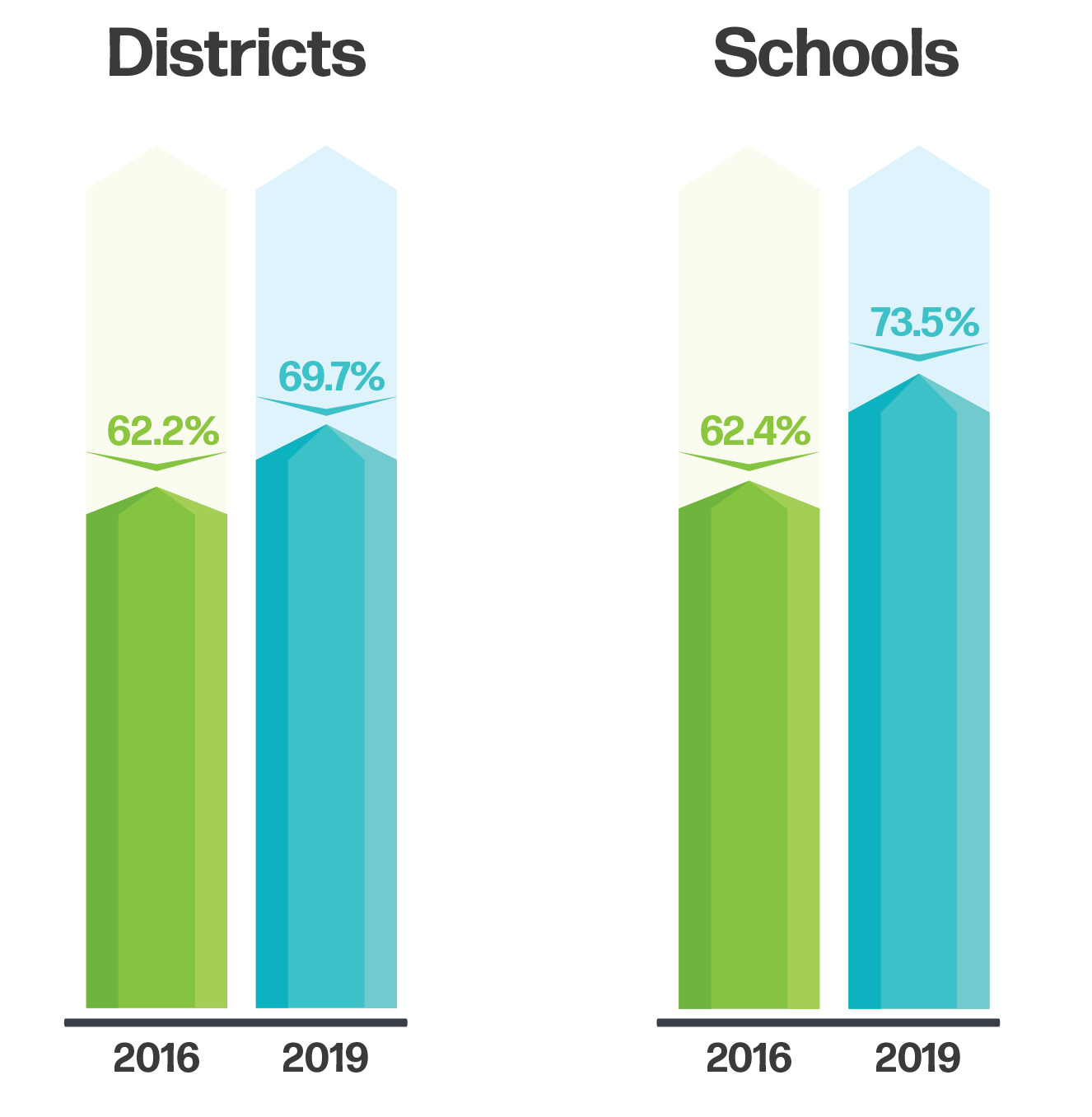
Percent of Districts and Schools Rated “C” or Higher

Slide 28
Acceleration
Participation 50%
Denominator:
All students enrolled in grades 11 and 12, plus 9th and 10th grade students taking and passing accelerated courses
Numerator:
All students taking accelerated courses (AP, IB, AICE, dual credit/enrollment, industry certification)
25 Points Possible:
e.g., 133 ÷ 200 = 0.67
0.67 x 25 = 16.8 points
$$÷$$
$$=$$
30.3 points total
Performance 50%
Numerator:
All courses/exams meeting performance standards by student (e.g., C grade in dual c/e, 3 on AP exam, or 4 on IB)
Denominator:
All courses/exams taken by participating students in AP, IB, AICE, dual credit/ enrollment, industry certifications
25 Points Possible:
e.g., 72 ÷ 133 = 0.54
0.54 x 25 = 13.5 points
$$÷$$
$$=$$

Slide 29
College and Career Readiness (CCR)
CCR
(from ACT) includes:
50% English or Reading;
+
50% Math
Numerator:
All students meeting ACT benchmarks (18 in English or 22 in Reading; 22 in Math)
Denominator:
All students from Senior Snapshot who participated in ACT (both statewide and non-state administration)
Example: School A has 40 students who participated in ACT; 34 met English/ Reading and 30 met Math benchmarks.
English/Reading (25 points):
34 ÷ 40 = 0.85 x 25 = 21.25
Math (25 points):
30 ÷ 40 = 0.75 x 25 = 18.75
21.3 + 18.8 = 40 points total
$$÷$$

Slide 30
Graduation and Completion Rates
In accordance with 34 C.F.R. 200.19(b) and MS Code Ann. 37-17-6, graduation rates are calculated following the four-year adjusted cohort method.
Four-Year Cohort: a group of students who enter 9th grade in MS for the first time, adjusted for students transferring into and out of the cohort, and are expected to graduate within four years
Graduate: a student receiving a standard high school diploma in four years
Completer: a student receiving an occupational diploma, certificate of attendance, or GED within the district
Still Enrolled: a student still enrolled as September 1 of the year after the cohort’s expected completion date
Dropout: a student who leaves school during the cohort period without a diploma or certificate from the district
Notes:
Note: changes to graduation. No longer use apportioning. Use where longest enrolled, or in case of tie, last enrolled.

Slide 31
Continuous Review and Improvement
Public Feedback
Accountability Task Force
Commission on School Accreditation
State Board of Education

Slide 32
Accountability Task Force
Web Page
Other Resources

Slide 33
U.S. History in Accountability

Slide 34
Background
The State Board has requested that the accountability task force examine the implications of potentially removing U.S. History from the accountability model
Key questions to consider:
  What are some options if U.S. History is removed?
  What is the likely impact?
  Would removal of U.S. History necessitate establishing a new baseline (i.e. setting new cut scores)?

Slide 35
How is U.S. History Currently Included?

Slide 36
Options
What are some options for removing U.S. History?
  1. Redistribute weights across all indicators
  2. Redistribute weights to only proficiency indicators: reading, math, and science.
  Redistribute weights to only science.
  Don’t redistribute weights, make an overall scale adjustment.
  Other?

Slide 37
Redistribute across all indicators
Proficiency changes from 28.5% to (285 out of 1000) to 25% (250 out of 1000) of the model

Slide 38
Redistribute to proficiency indicators
All weights remain the same as the original model except U.S. History is redistributed to reading, math, and science only.
Redistribution is proportional to the ratio of the original weights.
Specifically:
Add 19 to reading and math (95+19=114).
Add 9.5 to science (47.5+9.5=57)
Proficiency= 28.5% total weight; same as original model

Slide 39
Redistribute to science only
All weights remain the same as the original model except U.S. History is redistributed to science only.
Proficiency= 28.5% total weight; same as original model

Slide 40
Other Options
Make an overall scale adjustment.
- What score is the school predicted to have if science was included? (e.g. equipercentile to match previous distribution, mean/sigma, many other methods.)
Other approaches?

Slide 41
Moving US History Points to Science

Slide 42
Impact to District Composite Score

Slide 43
Moving US History Points to Science

Slide 44
Impact to School Composite Score

Slide 45
Will changes require new cut scores?
It is possible to make statistical adjustments to the individual indicators (i.e. weights) or the overall scale to promote comparability. However:
  Whenever there are changes to the indicators the interpretation and meaning of the scores will change.
  The relative rigor of attaining each level is not assumed to be the same for all schools even if the impact at the state level is minimal.
The decision is not solely or even primarily a statistical one. The committee’s recommendation should be grounded in a strong rationale consistent with the state’s policy priorities.
  Statistical changes to the indicators or scale may produce an overall scale with the same look and feel and even the same distribution as the past at the state level. This is only a part of a larger policy decision about what is best for students in Mississippi.

Slide 46
Growth Measures

Slide 47
Growth Measures
The issue:
  Are growth expectations appropriate and reasonable for all students and schools?
  More specifically, some contend that growth expectations for students in levels 3A or 3B is too rigorous.

Slide 48
Reminder: Calculation of Growth
Growth Levels
Earning Growth Points:
Moving 1 Growth* level = 1 pt
Moving 2 Proficiency* levels = 1.25 pts
Moving from any lower level to level 5 = 1.25 pts
Staying at level 5 = 1.25 pts
1a
4
5
1b
2a
2b
3a
3b
1.25pt
1.25pt
1.25pt
1pt
1pt
1
2
3
4
5
Proficiency Levels
*there are 5 Proficiency Levels and 8 Growth Levels

Slide 49
ELA Growth Data

Slide 50
Math Growth Data

Slide 51
Discussion Questions
Do you support changes to the growth measure?
If you support changes, a) what is the primary rationale? b) what types of changes would be consistent with this rationale?
What are the implications for comparability?
What additional research/ analyses would help inform the ATF’s decision making?

Slide 52
Acceleration, Business Rule 9.8

Slide 53
Business Rule 9.8
9.8 FAY requirements will not be applied to the participation or proficiency calculations in the Acceleration component.

Slide 54
The Concern
Students that participate in accelerated courses in the first semester and graduate in December are not included in the Acceleration component calculation.
These students do not have enrollment in month 8, which is the current requirement for inclusion.

Slide 55
Options
Make no change, but clarify business rules
Incorporate FAY into calculations
Add students with a December completion record
Some other definition for inclusion

Slide 56
Future Topics

Slide 57
Future Topics/ Meetings
As we prepare for future meetings, what issues should be prioritized?
Please write-down your suggestions and share (no more than) your top-three.
Schedule the next meeting

Slide 58
Thank you for your participation

