Slide 1
Accountability Task Force
April 30, 2024

Slide 2
Mississippi Department of Education

Slide 3
State Board of Education STRATEGIC PLAN GOALS

Slide 4
Welcome and Introductions
First Name: | Last Name: | Organization: | Position in Organization:
Lisa Renee | LaMastus | Cleveland School District | Principal
Ryan | Kuykendall | DeSoto County | Chief Accountability Officer
Christy | Hovanetz | Foundation for Excellence in Education | External Expert
Tarrinasha | Jones | Greenville Public School District | Principal
Jermaine | Brown | Hattiesburg | Director of College & Career Readiness
Robert | Sanders | Hinds County School District | Superintendent
Raina | Holmes | Jackson County School District | High School Principal
LaToya | Blackshear | Jackson Public Schools | Director of Planning and Evaluations
Steven | Hampton | Lamar County | Superintendent
Alicia | Conerly | Lawrence County | District Instructional Specialist
Lindsay | Brett | Lee County Schools | Principal
Greg | Paczak | Madison County Schools | Director of Research & Development
Alan | Burrow | Mississippi Department of Education | Director of District and School Performance
Deborah | Donovan | Mississippi Department of Education | Data Analytics and Reporting
Paula | Vanderford | Mississippi Department of Education | Chief Accountability Officer
Tim | Scott | Mississippi Department of Education | Director of Accountability Services
William | Roberson | Oxford School District | Superintendent
Angela | Burch | Pascagoula-Gautier School District | Principal
LaVonda | White | Rankin County School District | Director of Accreditation, Accountability, and Assessment
Glen | East | State Board of Education | Board Member
Chris | Domaleski | The Center for Assessment | External Facilitator
Crystal | Bates | Wayne County High School | Assistant Principal
Lawrence | Hudson | Western Line School District | Superintendent

Slide 5
Agenda
9:00am | Welcome and Introductions
9:15am | MDE Updates
10:00am | Break
10:15am | Implications for High School Assessment
11:15am | Progress in English Language Proficiency
12:15pm | Lunch
1:00pm | Reconceptualizing College and Career Readiness
2:00pm | Break
2:15pm | Accountability Performance Standards
2:45pm | Future Topics
3:00pm | Adjourn

Slide 6
Purpose and Overview
Primary purpose is to help MDE make good decisions about the design and implementation of the state, school accountability system under ESSA
We will focus on identifying policy priorities and identifying decisions in support of those priorities that are technically defensible and operationally feasible
Feedback from the Task Force is received as a recommendation to the department

Slide 7
Ground Rules/ Group Norms
Listen actively and attentively; ask for clarification as needed
Everyone should have an opportunity to ‘be heard’ without interruption and to receive courteous feedback
Critique ideas, not people or organizations
Build on one another’s comments; work toward shared understanding
We will attempt to make decisions based on group consensus, but when necessary we will take a vote
When/ if requested do not disclose confidential information
At the end of each meeting we will prioritize topics for future meetings and discuss action items

Slide 8
MDE Updates

Slide 9
Implications of Potential Changes to High School Assessment

Slide 10
SB 2689 - Summary
Would discontinue end-of-course tests in high school
Requires MDE to secure approval from U.S. Department of Education to allow a nationally recognized college readiness test such as ACT and WorkKeys
Requires all high schools students to take a nationally recognized college/career readiness test

Slide 11
Implications
We reviewed implementation in other states and discussed this at the recent meeting of Mississippi’s Technical Advisory Committee (TAC)
We’ll discuss implications related to three broad categories
Technical
Policy
Implementation

Slide 12
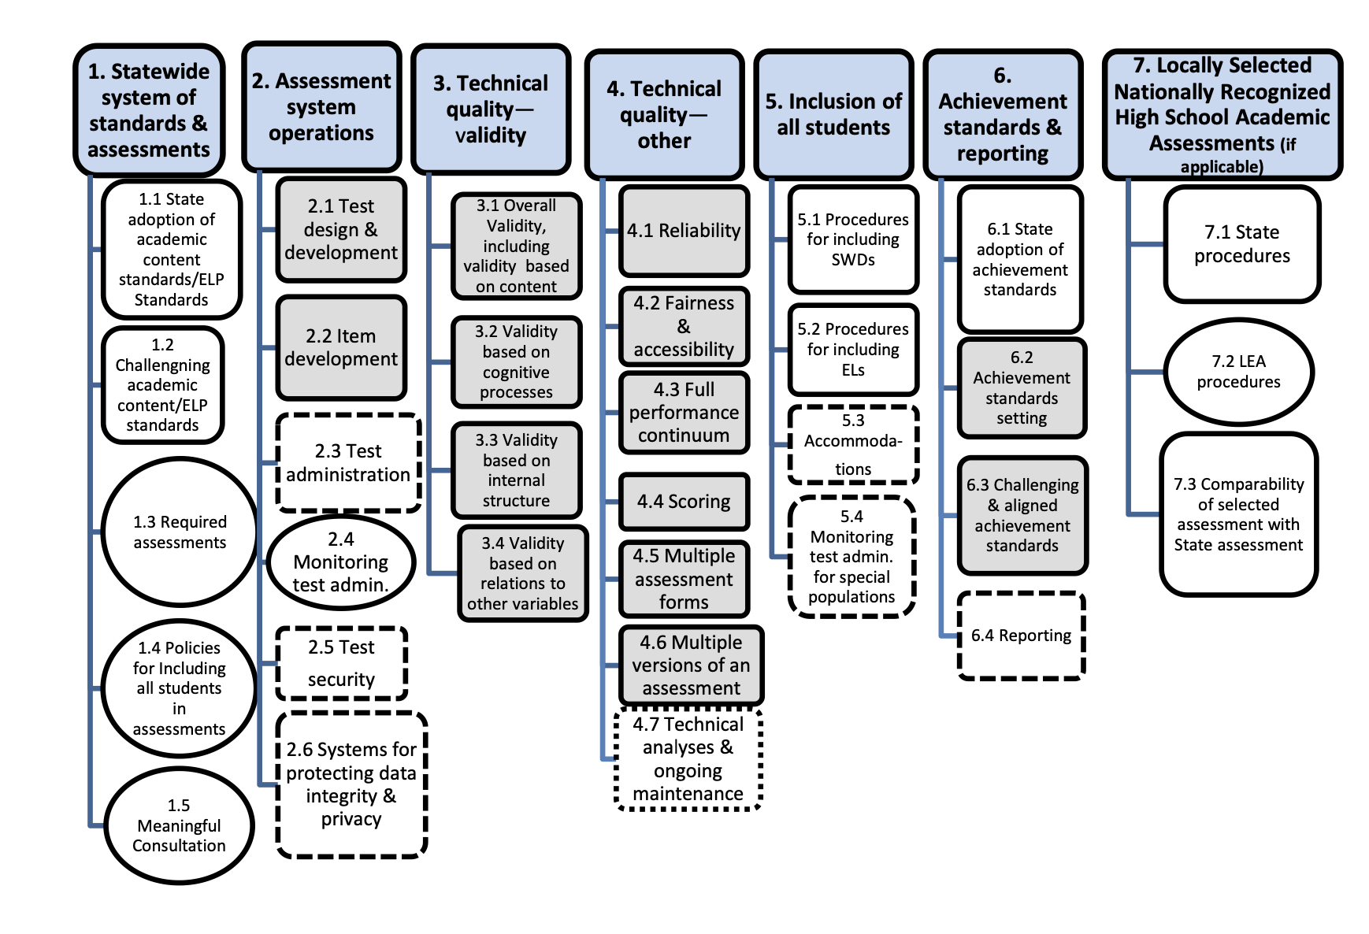
Technical
In order to receive approval from the U.S. Department of Education a wide range of technical requirements will need to be satisfied.

Slide 13
Technical
Some prominent technical considerations include
Alignment
Does the assessment reflect Mississippi academic content standards?
Other states have had to modify the assessment to demonstrate alignment. Modification could prevent use by institutions of higher education.
Full performance continuum
Does the assessment measure the full range with adequate precision?
Comparability
Are interpretations consistent across assessments - particularly important if ACT and WorkKeys are considered.

Slide 14
Policy
Some prominent policy considerations include
What are the appropriate performance expectations?
If we use the ACT Benchmarks that will represent a much more rigorous performance expectation.
What are the implications for student graduation requirements?
What are the implications for schools and district accountability?
Proficiency
Growth
College and career readiness

Slide 15
Implementation
Some prominent policy considerations include
Legal requirements include:
Adequate notification
Evidence of opportunity to learn
Ensuring appropriate accessibility and accommodations are offered
Adequacy and timing of data and reports

Slide 16
Discussion
Do you have any questions or feedback about the implications we identified?
What additional implications should we identify?
How does this impact the timing and nature of our continued work?

Slide 17
Progress in English Language Proficiency

Slide 18
EL Progress Study Goals
Help states effectively measure English learner growth towards English language proficiency.
Help states understand the relationship between English learner progress and EL program implementation.
Support participating states in refining their own growth models and using ELP assessment data to inform school improvement efforts.
Inform the field’s understanding of effective measures of growth towards English language proficiency and provide resources that states can customize and use.

Slide 19
College and Career Readiness

Slide 20
Background
In previous meetings we have discussed whether and how the college and career readiness should be reflected in the state accountability model.
The current model includes both acceleration, which incentivizes advanced course taking, and CCR, which incentivizes ACT/ WorkKeys performance
The discussion has focused on combining these components and broadening the indicators

Slide 21
Feedback from February
Prioritize models that include a broad range of measures
Do not give more weight to test based measures
Consider approaches that offer some flexibility/ choice
Differentiate performance to the extent practicable (in lieu of ‘all or nothing)
Consider adding diploma endorsements

Slide 22
Indicators for High Schools and Districts
READING | MATH | OTHER SUBJECTS | GRADUATION 4-YEAR | ACCELERATION | COLLEGE & CAREER READINESS | ENGLISH LANGUAGE PROGRESS
Proficiency 95 pts | Proficiency 95 pts | Science Proficiency 47.5 pts | 4-year Cohort Rate 190 pts | Performance 23.75 pts | ACT Performance 47.5 pts Or | Progress to Proficiency 50 pts
Growth All Students 95 pts | Growth All Students 95 pts | U.S. History Proficiency 47.5 pts |  | Participation 23.75 pts | ACT WorkKeys Option 47.5 pts
Growth Lowest 25% 95 pts | Growth Lowest 25% 95 pts
Combined, acceleration and CCR is 9.5% of the model (10% without ELP)

Slide 23
Acceleration
Numerator:
All students taking accelerated courses (AP, IB, AICE, dual credit/enrollment, industry certification)
Denominator:
All students enrolled in grades 11 and 12, plus 9th and 10th grade students taking and passing accelerated courses
25 Points Possible:
e.g., 133 ÷ 200 = 0.67
0.67 x 25 = 16.8 points
Participation 50%
30.3 points total
Numerator:
All courses/exams meeting performance standards by student (e.g., C grade in dual c/e, 3 on AP exam, or 4 on IB)
Denominator:
All courses/exams taken by participating students in AP, IB, AICE, dual credit/ enrollment, industry certifications
25 Points Possible:
e.g., 72 ÷ 133 = 0.54
0.54 x 25 = 13.5 points
Performance 50%

Slide 24
College- and Career-Readiness Component
CCR Measure Includes:
50% ACT English or Reading Benchmark
+
50% ACT Math Benchmark
OR
ACT WorkKeys Silver with Career Pathway/Industry Certification or ACT WorkKeys Gold or Platinum
CCR Score by Student:
0.5 Point + 0.5 Point
OR
1.0 Point
(Max 1 point/student)

Slide 25
Mississippi College and Career Readiness Index - Revised Illustration
Acceleration | 0 points | 20 Points | 30 Points | 40 Points | Maximum
 | No evidence of advanced coursework or program participation | Student participates in qualifying course or program (AP, IB, AICE, Dual Credit, Industry Certification) | Student meets performance expectation on at least 1 qualifying course (C or better in DC; 3 on AP; 4 on IB) | Student meets performance expectation on more than 1 qualifying course or program | 40
Achievement | 0 points | 20 Points | 30 Points | 40 Points | Maximum
 | Does not graduate or earn GED by end of grade 12 | Graduate or GED | Diploma with Academic or Career/ Technical Endorsement | Diploma with Distinguished Academic Endorsement | 40
Assessment | 0 points | 10 Points | 15 Points | 20 Points | Maximum
 | Does not attain qualifying assessment score | ACT 17 English OR ACT 19 Math | ACT 18 English AND ACT 22 Math | Meets ACT Benchmark in English AND Math | 20
 |  | ACT WorkKeys Silver OR ASVAB/ AFQT 31 | ACT WorkKeys Silver with Industry Certification OR ASVAB/ AFQT 50 | ACT WorkKeys Gold with Industry Certification or ASVAB/ AFQT 65
College and Career Readiness Score |  |  |  |  | 100

Slide 26
Discussion Questions
What are the advantages and disadvantages of the revised design illustration?
Do you agree with including diploma endorsements?
Are the proposed weights and levels of differentiation appropriate? If not, how should they be changed?
Are there any indicators that are omitted that should be included?
How can we support indicators that are not represented in formal accountability? For example:
Collection and reporting
Sharing best practices
Other?

Slide 27
Accountability Performance Standards

Slide 28
Overview
At the February meeting we engaged in a school rating exercise to elicit initial guidance from the task force regarding the characteristics of schools that are regarded as minimally sufficient to earn each letter grade.
Based on your feedback we produced some draft school performance level descriptors for elementary/middles schools for your review.
Based on your feedback, we’ll engage in a similar discussion for high schools and districts at a later date.

Slide 29
Structure
Indicator performance descriptors
Objective: This is short description of overall rationale for the indicator and any overarching policy goals that should be considered to inform the manner in which performance is differentiated.
Metric: This is a description of how the indicator is operationalized or measured in the state accountability system.
Guidance: This provides information to help determine where the specific thresholds should be set to differentiate performance at each indicator rating.
School Performance Level Descriptors
The School Performance Descriptions (SPDs) are descriptions of the features and characteristics of letter grade rating based upon the indicators in Mississippi’s accountability system. SPDs provide information about the expectations for each indicator and the relationships among indicators to inform the decision of panelists in standard setting.

Slide 30
Indicator Performance Descriptor - Proficiency
Proficiency – Reading, Math, and Science
Objective | Differentiate school performance based on the extent to which students have demonstrated performance that meets the state’s standards for proficiency in reading, mathematics, and science.
Metric | Proficiency is determined by the percentage of students who achieve proficient and above on federally required statewide assessments in Reading/Language Arts/English, Mathematics and Science. This includes all Alternate Assessments based on Alternate Achievement Standards (AA-AAS) for SCD students.
Guidance
High | Approximately two-thirds of the students are proficient or higher
Moderate | Approximately half of the students are proficient or higher
Low | Fewer than half of the students are proficient

Slide 31
Indicator Performance Descriptor - Growth
Growth – Reading and Math
Objective | Differentiate school performance based on the extent to which students demonstrate continuous improvement to proficiency and above.
Metric | Growth is determined by whether or not a student increases in performance/proficiency levels from one year to the next based on the following criteria: · An increase of ANY performance/proficiency level · Staying at Proficient from one year to the next · An increase within the lowest three performance/proficiency levels that crosses over the midpoint of the level. Additional weight in the numerator is given for the following increases: · Staying at Advanced from one year to the next will be given a weight of 1.25 · Any increase of two or more performance/proficiency levels will be given a weight of 1.25 · Any increase to the highest performance/proficiency level will be given a weight = 1.25.
Guidance
High | Approximately three-fourths of students are meeting growth targets
Moderate | More than half of the students are meeting growth targets
Low | Half or fewer of the students are meeting growth targets

Slide 32
Indicator Performance Descriptor - Growth Low 25%
Growth Lowest 25% – Reading and Math
Objective | Differentiate school performance based on the extent to which the lowest performing 25% of students on the state assessment demonstrate continuous improvement to proficiency and above.
Metric | The lowest 25% group is determined separately for reading and mathematics based on the whether their standardized state assessment scores in the prior year are in the lowest quartile for each school. Growth is determined by whether or not a student increases in performance/proficiency levels from one year to the next based on the following criteria: · An increase of ANY performance/proficiency level · Staying at Proficient from one year to the next · An increase within the lowest three performance/proficiency levels that crosses over the mid-point of the level. Additional weight in the numerator is given for the following increases: · Staying at Advanced from one year to the next will be given a weight of 1.25 · Any increase of two or more performance/proficiency levels will be given a weight of 1.25 · Any increase to the highest performance/proficiency level will be given a weight = 1.25.
Guidance
High | Approximately two-thirds of students are meeting growth targets
Moderate | Approximately half of the students are meeting growth targets
Low | Half or fewer of the students are meeting growth targets

Slide 33
Indicator Performance Descriptor - English Learner Progress
English Language Progress
Objective | Differentiate school performance based on the extent to which English learners are progress to an attaining proficiency on the state’s English Language Proficiency Test (ELPT).
Metric | Progress toward proficiency will be calculated for all EL students using the state ELPT. An annual progress goal will be calculated for each student based on reaching proficiency on the ELPT within five years of entry into an EL program. The annual progress goal will be equal to the minimum score needed to achieve proficiency at year five, minus the prior year score, divided by the number of years the student had remaining to exit the EL program in the prior year. In year five and beyond, the annual progress goal is equal to the minimum score needed to achieve proficiency, minus the prior year score. EL performance will be measured by the annual progress achieved by EL students. Each student will have a rate ranging between zero and one based on the student’s current year ELPT score, minus the prior year score, divided by the annual progress goal.
Guidance
High | Approximately two-thirds of students are meeting progress targets
Moderate | Approximately half of students are meeting progress targets
Low | Fewer than half of students are meeting progress targets

Slide 34
School Performance Descriptors - A
Category | School Performance Description
A | Recognizes an exemplary school in which most students are meeting or exceeding academic expectations and exhibiting high rates of growth for all students AND students in the low 25 group. A rated schools are among the highest performing schools in the state and typically earn high ratings for all indicator categories with few exceptions. A rated schools will be recognized for their exemplary achievement.

Slide 35
School Performance Descriptors - B
Category | School Performance Description
B | Recognizes a high performing school in which most students are meeting academic expectations or exhibiting moderate to high rates of growth for all students AND students in the low 25 group. B rated schools may perform at high to moderate level across multiple indicators. It is rare for a B rated school to have any indicator rated LOW.

Slide 36
School Performance Descriptors - C
Category | School Performance Description
C | Signifies a school exhibiting generally moderate performance. Performance does not consistently meet the state’s expectations and there may be areas in need of improvement including proficiency or growth. C rated schools typically perform at moderate level across multiple indicators. C schools may have inconsistent performance across indicators such that some indicators are high/moderate while others are low.

Slide 37
School Performance Descriptors - D
Category | School Performance Description
D | Identifies a school exhibiting unsatisfactory performance below the state’s expectations. D schools are in need of improvement in multiple areas including proficiency and growth. D rated schools are among the lowest performing schools in the state. These schools typically perform at low levels on multiple indicators, including proficiency and growth

Slide 38
Discussion
Are the levels (i.e., high, moderate, and low) associated with each indicator appropriate?
Do the draft school performance descriptors provide a clear, criterion-referenced description of the school profile associated with each grade?

Slide 39
Follow-Up and Future Topics

Slide 40
Before we adjourn…
What’s one thing we covered today that you want to emphasize and/or request we follow-up on?
What’s a topic or issue we have not covered you’d like the task force to address in the future?

