Slide 1
Accountability Task Force
April 11, 2023

Slide 2
Mississippi Department of Education

Slide 3
State Board of Education STRATEGIC PLAN GOALS

Slide 4
Welcome and Introductions
First Name: | Last Name: | Organization: | Position in Organization:
Rosemary | Aultman | State Board of Education | Board Member
Crystal | Bates | Wayne County High School | Assistant Principal
LaToya | Blackshear | Jackson Public Schools | Director of Planning and Evaluations
Lindsay | Brett | Lee County Schools | Principal
Jermaine | Brown | Hattiesburg | Director of College & Career Readiness
Angela | Burch | Pascagoula-Gautier School District | Principal
Alan | Burrow | Mississippi Department of Education | Director of District and School Performance
Alicia | Conerly | Lawrence County | Principal
Chris | Domaleski | The Center for Assessment | External Facilitator
Deborah | Donovan | Mississippi Department of Education | Data Analytics and Reporting
Glen | East | State Board of Education | Board Member
Steven | Hampton | Lamar County | Superintendent
Raina | Holmes | Jackson County School District | High School Principal
Christy | Hovanetz | Foundation for Excellence in Education | External Expert
Lawrence | Hudson | Western Line School District | Superintendent
Tameka | Hyland | Vicksburg Warren School District | Principal
Tarrinasha | Jones | Greenville Public School District | Principal
Ryan | Kuykendall | DeSoto County | Director of Accountability & Research
Lisa Renee | LaMastus | Cleveland School District | Principal
Greg | Paczak | Madison County Schools | Director of Research & Development
William | Roberson | Oxford School District | Superintendent
Robert | Sanders | Hinds County School District | Assistant Superintendent
Paula | Vanderford | Mississippi Department of Education | Chief Accountability Officer
LaVonda | White | Rankin County School District | Director of Accreditation, Accountability, and Assessment

Slide 5
Agenda
9:00 a.m. | Welcome and Introductions - MDE Updates
9:20 a.m. | Schools Impacted by Tornados
9:50 a.m. | Beyond Academics
10:45 a.m. | Break
11:00 a.m. | Exploring Innovations in District Accountability
12:00 p.m. | Lunch
1:00 p.m. | Growth Revisions
2:30 p.m. | Break
2:45 p.m. | Chronic Absenteeism
3:30 p.m. | Prioritizing Future Meeting Topics
4:00 p.m. | Adjourn

Slide 6
Purpose and Overview
Primary purpose is to help MDE make good decisions about the design and implementation of the state, school accountability system under ESSA
We will focus on identifying policy priorities and identifying decisions in support of those priorities that are technically defensible and operationally feasible
Feedback from the Task Force is received as a recommendation to the department

Slide 7
Ground Rules/ Group Norms
Listen actively and attentively; ask for clarification as needed
Everyone should have an opportunity to ‘be heard’ without interruption and to receive courteous feedback
Critique ideas, not people or organizations
Build on one another’s comments; work toward shared understanding
We will attempt to make decisions based on group consensus, but when necessary we will take a vote
When/ if requested do not disclosure confidential information
At the end of each meeting we will prioritize topics for future meetings and discuss action items

Slide 8
Schools Impacted by Tornados

Slide 9
Affected Districts
Amory
Carroll County
Humphreys County
Monroe County
New Albany
South Delta
Winona-Montgomery

Slide 10
Assessment Window
Assessment New Closing Date
ELPT 4/21/23
Kindergarten Readiness Post-Test 5/5/23
MAAP-A 5/12/23
MAAP* ELA, Math, Science & U.S. History 5/19/23
*Excluding 3rd grade ELA and early graduates/senior retesters

Slide 11
Assessment Window Changes
Any district that chooses to change its assessment schedule shall submit a revised schedule to the Office of Student Assessment by COB Wednesday, April 12. Updated schedules should be emailed to osasupport@mdek12.org with the subject line:
DISTRICT NAME_Testing Schedule Change.
The MDE will work with the tornado-affected districts to extend the window, if needed, for the 3rd Grade Reading Assessment (MAAP ELA Reading) and high school seniors who need to retest on high school end-of-course assessments (Algebra I, English II, Biology and U.S. History).
Extending the assessment window for 3rd Grade Reading and senior retesters to all districts will adversely impact district receipt of test scores. This will delay your 3rd grade retesting opportunities and impact your timelines for seniors to meet graduation requirements. Therefore, MDE is not extending the assessment window for these tests to all districts.

Slide 12
Beyond Academics

Slide 13
Overview
At the March meeting we discussed a range of indicators that may be considered to broaden the scope of the accountability system
We reviewed the feedback from the last meeting and streamlined the candidate indicators.
Our focus today is identifying the highest priorities and the recommendations for next steps.

Slide 14
Activity
Please individually review the indicator form with suggestions related to: readiness, digital literacy, service/ leadership, social-emotional, and school climate/ safety.
List specific sources of data that should be prioritized
Indicate what next steps you recommend (all that apply):
1: consider for inclusion in accountability system
2: collect and report
3: provide resources and support
4: conduct additional research to learn more

Slide 15
Example
Potential Indicator | Focal Question | Potential Sources of Data | What sources of data should be prioritized? | Recommendations for next steps; list all that apply: 1: consider for inclusion in accountability system 2: collect and report 3: provide resources and support 4: conduct additional research to learn more
Next-Level Readiness | To what degree does the school prepare its students for the next phase of their academic learning? | Postsecondary (college and career) readiness Capstone projects College applications, enrollment, and/or scholarships Earning diploma options/ endorsement Other? | Capstone projects Diploma options | 4 1, 2, 4

Slide 16
Activity
After your individual review, we will discuss in small groups
Please complete and submit a form for your group
We will share out to learn about recommendations across groups

Slide 17
Innovations in District Accountability

Slide 18
Introduction
The purpose of this topic is to discuss whether MDE should explore alternative approaches to district accountability
Should the accountability system treat districts like a ‘super-school’ or consider:
  Same indicators but different aggregations or standards
  Different indicators
We’ll start with a scan of district reporting practices

Slide 19
Introduction
To get a sense of the landscape, several districts' reporting practices were examined
We focused on public reporting which goes beyond formal accountability systems
A particular emphasis was placed on examining indicators positioned as important to equity priorities
Two examples are provided of initiatives in progress that may provide insights for future directions
  CPS
  MCIEA

Slide 20
Common Reports
Student demographics
Enrollment data by student group
Student achievement
status and growth on state and district assessments
Post-Secondary Readiness
graduation rate, percent of students earning advanced course credit or industry certifications
Attendance
Attendance rates, chronic absenteeism
Staffing data
educator demographics, experience, student/teacher ratio
Financial data
annual financial reports detailing revenues and expenses
Discipline data
incidents, suspensions, expulsions

Slide 21
Less-Common Reports
School climate
feedback from students, parents, and/or staff
Parent/ community engagement
district initiatives and participation
Transacdemic or social emotional learning
Resources and strategies to promote SEL
Broader measures of engagement
Co-curricular experiences, service
Post-secondary data
College going rates, remediation rates

Slide 22
Equity Focused Information
Performance for student groups
Measures of academic progress by group, achievement gaps
Resource allocation
Funding, data on educator credentials/ experience, technology access
Disparities in access/ opportunity
Participation in advanced coursework, group differences in suspension/expulsion

Slide 23
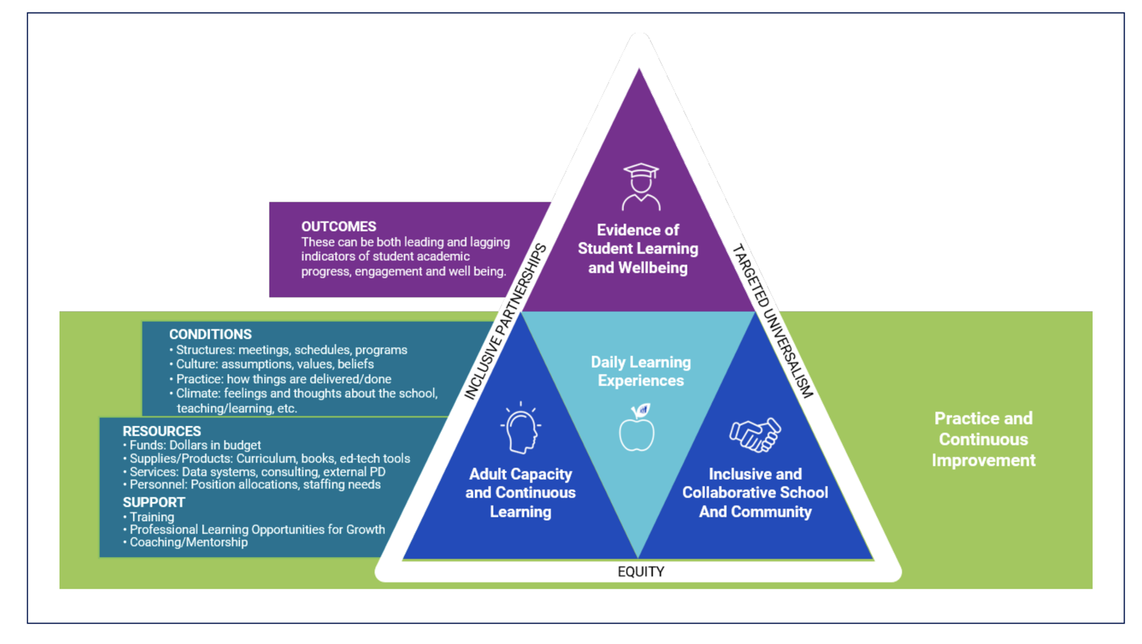
Chicago Public Schools - Revised Framework

Slide 24
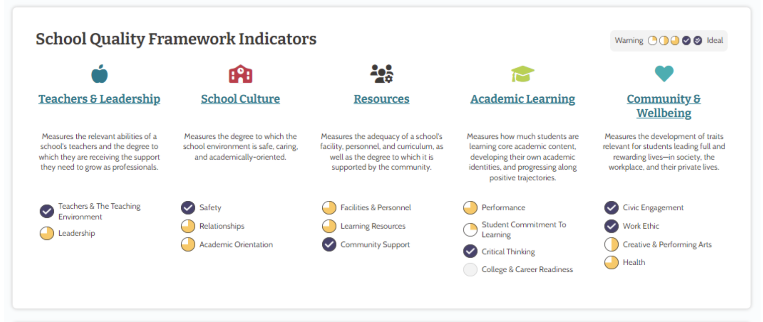
MCIEA Framework

Slide 25
Discussion
Do you think MDE should explore changes to district accountability?
Should the changes include expanded different indicators?
What new indicators should be considered for reporting and/or accountability?
What are the research priorities moving forward?

Slide 26
Examining Growth

Slide 27
Overview
The MDE has received questions/ suggestions about growth in accountability to include:
  Equal credit should be given for levels 4 and 5
  Growth is should be more sensitive to progress at or above level 3. For example:
    Create a level “3C”
    Give partial credit for maintaining a level in 3
  More weight should be given to students showing progress from levels within/ across levels 1-3.

Slide 28
Calculation of Growth
Earning Growth Points:
Moving 1 Growth* level = 1 pt
Moving 2 Proficiency* levels = 1.25 pts
Moving from any lower level to level 5 = 1.25 pts
Staying at level 5 = 1.25 pts
1a
4
5
1b
2a
2b
3a
3b
1.25pt
1.25pt
1.25pt
1pt
1pt
1
2
3
4
5
Proficiency Levels

Slide 29
Research Questions
To explore this issue further we will examine two research questions
1. To what extent do we observe academic growth on MAAP in scale score units. In other words, do we have evidence of growth external to the transition table model used for accountability?
2. What is the impact of adding an additional growth category in the model?

Slide 30
Research Question 1
We examined growth for students from 2018 to 2019. These administrations were selected because they are before the pandemic disruptions.
We calculated scale score differences for examinees in each year (e.g., Grade 8 2019 score – Grade 7 2018 score).
The distribution of these change scores are examined by scale score, performance level, and growth level.

Slide 31
Grade 4 to 5 Math
Solid horizontal red line at 100 which is “stable performance.” Above the red line represents growth. Below the red line represents decline.
Dashed vertical lines mark the region of performance level 3.

Slide 32
Grade 4 to 5 Math

Slide 33
Grade 4 to 5 Math

Slide 34
Grade 7 to 8 Math

Slide 35
Grade 7 to 8 Math

Slide 36
Grade 7 to 8 Math

Slide 37
Grade 4 to 5 ELA

Slide 38
Grade 4 to 5 ELA

Slide 39
Grade 4 to 5 ELA

Slide 40
Grade 7 to 8 ELA

Slide 41
Grade 7 to 8 ELA

Slide 42
Grade 7 to 8 ELA

Slide 43
Impact of Adding 3C - Math

Slide 44
Impact of Adding 3C - ELA

Slide 45
Summary of Findings
As expected growth declines for students performing at higher levels in year 1
For performance level 3, growth was relatively stable
  Vertical scale differences are approximately normally distributed around 100, meaning an equal number of students demonstrated growth and decline
  The median examinee in level 3 scored at the same level in 2018 and 2019
Adding a level 3C has a modestly favorable impact for math (+2.6% in growth scores) and a more substantial impact for ELA (+8.8% in growth scores)

Slide 46
Attendance/ Absenteeism

Slide 47
What Is Chronic Absenteeism
Chronic absenteeism is defined as missing 10% or more (18 days) of a school year for any reason. Chronic absenteeism differs from Average Daily Attendance (ADA), which is the average number of enrolled students who attend school each day. A school’s ADA often masks issues surrounding the number of students who are chronically absent. A school can potentially have an ADA of 95% or higher while having a chronic absenteeism rate greater than 10%. Mississippi’s chronic absenteeism rate for 2021-22 is 28%, which is the highest rate since the Mississippi Department of Education (MDE) started reporting the rates in 2016. During the 2021-22 school year, 128,275 students were chronically absent, which is an increase of 33,186 students from 2020-21. The rates increased steadily for all K-12 grades in 2021-22. The chronic absenteeism rate in K-5 elementary schools was highest for kindergarten at 28.4%. The chronic absenteeism rate in middle school was highest in grade 8 at 29.6% and highest in high school in grade 12 at 45.3%.

Slide 48
Causes for Chronic Absenteeism
  Bad grades: struggling in class can be demoralizing for students
  Bullying
  Illness and caring for another family member/Mental or emotional health issues
  Safety, Transportation, Poverty etc….

Slide 49
How to address chronic absenteeism
Action Plan
Raise awareness, promote collecting and using accurate data on attendance, develop an early warning system, and work with attendance officers, parents, and community partners to decrease chronic absenteeism.
Enacting policies that promote attendance rather than punishing absences.
Improving the school culture and providing resources to support students.

Slide 50
School Attendance Officer (SAO) roles
SAOs will work with the district to receive student referrals as prescribed by law. Districts must provide the necessary demographic information to SAOs to work on the referral accurately and promptly. Referrals are to be emailed to the SAOs.
SAOs will make daily phone calls, send letters (email letters when parents or districts have provided the correct email address), and perform home visits (when necessary) to ensure that parents understand the significance of their child(ren) attending school. Priority will be given to those students that have reached the prescribed number of unexcused absences according to the law.
SAOs will make weekly phone calls with the Truancy Director/Attendance Clerks (or his/her designee) to receive the necessary information and maintain regularly updated contact information for students and parents. SAOs are to make one in-person school visit a month to staff-student attendance issues with school personnel.

Slide 51
Armerita Tell, Ph.D.
Executive Director
Atell@mdek12.org

Slide 52
Future Topics

Slide 53
Discussion
In your opinion, what are the top priorities for discussion at future Accountability Task Force meetings?

