Slide 1
Accountability Task Force
Central High School
November 29, 2018

Slide 2
VISION
To create a world-class educational system that gives students the knowledge and skills to be successful in college and the workforce, and to flourish as parents and citizens
MISSION
To provide leadership through the development of policy and accountability systems so that all students are prepared to compete in the global community
Notes:
Vision and mission provides direction and foundation for all work of the SBE, MDE, and ultimately districts, schools, and teachers across the state.
Ultimately, we are working to prepare students for what comes next in life – postsecondary study, military service, technical programs, world of work, parenthood, and citizenship at large. MDE is responsible for providing policy to drive this and accountability to measure progress. In addition, the MDE takes an active role in supporting districts through PD, TA, and resources.

Slide 3
MISSISSIPPI STATE BOARD OF EDUCATION
STRATEGIC PLAN GOALS
1
2
3
4
5
6
All Students Proficient and Showing Growth in All Assessed Areas
Every Student Graduates from High School and is Ready for College and Career
Every Child Has Access to a High- Quality Early Childhood Program
Every School Has Effective Teachers and Leaders
Every Community Effectively Uses a World-Class Data System to Improve Student Outcomes
Every School and District is Rated “C” or Higher

Slide 4
Welcome and Introductions
First Name: | Last Name: | District: | Position:
Richard | Baliko | Noxubee County School District | Principal
Stacy | Baudoin | Pearl River County School District | Principal
Kimberly | Blunt | Columbus Municipal School District | Principal
Lisa | Bramuchi | Cleveland School District | Asst. Supt.
Ken | Byars | Amory School District | Superintendent
Tiffany | Fisher | Meridian School District | Teacher
Steven | Hampton | Lamar County School District | Director of Research and Accountability
Tracy | Jackson | Greenville Public School District | Academic Director
Ryan | Kuykendall | DeSoto County School District | Director of Accountability & Research
Delesicia | Martin | Hinds County School District | Superintendent
Aldo | Moran | Ocean Springs School District | Assistant Principal
Howard | Savage | Quitman School District | Administrator of the Year
Heather | Todd | Marshall County School District | Teacher
Benjamin | Torrey | Holmes County Consolidated School District | Coordinator of Testing & Accountability
Shannon | Vincent | Moss Point School District | Superintendent
Tim | Martin | Clinton School District | Assistant Superintendent
Michael | Lindsay | Gulfport School District | Commission on School Accreditation
Whitney | Drewrey | Lafayette School District | Teacher of the Year
Matt | Thompson | Union County School District | K-12 Subcommittee Member
Rosemary | Aultman | State Board of Education | Board Member
Chris | Domaleski | Center for Assessment | External Facilitator
Christy | Hovanetz | Foundation for Excellence in Education | External Expert
Deborah | Donovan | MDE | Data Analytics and Reporting
Paula | Vanderford | MDE | Chief Accountability Officer
Alan | Burrow | MDE | Director of District and School Performance

Slide 5
Agenda
9:00 a.m. | Welcome and Introductions Context and Group Norms
9:30 a.m. | Background: Accountability in Mississippi
10:15 a.m. | Break
10:30 a.m. | Discussion of Issues Related to Progress in English Language Proficiency
12:00 p.m. | Lunch
1:00 p.m. | High School Grade Configurations
2:00 p.m. | Break
2:15 p.m. | Prioritizing future meeting topics Identify Action Items
3:00 p.m. | Adjourn

Slide 6
Purpose and Overview
Primary purpose is to assist MDE in the design and implementation of the state, school accountability system under ESSA
We will focus on identifying policy priorities and identifying decisions in support of those priorities that are technically defensible and operationally feasible
Feedback from the Accountabily Task Force is received as a recommendation to the Department

Slide 7
Ground Rules/ Group Norms
Listen actively and attentively; ask for clarification as needed
Everyone should have an opportunity to ‘be heard’ without interruption and to receive courteous feedback
Critique ideas, not people or organizations
Build on one another’s comments; work toward shared understanding
We will attempt to make decisions based on group consensus, but when necessary we will take a vote
When/ if requested do not disclose confidential information
At the end of each meeting we will prioritize topics for future meetings and discuss action items

Slide 8
Accountability in Mississippi

Slide 9
Prior to 2013…
1988
First Accountability Results, Districts rated 1 – 3, based on Performance
1995
Districts Rated 1 – 5, based on Performance
2003
Schools Rated Level 1 – 5 based on Performance and Growth
2009
Districts and Schools Rated 1-7, based on Performance, Growth, and Completion
2013
Current Model Implemented

Slide 10
Concerns with prior model
Quality of Distribution Index (QDI)
Growth Status – Met/Not Met
High School Completion Index vs. Graduation Rate
Separate State and Federal Measures
Seven (7) performance descriptors
MCT2 Rigor

Slide 11
What is Accountability Today?
The Mississippi Statewide Accountability System establishes a set of minimum standards for public schools and districts in our state to ensure that Mississippi students are prepared to compete in a national workforce, or go on to post-secondary education.

Slide 12
What is Accountability Today?
The Mississippi Statewide Accountability System also informs the public on how well schools and districts are performing. Mississippi’s accountability system considers how well students perform on state tests, whether students are showing improvement on those tests from year to year and whether students are graduating on time.

Slide 13
What is Accountability Today
Accountability systems also drive behavior of schools and districts and influence planning and interim measures of performance. This results in consistent best practices and can be seen in improvements on both statewide assessments and national assessments, such as NAEP and ACT.

Slide 14
NAEP - Math

Slide 15
NAEP - Reading

Slide 16
ELA and Math Overall Proficiency

Slide 17
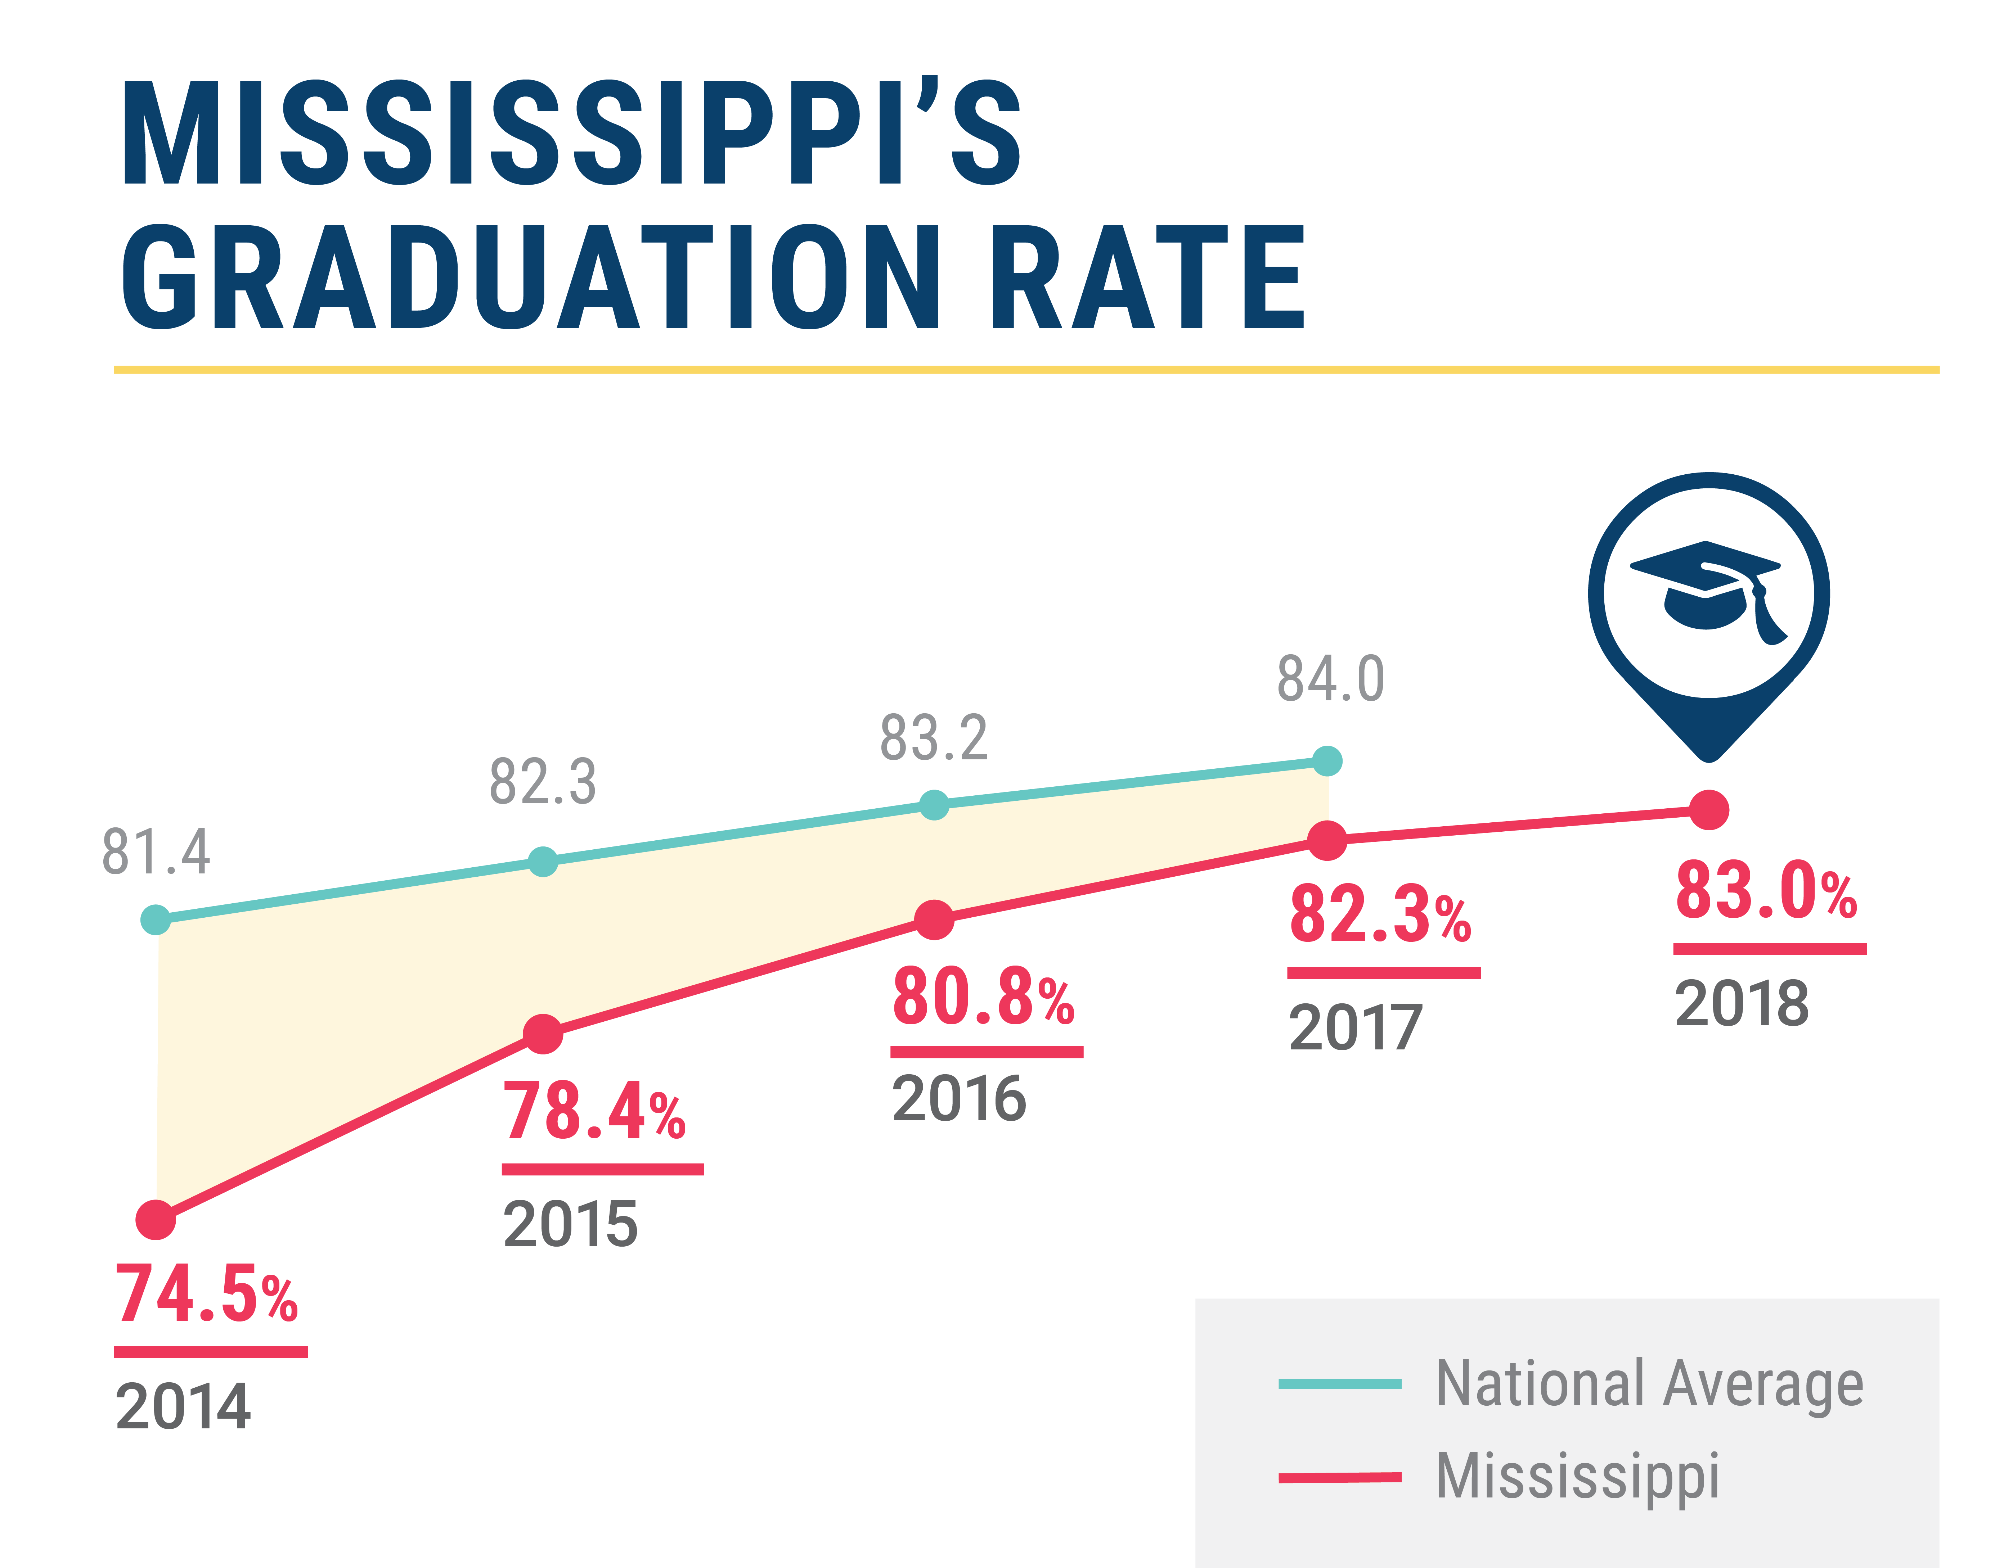
Graduation Rates

Slide 18
Dual Credit

Slide 19
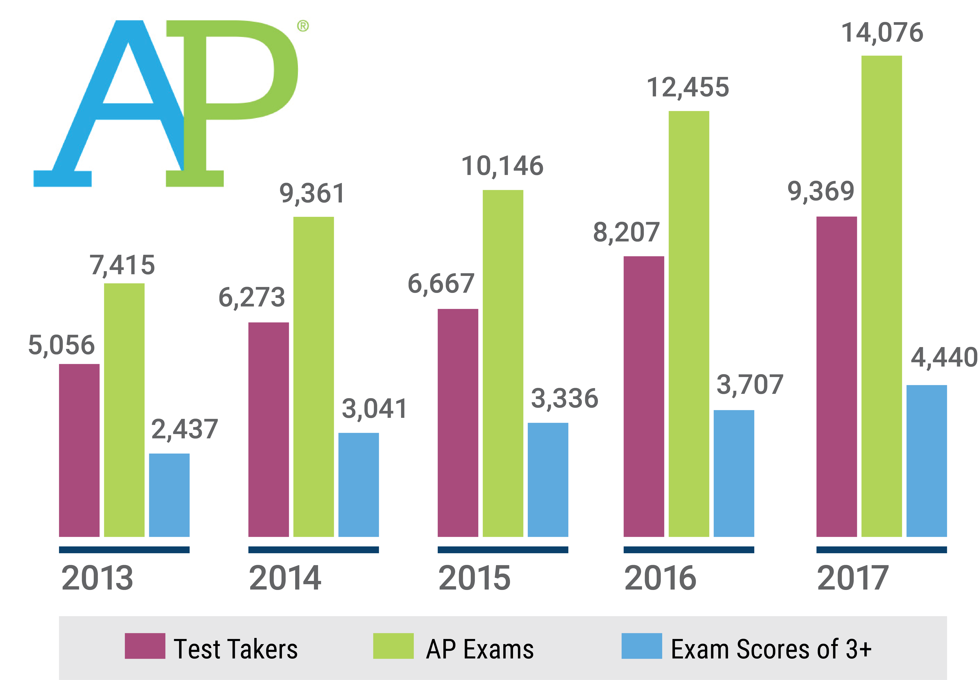
Advanced Placement

Slide 20
Career and Technical Education

Slide 21
Mississippi Statewide Accountability System
Single “A” through “F” statewide accountability system with applicable state and federal requirements (MS Code Ann. Section 37-17-6)
Approved by the Mississippi Board of Education January 17, 2014
System developed in collaboration with the Accountability Task Force, Technical Review Committee, State Legislative Leaders, and MDE Staff

Slide 22
Miss. Code Ann. § 37-17-6 (Senate Bill 2396)
Implement a single “A” through “F” school and school district accountability system
Combine state and federal accountability systems into one (federally approved) system
Establish five (5) performance categories (“A, B, C, D, & F”) and discontinue the use of the designations of “Star, High Performing, Successful, Low-Performing, At Risk of Failing”
Incorporate a standards-based growth model
Discontinue use of QDI
Include the federally compliant (4)-year graduation rate and discontinue use of HSCI
Increase standards when 75% of students are Proficient and/or when 65% of schools or districts earn a “B” or higher grade

Slide 23
Mississippi Statewide Accountability System
Proficiency/Performance – Did the student meet expectations?
Growth - Did the student improve as expected?
Participation – Did the student participate in assessments/classes?
Graduation Rates – Did the student graduate as expected and on time?

Slide 24
Annual Subject Area Assessments
Assessments used for calculation of growth and proficiency include:
Grade-level (3-8) assessments in Reading/Language Arts
Grade-level (3-8) assessments in Mathematics
High School-level assessment in English II
High School-level assessments in Algebra I
Alternate Assessment (3-8 and High School) in Reading
Alternate Assessment (3-8 and High School) in Mathematics
Proficiency (not growth) is measured in Grades 5 and 8 Science, Biology and U.S. History assessments.

Slide 25
Calculation of Growth
Growth Levels
Earning Growth Points:
Moving 1 Growth* level = 1 pt
Moving 2 Proficiency* levels = 1.25 pts
Moving from any lower level to level 5 = 1.25 pts
Staying at level 5 = 1.25 pts
1a
4
5
1b
2a
2b
3a
3b
1.25pt
1.25pt
1.25pt
1pt
1pt
1
2
3
4
5
Proficiency Levels
*there are 5 Proficiency Levels and 8 Growth Levels

Slide 26
700-Point Elementary and Middle Schools
READING | MATH | SCIENCE | ENGLISH LANGUAGE PROGRESS
Proficiency 95 pts | Proficiency 95 pts | Proficiency 95 pts
Growth All Students 95 pts | Growth All Students 95 pts
Growth Lowest 25% 95 pts | Growth Lowest 25% 95 pts
 |  |  | Progress to Proficiency 35 pts

Slide 27
1,000-Point Schools and Districts
READING | MATH | OTHER SUBJECTS | GRADUATION 4-YEAR | ACCELERATION | COLLEGE & CAREER READINESS | ENGLISH LANGUAGE PROGRESS
Proficiency 95 pts | Proficiency 95 pts | Science Proficiency 47.5 pts | 4-year Cohort Rate 190 pts | Performance 23.75 pts | ACT Math Performance 23.75 pts
Growth All Students 95 pts | Growth All Students 95 pts | U.S. History Proficiency 47.5 pts |  | Participation 23.75 pts | ACT Reading or English Performance 23.75 pts
Growth Lowest 25% 95 pts | Growth Lowest 25% 95 pts
 |  |  |  |  |  | Progress to Proficiency 50 pts

Slide 28
Acceleration
Participation 50%
Denominator:
All students enrolled in grades 11 and 12, plus 9th and 10th grade students taking and passing accelerated courses
Numerator:
All students taking accelerated courses (AP, IB, AICE, dual credit/enrollment, industry certification)
25 Points Possible:
e.g., 133 ÷ 200 = 0.67
0.67 x 25 = 16.8 points
$$÷$$
$$=$$
30.3 points total
Performance 50%
Numerator:
All students meeting performance standards in accelerated courses (e.g., C grade in dual c/e, 3 on AP exam, or 4 on IB)
Denominator:
All students taking accelerated courses (AP, IB, AICE, dual credit/ enrollment, industry certification)
25 Points Possible:
e.g., 72 ÷ 133 = 0.54
0.54 x 25 = 13.5 points
$$÷$$
$$=$$

Slide 29
College and Career Readiness (CCR)
CCR
(from ACT) includes:
50% English or Reading;
+
50% Math
Numerator:
All students meeting ACT benchmarks (18 in English or 22 in Reading; 22 in Math)
Denominator:
All students from Senior Snapshot who participated in ACT (both statewide and non-state administration)
Example: School A has 40 students who participated in ACT; 34 met English/ Reading and 30 met Math benchmarks.
English/Reading (25 points):
34 ÷ 40 = 0.85 x 25 = 21.25
Math (25 points):
30 ÷ 40 = 0.75 x 25 = 18.75
21.3 + 18.8 = 40 points total
$$÷$$

Slide 30
Graduation and Completion Rates
In accordance with 34 C.F.R. 200.19(b) and Miss Code Ann. §37-17-6, graduation rates are calculated following the four-year adjusted cohort method.
Four-Year Cohort: a group of students who enter 9th grade in MS for the first time, adjusted for students transferring into and out of the cohort, and are expected to graduate within four years
Graduate: a student receiving a standard high school diploma in four (4) years
Completer: a student receiving an occupational diploma, certificate of attendance, or GED within the district
Still Enrolled: a student still enrolled as September 1 of the year after the cohort’s expected completion date
Dropout: a student who leaves school during the cohort period without a diploma or certificate from the district
Notes:
Note: changes to graduation. No longer use apportioning. Use where longest enrolled, or in case of tie, last enrolled.

Slide 31
English Learner (EL) Component
EL students are expected to achieve English proficiency within five (5) years of entering an EL program, or graduation
First year students will be exempt from the EL component
Students must have a valid EL assessment score for the current and prior year
Students must meet FAY for current year, but not prior year
Individual student scores will range between 0 and 1
A student who regresses on his/her EL assessment will receive a score of 0
A student meeting the progress target will receive a score of 1

Slide 32
EL Accountability Component Score
Only schools/districts with at least 10 eligible EL students will have an EL component included
The average of the points earned for all EL students will be calculated for eligible schools/districts
Points for schools and districts rescaled to attenuate the impact on accountability points
Schools/districts with a student average ≥ 0.90 will receive full accountability points for EL component
Schools/districts < 0.90 student average will have their student average multiplied to the allowable EL points
Notes:
Note: a school may not have 10 or more students, but the district may.

Slide 33
Schools with Less Than Minimum EL N-Count
For schools in which the minimum n-count is not met for the English Language Proficiency indicator to be included in calculations, the 5% of total points typically assigned to the ELP indicator will be distributed proportionally among the remaining indicators.
This will keep the overall points available consistent at 700 or 1,000 points, depending on the grade-level configuration of the school.

Slide 34
Grade Cuts
Grade | Districts | 700 Point Schools | 1,000 Point Schools
A | 668 | 442 | 754
B | 599 | 377 | 648
C | 536 | 328 | 584
D | 489 | 269 | 510
F | < 489 | < 269 | < 510

Slide 35
Progress in English Language Proficiency

Slide 36
EL Progress Overview
Annual progress goal: minimum score needed to achieve proficiency (at year five (5) or graduation), minus the prior year score, divided by the number of years the student had remaining to exit the EL program in the prior year.
Progress rate: rates range between 0 and 1 based on the student’s current year ELPT score, minus the prior year score, divided by the annual progress goal (above). Any student who does not demonstrate progress will have a rate of 0. No student will receive a rate higher than 1.
Any student not exiting the EL program within five years will have a reduction in the calculation of the progress rate based on the following schedule: Year six (6), the student progress rate will be multiplied by 0.75 year ≥ seven (7), the student progress rate will be multiplied by 0.50

Slide 37
Weights
EL Progress has a 5% influence on outcomes:
- 35 points for schools with a maximum of 700 points
- 50 points for schools/ districts with a maximum of 1000 points

Slide 38
Impact by Grade
Grade | Average Scale Score
PK | 386.53
KG | 350
1 | 436.54
2 | 469.86
3 | 489.11
4 | 503.41
5 | 511.94
6 | 514.75
7 | 517.82
8 | 512.78
9 | 492.22
10 | 522.19
11 | 526.82
12 | 519.04
Grade | Students | Avg Score | Points Impact
K | 157 | 0.8 | 6
1 | 1203 | 0.8 | 6
2 | 1312 | 0.7 | 11.5
3 | 1141 | 0.7 | 11.5
4 | 1023 | 0.7 | 11.5
5 | 802 | 0.6 | 17
6 | 495 | 0.5 | 22.5
7 | 464 | 0.5 | 22.5
8 | 440 | 0.5 | 22.5
9 | 341 | 0.4 | 28
10 | 351 | 0.5 | 22.5
11 | 304 | 0.5 | 22.5
12 | 187 | 0.4 | 28

Slide 39
Grade by Years of Service
Grade | 1 | 2 | 3 | 4 | 5 | 6 | 7 | 8 | 9 | 10 | 11 | 12
PK | 73 | 1
K | 1639 | 219 | 4 | 2 | 1
1 | 338 | 1086 | 234 | 4 | 1 |  | 1
2 | 154 | 360 | 883 | 205 | 15
3 | 153 | 126 | 329 | 614 | 189 | 16 | 1
4 | 149 | 109 | 117 | 256 | 474 | 161 | 13
5 | 110 | 98 | 77 | 88 | 142 | 326 | 140 | 14 | 1
6 | 111 | 94 | 67 | 64 | 41 | 116 | 151 | 53 | 2 |  | 1 | 1
7 | 73 | 70 | 57 | 70 | 41 | 16 | 75 | 138 | 32 | 6 | 1
8 | 103 | 88 | 61 | 56 | 32 | 38 | 20 | 61 | 94 | 38 | 5
9 | 172 | 103 | 59 | 50 | 15 | 22 | 7 | 25 | 53 | 64 | 15 | 2
10 | 61 | 116 | 57 | 51 | 24 | 30 | 18 | 19 | 18 | 41 | 47 | 16
11 | 56 | 46 | 71 | 62 | 29 | 17 | 14 | 16 | 12 | 13 | 31 | 56
12 | 23 | 27 | 26 | 44 | 23 | 9 | 8 | 11 | 11 | 7 | 9 | 49

Slide 40
Performance with and without EL (700pt)
Total Points
Includes EL Progress | Mean | N
No | 367.48 | 402
Yes | 392.38 | 152
Total | 374.31 | 554
Includes EL Progress
 | No | Yes
A | 20.10% | 25.70% | 21.70%
B | 25.60% | 33.60% | 27.80%
C | 20.10% | 20.40% | 20.20%
D | 19.70% | 14.50% | 18.20%
F | 14.40% | 5.90% | 12.10%
Total | 100.00% | 100.00% | 100.00%

Slide 41
Performance with and without EL (1000pt)
Includes EL Progress | Mean | N
No | 610.61 | 194
Yes | 637.39 | 46
Total | 615.75 | 240
 | No | Yes
A | 7.70% | 15.20% | 9.20%
B | 24.70% | 37.00% | 27.10%
C | 26.30% | 19.60% | 25.00%
D | 27.30% | 15.20% | 25.00%
F | 13.90% | 13.00% | 13.80%
Total | 100.00% | 100.00% | 100.00%

Slide 42
Moving Forward
After this initial year of implementation, we are in a good position to evaluate the methods and impact.
MDE discussed this component with the state’s Technical Advisory Committee (TAC) and with a national consultant from CCSSO.
These groups identified four (4) potential changes for consideration by the ATF.

Slide 43
Potential Changes
1. Adjust the method of aggregation to better reflect the intended weight/ influence of progress in ELP.
2. Remove the point adjustment after the target exit year
3. Explore different goals for time to proficiency based on starting level and/or grade band
4. Award maximum points for achieving 70% progress toward or attainment of ELP

Slide 44
Aggregation
- The current method involves an adjustment to the final score for schools that meet minimum n-size for ELP.
This adjustment subtracts the difference between earned ELP points and maximum points.
The points earned for the other indicators are preserved.
- An alternative approach is to adjust the points earned on the other indicators first, then add the EL points.
Schools with an EL component would get 95% of their earned points on the other indicators plus the EL points.

Slide 45
Remove Point Adjustment
The current approach reduces earned points by 25% for each student one (1) year after target exit year and by 50% for each student two (2) or more years following the exit year.
An alternative approach would be to remove this adjustment.

Slide 46
Different Time to Proficient Goals
Currently, the time to proficient target is five (5) years for all students.
Alternatively, we propose to explore targets that vary by starting level or starting level and grade (or grade band).
The desire is to make the standard for every student in every year more equivalent.
Note: This may have the effect of increasing the rigor for some students who currently have ‘lenient’ progress goals.

Slide 47
Award Maximum Points at 70%
Currently, maximum points (35 or 50) are awarded to schools that demonstrate 90% or more of the students have achieved or are making adequate progress to ELP.
Alternatively, this can be adjusted to 70%, which is in line with the state’s long-term goal outlined in the state’s ESSA plan.

Slide 48
Next Steps
What feedback does the ATF have on these proposals?
What other suggestions do you have?
What proposals are the highest priority?
The MDE proposes to model impact and report back to the ATF.

Slide 49
High School Grade Configurations

Slide 50
Concern
How should we handle schools with non-conventional grade configurations (K-12, 5-12, 6-12, 7-12, 8-12)?
Should schools receive one grade or a grade for ES/MS as well as HS?

Slide 51
Grade 9-12 Schools

Slide 52
Grade 7-8 Schools

Slide 53
Grade K-8 Schools

Slide 54
Grade PK-8 Schools

Slide 55
Discussion
What feedback do you have on the current approach and or suggestions for an alternative approach?

Slide 56
Future Topics

Slide 57
Future Topics/ Meetings
As we prepare for future meetings, what issues should be prioritized?
Please write-down your suggestions and share (no more than) your top-three.
Schedule the next meeting

Slide 58
Thank you for your participation

