Slide 1
FY 2026 Budget Request Presented to the MS State Board of Education
Mr. Glen East
Chair, Mississippi State Board of Education
Dr. Ray Morgigno
Interim State Superintendent of Education
June 19, 2024

Slide 2
Table of Contents
Agenda 2
Vision and Mission 3
Goals 4
Legislative Priorities 5-6
Fiscal Priorities & Budget Overview 7-12
FY 2026 Proposed Budget Request – Executive Leadership Team
Boone
General Education 13-19
Career & Technical Education (Vocational Ed.) 20-21
Vanderford 22-25
Kraman 26-27
Amis 28-29
Gavin
General Counsel (Meyer)
Operations, Communications, Superintendent 30-38

Slide 3
Agenda
I. Call to Order – Mr. Miller
II. Opening Remarks – Dr. Morgigno
III. Review of Vision and Mission Statement – Dr. Morgigno
Review of Strategic Goals – Dr. Morgigno
2025 Legislative Priorities – Dr. Morgigno
FY 2026 Fiscal Priorities and Overview of Budget Request – Dr. Gavin
Presentation of FY 2026 Proposed Budget Request – Executive Leadership Team
Questions
Adjournment

Slide 4
Mississippi Department of Education

Slide 5
State Board of Education STRATEGIC PLAN GOALS

Slide 6
2024 Legislative Priorities for FY 2025 Budget
Achievement School District/District of Transformation technical amendment
Mississippi Teacher Residency Program
School Attendance Officers transition to the purview of local districts
Fees assessed for issuance and renewal of educator licenses

Slide 7
Proposed 2025 Legislative Priorities for FY 2026 Budget
School Attendance Officers transition to the purview of local districts with increase in salary
Fees assessed for issuance and renewal of educator licenses
Potential technical amendments to Mississippi Student Funding Formula (MSFF)
Building repairs & maintenance for Mississippi School of the Arts - $3.5M
Building repairs & maintenance for Mississippi School for Math & Science - $232K

Slide 8
FY2026 Fiscal Priorities
Additional funding for Early Childhood ($6.7M) (Goal 3)
Additional funding for Mississippi’s Community Oriented Policing Services (MCOPS) ($1M) (Goals 1, 2, 3, 4, 5, 6)
Additional funding for statewide assessments ($2.3M) (Goals 1, 2)
Funding for the establishment of the Office of Test Security ($336K) (Goals 1, 2, 3, 4, 5, 6)
Funding for accreditation review teams ($372K) (Goals 1, 2, 3, 4, 5, 6)
Funding to support MSIS 2.0 ($5.2M) (Goal 5)
Funding for Mississippi Teacher Residency ($6.8M) (Goal 4)
Funding for Drivers Education equipment ($8.3M) in accordance with SB2695 (Goals 1, 2, 3, 4, 5, 6)
Additional funding to support rising cost of braille services for students at MSDB ($1.6M) (Goals 1, 2)
Funding for Innovative Programs ($3M)
Funding for transfer with pay raise for SAOs to Local School Districts ($3.1M) (Goals 1, 2)
(Note: Not in priority order)

Slide 9
MS Department of Education – Budget Overview
MDE has four major budgets:
General Education (including MSA, MSMS & MSDB)
Career & Technical Education (Vocational Education)
Mississippi Student Funding Formula (MSFF)
Chickasaw Cession
Today’s work session discussion will cover the General Education, Career & Technical Education (Vocational Education) and Chickasaw Cession budget requests
MSFF will be presented in July

Slide 10
MS Department of Education – Funding Overview
The Mississippi Legislature appropriates funding to MDE by using several different sources of revenue:
General Fund – revenue from the State’s general tax revenues and most common source of revenue for MDE
Education Enhancement Funds (EEF) – special revenue fund based on one cent sales tax collections
Education Trust Fund – special fund derived from the interest earned on deposits of the State’s share of oil & gas severance taxes
Health Care Expendable Trust Fund – monies from the special fund established from the State’s tobacco settlement payments
Capital Expense Fund – funds derived from a distribution of the fiscal year unencumbered ending general fund cash

Slide 11
MDE FY 2026 Summary Budget Request
Major Program | Total State Support Request | % of K12 Total | Amount over FY25 Level | % of Increase
MSFF | $2,958,652,725 | 88.49% | $0 | 0%
Preliminary estimate for full funding of the Mississippi Student Funding Formula (MSFF)
Career & Technical Education | $ 102,501,072 | 3.07% | $ 9,313,845 | 9.33%
New CTE Programs-Additional Teachers/Equipment National Certification-Costs for students to take National Industry Certification exams Innovative Districts and Schools-Support to help struggling schools implement innovative practices as mandated by Legislation Expand Early College High School Programs
Chickasaw School Fund | $ 15,223,869 | 0.46% | $ 0 | 0%
Funding formula as established by Federal Court Order 84-4109 is based on revenue generated from Sixteenth Section lands in non-Chickasaw county districts. Provides funding for Districts in Chickasaw Cession counties.

Slide 12
MDE FY 2026 Summary Budget Request
Major Program | Total State Support Request | % of K12 Total | Amount over FY25 Level | % of Increase
General Education – MDE Other | $ 235,570,862 | 7.06% | $ 9,438,773 | 3.89%
Direct Support to School Districts - $196,196,581 (National Board, Educable Child, Literacy Based Promotion Act, Buildings & Buses, Statewide Testing, Teacher Supply, Early Childhood/Pre-kindergarten Program, MS Community Oriented Policing Services (MCOPS), Child Nutrition Federal Program Match Requirement, Equal Opportunity for Students with Special Needs, Drivers Penalty, Mississippi Teacher Residency Program, etc.,)
Flow Through Programs - $6,779,306 (Algebra Nation, Detention Centers, Amplify Data Coaching, MS Department of Health, World Class Teacher Programs, MS Construction Education Program, Dyslexia)
State Schools/School Attendance Officers - $32,594,975 (MS School for Math & Science-MSMS, MS School for the Arts-MSA, MS Schools for the Deaf and the Blind-MSDB, Compulsory School Attendance Officers-SAOs)
General Education – MDE Operations | $ 24,729,032 | 0.74% | $ 8,379,085 | 51.25%
Total K-12’s FY26 State Support Request | $3,336,677,560 | 100.00% | $ 27,131,703 | 0.82%

Slide 13
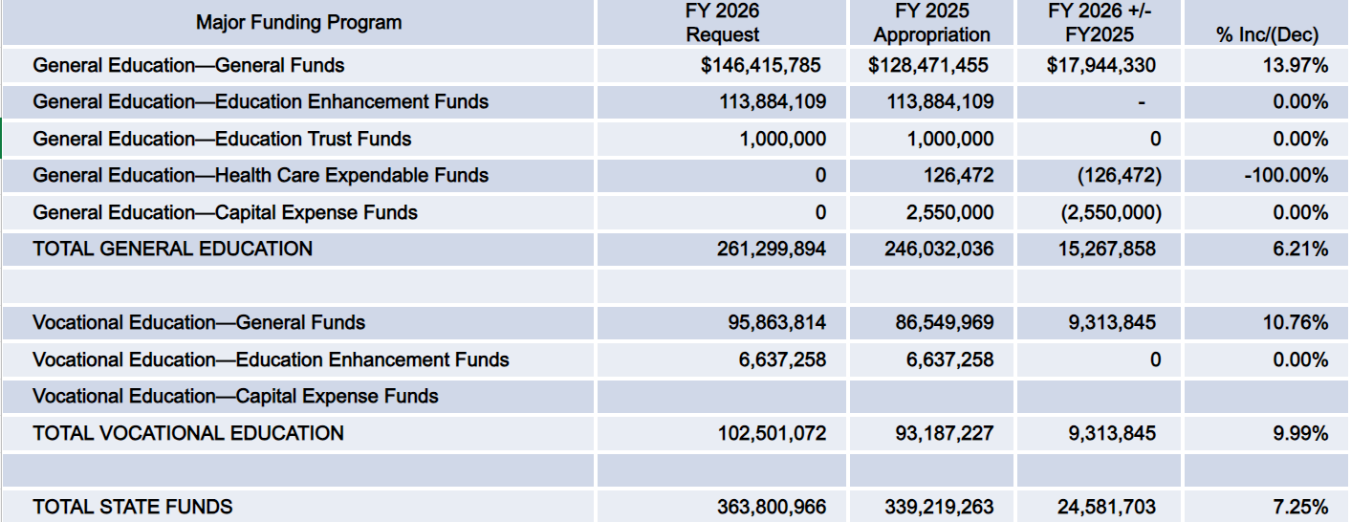
MDE FY 2026 Request - State Funds Summary
General Education (including MSA, MSMS & MSDB) & Vocational Education (CTE)

Slide 14
Office of Chief Academic Officer – Budget Highlights
Expansion of Early Childhood Education Programs – $51.4M
The proposed budget reflects an increase in general funds of $6.7M over the FY25 funding level
The proposed budget will fund contract workers that help with coaching and Class Assessment Scoring System (CLASS) observations in state funded Pre-K programs
The proposed budget will fund an additional 48 early learning coaches to serve 40 Early Learning Collaboratives and 23 State Invested Pre-K programs (approximately 478 classrooms)
Funds will be used to support grants to communities to provide high-quality Pre-K programs

Slide 15
Office of Chief Academic Officer – Budget Highlights
Expansion of the Literacy-Based Promotion Act – $15.4M
The proposed budget reflects a minimal increase for operational expenditures
Provide professional development opportunities for educators focused on the implementation of evidence-based reading instruction and interventions across the state
Funding will continue to support literacy screeners, acceleration and intervention services, 3rd grade summative assessment training, development and administration, and grants to districts for Educators in Residence
School Attendance Officers (SAOs) – $9.3M
The proposed budget reflects an increase of $3.1M
The proposed budget reflects an increase to provide a School Attendance Officer (SAO) to each school district and increase salaries by 25%
Funds will be allocated to districts to assume the responsibility of employing SAOs

Slide 16
Office of Chief Academic Officer – Budget Highlights
Dropout Prevention – $114K
The request includes an increase of $100K for an additional position to serve as the Dropout Prevention Director to manage the Dropout Prevention Plans submitted by districts
Innovative Programs – $3.4M
The request includes an increase of $3M to reinstitute a college-and-career readiness platform and continuing the work of developing career-centered learning through the career academy model
Grants will be provided to support the work of Districts and Schools of Innovation through professional development, technical assistance and any support for future Districts of Innovation

Slide 17
Office of Chief Academic Officer – Budget Highlights
Mississippi School for Mathematics and Science (MSMS) – $5.6M
The request reflects an increase of $435K over FY25 level to include the cost of two new positions (Business Manager and Computer Science/Engineering position), the purchase of a school bus, renovations, improvements and an increase in operating costs​
Mississippi School of the Arts (MSA) – $4.1M
The request reflects an increase of $443K to include three additional positions (Nurse, General Service, and Resident Education Parent) and an increase in all operating costs (staff, security, food, facilities, utilities, maintenance, etc.)
Mississippi School for the Deaf & the Blind (MSDB) – $13.6M
The request reflects an increase of $1.6M over FY25 level to provide additional funds to cover the increasing cost of supplies (braille textbooks, utility, fuel, repairs and services because of inflation)

Slide 18
Office of Chief Academic Officer – Budget Highlights
Secondary Education: Middle/High School Innovation & Redesign – $665K
Requested increase of $282K will support Districts of Innovation implementation, counseling services and curriculum development
School Improvement – $650K
Requested increase of $287K will provide three full-time staff members to support low-performing schools and districts

Slide 19
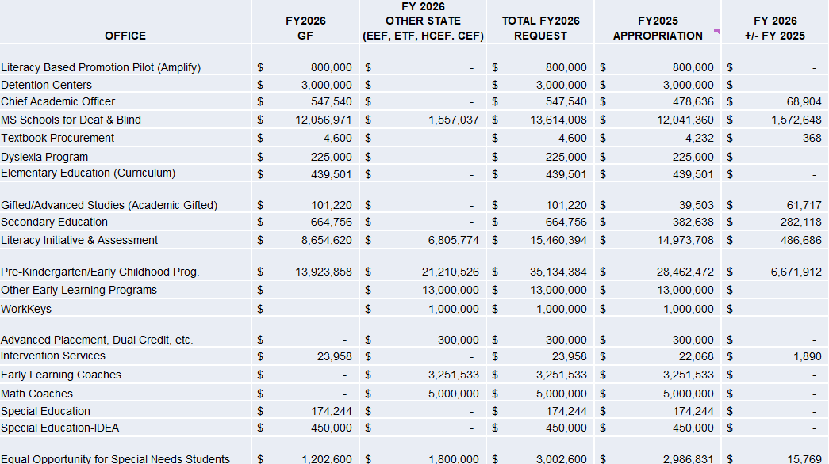
Office of Chief Academic Officer
Continued on next page

Slide 20
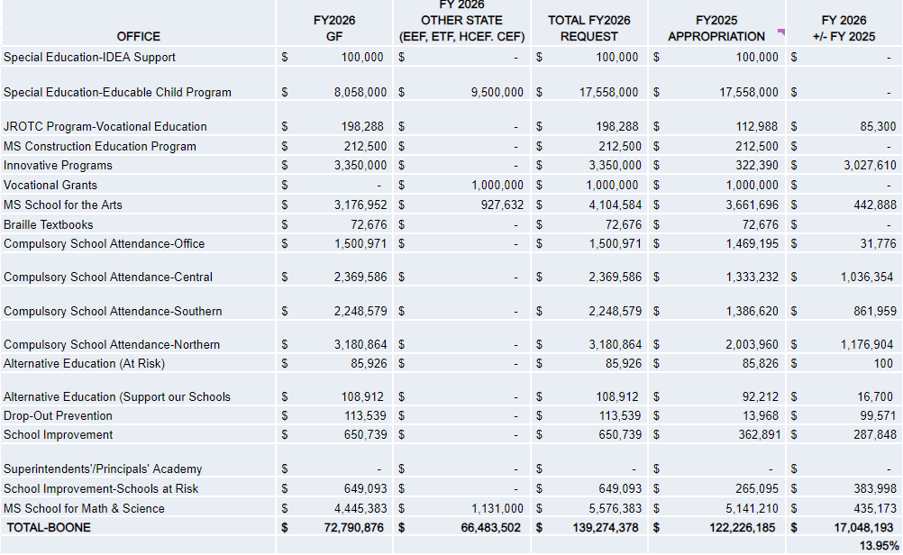
Office of Chief Academic Officer

Slide 21
Career & Technical Education – Budget Highlights
Career & Technical Education (CTE) – $103M
Request includes an additional $9.3M to expand funding for CTE programming at school districts, MS Community College Board, MS Department of Human Services and MS Department of Corrections

Slide 22
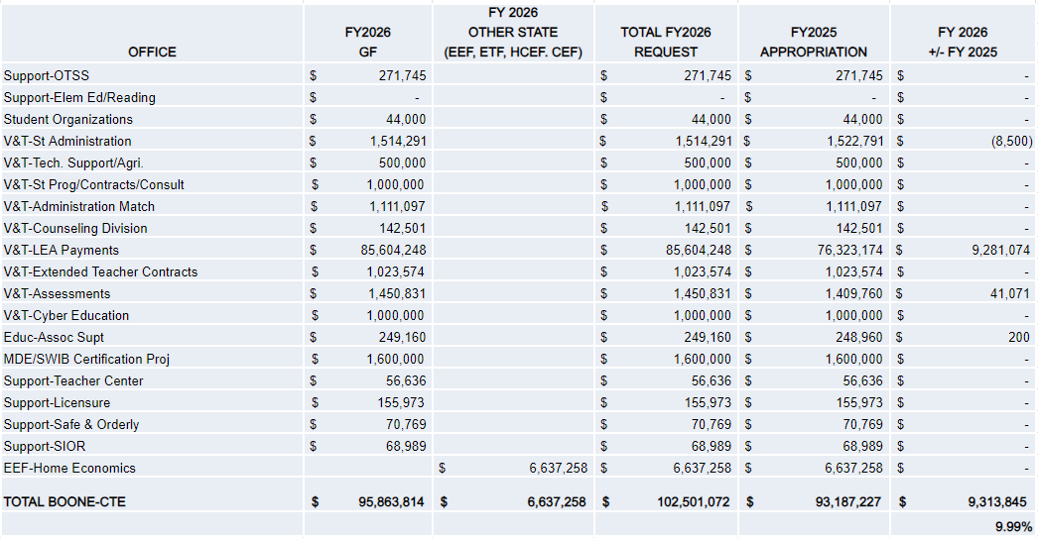
Career & Technical Education

Slide 23
Office of Chief Accountability Officer – Budget Highlights
Mississippi Community Oriented Policing Services (MCOPS) – $3M
The proposed budget reflects an increase in general funds of $1M over the FY25 funding level
Grants will be awarded for 199 School Resource Officers (SROs) to serve 410 schools in FY25 at $10K each, with matching local funds on a 50/50 basis
Additional funding will allow the MDE to grant awards to an additional 100 SROs in FY26 to serve schools within the local school districts
Statewide Assessment and Test Security – $11M
The proposed budget reflects an increase in general funds of $2.3M over the FY25 funding level
The increase in funding requested is to continue administering state and federally mandated assessment programs and to investigate allegations of test irregularities/cheating in accordance with Miss. Code Ann. § 37-16-4

Slide 24
Office of Chief Accountability Officer – Budget Highlights
Mississippi Teacher Residency Program (MTR) – $6.8M
The proposed budget reflects a request of $6.8M to continue the MTR for 189 residents enrolled in Cohorts 1-4. The MDE expanded MTR with ESSER funds by awarding funds to five Mississippi universities: Delta State University, Jackson State University, Mississippi State University, Southern Mississippi University, and William Carey University
Accreditation Audit Review Teams – $395K
The proposed budget reflects an increase in general funds of $372K over the FY25 funding level
The increased funding will provide the Office of Accreditation the additional capacity to conduct approximately 25 on-site reviews of compliance with accreditation standards and accountability requirements in accordance with state and federal law

Slide 25
Office of Chief Accountability Officer – Budget Highlights
Driver Penalty – $8.9M
Budget reflects an increase of $8.3M over the FY25 funding level
The increase in funding requested is in accordance with SB2695 to purchase equipment for driver education. The funds will add approximately 40 driver education simulators and four 5,500-ton trucks to move the simulators
Professional Development – $595K
Budget reflects an increase of $450K over the FY25 funding level
The increase in funding requested will support salaries and travel for four Professional Development Coordinators (PDCs) that serve as content specialists for the purpose of developing engaging training modules and instructional resources that will be delivered through online and face-to-face professional development. These services are administer as part of the Regional Service Delivery Model component through Regional Education Service Agencies (RESAs)

Slide 26
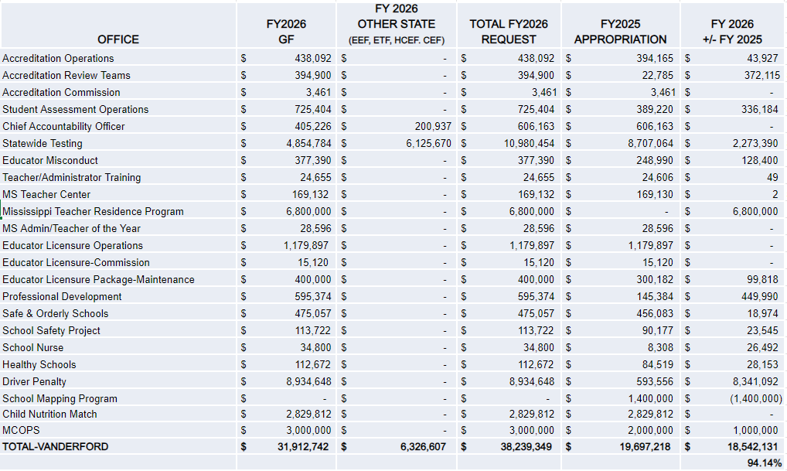
Office of Chief Accountability Officer

Slide 27
Office of Chief Information Officer – Budget Highlights
Office of Chief of Technology and Strategic Services – $8.4M
Budget reflects an increase of $5.2M over the FY25 funding level
The increase will be used to maintain professional services contracts with Guidesoft staff augmentation, license renewals, other contractual services, and to host MSIS district training (regional roadshows and bootcamps), and office operations
The increase will provide funds to refresh MDE desktops and laptops three-years or older and to purchase network equipment (servers, switches, firewalls, etc.)
The increase will provide support of the MDE E-Rate Program
The increase will provide consultant services for two Network Engineers to provide network and technical support to local school districts

Slide 28
Office of Chief Information Officer

Slide 29
Office of Educational Accountability Director – Budget Highlights
Office of Educational Accountability – $1.3M
Request includes an increase of $493K over FY25 level to restore funding for two positions and operations to FY17 and FY19 levels
Request includes an increase in funds to outsource projects in the Office of Educational Accountability in lieu of positions requested by the Bureaus of Program Evaluation, Public Reporting, and Internal Audit
Request includes an increase in funds for one additional position to conduct internal audits in the Bureau of Internal Audit

Slide 30
Office of Educational Accountability Director

Slide 31
Office of General Counsel
Office of General Counsel – $767K
Minimal increase of $74K for operational expenditures

Slide 32
Office of General Counsel

Slide 33
Office of Chief Operations Officer – Budget Highlights
Office of Chief Operations Officer – $6.2M
Request excludes $3.6M for flow through line items
Funding request reflects a $1M net increase for National Board Certification

Slide 34
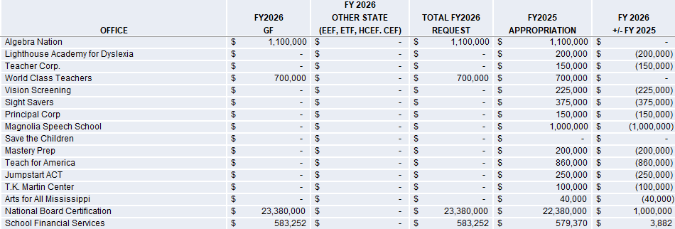
Office of Chief Operations Officer
Continued on next page

Slide 35
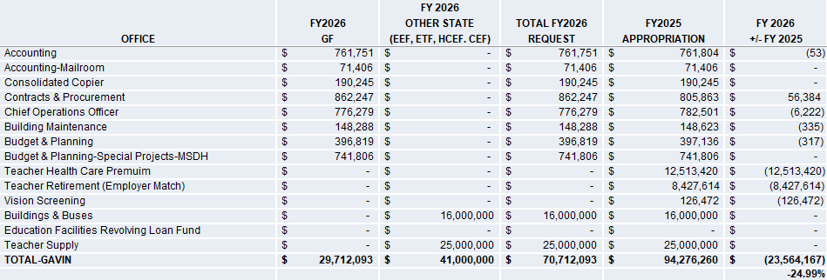
Office of Chief Operations Officer

Slide 36
Office of Chief of Communications/Gov’t Relations – Budget Highlights
Office of Chief of Communications & Government Relations – $611K
Minimal increase above the FY25 budget for operational expenditures

Slide 37
Office of Chief of Communications/Gov’t Relations

Slide 38
Office of State Superintendent – Budget Highlights
Office of State Superintendent – $1M
Includes State Board and State Superintendent
The office is requesting FY25 level funding

Slide 39
Office of State Superintendent

Slide 40
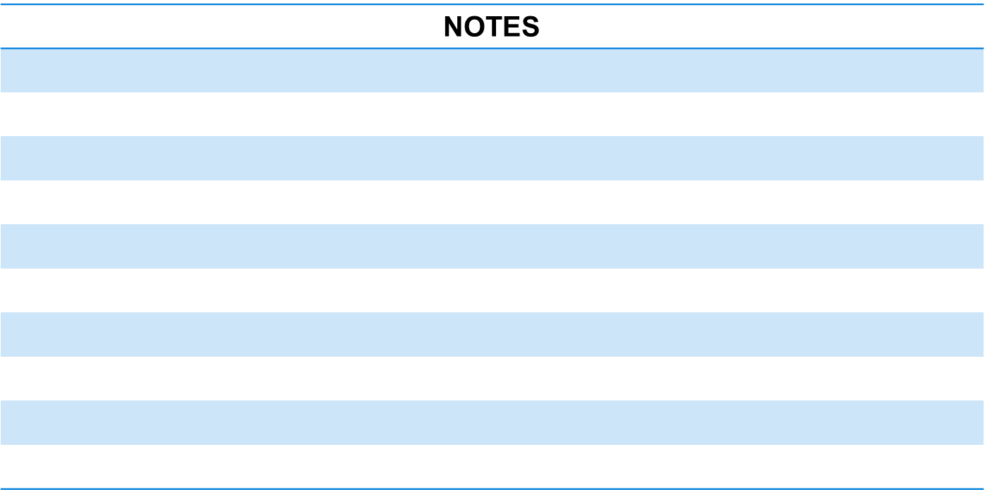
MDE FY 2026 Budget Request

