Slide 1
21st Century Community Learning Centers
Regional Technical Assistance Workshops
August 14-23, 2017
Farrah Nicholson & Dr. Sametra Brown
Office Director Division Director II
Office Phone: (601) 359-3499

Slide 3
State Board of Education Goals FIVE-YEAR STRATEGIC PLAN FOR 2016-2020
All Students Proficient and Showing Growth in All Assessed Areas
Every Student Graduates from High School and is Ready for College and Career
Every Child Has Access to a High-Quality Early Childhood Program
Every School Has Effective Teachers and Leaders
Every Community Effectively Uses a World-Class Data System to Improve Student Outcomes
Every School and District is Rated “C” or Higher

Slide 4
Office of Federal Programs’ Vision, Mission, and Goals
Vision The vision of Mississippi State Board of Education is to create a world-class educational system that gives students the knowledge and skills to be successful in college and the workforce, and to flourish as parents and citizens.
Mission In support of this vision, the mission of the Office of Federal Programs (OFP) is to provide leadership in the effective use of federal funds so that all students are prepared to compete in the global community.
Goal 1 To collaborate across the agency in support of state initiatives | Goal 2 To support district planning and implementation | Goal 3 To evaluate and monitor performance

Slide 5
PROGRAM PURPOSE
& GOALS

Slide 6
Program Purpose
Provide opportunities for academic enrichment activities during non school hours or periods when school is not in session
Offer families opportunities for active and meaningful engagement in their child’s education, including opportunities for literacy and related educational development

Slide 7
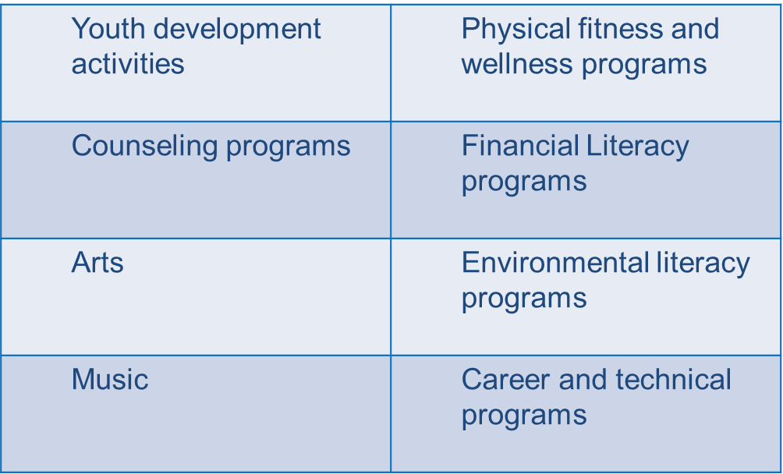
Program Purpose
Offer students a broad array of additional services, programs and activities that are designed to complement the regular academic program such as:

Slide 8
Program Goals
Provide opportunities for academic enrichment, including providing tutorial services to help students, particularly students who attend low-performing schools, to meet the challenging State academic standards (Mississippi State Board of Education Goals 1, 2, 3, 4, 5, and 6)

Slide 9
Program Goals
Offer students a broad array of additional services, programs, and activities, such as youth development activities, service learning, nutrition and health education, drug and violence prevention programs, counseling programs, arts, music, physical fitness and wellness programs, technology education programs, financial literacy programs, environmental literacy programs, mathematics, science, career and technical programs, internship or apprenticeship programs, and other ties to an in-demand industry sector or occupation for high school students that are designed to reinforce and complement that regular academic program of participating students (Mississippi State Board of Education Goals 1, 2, 3, 4, 5 and 6)

Slide 10
Program Goals
Offer families of students served by community learning centers opportunities for active and meaningful engagement in their children’s education, including opportunities for literacy and related educational development (Mississippi State Board of Education Goals 2 and 3)

Slide 11
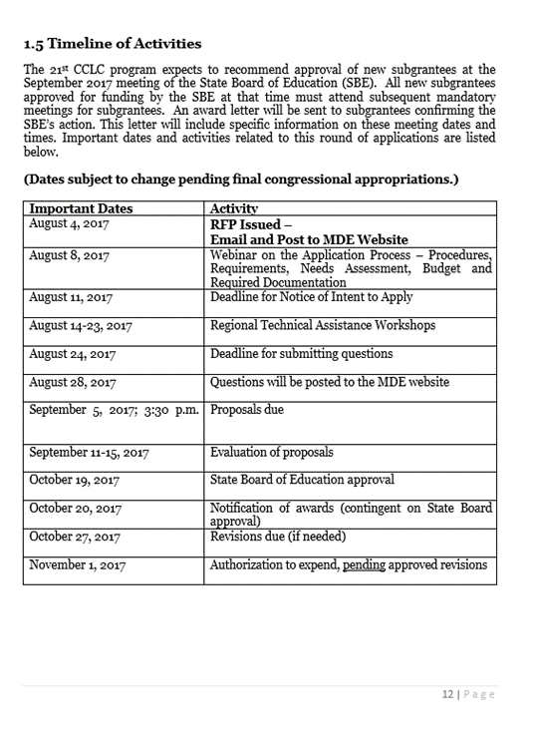
Timeline of Activities

Slide 12
REQUIREMENTS
& PROCEDURES

Slide 13
Requirements
REQUIRED ELEMENTS submitted in this order:
Signed Application Cover Sheet (Form 1)
Signed Assurances (Form 2)
Signed Private School Consultation (Form 3)
Signed Conflict of Interest (Form 4)
Competitive Priority Worksheet (Form 5)
Participation Letter(s) (Form 6)
Summary of Partners (Form 7)
Co-Applicant/Consortium (Form 8) (if applicable)

Slide 14
Requirements
REQUIRED ELEMENTS submitted in this order: (continued)
Abstract
Needs Assessment
Program Plan
Evaluation Plan
Budget Forms A, B, & C
Most recent Single or Program-specific Audit
Note: The narrative portions of the application should not exceed 15 pages.

Slide 15
Application Formatting
8.5” x 11” white paper using 12 point Times New Roman font (strong recommendation)
Formatted using 1”margins on all sides (strong recommendation)
Portrait setting (strong recommendation)
Landscape setting for Goals, Objectives, Activities, and Timeframe Table ONLY (strong recommendation)
Double-spaced and single-sided with grantee’s name and page number within the footer in the lower right-hand corner (strong recommendation)

Slide 16
Submission and Delivery
Submit one (1) non-stapled, complete original application with full original signatures preferably in blue ink and two (2) copies, secured solely by a single binder clip at the top
Submit 1 electronic copy saved to a USB flash drive in a “read only” format
Do not submit any documents using rubber bands, paperclips, staples, 3-ring or spiral binders, or envelopes
Assemble the application in the order presented in the Required Elements Checklist (Supplemental Form B) on page 45
Must be received by 3:30 p.m. on Tuesday, September 5, 2017 at the following address based upon the delivery method used

Slide 17
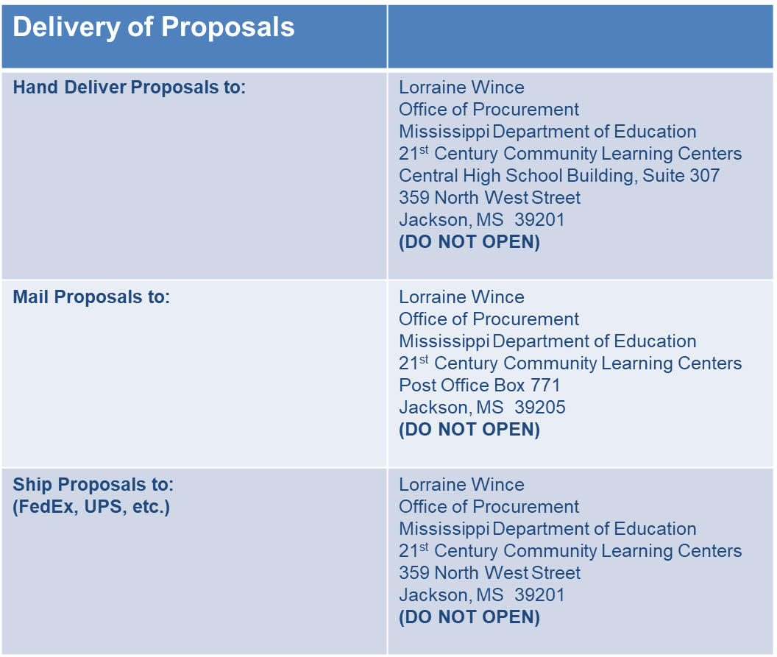
Submission and Delivery

Slide 18
Submission and Delivery
Offeror is responsible for and assumes all risks of delivery.
Proposals and modifications received after the time set will be considered late and will not be considered for award.
Upon receipt, the proposals will be date stamped and recorded in the Office of Procurement.
No faxed or emailed copies will be accepted.
Proposals must be signed by an authorized official to bind the offeror.
Please allow adequate time for parking and time to proceed through building security procedures.

Slide 19
Submission and Delivery
Incomplete proposals will not be evaluated.
No changes or additions to an application will be accepted once it is received by the MDE.
Submit only the requested information. Supplementary materials will not be reviewed nor returned to the applicant.
Applications that fail to contain any of the required elements will NOT be given to readers for scoring.
The final decision to award a grant rests solely with the MDE.

Slide 20
Submission and Delivery
All proposals will become the property of the MDE.
Proposals may be rejected.
A Complaint/Grievance Policy is in place.
Each sub grantee must maintain a written conflict of interest policy.

Slide 21
APPLICATION
DETAILS

Slide 22
Application Details
Eligibility Criteria
Local school districts, also referred to as local educational agencies (LEAs)
Charter schools
Indian tribe or tribal organization
Educational consortia
Non-profit agencies
City or county government agencies
Faith and community-based organizations
Institutions of higher education
For-profit corporations
All applicants MUST have an active DUNS number.

Slide 23
Application Details
Grants will be awarded in the name of the fiscal agent.
Previous grant recipients must be in good standing with MDE.
Funds awarded will be used for program activities that advance student achievement and support student success.
Applicants are obligated under Section 504 of the Rehabilitation Act, the Americans with Disabilities Act, and the Individuals with Disabilities Education Act to ensure accessibility to those persons with disabilities.

Slide 24
Application Details
Absolute priority will be given to applicants primarily serving students who attend schools with a high concentration of low-income students and families.
Competitive priority points will be awarded to those applicants meeting very specific criteria. These points will only be added after the minimum quality score of 80 has been met.

Slide 25
Application Details
The approved grant period of 3 years is contingent upon the availability of continued funding, evidence of documented progress, increased student achievement, and adherence to the annual program Assurances.
Programs must become operational within 30 days of the MDE award notification or within eight weeks from the first day of school, whichever is later.
Funds are subject to appropriations by the federal government.
All grants will be awarded for three years contingent upon proper implementation of the project.

Slide 26
Application Details
The MDE reserves the right to negotiate grant award amounts with all grantees.
Recipients will receive funding at 100% for the first and second years and 80% for year three pending congressional appropriations.
A formal sustainability plan is a requirement of the 21st CCLC program.
The MDE will collect all unobligated 21st CCLC funds at the end of the initial grant period and redistribute them to other participating sub-grantees.

Slide 27
Application Details
Funds can be used for:
Program implementation
Personnel and personnel benefits
Staff development and training
Consultants, subcontractors and evaluators
Classroom equipment, materials, and supplies
Intervention and remedial activities
Academic enrichment learning programs
Mathematics and science education activities
Arts and music education
Entrepreneurial education programs
Tutoring services and mentoring programs

Slide 28
Application Details
Funds can be used for:
Limited English proficient programs
Recreational activities
Telecommunications and technology education programs
Expanded library service hours
Parental involvement and family literacy programs
Truant, suspended, or expelled student programs
Drug and violence prevention programs
Counseling programs
Character education programs

Slide 29
Application Details
All applicants’ budgets MUST meet the following requirements:
A maximum of 20% of each year’s budget can be allocated for activities related to the administration of the 21st CCLC sub grant.
Administrative expenses should be within 20% of annual budget, and indirect cost rates are considered administrative expenses for this calculation.
A maximum 3% of each year’s budget can be allocated for the external evaluator.
This is a reimbursement only grant.

Slide 30
Application Details
Responsibilities of a Fiscal Agent
Must be adopted by the Local Board of Education for LEAs or the Board of Directors for non-LEAs
Administer the sub grant from award to closeout in accordance with all applicable laws and regulations
Serve as the organizational representative and point-of-contact for all business management aspects of the award agreement

Slide 31
Application Details
Responsibilities of a Fiscal Agent
Apply appropriate management controls using management systems, checklists, and records, including, but not limited to:
Internal controls
Operating controls
Accounting controls
Compliance controls
Document control system
Submit sub grant reimbursement requests no later than the 10th of every month
Eligibility of Expenditures
Notes:
Adhere to the list of eligible activities for which funds under the program may be spent, as well as allowable cost objectives in applicable cost principles; and
Ensure that transactions are made in a reasonable and prudent manner, are allowable and allocable, and avoid double charging and ensure that credits are applied appropriately.

Slide 32
Application Details
Responsibilities of a Fiscal Agent
Assemble appropriate staff resources and communicate all compliance requirements and resources of the sub grant
Keep abreast of changes in policies, procedures or requirements and continue to advise program staff of sub grant requirements
Request any further “prior approvals” when identified
Prepare necessary reports
Source Documentation
Audit trail
Notes:
Source Documentation
Appropriately support transactions entered into the sub grantee's system
Documentation tracks each sub grant transaction and supports the validity of financial data reported; and
Maintain separate funding lines for 21st CCLC funds
Audit Trail
The lowest level of detail the system should provide is documentation that supports all transactions (e.g., invoices, contracts, purchase orders);
The overall recordkeeping system should be able to trace financial statement balances through the sub grantee's general ledger, cash books and other journals; and
Amounts claimed on financial statements and reports accurately reflect the accounting books and records from which they were prepared.

Slide 33
Application Details
Responsibilities of a Fiscal Agent
Use feedback from site visits by the MDE to enhance the program, show organizational strength, and demonstrate commitment to the project
Keep the MDE and the public aware and informed about grant project progress
Evaluate the extent to which measurable project objectives are being met
Liquidate all obligations incurred under the award within the set deadline
Ensure and oversee the performance of final audits and resolution of findings
Establish adequate system for records retention

Slide 34
Application Details
Audit
Include a financial audit from the most recently completed fiscal year
Current FY17 programs required to include financial audit
Must be conducted by a certified public accountant or by an accountant certified as qualified to audit local government accounts
Must be performed in accordance with generally accepted auditing standards (GAAS)
Financial statements must be prepared in conformity with general accepted accounting principles (GAAP)
Single Audit Act Amendments of 1996 and 2 C.F.R. Part 200 Subpart F

Slide 35
Application Details
Program Reports and Evaluation
End-of-year evaluation report required no later than August 15th of each year
Program’s ongoing planning, design, and implementation
Evaluates specific targets that will enable the sub grantee to make informed decisions about changes that the program may need
Required to provide data through the U.S. Department of Education’s 21st CCLC data collection system (21 APR)
Must undergo a periodic evaluation to assess progress toward achieving its goal
Must be based on the factors included in the Measures of Effectiveness (Title IV-B, Section 4205)

Slide 36
Application Details
Program Reports and Evaluation
All programs or activities shall:
Be based upon an assessment of objective data regarding the need for before and after school (or summer recess) programs and activities in the schools and communities
Be based upon an established set of performance measures aimed at ensuring the availability of high-quality academic achievement opportunities
Be based upon evidence-based research that the program or activity will help students meet the challenging State academic standards and any local academic standards

Slide 37
Application Details
Program Reports and Evaluation
All programs or activities shall:
Ensure that measures of student success align with the regular academic program and the academic needs of participating students and include performance indicators and measures
Collect the necessary data necessary for the measures of student success
The results of the evaluation must be:
Used to refine, improve, and strengthen the program and to refine the performance measures
Made available to the public upon request
Used by the MDE to determine whether a sub grant is eligible to be renewed

Slide 38
Application Details
Equitable Participation of Private, Non-Public School Students
Must provide equitable services to eligible private, non-public schools students and their families
Must conduct timely and meaningful consultation with private and non-public school officials during the design and development of the 21st CCLC program
Private schools may apply for this grant and are likewise held to the standard requirements of equitable participation and timely and meaningful consultation

Slide 39
APPLICATION REVIEW
& SELECTION PROCESS

Slide 40
Application Review and Selection Process
Phase 1-Review of Application Components
Review of application to determine if all formatting and submission requirements are met
Phase 2-Reader Review and Scoring
A MDE authorized Peer Review Committee will evaluate and score each application based on the following:
Quality of the proposed activities
Evidence provided to demonstrate the capacity of the applicant to implement the proposed program
Program Abstract

Slide 41
Application Review and Selection Process
Phase 2 Reader Review and Scoring (continued)
Needs Assessment (20 Total Points)
The Process (4 Points)
Specific Needs (10 Points)
Program Focus (6 Points)
Budget (10 Total points)
Notes:
Discuss each component in detail

Slide 42
Application Review and Selection Process
Phase 2 Reader Review and Scoring (continued)
Program Plan and Implementation (60 Total Points)
Program Plan (20 Points)
Quality Contact Time (5 Points)
Recruitment and Retention (6 Points)
Staffing and Professional Development (6 Points)
Notes:
Discuss each component in detail

Slide 43
Application Review and Selection Process
Phase 2 Reader Review and Scoring (continued)
Program Plan and Implementation (60 Total Points)
Advisory Council and Operating Partnership (5 Points)
Collaboration and Communication (6 Points)
Student Safety and Transportation (6 Points)
Sustainability Plan (6 Points)
Evaluation (10 Total Points)

Slide 44
Application Review and Selection Process
Evaluation
Expected Reporting Outcomes-Formative Evaluation Requirement
All programs MUST indicate how each activity satisfies the measures of effectiveness.
Programs must be based upon the following:
An assessment of objective data regarding the need for before and after school (including summer school programs) programs and activities in schools and communities
An established set of performance measures aimed at ensuring quality academic enrichment opportunities
Where appropriate, evidence-based research that provides evidence that the program will help students meet the State academic achievement standards

Slide 45
Application Review and Selection Process
Evaluation
Expected Reporting Outcomes-Formative Evaluation Requirement (continued)
Must be based on the measures of effectiveness
Must include quantitative and qualitative data collection
Must be used to refine, improve, and strengthen program
Must be made available to the public upon request
Must be documented in written reports by the external evaluators and submitted to the MDE no later than February 1 of each year
The following elements must be included at a minimum:
-Student attendance -Objective assessment
-Program operation -Recommendations
Notes:
Data on average daily attendance and enrollment at each site
Synopsis of current level of operation at each site
Data analysis and indication of progress towards achieving EACH objective, all objectives must include measures that allow for continuous (formative) assessment
Recommendations for programmatic refinement for all objectives where progress is not being achieved and/or where the program is not likely to achieve the stated objective by the end of the program year

Slide 46
Application Review and Selection Process
Evaluation
Expected Reporting Outcomes-Summative Evaluation Requirement
Summative Evaluation Report is required of all 21st CCLC programs
Must submit an annual summative evaluation report by August 15
Report MUST provide a detailed summary of the program and progress towards meeting each stated objective
Must include data collected during the 2017-2018 school year
Must include, at minimum, the following:
-Overview and history -Objective assessment
-Student attendance and enrollment -Other observations (optional)
-Program operation -Progress towards sustainability
-Quality of staffing -Overall recommendations
Notes:
Provide a general overview of the 21st CCLC program, including a history of previous operation and how the program has progressed and improved over the past year(s) of operation
Total and regularly-participating student enrollment (per site)
Student demographics (e.g., gender, ethnicity)
Average daily attendance (per site) Within the grant application, 21st CCLC programs proposed goals, objectives, and methods of evaluating progress towards achieving the objectives. The summative report must include detailed information and assessment fore each objective approved by the MDE (e.g., activities, data collected, timeline, analysis, and results
If appropriate, provide other relevant findings pertaining to this 21st CCLC program. Other findings could include qualitative and/or quantitative data to related to specific objectives; quotes, and/or statements from students, parents, and/or teachers; success stories of students within the program; and photographs demonstrating unique program activities and services. Programs may also include results and outcomes based upon the Mississippi College and Career Ready Standards to improve, refine, and strengthen the 21st CCLC program.
The summative report must assess the program’s progress towards following the sustainability plan and provide current information about program partnerships (e.g., partnership development, partner maintenance, and contributions to the program)

Slide 47
FORMS

Slide 48
Farrah Nicholson
Office Director
fnicholson@mdek12.org

Slide 49
Dr. Sametra D. Brown
Division Director II
schisolm-brown@mdek12.org

Slide 50
Questions
21century@mdek12.org
Office Phone: (601) 359-3499

