Slide 1
Dual Credit/Enrollment
2021-2022 MSIS Changes
Heather Morrison
Director P20 Partnerships, MDE/IHL
Date

Slide 2
State Board of Education STRATEGIC PLAN GOALS

Slide 3
Mississippi Department of Education

Slide 4
Dual Credit Academic MSIS Changes 2021-2022
Beginning with the 2021-2022 school-year, dual credit (DC) academic courses not listed on the DC approved course listing will be coded based on one of the eight community college pathway names
  Agriculture, Construction, Manufacturing and Transportation
  Arts and Humanities
  Business
  Education
  Health Science and Nursing
  Hospitality and Human Services
  Public Safety and Administration
  Science, Technology, Engineering, and Mathematics

Slide 5
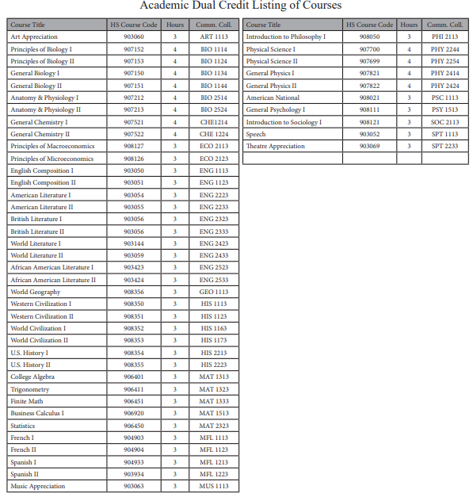
http://www.mississippi.edu/cjc/downloads/dual_credit_course_listing.pdf
Dual Credit Academic Approved Course Listing
Notes:
Please note a full list will be available on the MDE Accelerated Programs Webpage under Secondary Education

Slide 6
Dual Credit Career and Technical MSIS Changes 2021-2022
Beginning with the 2021-2022 school-year, all DC CTE MSIS codes will be deleted except for a limited number of courses
CTE dual credit (DC) courses will be coded based on one of the eight community college pathway names
  Example: DC Child Development CDT 1713 = CTE Education Pathway MSIS 920155
If a student is a DC completer, the DC CTE Pathway Completer code should be utilized

Slide 7
Examples of CTE Dual Credit MSIS Changes
CC CTE Pathway | Pathway | MSIS Code
Agriculture, Construction, Manufacturing, And Transportation Pathway CTE Pathway | Agriculture, Construction, Manufacturing, And Transportation CTE Pathway | 902014
Agriculture, Construction, Manufacturing, And Transportation CTE Pathway (Completer) | Agriculture, Construction, Manufacturing, And Transportation CTE Pathway | 920110
Arts And Humanities CTE Pathway | Arts And Humanities CTE Pathway | 920145
Arts and Humanties CTE Pathway (Completer) | Arts And Humanities CTE Pathway | 920112
Business CTE Pathway | Business CTE Pathway | 920150
Business CTE Pathway (Completer) | Business CTE Pathway | 920115
Education CTE Pathway | Education CTE Pathway | 920155
Education CTE Pathway (Completer) | Education CTE Pathway | 920120
Health Science & Nursing CTE Pathway | Health Science & Nursing CTE Pathway | 920160
Health Science & Nursing CTE Pathway (Completer) | Health Science & Nursing CTE Pathway | 920125
Hospitality And Human Services CTE Pathway | Hospitality And Human Services CTE Pathway | 920165
Hospitality And Human Services CTE Pathway (Completer) | Hospitality And Human Services CTE Pathway | 920128
Public Safety & Administration CTE Pathway | Public Safety & Administration CTE Pathway | 920170
Public Safety & Administration CTE Pathway (Completer) | Public Safety & Administration CTE Pathway | 920130
Notes:
Please note a full list will be available on the MDE Accelerated Programs Webpage under Secondary Education

Slide 8
Dual Credit Academic and CTE MSIS Changes 2021-2022
Districts may duplicate the academic and CTE DC Pathway Codes if the local code and section numbers are different
Districts should enter the exact community college course name within the SMS

Slide 9
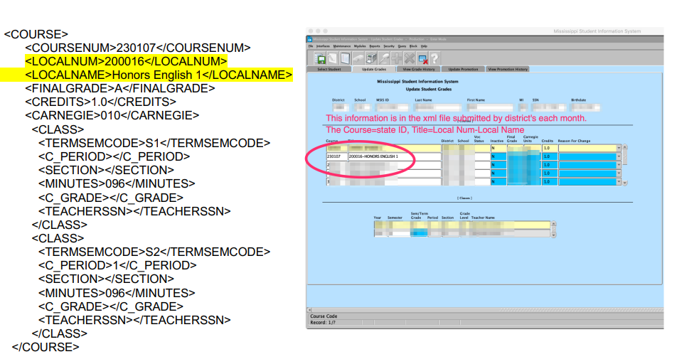
LOCAL Number and Section Example

Slide 10
Mywayms.org and Pathways
mywaymississippi.org
  Planning My Way
  Career Pathways
  Click here to see career pathways
    Page is divided in the 16 national career clusters
    Each career cluster funnels into one of the eight community college pathways
      Example: Agriculture, Food, and Natural Resources = Agriculture, Construction, Manufacturing, and Transportation Pathway (MS CC name)
      Click on read more to determine the CC academic and career technical programs under each pathway

Slide 11
Questions concerning Dual Credit
Heather Morrison
Director of P20 Partnerships
hmorrison@mississippi.edu

