Slide 1
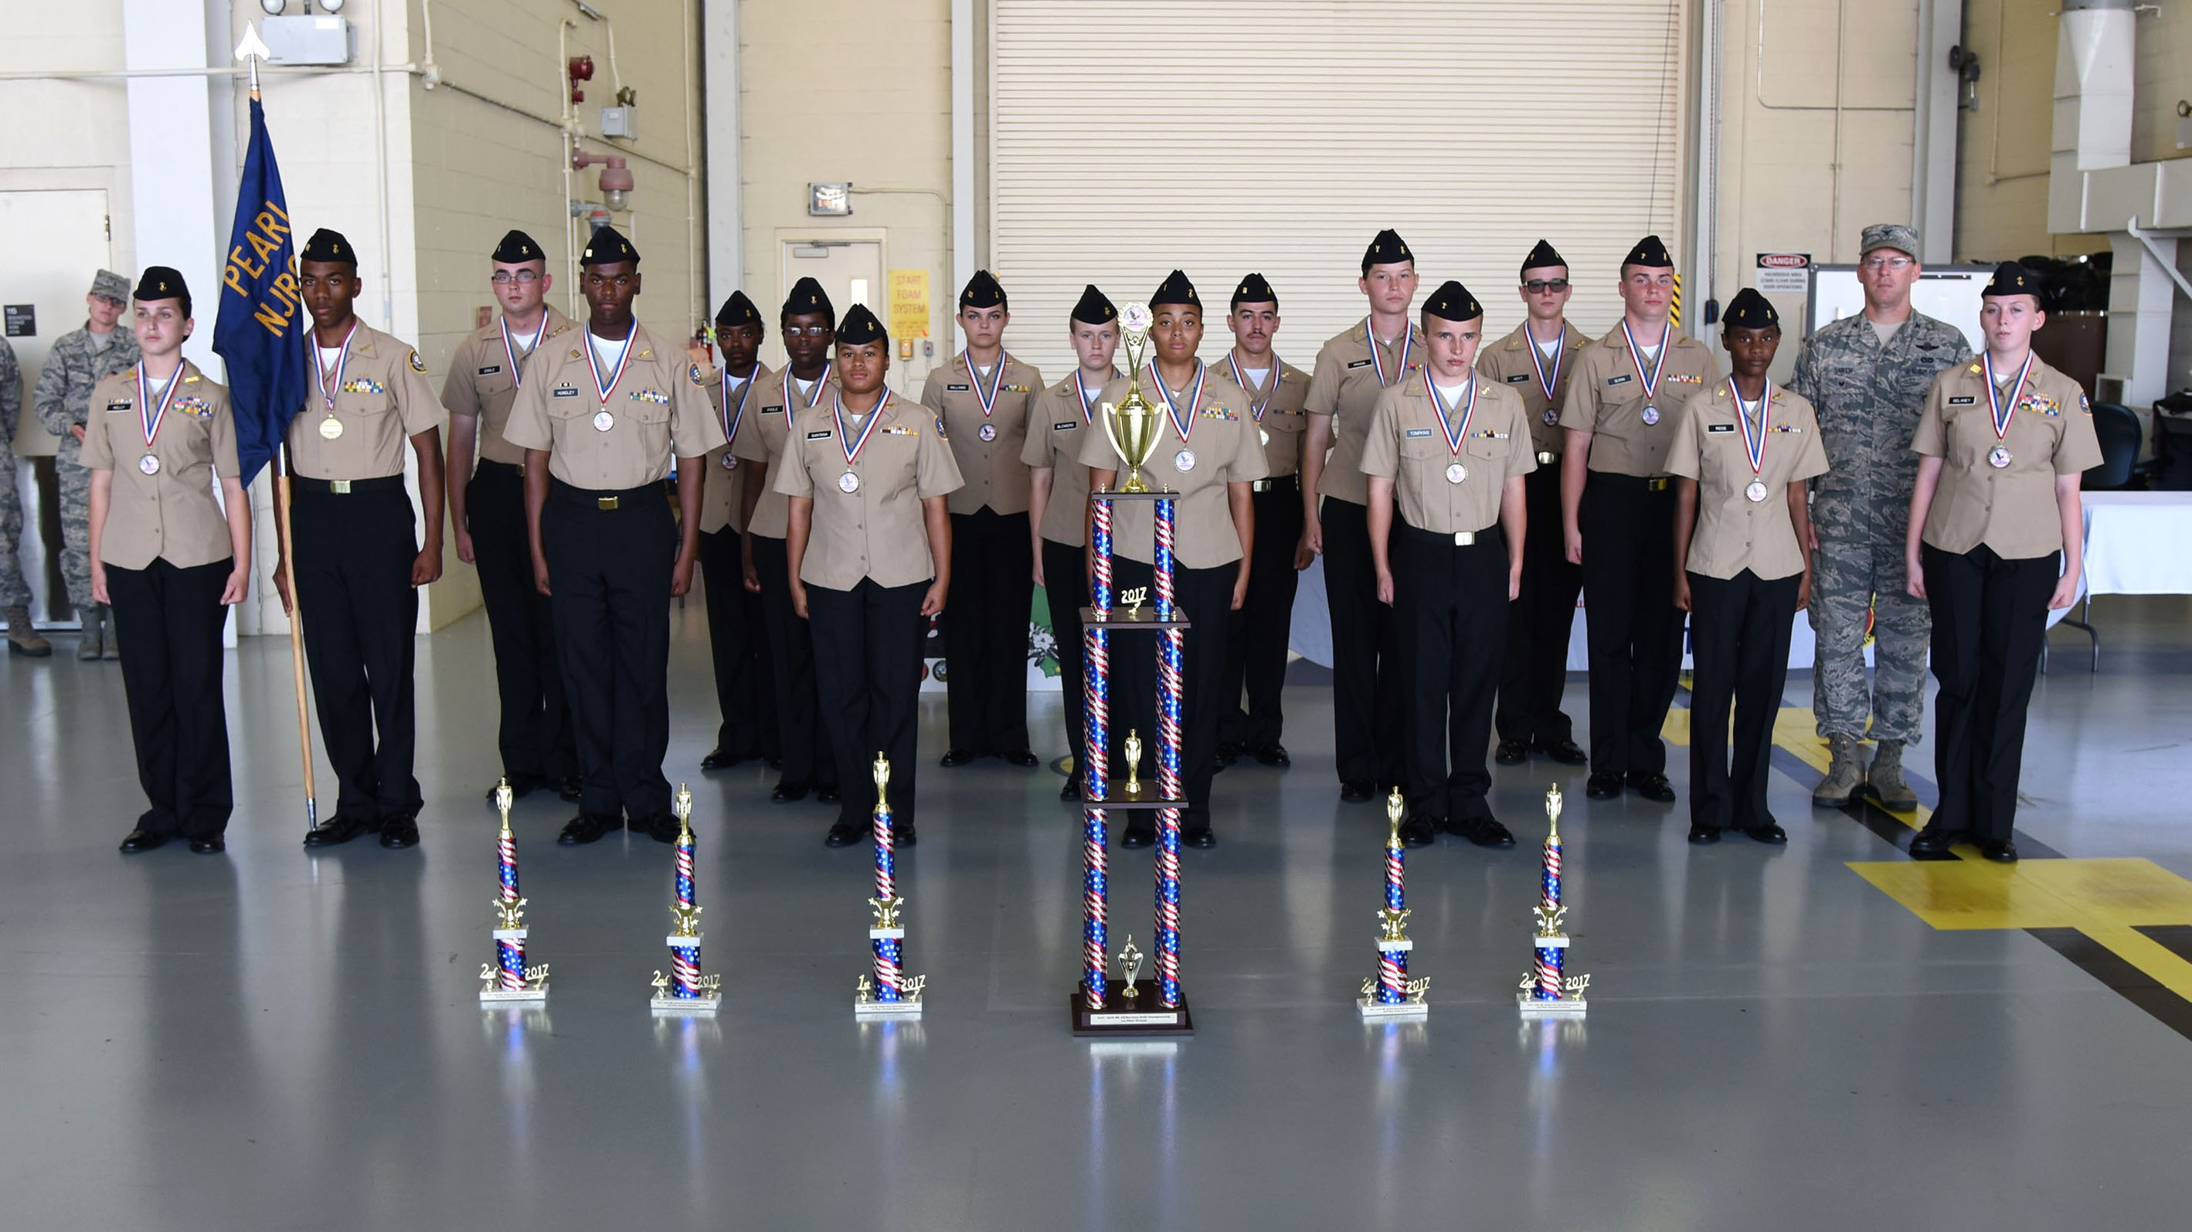
Col C. Mike Smith, Vice Commander, 81st Training Wing, Keesler AFB, MS (right) with the members of Pearl High School’s Navy JROTC Drill Team. Pearl won the 2017-2018 MS All-Services JROTC Drill Championship at Keesler AFB on 4 Nov 2017. This exceptional group of young men and women won 1st overall, 2nd in Color Guard, 2nd in Personnel Inspection, 2nd in Armed Regulation, 1st in Unarmed Regulation, and 2nd in Unarmed Exhibition.

