Slide 1
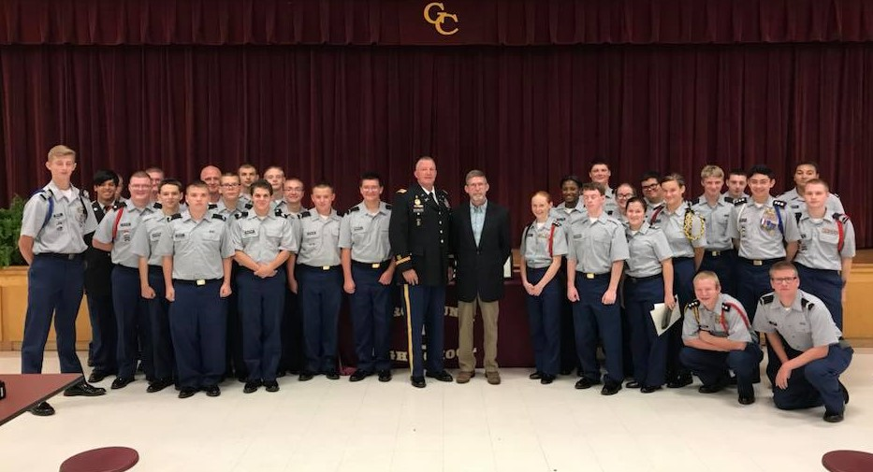
The George County High School Army JROTC "Rebel Battalion" hosted their annual Veteran's Day Breakfast for the veterans of George County. Cadets in attendance presented letters and recognition pins to the Vets in appreciation for their service to our great country. The Keynote speaker for this event was Special Agent James M. Burton from the Gulfport F.B.I. Field Office. Agent Burton, a veteran of the 1st Persian Gulf War and Army Officer spoke to the students about the military attribute of never giving up. A point known and understood by all Veterans. Great job to MAJ Spangler, SFC Williams and GCHS cadets!

