Slide 1
Effective Instructional Practices in Exemplar Units
Mathematics

Slide 2
Mississippi Board of Education
Vision
To create a world-class educational system that gives students the knowledge and skills to be successful in college and the workforce and to flourish as parents and citizens
Mission
To provide leadership through the development of policy and accountability systems so that all students are prepared to compete in the global community
2

Slide 3
Board Strategic Plan Goals
All Students Proficient and Showing Growth in All Assessed Areas
Every Student Graduates From High School and is Ready for College and Career
Every Child Has Access to a High-Quality Early Childhood Program
Every School Has Effective Teachers and Leaders
Every Community Effectively Using a World-Class Data System to Improve Student Outcomes
Every School and District is Rated “C” or Higher
3

Slide 4
Getting to Know You
Share a few things
about yourself:
Name
School/District
Grade Level
Reason for coming today

Slide 5
Session Goals
During this training, participants will
identify and discuss the major elements and qualities of an exemplar unit.
develop an understanding of effective content-specific instructional practices in exemplar units.
discuss how to make informed instructional decisions concerning instructional units.
Notes:
On this slide, briefly touch on the goals of the day.

Slide 6
Session Norms
Silence your cell phones.
Do not hesitate to ask questions.
Be willing to share with other participants throughout the day.
Notes:
These are the norms we are asking the teachers to follow during the training session. ​
When asking them to silence, tell them you understand things come up, but to please step outside if they need to use their phone during the session. ​
Groups will be less than 25, but some participants may be less willing to share than others. Encourage them to ask if they need clarification or to write their question on a post-it note so you can make sure everyone leaves with a solid understanding of exemplar units. ​
Point out the parking lot/poster broken up into the 4 elements. Ask participants to add post-its with questions to each section as they come up if they want something addressed when it’s not being discussed. ​
Explain that we will be asking them to share at their table and with partners across the room. Ask they are willing to share with their partners and are active listeners as well.​
​

Slide 7
Agenda
8:00 a.m. Registration
8:30 a.m. Introductions, Agenda, Overview, Clock Partners
8:40 a.m. Unit Preview
9:00 a.m. Effective Instructional Practices in Exemplar Units: Alignment to the MS CCRS
9:45 a.m. Break
10:00 a.m. Effective Instructional Practices in Exemplar Units: Key Shifts
11:00 a.m. Lunch
Notes:
Tell participants they should have received a copy of the agenda when they signed in, but you want to reinforce the schedule.​
Lunch will be from 11-12:15, and you will start promptly at 12:30, so please plan to be on time.

Slide 8
Agenda
12:30 p.m. Effective Instructional Practices in Exemplar Units: Key Shifts (Continued)
1:00 p.m. Continue Effective Instructional Practices in Exemplar Units: Instructional Supports
2:00 p.m. Break
2:15 p.m. Continue Effective Instructional Practices in Exemplar Units: Assessment
3:00 p.m. Reflection and Plan of Action
3:15 p.m. Closing Remarks
3:30 p.m. Dismissal

Slide 9
Clock Partners
Stand up.
Grab your clock sheet and a pen.
Find a partner for the different appointment times:
12 o’clock
3 o’clock
6 o’clock
9 o’clock
You and your partner will write each other’s names in the appointment slot.
Notes:
At this time, teachers will complete the clock partner activity sheet to determine who they will be working with throughout the day. ​
Instruct teachers to find their clock sheet and something to write with. They will then walk around the room and find someone to fill each appointment space on their sheet following the guidelines above. ​
If there is no one in the room that matches that description, find the closest option. ​

Slide 10
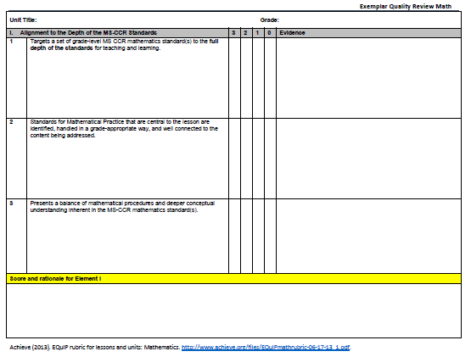
Today’s Documents
Exemplar Quality Review Packet
Mississippi Unit
Notes:
At this time, make sure everyone identifies the two documents.
Starting with the Exemplar Quality Review Packet:
Give participants time to highlight the headers, each in a different color: Alignment, Key Shifts, Instructional Support, and Assessment. This will alleviate confusion when you get to Instructional Supports since it’s 2 pages long.
Guide participants to the last page with the Key to Scoring.
Ask them to highlight the words “most to all,” “many,” “some,” and “does not meet” for Element I. Explain that a unit must score a 2-3 to move on to the other Elements.
Repeat this process for the Element II, III, IV Scoring.
Explain to participants that the score for each Element will be a rounded average for all standards within the Element, but the Final Score will be the total of the Elements.
Click to bring up the MS Exemplar Units:
Briefly explain the Kellogg Grant and the writing process.
Explain to teachers that we will be analyzing these units using the Exemplar Quality Review Packet.
Ask teachers at this time to use the Post-It flags to mark the pages where the Overview and each lesson begins to help them navigate the units easier throughout the day.
Reassure the teachers that while this may seem to be an overwhelming amount of paper, the MDE website has these organized to print one lesson at a time.

Slide 11
Mississippi Unit Scan
Locate the Mississippi Unit for your grade level.
Focusing only on the Unit Overview and Lesson 1, annotate the unit using the symbols shown on the next slide.
Be prepared to share your findings.
Notes:
Give 15 minutes to look through the overview and lesson 1.
Create an anchor chart of ideas shared from annotations.

Slide 12
Annotating the MS Unit

Slide 13
Effective Instructional Practices in Exemplar Units

Slide 14
Four Major Elements of a Unit
Alignment to the Depth of the MS CCRS
Key Shifts in the MS CCRS
Instructional Supports
Assessment
Notes:
These four elements are the Dimensions from the EQuIP Rubric. We wanted to use language our teachers would feel a little more comfortable with, so we are calling them elements and not referring to EQuIP until the end of the PowerPoint. ​
Ask teachers to talk with their table about what each of these elements means to them, then based on the conversations you heard while walking around, select tables to share out what was discussed. ​
When walking around, listen for tables who discuss: ​
1. Content, Scaffolding Document, and being Grade Appropriate​
2. Focus, Coherence, and Rigor www.corestandards.org/other-resources/key-shifts-in-mathematics/​ AND ELA shifts Balanced literacy, Grade appropriate text, Write to text, and Vocabulary http://www.mde.k12.ms.us/docs/secondary-education/ela-student-shifts77BBA44F71D5.pdf?sfvrsn=2
3. Technology/media, precise language, concrete and abstract models, productive struggle, questioning, differentiates, scope and sequence…​
4. Formative assessment throughout, rubrics, answer keys, unbiased, various assessments. ​

Slide 15
Alignment to the Depth of the MS CCRS
Notes:
This session is 45 minutes. ​
Remind participants that alignment refers to the content, best practices, and grade appropriateness.​

Slide 16
Clock Partner Sharing
Find your 12 o’clock partner and discuss what each of the traits in the Alignment Element on the Exemplar Quality Review packet means to you.
Ask yourselves:
“What would evidence
of each trait look like?”
Notes:
Participants can write responses on post-its or on the left side of the Exemplar Quality Review Packet underneath the standards.

Slide 17
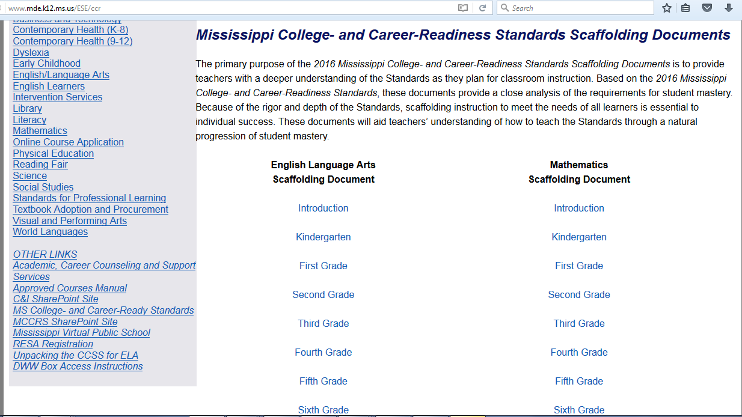
Scaffolding Documents
Notes:
Explain how the scaffolding documents can help to meet this exemplar quality.

Slide 18
Standards for Mathematical Practice
Make sense of problems and persevere in solving them.
Reason abstractly and quantitatively.
Construct viable arguments and critique the reasoning of others.
Model with mathematics.
Use appropriate tools.
Attend to precision.
Look for and make use of structure.
Look for regularity in repeated reasoning.
Notes:
Take time to break down the 8 SMPs for teachers.
Typically they struggle to understand 2, 7, and 8.

Slide 19
Finding a Balance
Mathematical Procedures
Exploration
Deeper Conceptual Understanding
Skills
Notes:
Often, it’s easy to lean too far in one direction or another. Exemplar Units find a balance between conceptual understanding and procedural fluency.

Slide 20
Finding Evidence: Alignment to the Depth of the MS CCRS
Locate the Mississippi Unit for your grade level and the Exemplar Quality Review packet.
Focus on the first major element: Alignment to the Depth of the MS CCRS.
Work with others to identify evidence and discuss which parts are of exemplar quality.
Record your findings on the Exemplar Quality Review packet with your table group.
Notes:
Now that the facilitator has modeled how to find and cite evidence, have the participants locate the MS UNIT and QUALITY packet. ​
They will now work with their table to find evidence to support the units exemplar status. ​
​
Have tables share their findings and facilitate a whole group discussion on the MS units​

Slide 21
Share Out

Slide 22
Teacher Growth Rubric:
Alignment to the Depth of Standards
Notes:
Allow time to discuss how verifying Alignment can help move them towards being a Level 4 teacher in Standard 1.
Key Point:
The Mississippi Educator and Administrator Professional Growth System is designed to facilitate continuous improvement in practice. The system can be referred to as the Professional Growth System.

Slide 23
Key Shifts in the MS CCRS
Notes:
This session is 1 hour long. ​
​
Remind teachers that when we discuss the Key shifts, we are referring to the focus, coherence and the rigor of the unit.

Slide 24
Clock Partner Sharing
Find your 3 o’clock partner and discuss what each of the traits in the Key Shifts Element on the Exemplar Quality Review packet means to you.
Ask yourselves:
“What would evidence
of each trait look like?”

Slide 25
Key Shifts
Focus
Coherence
Rigor
Stays on grade level
Additional standards support focus
High expectations
Connections to other clusters, domains, or prior grades
Clearly fits together
Skills aren’t taught in isolation
Application
Conceptual Understanding
Procedural Fluency

Slide 26
Finding Evidence: Key Shifts in the MS CCRS
Locate the Mississippi Unit for your grade level and the Exemplar Quality Review packet.
Focus on the second major element: Key Shifts in the MS CCRS.
Work with others to identify evidence and discuss which parts are of exemplar quality.
Record your findings on the Exemplar Quality Review packet with your table group.
Notes:
Now that the facilitator has modeled how to find and cite evidence, have the participants locate the MS UNIT and QUALITY packet. ​
They will now work with their table to find evidence to support the units exemplar status. ​
​
Have tables share their findings and facilitate a whole group discussion on the MS units​

Slide 27
Share Out

Slide 28
Teacher Growth Rubric:
Key Shifts in the MS CCRS
Notes:
Allow time to discuss how verifying Key Shifts can help move them towards being a Level 4 teacher in Standard 4
Key Point:
The Mississippi Educator and Administrator Professional Growth System is designed to facilitate continuous improvement in practice. The system can be referred to as the Professional Growth System.

Slide 29
Instructional Supports
Notes:
This session is 1.5 hours long. ​
​
Remind teachers that when we discuss the instructional supports, we are talking about the actual support a teacher gets in how to teach and differentiate.

Slide 30
Clock Partner Sharing
Find your 6 o’clock partner and discuss what each of the traits in the Instructional Supports Element on the Exemplar Quality Review packet means to you.
Ask yourselves:
“What would evidence
of each trait look like?”

Slide 31
Instructional Support
Standards for
Mathematical Practice
Differentiation
Questioning
Grouping
Progression
Problem Solving
Removal of Supports
Notes:
Embedding the Standards for Mathematical Practice in your activities can help provide students with the Instructional Supports addressed in this Element.
This matrix provides examples of support that work together to improve instruction and drive student learning.

Slide 32
Finding Evidence: Instructional Supports
Locate the Mississippi Unit for your grade level and the Exemplar Quality Review packet.
Focus on the third major element: Instructional Supports.
Work with others to identify evidence and discuss which parts are of exemplar quality.
Record your findings on the Exemplar Quality Review packet with your table group.
Notes:
Now that the facilitator has modeled how to find and cite evidence, have the participants locate the MS UNIT and QUALITY packet. ​
They will now work with their table to find evidence to support the units exemplar status. ​
​
Have tables share their findings and facilitate a whole group discussion on the MS units​

Slide 33
Share Out

Slide 34
Teacher Growth Rubric: Instructional Supports
Notes:
Allow time to discuss how verifying Instructional Supports can help move them towards being a Level 4 teacher in Standard 2.
Key Point:
The Mississippi Educator and Administrator Professional Growth System is designed to facilitate continuous improvement in practice. The system can be referred to as the Professional Growth System.

Slide 35
Family Guides for Student Success
Notes:
Explain how to use these books to accomplish this domain and standard.

Slide 36
Assessment
Notes:
This session is 45 minutes long. ​
​
Remind teachers that when we discuss the assessments, we are looking for unbiased, variety, and rubrics/answer keys provided.​
​

Slide 37
Clock Partner Sharing
Find your 9 o’clock partner and discuss what each of the traits in the Assessment Element on the Exemplar Quality Review packet means to you.
Ask yourselves:
“What would evidence
of each trait look like?”

Slide 38
Assessment Evidence
Assessments
provide observable evidence of the degree a student can independently demonstrate mastery.
are accessible and unbiased.
include rubrics, answer keys, and scoring guidelines.
varied modes of:
pre-assessment,
formative assessment,
summative assessment, and
self-assessment.
Notes:
Each of these explains an aspect of assessment teachers need to consider when determining Exemplar Quality.
This slide is read as:
Assessments provide… (Discuss what evidence is required for this)
Assessments are accessible and unbiased (Discuss accessibility of materials and unbiased including experiences, grade-level, gender, interests)
Assessments include rubrics… (Discuss how rubrics should be objective and leave no wiggle room for biases)
Assessments include varied modes of…(discuss how pre-assessments should be used to guide decisions, what types of formative assessments they maybe looking for, why self-assessment might help guide instruction, and the performance task)

Slide 39
Finding Evidence: Assessments
Locate the Mississippi Unit for your grade level and the Exemplar Quality Review packet.
Focus on the fourth major element: Assessment.
Work with others to identify evidence and discuss which parts are of exemplar quality.
Record your findings on the Exemplar Quality Review packet with your table group.
Notes:
Now that the facilitator has modeled how to find and cite evidence, have the participants locate the MS UNIT and QUALITY packet. ​
They will now work with their table to find evidence to support the units exemplar status. ​
​
Have tables share their findings and facilitate a whole group discussion on the MS units​

Slide 40
Share Out

Slide 41
Teacher Growth Rubric: Assessments
Notes:
Allow time to discuss how verifying Assessment can help move them towards being a Level 4 teacher in Standard 3.
Key Point:
The Mississippi Educator and Administrator Professional Growth System is designed to facilitate continuous improvement in practice. The system can be referred to as the Professional Growth System.

Slide 42
Feedback on Mississippi Units
Notes:
This part is only 15 minutes total.

Slide 43
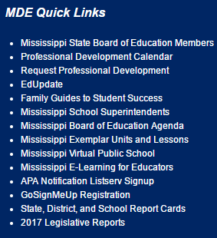
Provide Feedback
Go to www.mdek12.org.

Slide 44
Provide Feedback
Once you have reviewed and/or used the unit, provide feedback.

Slide 45
Reflection and Plan of Action
Notes:
This part is only 15 minutes total.

Slide 46
3-2-1 Strategy
Jot down:
3 things you learned today,
2 components of exemplar quality you will look for when selecting units, and
1 idea we discussed that you want to know more about.

Slide 47
Resources
Notes:
This part is only 15 minutes total.

Slide 48
Exemplar Resources

Slide 49
Exemplar Resources

Slide 50
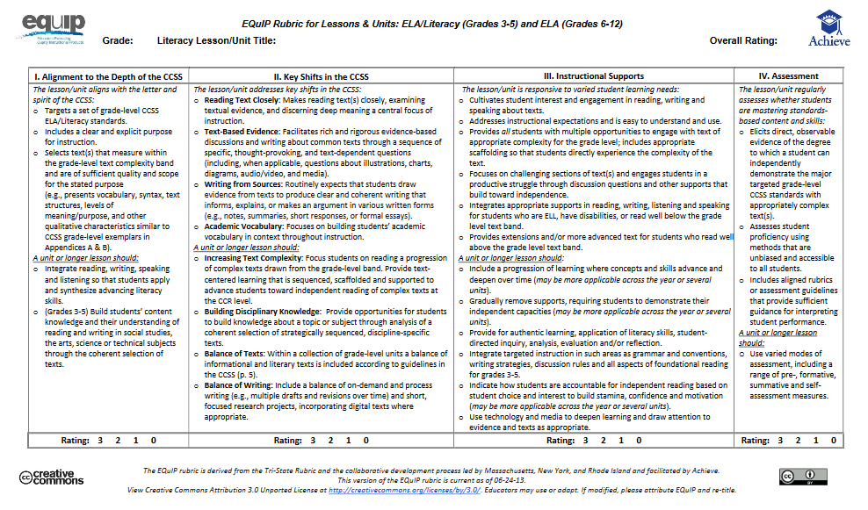
EQuIP Rubric
Notes:
The Exemplar Quality Review we used today was based on the EQuIP Rubric, which is used to evaluate units for exemplarity. ​
You can find the rubric at ​
https://www.achieve.org/our-initiatives/equip/rubrics-and-feedback-forms
Key Point:
The Mississippi Educator and Administrator Professional Growth System is designed to facilitate continuous improvement in practice. The system can be referred to as the Professional Growth System.

Slide 51
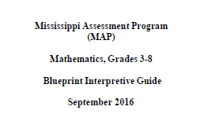
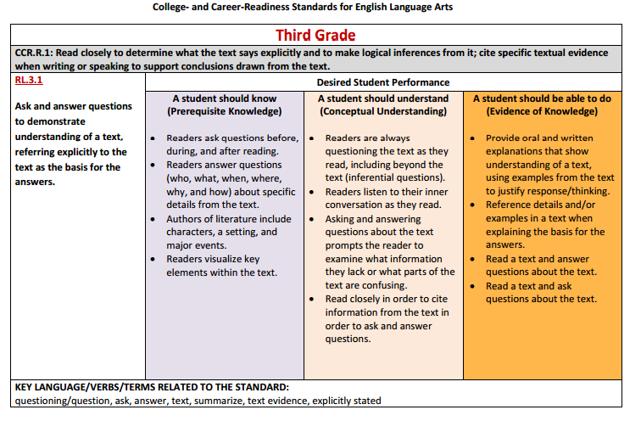
Resources & Publications for Math Teachers
Assessment Blueprints and Guides
3-HS
Instructional Scaffolding Document
PK-Algebra II
2016 MS CCRS for Mathematics
K-12
Multi-Tiered System of Supports
PK-12

Slide 52
Resources & Publications
for Administrators
On Demand PD &
Technical Assistance
Strong Readers = Strong Leaders
Early Warning System
College and Career Readiness Data Guidance Document

Slide 53
Resources & Publications
for Parents
Family Guides for Student Success
PK-8
Parents As Partners
LBPA
Parent Presentation
Parents’ Read-At-Home Plan
LBPA Parent Document

Slide 54
Professional Development Contact Information
Wendy Clemons, Ed.S​
Bureau Director​
Wclemons@mdek12.org​
​
​
Kristina Livingston, Ed.D., NBCT​ Lead Professional Development Coordinator​
klivingston@mdek12.org

Slide 55
Professional Development Contact Information
Elise Brown
Professional Development Coordinator
elise.brown@mdek12.org
Celeste Maugh
Professional Development Coordinator
celeste.maugh@mdek12.org

