Slide 1
Textbook Inventory Management System (TIMS) Policies, Procedures, and Best Practices for Local Districts
Office of Elementary Education and Reading
Chauncey Spears, Director- Textbooks

Slide 2
Vision
To create a world-class educational system that gives students the knowledge and skills to be successful in college and the workforce, and to flourish as parents and citizens
Mission
To provide leadership through the development of policy and accountability systems so that all students are prepared to compete in the global community
©MDE – Board of Education Strategic Plan

Slide 3
State Board of Education Goals
5-Year Strategic Plan for 2016-2020
All Students Proficient and Showing Growth in All Assessed Areas
Every Student Graduates High School and is Ready for College and Career
Every Child Has Access to a High-Quality Early Childhood Program
Every School Has Effective Teachers and Leaders
Every Community Effectively Using a World-Class Data System to Improve Student Outcomes
Every School and District is Rated “C” or Higher

Slide 4
Textbook Accountability Standard 19
19. The school district is in compliance with state law and State Board of Education policies for state adopted textbooks. {MS Code 37-43-1, 37-43-24, 37-43- 31(2), 3743-51, 37-9-14(2)(b), and 37-7-301(ff)} (7 Miss. Admin. Code Pt. 3, Ch. 79, R. 79.1, R. 79.2) (Refer to the Current Edition of Textbook Administration Handbook Rules and Regulations.)
19.1 Each school district provides student in each school with access to current or otherwise appropriate textbooks that are in good condition.(See glossary for definition of textbook. {MS Code 37-43-1, 37-914(2)(b), and 37-7-301(ff)}
19.2 Each school district shall keep an active and surplus inventory for each school in the district to be completed by June 15 of each year. The district shall report the inventory in the Textbook Inventory Management System. {MS Code 37-4351} (Refer to the current edition of the Textbook Administration Handbook Rules and Regulations.)

Slide 5
TEXTBOOK INVENTORY MANAGEMENT SYSTEM
The Textbook Inventory Management System (TIMS) is the web-based inventory system for the Mississippi Department of Education – Office of Textbooks. TIMS must be accurately updated by June 15th each year.
Textbook coordinators are responsible for documenting the Active, Surplus, and Disposal listings in TIMS for each school in the district.
Districts determine the local procedures for documenting their textbook inventory in TIMS.
TIMS User Manual
Notes:
Be prudent in selecting the local textbook and other instructional materials. It is the expectation of MDE and the State Legislature that textbooks/instructional materials be used by the district for 5 to 7 years. Switching programs after a year or two creates build up of surplus texts that the state has paid for and the districts are not using.

Slide 6
Textbook Inventory Management System (TIMS)
Legal Definition of a Textbook: Any medium or manual of instruction which contains a systematic presentation of the principles of a subject and which constitutes a major instructional vehicle for that subject.
All Textbooks/Workbooks (including consumables) that were procured with state dollars need to be documented in TIMS

Slide 7
Access TIMS : http://www.mde.k12.ms.us/ESE/TAP/tims

Slide 8
Log into TIMS
Enter Username, Password, (Obtain these from submission of the TIMS-2 Security Update Form)
Database: MDED

Slide 9
Adding Books into the TIMS System
Textbook titles that are State Adopted are entered into the system by the MDE.
Textbooks that are not State Adopted must be entered into TIMS locally. This is done by updating the Catalog in TIMS

Slide 10
Adding Books into the TIMS System
Enter the ISBN-13 Number for the textbook, hit the “Tab” key.
Enter in the requested info in the Blue Fields. (Double Click in the field for listings)
Click on the Save button at the top once finished. A “successful” pop up message will indicate that the catalog has been updated.

Slide 11
Active Inventory
The Active Inventory is the list of textbooks that are currently in use in classrooms.
To add titles the active inventory, click Inventory on the file menu and choose Update Active.

Slide 12
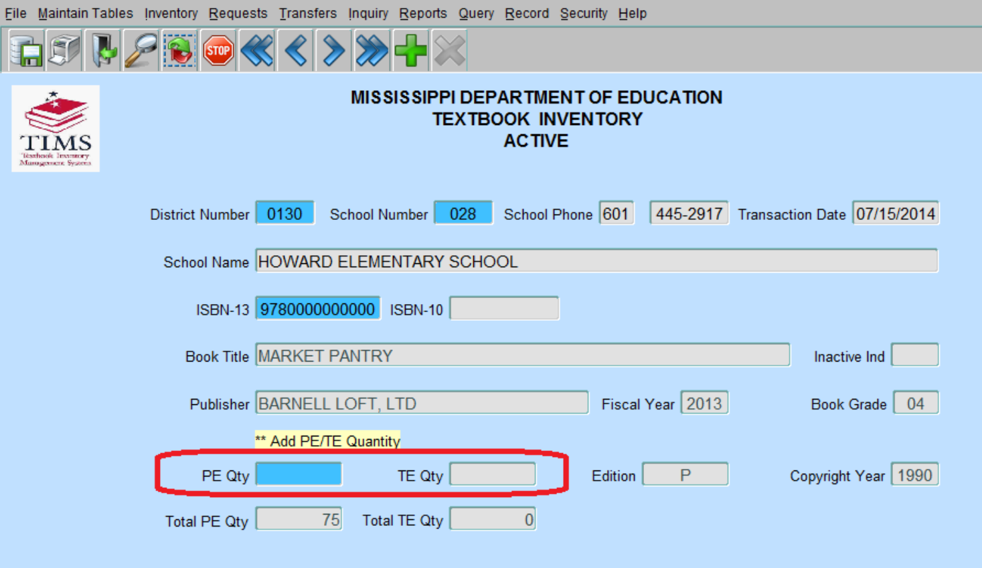
Active Inventory
For Textbook Coordinators, a listing of schools in your district will appear.
Select your school and click OK, the Active Inventory form will appear, with school and district information already entered.

Slide 13
Active Inventory
Enter the ISBN and press “Tab” key
Once a valid ISBN has been selected, the gray textbook information fields will populate automatically.
Enter the quantity of textbooks you want to add in the PE Qty or TE Qty field. You will only be allowed to enter information in one of these fields, depending on the ISBN entered.
Save the information by choosing Save from the File Menu or click on Save icon on toolbar. “Transactions added/updated successfully”
You cannot “subtract” or “delete” textbooks from the active inventory with this method. To delete books, transfer the quantity to be deleted from the Active to the Disposal listing.
All transfers require a Transfer Request

Slide 14
Active Inventory

Slide 15
Transfer Requests
There are several transfer types that can be requested. As a textbook coordinator, you will primarily be either updating the active listing for your school/district or transferring books from the active to disposal listing for your school/district.
In some instances, you maybe required to transfer books to the “Surplus” Listing. The surplus listing is for books schools/districts no longer use, but are less than 12 years old and are in good condition.
Instructions on how to use the Surplus Transfer Listing are found in the TIMS User Manual on Pages 16-20.

Slide 16
Active to Disposal Transfer
From File Menu, select “Transfer”, then “Request Transfer”

Slide 17
Active to Disposal Transfer
After the From School is entered the user will be prompted to select a To District/School. These must be the same if you are transferring books form the Active to Disposal listing.
When the From Dist/Sch and To Dist/Sch have been populated, the Transfer form will display.

Slide 18
Active to Disposal
Enter in the ISBN Number, then hit “Tab” key.
Enter in the number of books to be transferred in the blue highlighted “Qty” field. Then save the transfer.
All disposals must be approved by the Office of Textbooks at the MDE.
  Determination of Disposable Textbooks- Each local school district will determine if textbooks are unusable. Textbooks may be unusable because they are:
    twelve years or older,
    not relative to current curriculum framework (after new standards are adopted),
    or the textbooks may be physically worn-out to the point that it is not feasible or practical for continued use.
Notes:
Be prudent in selecting the local textbook and other instructional materials. It is the expectation of MDE and the State Legislature that textbooks/instructional materials be used by the district for 5 to 7 years. Switching programs after a year or two creates build up of surplus texts that the state has paid for and the districts are not using.

Slide 19
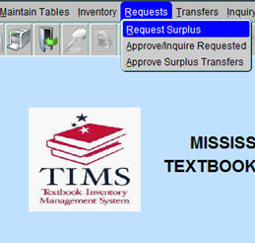
Request Surplus
Click Requests on the TIMS file menu and choose Request Surplus.
If you are a Textbook Coordinator, select the school that will receive the textbooks and click OK.
School information in the Requester Information section of the Request form will be automatically populated.

Slide 20
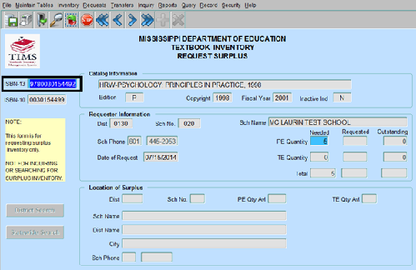
Request Surplus
Enter a valid ISBN and press tab key
The Catalog Information section will automatically populate based on your selection.
Enter the number of textbooks needed into the PE Quantity or TE Quantity fields.

Slide 21
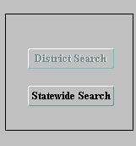
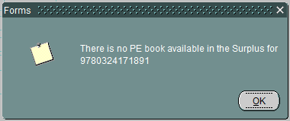
Request Surplus
Click the District Search button or the Statewide Search button.
If textbooks are available within the selected district, the District Search button will be highlighted for you to click.
If there are no textbooks available within the selected district, the Statewide Search button will be highlighted.
If there are no textbooks available anywhere, a message will display indicating that there are no books available in surplus for this ISBN.
Once surplus inventory has been located and populated in the Request Surplus form, Save the information by choosing Save from the File Menu or click on Save icon on toolbar. A message will display indicating that the transaction was added/updated successfully.

Slide 22
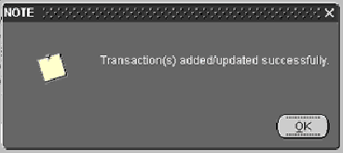
Request Surplus
Click OK. Exit the form by selecting Exit from the File menu, or Click Exit button on the toolbar.

Slide 23
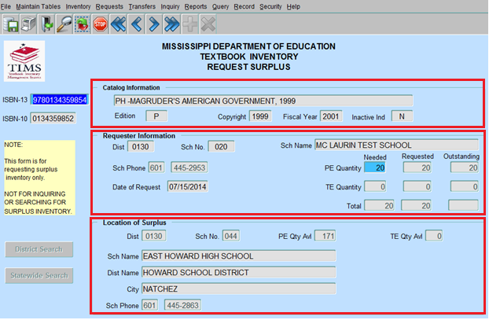
Request Surplus
Overview of form
Catalog Information
Requestor Information
Location of Surplus
Once this information has been saved, contact the school /district where the surplus is located to arrange physical transfer.

Slide 24
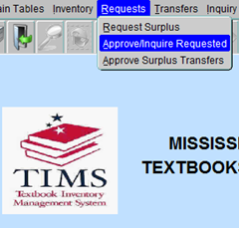
Approve/Inquire Requested
To inquire on inventory that has been
requested and to change the status of
those requests
Click Requests on the main menu
Select Approve/Inquire Requested.

Slide 25
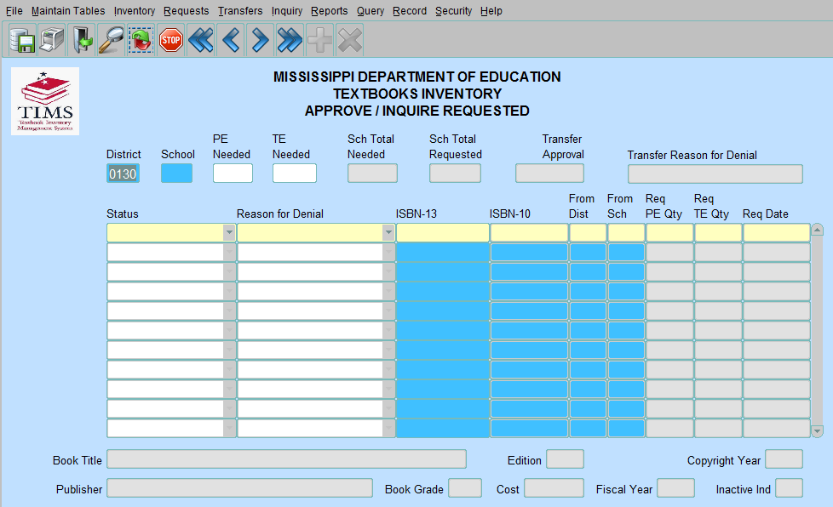
Approve/Inquire Requested
Textbook Coordinator Role
Select School Number and the Approve/Inquire Requested form will display. You will Approve, Deny or Pend a request.
Principal Role
The requested surplus for the selected school will display. Principal will view a request.

Slide 26
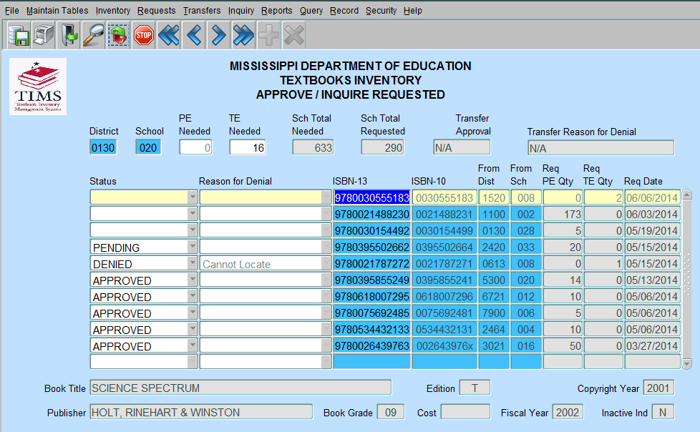
Approve/Inquire Requested
The small scroll bar can be used to scroll through the Approve/Inquire Requested entries, however the cursor must be on a specific ISBN in order to change information or view catalog information.
Textbook Coordinators may change the status of a surplus request to Approved, Pending, Denied, or leave the status blank. Should the status for an ISBN be changed to Denied, a reason must be selected from the Reason for Denial field.
Save the information by choosing Save from the File Menu.

Slide 27
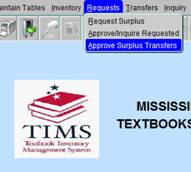
Approve Surplus Transfers
The Textbook Coordinator has the ability to change the status of surplus requested from another District/School by clicking on the Request menu and selecting Approve Surplus Transfers.
Select a From School
The District/School is the place where the inventory will be moved from, and the To District/School is the destination of the inventory. Once selected, the Approve Surplus Transfers form will appear.

Slide 28
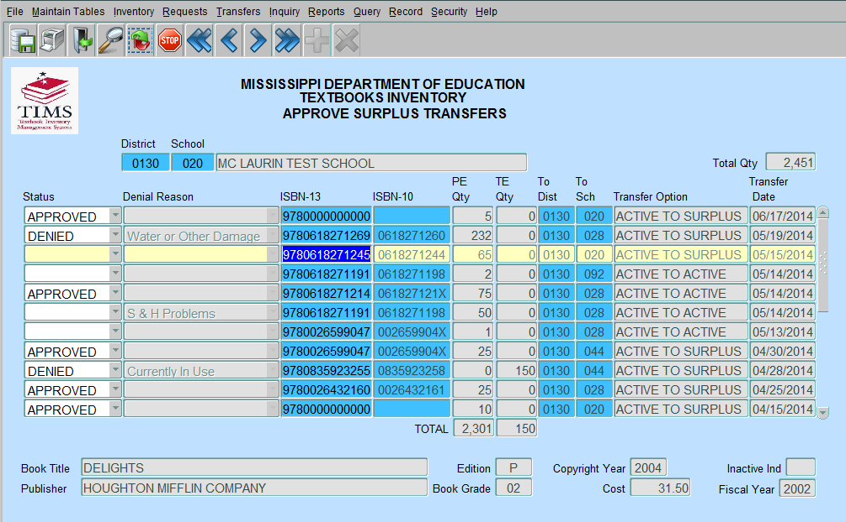
Approve Surplus Transfers
The requested surplus for the selected school will display. Textbook coordinators may select another school in their district by double clicking on the school field to display a list of available schools.
Textbook Coordinators may change the status of requested surplus to Approved, Denied, or they may leave the status blank. Should the status for an ISBN be changed to Denied, a reason must be selected from the Reason for Denial field.
Changes to this form can be saved by clicking Save on the File menu or click on Save icon on toolbar.
To exit without saving changes, select Exit from the File menu, or Click Exit button on the toolbar.

Slide 29
Transfers
Active to Active – must be done within the same district. The To Sch cannot be the same as the From Sch.
Active to Surplus – the From Dist/Sch and the To Dist/Sch must be the same or the system will change it to what is in the From Dist/Sch.
Active to Disposal – the From Dist/Sch and the To Dist/Sch must be the same or the transfer option will be disabled.
Surplus to Active – the From Dist/Sch and the To Dist/Sch must be the same or the transfer option will be disabled.
Surplus to Disposal – the From Dist/Sch and the To Dist/Sch must be the same or the transfer option will be disabled.

Slide 30
TIMS Reports
Districts are able to generate PDF copies of their various listings in TIMS.
Textbook Coordinators can request the Status of a Transfer, and Surplus Listings.

Slide 31
TIMS Reports
The Report Inventory section contains reports for Active and Surplus by Listing, Subject, and Grade, Disposal Listing, and Transfer Listing.
You may run the report with just the District/School that is selected or click the box next to the school name that says All Schools to get a listing of all schools within your district.

Slide 32
TIMS Reports
The reports are generated in a new Web browser in PDF format (check Pop Up Blockers if reports do not appear).

Slide 33
Security User Listing Report
The Security User Listing Report is a listing of all users in the district; it includes first and last name of the user, the user name, and the role of the user.
To obtain a Security User Listing, click Reports and select Security User Listing Report.

Slide 34
Security User Listing Report
The Textbook Coordinator must then select a school for which to run a report. The Run Report form will display.
Click the box next to the school name that says All Schools to get a listing of all schools within the district.

Slide 35
Things to Remember in TIMS
Textbook inventory should be entered year round! When you receive textbooks, please enter inventory into TIMS, immediately!
Use the ISBN-13 that is located inside the book on the copyright page.
Textbooks that are 12 years or older should not be in the Active Listing in TIMS ! It is an Accreditation violation. These textbooks should be transferred to Disposal.
Save after every transaction.
Log out of TIMS after every 3-4 transactions to let the system refresh.

Slide 36
Questions and Contact Information
Questions?
Contact Chauncey Spears, Textbook Procurement Director crspears@mdek12.org
Textbook Office Phone 601-984-8273

