Slide 1
NAEP 2015 Mathematics and Reading Results
October 2015
Dr. Carey M. Wright
State Superintendent of Education
Notes:
Welcome to the first superintendents’ meeting of the school year. Thank you for joining me today. We have full agenda of items to share with you today, and we will be happy to answer any questions you may have.

Slide 2
Grade 4 Mathematics Results

Slide 3
Grade 4 Mathematics Results

Slide 4
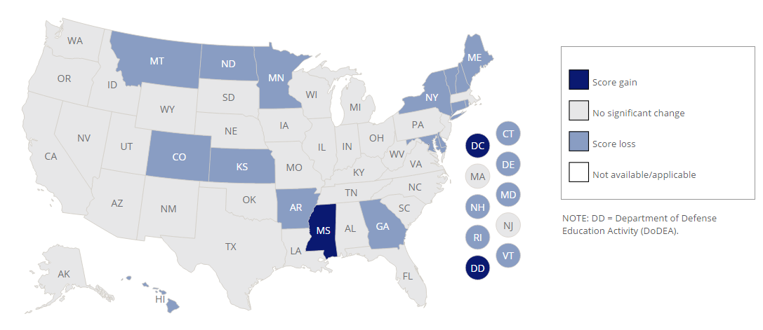
Grade 4 Mathematics Results
Score Changes Since 2013

Slide 5
Grade 8 Mathematics Results
Notes:
My leadership team and I will provide overviews on the following items …

Slide 6
Grade 8 Mathematics Results
Notes:
My leadership team and I will provide overviews on the following items …

Slide 7
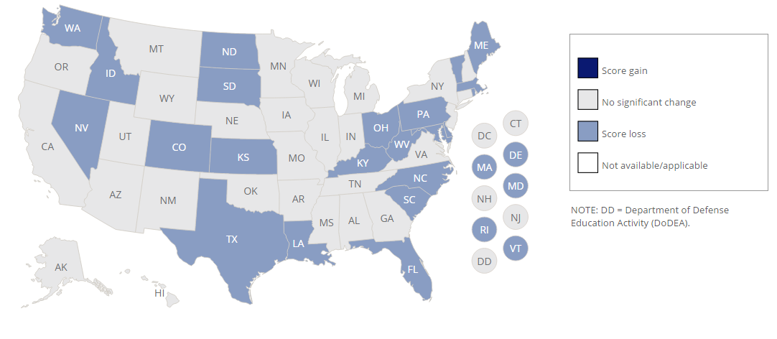
Grade 8 Mathematics Results
Score Changes Since 2013
Notes:
My leadership team and I will provide overviews on the following items …

Slide 8
Grade 4 Reading Results

Slide 9
Grade 4 Reading Results

Slide 10
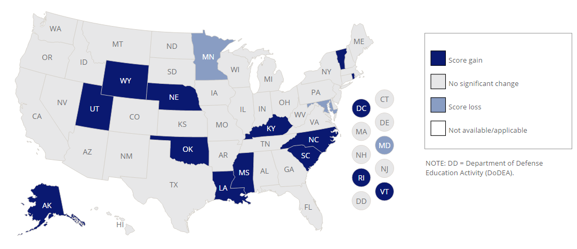
Grade 4 Reading Results Score Changes Since 2013

Slide 11
Grade 8 Reading Results

Slide 12
Grade 8 Reading Results

Slide 13
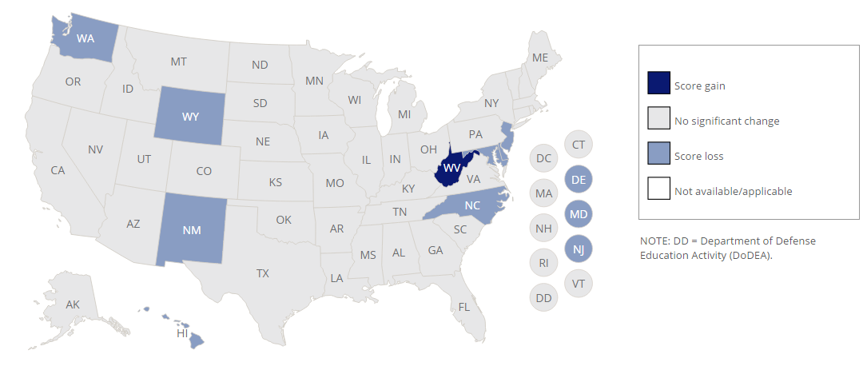
Grade 8 Reading Results
Score Changes Since 2013

