Slide 1
Impact of Pre-Kindergarten Programs on Student Performance in Early Schooling in the State of Mississippi
Impact of Pre-Kindergarten Programs on Student Performance in Early Schooling in the State of Mississippi
Collaboration Works!
John Kraman
Chief Information Officer
Mississippi Department of Education
Jkraman@mdek12.org
Domenico “Mimmo” Parisi, Ph.D.
Executive Director
National Strategic Planning and Analysis Research Center
Mississippi State University
mparisi@nsparc.msstate.edu
Yan Li, Ph.D.
Director, Office of Research and Development
Mississippi Department of Education YLi@mdek12.org
July 26th, 2018
2018 NCES STATS-DC Data Conference
“Visualizing the Future of Education through Data”

Slide 2
Outlines
Outlines
Impact of Pre-Kindergarten Programs on Student Performance in Early Schooling in the State of Mississippi

Slide 3
Outline-Bullets
Outlines
Introduction
Early Learning Collaboratives
Research Study
Concluding Remarks and Questions

Slide 4
Introduction
Introduction
Research Goals and Research Capacity Maturity Model

Slide 5
Goals
Goals
Disseminate knowledge and Insights
Identify and leverage talents for maximum effectiveness and efficiency
Achieve better integration with better data
Leverage the statewide longitudinal data system for each data contributor to achieve its goals

Slide 6
Research Capacity
Research Capacity Maturity Model
Level 1:
Ad-Hoc
Level 2:
Directed
Level 3:
Managed
Level 4:
Optimized
Level 5:
Matured
Level 1 – No control of any kind
Level 2 – In response to a need
Level 3 – Clearly articulated accountability
Level 4 – Portfolio-based approach
Level 5 – Maturation: absolute advantages to comparative advantages

Slide 7
Grants Prior 2015
Grants Prior to 2015
2009 Grant - Mississippi’s PK16 Longitudinal Data Initiative:
Expanded existing K-12 statewide data systems, and integrate the systems and related data of Mississippi's Workforce Performance Management System.
2009 ARRA Grant - Mississippi Integrated Education and Workforce Longitudinal Data System:
Created a relational database linking all education (K-20) and workforce data through a unique common identifier, and Include all the necessary data to link PK with K-20

Slide 8
2015-SLDS
2015 Mississippi SLDS Grant
Grant Period
September 2015 – September 2019
Grant Priorities
1. Research and Evaluation
2. Early Learning
Grant Expected Outcomes
1. Creating data dashboard and establishing a research office
2. Completing the Early Childhood Education component of the P-20W SLDS
For more information:
Statewide Longitudinal Data Systems Grant Program

Slide 9
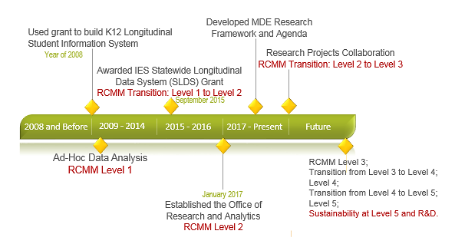
MDE’s Research
MDE’s Research State

Slide 10
Early learning
Early Learning Collaboratives
Mississippi’s Early Learning effort

Slide 11
Act 2013
MS Early Learning Collaborative (ELC) Act 2013
What is Mississippi’s Early Learning Collaboratives?
The Early Learning Collaborative Act of 2013, which become law on April 18, 2013, establishes Mississippi’s first state-funded, voluntary Pre-K program on a phased-in basis.
Provide funding (competitive basis) to local communities to establish, expand, support and facilitate the successful implementation of quality early childhood education and development services.
The state provides $2150 per full-time child enrolled. All state dollars must be matched on a 1:1 basis at the local level to make the total investment for each child enrolled in ELC $4300.

Slide 12
ELCs
MS Early Learning Collaboratives
Public schools
Head Start
Private agencies (i.e. child care centers or non-profit organizations)
Faith-based centers
The majority of the ELCs are led by school districts, but some are led by nonprofit organizations. A few ELCs include multiple school districts.
Lead Partner
History, commitment, and need
Staff qualifications
((assistant) teachers+
CLASS)
Professional development
(15 hours APD, PCL)
Assessments
Learning standards, curriculum
(MKAS2, OWL)
Program length, class size, teacher-child ratio, and parent engagement
For more information:
Early Childhood

Slide 13
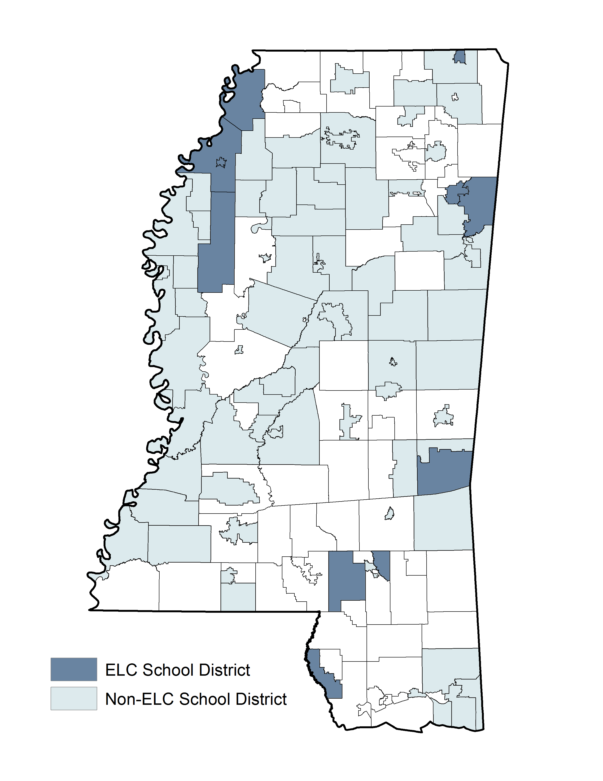
Facts
MS Early Learning Collaboratives – Facts
School Year 2016-2017:
14 out of 144 school districts
11 out of 82 counties in the state
All of the ELCs have Head Start partners
Total number of children 1642 (717 in public schools, 837 in Head Start, others in other settings)
Total fiscal year spending $9,576,610 (Amount of total from state sources $4,000,000, amount of total from required local sources $4,000,000, and amount from non-required local sources $1,576,610).
Mississippi Early Learning Standards for Classrooms Serving Four-Year-Old Children
One of the only five states meeting the majority of NIEER’s quality standards three years in a row.
Location of ELC and Non-ELC Public Pre-K School Districts

Slide 14
Research Study
Research Study
Impact of Pre-Kindergarten Programs on Student Performance in Early Schooling in the State of Mississippi

Slide 15
Capacity
MDE’s Research Capacity
Office of Research and Development
The Office of Research and Development (ORD) is committed to producing objective and accurate research and analytics. It transforms data into insights that inform the decision-making of the MDE leadership. ORD supports the broader mission of Mississippi State Board of Education strategic plan, to improve student achievement, and opportunities throughout Mississippi’s education system.

Slide 16
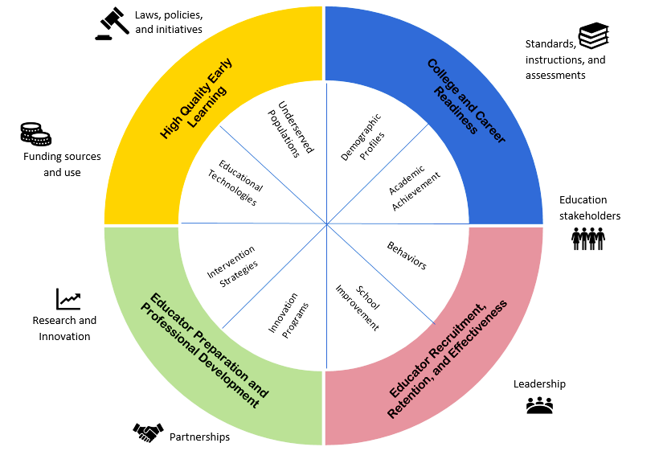
Alignment
Research Motivation: Alignment with MDE Research Framework

Slide 17
Questions
Research Questions
Does attending an Early Learning Collaborative (ELC) center improve preschoolers’ kindergarten readiness?
Compare to students enrolled in other public PreK classrooms, how much more (or less) likely will students enrolled in ELCs program be “kindergarten-ready”?
How many more (or less) points will students enrolled in ELCs programs earn on average based on the Kindergarten Readiness assessment results?
What is the impact of ELCs program on student’s performance over time? Is the impact increasing or decreasing since the program implemented?

Slide 18
Kindergarten
Measure of Kindergarten Readiness
Kindergarten Readiness Assessment:
Administered in fall (pre-test) and spring (post-test)
Performance Levels: Early Emergent Reader (lowest), Late Emergent Reader, Transitional Reader, Probable Reader (highest)
Scale score

Slide 19
Data
Data
Analytical Sample: Students who attended an ELC Public Pre-K or a non-ELC Public Pre-K, and were twice tested using the Kindergarten Readiness Assessment, during the 2014-2015, 2015-2016, or 2016-2017 school years.
Treatment Group. Students who attended an ELC Public Pre-K.
Comparison Group. Students who attended a non-ELC Public Pre-K program, weighted so that their distributions on the following characteristics match those of the treatment group:
Gender | Race
Free/reduced-price lunch status | Special education status
English language learner status | Accountability status grade of school district
Pre-test performance Level/scale score | Regional location of school district
Year

Slide 20
Overview
Overview of Findings
An overall positive trend of relationship between ELC participation and the likelihood that a student will achieve proficiency as well as score higher on the Kindergarten Readiness Assessment from over two-year window (SY14-15 to SY16-17)
With SY14-15 as the base year and other things being equal, a kid enrolled in an ELC public classroom is 7% more likely than his/her peer who enrolled in a non-ELC public classroom to achieve proficiency on the Kindergarten Readiness Assessment in SY16-17.
With SY14-15 as the base year and other things being equal, a kid enrolled in an ELC public classroom in SY16-17 earned about 18 points more than his/her peer who enrolled in a non-ELC public classroom.

Slide 21
Descriptive
Descriptive Statistics
Table 1. Number of Observations of Public Pre-K Students taking the Kindergarten Readiness Assessment, by ELC Status (Unweighted)
Program Status | Number of Observations (Unweighted)
ELC (Total) | 1,436
2014-2015 | 171
2015-2016 | 617
2016-2017 | 648
Non-ELC (Total) | 11,870
2014-2015 | 3,346
2015-2016 | 3,659
2016-2017 | 4,865

Slide 22
Table 2
Descriptive Statistics
Table 2. Performance of Public Pre-K Students on the Kindergarten Readiness Assessment, by ELC Status
The percentage of achieving proficiency keeps rising for ELC public PreK students
The average scale score keeps rising for ELC public PreK students

Slide 23
Table 4
Descriptive Statistics
Table 4. Performance of Public Pre-K Students on the Kindergarten Readiness Assessment, by ELC Status and Race

Slide 24
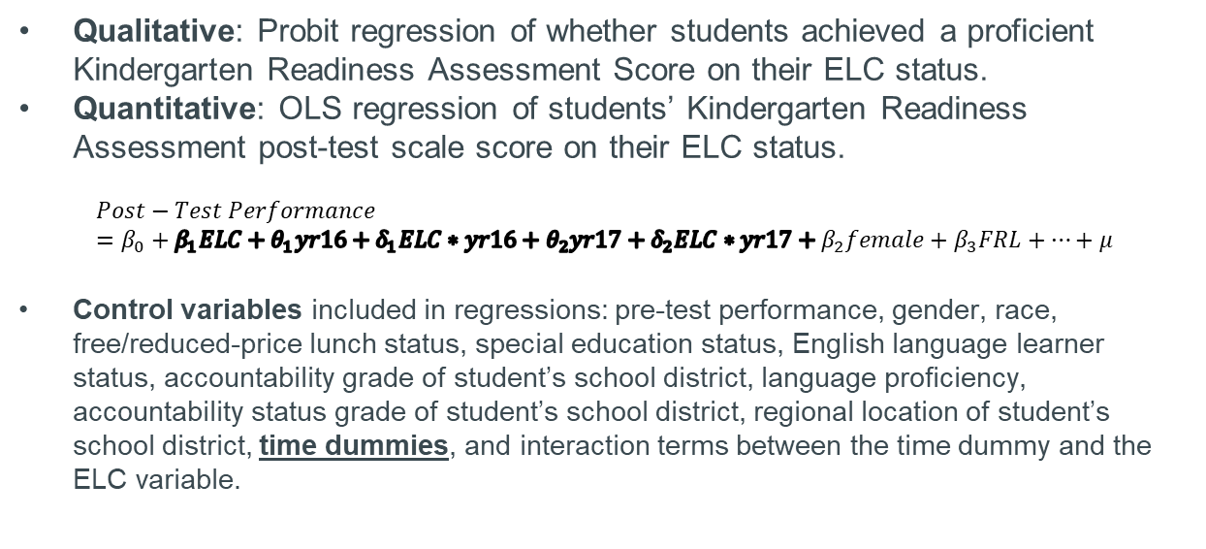
Methodology
Methodologies
Qualitative: Probit regression of whether students achieved a proficient Kindergarten Readiness Assessment Score on their ELC status.
Quantitative: OLS regression of students’ Kindergarten Readiness Assessment post-test scale score on their ELC status.
$$Post−Test Performance=β_{0}+β_{1}ELC+θ_{1}yr16+δ_{1}ELC∗yr16+θ_{2}yr17+δ_{2}ELC∗yr17+β_{2}female+β_{3}FRL+…+μ$$
Control variables included in regressions: pre-test performance, gender, race, free/reduced-price lunch status, special education status, English language learner status, accountability grade of student’s school district, language proficiency, accountability status grade of student’s school district, regional location of student’s school district, time dummies, and interaction terms between the time dummy and the ELC variable.

Slide 25
Findings
Findings – Probit Estimation
The Beginning Is The Hardest:
ELC public PreK students less likely to achieve proficiency during the first year,
but situation has changed since then.
Variables of Interest | Coefficient | SE | Marginal Effect
ELC | -0.27* | 0.12 | -0.08
Year (2014-2015 as Reference)
2015-2016 | 0.48*** | 0.12 | 0.14
2016-2017 | 0.35** | 0.12 | 0.10
ELC-Year Interactions
ELC*2015-2016 | 0.34* | 0.14 | 0.10
ELC*2016-2017 | 0.53*** | 0.14 | 0.15
These results indicate that ELC students were significantly less likely than other Public Pre-K students to achieve proficiency on the Kindergarten Readiness Assessment in 2014-2015 but were significantly more likely to in 2015-2016 and 2016-2017.
Note: † p<.10; * p<0.05; ** p<0.01; p<0.001.

Slide 26
Pool OLS
Findings – Pooled OLS Estimation
ELC public PreK students scored less during the first year, but scored more in the third year.
¹ELC-Year interaction variables jointly significant at the p<0.0001 level.
Note: † p<.10; * p<0.05; ** p<0.01; p<0.001.

Slide 27
Policy
Policy Indications
There is an overall positive trend of relationship between ELC participation and the likelihood that a student will achieve proficiency as well as score higher on the Kindergarten Readiness Assessment.
The effect of ELC participation on Kindergarten Readiness Assessment outcomes grew more positive between 2014-2015 and 2016-2017. This could reflect a maturing of the program and resultant increase in program quality.

Slide 28
Conclusions
Concluding Remarks and Questions

Slide 29
Contact
John Kraman
Chief Information Officer
Mississippi Department of Education
Jkraman@mdek12.org
Yan Li, Ph.D.
Director, Office of Research and Development
Mississippi Department of Education
YLi@mdek12.org
Domenico “Mimmo” Parisi, Ph.D.
Executive Director
National Strategic Planning and Analysis Research Center
Mississippi State University
mparisi@nsparc.msstate.edu

