Slide 1
Research Agenda Progress: What’s happened since implementation?
The presentation will begin at approximately 3:00 p.m. ET
Information on joining the teleconference can be found on the “Info” tab in the upper left of this screen. Be sure to use the “Attendee ID” number on the Info tab when dialing in to associate your name with your phone.
In order to cut down on background noise, we have placed you on mute upon entry into the meeting.
During the question and answer portion of this presentation, type your question into the Q&A panel below the participant list and click “Send.”
A copy of this presentation and a link to the recording will be shared on the SLDS GRADS360° site at https://slds.grads360.org.

Slide 2
Research Agenda Progress: What’s Happened Since Implementation?
May 4, 2018
Carla Howe & Kathy Gosa – SLDS SST
Brett Carter – Montana
Yan Li – Mississippi

Slide 3
Agenda
Welcome and introductions
Overview and background
States’ perspectives
Q & A
Wrap up
Research Agenda Progress | May 2018

Slide 4
Background
FY15 SLDS Grants have a Data Use focus
Research & Evaluation was one priority area funded under the FY15 grants
SST held workshops to support the development, implementation, and use of the Research Agendas beginning in the fall of 2015 for grantees and non-grantees

Slide 5
State Panel
Features MT and MS. They’ll share information about:
Research agenda:
Current status
Its development
The research agenda and SLDS sustainability connection
Expectations for the future
Lessons learned

Slide 6
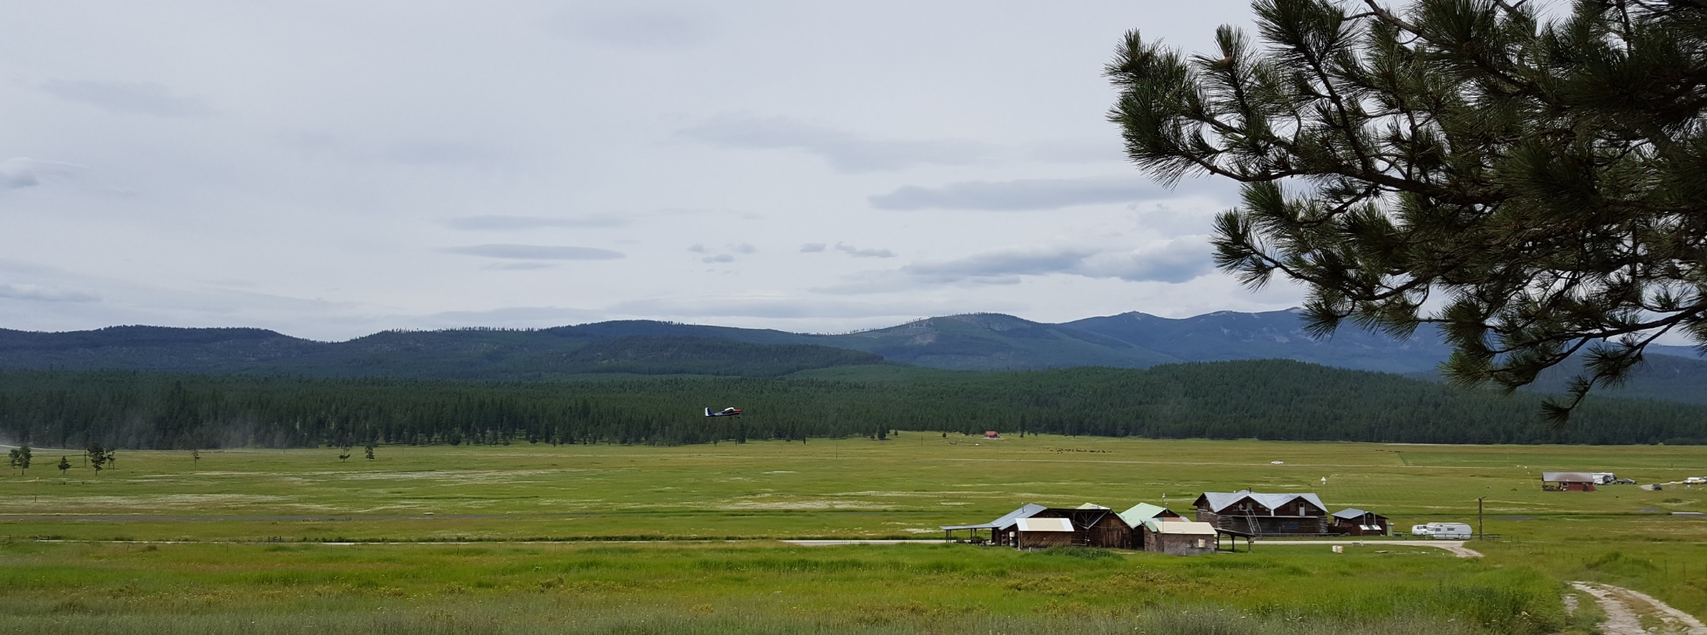
Creating and Supporting a Research agenda
Brett Carter
Montana Office of Public Instruction

Slide 7
Timeline
October, 2015 – Montana was awarded the 2015 SLDS grant in the Research and Evaluation Category
December, 2015 – The grant team was finalized and began working on agency wide “Research Priorities”
April, 2016 – Finalized these priorities for approval of the Montana Office of Public Instruction Data Governance Committee

Slide 8
Overview
Description and staffing for research themes
Theme | Description | Staffing resources
General Student Outcomes | Research on student outcomes. American Indian student achievement will have a special focus. | This research will be completed by OPI staff from the Measurement and Accountability Division. The Technology Services Division will lead development of new GEMS reports and dashboards
Special Program Effectiveness | Research on state efforts to strengthen the Montana education system to investigate the long term outcomes of these special programs on student success. | This research will be completed by OPI staff from the Measurement and Accountability Division with the guidance of each division managing each special program. The Technology Services Division will lead development of GEMS reports and dashboards
University Research Projects | These partnerships will research policy questions as they relate to the Montana education system. Research questions will be driven by external researchers and supported by OPI. | University faculty and graduate research assistants will take the lead on this research. Data requests will be approved by OPI leadership and managed by the Measurement and Accountability Division.
Teacher quality | These partnerships will foster a cooperative relationship between OPI and the teacher preparation programs in Montana | Staff from the Measurement and Accountability Division will assist faculty from the teacher prep programs in the creation of lessons on Montana data literacy.

Slide 9
Progress
With Data Governance approval, there was agency-wide buy in to the these ideas
This information has also been shared and received buy in from our external stakeholders (e.g. university faculty, other agency staff, LEAs, etc.)
These priorities clearly outline what work needs to be done and who should be responsible for completing this work
The priorities are aligned with our 2015 SLDS project plan and both get updated in synchronous way
The priorities align with internal agency goals as well as shared policy goals with other agencies (sustainability)

Slide 10
Future Directions
Continue to work with Data Governance to update these priorities
There is a need to update leadership as turnover happens to make sure there is buy-in from the top
These priorities may change over time depending on new goals and existing research outcomes

Slide 11
Where Are We Now?
Mississippi Research Agenda Progress
May 4, 2018
Yan Li, Ph.D.
Director
Office of Research and Development
Yli@mdek12.org

Slide 13
State Board of Education Goals FIVE-YEAR STRATEGIC PLAN FOR 2016-2020
All Students Proficient and Showing Growth in All Assessed Areas
Every Student Graduates from High School and is Ready for College and Career
Every Child Has Access to a High-Quality Early Childhood Program
Every School Has Effective Teachers and Leaders
Every Community Effectively Uses a World-Class Data System to Improve Student Outcomes
Every School and District is Rated “C” or Higher

Slide 14
Timeline
Mississippi began its efforts to establish an SLDS in the late 1990’s.
2008 grant – establishment of the K-12 system
2009 grant – creation of the P-20w system

Slide 15
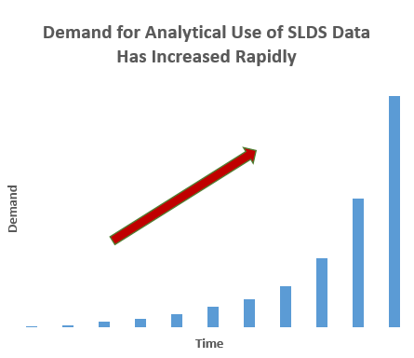
Increase in Demand
Prior to the 2015 SLDS grant, there was no research agenda.
The K-12 system was mostly used as a single location producing data reports to meet state and federal reporting requirements.
Demand grew for more analytical use of the SLDS data to inform decision-making and program implementation.
However, capacity at MDE to use data in its K-12 data warehouse or data sought from the P-20w system for research and analysis was limited.

Slide 16
FY15 SLDS Grant Awarded
2015 SLDS grant: October 2015 – September 2019
Priority area #1: Research and Evaluation
Projected outcome: Establishment of the Office of Research and Development
Key mission: Development of a research agenda

Slide 17
Staffing to increase research capacity
In February 2017, only 1 researcher was in the office.
Other than developing a research agenda, graduation rate calculations, federal EdFacts student assessment statistics reporting, and other technical support to other program offices were added to the function of the office.
There was an urgent need to increase the agency’s awareness of what is a research agenda is and why it is needed.

Slide 18
MDE Research Agenda Development Process

Slide 19
Staffing to increase research capacity
New Hires
April 2017: lead researcher
November 2017: research analyst
The Office of Research and Development reached the planned staffing level of 3 researchers.

Slide 20
Re-identified key stakeholders
Renewed Research Agenda Advisory Committee
Conducted committee meetings to discuss changes in the research agenda

Slide 21
Data Elements Identification
The Research Office internally identified data elements, and conducted data availability evaluations.
The longitudinal data system is great research resource, but it may take effort to organize it in a way that allows researchers to easily use it for research. So an important step is to identify and document the available data and business rules, to save time when answering research questions.
Our data elements identification effort was guided by several parameters:
What are the questions asking? What data will researchers need to provide a good answer? Where the data is sourced from? Whom may we need support from? What is the difficulty level of getting the data? If not possible, what kind of proxy variables are available?
Our research office believes that, if a question is focused, and clearly establishes what data is needed to answer the question, the research process will likely be smooth and achievable within a reasonable time frame.

Slide 22
Literature Review
The Research Office conducted literature review.
What has already been done on the topic?
What are the issues surrounding the topic?

Slide 23
Subject Matter Expert Team
Created a Subject Matter Expert Team
The Subject Matter Expert team help us narrow down a broad topic, focusing it even more, by looking at a particular perspective, time period, place, population group, or more than one of these.
The Subject Matter Expert team also help us to avoid questions that are too focused that can lead to “tunnel vision” which can inhibit our understanding and analysis.

Slide 24
Communications with Other SEAs
Initiated communications with researchers at SEA level from other states, to learn and share best practices.
From communications with researchers and research offices in other states, we learn their process of handling research requests, locating the focus areas for their research agenda, and utilizing resources efficiently and effectively.

Slide 25
Conferences and Workshops
Attend educational data/research conferences, webinars, and workshops to get strategies and gain insights.

Slide 26
Goal Alignment
State Board of Education’s six strategic goals
MDE’s research agenda is guided and driven by our strategic plan, with each goal in our strategic plan carrying a set of research questions.
Alignment of research questions and the goals
The following questions guides the alignment of our research questions and strategic goals:
Are they relevant to the priority areas listed in our strategic plan? What did we miss, or not understand? What is going on in this focus area? What are the basic processes, and are they working? How do we convince the policymakers and practitioners, that the research questions have something new and important to say about the strategic goals?

Slide 27
MDE Research Agenda Efforts Today

Slide 28
Research Agenda Progress
We have made exciting progress on our research agenda so far!
The current research agenda has 32 research questions, which covers areas of student growth, achievement gap, early learning, teacher effectiveness, educator preparation, educational technology, and school improvement.
The research agenda is in its refinement process and ready to have its third round of review by the Research Agenda Advisory Committee.
We plan to publish our research agenda when our new website goes live.

Slide 29
Looking back…
After a year’s effort:
a more mature research agenda is available and is centered on the State Board of Education’s strategic goals
An increased awareness of what is a research agenda has been achieved

Slide 30
Some challenges persist
The channel of communication hasn’t fully reached all the agency’s levels yet.
The need to strengthen the relationship with the agency’s executive leadership and key stakeholders is becoming more apparent.
The office is a small team.
The need to create partnerships with external researchers is becoming more urgent.

Slide 31
New Leadership
Under the leadership of our new Chief:
We are having more thorough and in-depth discussions with all program offices in the agency;
The discussions go horizontally and vertically, with the objective of aligning the research priorities to what the agency considers important.

Slide 32
Current Work
We are also working on:
Creating a Researchers’ Guide to Mississippi State Education Data, including the research agenda
Strengthening the relationship with MS’s National Strategic Planning and Analysis Research Center (NSPARC) and the state data center
Data governance

Slide 33
Lessons learned along the way
Communication plan
Collaboration with other states who are conducting similar work
Internal relationship building and priority alignment
Importance of consistent support from the agency’s leadership
Study questions that matter, and answer policy questions of interest in a rigorous way

Slide 34
Expectations for the Future
We genuinely expect our diligent work to yield the best outcomes through the research agenda, by:
Maintaining a proactive research agenda
Having the internal research office attain strength in descriptive and comparative, linear modeling, and rapid turnaround;
Working with external groups to have enhanced level of sophistication and qualitative/quantitative analysis;
Strengthening long-term relationships and trust;
Turning research methods to state-wide metrics, to establish a more efficient and matured system.

Slide 35
Questions?
35

Slide 36
Research Agenda Toolkit

Slide 37
Research Agenda Toolkit

Slide 38
Research Agenda Toolkit

Slide 39
Research Agenda Toolkit

Slide 40
Additional Resources
State Resources
Other resources of interest
NCES Forum - Research Access to Data – SEA Perspective https://nces.ed.gov/forum/pub_2012809.asp and One-Pager
NCES Forum - Researcher Access to Data – LEA Perspective https://nces.ed.gov/forum/pub_2014801.asp and One-Pager
SLDS – Research Toolkits https://slds.grads360.org/#program/research-toolkits
CEDS - https://ceds.ed.gov/Researchers.aspx
Helpful links
SLDS SST Points of Contact https://slds.grads360.org/#communities/pdc/documents/14522
SST general help email: support@sst-slds.org
SLDS GRADS360° website: http://slds.grads360.org

Slide 41
Contacts
Kathy Gosa – SLDS State Support Team
Kathy.Gosa@sst-slds.org
Carla Howe – SLDS State Support Team
Carla.Howe@sst-slds.org
Brett Carter – Montana Office of Public Instruction
BCarter2@mt.gov
Yan Li – Mississippi Department of Education YLi@mdek12.org

Slide 42
Thank You!
42

