Slide 1
Office of Federal Programs
FY15 (SY2014-2015)
ESEA Programs
Applications and Due Dates
October 31, 2014

Slide 2
AGENDA
Applications and Due Dates
Consolidated Federal Programs Application
    Title I, Part A – Basic
    Title II, Part A – Improving Teacher Quality
Title I, Part D - Delinquent
Title III, Part A – Limited English Proficient
Title III, Part A – Immigrant
Title VI, Part B – Rural and Low Income
Monitoring Cycles

Slide 3
Titles I and II
Revisit Preliminary Plan
  Signatures
  Contact Information
  Scope of services
Ensure new allocations are reflective on all budget pages
  Private Schools
  Parental Involvement
  Set-Asides

Slide 4
Consolidated Federal Programs Application (CFPA)
1
1
5
March
MDE Action: MDE enters Preliminary USDE Allocations & provide information for districts to complete preliminary CFPA.
MDE Action: When ALL plans are approved, Federal Funds are uploaded to SPS & MDE sends Official Award Letter
6
Ongoing
District Action: If the District deviates from the approved plan, they must revise the CFPA and send in an MDE will review plan for approval.
2
2
4
June 30th
District Action: District completes CFPA & submits via SharePoint for MDE review & preliminary approval.
October 1st
MDE Action: MDE updates final USDE Allocations for
Title I-A, II-A, III, & VI.
LEA revise CFPA based on new allocations.
3a3
3a
3b
3b
MDE Action: District Contacts review CFPA plans & budgets.
If CFPA is Not Approved, MDE will provide comments & support for Districts to revise.
District Action: District revises & resubmits CFPA for MDE Review
Note: Only re-submit when ALL comments are addressed.

Slide 5
Title I, Part A Set-Asides
Parental Involvement Set-Aside
  For districts with an allocation greater than $500,000, budget sets aside 1%
  95% of this set aside must go to Title I schools
  Parents must be involved in the school’s decision on how to use these funds
  District may retain the remaining 5% of the set aside for district level parental activities
  District Managed Activities can be used to reserve additional funds for district level parental activities

Slide 6
Title I, Part A Set-Asides
Homeless Set-Aside
  Automatically set at $100
  Increase this amount to meet the district’s needs
Condition Change for FY 14-15 ONLY:
  Can support excess Transportation costs
    Must align with identified need/strategies
    One of many ways to use Homeless Set Aside
    Was previously allowable, then retracted

Slide 7
Title I, Part A Set-Asides
Neglected Set-Aside
  Input amount for districts with a neglected facility
Preschool
  Provide support for preschool activities
  Direct intervention with students
  Supplemental intervention materials
  Professional learning for preschool teachers

Slide 8
Title II, Part A
A completed Title II Plan includes all of the following:
  Needs Assessment
  Planning Team
  Challenging State Standards
  Research-based Practices and Programs
  Integration and Coordination
  Activities and Allowable Costs
  Highly Qualified Teachers
  Activities & Expenditures At-A-Glance Page

Slide 9
Title II, Part A – Needs Assessment
All responses and activities must be linked to the results of the comprehensive needs assessment.
  Determine the needs of the teaching force.
  Identify local teacher quality needs.
  Identify those areas that an LEA should strengthen as part of a meaningful plan for professional development and hiring.

Slide 10
Title II, Part A – Needs Assessment
  Shall take into account the activities that need to be conducted in order to give teachers the means, including subject-matter knowledge and teaching skills, and to give principals the instructional leadership skills to help teachers to provide students with the opportunity to meet challenging State and local student academic achievement standards.

Slide 11
Title II, Part A – Planning Team
Consist of all stakeholders
  Teachers
  Paraprofessionals
  Principals
  Parents
  Administrators
  Other Relevant personnel
Develop your plan

Slide 12
Title II, Part A – Challenging State Standards
  All activities must be aligned with challenging state standards.

Slide 13
Title II, Part A – Researched-based Practices and Programs
  Activities and programs being implemented can be linked to research that has been proven to increase student achievement.

Slide 14
Title II, Part A – Integration and Coordination
Integrated into the overall plan in your district/schools to increase student achievement
Coordinate your Professional Development activities from all funding sources

Slide 15
Title II, Part A – Activities and Allowable Cost
  Activities should meet the needs of all students. (i.e. students with disabilities, ELL students, gifted students, behavioral management)

Slide 16
Title II, Part A – Highly Qualified
All teachers should be highly qualified.
Increase the content knowledge

Slide 17
Titles I and II – Allocations
Allocations prepared by USDE
  Based on Census Data from 2012
    Total poverty count age 5 through 17
    Total population age 5 through 17
  MDE uses Total Enrollment and F&R Lunch counts to equate funds for the two special schools
    Coahoma County Agricultural High School
    Forrest County Agricultural High School

Slide 18
Titles I and II – Budget
Budget Template and Instructions
  Cover Page
  Transferability Page
  Reservation of Funds
    Mandatory Set-asides
    Discretionary Set-asides
  Demographics
    Public School Allocations
    Private School Allocations
    All Set-Asides

Slide 19
Titles I and II – Budget
  Equitable Services (Titles I and II)
    To be recorded on the Reservations of Funds page
  District and School Summary
    One page per set-aside
  Indirect Cost (Titles I and II)
  Cost Pool
  Budget Template location
    http://www.mde.k12.ms.us/federal-programs/federal-programs---cfpa
Notes:
Administrative Fees are transferred to the Cost Pool. Title I’s admin is capped at 20%. Be mindful that the 20% is inclusive of indirect cost. Title II’s admin is capped at the restricted indirect cost rate. The same principle applies for indirect cost.

Slide 20
Titles I and II - CFPA
Application due 12/01/2014
Application location
  http://www.mde.k12.ms.us/federal-programs/federal-programs---cfpa

Slide 21
Title I, 1003(a)-Priority and Focus Eligibility
LEAs who have a Priority and Focus school, provided the school does not also receive 1003(g) grant dollars in the same year

Slide 22
Title I, 1003(a)-Priority and Focus
Funding
All qualifying applicants will receive awards based on a prescribed formula that provides a base allocation relative to the school designation (Priority School designation: $90,000 per school site; Focus School designation: $40,000 per school site).

Slide 23
Title I, 1003(a)-Priority and Focus
Uses of Funds
Schools may use funds to support interventions needed to address the school’s reason for receiving the designation.

Slide 24
Title I, 1003(a)-Priority and Focus
Application Requirements
Cover Page
  Includes all the required information
  Lists each designated school with the correct school-level allocation
  Totals the school allocations for one district-level allocation
Assurances
  Includes original signatures by all required personnel

Slide 25
Title I, 1003(a)-Priority and Focus
Application Requirements
Priority School: Action Plan Summary
  Includes one summary page per school designated as Priority
  Addresses each Transformational Principle, regardless of funding source for activities
  Includes subtotals for Title I Basic, 1003a, and Other sources
  Matches the budget narrative in summary form
  Includes the up to 20% amount for the LEA

Slide 26
Title I, 1003(a)-Priority and Focus
Application Requirements
Focus School: Action Plan Summary
  Includes one summary page per school designated as Focus
  Addresses each goal, regardless of funding source for activities
  Includes subtotals for Title I Basic, 1003a, and Other sources
  Matches the budget narrative in summary form
  Includes the 10% amount for the school

Slide 27
Title I, 1003(a)-Priority and Focus
Application Requirements
Budget Narrative
  Includes one budget narrative page per school designated as Priority or Focus as listed on the Cover Page
  Activities listed are only those funded by FY15 1003a
  Ensures that Total Allocation matches the allocation on the Cover Page

Slide 28
Title I, 1003(a)-Priority and Focus
Application Requirements
Community-Based Council (one per district, minimum; may be one per school)
  Includes a listing of the membership of the council
  Describes the activities of the council
  Includes a copy of the Notification Letter for each school listed on the Cover Page (may be the letter from 2012 original notification or, if applicable, a new letter sent 2014)

Slide 29
Title I, 1003(a) – Application
Application due date “TBD”
Application location
  http://www.mde.k12.ms.us/federal-programs/title-i-1003a

Slide 30
Title I, Part D – Delinquent
Title I, Part D Subpart II
  Conducting a needs assessment
  Using data to drive your needs
  Be specific in answering the 13 questions on the application
  Evaluate your program to ensure the funds are spent according to student needs
  Ensure all expenditures are essential to improving student achievement

Slide 31
Title I, Part D – Application
Application Due
  December 15, 2014
Annual Survey Due
  December 31, 2014
Application location
  http://www.mde.k12.ms.us/federal-programs/federal-programs---title-1-neglected-and-delinquent

Slide 32
Title III, Limited English Proficient
The purpose of Title III, Part A is to help ensure that children who are limited English proficient, including immigrant children and youth, attain English proficiency, develop high levels of academic attainment in English, and meet the same challenging State academic achievement standards as all children are expected to meet;

Slide 33
Title III, Limited English Proficient
Title III LEP application is comprised of six parts. Each part has a series of questions that should be addressed.
Identification
High Quality Instructional Program
Assessment and Accountability
High Quality Professional Development and Staffing
Parent and Community Participation
Budget
Notes:
The Title III Limited English Proficient application is comprised of six parts. Each part has a series of questions that should be completed.
Identification:(in this section) Districts must describe its methods of identifying and assessing students. Also, the LEA should provide a description of the districts educational theory and goals for educating the EL population in your district.
High quality Instructional Program: In this section, LEAs should describe.
13-14 needs assessment process. Based on the data collected from the needs assessment, what goals and activities will be developed, how will they be implemented, and administered. Each LEA will describe specific components of the LEAs program, such as what types of computer based programs are being used and which program model is being used at the schools. The roles and responsibilities of the Student Evaluation Team (SET team). What are the LEAs procedures for consulting teacher and administrators on developing the districts local plan. In what capacity does the translator serves. Districts will also describe the exiting and monitoring process. How the LEA will collect and submit data, finally in this section LEAs will describe how they will serve students in eligible private schools.
Assessment and Accountability: Describe the process of how the LEA is holding the schools accountable for meeting proficiency and AMAOs. Also, for the participation in state administered ELP testing. Two new questions have been added, regarding AMAOs. How does the district plan to meet the AMAO targets, if they have missed AMAO for two consecutive years.
Highly quality professional development and staffing: Describe the types of professional development the LEA will conduct and send teachers and administrator to. How will the district ensure that the said trainings methods are based on scientifically based research. How will the LEA ensure that all teachers are fluent in written and oral language. LEAs should describe specific staffing and other resources are being used to provide LEP students instruction education program.
Parent and Community Participation: describe how the LEA promote parent and community involvement. As well as, how does the LEA notify parents about AMAO status.
Budget: Each LEA must complete the budget, budget narrative, and the personnel detail. Remember that administrative cost cannot exceed 2% of the LEA’s allocation.

Slide 34
Title III, Immigrant Children and Youth
The Immigrant Children and Youth application consist of five components that must be addressed:
Need for the project
Quality of project design
Timeline
Quality of project evaluation
Budget
Notes:
Need for the project: Each LEA must provide a data table showing a significant increase of immigrant children and youth for at least a two year period and the languages that are spoken. LEAs should also provide a comparison of immigrant children and their English speaking peers based on how they scored on the state assessments.
A description should be provided on how immigrant funds will be used to impact academic achievement, English language development, native language support in content area instruction, capacity building (professional development) and parent training.
Quality of project design: based on test results from standardized test, districts must set goals and expectations for the immigrant program. How does the LEA plan to maintain and sustain the program after the grant period. How will the LEA tro the extent possible plan on collaborating with higher education programs, community based resources, and State and Federal resources to assist immigrant children and youth once they exit the program.
Timeline: please provide a timeline for the project and activities that were previously stated in the plan.
Quality of project evaluation: provide a description of process that will be used to evaluate the effectiveness of the Immigrant Children and Youth program.
Budget: Each LEA must complete the budget, budget narrative, and the personnel detail. Remember that administrative cost cannot exceed 2% of the LEA’s allocation

Slide 35
Title III, LEP and Immigrant
Applications due 12/15/2014
Applications location
  http://www.mde.k12.ms.us/federal-programs/federal-programs---title-iii-ell

Slide 36
Title VI, Part B – Purpose
To address the unique needs of rural school districts that frequently:
Lack the personnel and resources needed to compete effectively for Federal competitive grants; and
Receive formula grant allocations in amounts too small to be effective in meeting their intended purposes.

Slide 37
Title VI, Part B – Use of Funds
Use of Funds
Teacher recruitment and retention
Teacher professional development
Educational technology
Parental involvement activities
After-school programs
Activities authorized under Titles I, II and III

Slide 38
Title VI, Part B – Application
A completed application includes all of the following components in sequential order:
A completed application cover sheet, including all required signatures.
Signed assurances with original signatures.
A complete Project Narrative (maximum of three pages).
A complete CSPR/Budget Review (use 2013-2014 school year data).

Slide 39
Title VI, Part B – Application
5. A complete District Budget Narrative Page
prepared according to the following:
  a. Indicate the district name in the appropriate blanks;

Slide 40
Title VI, Part B – Application
  b. In completing the budget table, use the space provided under the “General Descriptions” column to detail the description of all expenditures. Include information that will sufficiently document the necessity and reasonableness of all expenditures. Also, detail the computations used to arrive at the total amount indicated for each line item; and

Slide 41
Title VI, Part B – Application
  c. Title VI (Rural and Low Income Schools) funds must supplement, and not supplant, Federal, State, and local funds that LEAs, schools, and organizations would otherwise receive.
6. A complete District Budget Summary
Page and School Budget Summary
Page(s).

Slide 42
Title VI, Part B – Project Narrative
The entire narrative should be limited to no more than three pages, front only, and no fonts smaller than 11 in size.
  Describe in detail the need for the project, the goals and objectives relating to:
    Increased student academic achievement;
    Decreased student dropout rates; or
    Other factors as the Local Educational Agency (LEA) may choose to measure.

Slide 43
Title VI, Part B – Project Narrative
  2. The following components must be included in
  the narrative:
    A summary of your comprehensive needs assessment;
    A summary of the LEA’s academic achievement on state assessments.
  3. List the ESEA goal(s) and indicator(s) that your district
  will implement and describe the activities that the LEA
  will use to meet the goal and indicator. ESEA Goals
    and Indicators can be found in the application on page 11.

Slide 44
Title VI, Part B – Rural and Low
Application due 12/10/2014
Application location http://www.mde.k12.ms.us/federal-programs/federal-programs---title-vi-rural-education

Slide 45
FY15 Monitoring Schedules
  Cycle I – Self Assessment - Survey Due 12/10/2014
  http://www.mde.k12.ms.us/docs/federal-programs/sy-2014-15-cycle-i-self-assessment.pdf?sfvrsn=2
  Cycle II – Technical Assistance
    http://www.mde.k12.ms.us/docs/federal-programs/sy-2014-15-cycle-ii-technical-assistance.pdf?sfvrsn=2
Cycle III – On site Monitoring Visit
http://www.mde.k12.ms.us/docs/federal-programs/sy-2014-15-cycle-iii-scheduled-date-of-on-site-monitoring-visit-20140702.pdf?sfvrsn=2
Compliance and Monitoring Webpage
  http://www.mde.k12.ms.us/federal-programs/federal-programs---compliance-and-monitoring

Slide 46

Use of Funds

Slide 47
RECAP – Due Dates
Titles I and II CFPA 12/01/2014
Title I, Part D 12/15/2014
Title I, 1003(a) “TBD”
Title III, LEP 12/15/2014
Title III, Immigrant 12/15/2014
Title VI, Rural & Low 12/10/2014
Monitoring Survey 12/10/2014

Slide 48
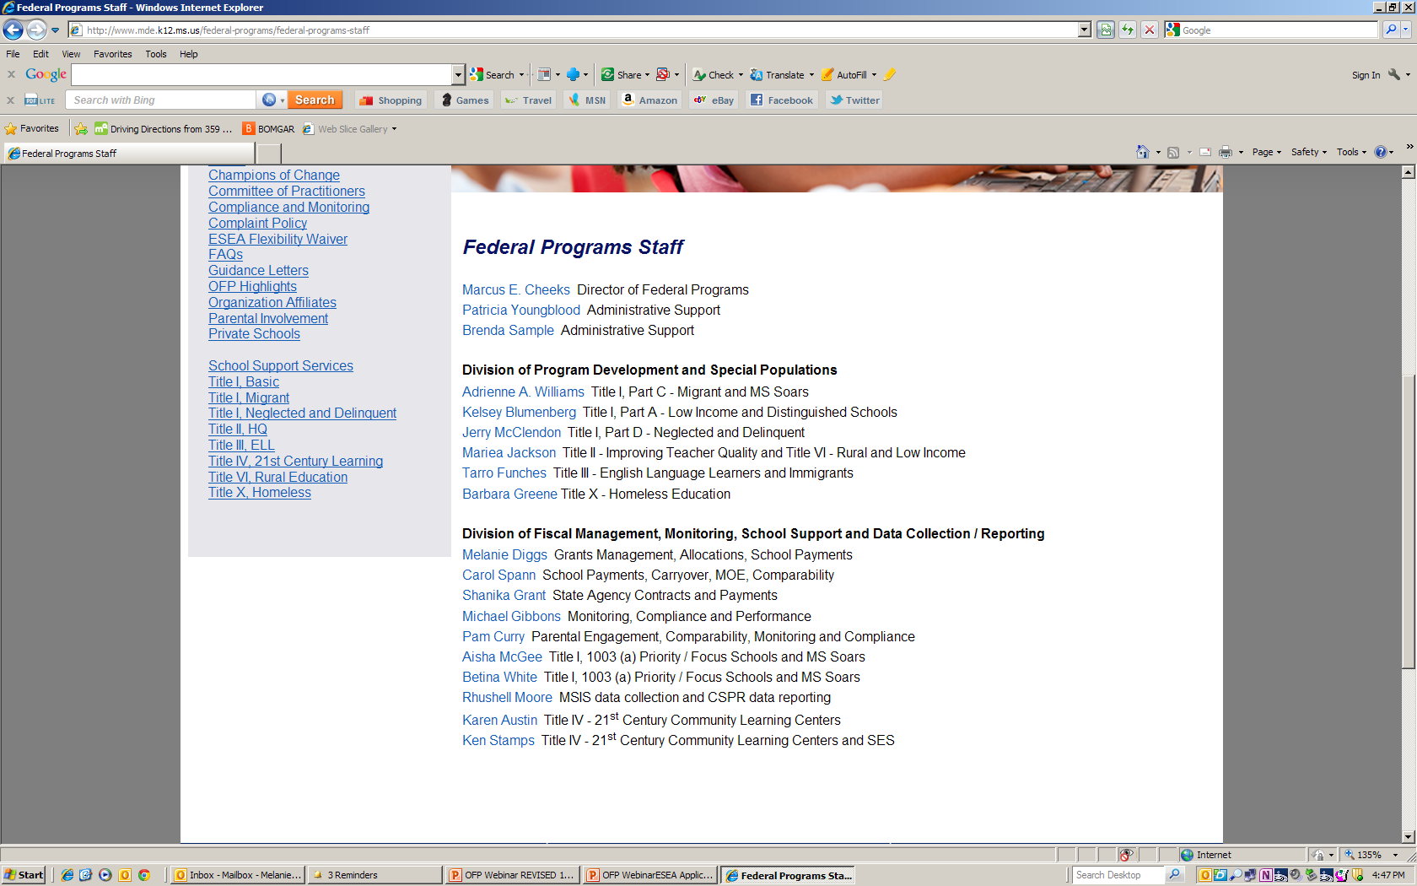
Federal Programs Staff

Slide 49

Office of Federal Programs
Marcus E. Cheeks, Bureau Director
mcheeks@mde.k12.ms.us
(601) 359-3499

