Slide 1





Slide 2
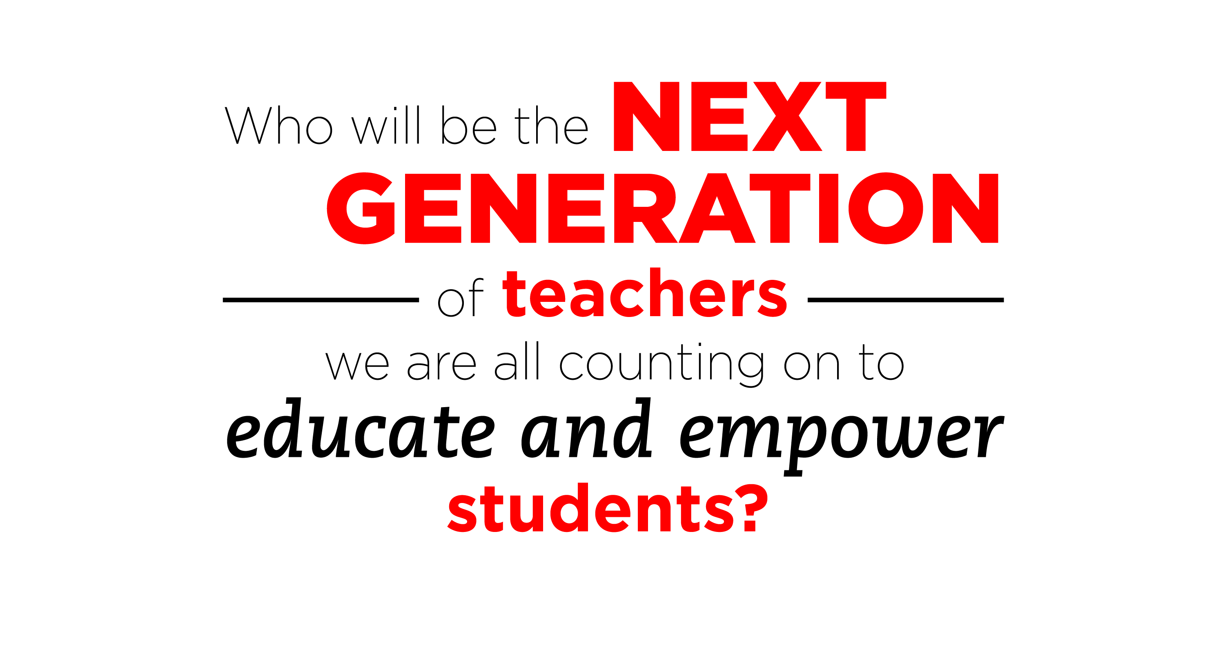



Slide 3
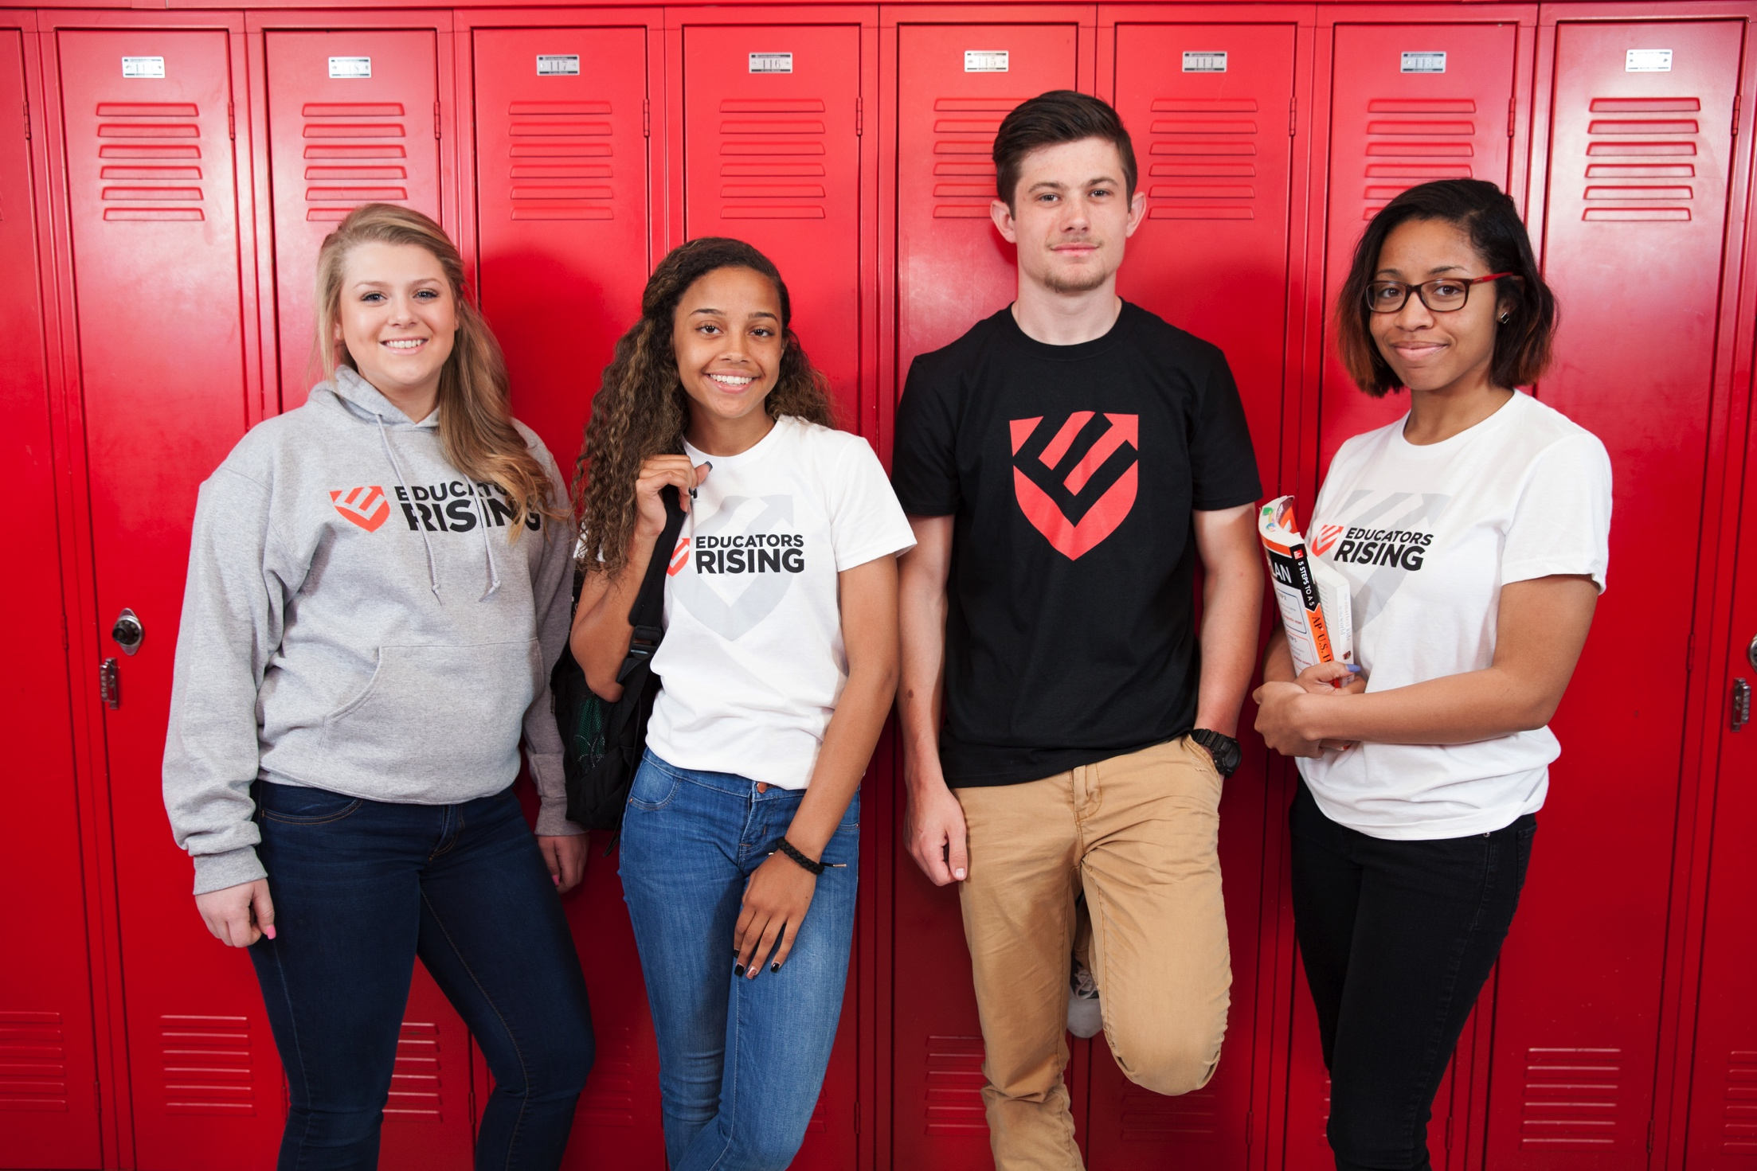

Slide 4

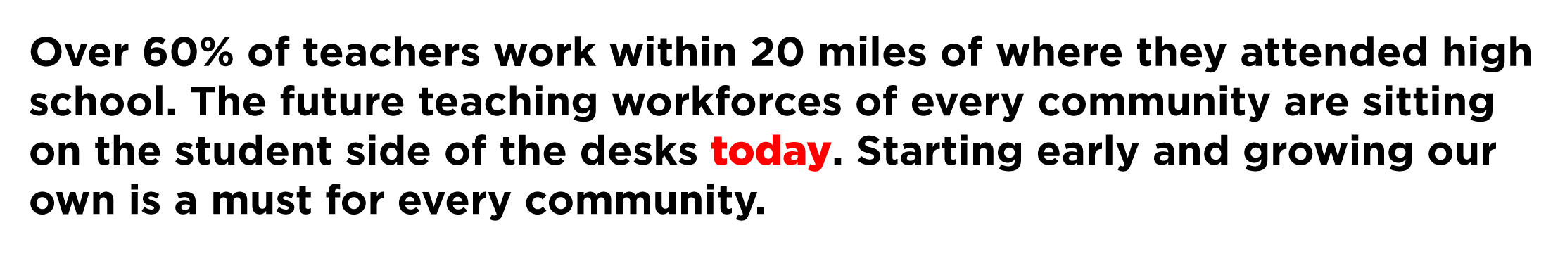

Slide 5
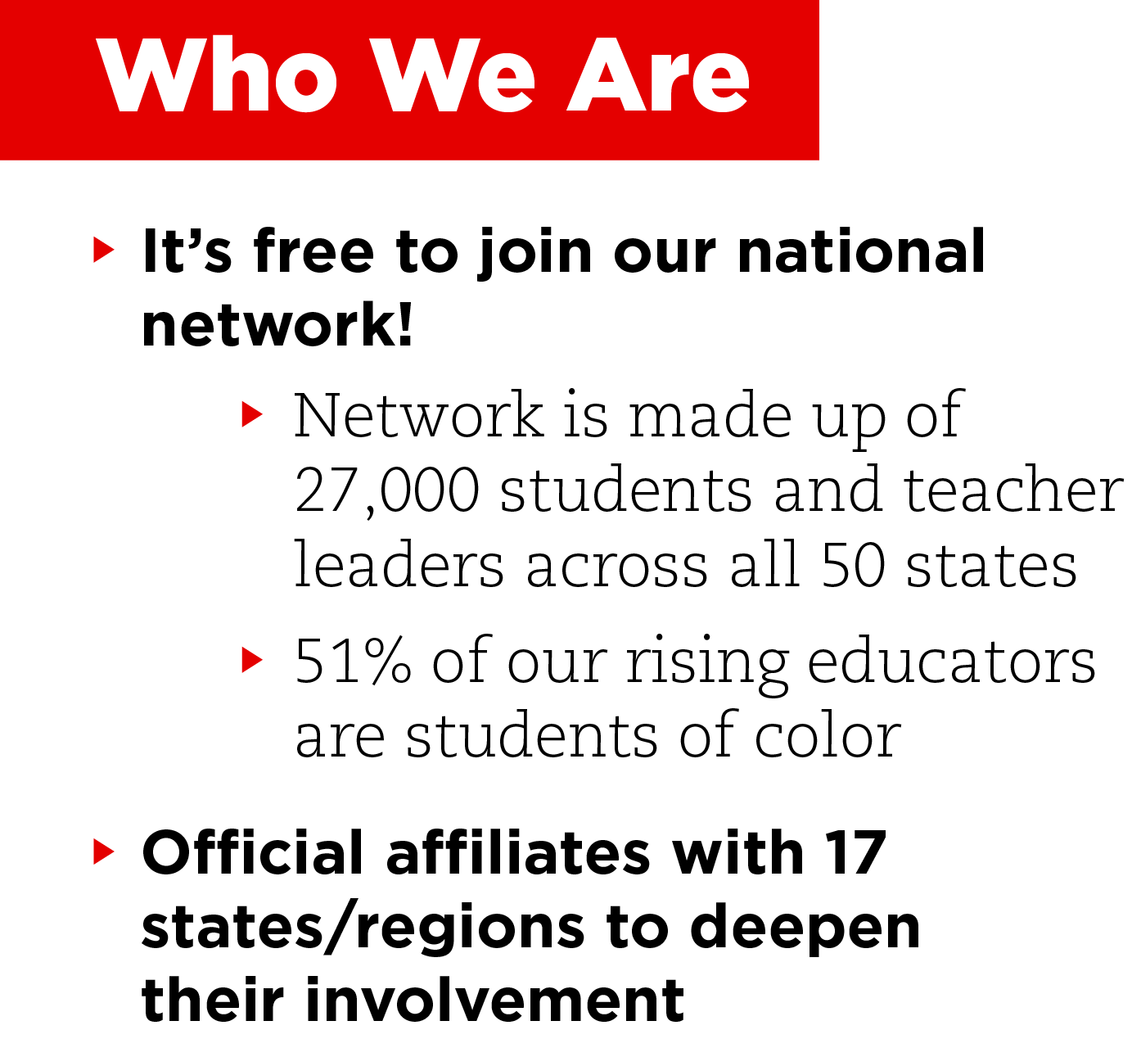
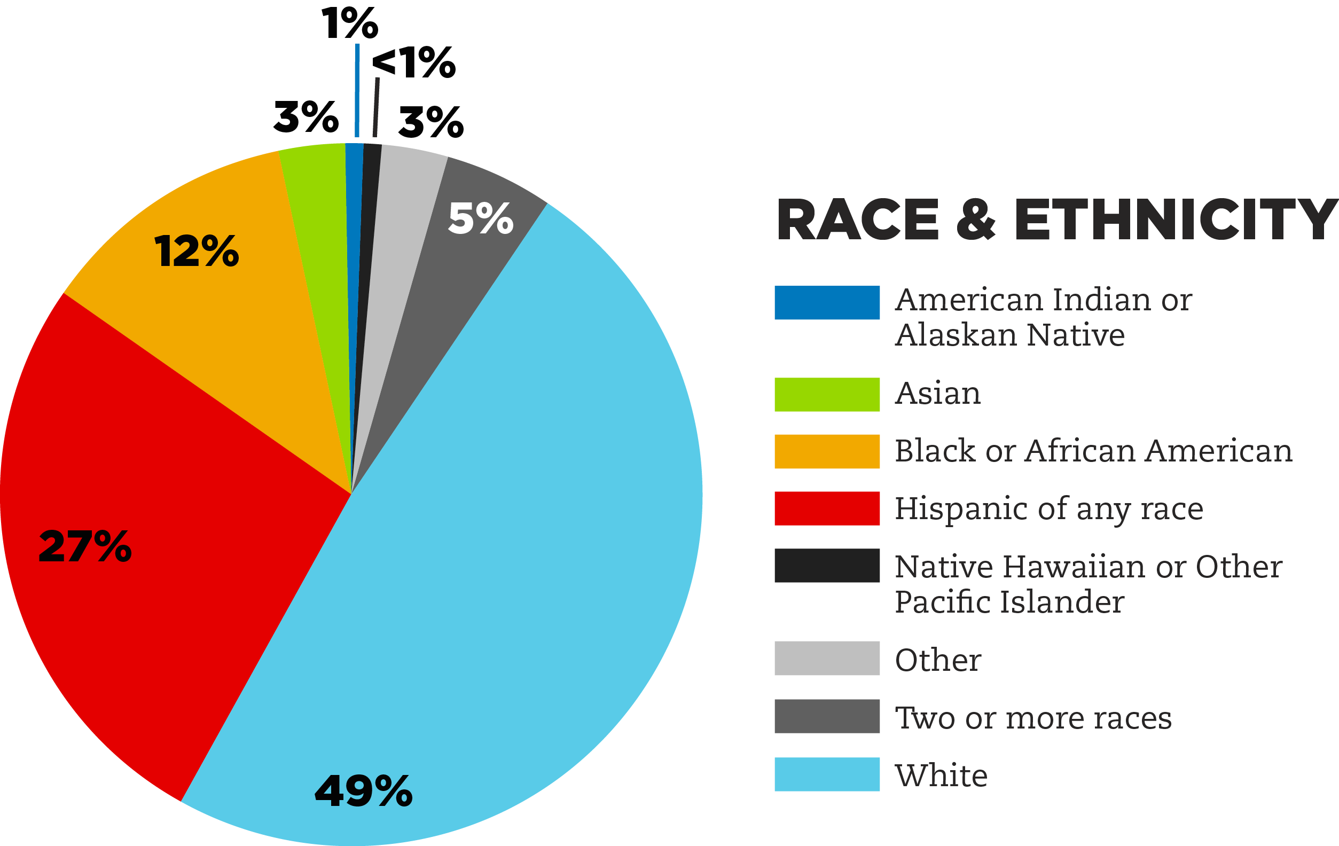

Slide 6
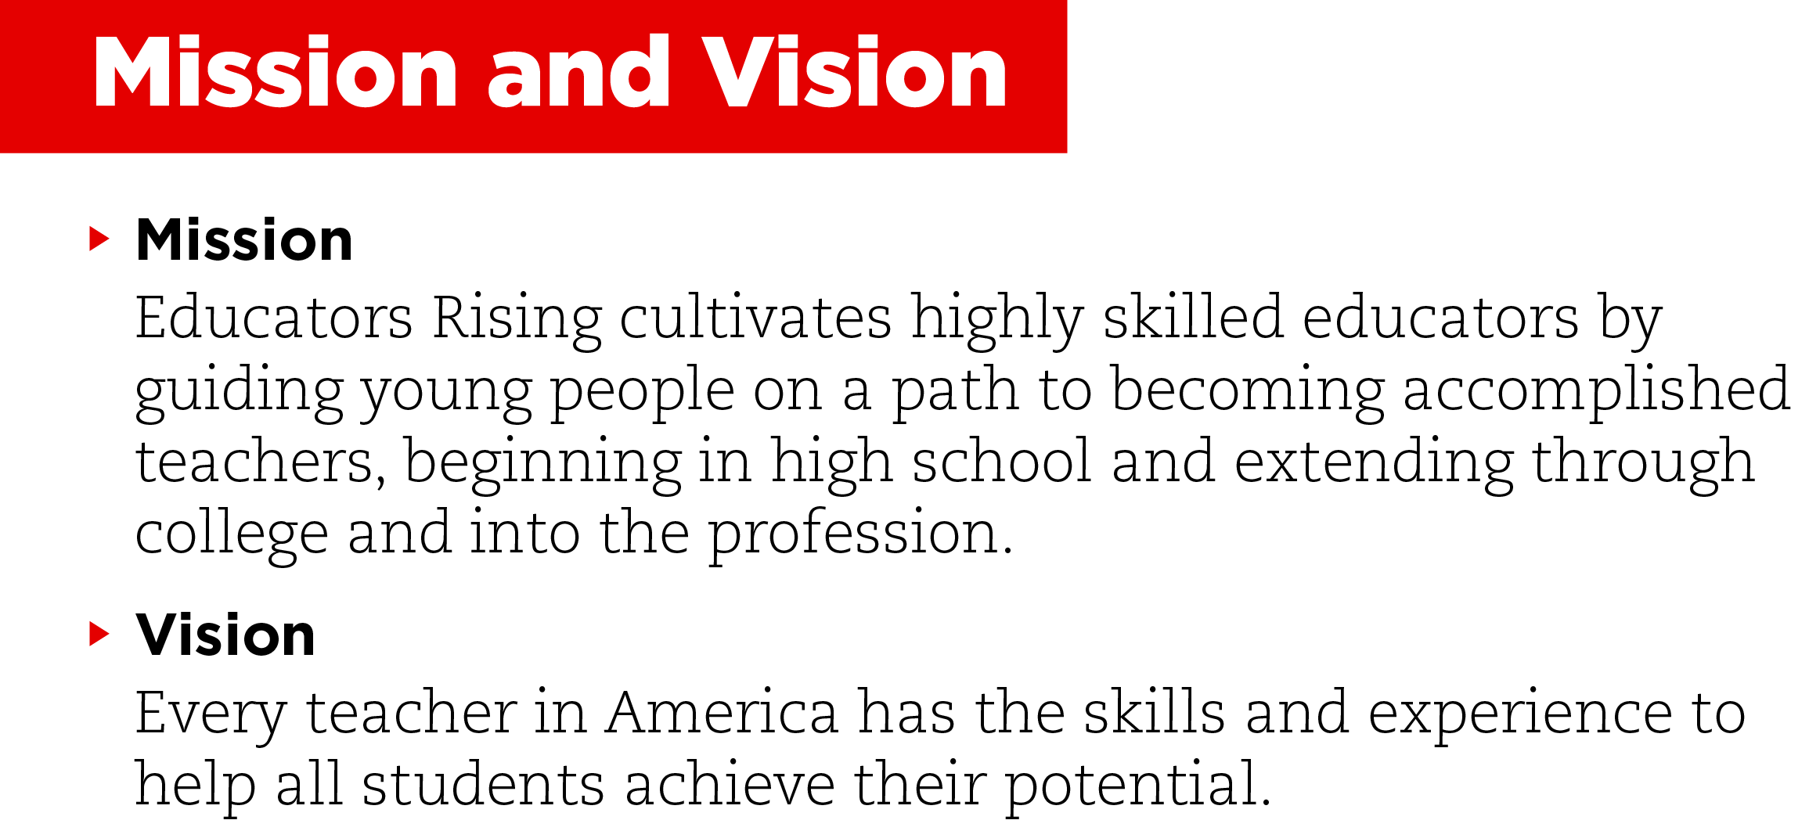

Slide 7
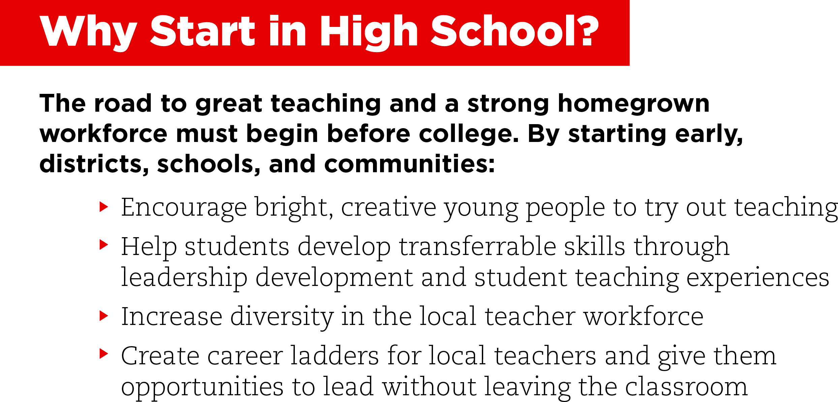
Notes:
Broaden the tent for bright, creative young people to experience the high-impact empowerment teaching can offer.
Offer students opportunities to develop transferrable skills through leadership development and student teaching experiences that also advance local career readiness agendas.
Increase diversity in thelocal teacher workforce (51% of Educators Rising members are students of color!) and steer rising educators toward exploring high-needs subject areas.
Create career ladders for local teachers and give them opportunities to lead without leaving the classroom as they pay forward their talent and expertise by recruiting and mentoring the next generation.

Slide 8


Slide 9

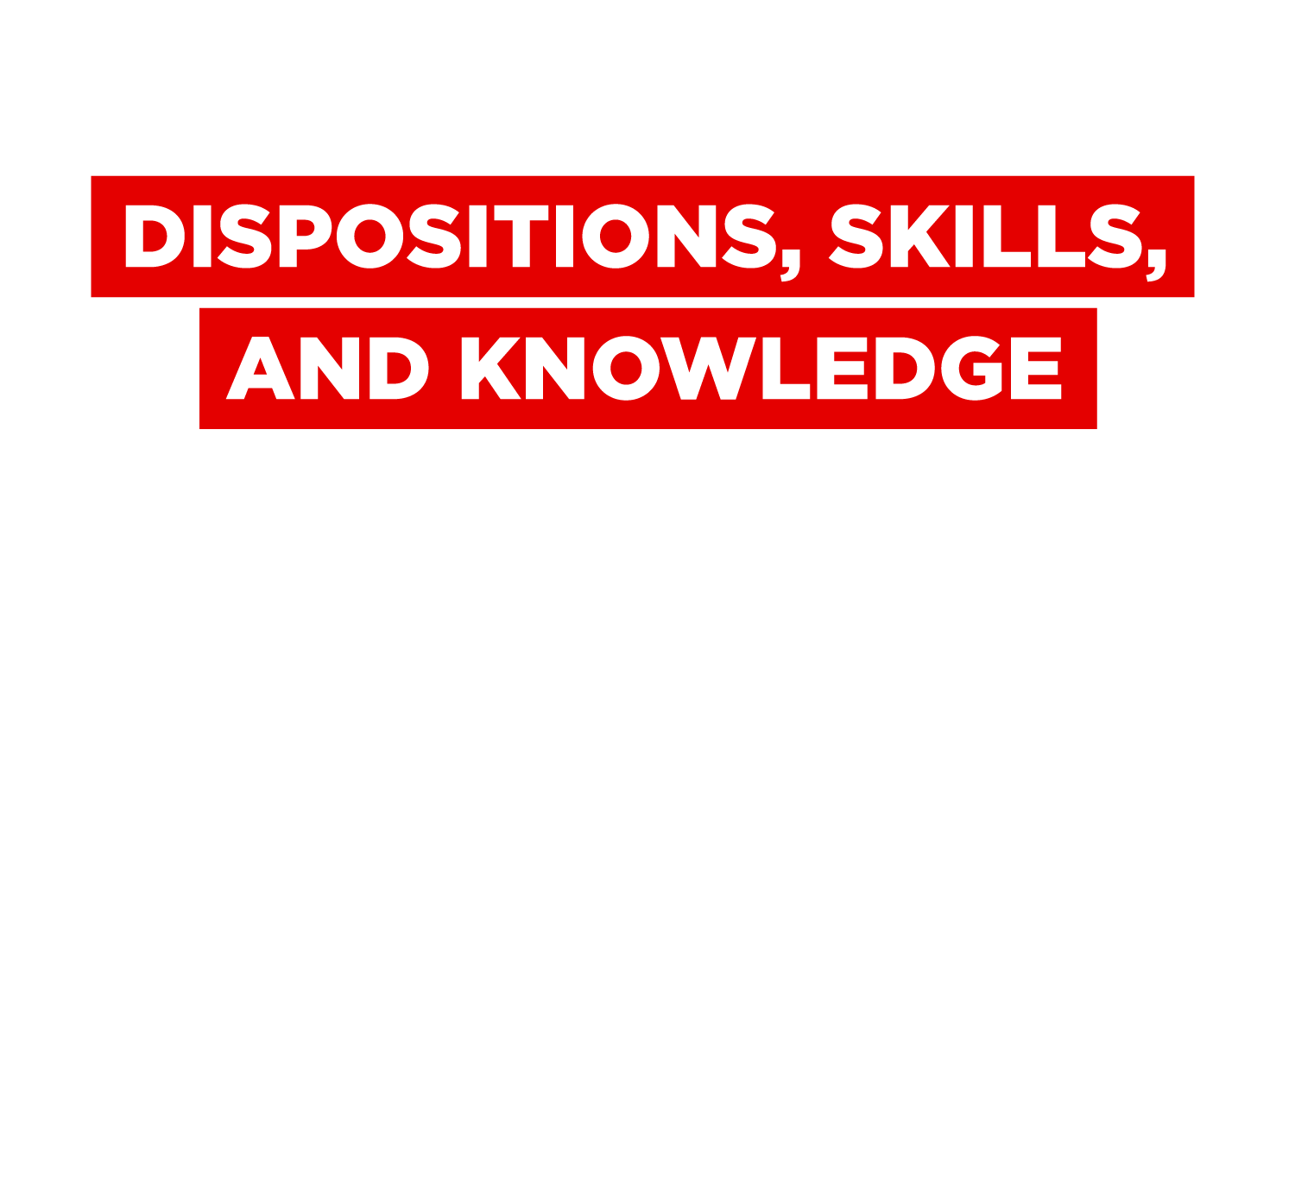

Slide 10
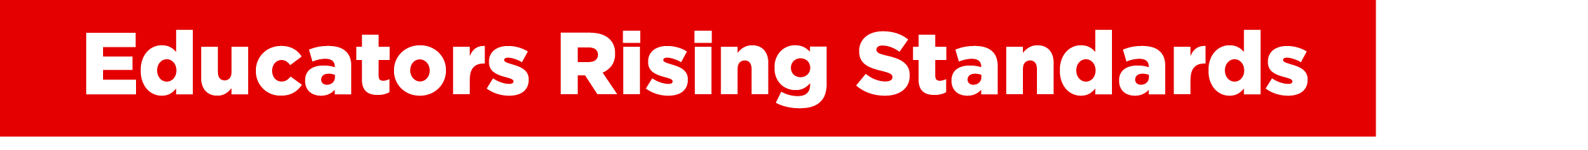
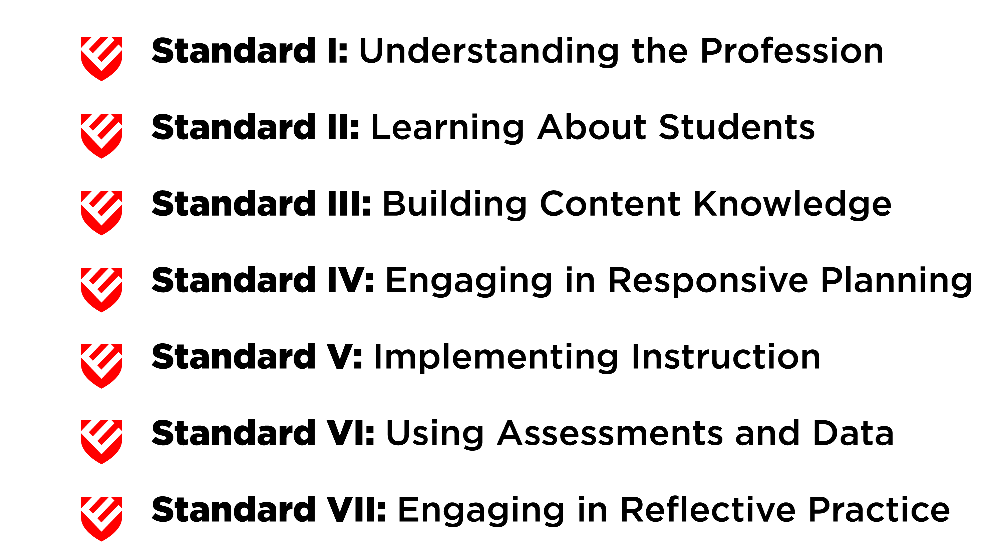

Notes:
Created with support from the National Education Association and the National Board for Professional Teaching Standards, the seven Educators Rising Standards define the skills, knowledge, and habits of mind that young people need as they take the first steps on the path to accomplished teaching.
Check out the standards online at www.educatorsrising.org/standards.

Slide 11
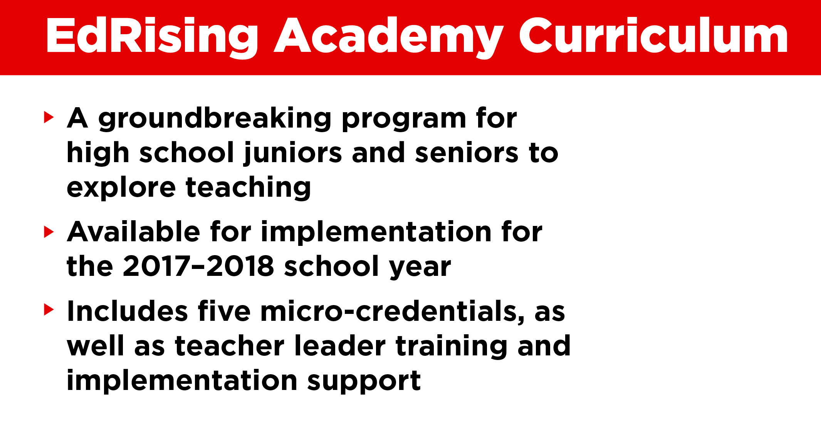


Notes:
Created with support from the American Federation of Teachers and the National Education Association

Slide 12
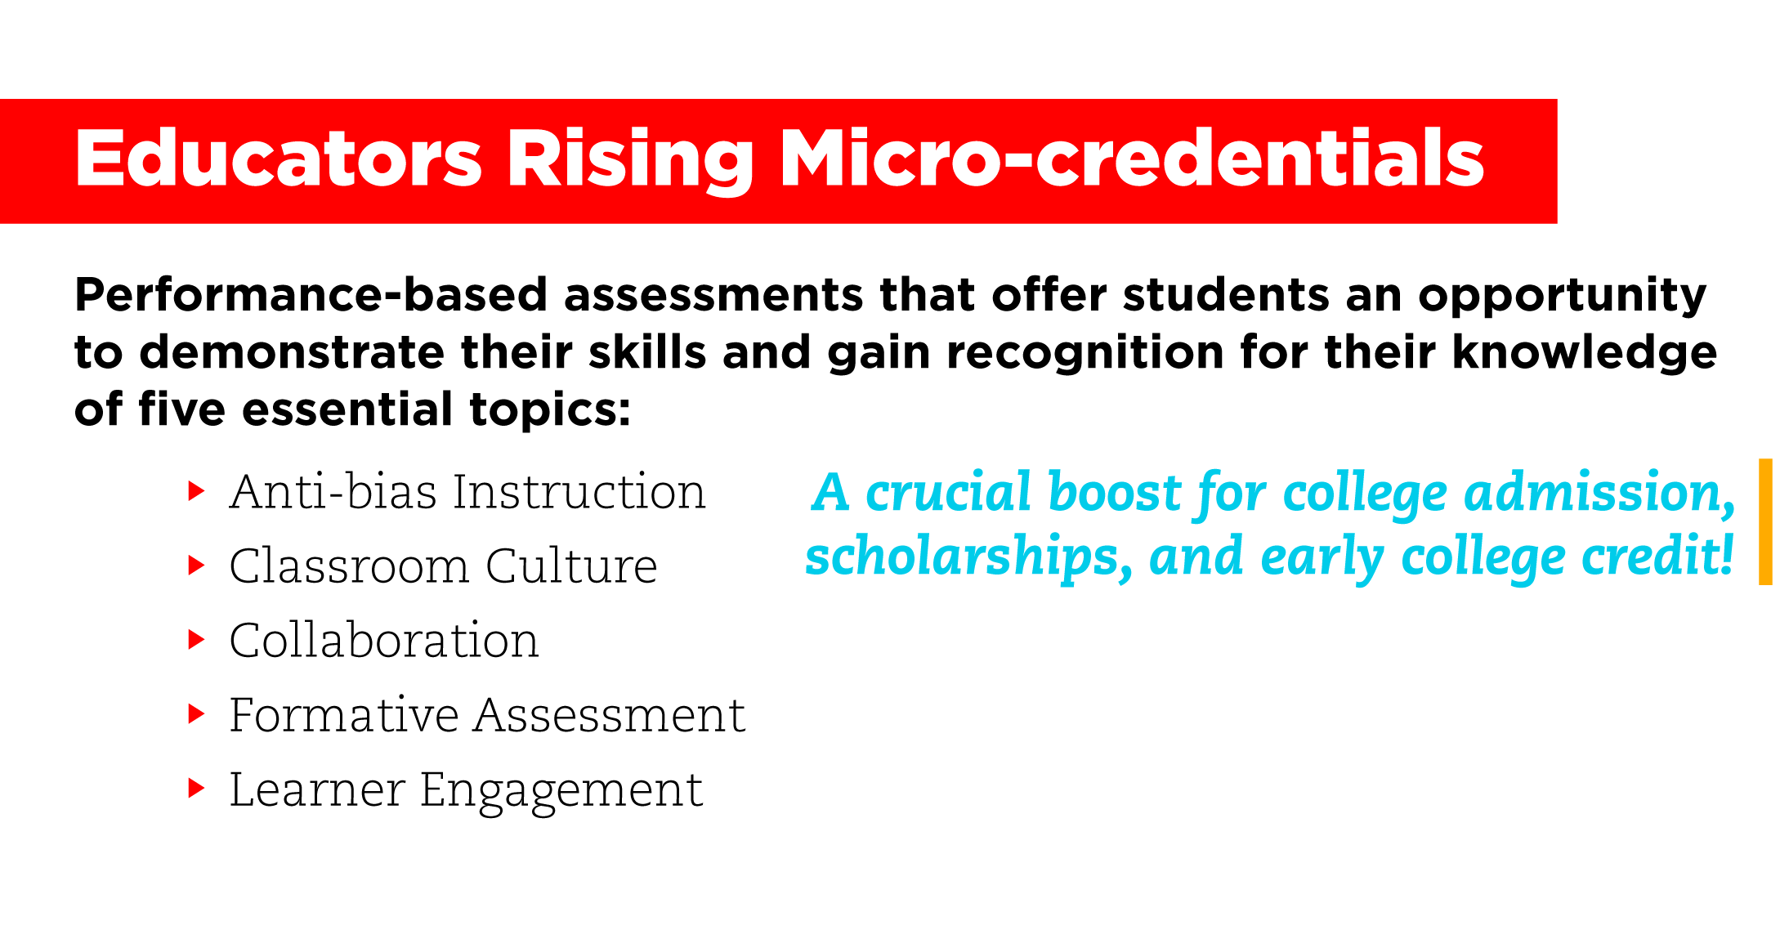


Notes:
Created through a partnership with Digital Promise and the Hewlett Foundation
The digital badges earned by successfully completely micro-credentials can provide a crucial boost for college admission, scholarships, and early college credit.

Slide 13
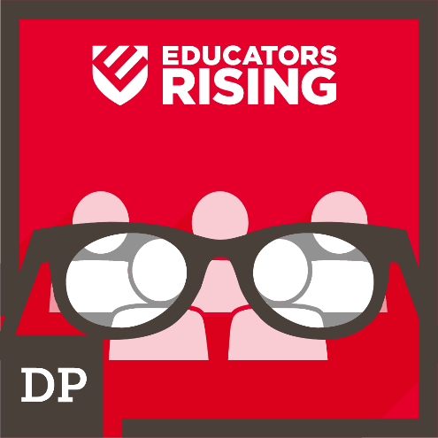
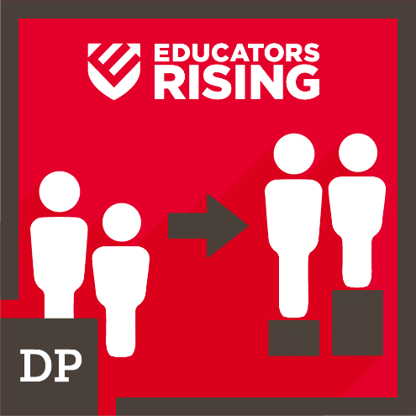
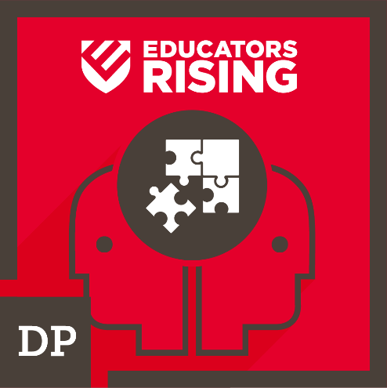
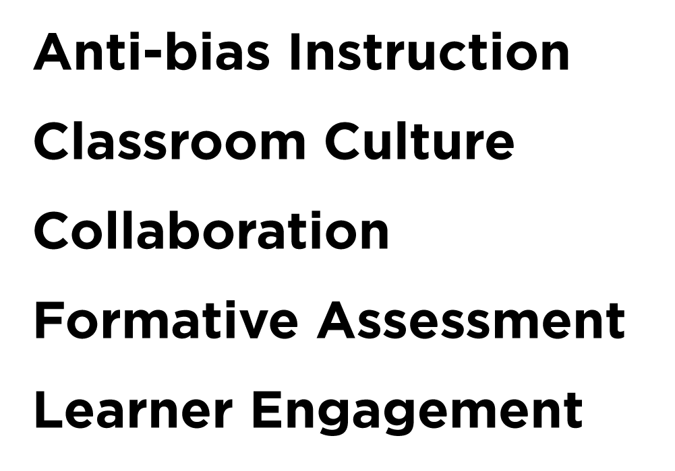
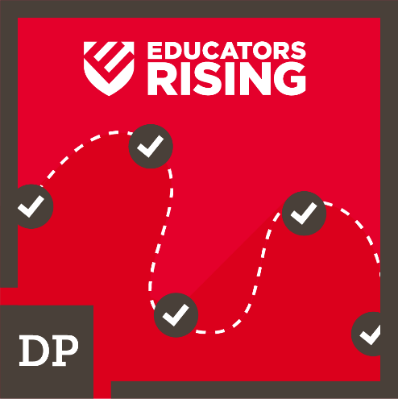
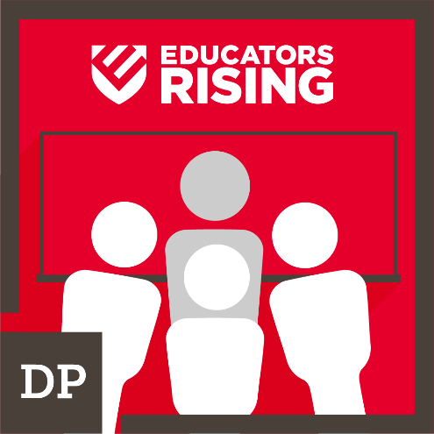

Slide 14
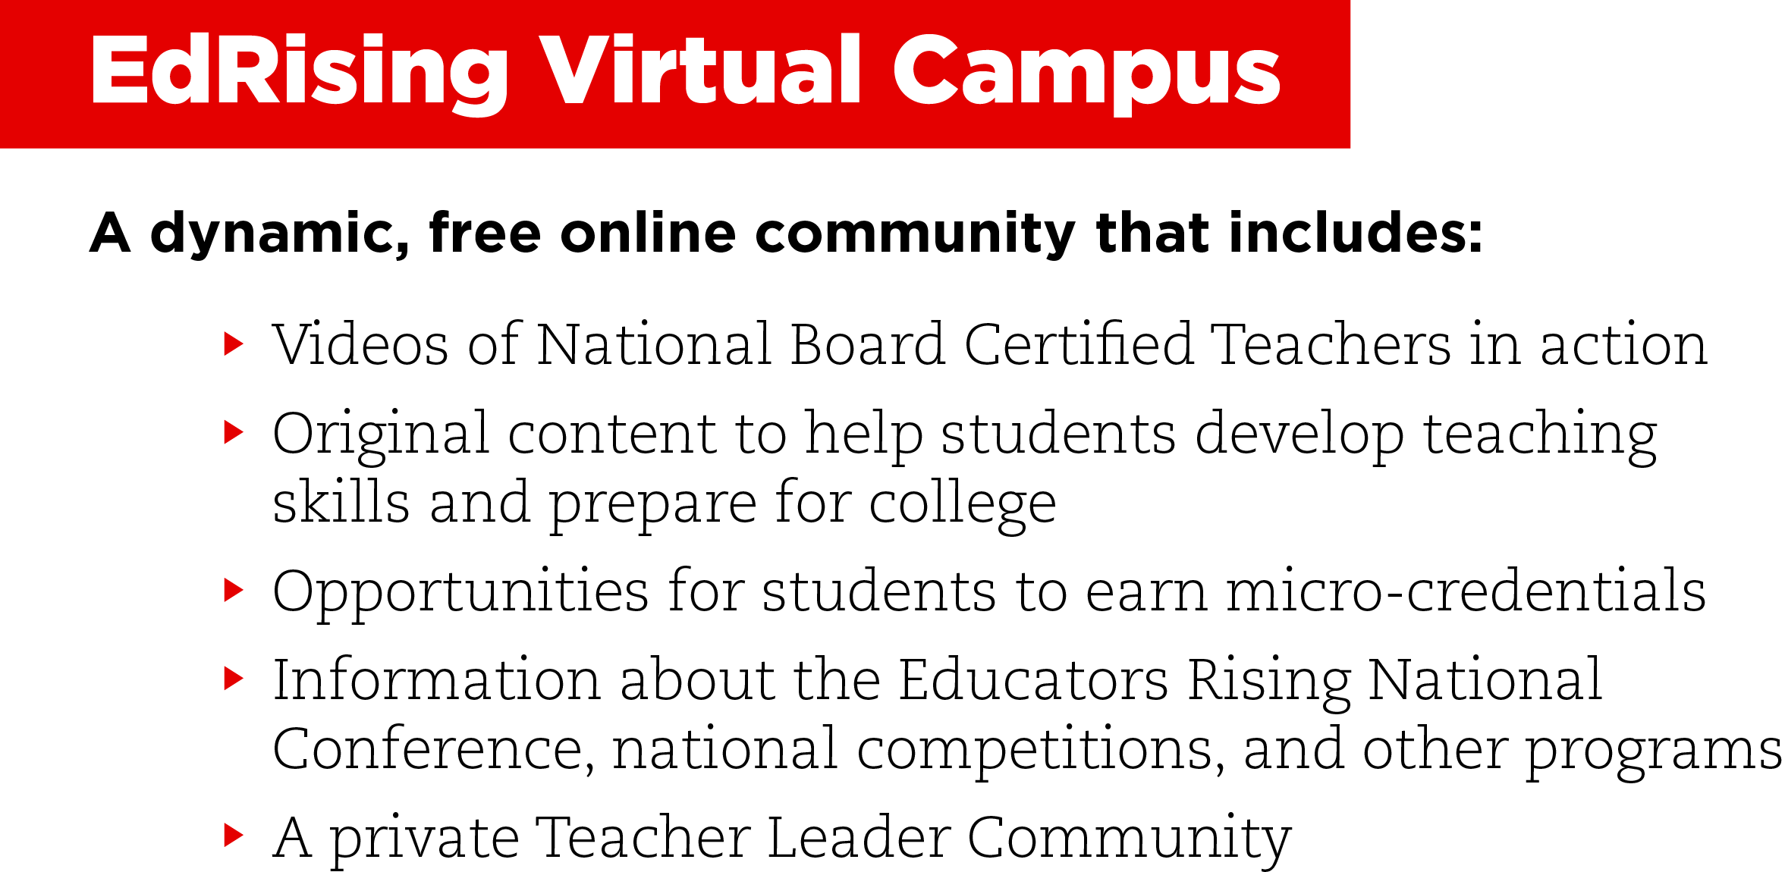
Notes:
The goal of the Virtual Campus is to help students become great teachers.
The Teacher Leader Community is a private section within the Virtual Campus where teachers can connect with other Educators Rising teacher leaders and access curricular resources that immerse students in teaching, complete with hands-on experiences.

Slide 15
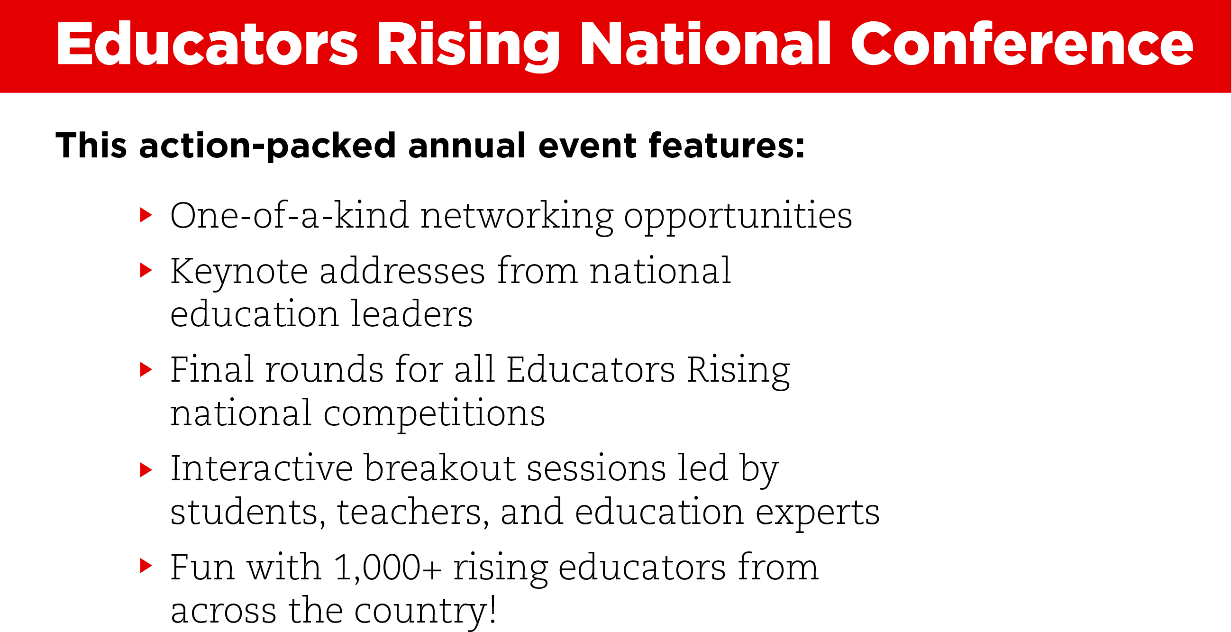


Slide 16
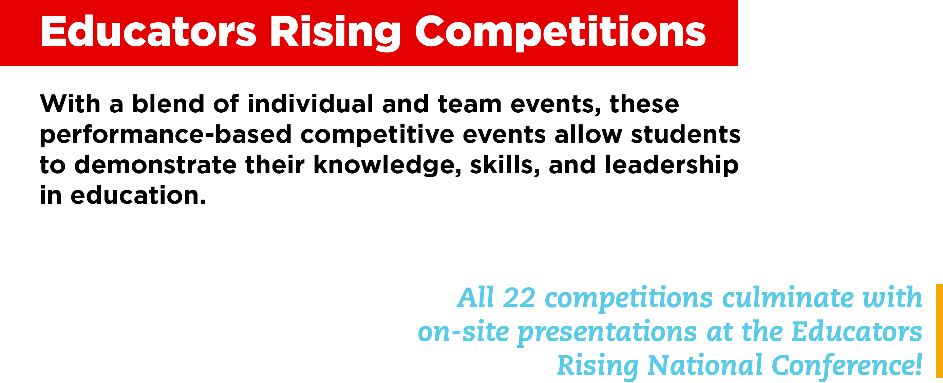
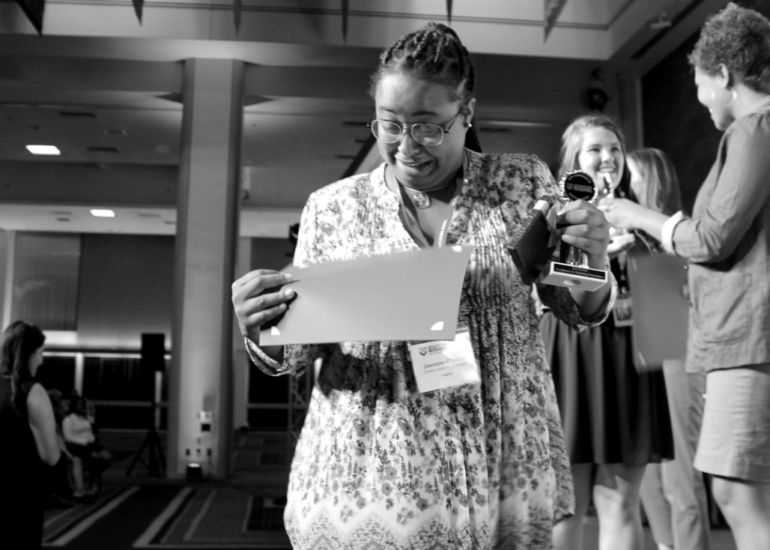
Notes:
Popular competitions include Children's Literature, Public Speaking, and Educators Rising Moment

Slide 17
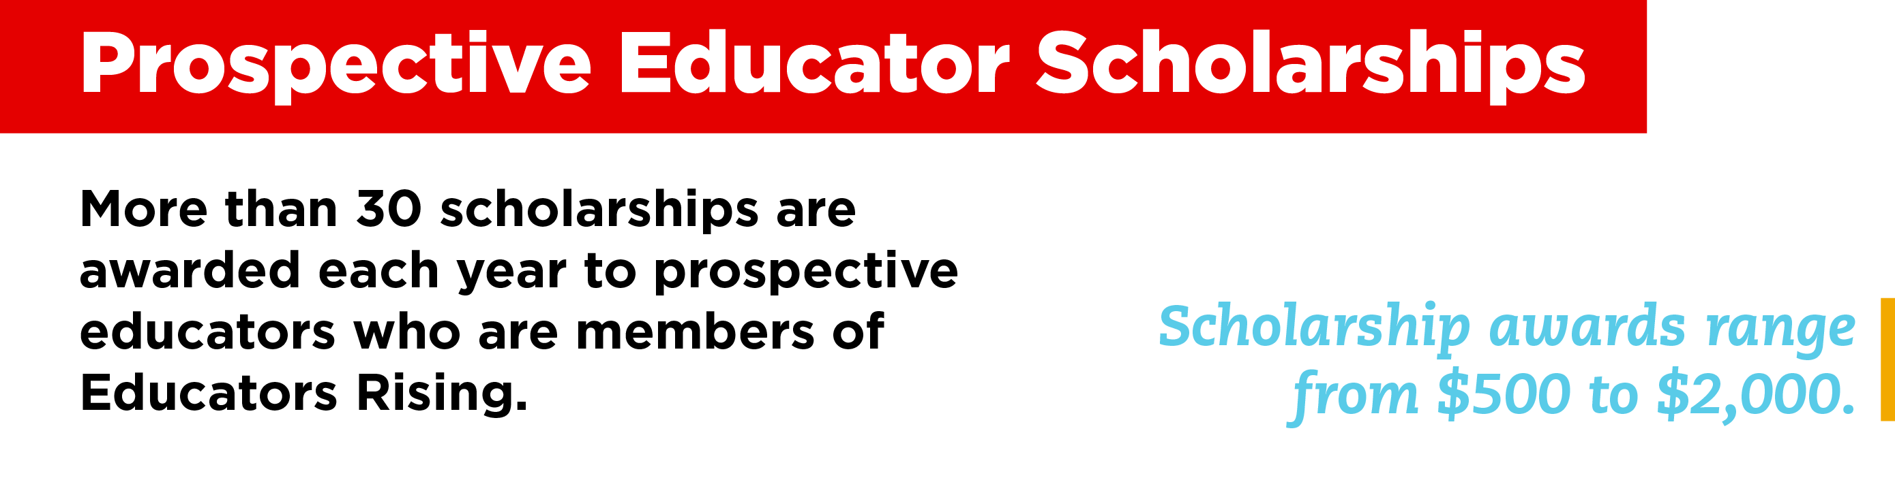

Notes:
Educators Rising is powered by PDK International.
One of the many ways that PDK International supports Educators Rising and fulfills its vision of cultivating great educators for tomorrow is through the PDK Educational Foundation, which awards more than 30 scholarships each year to prospective educators who are members of Educators Rising.

Slide 18
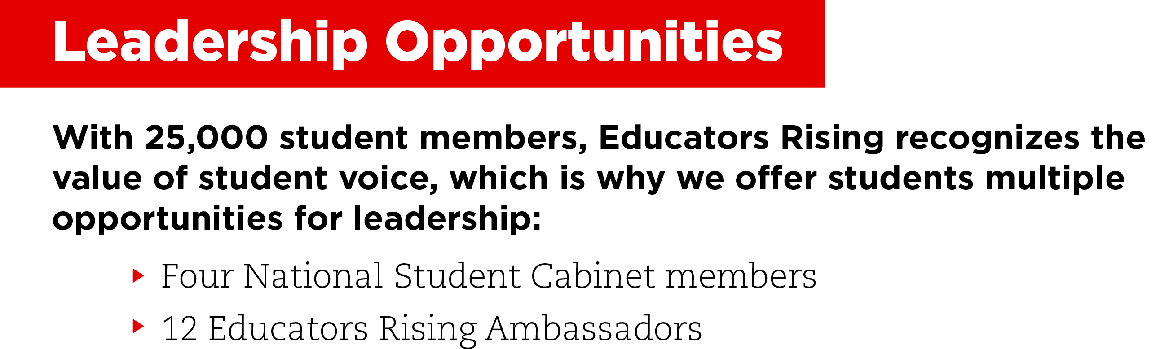

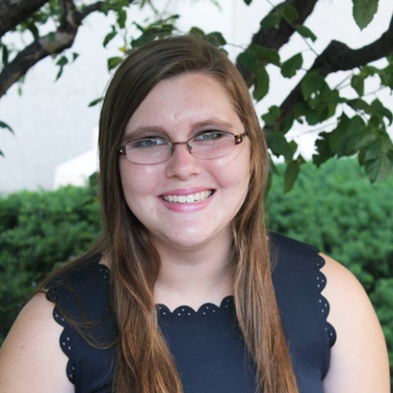
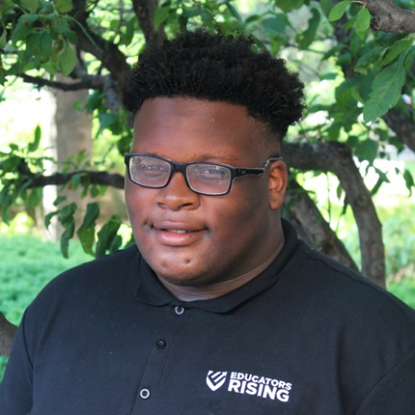
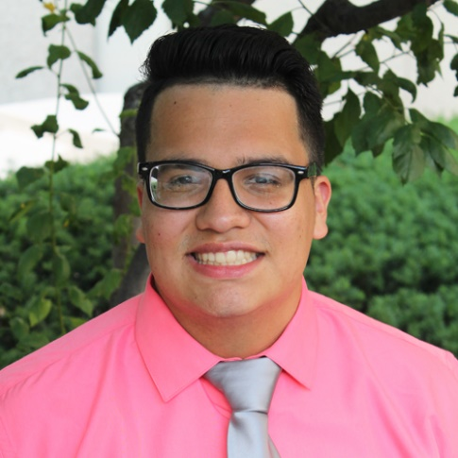
Notes:
Our four National Student Cabinet members exemplify the finest qualities of our national network and of the future of the teaching profession.
Our 12 Educators Rising Ambassadors provide student perspectives on teaching to a wider audience via social media.

Slide 19



