Slide 1

K-3 Assessments
Literacy-Based Promotion Act (LBPA)
Melissa Beck
K-3 Assessment Coordinator
Fall 2021

Slide 2
State Board of Education STRATEGIC PLAN GOALS

Slide 3
Mississippi Department of Education

Slide 4
Session Goals
Literacy-Based Promotion Act (LBPA)
Universal Screener
Kindergarten Readiness
3rd Grade MAAP-ELA

Slide 5
Literacy-Based
Promotion Act
LBPA

Slide 6
Literacy-Based Promotion Act Overview
The purpose of the Literacy-Based Promotion Act is to eliminates social promotion and to improve reading skills of Kindergarten through 3rd grade public school students so that every student completing 3rd grade reads at or above grade level.

Slide 7
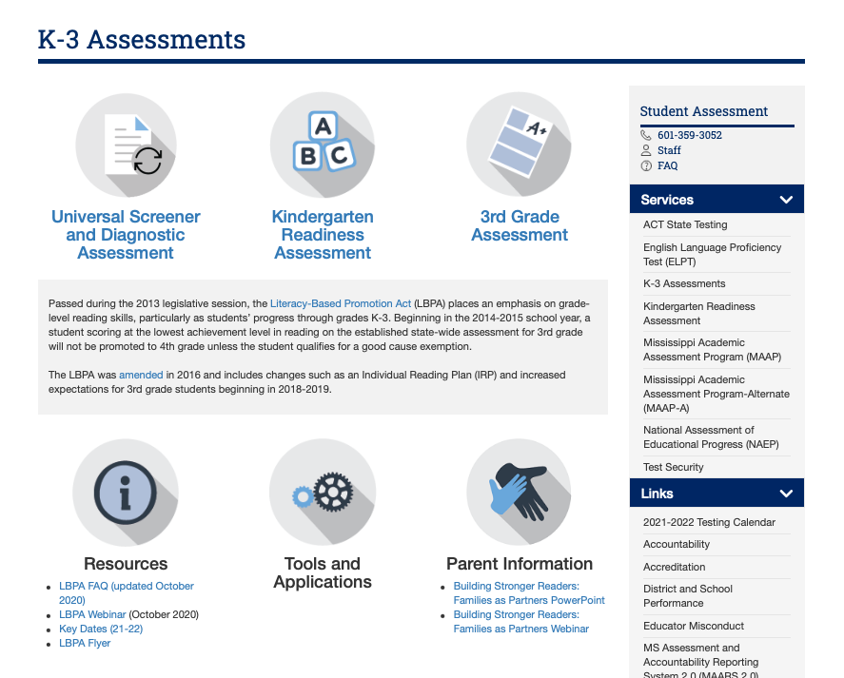
LBPA Testing Timeline Update

Slide 8
Universal Screener
Component 1

Slide 9
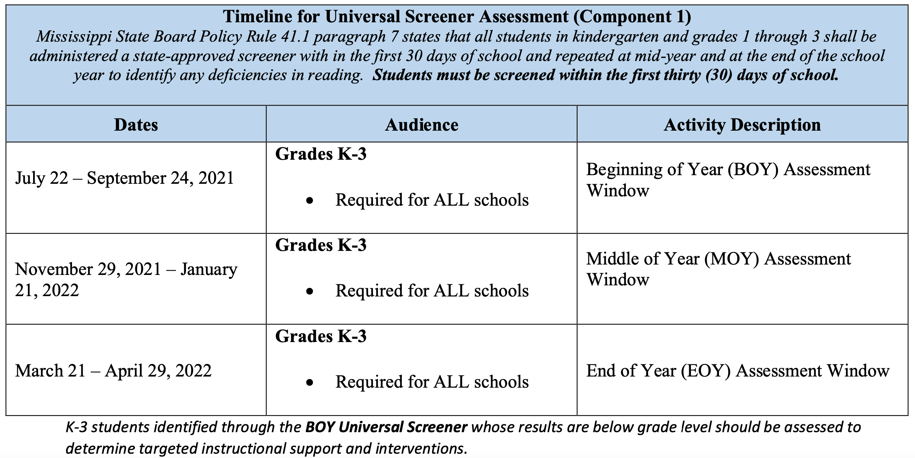
Universal Screener Test Window

Slide 10
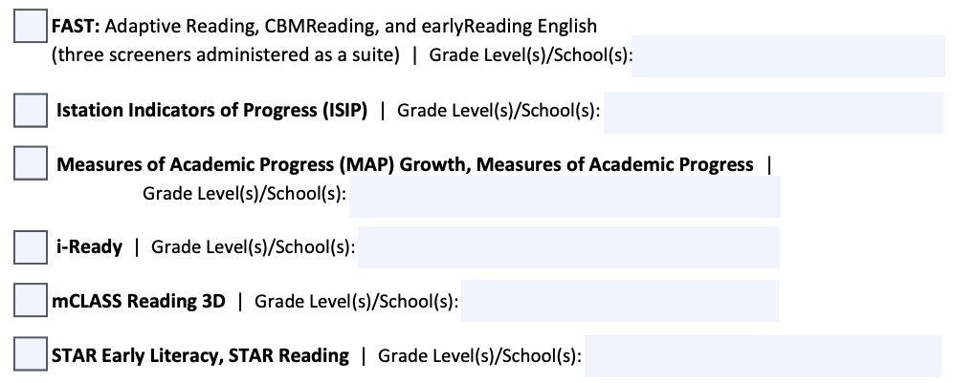
Universal Screeners

Slide 11
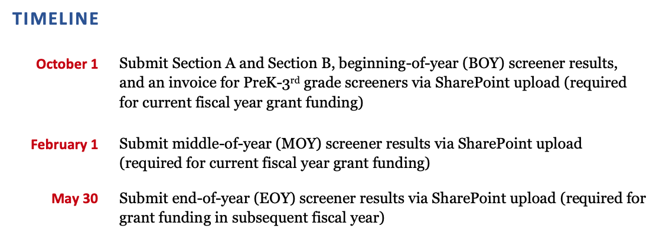
Universal Screener Timeline Updates

Slide 12
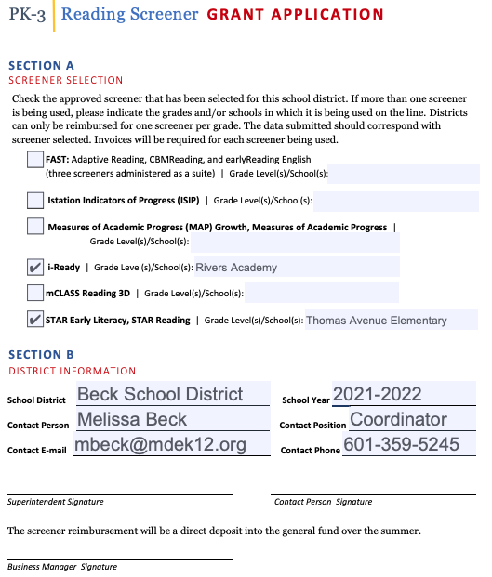
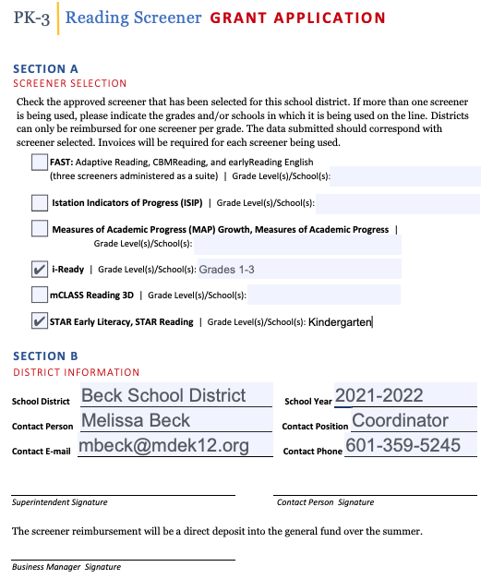
Universal Screener Grant Application

Slide 13
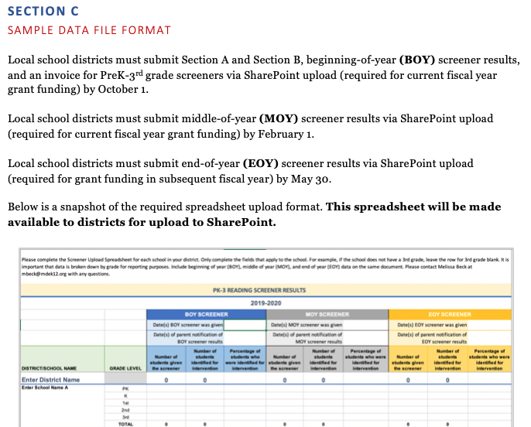
Screener Data Requirements

Slide 14
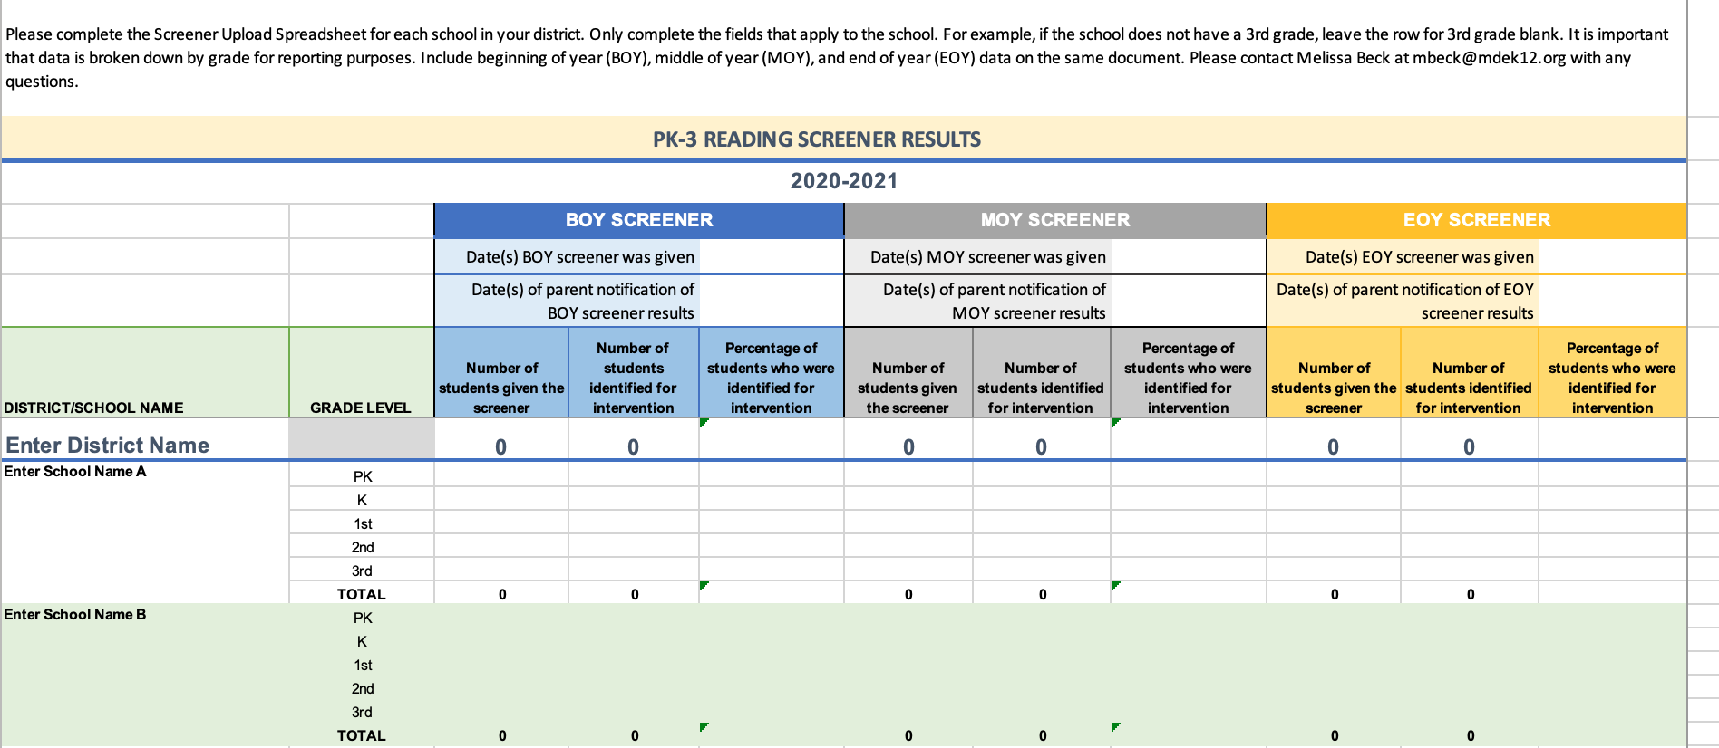

Screener Data Spreadsheet

Slide 15
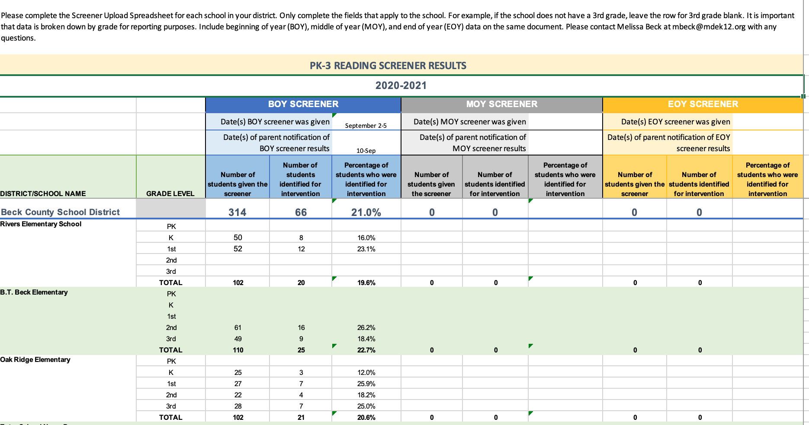
Screener Data Spreadsheet Example

Slide 16
Invoices
May include
PreK–3rd Grade reading screeners (as well as math if bundled as single product)
hosting fees required to run screeners
required data transfer technology
Please separate the costs for Pre-K through 3rd grade from all other grades.

Slide 17
Kindergarten Readiness
Component 2

Slide 18
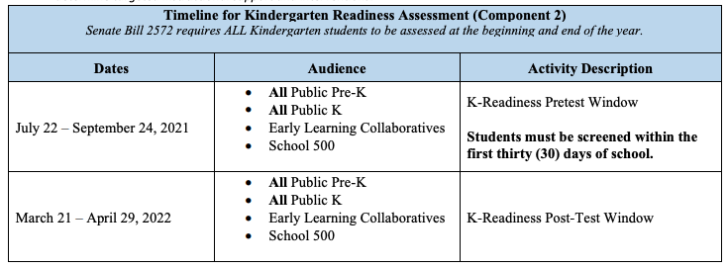
K-Readiness Test Window
Administered through the secure state portal in the fall and spring

Slide 19
K-Readiness
Administered to all Public Pre-K, All Public K, Early Learning Collaboratives, and School 500 students
  Students must be 4 years of age on or before September 1st
  Exceptions unless otherwise indicated by the IEP:
  Significant Cognitive Delay (SCD)
  Hearing Impaired (HI)
  Visually Impaired (VI)
  Deaf-Blind (DB)
  Multiple Disorder (if HI or VI)

Slide 20

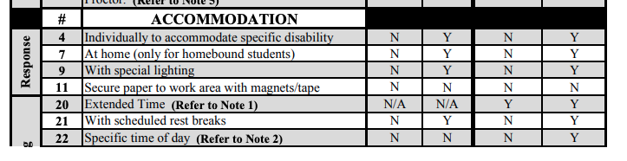
Accommodations

Slide 21
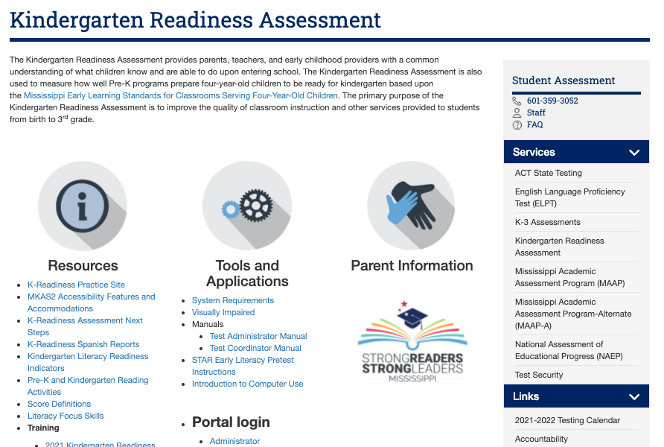
Accommodations

Slide 22
Updated Testing Manuals

Slide 23
K-Readiness Scores
Kindergarten goals
  530 or higher at the beginning of kindergarten
  681 or higher at the end of kindergarten
Pre-K goals
  498 or higher at the end of pre- kindergarten

Slide 24
K-Readiness Reports
Provide access or printed reports to teachers.
Teacher training is available.
  Reports and Data Conversations for Kindergarten Parents Video
  Reports and Data Conversations for Kindergarten Parents Slides
  End of Year Data Conversations for Kindergarten Parents and Teachers Video
  End of Year Data Conversations for Kindergarten Parents and Teachers Slides
Print all reports at the end of each testing window.
Reports CAN NOT be recovered once the portal is updated for the new year.

Slide 25
Survey for Deletions
We will no longer complete the survey for deletions.
Renaissance automatically merges accounts with a Temporary ID and a MSIS with the same name and birthdate.
Any account without a test score is excluded from reporting.
Kindergarten Readiness is not used in Accountability, so percent tested is not a factor.
Districts must test all students enrolled during the screening window.
Students not tested can be moved to “unassigned teacher.”

Slide 26
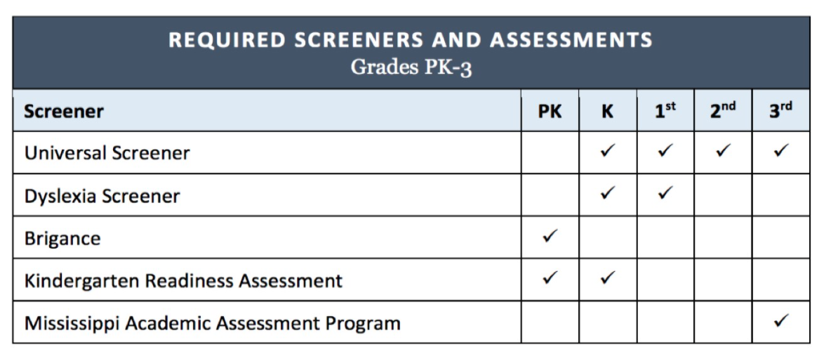
Universal Screening and the Kindergarten Readiness
The Universal Screener and Kindergarten Readiness Assessment are both checked for Kindergarten.
Both are required by MS codes/State Board policy.

Slide 27
Universal Screening and the Kindergarten Readiness
If district uses Renaissance as their screener, then the Kindergarten Readiness Assessment suffices as the BOY and EOY universal screener since the Kindergarten Readiness Assessment is STAR Early Literacy.
If districts do not use Renaissance, the Kindergarten Readiness and the Universal Screener must both be given.

Slide 28
3rd Grade MAAP-ELA
Component 3

Slide 29
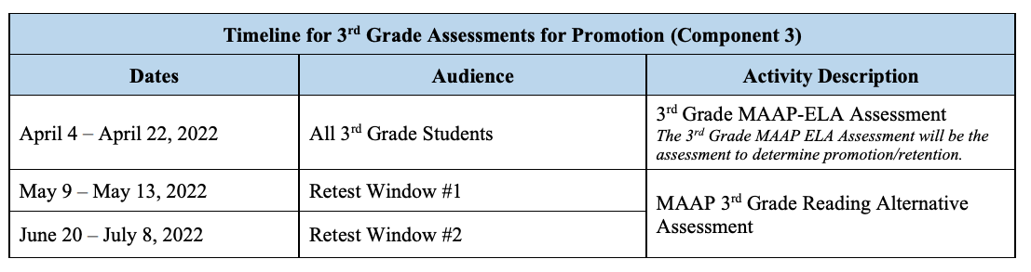
3rd Grade MAAP-ELA Test Window

Slide 30
Resources
Key Dates (21-22)
District Notification of Selection and Grant Application
Screener Data Upload Spreadsheet
Screener Directions for Upload
2021 Kindergarten Readiness Training Video
2021 Kindergarten Readiness Training Slides
Reports and Data Conversations for Kindergarten Parents Video
Reports and Data Conversations for Kindergarten Parents Slides
KRA Manuals
  Test Administrator Manual
  Test Coordinator Manual

Slide 31
Melissa Beck
K-3 Assessment Coordinator
mbeck@mdek12.org

